Slide 1
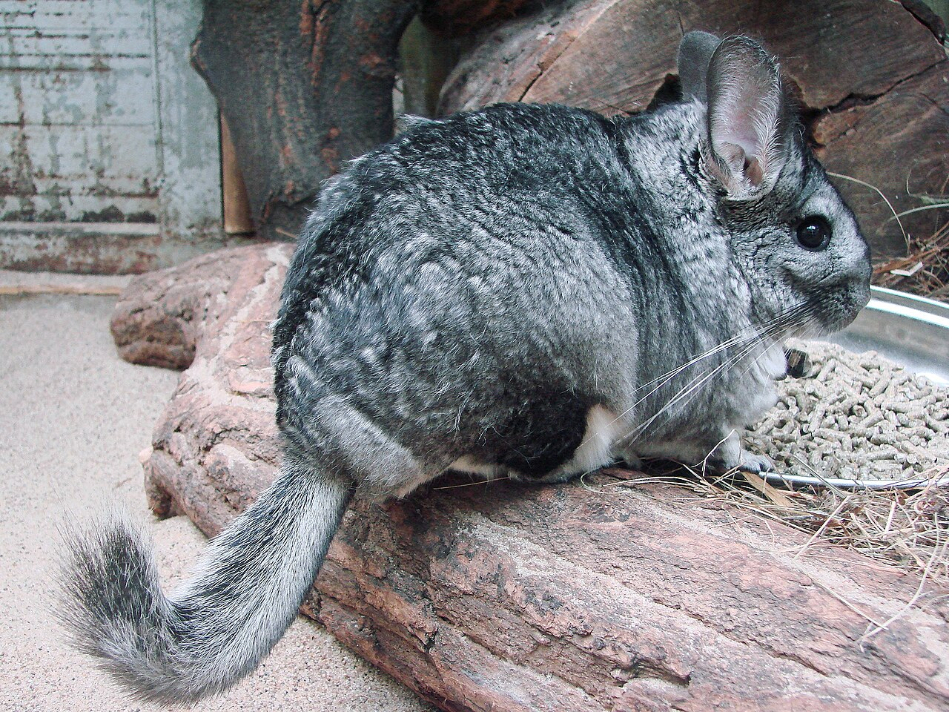
CSCI 3495
Scaling Laws & Emergent Abilities
Natural Language Processing & Large Language Models
Week 9, Class 2 · Wed Oct 21, 2026
Source: Guerin Nicolas, Wikimedia Commons, CC BY-SA 3.0
Notes:
Meet the chinchilla. Ask the class why one of the most important LLM papers of 2022 is named after this rodent, take a guess or two, and leave it hanging until the result slide.

Slide 2
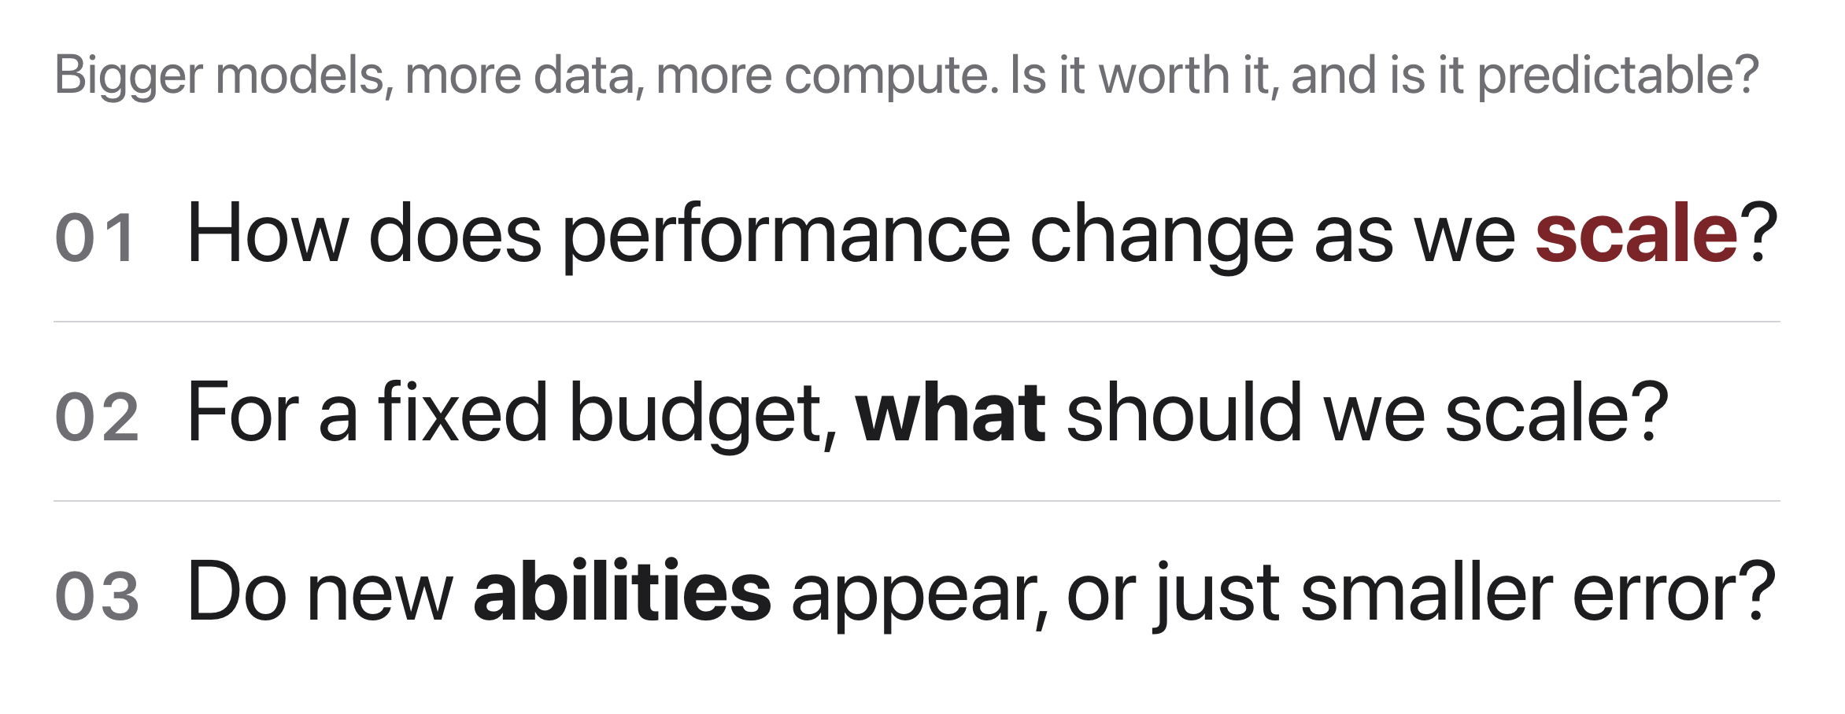
The central question
Source: original figure
Notes:
Three questions frame the day. How performance changes with scale, what to spend a fixed budget on, and whether anything genuinely new appears or the error just gets smaller. The middle one is what they will spend the second half of the period arguing about in teams.

Slide 3
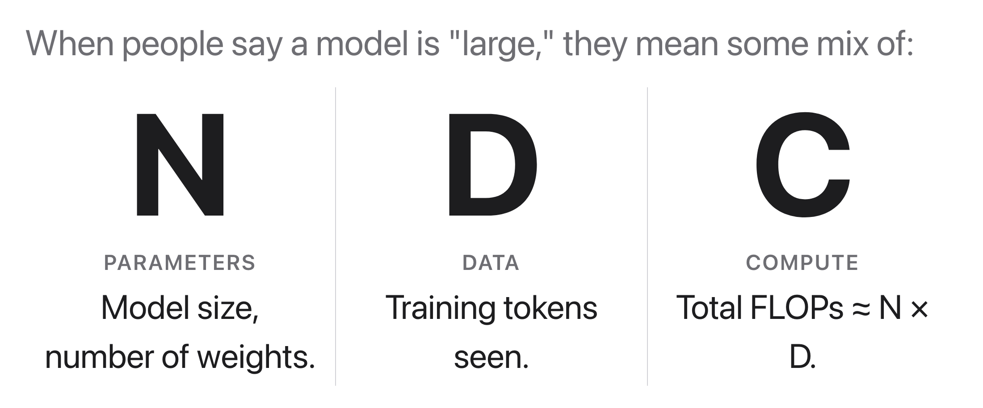
Three axes of scale
Source: original figure
Notes:
N parameters, D training tokens, C compute. Everything today is a relationship between these three, and the one they need in their hands after the break is that C is about 6ND. Say the number out loud now so it is not new later.

Slide 4
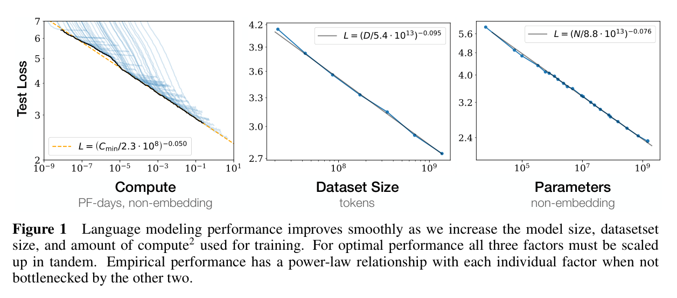
Scaling laws (Kaplan et al., 2020)
Source: Kaplan et al. 2020, "Scaling Laws for Neural Language Models" (arXiv:2001.08361), Fig. 1
Notes:
One of the most reproduced plots in modern ML. A straight line on log-log axes IS a power law, and each panel holds while the other two factors are not the bottleneck. Loss falls slowly, so gains cost orders of magnitude. It forecasts a big model's loss from small runs within the studied range; far past it, all bets are off.

Slide 5
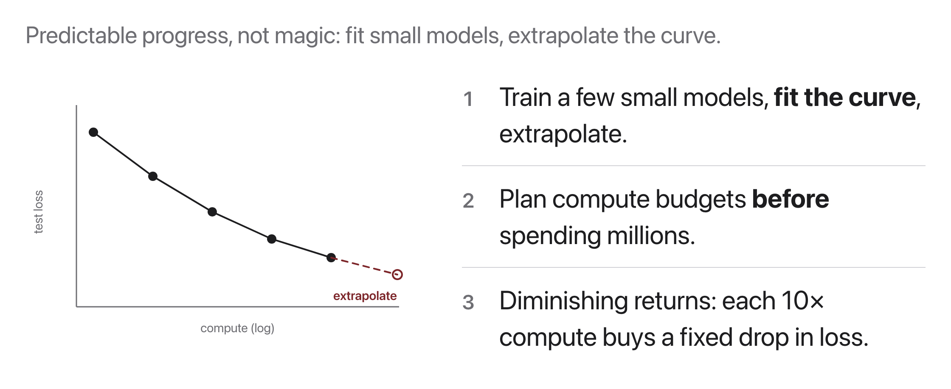
Why power laws matter
Source: original figure
Notes:
The point is not the curve, it is that the curve is predictable. Train a few small models, fit, extrapolate, and you can plan a budget of millions before spending any of it. That is what turned scaling from a gamble into engineering, and it is the only reason the activity after the break is answerable at all.

Slide 6
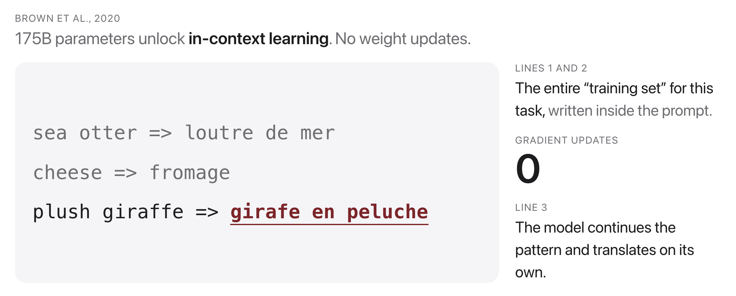
What 175B parameters bought
Source: Brown et al. 2020, "Language Models are Few-Shot Learners" (arXiv:2005.14165)
Notes:
GPT-3 is what following Kaplan's advice actually produced: pour the budget into parameters. Its contribution is not that it was big, it is what being big turned out to enable. Put a few examples in the prompt and the model does the task with no fine-tuning and no gradient updates. Nobody trained it to do that.

Slide 7
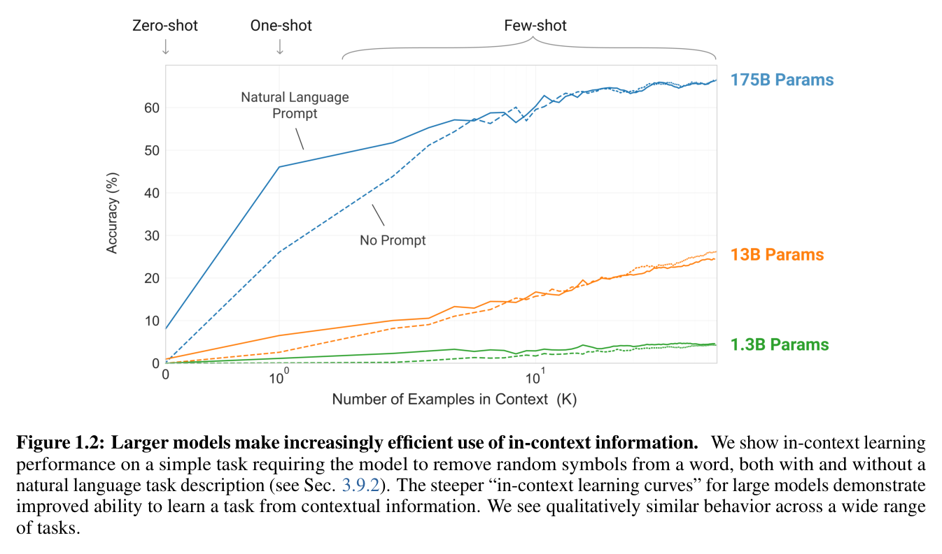
Bigger models squeeze more from a prompt
Source: Brown et al. 2020, "Language Models are Few-Shot Learners" (arXiv:2005.14165), Fig. 1.2
Notes:
The task is stripping random symbols from a word. Every size sees the same examples, but only the largest converts each extra example into a large accuracy jump. The steeper curve is the claim: in-context learning is itself something that arrives with scale. We spend a whole week on how to exploit it.

Slide 8
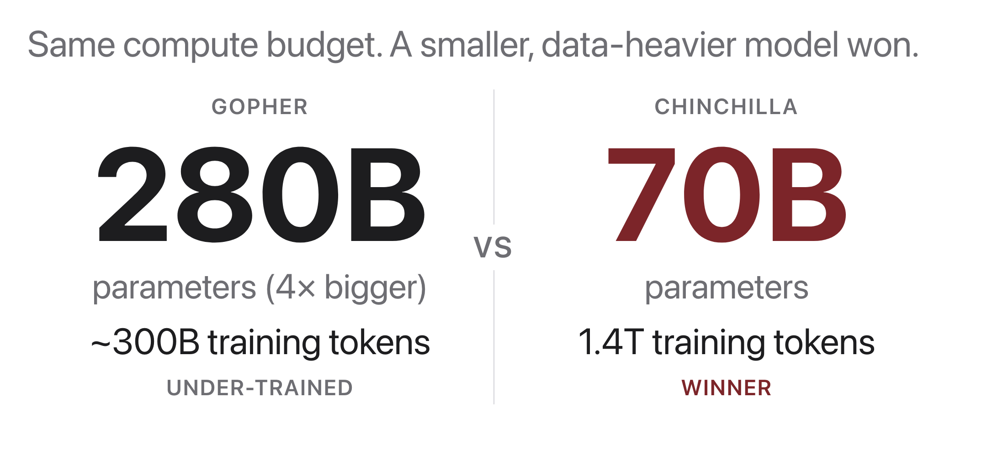
The Chinchilla result
Source: Hoffmann et al. 2022, "Training Compute-Optimal LLMs" (arXiv:2203.15556)
Notes:
Now the rodent pays off. A model four times smaller, trained on far more data, beat Gopher across a wide range of tasks at the same compute cost. The giants of the era were not too small, they were starved of data, and the fix is the rule of thumb they are about to use: roughly 20 training tokens per parameter.

Slide 9
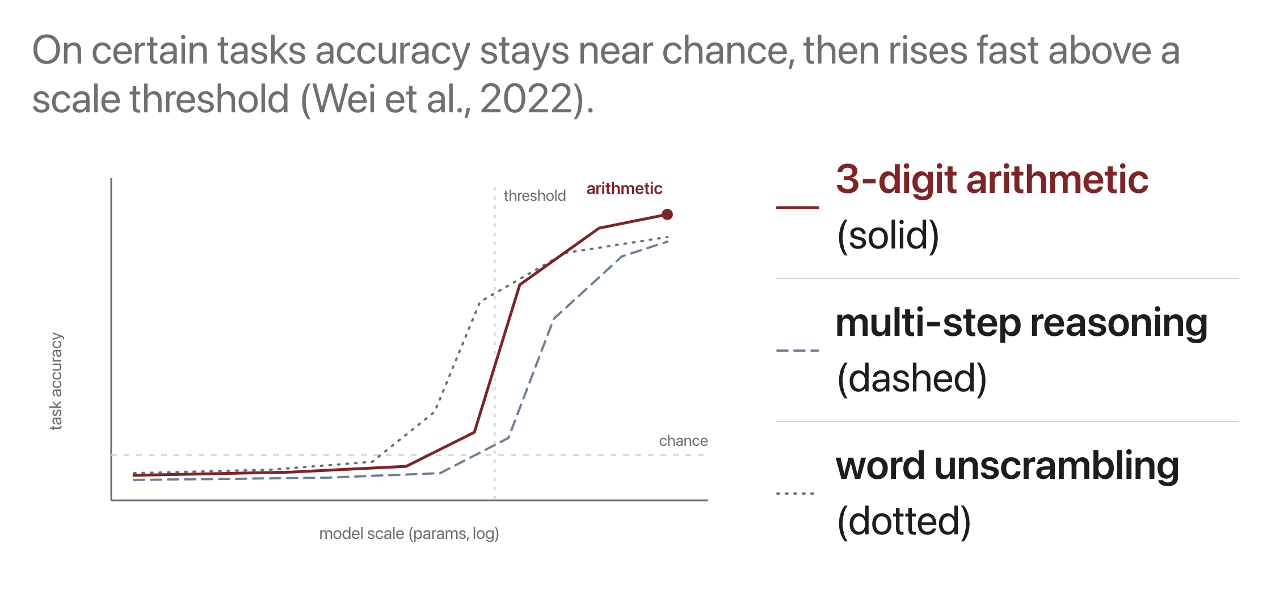
Emergent abilities
Source: original figure; Wei et al. 2022, "Emergent Abilities of Large Language Models"
Notes:
The smooth loss curve does not obviously forecast these jumps. Whether a jump is a true phase change or an artifact of a harsh all-or-nothing metric is contested, Schaeffer et al. 2023 being the sharpest version of the objection. Hold both: something real changes with scale, and the sharpness of the picture depends on how you chose to measure.

Slide 10
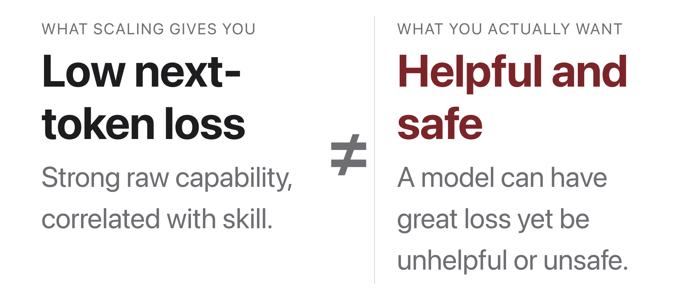
Loss ≠ usefulness
Source: original figure
Notes:
A lower loss is not a more helpful, more honest or safer model. That gap is the whole reason alignment and evaluation are their own weeks. Scaling buys raw capability; the rest of the course makes it useful.

Slide 11
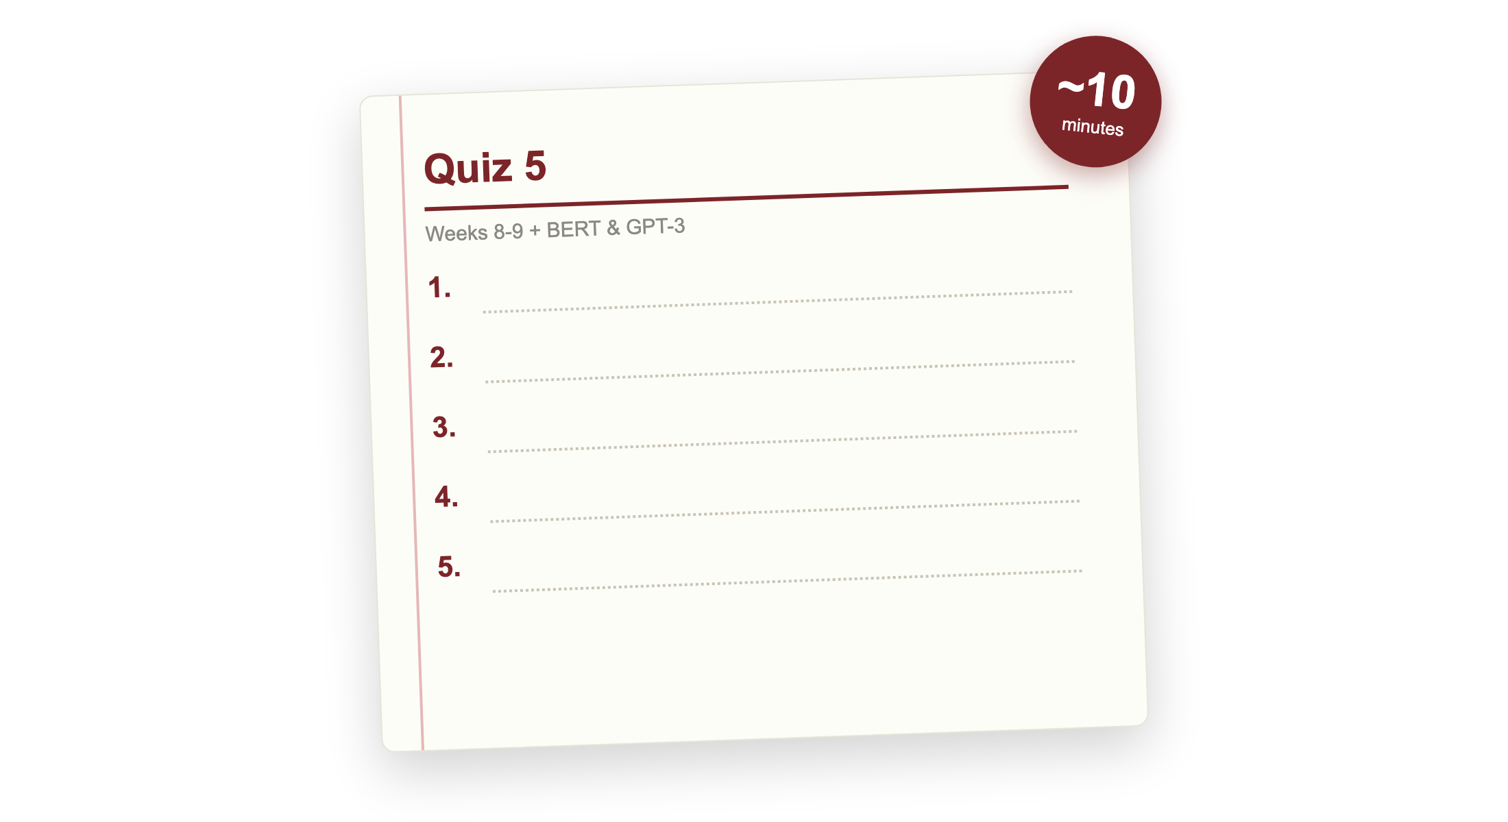
Quiz 5 (paper)
Source: quizzes/quiz-05.md
Notes:
Covers Weeks 8 and 9: BERT and masked language modeling, decoding strategies, scaling laws, plus BERT (Devlin 2019) and GPT-3 (Brown 2020). Clear your desk. Finish early and your break starts early; need more time and it comes out of the break.

Slide 12

Break
Source: original figure

Slide 13
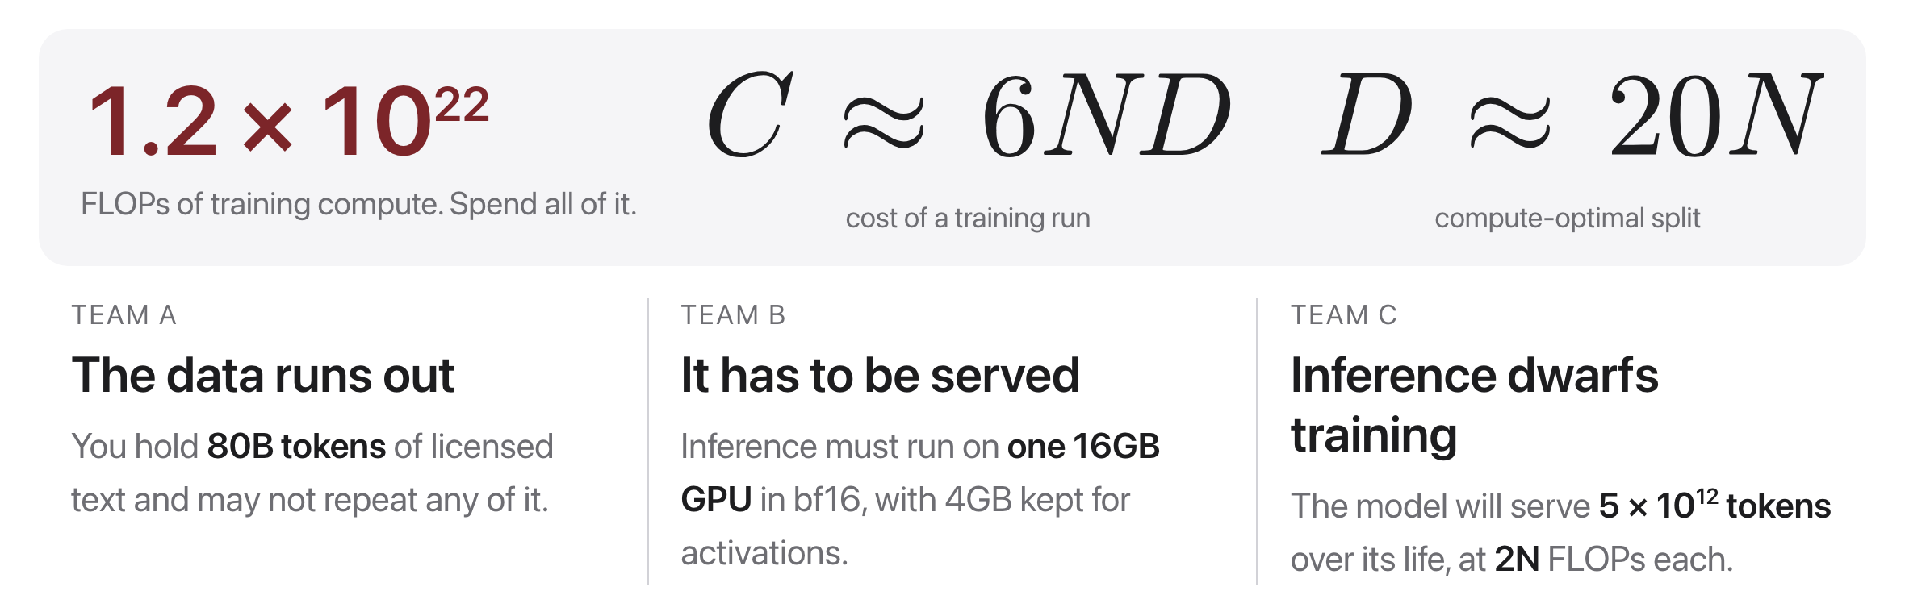
You have a compute budget. Spend it.
Source: original figure; C = 6ND per Kaplan et al. 2020; D = 20N per Hoffmann et al. 2022
Notes:
Read the band first: the budget and the two formulas are everything they need. Every team starts by finding the compute-optimal point with no constraints, which should take five minutes and should come out round. Then each team takes its own constraint and works out what it does to the answer. Boards and markers, no laptops.

Slide 14
Teams of four, boards, no laptops
5 min: the unconstrained answer. 15 min: your team's constraint. 10 min: we compare.
Notes:
Assign constraints round-robin so each of the three is held by at least two teams. Push every team to write N and D on the board as numbers with units, not as an expression. The move to watch for is the team that quietly changes the budget to make its constraint go away; the budget is fixed, the constraint is the problem.

Slide 15
So who was right?
Two of the three constraints push the same way, and it is not the way Kaplan pointed.
Notes:
Take Team A first, because its answer is the uncomfortable one: with 80B tokens the compute-optimal model is 4B parameters and uses only 16 percent of the budget, so the honest answer is that the compute is not spendable. Then B and C, which both land on a smaller model trained far past 20 tokens per parameter, for two independent reasons: memory at serving time, and total FLOPs over the model's life. That is why Llama-7B saw a trillion tokens. Close on the point: compute-optimal is optimal for training loss, and training loss was never what you were paying for.

