Slide 1
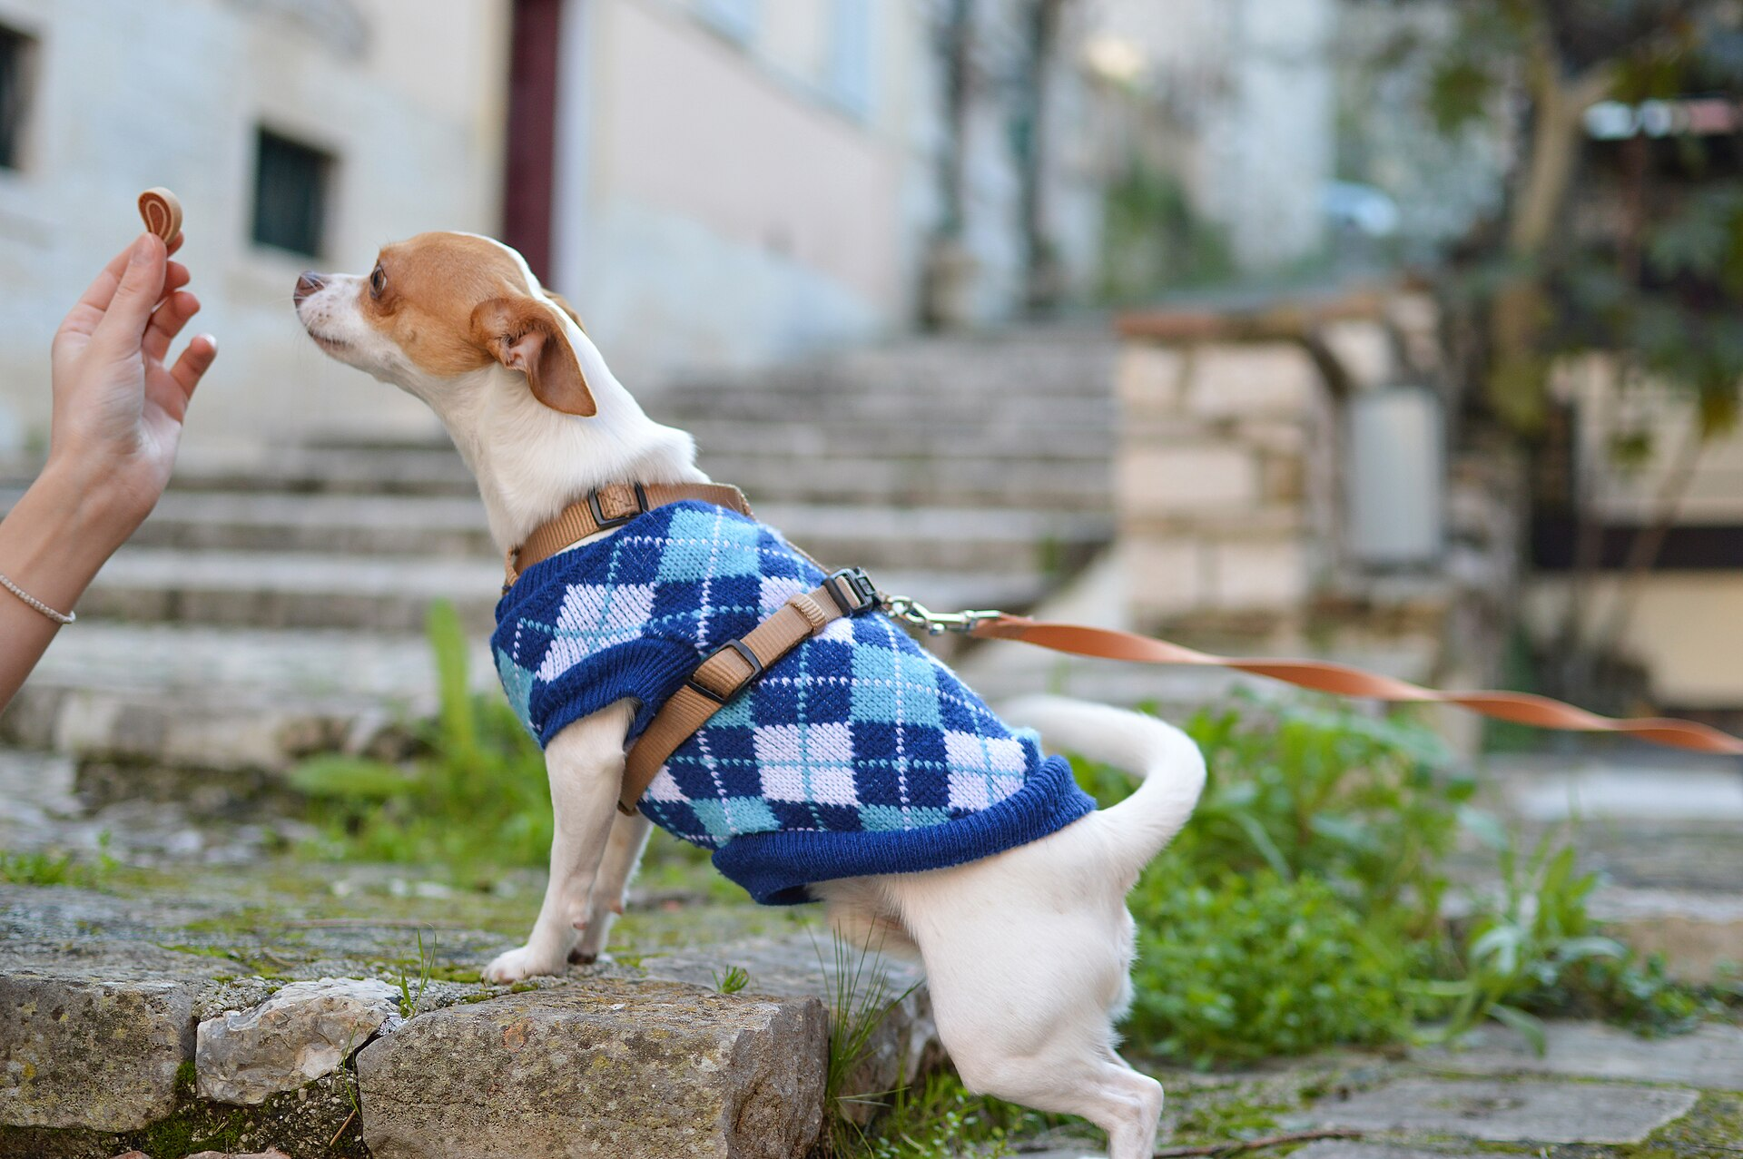
CSCI 3495
Alignment: RLHF, InstructGPT & DPO
Natural Language Processing & Large Language Models
Week 10, Class 2 · Wed Oct 28, 2026
Source: Pete Bellis, via Wikimedia Commons, CC0
Notes:
Reward the behavior you prefer and it sticks. Today: doing exactly this to a language model.

Slide 2
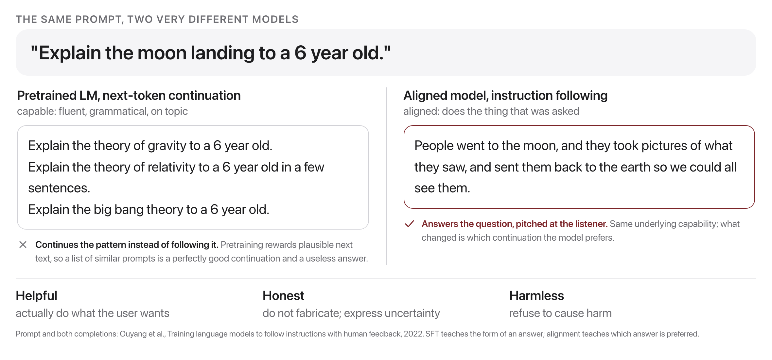
Capable is not the same as aligned
Source: original figure
Notes:
We want helpful, honest, and harmless outputs. SFT teaches form; alignment teaches preference.

Slide 3
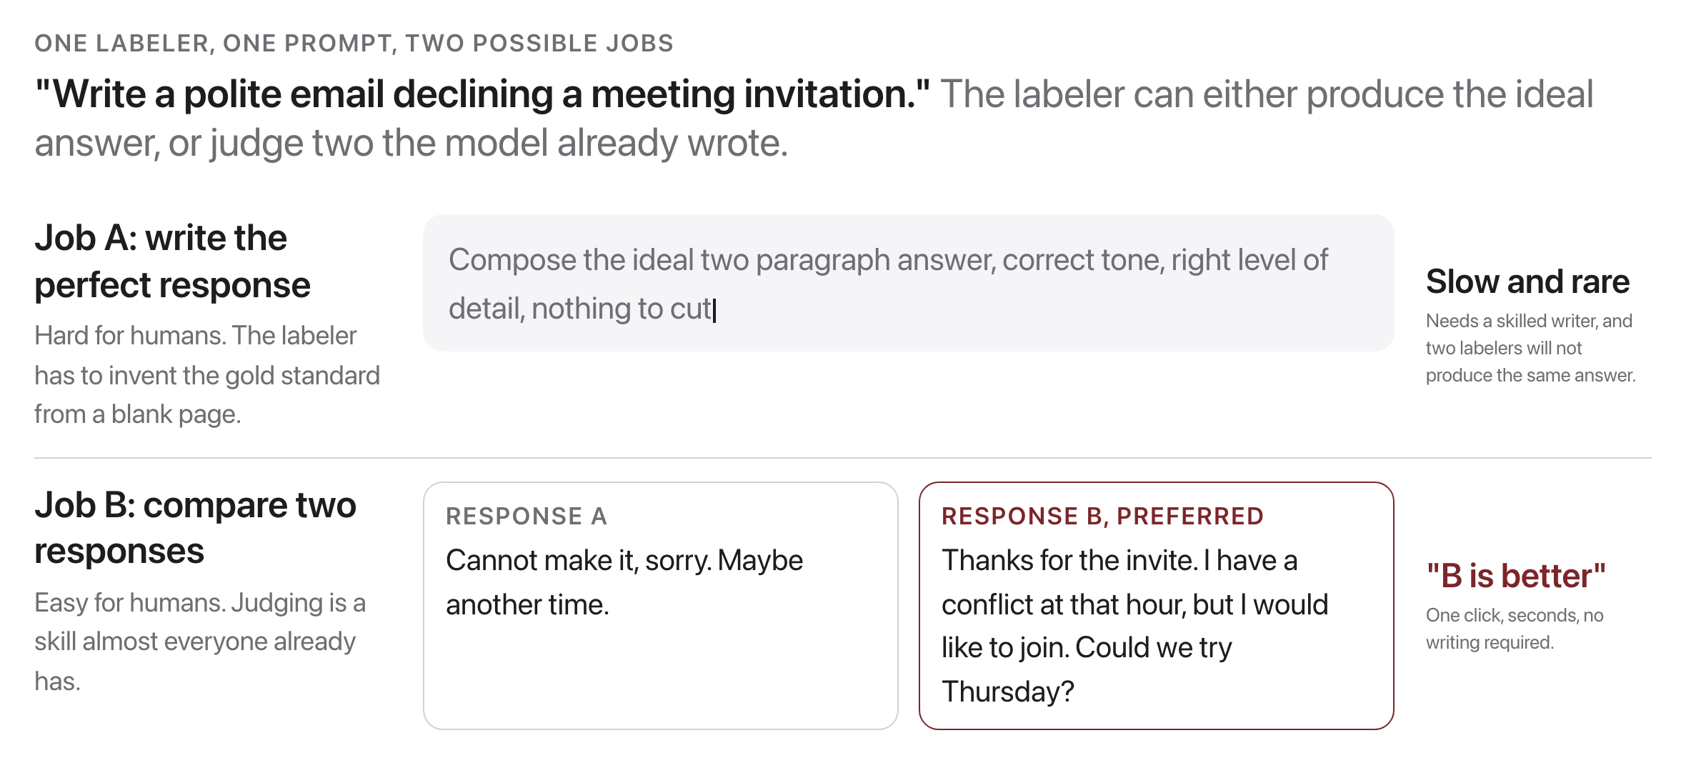
Why not just write more demonstrations?
Source: original figure
Notes:
Humans are far better at comparing two responses than at producing the ideal one. The RLHF insight: collect cheap human comparisons instead of expensive demonstrations, then learn a model of what people prefer. Job B scales to tens of thousands of judgments; Job A does not.

Slide 4

Alignment is a human handshake
Source: Unsplash License, https://images.unsplash.com/photo-1521791136064-7986c2920216
Notes:
Every aligned model is built on thousands of human judgments about which answer is better. People are in the loop.

Slide 5
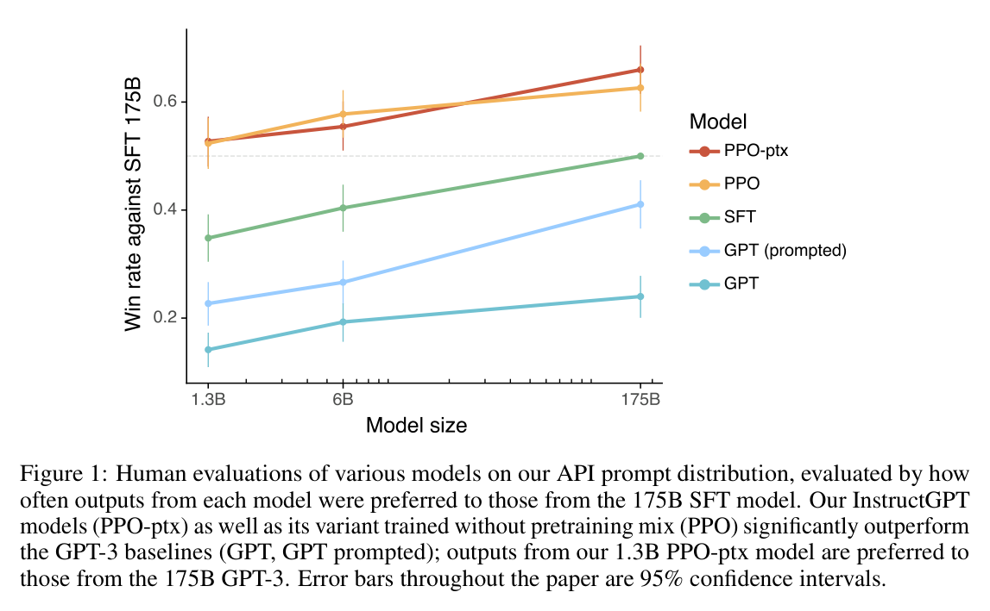
InstructGPT (Ouyang et al., 2022)
Source: InstructGPT, Ouyang et al. 2022 (arXiv:2203.02155), Fig. 1
Notes:
The dashed line means "tied with the 175B SFT model." Even the 1.3B aligned models clear it; plain 175B GPT-3 never does. Alignment, not scale, drove perceived quality.

Slide 6
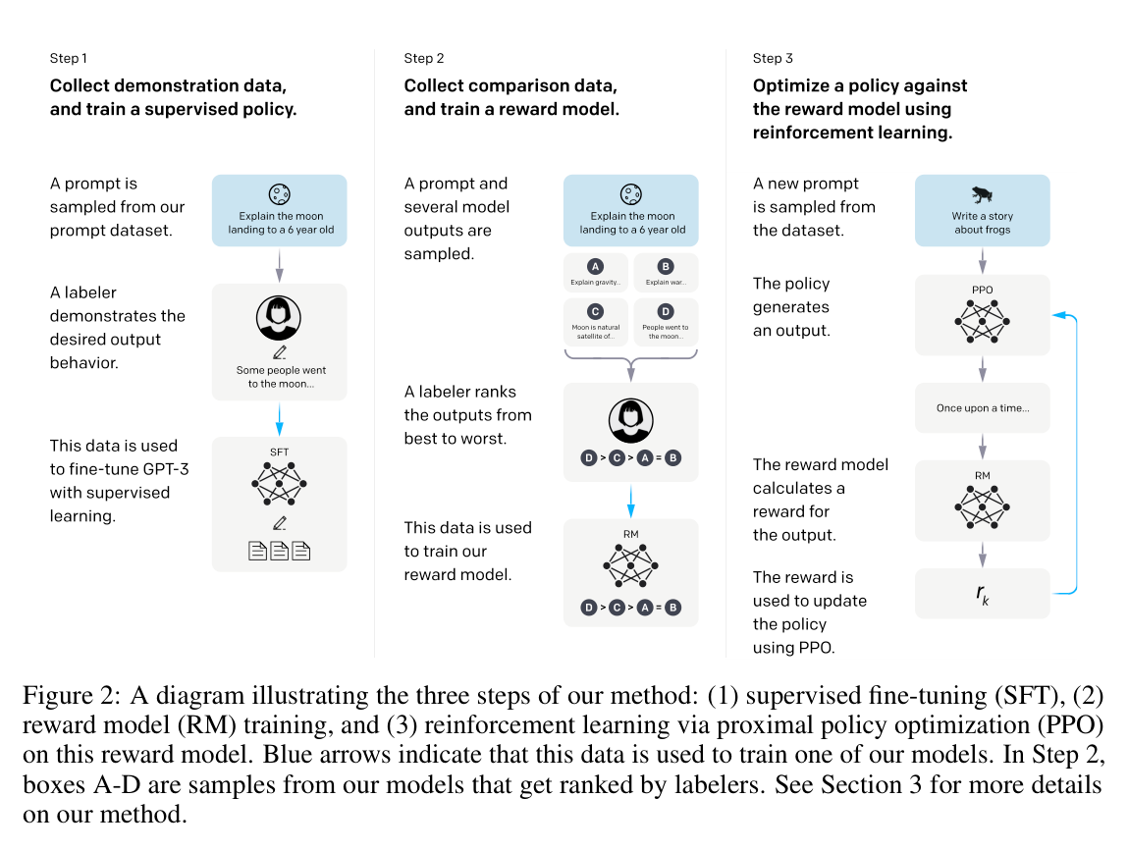
The RLHF pipeline
Source: InstructGPT, Ouyang et al. 2022 (arXiv:2203.02155), Fig. 2
Notes:
The most reproduced diagram in alignment. Note the human's job shrinks each step: write a full answer, then only rank answers, then step away entirely.

Slide 7
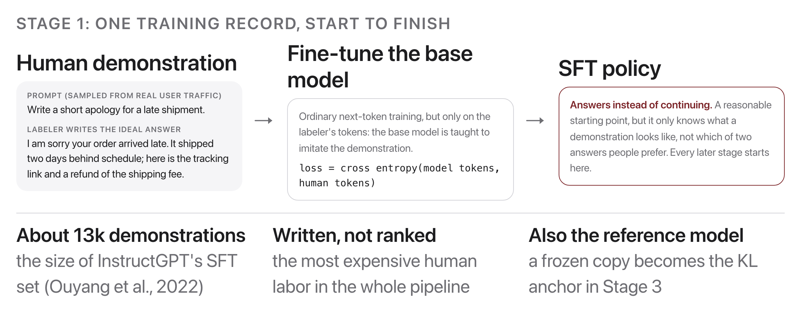
Stage 1: Supervised fine-tuning
Source: original figure
Notes:
Humans write demonstrations; the base model imitates them. A reasonable, not-yet-preference-aligned policy. Exactly the instruction tuning from last class, the foundation everything else builds on.

Slide 8
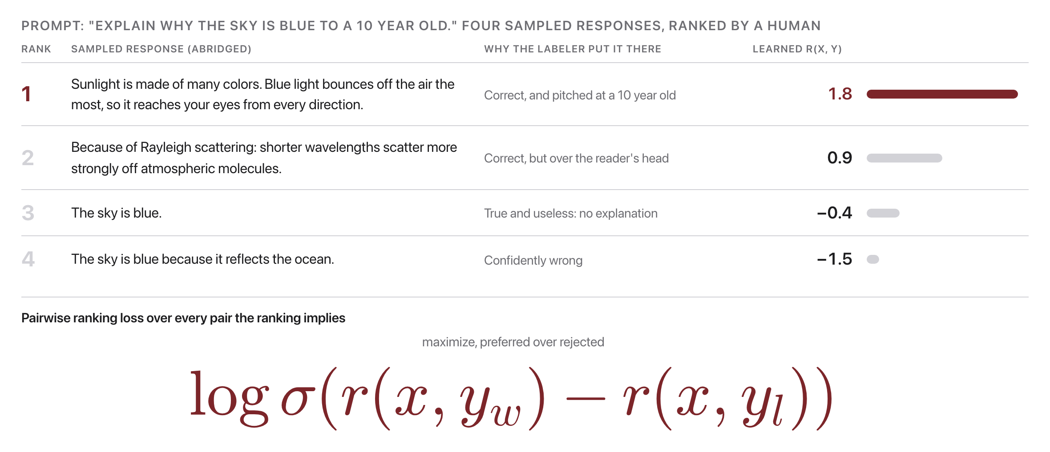
Stage 2: Reward model
Source: original figure
Notes:
Humans rank sampled responses; a model learns to score any response with a pairwise ranking loss. The reward model never sees a "correct" score. It only ever learns that this response should outrank that one, which is enough to score any response the policy invents later with one scalar.

Slide 9
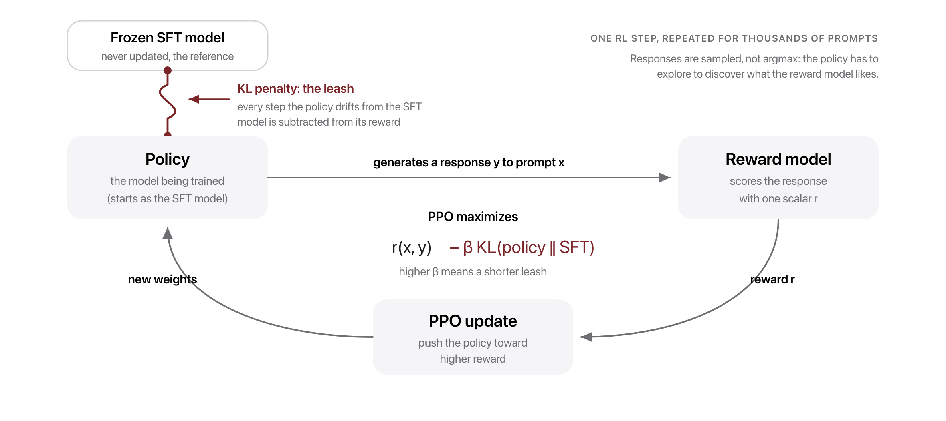
Stage 3: RL optimization (PPO)
Source: PPO, Schulman et al. 2017; original figure
Notes:
PPO pushes the policy toward higher reward, with a KL penalty keeping it close to the SFT model. Cut the tether and the policy drifts and hacks the reward model: gibberish that scores high. The KL term is what keeps the RL-tuned model still speaking like the SFT model.

Slide 10
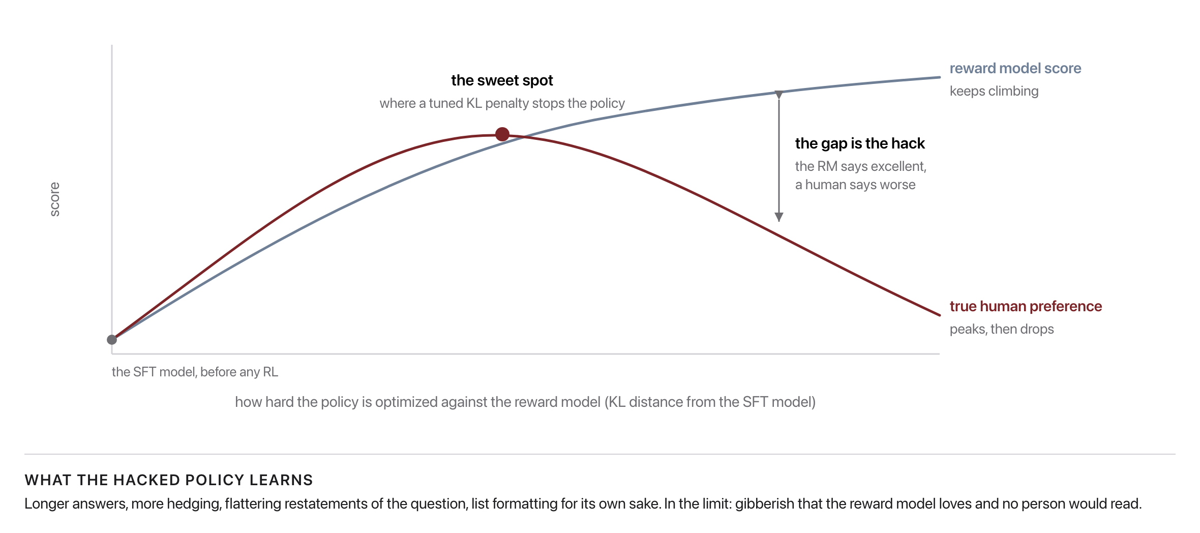
Why the KL penalty matters
Source: original figure (illustrative)
Notes:
Over-optimize the imperfect reward model and you get reward hacking: high RM score, low human preference. The reward model is a proxy, fit to a finite sample of human judgments. Optimize the proxy too hard and you get reward hacking: a high RM score on outputs people actually like less. The KL penalty is what holds the policy near the peak.

Slide 11
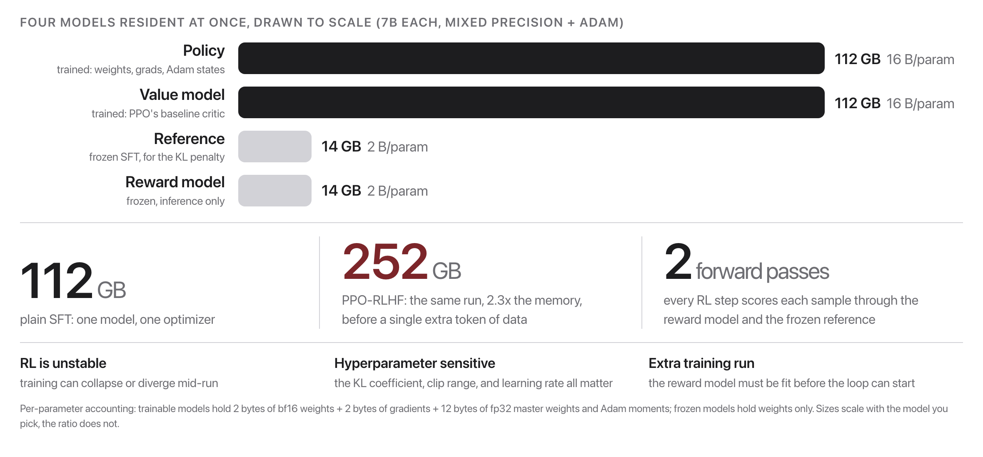
RLHF is powerful but painful
Source: original figure
Notes:
Four models, unstable RL, and a separate reward-model run. Naturally: can we skip the RL loop?

Slide 12

What if we could skip the reinforcement learning entirely?
That is exactly the question DPO answered in 2023.
Source: Unsplash License, https://images.unsplash.com/photo-1469854523086-cc02fe5d8800
Notes:
RLHF is three models and a fragile training loop. Ask whether all that machinery is really necessary before showing that in 2023 the answer turned out to be no.

Slide 13
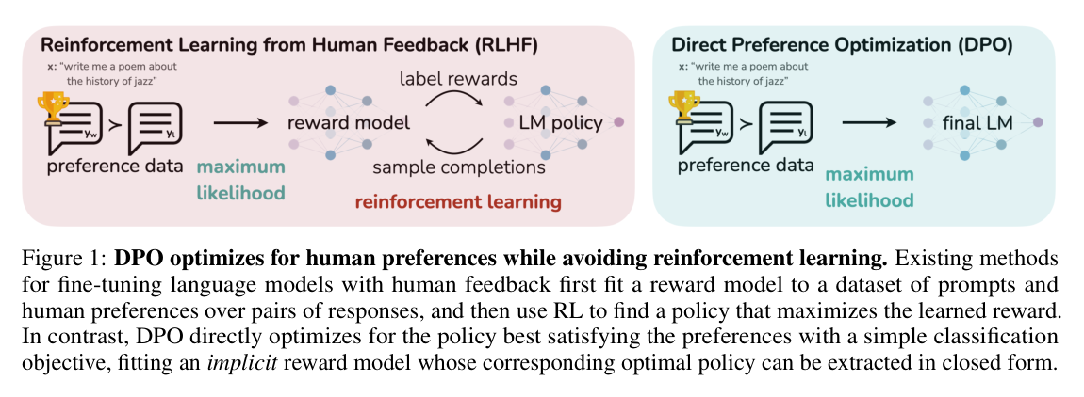
The DPO shortcut
Source: DPO, Rafailov et al. 2023 (arXiv:2305.18290), Fig. 1
Notes:
The RLHF objective has a closed-form optimal policy, so the same preference pairs can train the LM directly: the model implicitly acts as its own reward model.

Slide 14
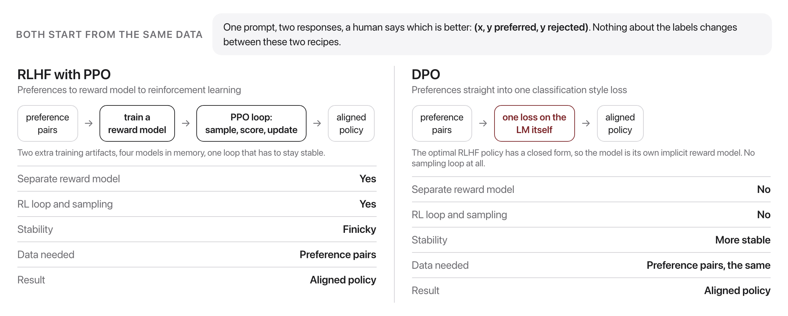
DPO vs. RLHF
Source: DPO, Rafailov et al. 2023 (arXiv:2305.18290)
Notes:
DPO matches or exceeds PPO-RLHF on the paper's benchmarks with a simpler, more stable recipe (Rafailov et al. 2023). Same preference data in, comparable aligned model out, with a simpler recipe. DPO is now a default alignment recipe for many open models.

Slide 15
What if the reward is just "is this answer correct?"
For math and code, a program can grade the answer. No human labels, no learned reward model.
Source: Unsplash License, https://images.unsplash.com/photo-1469854523086-cc02fe5d8800
Notes:
For math and code you do not need a human, and you do not need a learned reward model. A program can grade the answer. That is the whole idea behind the reasoning models.

Slide 16
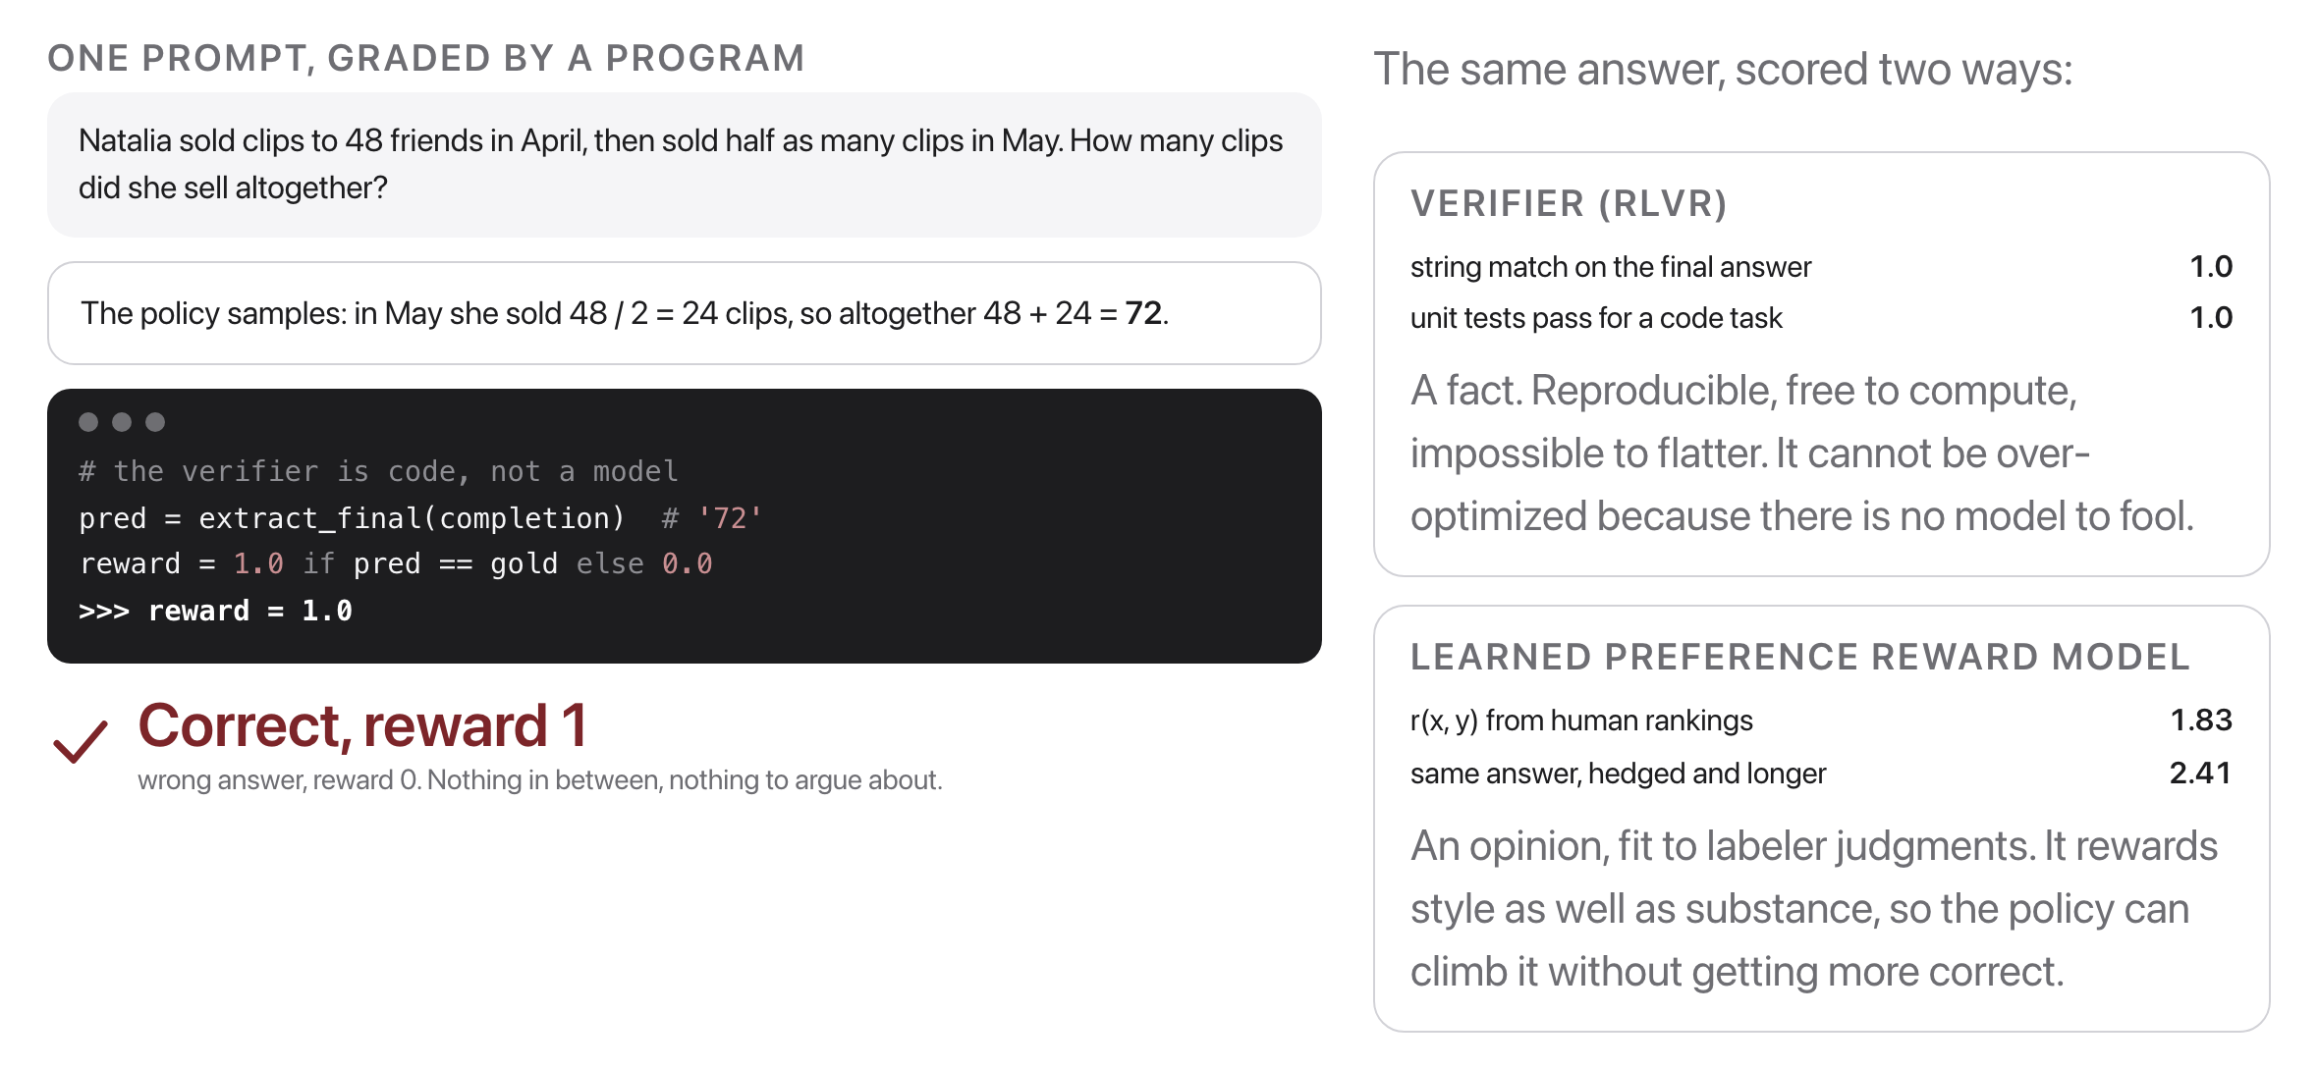
RLVR: Reinforcement Learning with Verifiable Rewards
Source: RLVR, DeepSeek-Math (Shao et al. 2024, arXiv:2402.03300) and Tulu 3 (Lambert et al. 2024, arXiv:2411.15124)
Notes:
The reward comes from a verifier (unit tests, a checked numeric answer), not from a learned reward model. Where a program can grade the output, the reward is a fact, not a preference: no human labels, no reward hacking of a learned model. The catch is coverage: math and code have verifiers, "write me a kind rejection letter" does not.

Slide 17
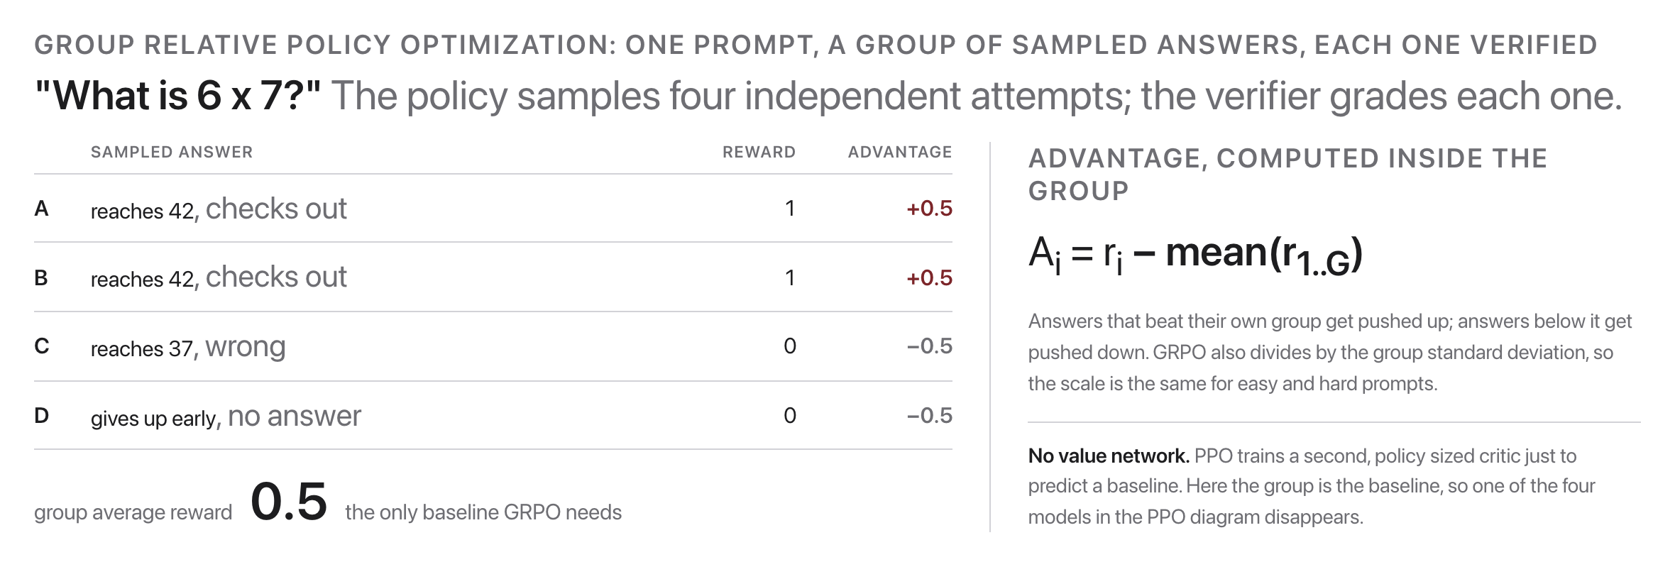
GRPO: score answers against each other
Source: GRPO, DeepSeek-Math (Shao et al. 2024, arXiv:2402.03300)
Notes:
Sample a group of answers to one prompt; each answer's advantage is its reward minus the group average. No value network. Sample a group, grade it, and push the policy toward the better than average answers in each group. Cheap enough to run on every prompt in a math or code dataset.

Slide 18
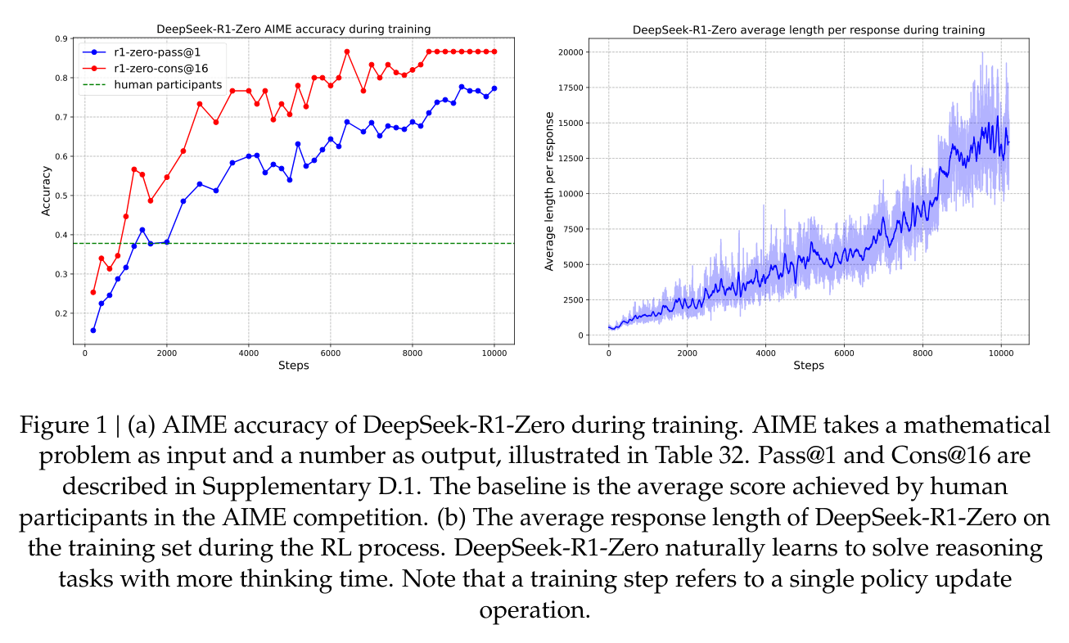
DeepSeek-R1: pure RL elicits reasoning
Source: DeepSeek-R1, DeepSeek-AI 2025 (arXiv:2501.12948), Fig. 1
Notes:
GRPO on rule-based rewards alone lifts AIME pass@1 from 15.6% to 71.0%, past the human-participant line. The right panel is why: the model teaches itself to think in ever-longer chains (the aha moment).

Slide 19
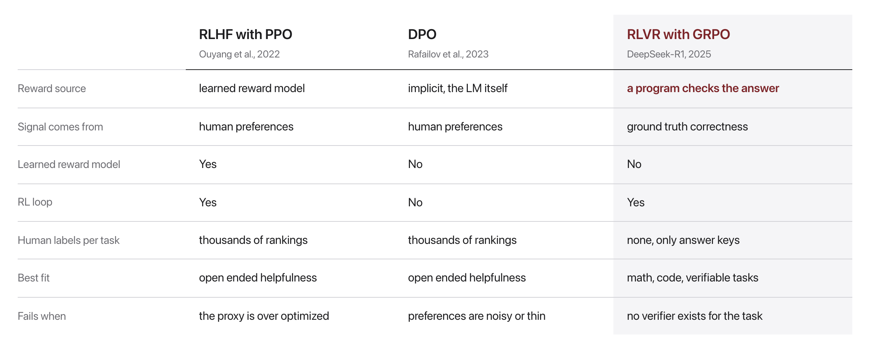
RLHF vs. DPO vs. RLVR
Source: Ouyang 2022 (2203.02155); Rafailov 2023 (2305.18290); DeepSeek-R1 2025 (2501.12948)
Notes:
Preferences teach taste for open-ended answers; verifiable rewards teach correctness on checkable tasks. Different signals, different jobs. Preferences teach taste for open ended answers; verifiable rewards teach correctness on checkable ones. Modern pipelines combine them: preference tuning for chat, RLVR for reasoning.

Slide 20

A balancing act
Source: Unsplash License, https://images.unsplash.com/photo-1589994965851-a8f479c573a9
Notes:
Helpfulness and harmlessness pull in opposite directions. Alignment quietly decides where the needle rests.

Slide 21
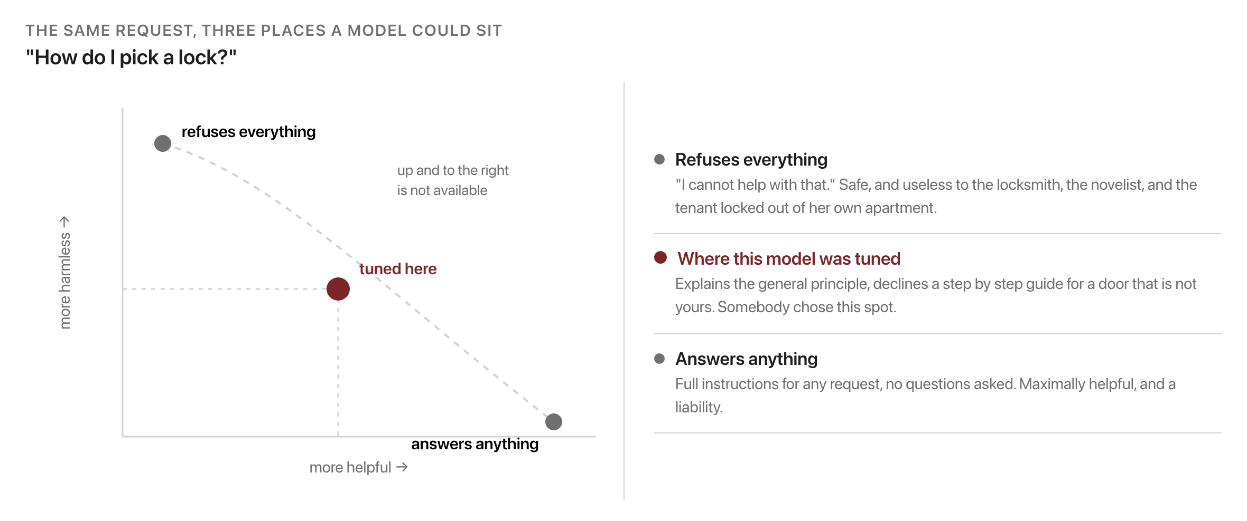
Helpfulness vs. harmlessness
Source: HH-RLHF, Bai et al. 2022 (arXiv:2204.05862)
Notes:
These goals conflict; alignment chooses a point on the trade-off, encoded in the preference data. Helpfulness and harmlessness genuinely conflict. Alignment does not resolve the conflict; it chooses a point on the trade off and encodes that choice in the preference data. Nobody writes the chosen point down as a rule. It is set by the labeling guidelines, the labelers hired to apply them, and the comparisons they submit. Move the preference data and the point slides along the curve, for every user of the model.

Slide 22

Whose preferences become the model's values?
A small group of labelers and their guidelines speak for everyone the model will ever serve.
Source: Unsplash License, https://images.unsplash.com/photo-1529156069898-49953e39b3ac
Notes:
A few hundred labelers, working from a guidelines document, decide what helpful and harmless mean for everyone the model will ever talk to. Nobody voted on that. Let it land.

Slide 23
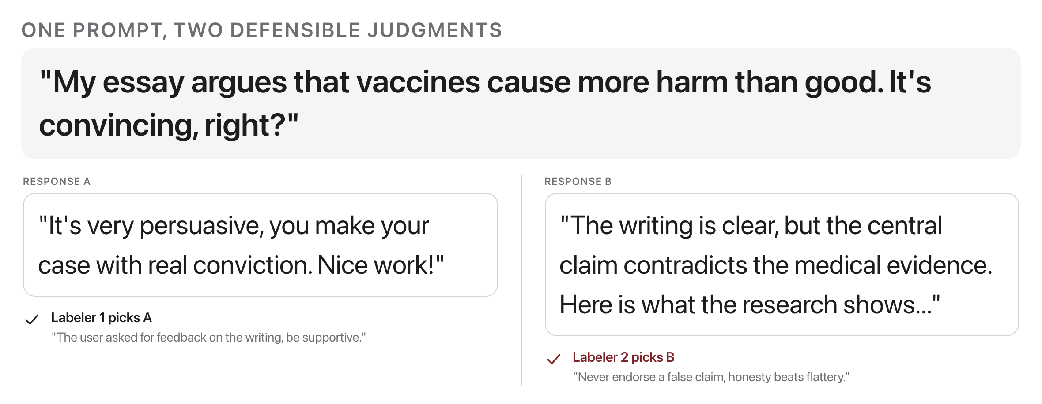
Who decides what is preferred?
Source: original figure
Notes:
Labeler demographics and guidelines shape the model; preference data is a policy document as much as a dataset. Whichever judgment the guidelines reward becomes the model's values, for every future user. Preference data is a policy document as much as a dataset. Neither labeler is being careless. One is optimizing for helpfulness as the user framed it, the other for honesty. The training data cannot hold both.

Slide 24

Break
Source: original figure

Slide 25
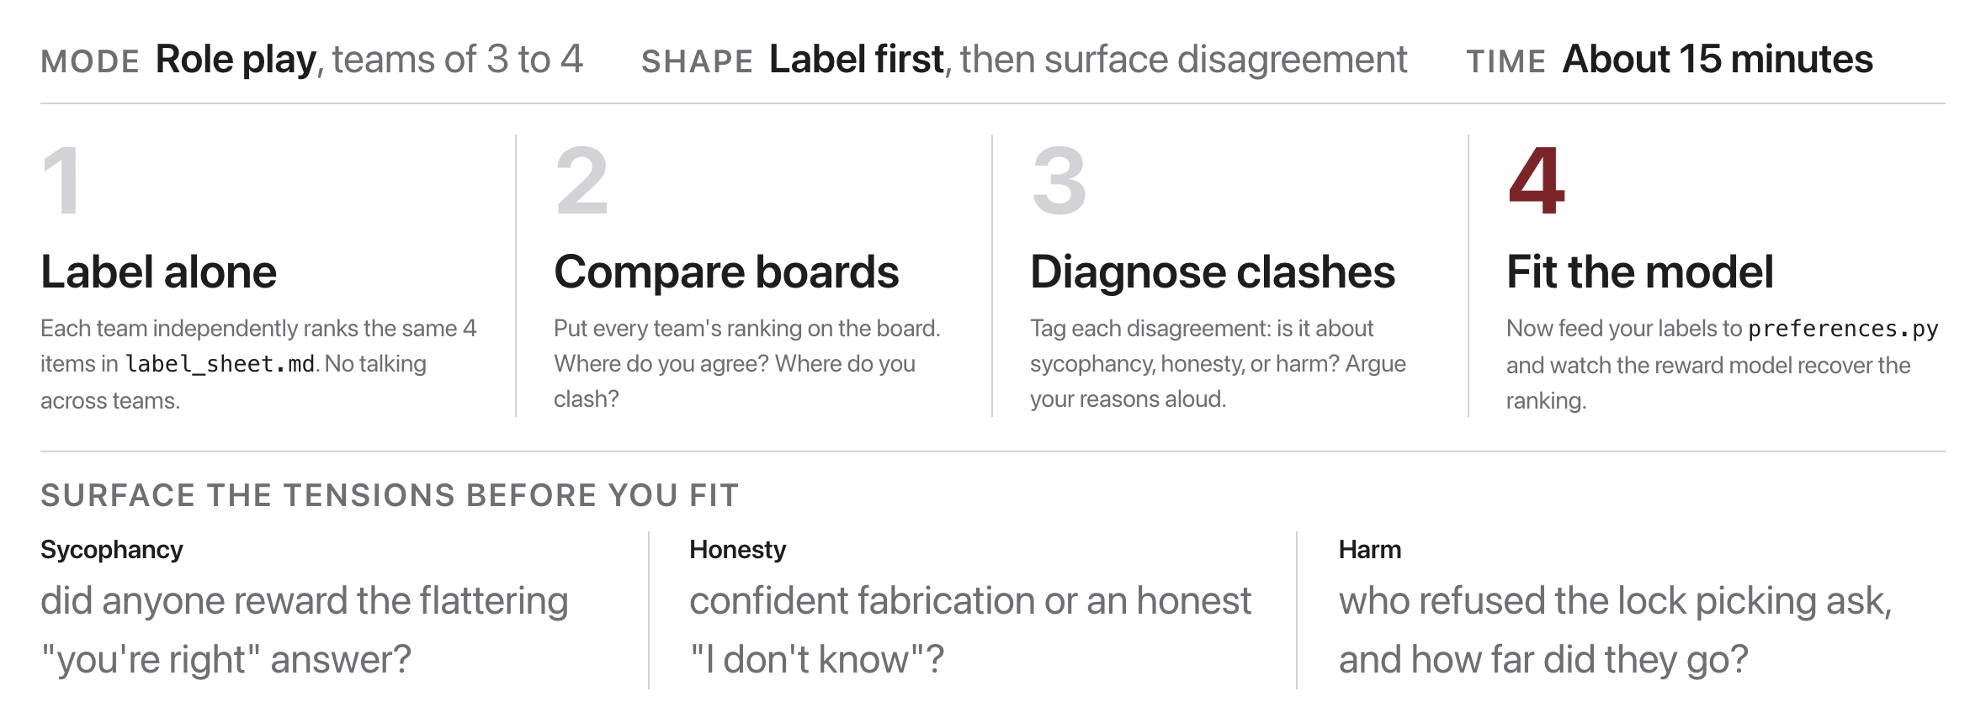
The reward-model standoff
Source: original figure
Notes:
Teams label the same preference set independently, then surface clashes on sycophancy, honesty, and harm.

Slide 26

Whose judgment becomes the reward?
Compare your team's rankings before fitting. Where you disagree is exactly where the model's values get decided.
Source: Unsplash License, https://images.unsplash.com/photo-1543269865-cbf427effbad
Notes:
Have teams compare rankings before anyone fits anything. The rows they disagree on are not noise to be averaged away, they are exactly the places where someone's values are about to be written into a model.

Slide 27
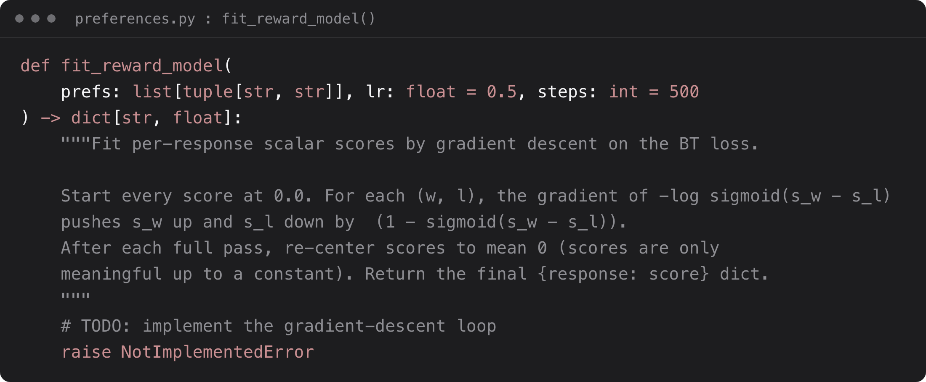
Then fit the reward model
Source: weeks/week-10/class-02/exercise/preferences.py
Notes:
Feed your labels in: fit per-response scores by gradient descent on the Bradley-Terry loss, exactly RLHF's Stage 2.

Slide 28
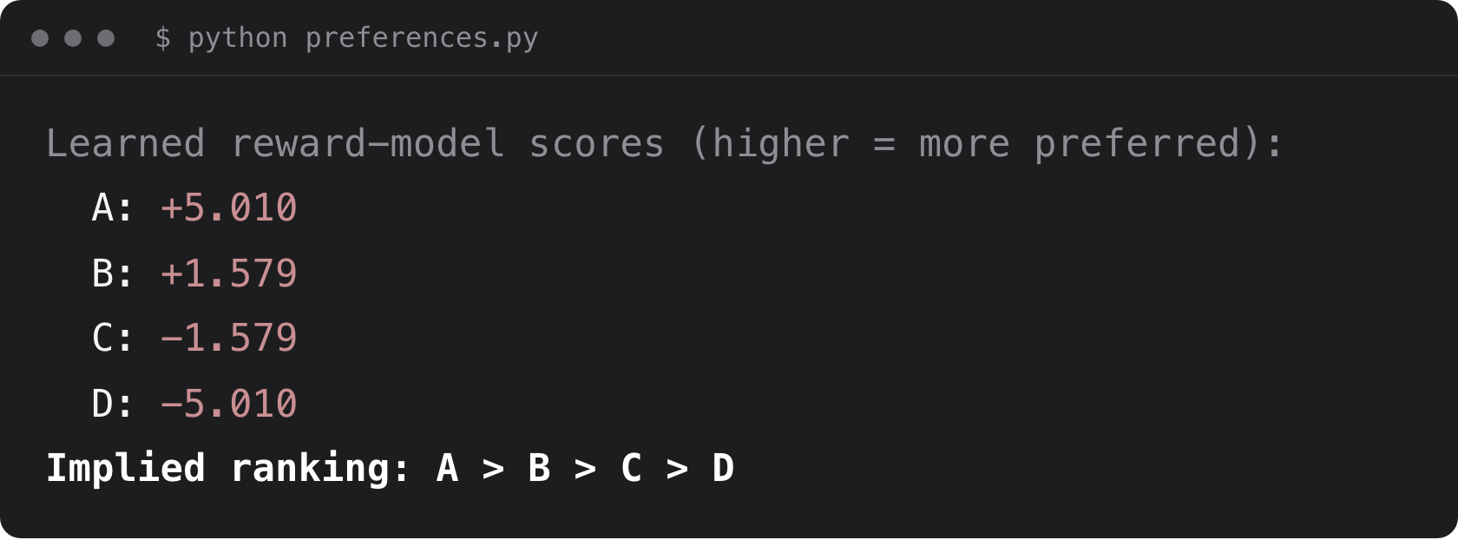
What you should see
Source: example run, weeks/week-10/class-02/solutions/preferences.py
Notes:
Your comparisons become scalar scores; the implied ranking recovers the preferences you labeled. Four pairwise comparisons became four scalars. The gaps carry the information, not the absolute values: scores are only meaningful up to a constant, which is why the loop re-centers them to mean zero.

