Slide 1
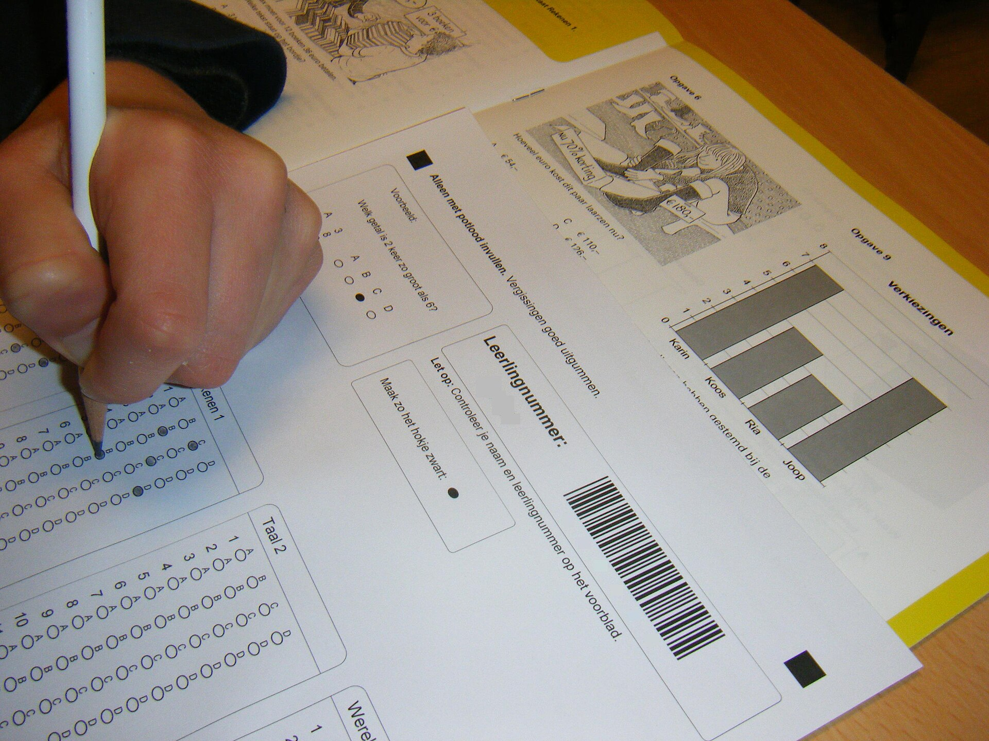
CSCI 3495
Evaluation & Benchmarks
Natural Language Processing & Large Language Models
Week 11, Class 2 · Wed Nov 4, 2026
Source: Onderwijsgek, Wikimedia Commons, CC BY-SA 2.5 NL
Notes:
Bubble sheets made grading kids scalable; MMLU grades models the same way. Ask the class: what can a bubble sheet never measure?

Slide 2

How do you grade a machine?
Source: Unsplash License, https://images.unsplash.com/photo-1434030216411-0b793f4b4173
Notes:
We grade students with exams. Benchmarks are the exams we write for models, and they are just as easy to get wrong.

Slide 3
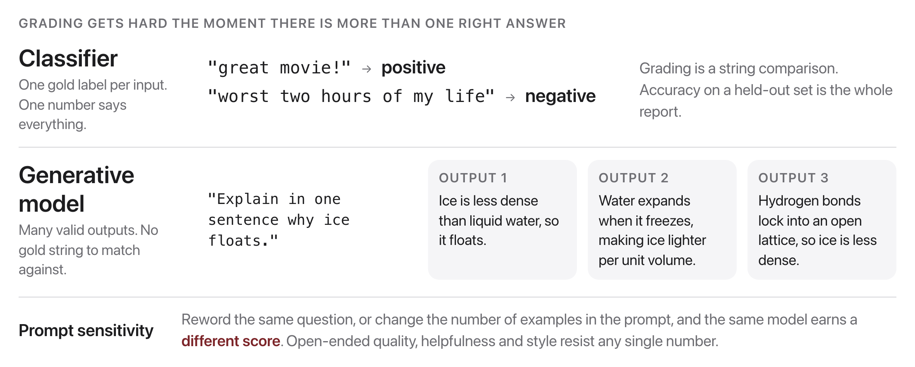
Why is evaluating LLMs hard?
Source: original figure
Notes:
With a classifier there is one gold label and grading is a string comparison. The moment there is more than one right answer, accuracy stops meaning anything and you have to decide what good even is.

Slide 4
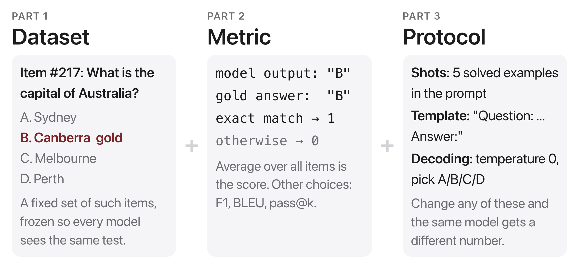
What is a benchmark?
Source: original figure
Notes:
Always report the protocol. Two papers with different shot counts or prompt templates are not comparable.

Slide 5
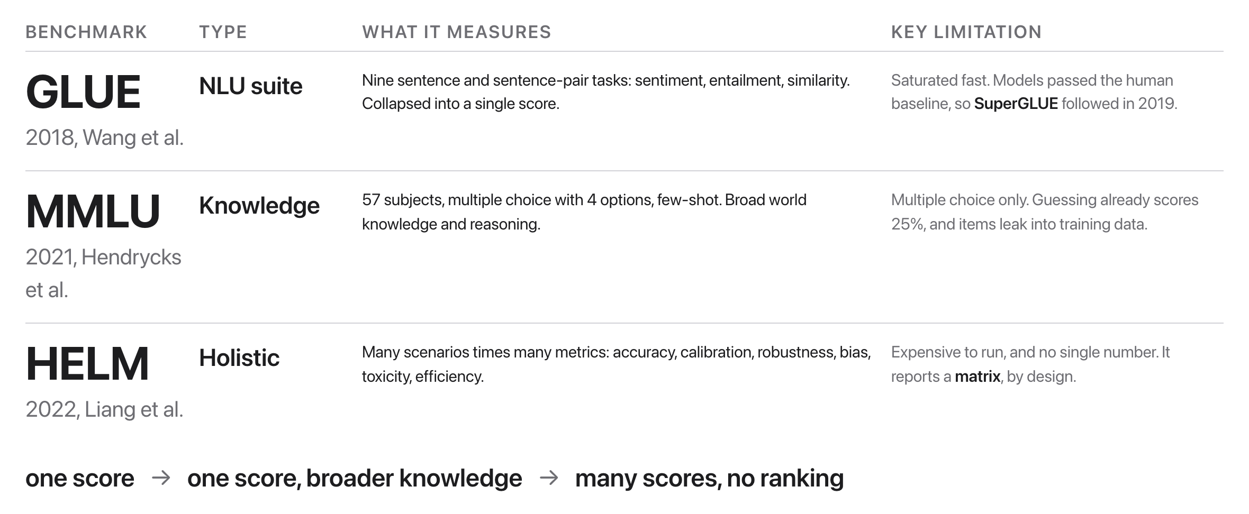
Three landmark benchmarks
Source: GLUE 1804.07461; MMLU 2009.03300; HELM 2211.09110
Notes:
Watch out for contamination (test items leaked into training inflate the score) and construct validity (does the score measure the capability you care about?). A high MMLU number promises nothing about truthfulness, calibration, or safety.

Slide 6
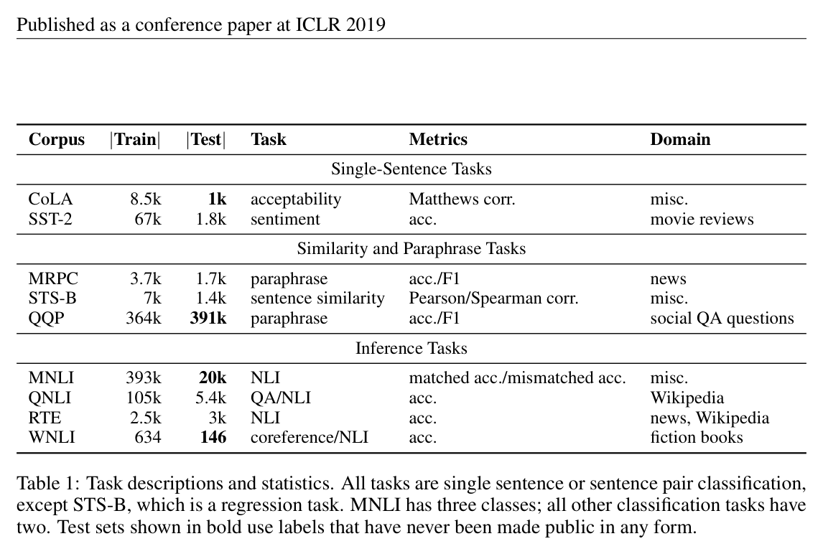
GLUE
Source: Wang et al. 2018 (arXiv:1804.07461), Table 1
Notes:
Nine sentence-level tasks, one aggregate number. It drove real progress and then models passed the human baseline in about a year, which is why SuperGLUE existed almost immediately.

Slide 7
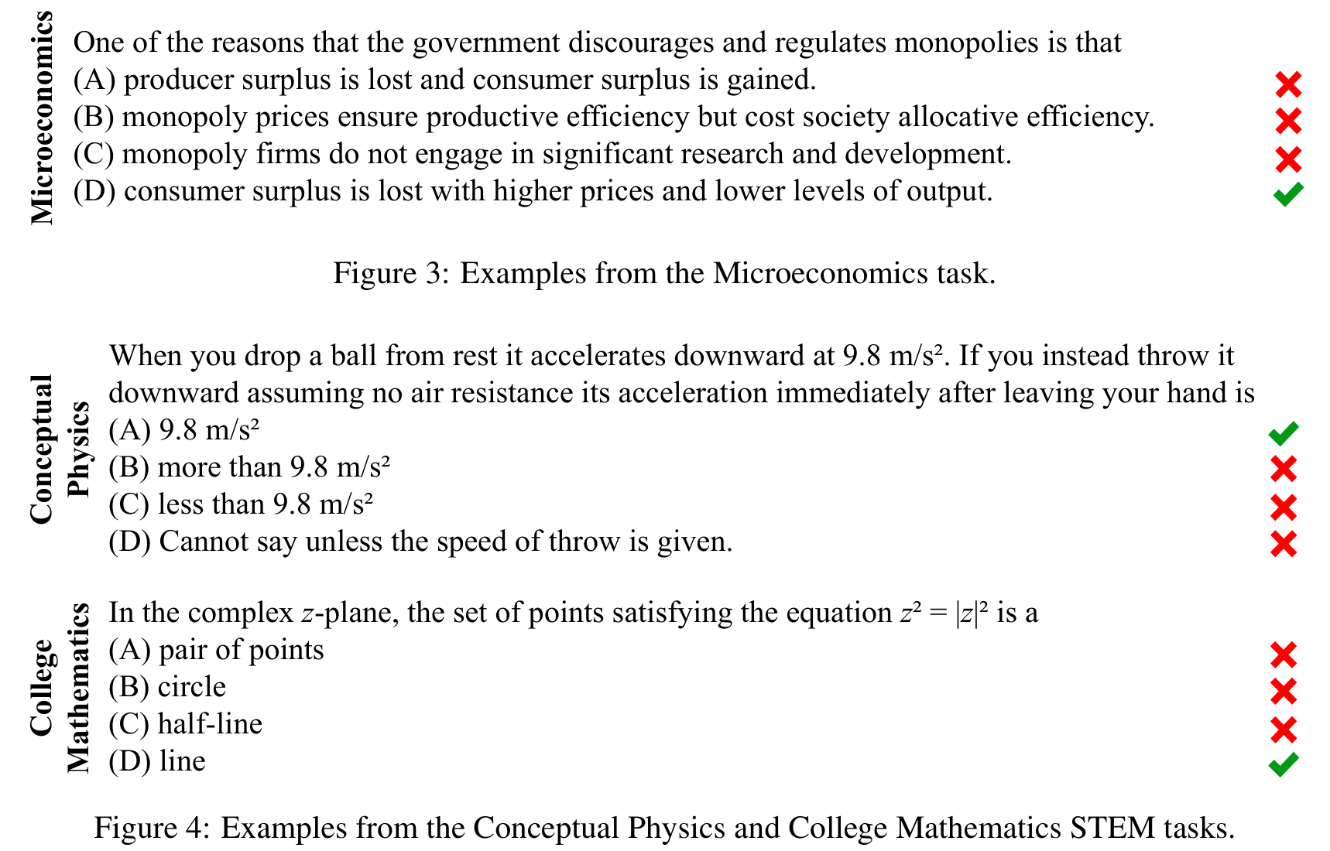
MMLU
Source: Hendrycks et al. 2021 (arXiv:2009.03300), Figs. 3-4
Notes:
Real items from 3 of the 57 subjects. Four options means random guessing scores 25%; multiple choice makes grading trivial but invites contamination. Real items from 3 of 57 subjects; with 4 options, random guessing scores 25%.

Slide 8
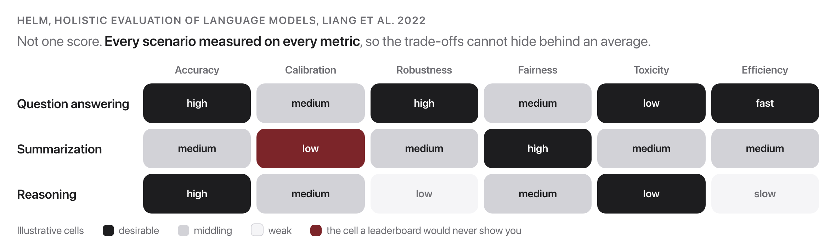
HELM
Source: Liang et al., 2022, arxiv.org/abs/2211.09110
Notes:
Forces trade-offs into view that one accuracy number hides: this model summarizes acceptably while being badly calibrated about it. Cost: expensive to run, and no tidy rank, by design.

Slide 9
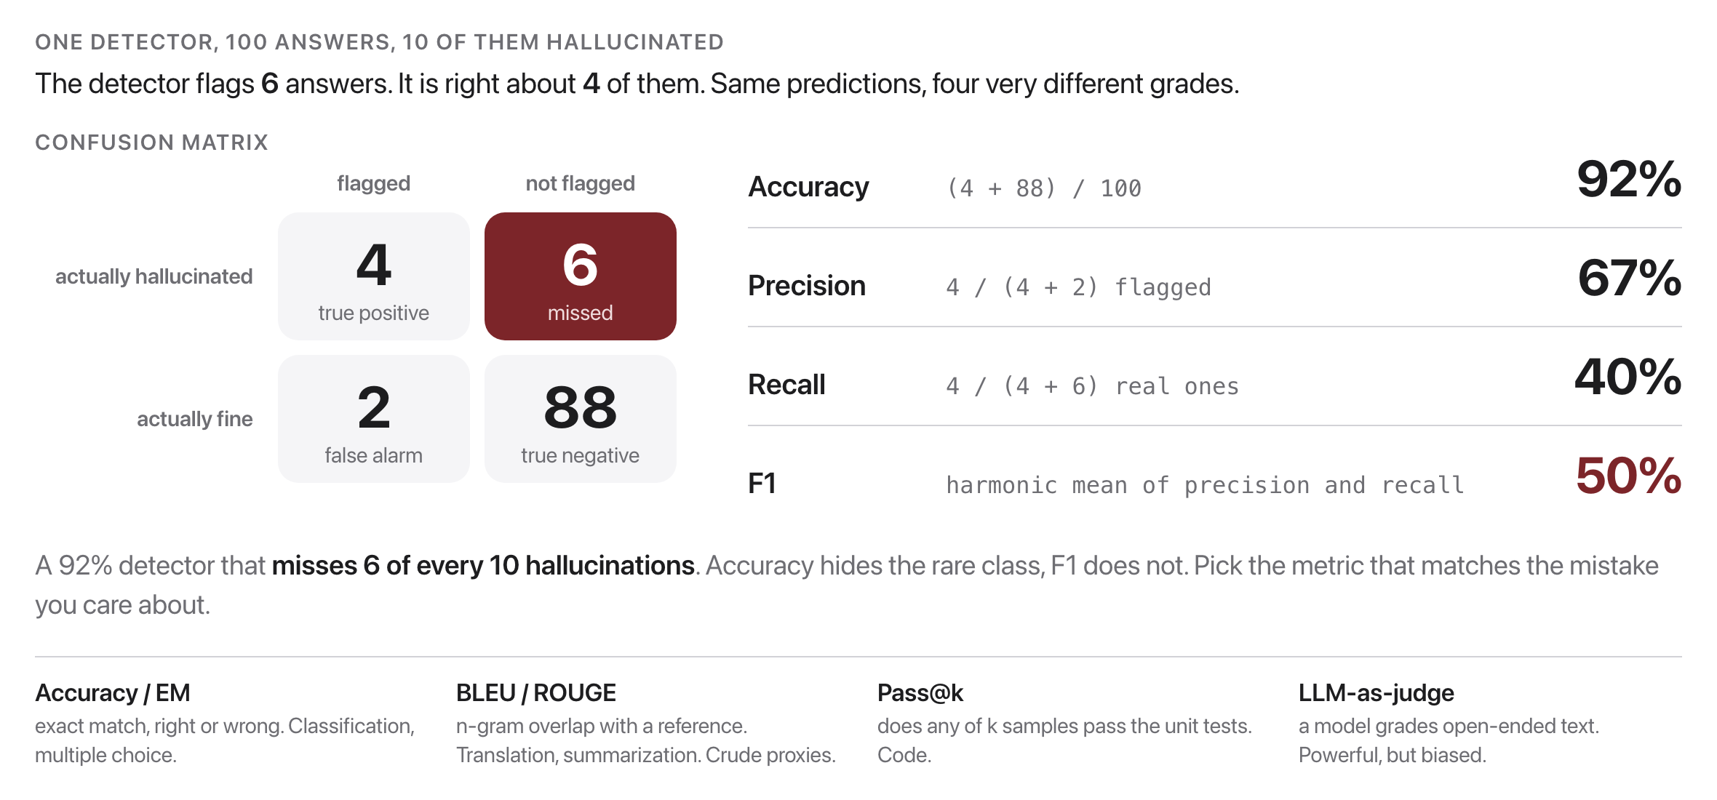
Metrics matter as much as data
Source: original figure
Notes:
Pick the metric that matches what you actually care about.

Slide 10

If a model tops every leaderboard, is it actually good?
Not necessarily. Contamination, narrow metrics, and overfitting can fake a high score.
Source: Unsplash License, https://images.unsplash.com/photo-1453928582365-b6ad33cbcf64
Notes:
Take a couple of answers before moving on. Contamination, a narrow metric and plain overfitting can all produce a top score with nothing behind it.

Slide 11
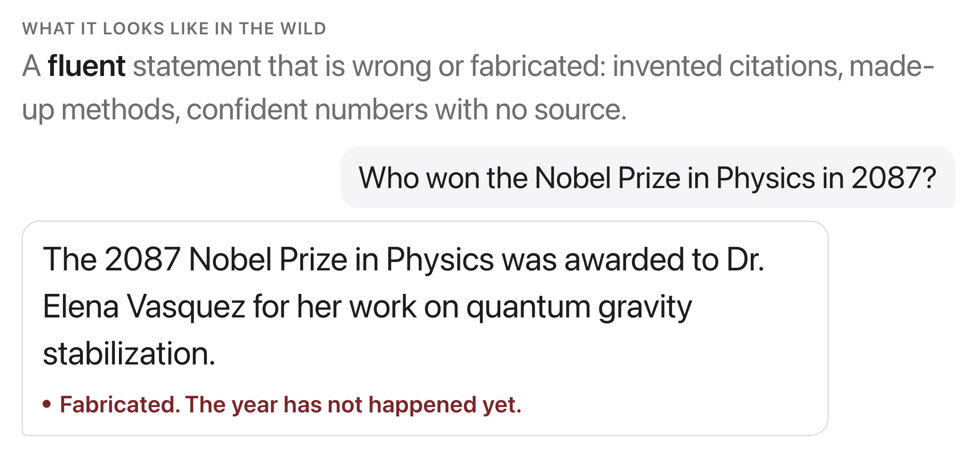
Hallucination
Source: original figure; example matches the exercise dataset
Notes:
Why it is dangerous: the model optimizes for plausible text, not truth. Fluency is not accuracy, and the wrong answer sounds exactly as authoritative as a right one. You will deliberately catch one today.

Slide 12
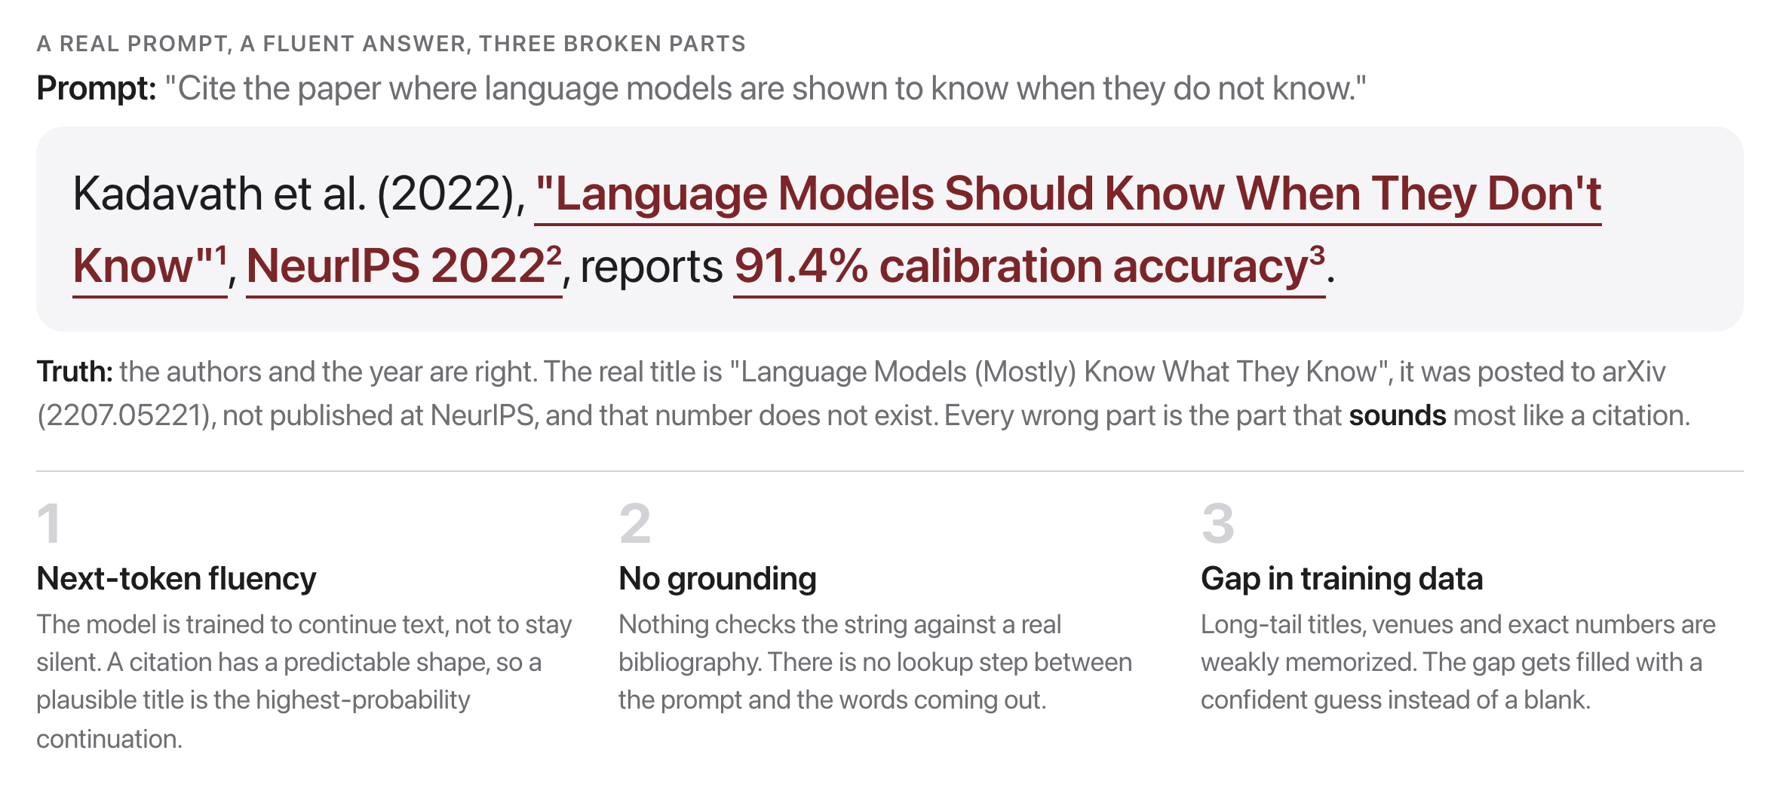
Why models hallucinate
Source: original figure
Notes:
Mitigations, later weeks: retrieval grounding (RAG, Week 13), demand verifiable citations, calibrate confidence and let the model abstain.

Slide 13
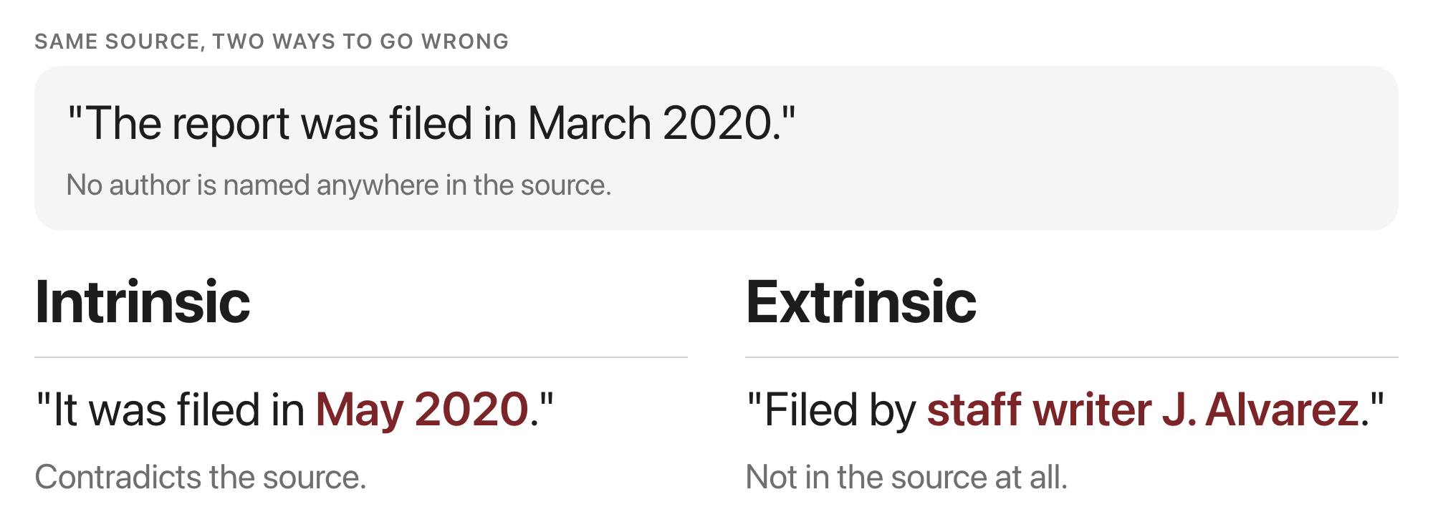
Two kinds of hallucination
Source: original figure; intrinsic vs extrinsic framing, Ji et al. 2023 survey
Notes:
Intrinsic contradicts the source, extrinsic invents something the source never mentioned. The second is more dangerous, because there is nothing to contradict and it reads perfectly.

Slide 14
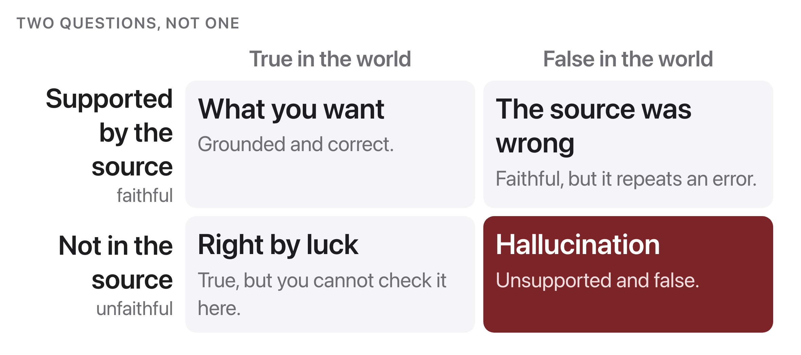
Faithfulness vs factuality
Source: original figure
Notes:
For RAG and summarization we grade faithfulness: the answer must come from the source. Factuality is the broader, harder world-truth test.

Slide 15
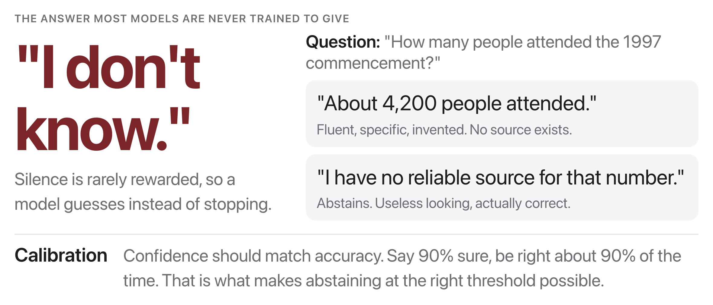
Abstention: saying "I don't know"
Source: original figure
Notes:
The answer almost no model is trained to give. Silence is rarely rewarded during training, so a guess scores better than an admission, and you get a fluent number with nothing behind it.

Slide 16

Would you bet your job on this answer?
If the cost of a wrong answer is high, "I don't know" is the right answer.
Source: Unsplash License, https://images.unsplash.com/photo-1454165804606-c3d57bc86b40
Notes:
Reframe it as cost. When a wrong answer is expensive, I do not know is not a failure, it is the correct output.

Slide 17
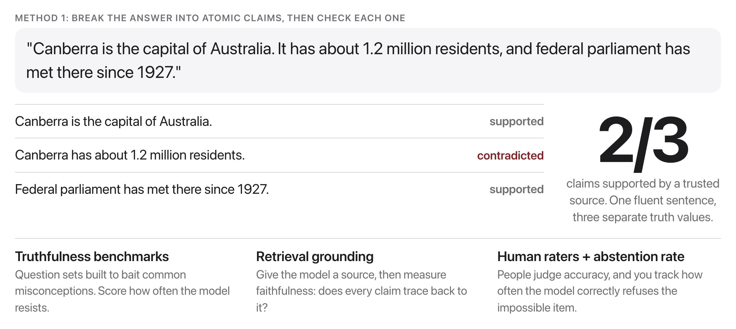
How do we measure factuality?
Source: original figure
Notes:
Caution: every automatic checker is itself imperfect. A factuality score is only as trustworthy as the source and the checker behind it.

Slide 18
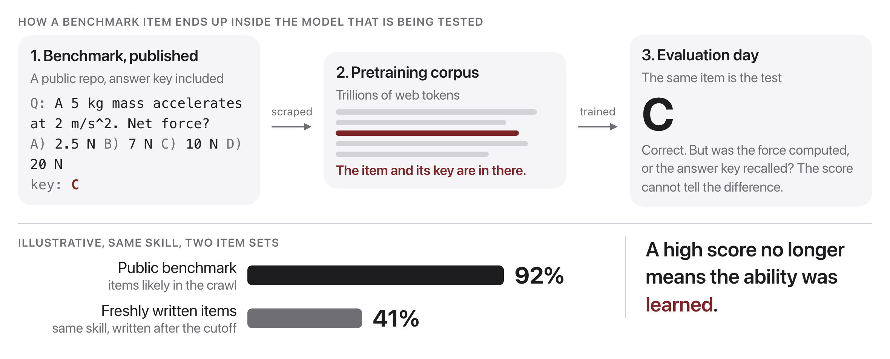
What if the test set was already in the training data?
Source: original figure
Notes:
Then the score measures memorization, not ability. Benchmarks are public text, so they get scraped into pretraining corpora. Defenses: private or held-out test sets, canary strings, freshly collected items, and checking the corpus for verbatim overlap. It can mean the answers were memorized. Contamination breaks the one assumption a benchmark rests on: the model has never seen the test.

Slide 19
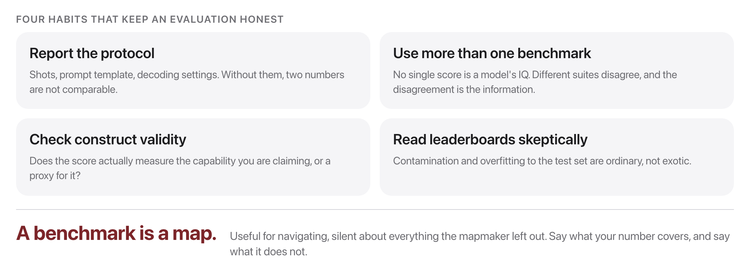
Evaluating responsibly
Source: original figure
Notes:
Four habits. Report the protocol so two numbers can be compared at all, use more than one benchmark, check for contamination, and look at the errors rather than only the aggregate.

Slide 20
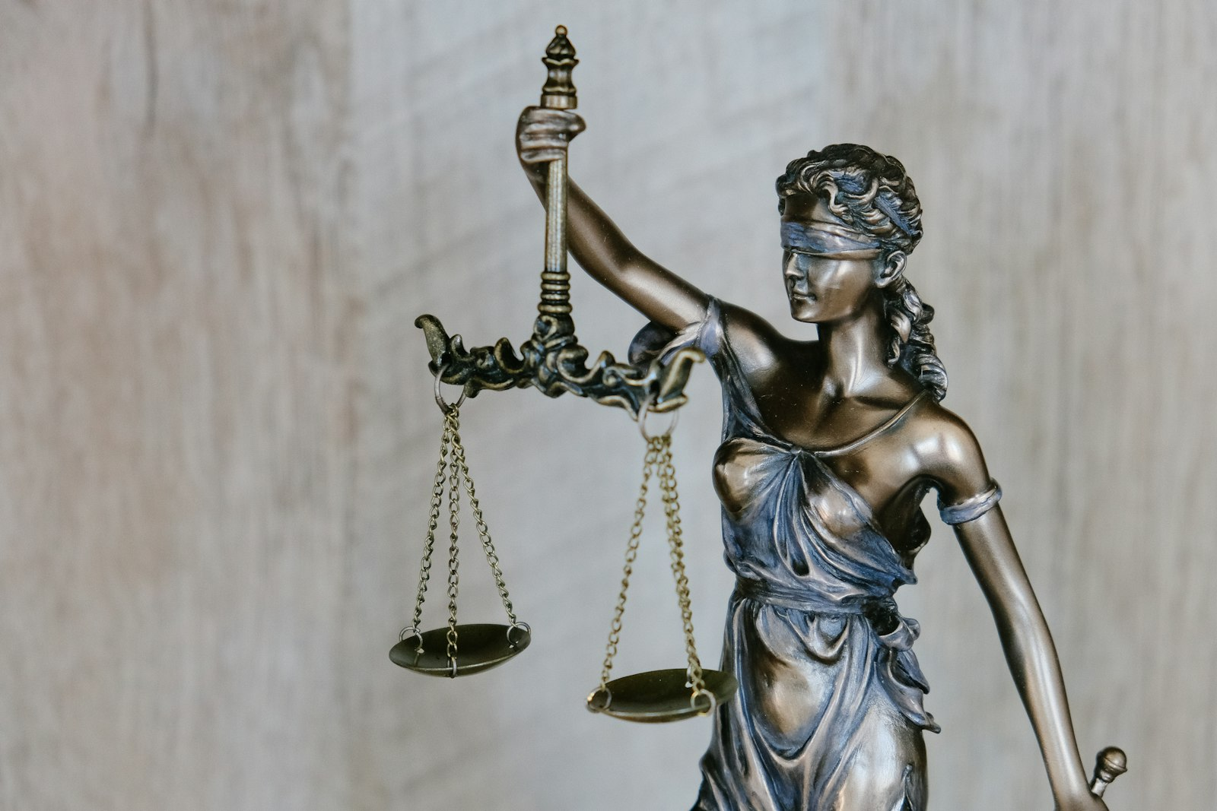
Should a robot grade a robot?
We do it all the time now. The question is whether to trust the verdict.
Source: Unsplash License, https://images.unsplash.com/photo-1589829545856-d10d557cf95f
Notes:
We already do, at scale. The question is not whether it happens but whether the verdict deserves trust, which is the next two slides.

Slide 21
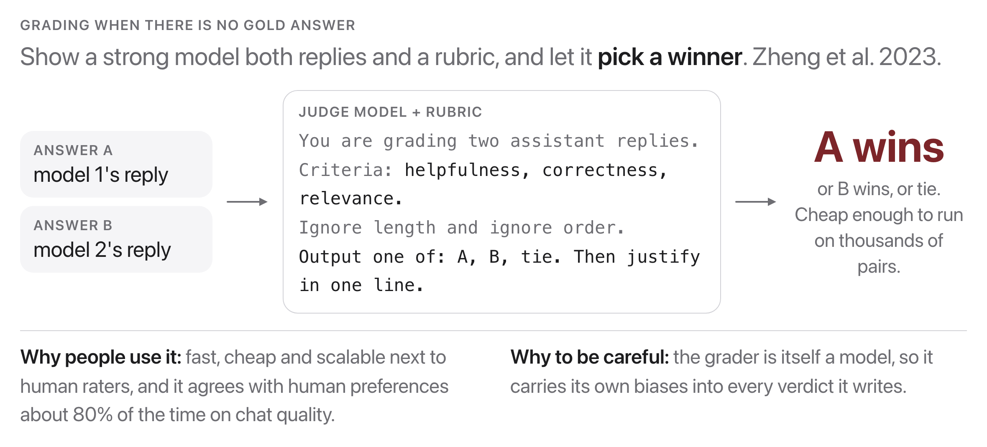
LLM-as-a-judge
Source: Zheng et al., 2023, arxiv.org/abs/2306.05685
Notes:
Show a strong model both replies and a rubric, and let it pick. It correlates surprisingly well with human preference, which is why it is now everywhere.

Slide 22
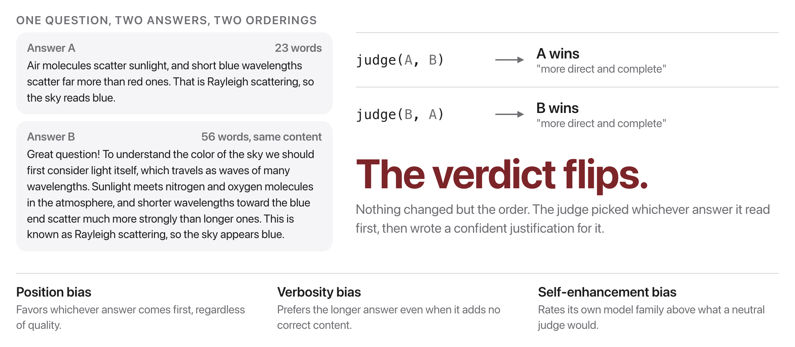
The judge has biases
Source: Zheng et al., 2023, arxiv.org/abs/2306.05685
Notes:
Same question, same content, two orderings, and the judge changes its mind. It also prefers the longer answer. Any evaluation built on this needs the positions swapped and averaged, or it is measuring the judge. Fixes: run both orders and keep only verdicts that survive the swap, give an explicit rubric, compare pairwise, and judge with a different model family. Zheng et al. 2023.

Slide 23
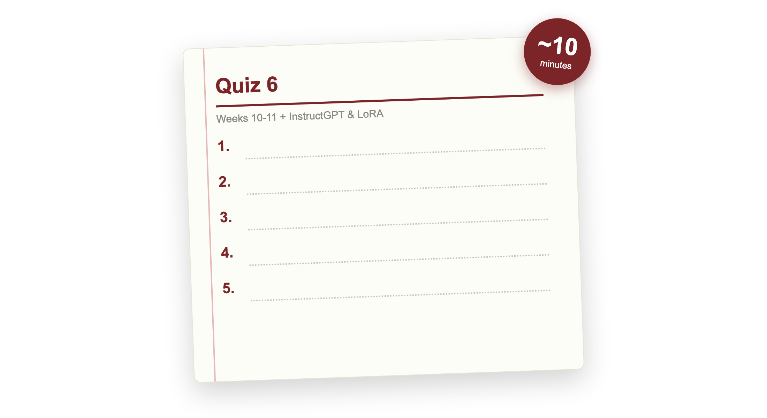
Quiz 6 (paper)
Source: quizzes/quiz-06.md
Notes:
Covers Weeks 10 and 11: BPE at scale, instruction tuning, alignment, LoRA and quantization, evaluation, plus InstructGPT (Ouyang 2022) and LoRA (Hu 2021). Clear your desk. Finish early and your break starts early; need more time and it comes out of the break.

Slide 24

Break
Source: original figure

Slide 25
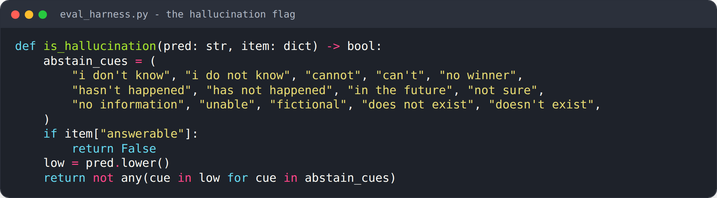
Build the evaluation harness
Source: weeks/week-11/class-02/exercise/README.md
Notes:
Flag a hallucination, then build the swap test that catches a biased judge.

Slide 26
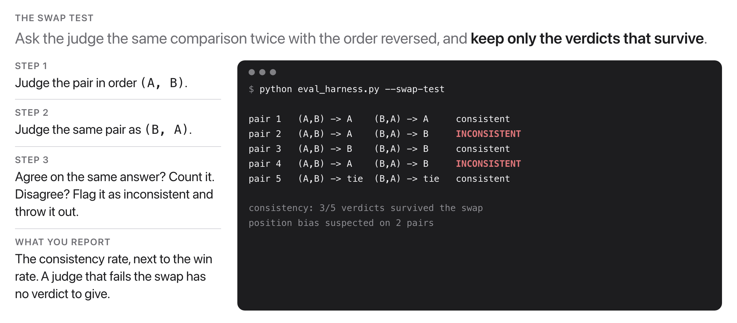
The punchline: catch a biased judge
Source: original figure; swap test, Zheng et al. 2023
Notes:
The provided swap-test makes every team's red-team concrete. The punchline for the activity: the winner can depend on the slot, not the answer. Every team runs this on the eval they received, so the red-teaming ends with a number instead of an opinion.

