Slide 1

CSCI 3495
Chain-of-Thought, Self-Consistency & Decomposition
Natural Language Processing & Large Language Models
Week 12, Class 2 · Wed Nov 11, 2026
Source: Kurt:S, Wikimedia Commons, CC BY 2.0
Notes:
One nudge, then every step sets up the next. What happens when one domino is out of line?

Slide 2
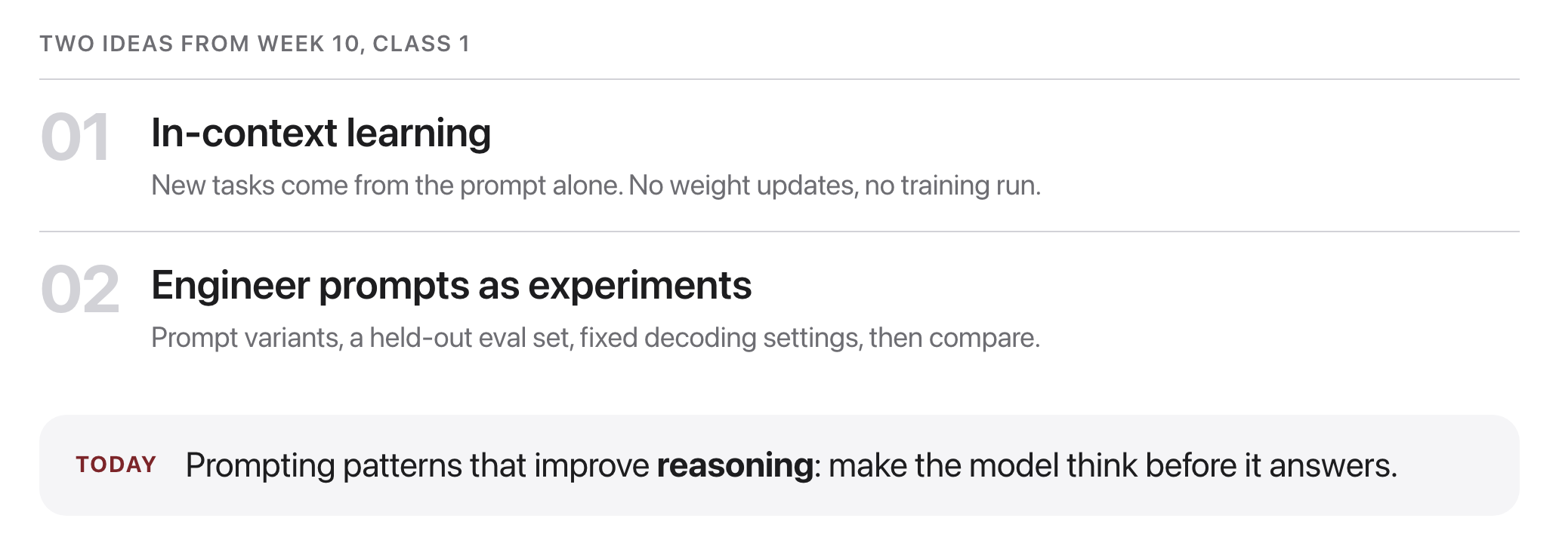
Where we left off
Source: original figure
Notes:
Two ideas carry forward. New tasks come from the prompt with no training run, and a prompt is something you test against a held-out set with the decoding pinned.

Slide 3
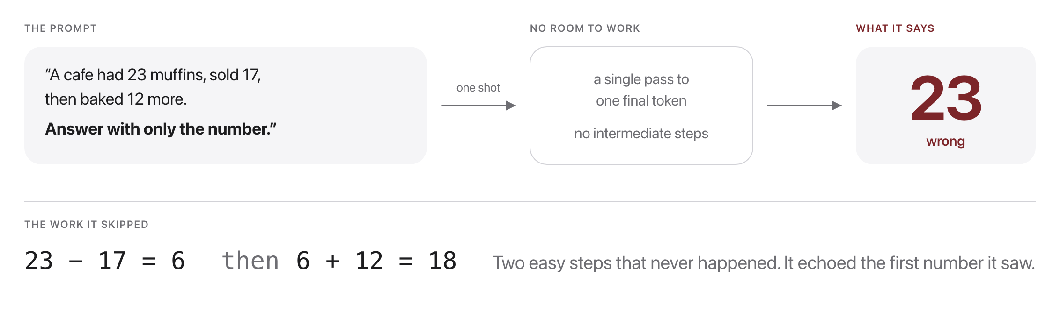
One-step answers fail multi-step problems
Source: original figure
Notes:
The information is in there. Demanding the answer immediately leaves the model nowhere to do the work.

Slide 4
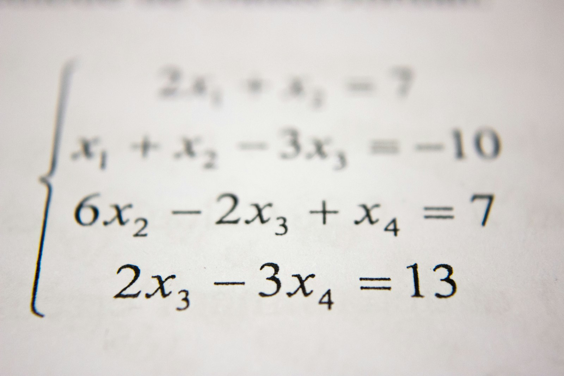
Could you solve this in one glance, or do you need to show your work?
Hard problems need steps. So do language models.
Source: Unsplash License, https://images.unsplash.com/photo-1509228468518-180dd4864904
Notes:
Give them an actual multi-step arithmetic problem for five seconds. Nobody solves it at a glance. Then make the point: we ask models to do exactly that constantly.

Slide 5
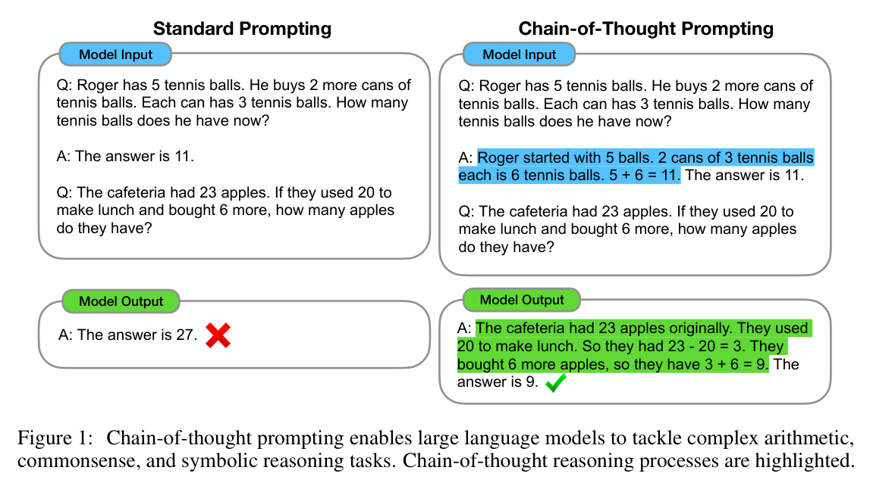
CoT: put the steps in the exemplar
Source: Wei et al. 2022 (arXiv:2201.11903), Fig. 1
Notes:
The most reproduced figure of the prompting era. Only the highlighted worked solution differs between the two prompts, yet it flips the cafeteria answer from 27 to 9.

Slide 6
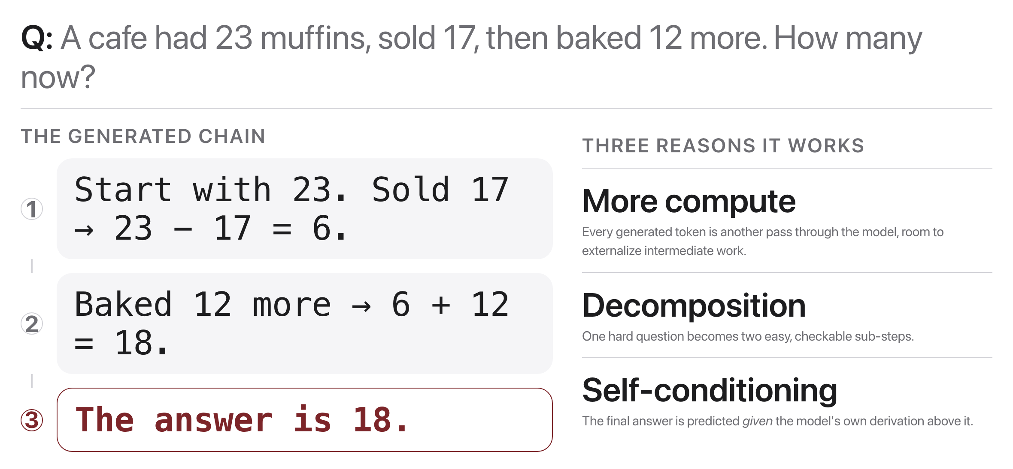
Why does CoT help?
Source: original figure; Wei et al. 2022 (arXiv:2201.11903)
Notes:
Like asking students to show your work: the steps make the answer better.

Slide 7
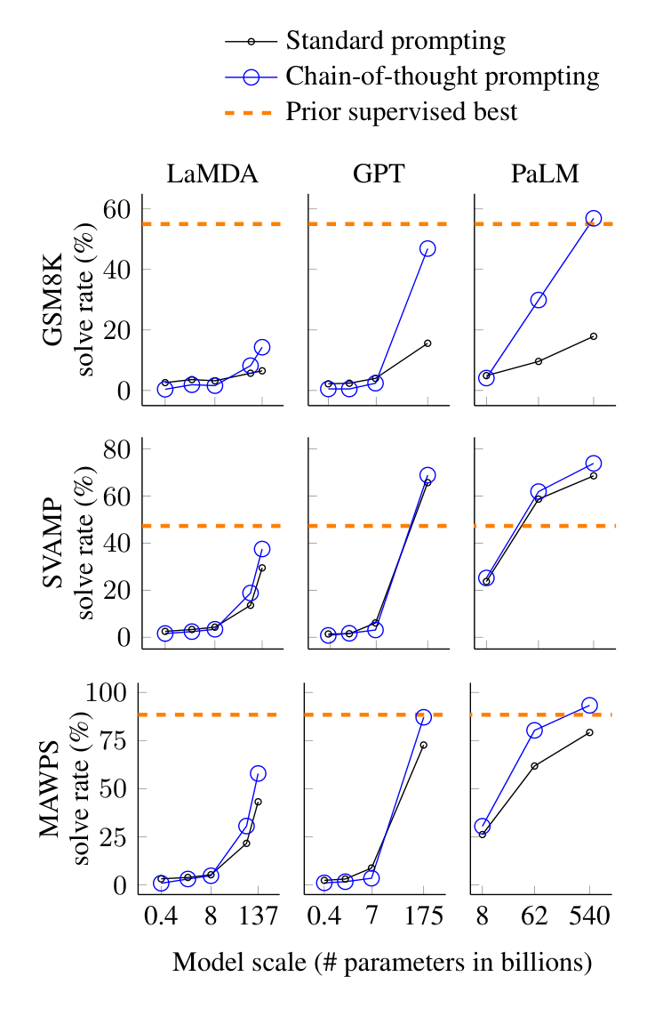
CoT and scale
Figure 4: Chain-of-thought prompting enables large language models to solve challenging math problems. Notably, chain-of-thought reasoning is an emergent ability of increasing model scale. Prior best numbers are from Cobbe et al. (2021) for GSM8K, Jie et al. (2022) for SVAMP, and Lan et al. (2021) for MAWPS.
Source: Wei et al. 2022 (arXiv:2201.11903), Fig. 4
Notes:
Blue pulls away from black only at each family's largest model; small models gain nothing or get worse.

Slide 8
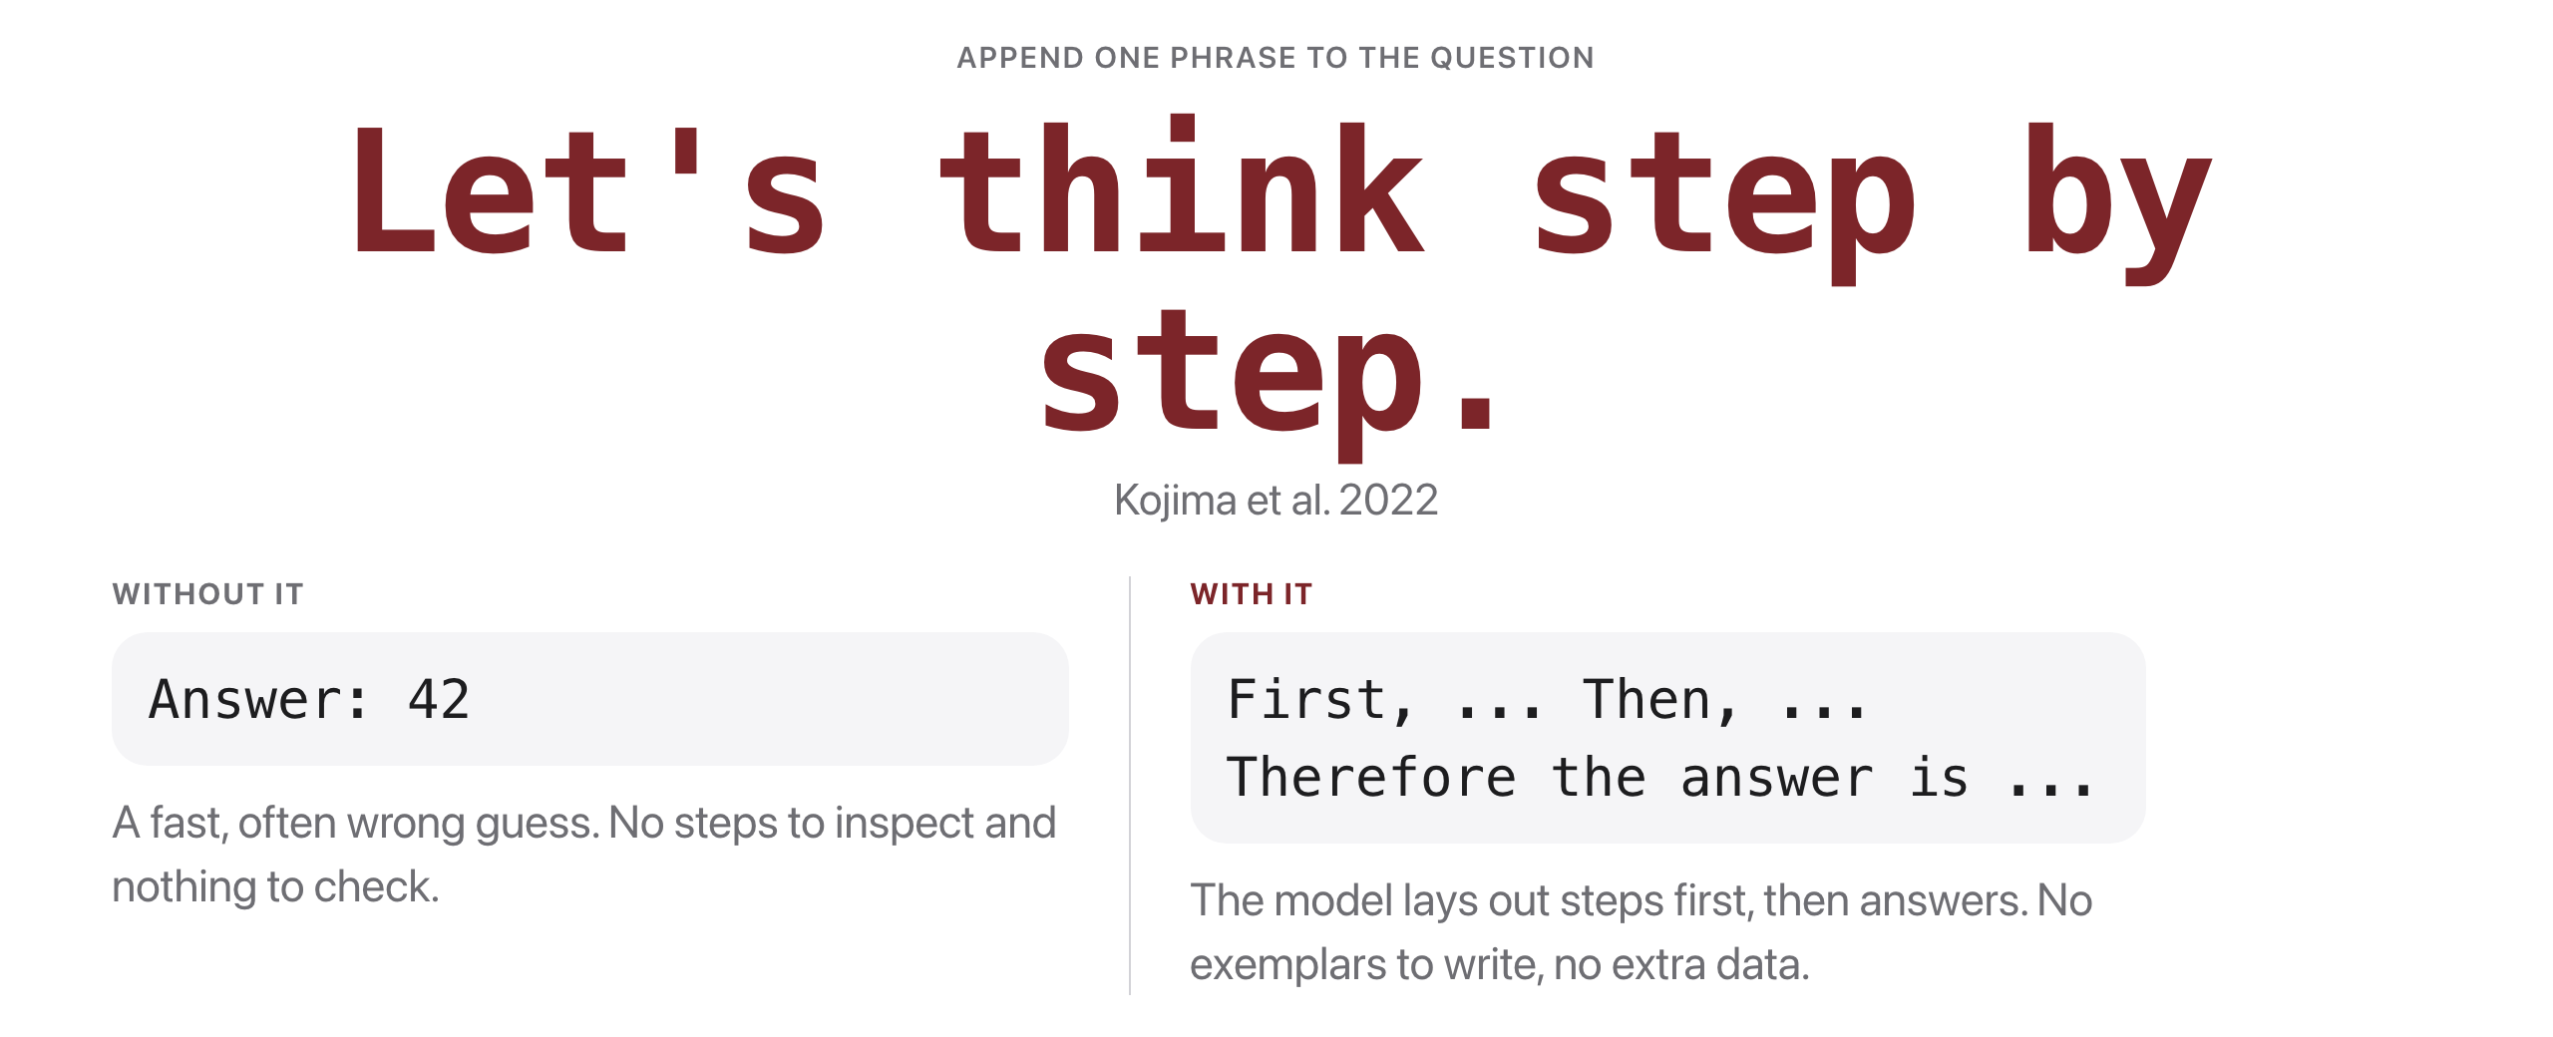
Zero-shot CoT
Source: original figure; Kojima et al. 2022 (arXiv:2205.11916)
Notes:
Elicits reasoning zero-shot: cheap, surprisingly effective, the first thing to try.

Slide 9
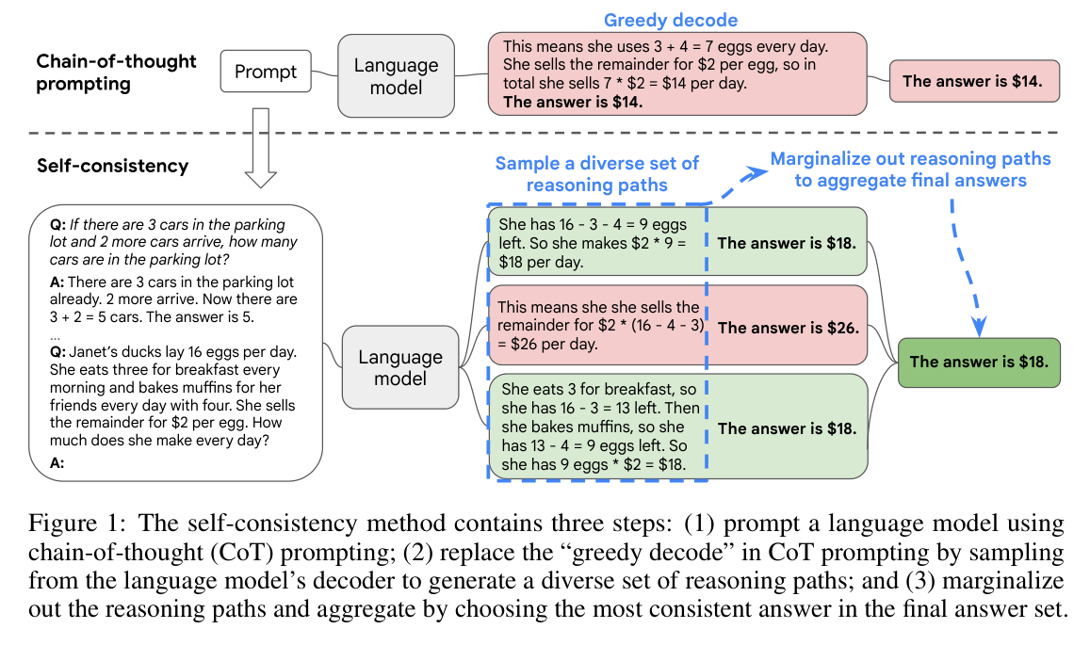
Sample many chains, then vote
Source: Wang et al. 2022 (arXiv:2203.11171), Fig. 1
Notes:
Self-consistency: greedy decoding commits to one flawed path ($14); sampling at temperature > 0 explores several, and the stray $26 path is outvoted by the two that agree on $18.

Slide 10
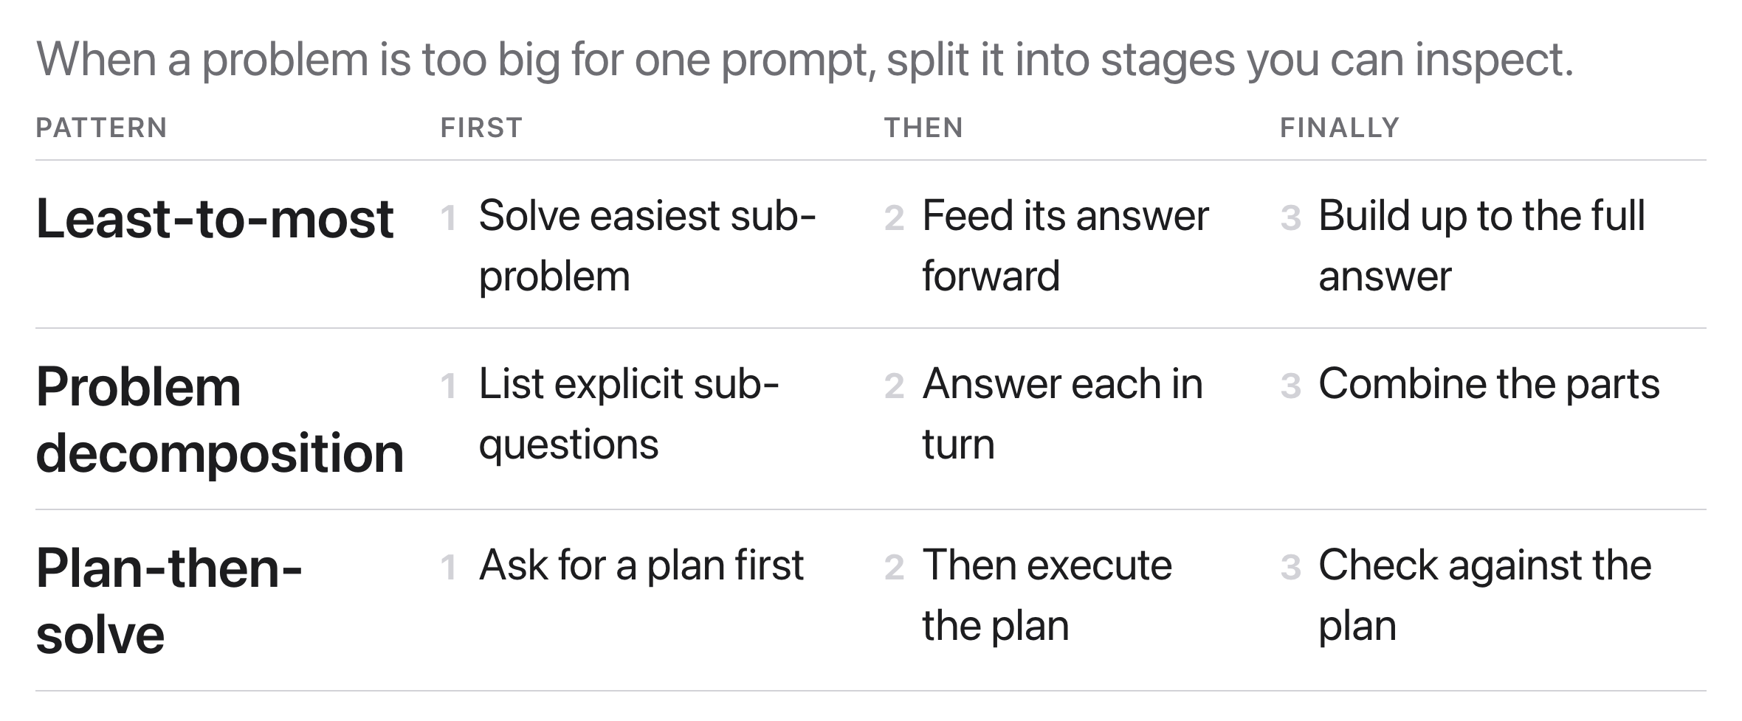
Decomposition: break the task apart
Source: original figure; least-to-most, Zhou et al. 2022 (arXiv:2205.10625)
Notes:
All three foreshadow agents (Weeks 12 to 14), where each step becomes a tool call.

Slide 11
What if we stopped prompting for reasoning and trained it in?
The 2024 to 2025 idea: make the chain a learned behavior, not a prompt you write.
Source: Unsplash License, https://images.unsplash.com/photo-1509228468518-180dd4864904
Notes:
This is the 2024 to 2025 turn. Instead of writing let us think step by step every time, train the chain in as a behaviour and reward the correct final answer.

Slide 12
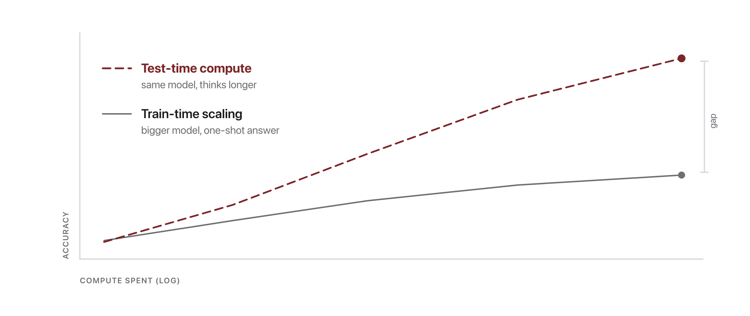
Scale inference, not just parameters
Source: original schematic; test-time compute scaling, Snell et al. 2024 (arXiv:2408.03314)
Notes:
Inference-time scaling: a fixed model that generates a long reasoning chain, samples many tries, or checks its work can beat a much larger model that answers in one shot.

Slide 13
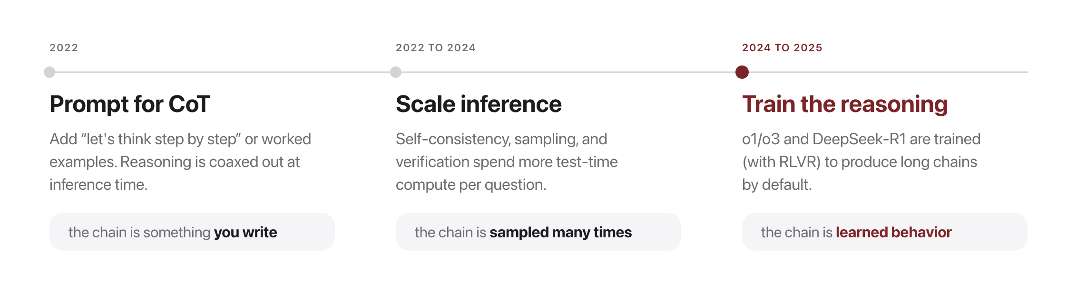
CoT to trained reasoning
Source: original figure; Wei et al. 2022 (2201.11903); DeepSeek-R1 2025 (2501.12948)
Notes:
The chain moves from something you write to something the model learned to do on its own.

Slide 14
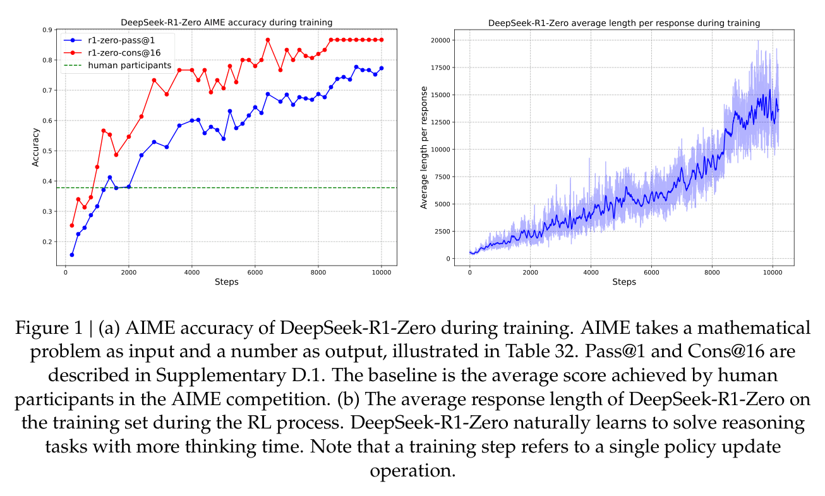
Reasoning models: what RL training buys
Source: DeepSeek-AI 2025 (arXiv:2501.12948), Fig. 1
Notes:
RL on verifiable rewards, the Week 10 alignment idea aimed at reasoning: AIME accuracy climbs past the average human competitor while responses grow 10x longer. Thinking longer is learned, never prompted. Same skepticism applies: plausible chain does not guarantee a correct answer.

Slide 15
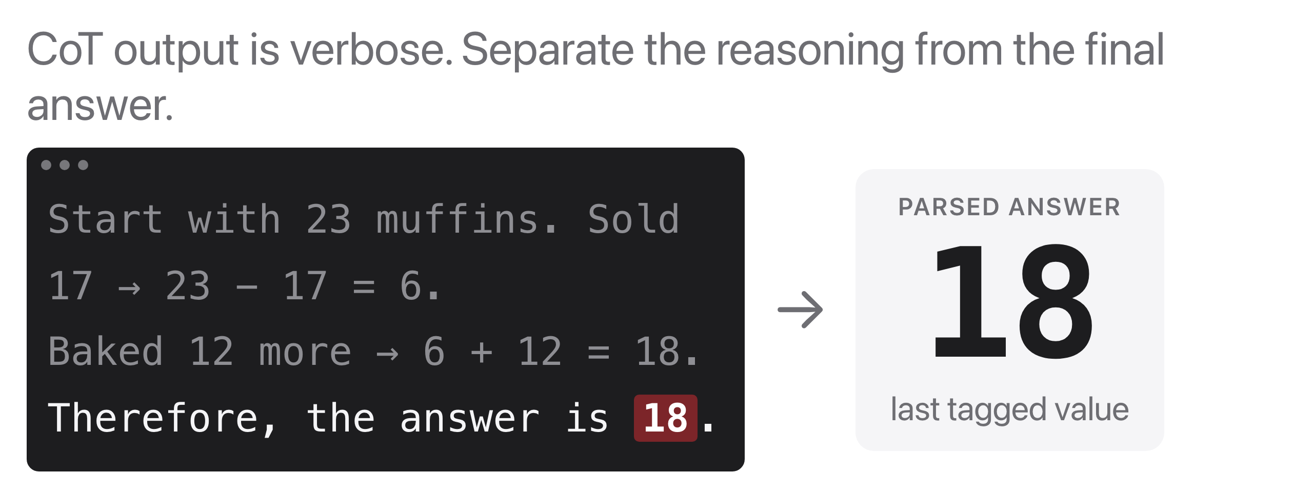
Extract the answer reliably
Source: original figure
Notes:
Ask for a tagged final line, Therefore, the answer is X., then parse the last marked answer. Reliability comes from format discipline (Week 13).

Slide 16
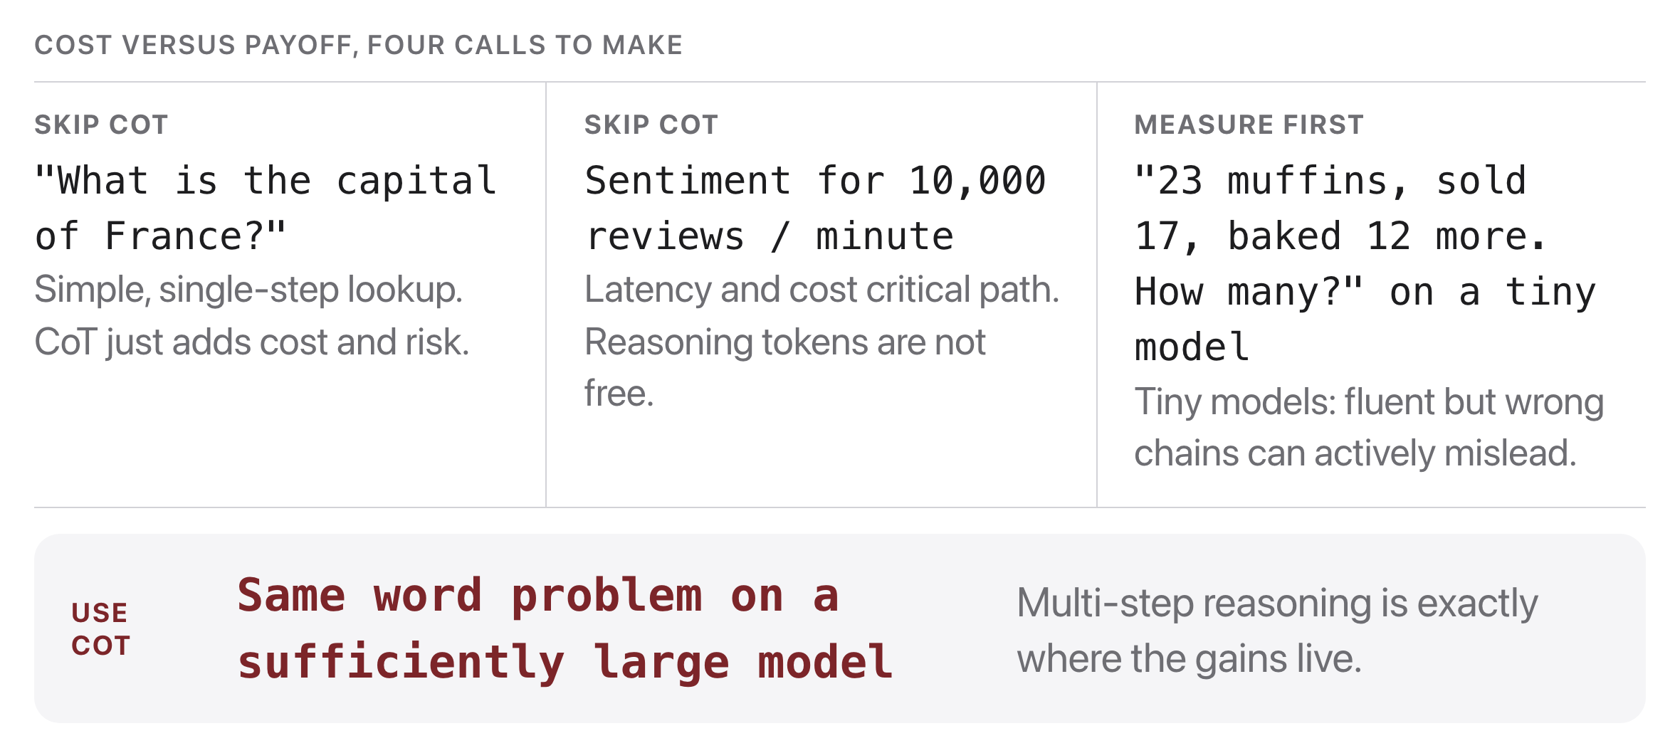
When NOT to use CoT
Source: original figure
Notes:
Like all tools: use it where it pays for itself, and measure it.

Slide 17
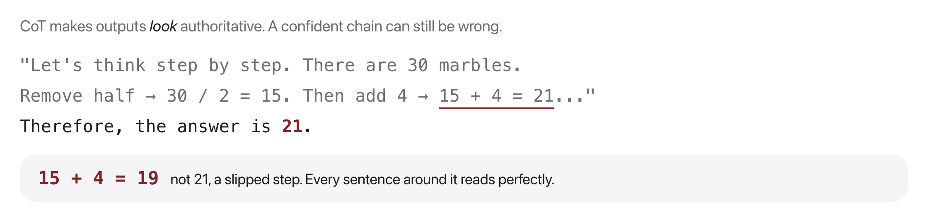
Risks: plausible ≠ correct
Source: original figure
Notes:
The stated reasoning may be a post-hoc rationalization. Do not equate "shows steps" with "is right": verify the final answer, not the vibe.

Slide 18
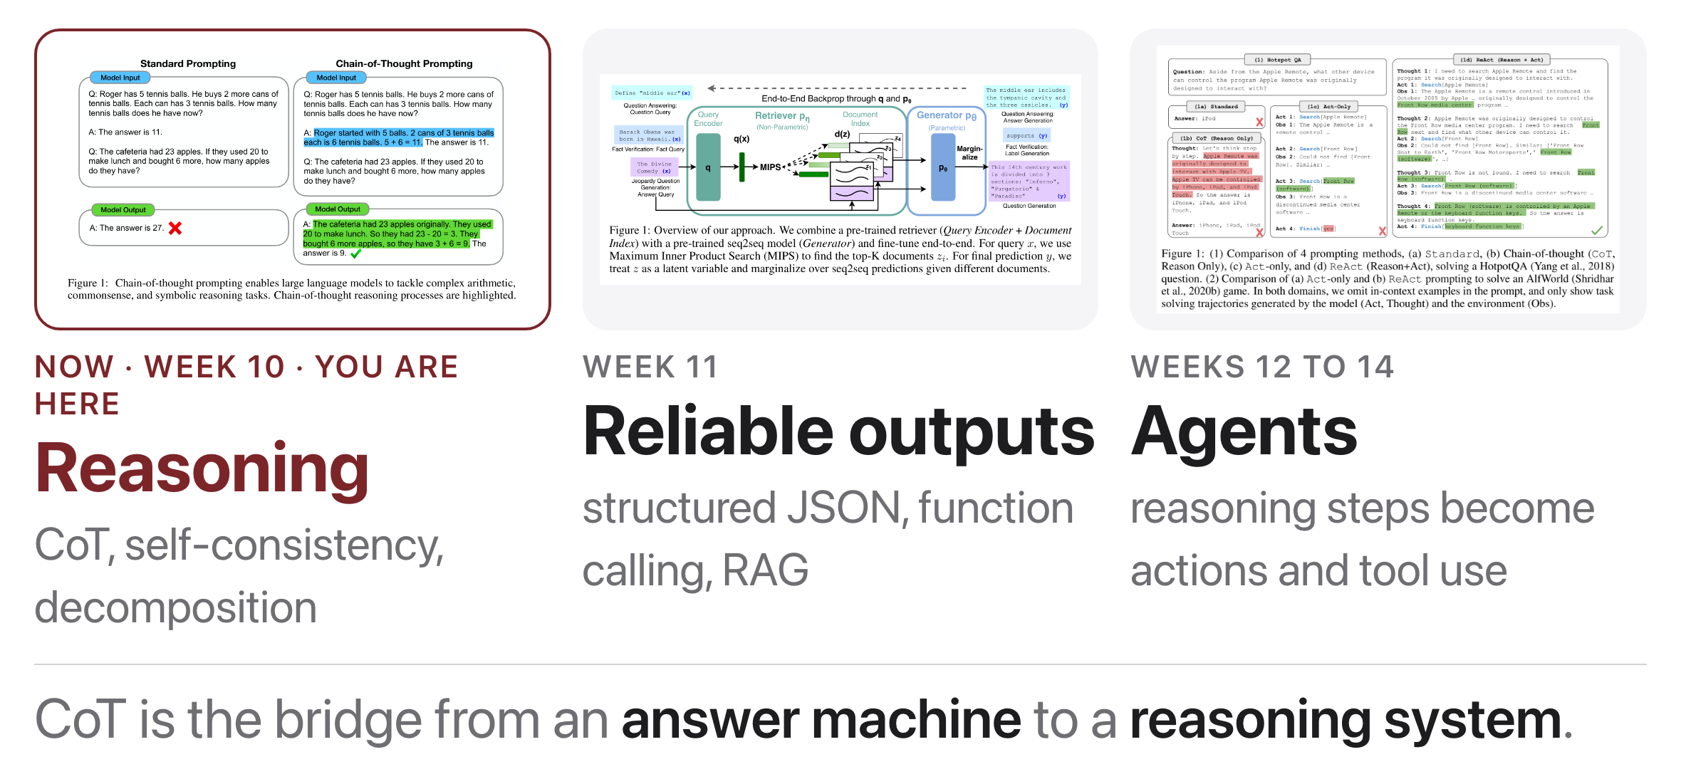
Looking ahead
Source: schedule/SCHEDULE.md; thumbnails: Wei et al. 2022 (2201.11903) Fig. 1, Lewis et al. 2020 (2005.11401) Fig. 1, Yao et al. 2022 (2210.03629) Fig. 1
Notes:
Chain of thought is the hinge. Next week those reasoning steps get forced into a structure the code can read, and in Weeks 12 to 14 each step becomes an action that touches the world.

Slide 19

Break
Source: original figure

Slide 20
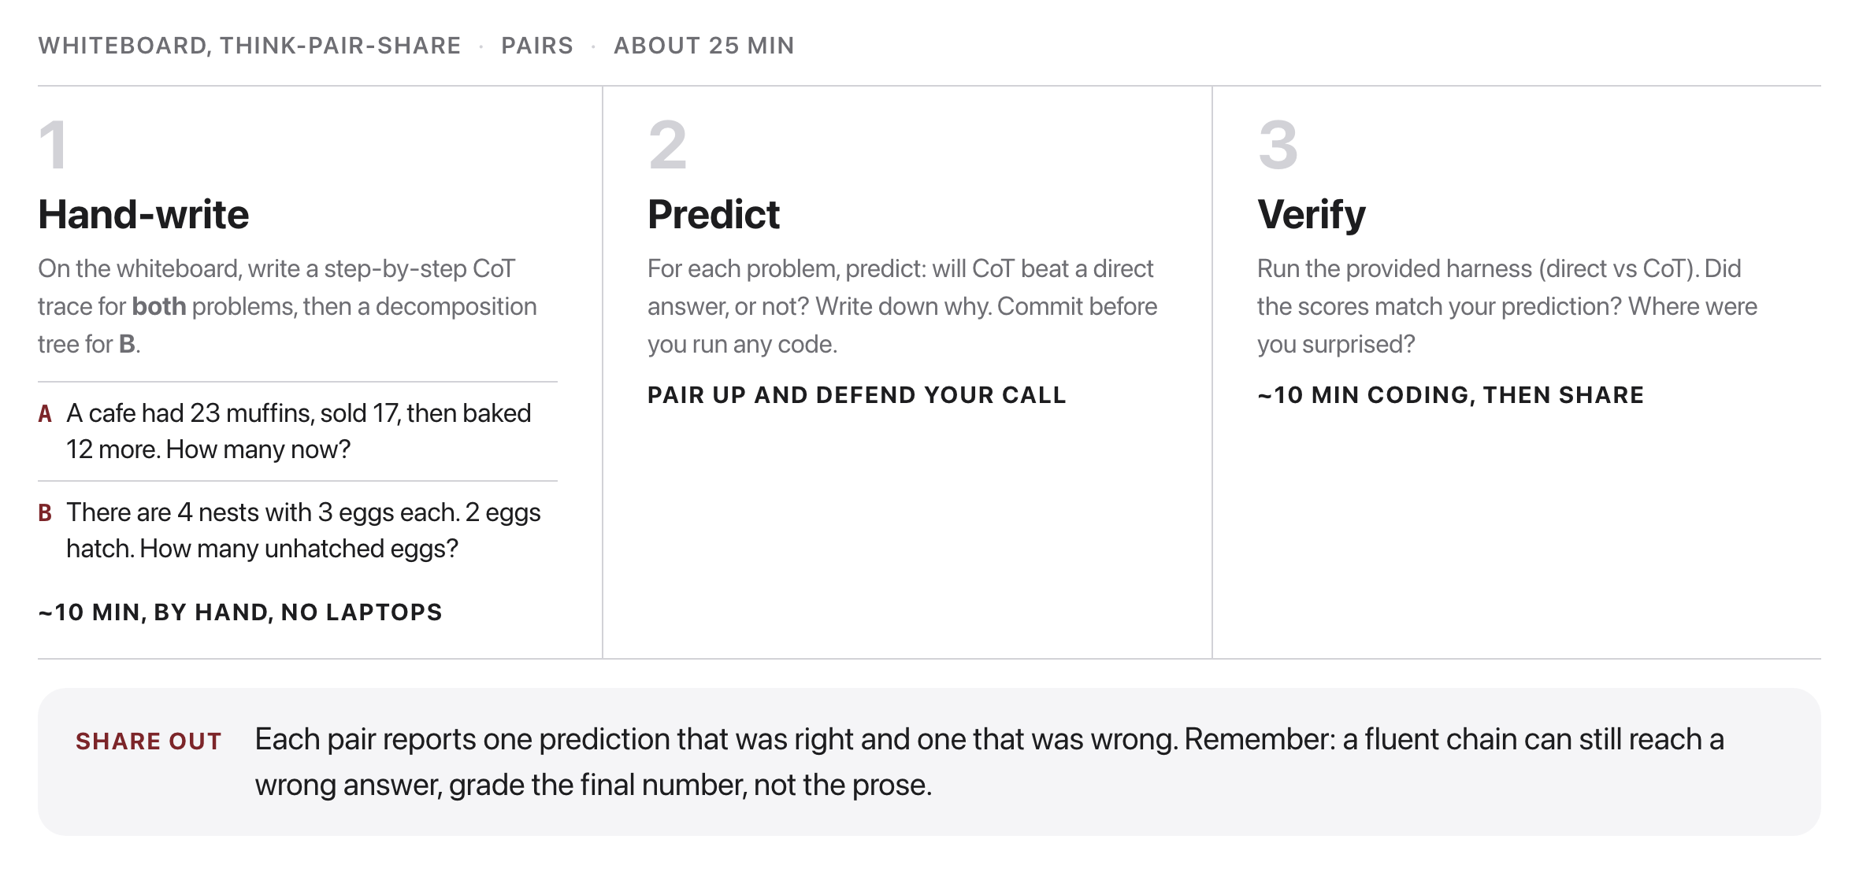
Predict, then Verify CoT
Source: weeks/week-12/class-02/exercise/cot_lab.py
Notes:
Pairs, about twenty-five minutes. Hand-write the trace first, then a decomposition tree for the second problem, and only then run it. Committing to an answer on the board before running is what makes the comparison worth anything.

Slide 21
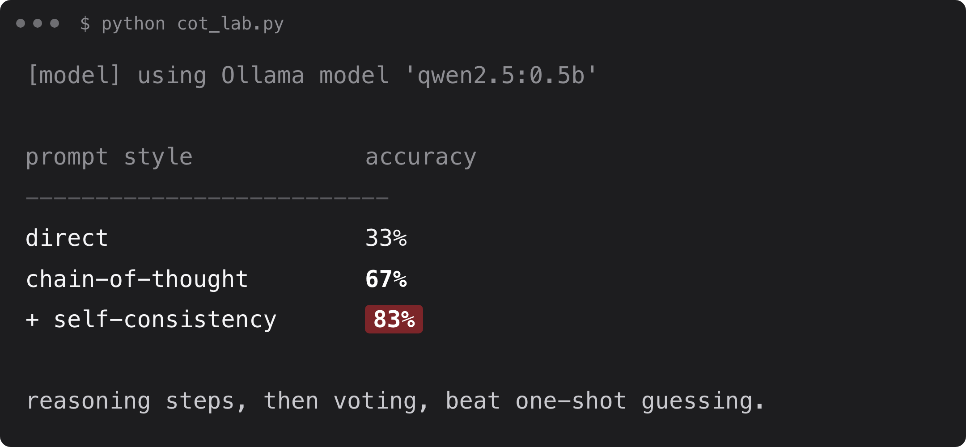
Verify your predictions
Source: example run, qwen2.5:0.5b via Ollama
Notes:
Did the scores match what you predicted?

Slide 22
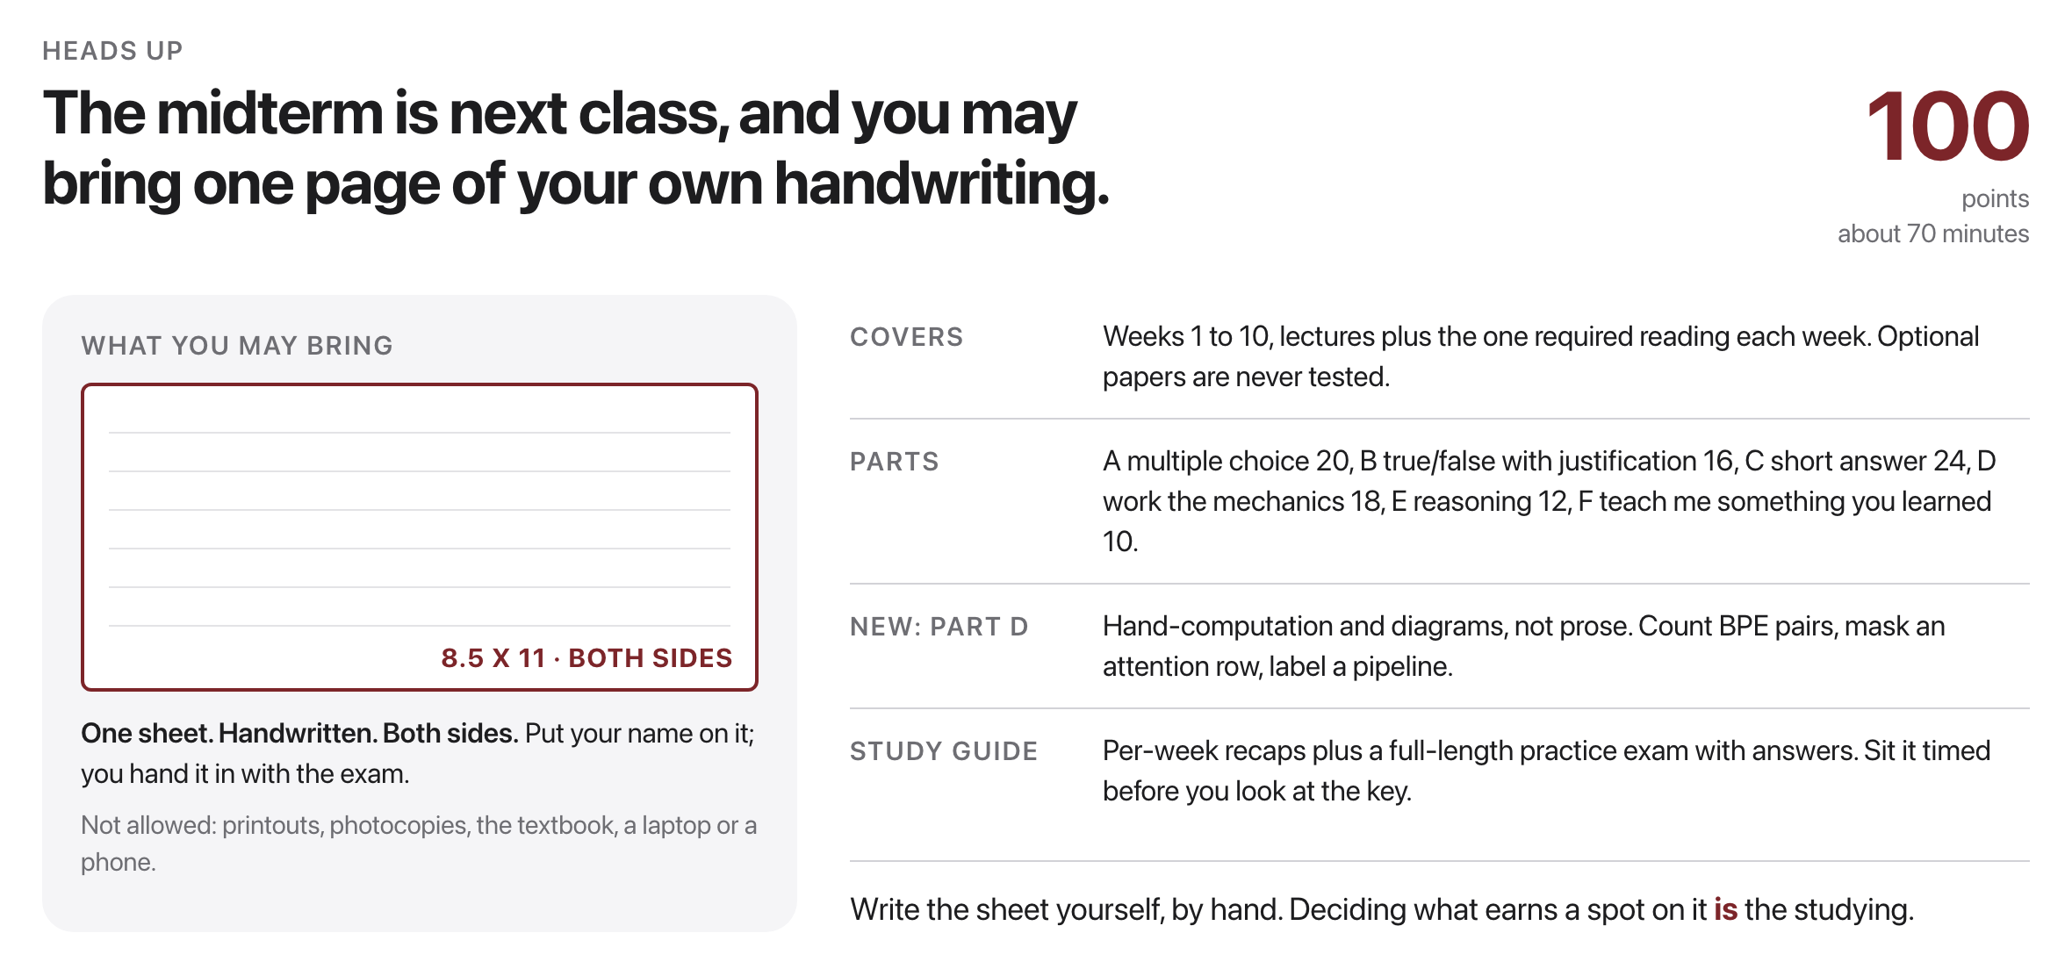
Midterm next class
Source: exams/midterm-study-guide.md
Notes:
One handwritten 8.5 x 11 sheet, both sides, name on it, handed in with the exam. Study guide has a full-length practice exam.

