Slide 1

CSCI 3495
Midterm Exam
Natural Language Processing & Large Language Models
Week 13, Class 1 · Mon Nov 16, 2026
Source: Tony Webster, Wikimedia Commons, CC BY 2.0
Notes:
Take a breath. You have met every idea on this exam at least twice, and your note sheet is on the desk.

Slide 2
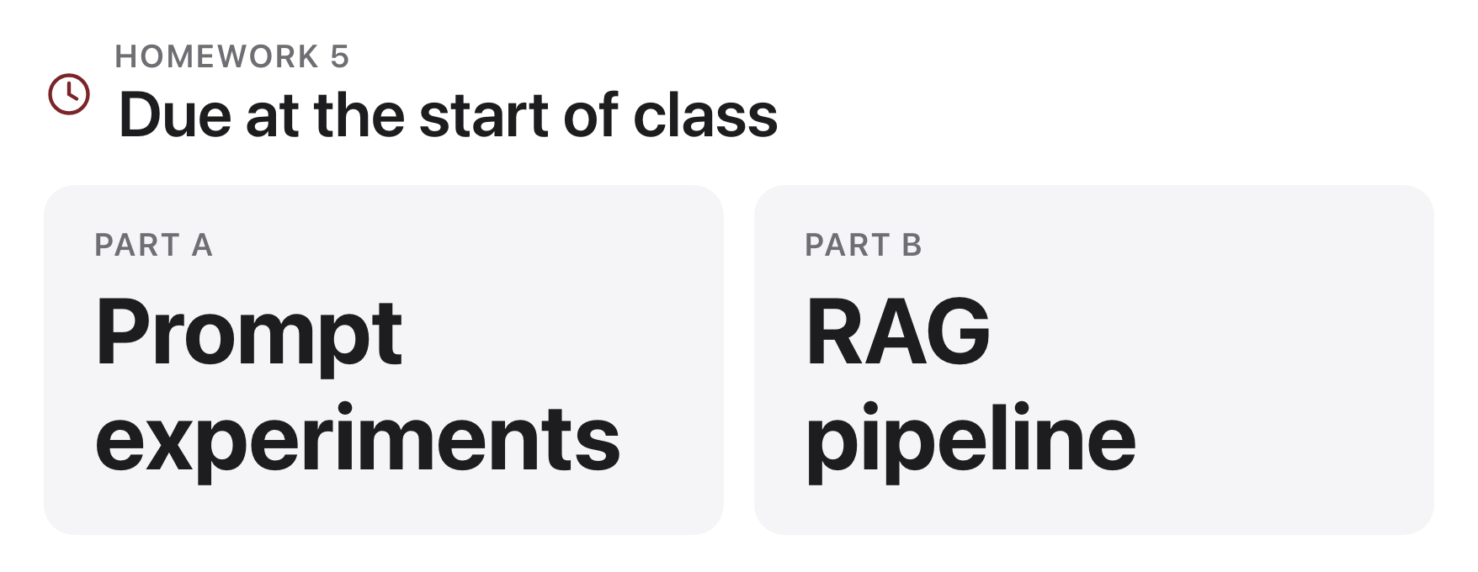
HW5 due today
Source: original figure
Notes:
Parts A (prompt experiments) and B (RAG) both due at the start of class, before the exam begins. Both parts come in now, before the exam begins.

Slide 3
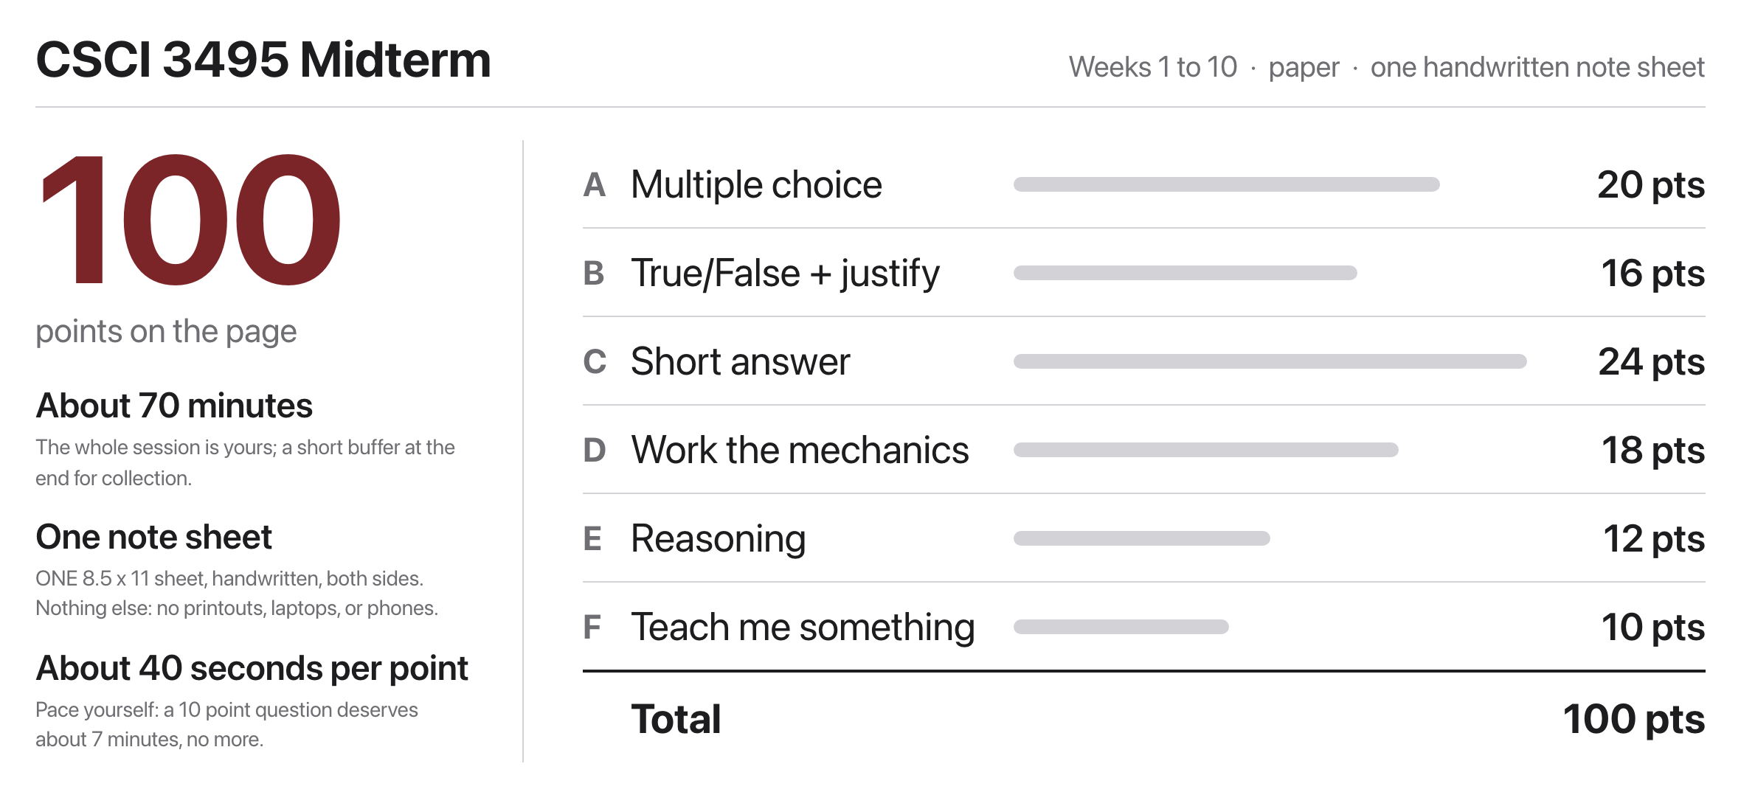
The midterm: 100 points, about 70 minutes
Source: original figure
Notes:
100 points, about 70 minutes, one handwritten note sheet. Budget roughly 40 seconds per point and bank time on the cheap parts.

Slide 4
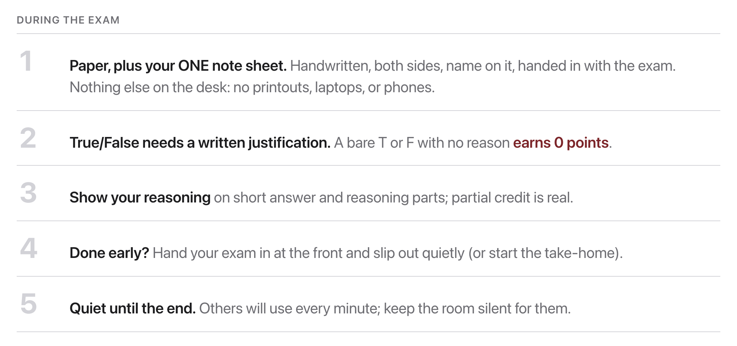
Ground rules
Source: original figure
Notes:
One exception to the silence: raise your hand and I will come to you.

Slide 5
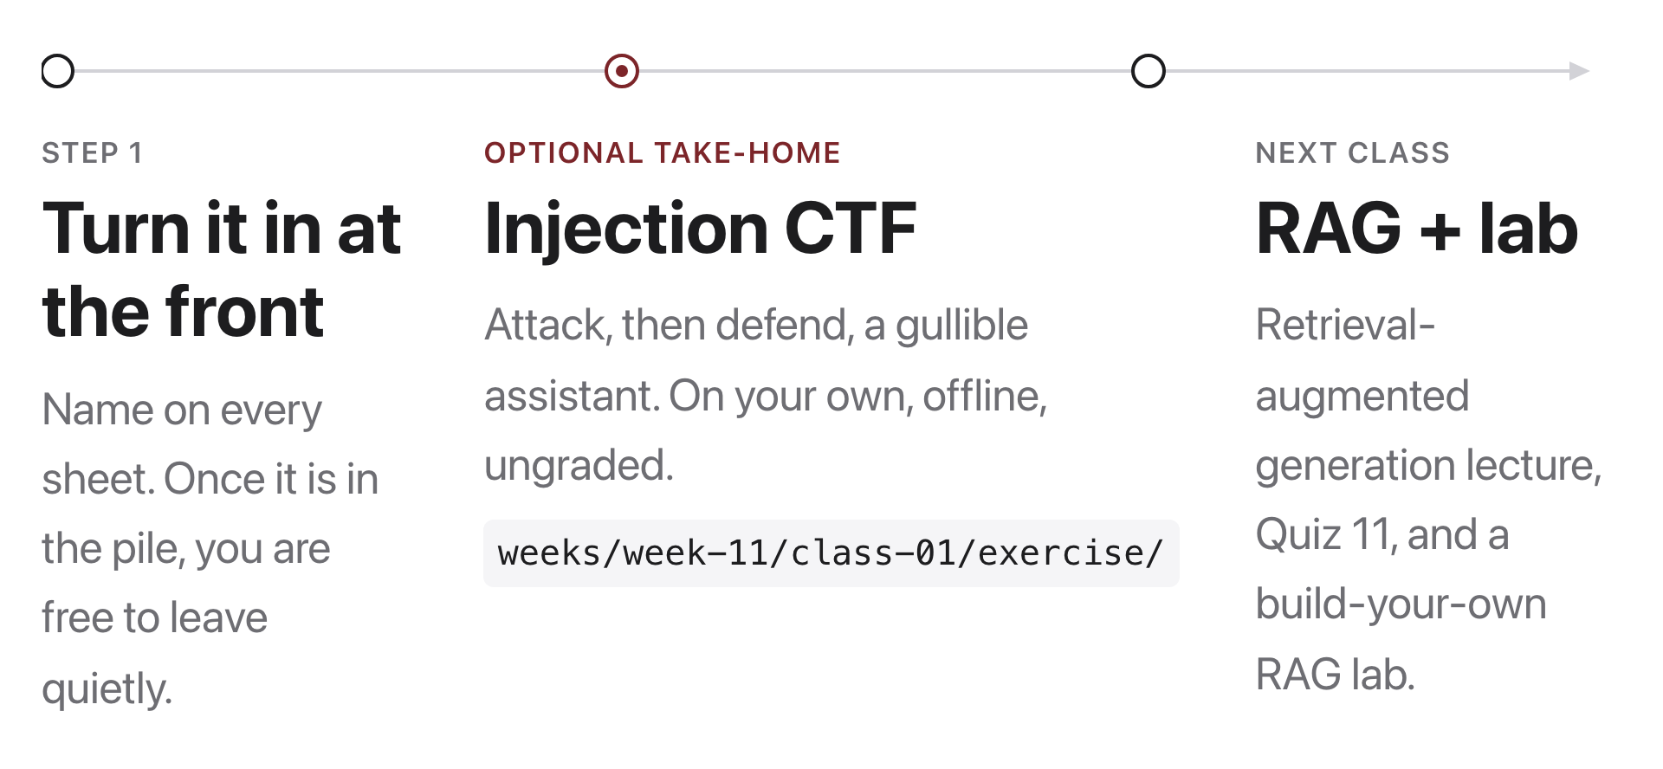
When you finish
Source: original figure; weeks/week-13/class-01/exercise/ctf.py
Notes:
The Injection CTF is optional and ungraded; its attack and defend ideas return in Week 13's Break-the-Agent.

Slide 6
Next class: RAG, we give the model an open book.
Required reading: Lewis et al. 2020 (RAG, arXiv:2005.11401) plus J&M SLP3 Ch. 11. Quiz 7 runs right before the break, then the RAG lab.
Source: arXiv:2005.11401; web.stanford.edu/~jurafsky/slp3/
Notes:
Read Lewis 2020 and SLP3 chapter 11 before Wednesday. Quiz 7 runs right before the break and then the RAG lab takes the rest of the period.

