Slide 1
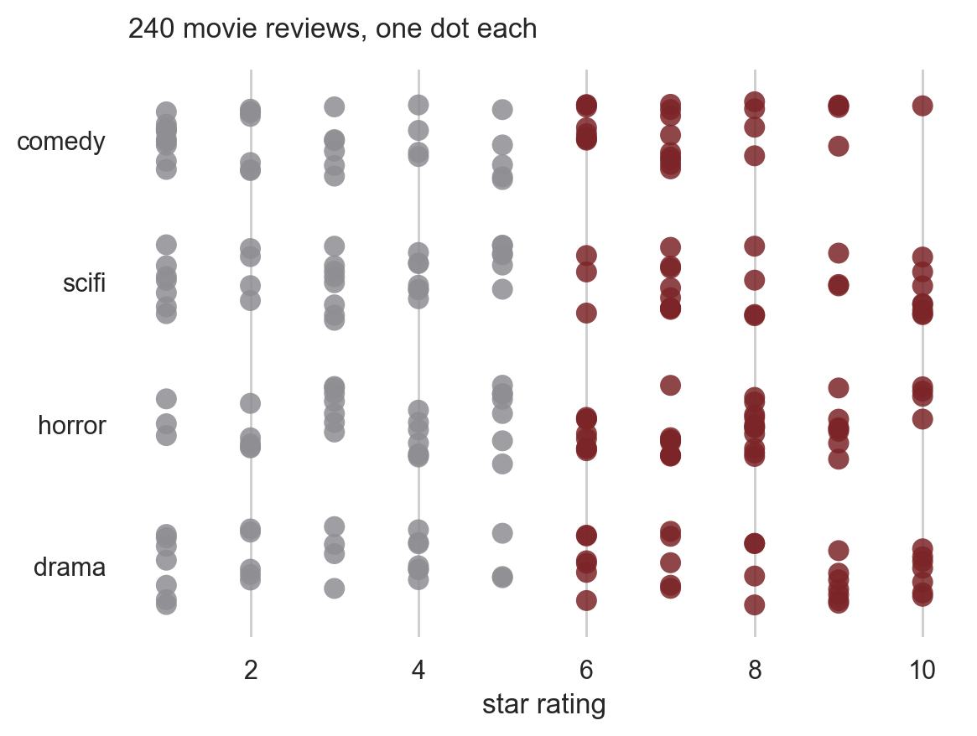
CSCI 3495
Data Science for NLP
Natural Language Processing & Large Language Models
Week 3, Class 1 · Wed Sep 9, 2026
Source: original figure, drawn from the course corpus of 240 reviews
Notes:
Laptops open and the repository pulled before we start. We alternate all period: a slide or two for the idea, then straight into the notebook to use it. Everything on screen is drawn from the 240-review corpus you are about to load.

Slide 2
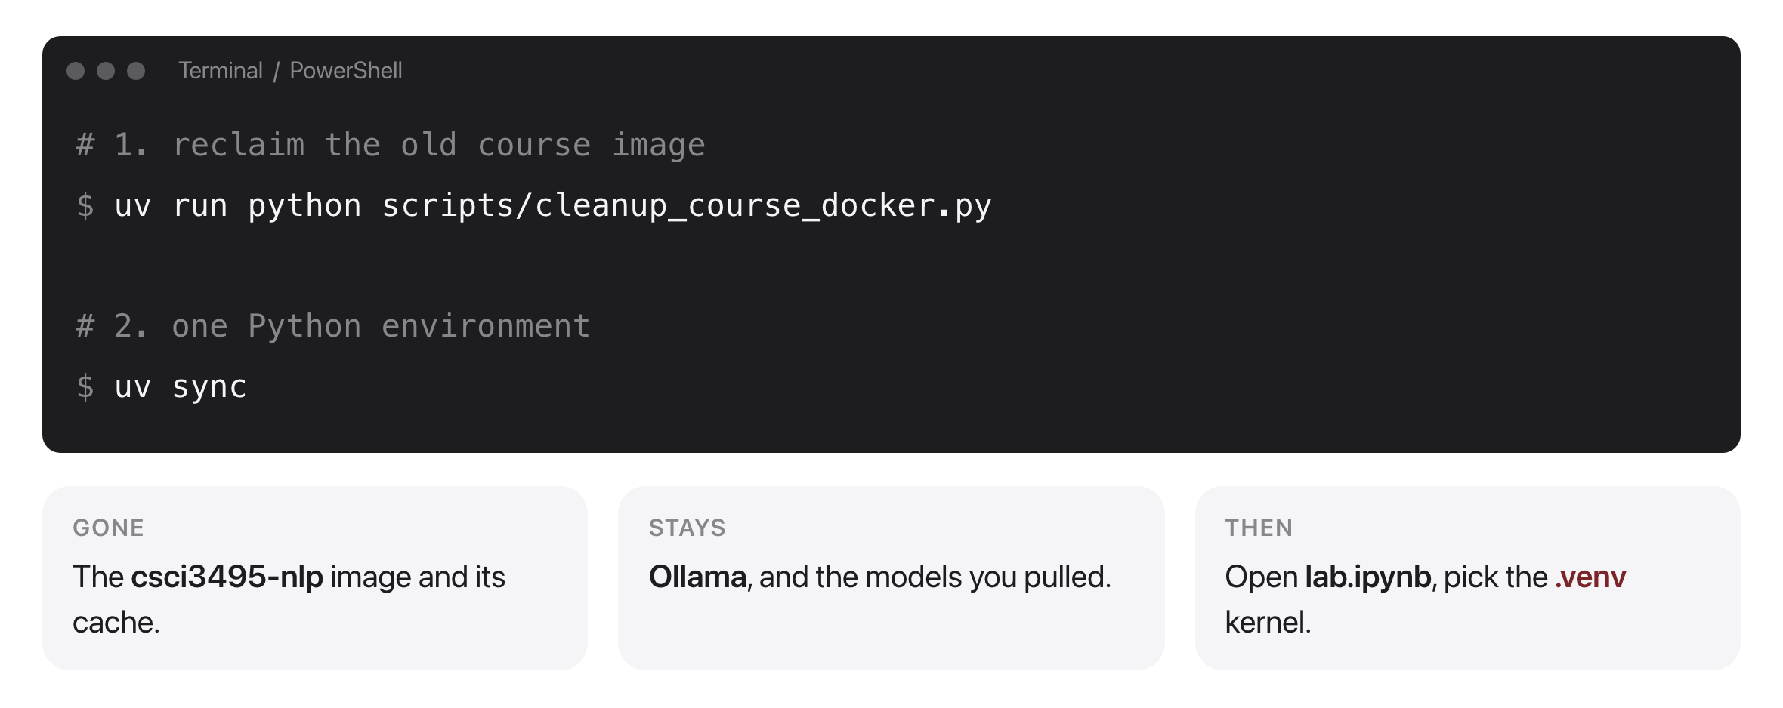
One environment for the whole term
Source: original figure; scripts/cleanup_course_docker.py
Notes:
The course no longer runs inside a Docker image, so the old one is three to five gigabytes of dead weight and the cleanup script reclaims it. The script is surgical: it names the one image it removes and refuses to touch anything matching ollama. It is Python rather than bash, so the same command runs on macOS and on Windows. Docker keeps exactly one job, the local LLM server, and we do not start it until Week 9, so there is nothing to run for it today. Python is uv from here on, and after uv sync you pick the .venv kernel inside the notebook. There is nothing else to install all semester.

Slide 3
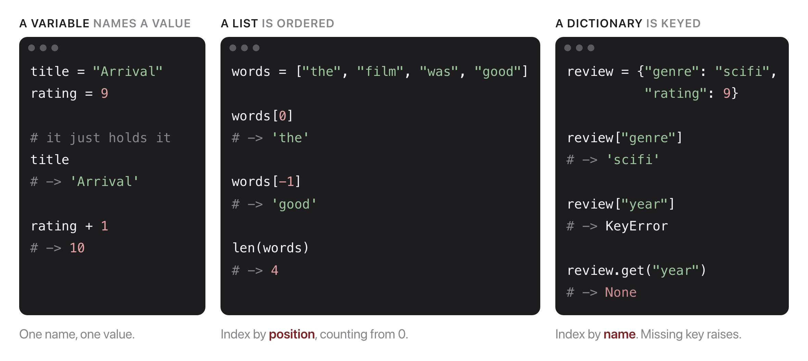
Python, in one slide
Source: original figure
Notes:
A refresher before we touch a library, because everything today is built out of these three. A variable is a name for one value. A list is ordered, so you index it by POSITION and the counting starts at zero, which is also why -1 is the last one. A dictionary is keyed, so you index it by NAME. Point at the KeyError: a missing key is a crash, not a None, and .get is the version that hands back None instead. A DataFrame column is indexed exactly like that dictionary, which is the bridge to the next slide.

Slide 4
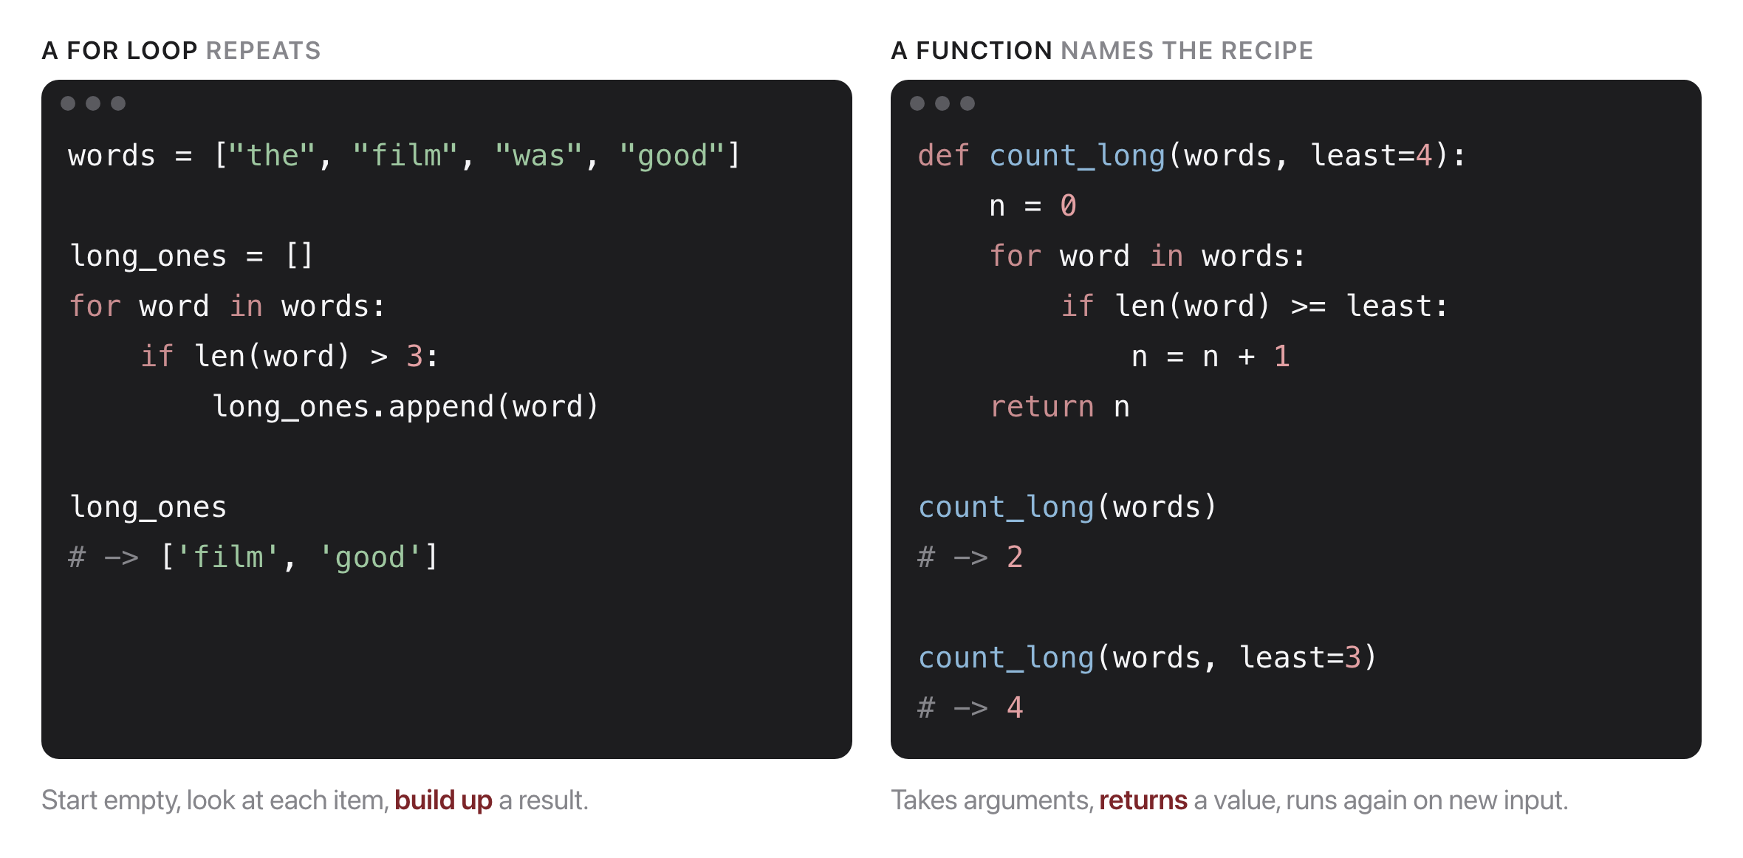
Two things you do with them
Source: original figure
Notes:
The loop is the shape you already know: start with something empty, look at each item in turn, build the answer up. The function is the same work with a name on it, so you can run it again on different input; note the default argument, which is how least=4 becomes least=3 at the call site without editing the function. Keep both in view, because the rest of the period is about replacing the loop on the left with one line of pandas or NumPy, and the function on the right is what you will still be writing in Week 6.

Slide 5
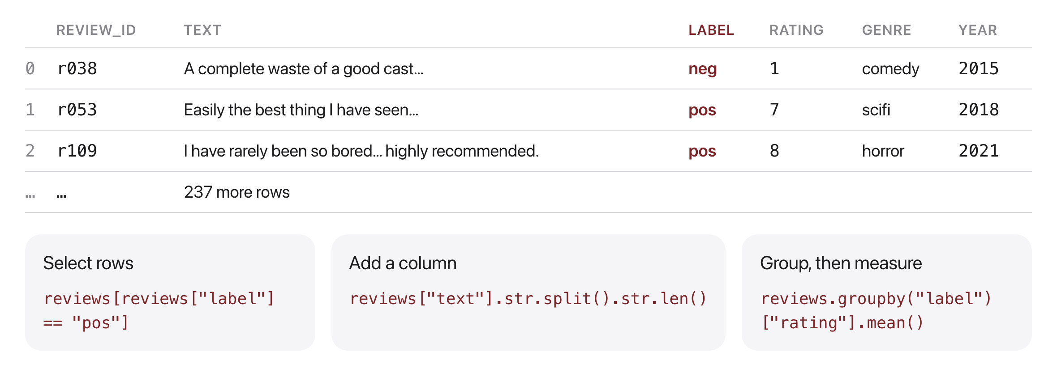
A DataFrame answers questions
Source: original figure; data from the course corpus
Notes:
Six columns, 240 rows, one row per review. Three operations cover almost everything: keep the rows matching a condition, add a column computed from another, and split into groups to measure each. Point out row 2: it opens by panning the film and reverses in the last sentence, and that kind of review is going to matter at the end of the period.

Slide 6
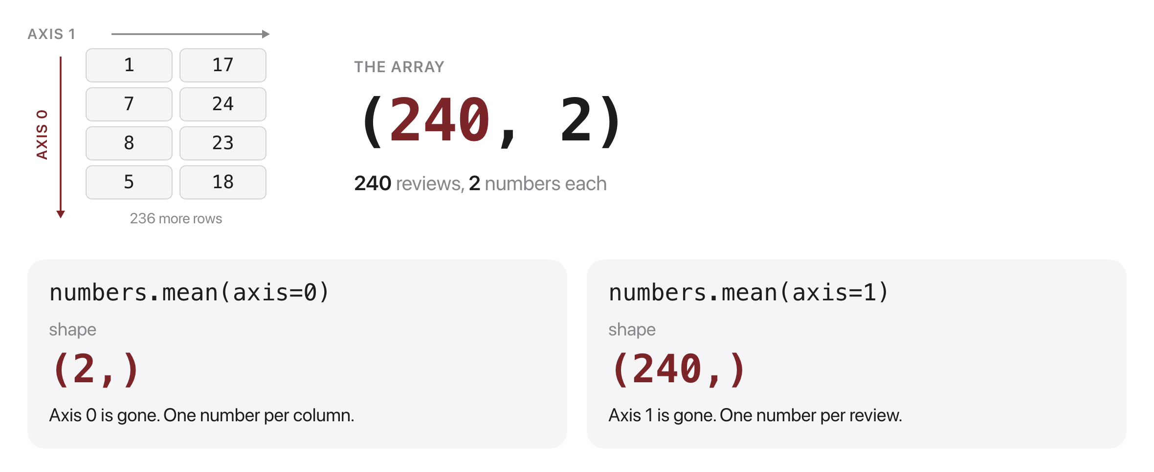
The axis you name is the one that disappears
Source: original figure
Notes:
Shape is what tells you what a block of numbers means, and this is the one concept that carries unchanged across pandas, NumPy and PyTorch. Naming axis 0 collapses the rows and leaves one number per column; naming axis 1 collapses the columns and leaves one number per review. Half the bugs in this course are an axis argument, so print the shape whenever you are unsure.

Slide 7
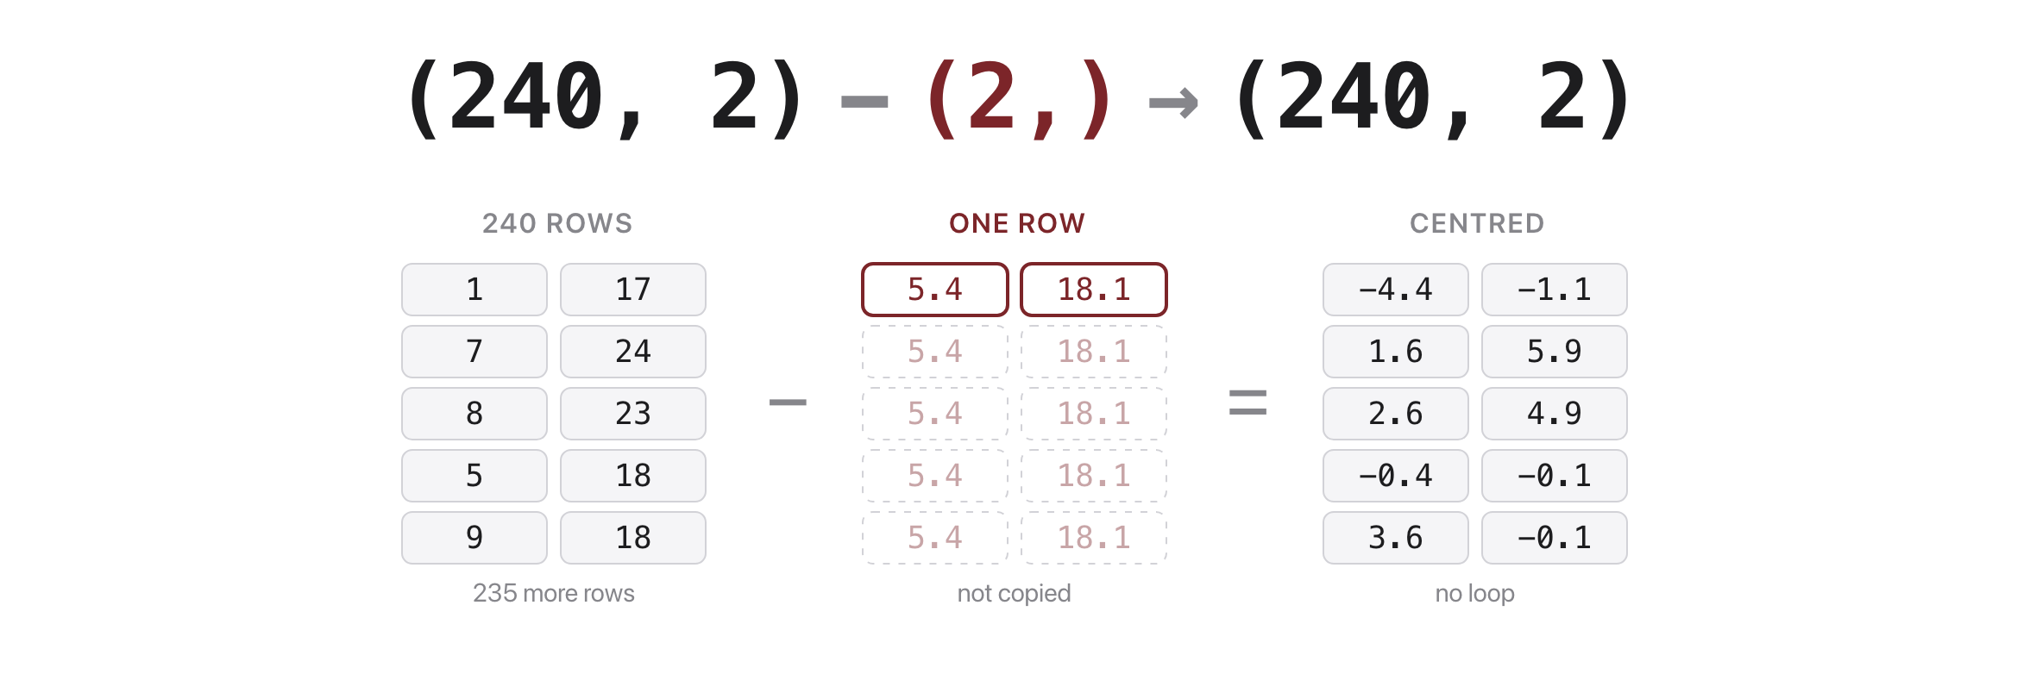
Broadcasting writes the loop for you
Source: original figure
Notes:
Subtracting a two-number row from a 240-by-2 array is legal, because the small one is stretched to fit the big one. Nothing is copied in memory and no loop is written; this is how every feature gets put on the same scale. The rule is that dimensions have to match or be one.

Slide 8
Let's walk through Parts 1 and 2 in the notebook
Load it, filter it, group it.
Notes:
Everyone into lab.ipynb now. Run from the very top and stop me the moment your output does not match mine. Two TRY IT cells in this stretch, one at the end of each part.

Slide 9
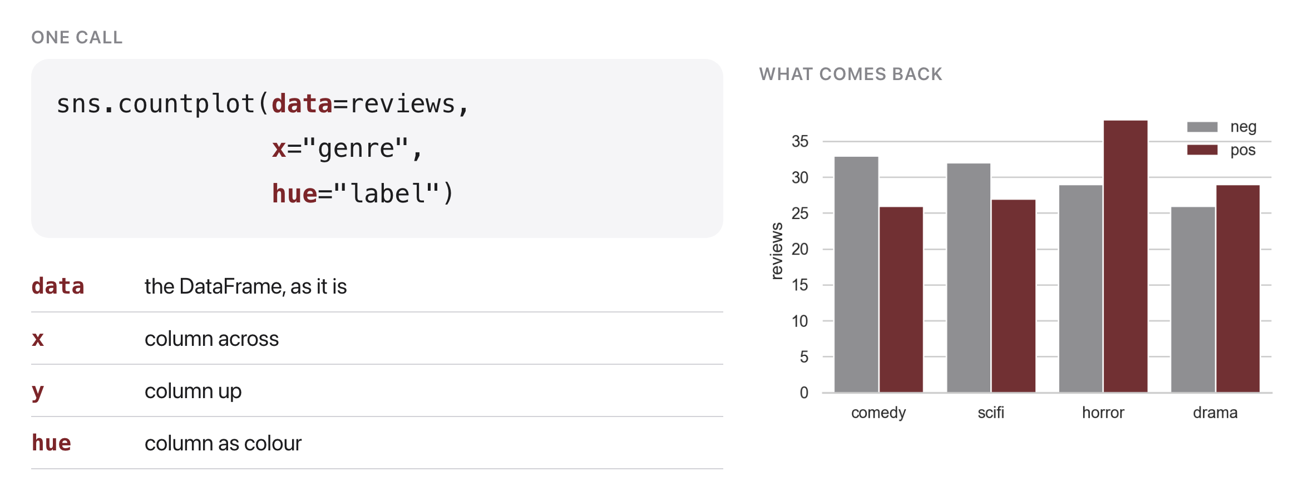
Name the columns, seaborn draws
Source: original figure; seaborn 0.13, data from the course corpus
Notes:
This is the whole mental model. You never compute anything yourself: you hand seaborn the DataFrame and say which column goes across, which goes up, and which becomes the colour. It groups, counts and draws. Every chart in Part 3 is that same four-argument shape with a different function name in front.

Slide 10
Let's walk through Part 3 in the notebook
Four charts, four lines.
Notes:
Countplot, histplot, boxplot, barplot. The TRY IT at the end asks them to point the histogram at a different column, and the answer is the point of the whole part.

Slide 11
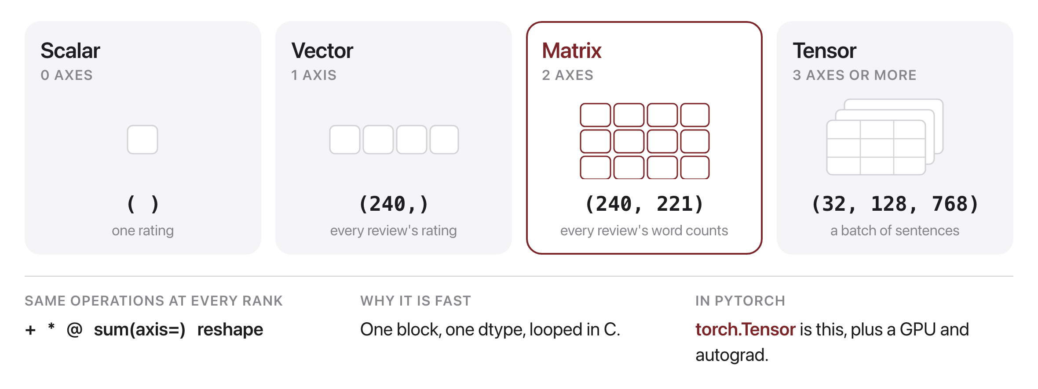
One library, any number of axes
Source: original figure
Notes:
A scalar, a vector, a matrix and a tensor are the same object with a different number of axes, and NumPy gives you one set of operations that work at every rank. That is why shape is the thing you check: it is the only difference between them. Nothing is fast because of clever maths, it is fast because the numbers sit in one contiguous block of one type and the loop happens in C. PyTorch's torch.Tensor is exactly this with a GPU and a memory of how it was built.

Slide 12
Let's walk through Part 4 in the notebook
Shape, axis, broadcasting, masking.
Notes:
This is where the two slides from the start of the period get used. Ask them to predict the shape before you run each reduction.

Slide 13
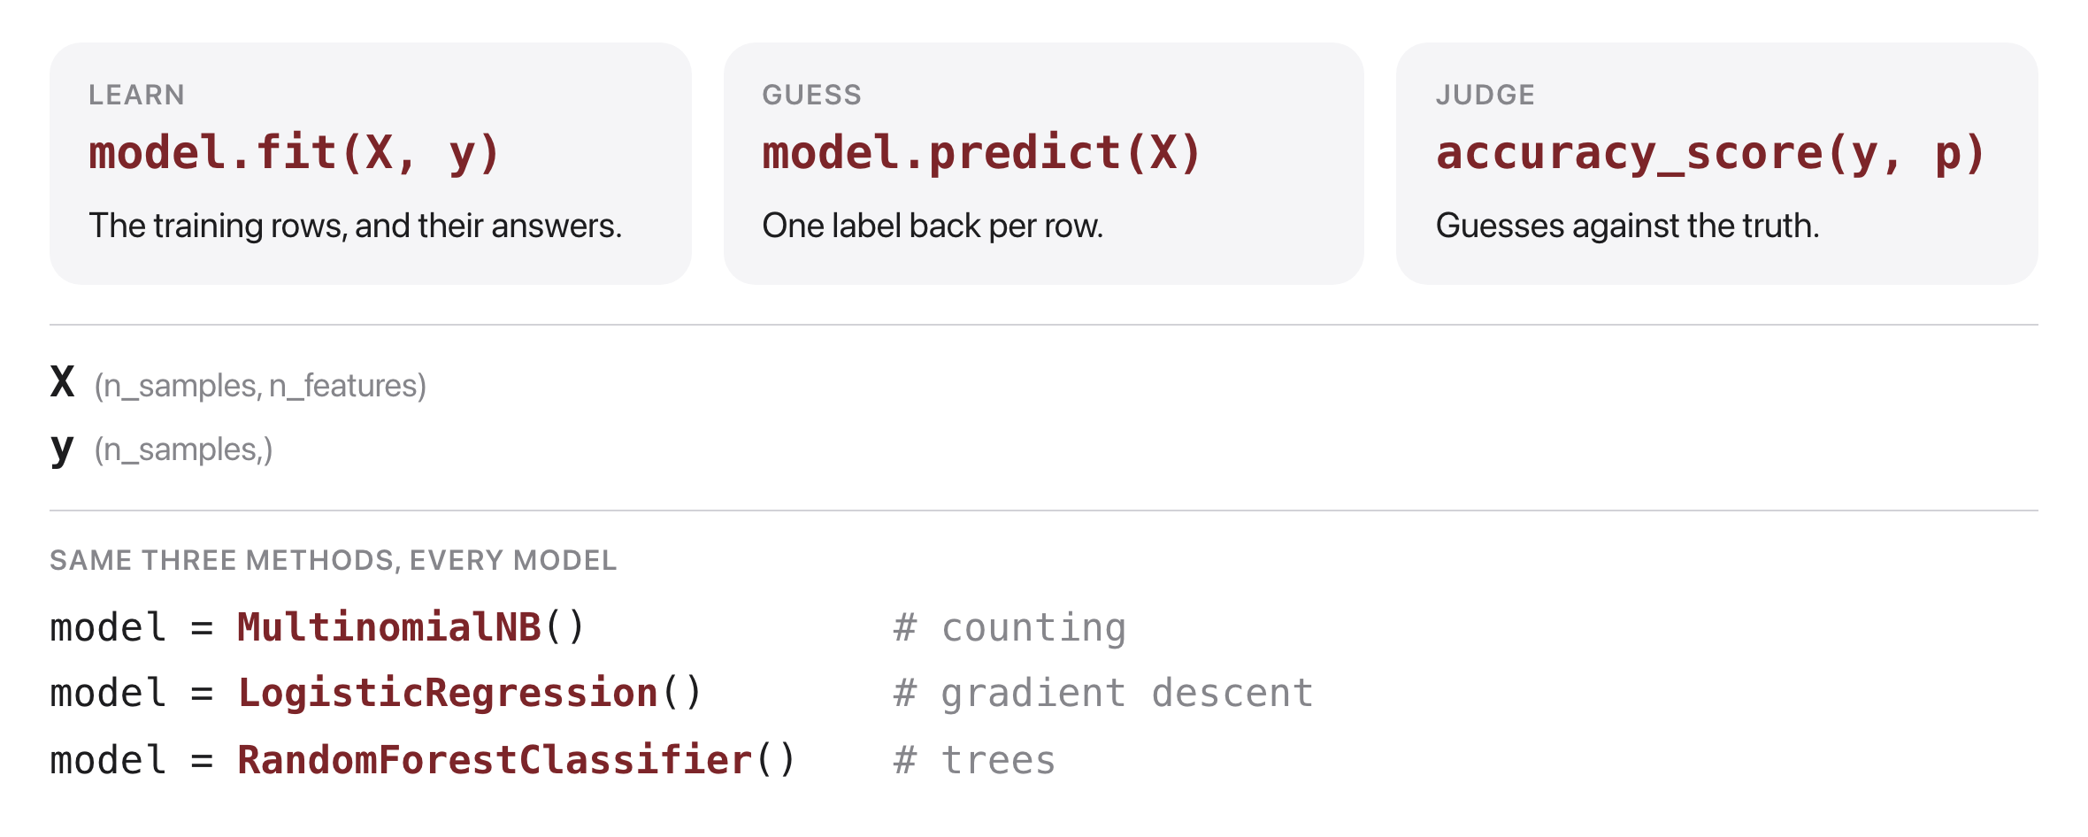
Every model: fit, predict, score
Source: original figure; scikit-learn 1.9
Notes:
The library's whole design is that every estimator answers the same three calls, so swapping Naive Bayes for logistic regression is a one-line change and nothing else moves. X is always a two-dimensional block, rows by features, and y is one label per row, which is why the last hour was about shape. The one rule that is not in the API: score on rows the model has never seen.

Slide 14
Let's walk through Part 5 in the notebook
Split, vectorize, train, read the mistakes.
Notes:
Get to the misclassified reviews before the break if you can: they all have the same shape, praise then a reversal in the last sentence, and a bag of words threw the order away. That is the bridge to attention, later in the course.

Slide 15

Break
Source: course-standard break figure

Slide 16
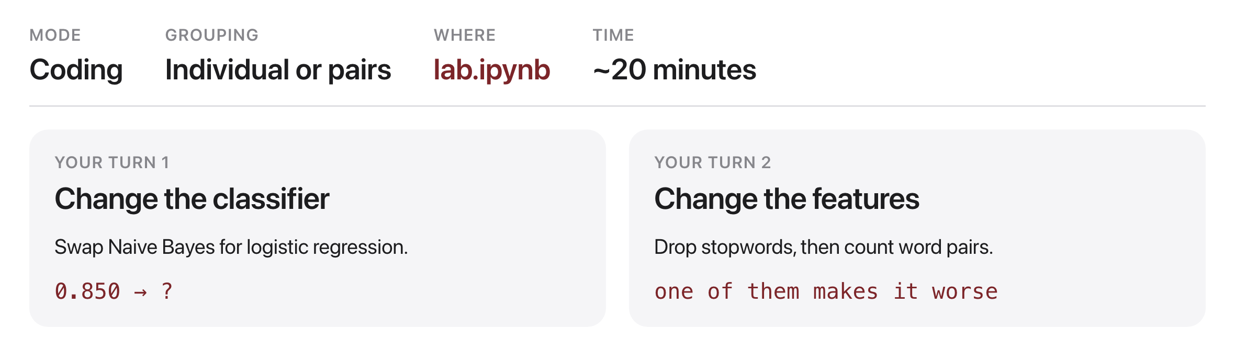
Your turn
Source: original figure
Notes:
Two experiments, each a few lines, each drawing something. First change the classifier and leave the features alone; then change the features and leave the classifier alone. One of the three feature sets makes it worse, and working out why is the point of the second task. Answers are in the last cell, but try first.

