Slide 1

CSCI 3495
LLM Agents
Natural Language Processing & Large Language Models
Week 8, Class 1 · Mon Oct 12, 2026
Source: Charles J. Sharp, Wikimedia Commons, CC BY-SA 4.0

Slide 2

What is an Agent?

Slide 3
Traditional, Boring LLM
LLM
Input Prompt
Output Response
But what if we gave the LLM to agency?

Slide 4
The Augmented LLM
LLM
Input Prompt
Output Response
Through “augmenting” the nature of the LLM, we can make it not only think but act!
Environment

Slide 5
An LLM Agent
Input Prompt
The main aspects that make an agent an agent is the ability to:
Remember facts/data through memory
Have access to tools that provide information about the environment
Agent
LLM
Engine
Environment
Tools
Memory
Output Result

Slide 6
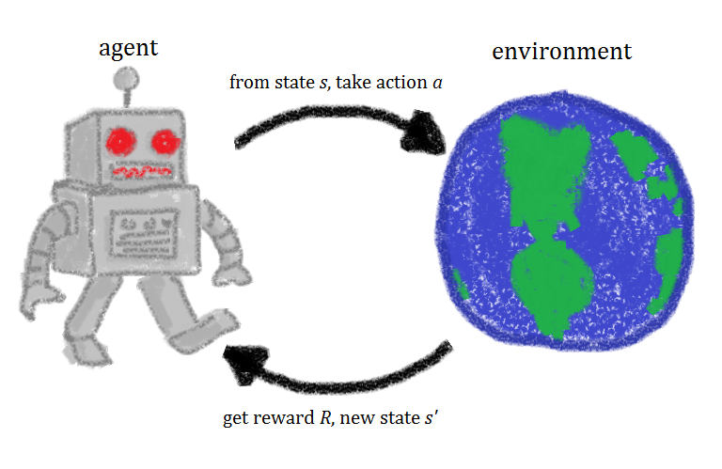
A Traditional Agent
The traditional (math, game theory, and reinforcement learning) agent includes:
State, s
Actions, a
Reward, r
Analog
State is the memory, actions are transformative tools, and reward is informative tools

Slide 7
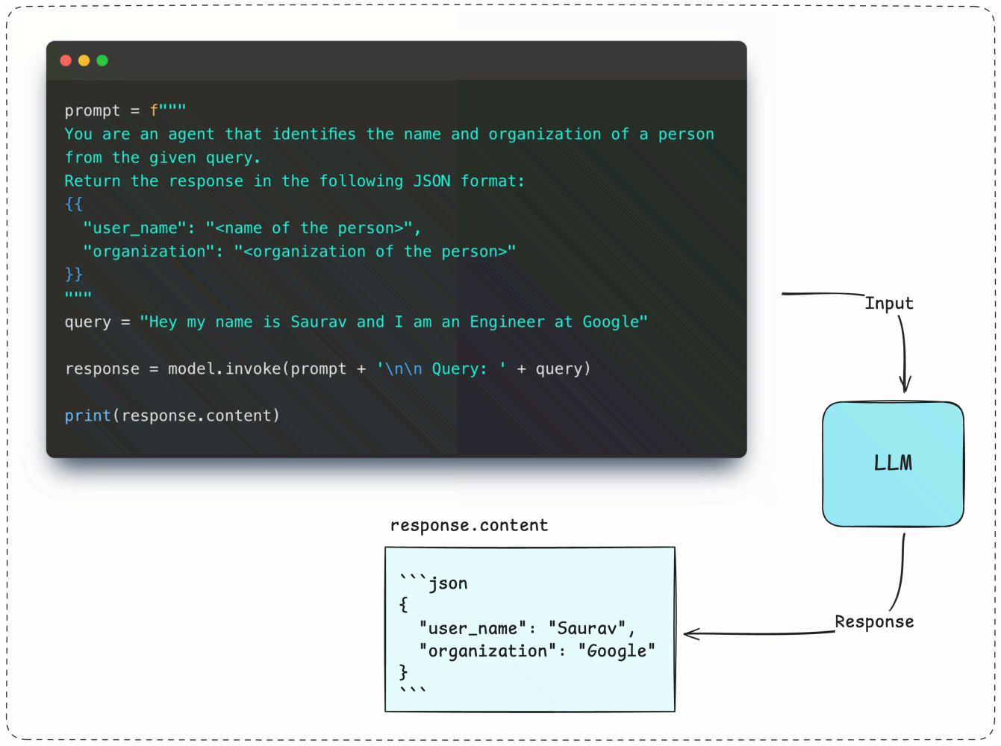
Natural vs Structured Outputs

Slide 8
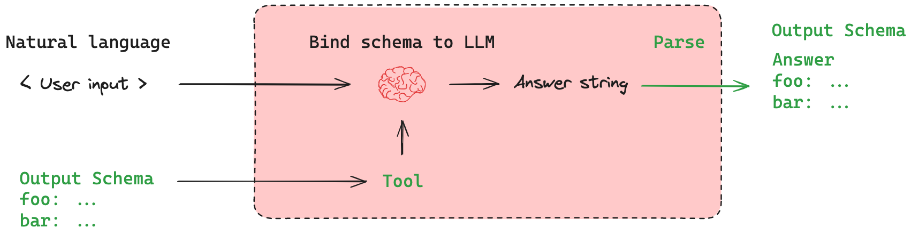
Structured Outputs defined by a Schema

Slide 9
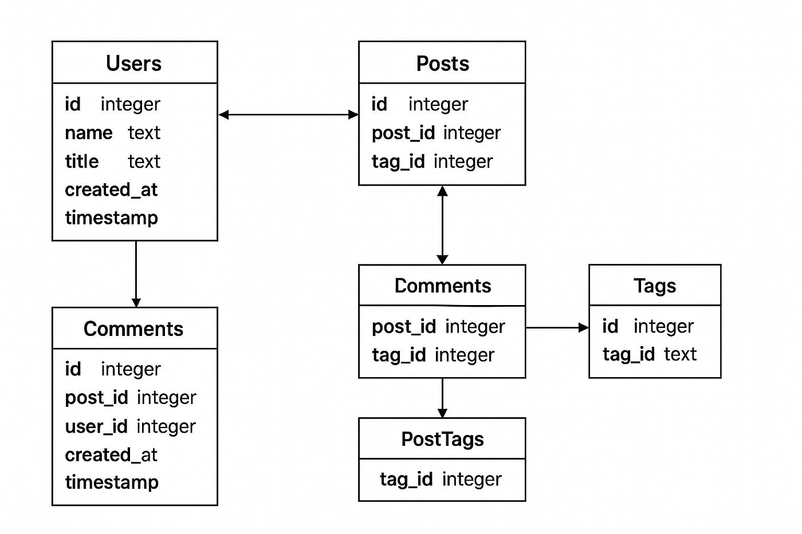
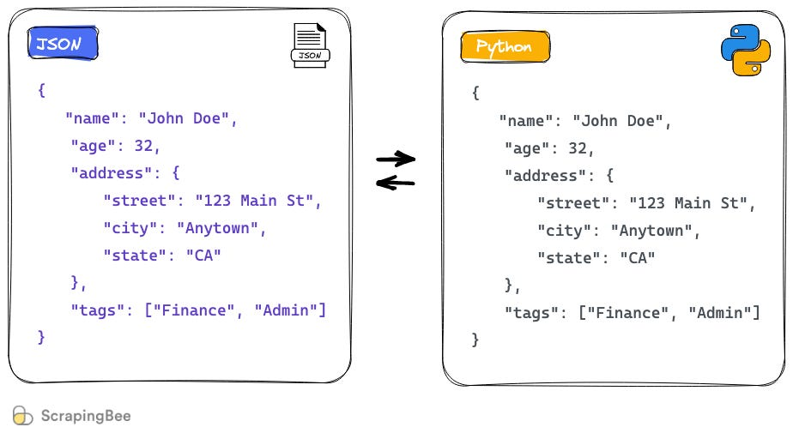
Schema
A Schema is a set of Data Types/Models that we would want the model to follow. It generates them as a JSON that then we convert to a Dictionary in Python.

Slide 10
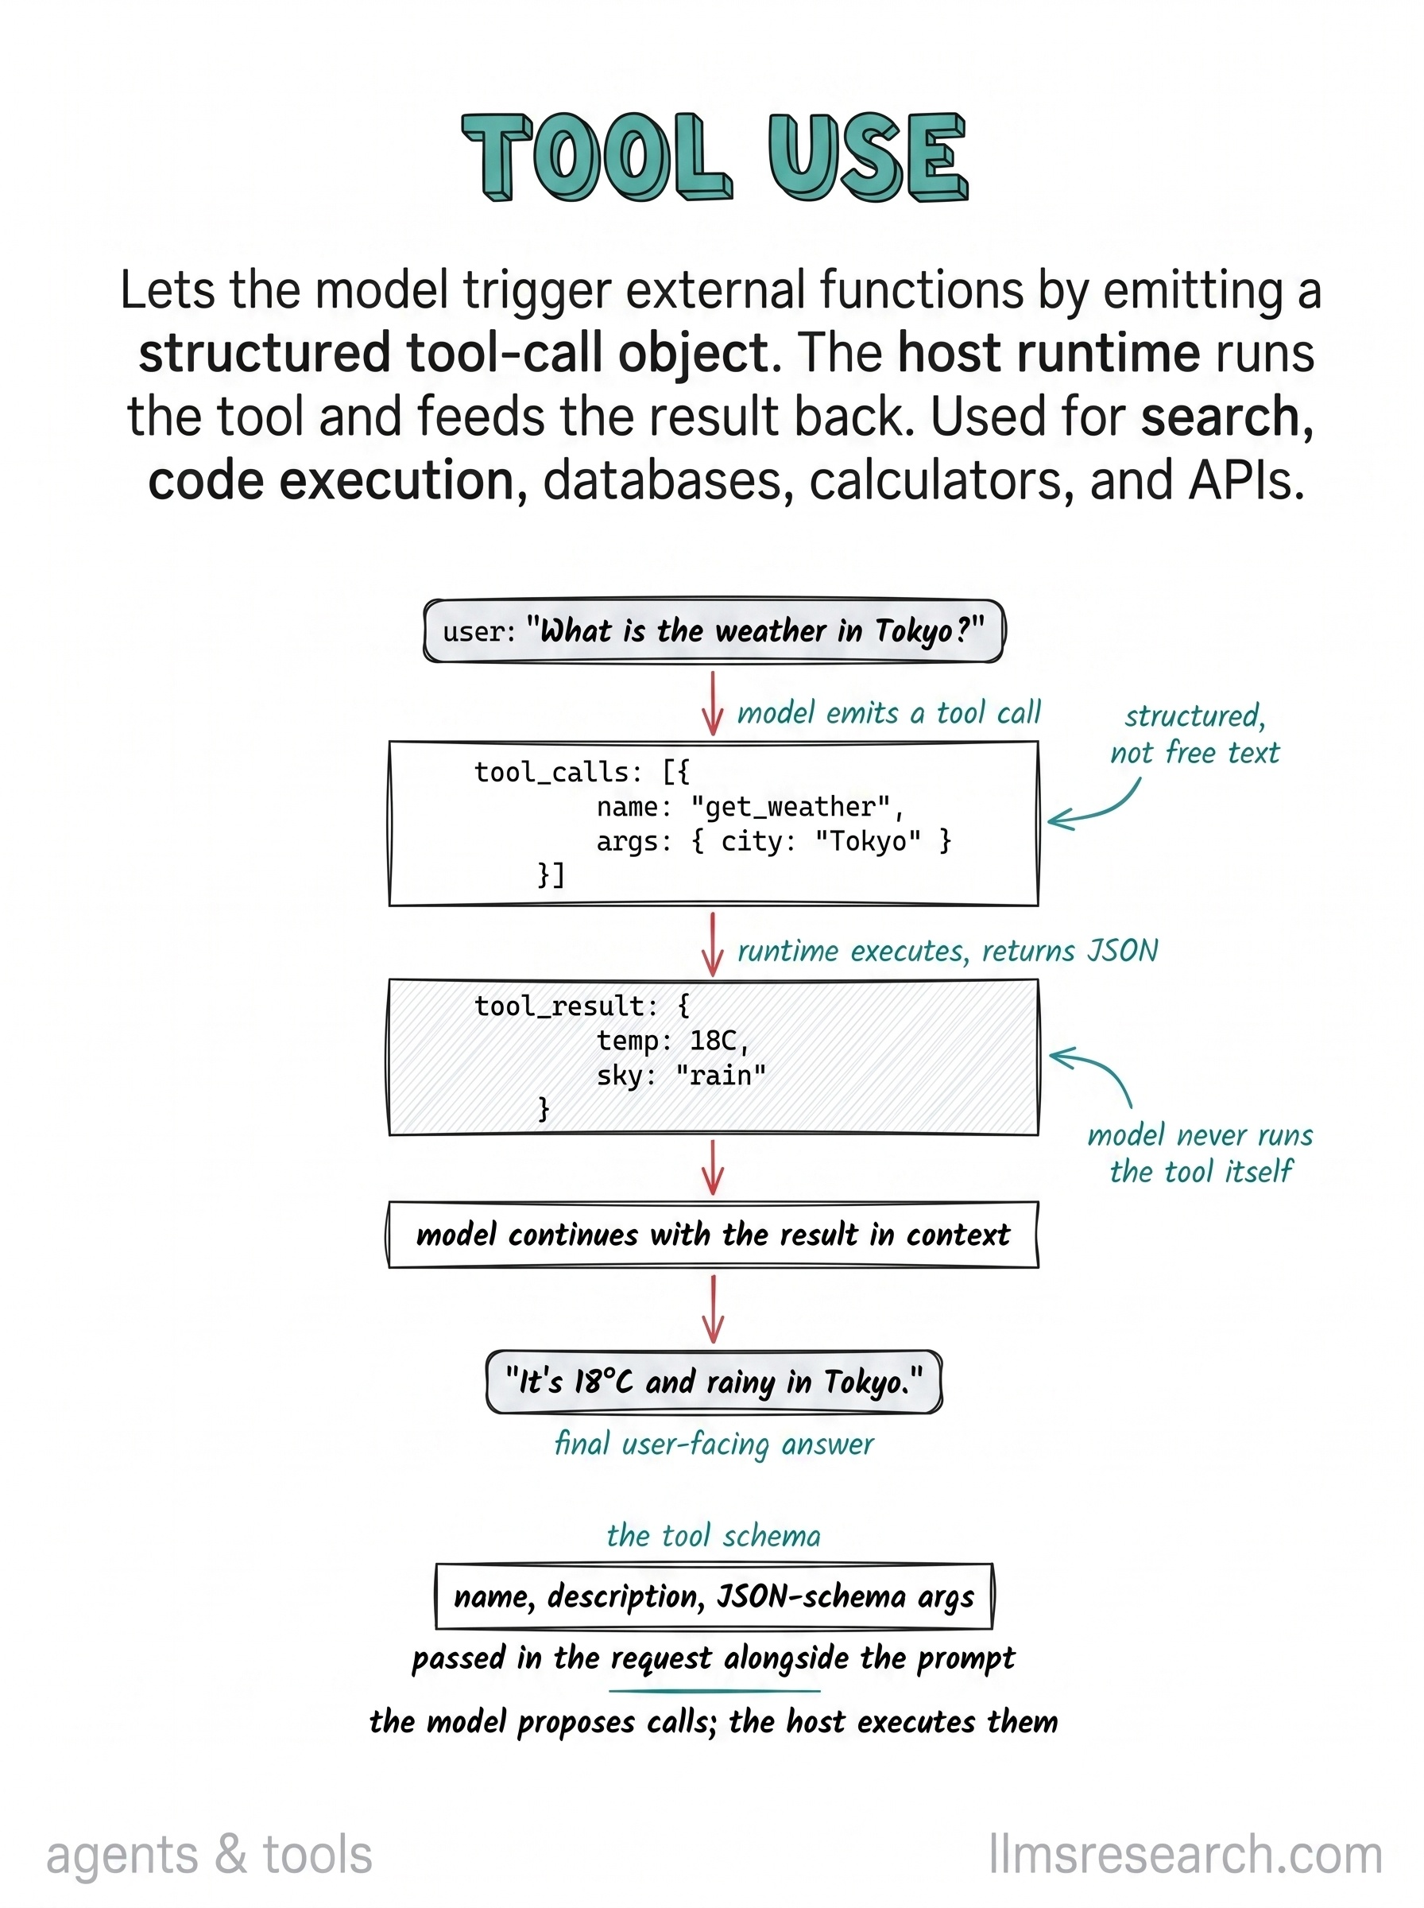
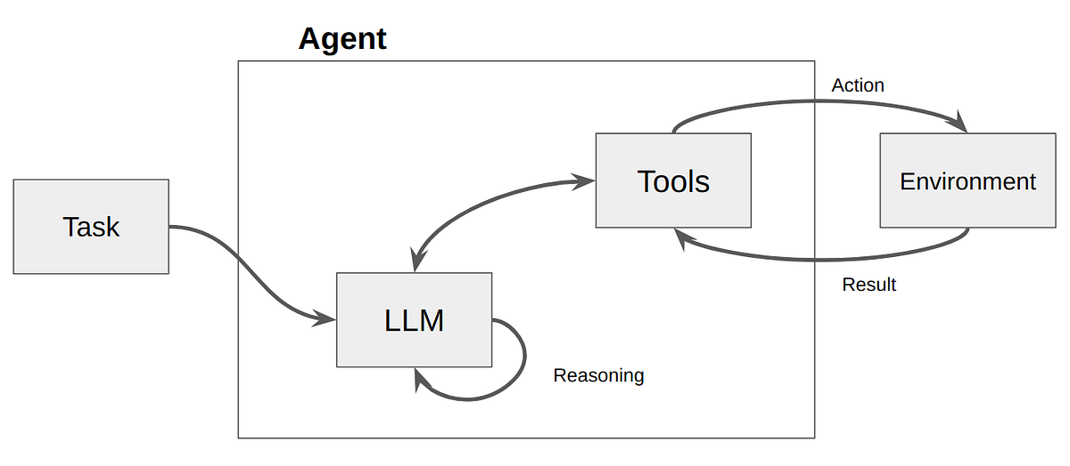
Tool Calling
Tools are the key for providing the LLM with needed information to complete task
Tool calls are based on structured output from the LLM. The parameter definition is the schema.

Slide 11


Giving LLMs tools?

Slide 12

How does an LLM know how to use tools?

Slide 13
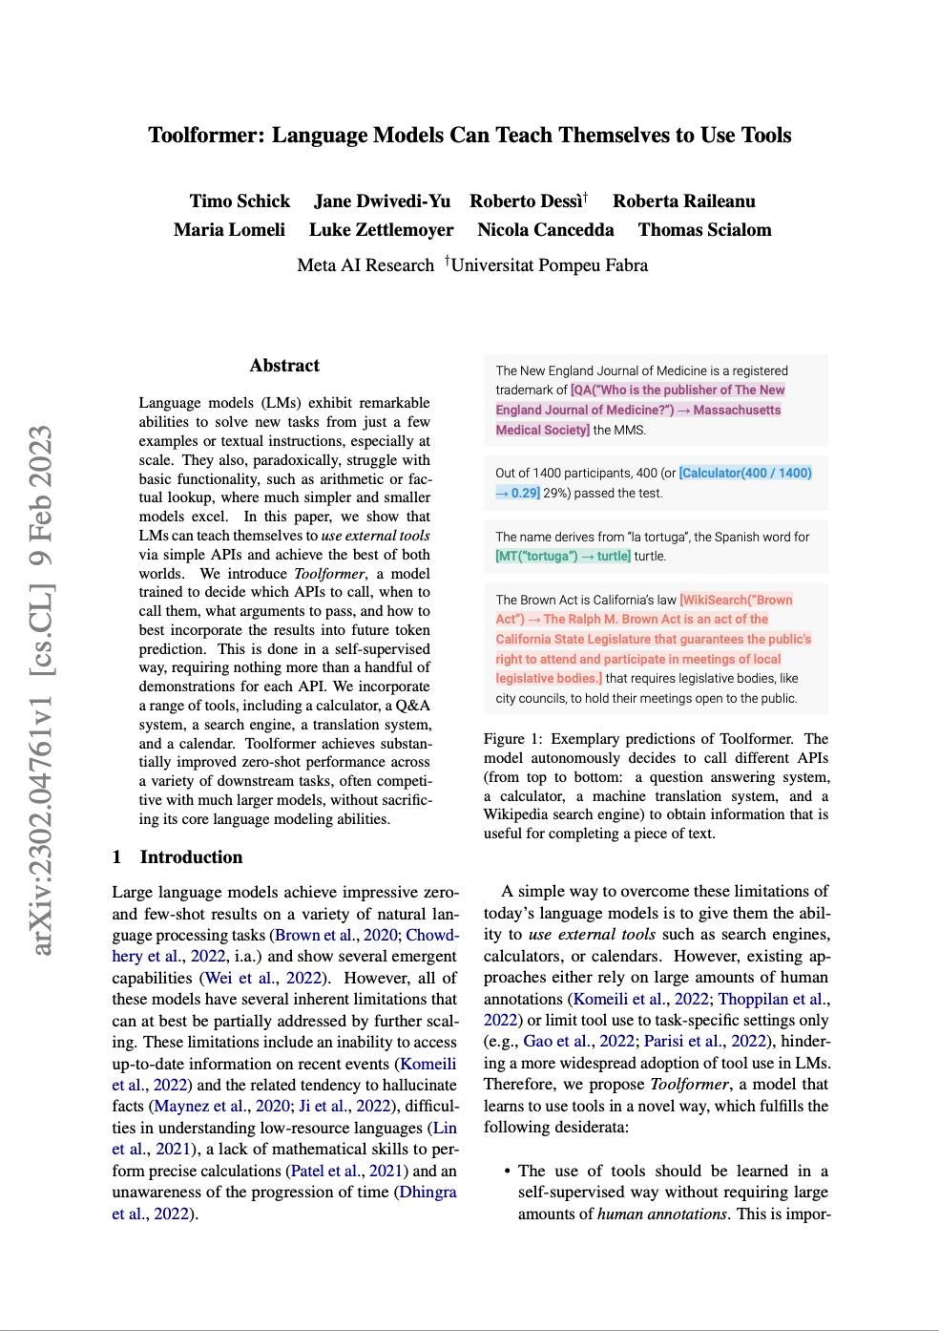
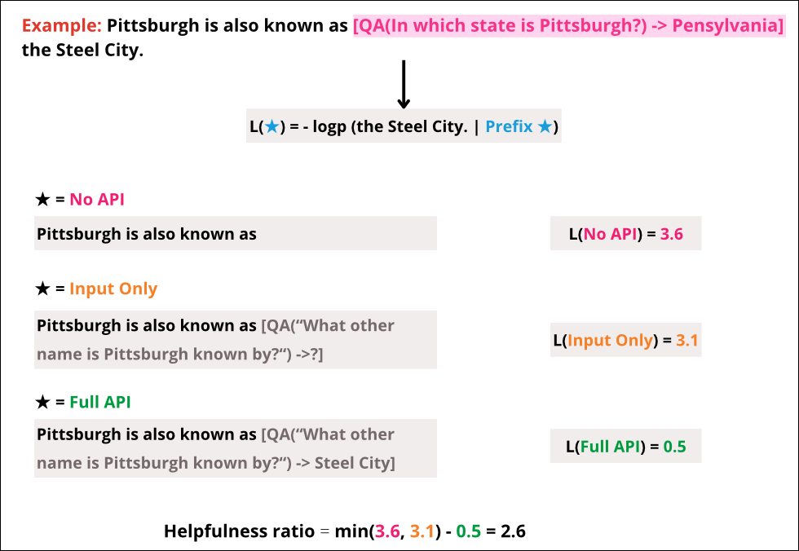
Toolformer: Training the LLM to use Tools

Slide 14
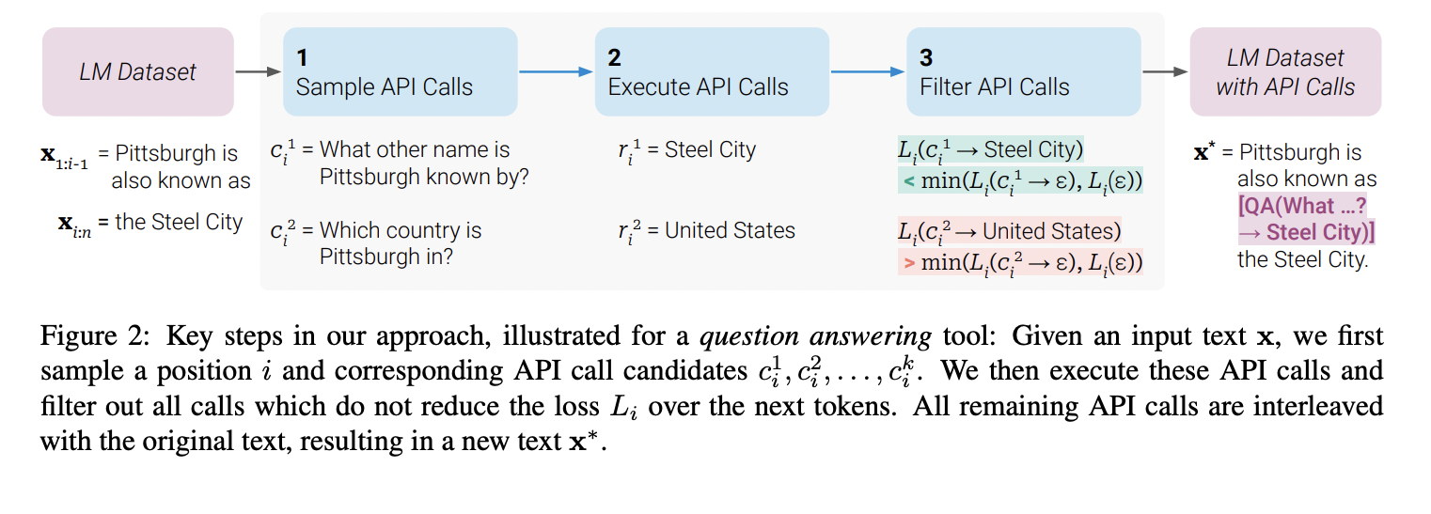
Toolformer: Training the LLM to use Tools

Slide 15
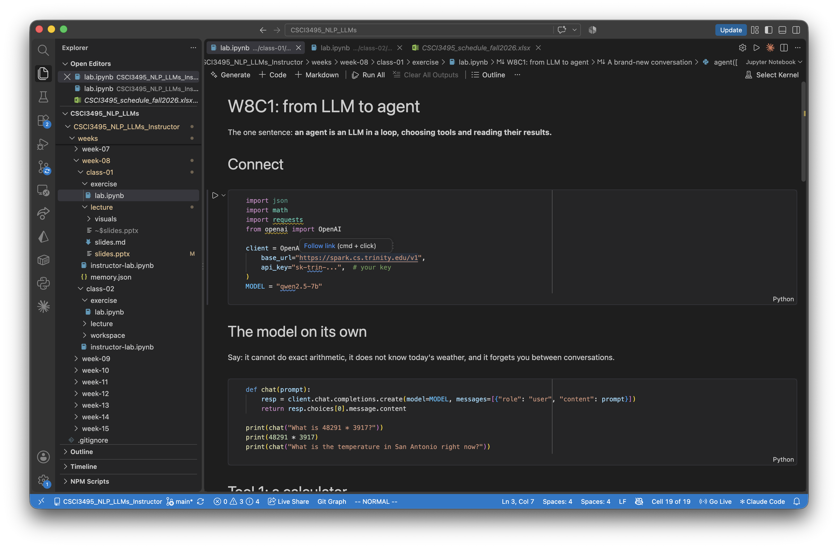
Coding Walkthrough

Slide 16

Break
Source: original figure

Slide 17
Coding Challenge
Add a get_today tool. Then ask the agent: "How many days until Thanksgiving?" and "What day of the week will it be 100 days from now?" Check its answers yourself.

