Slide 1

CSCI 3495
Coding Agents:
Giving an LLM a Sneaky Tool
LLM & AI
Natural Language Processing & Large Language Models
Week 8, Class 2 · Wed Oct 14, 2026
Source: Unsplash License, https://images.unsplash.com/photo-1518770660439-4636190af475

Slide 2
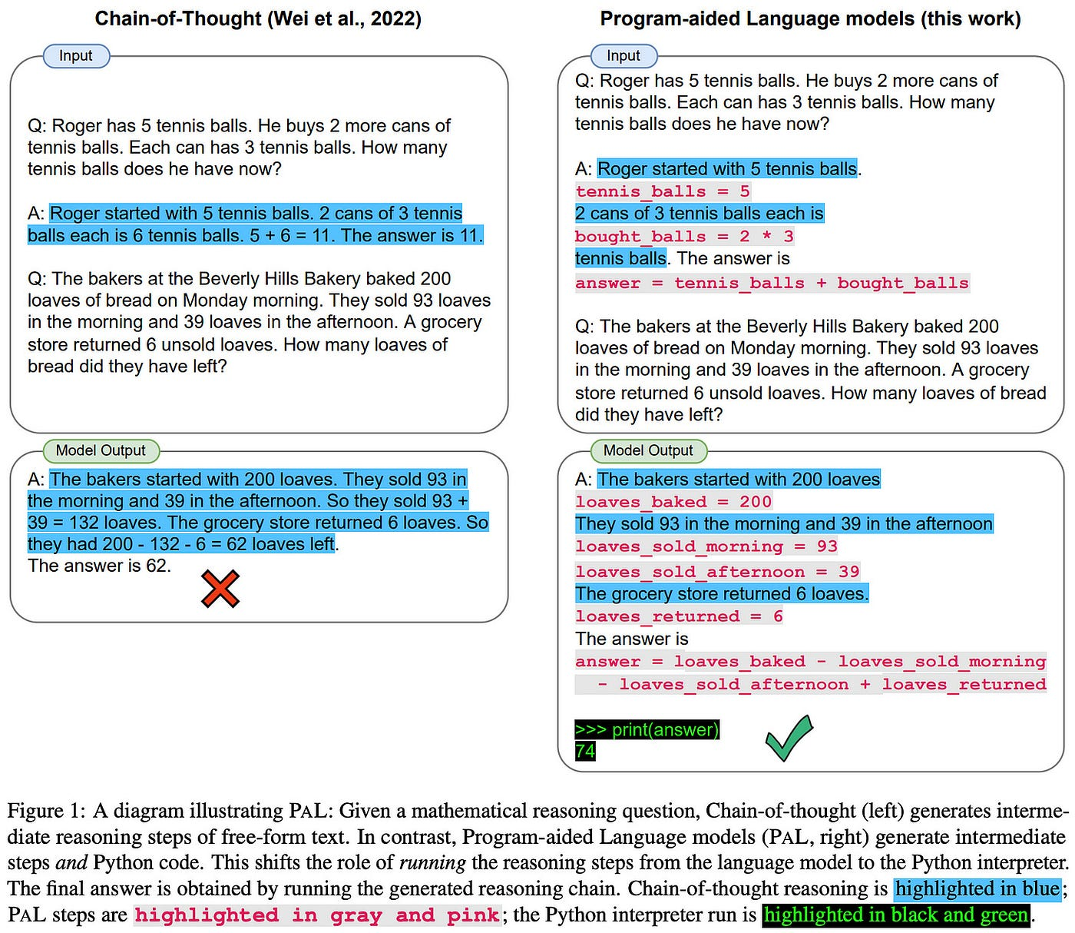
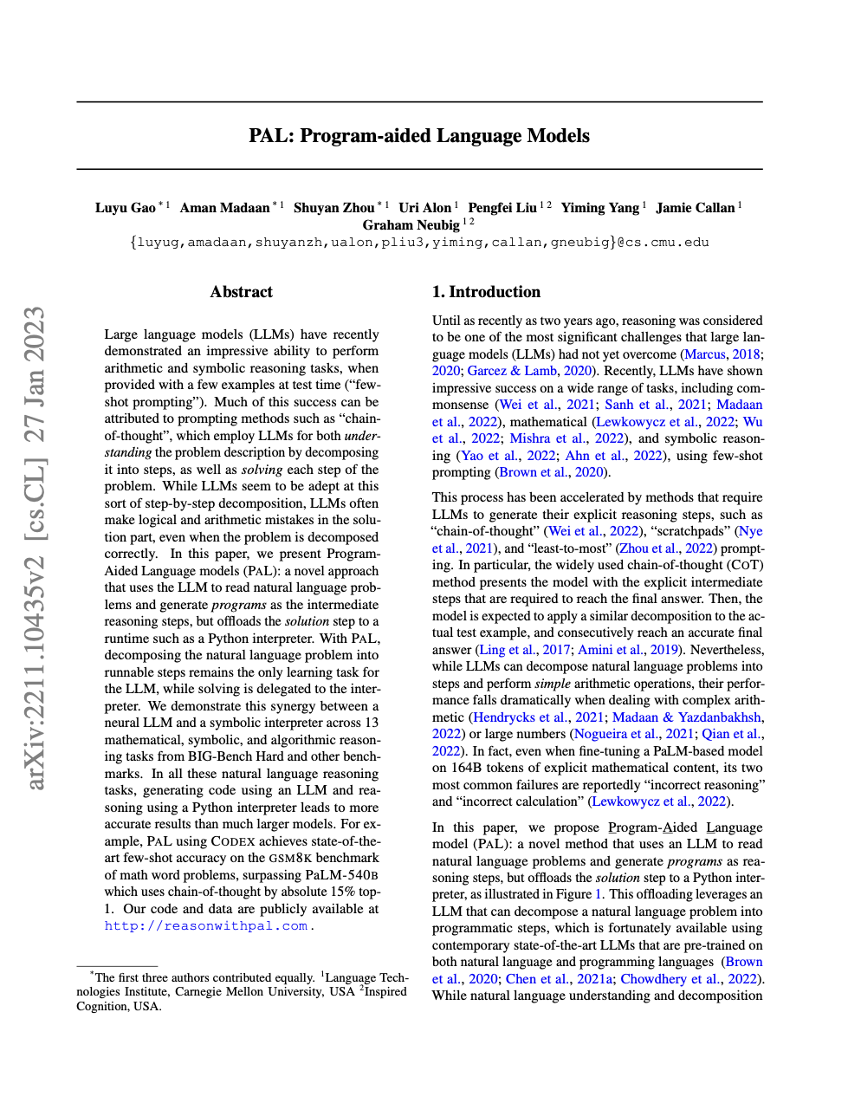
Allowing LLMs to Code & Execute

Slide 3
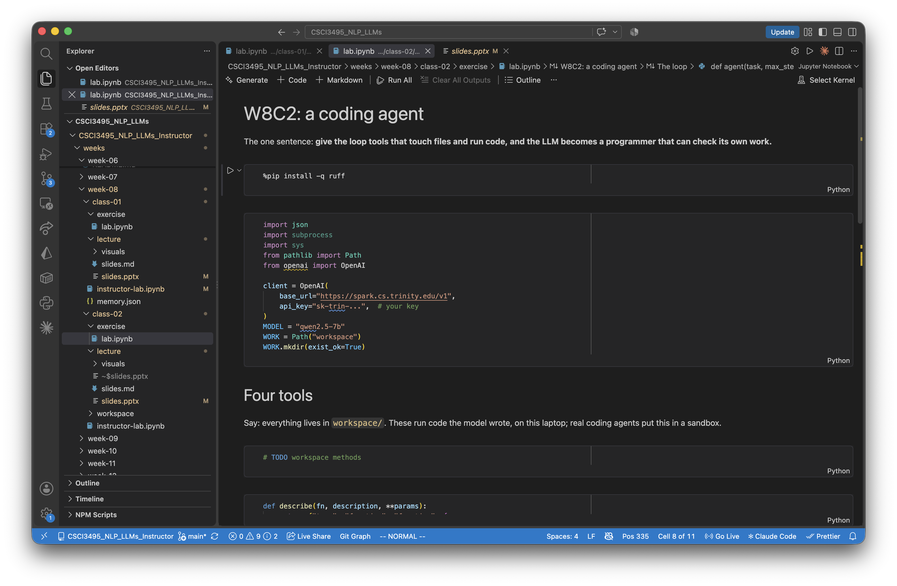
Coding Walkthrough

