Slide 1
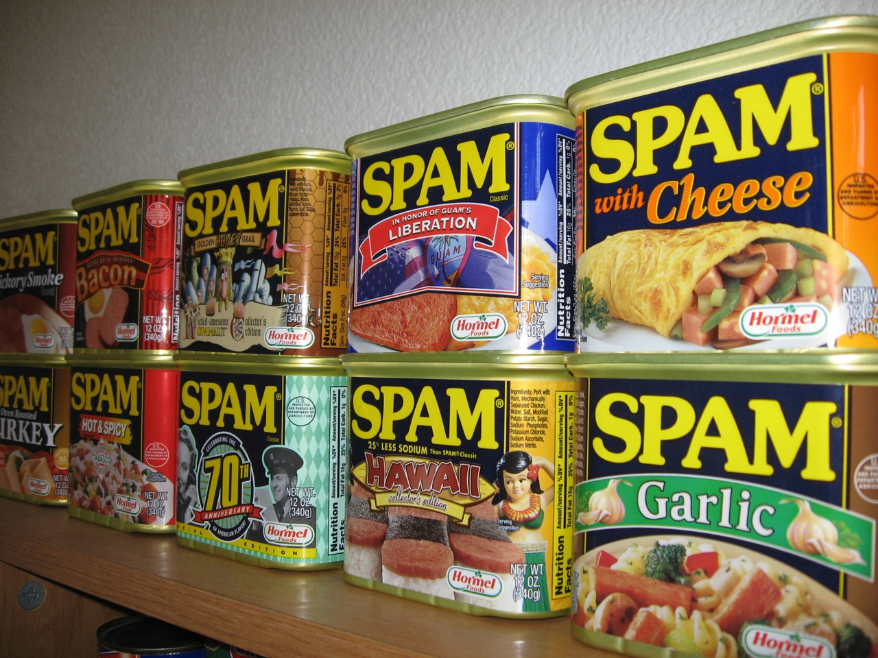
CSCI 3495
Text Classification
Natural Language Processing & Large Language Models
Week 2, Class 2 · Wed Sep 2, 2026
Source: Arnold Gatilao, CC BY 2.0, Wikimedia Commons (SPAM Shrine.jpg)

Slide 2

Every inbox is a classifier at work
Source: Unsplash License, https://images.unsplash.com/photo-1450101499163-c8848c66ca85

Slide 3
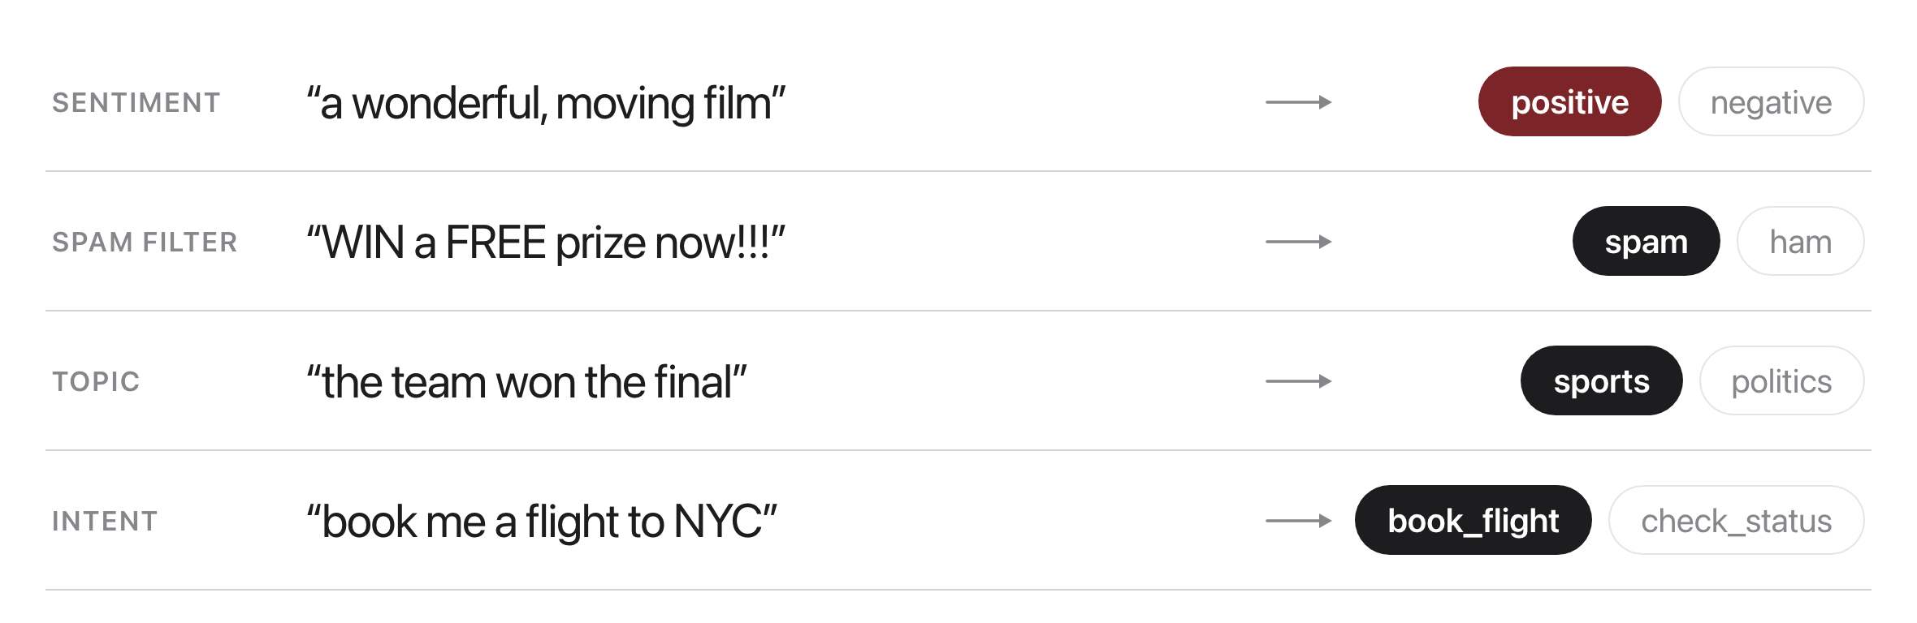
The task
Source: original figure

Slide 4
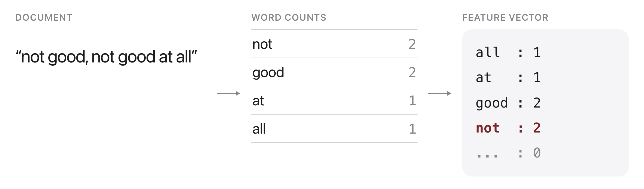
Features: bag-of-words
Source: original figure

Slide 5
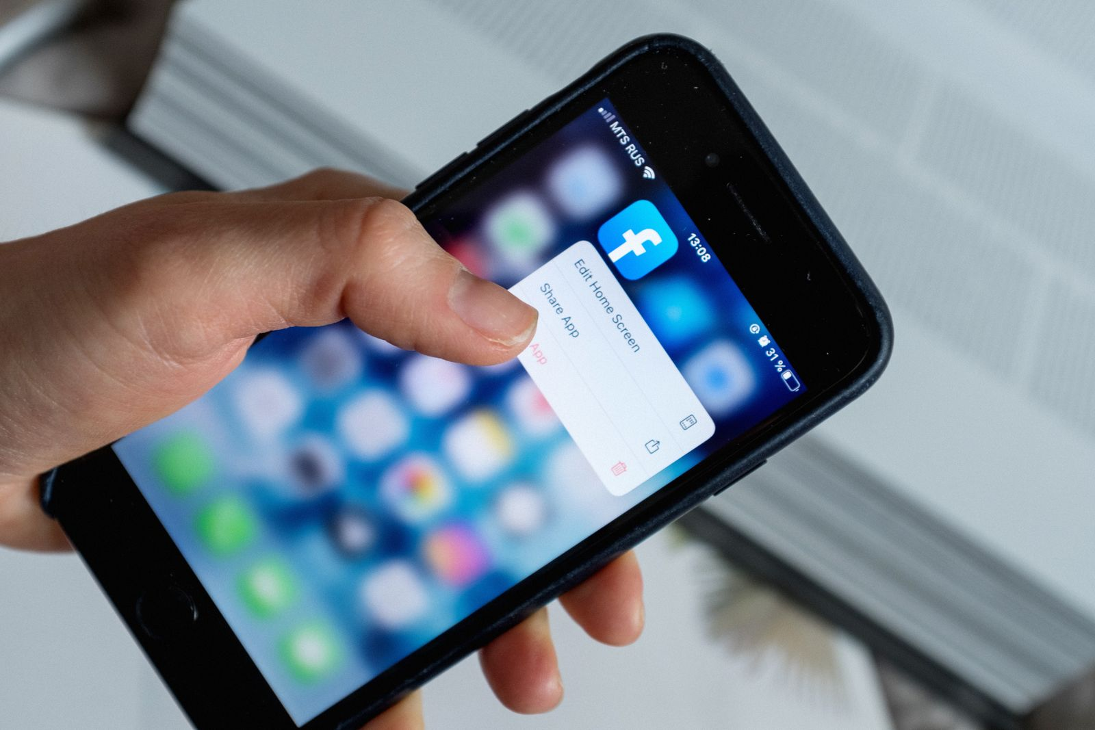
Is this review positive or negative?
Source: Pexels License, https://images.pexels.com/photos/3850250/pexels-photo-3850250.jpeg

Slide 6
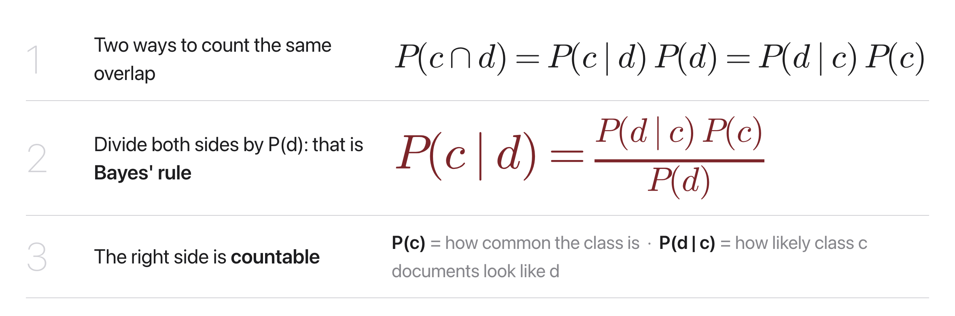
Bayes' rule, from counting
Source: original figure

Slide 7
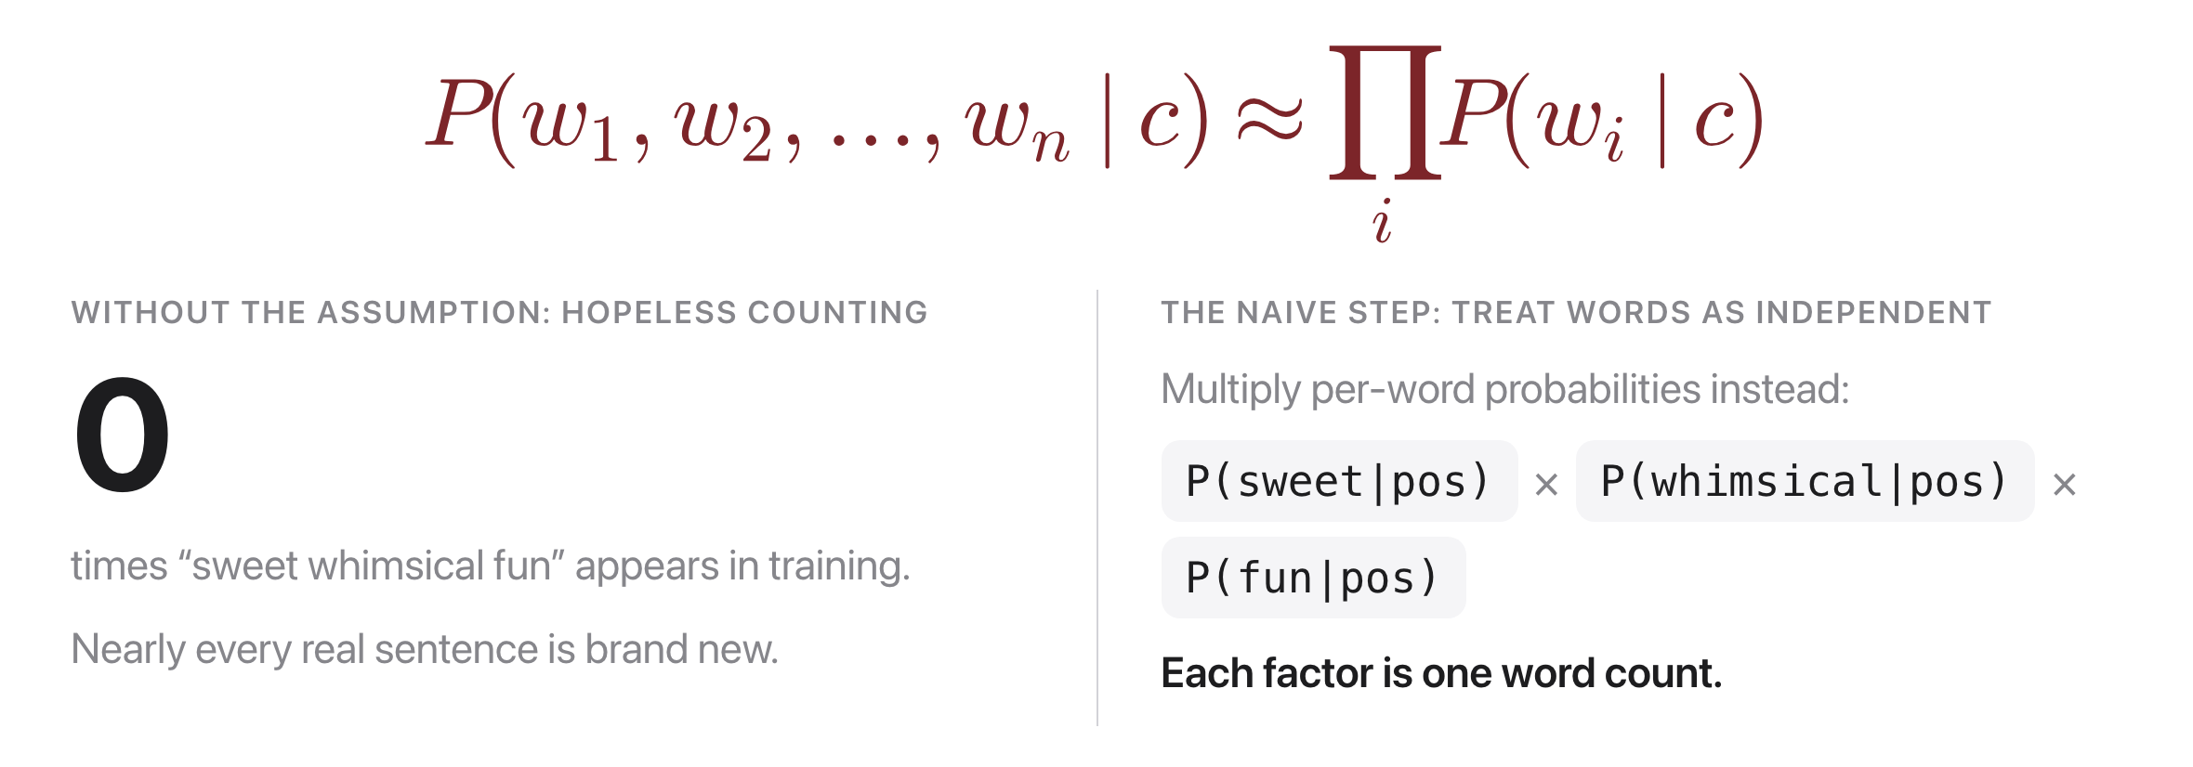
The naive assumption, laid out
Source: original figure

Slide 8
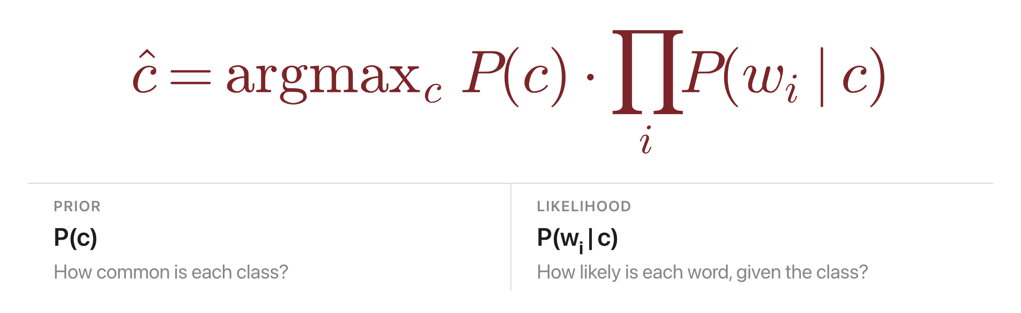
Naive Bayes: the idea
Source: original figure

Slide 9
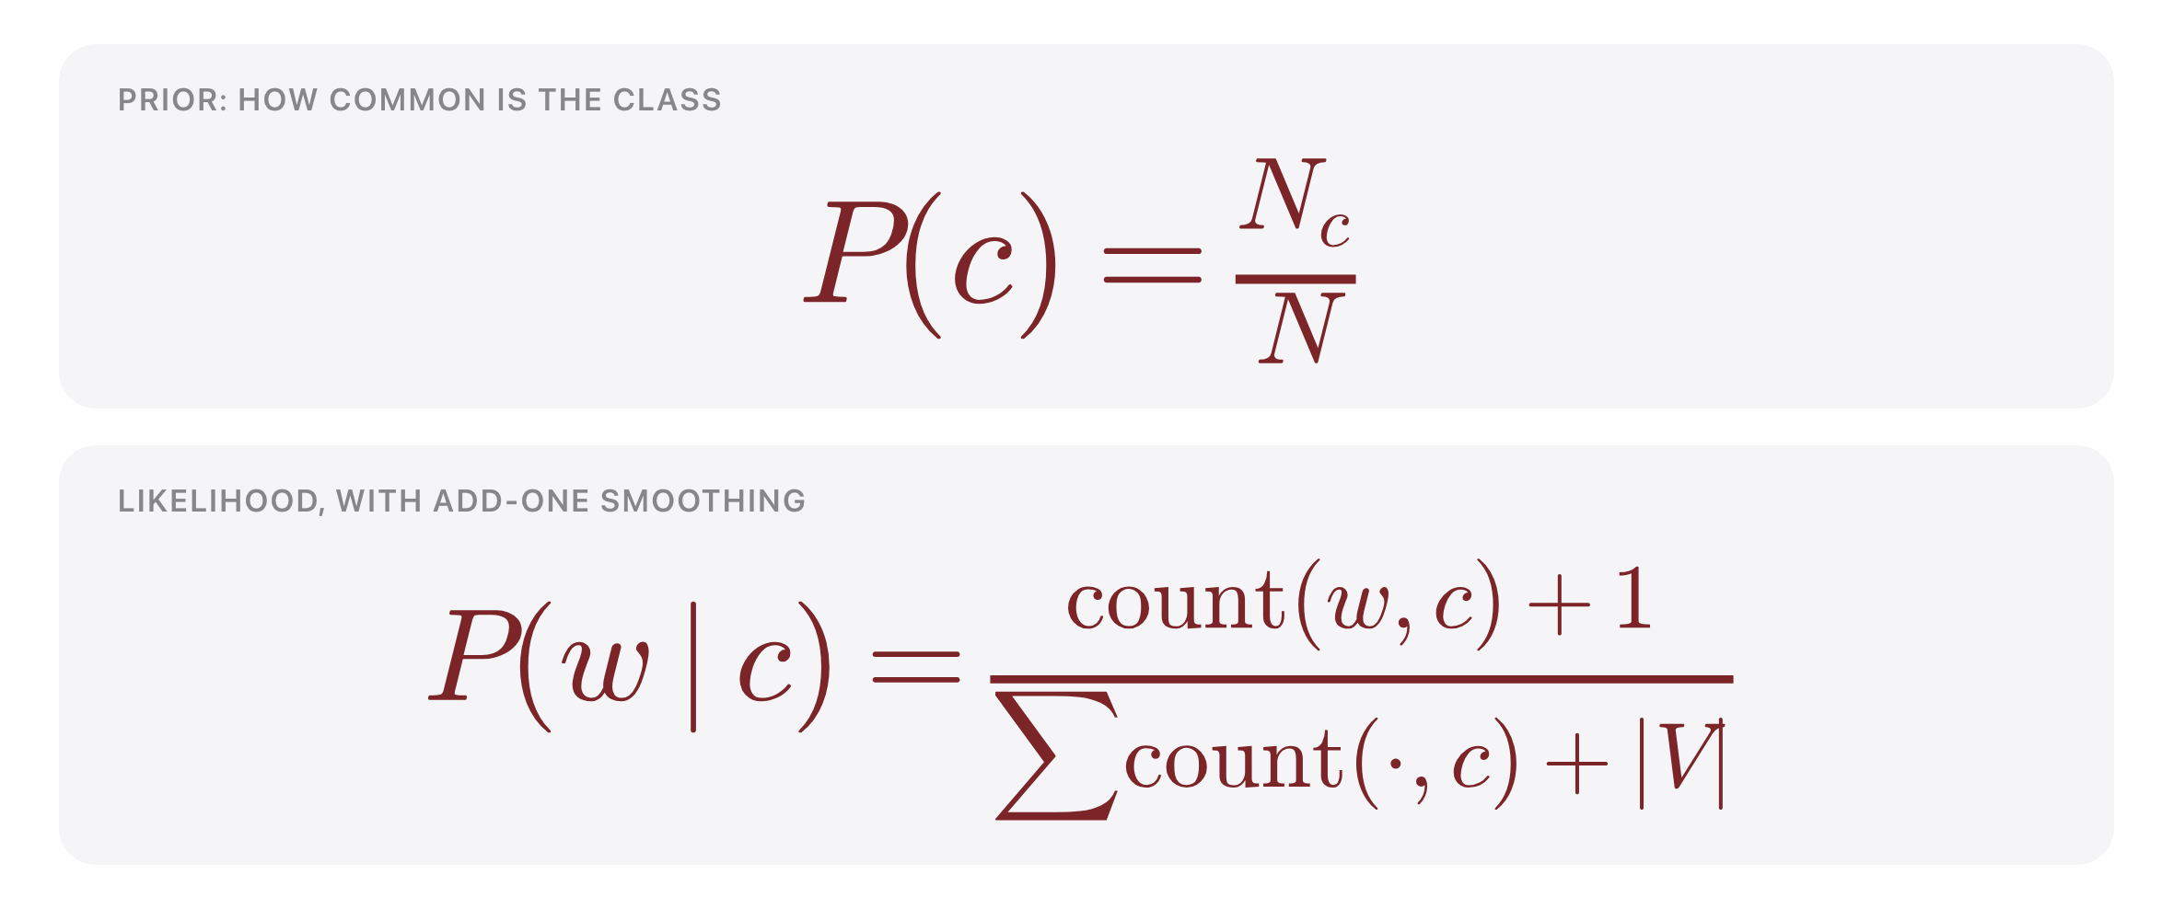
Training Naive Bayes
Source: original figure

Slide 10

The independence assumption
Source: original figure

Slide 11
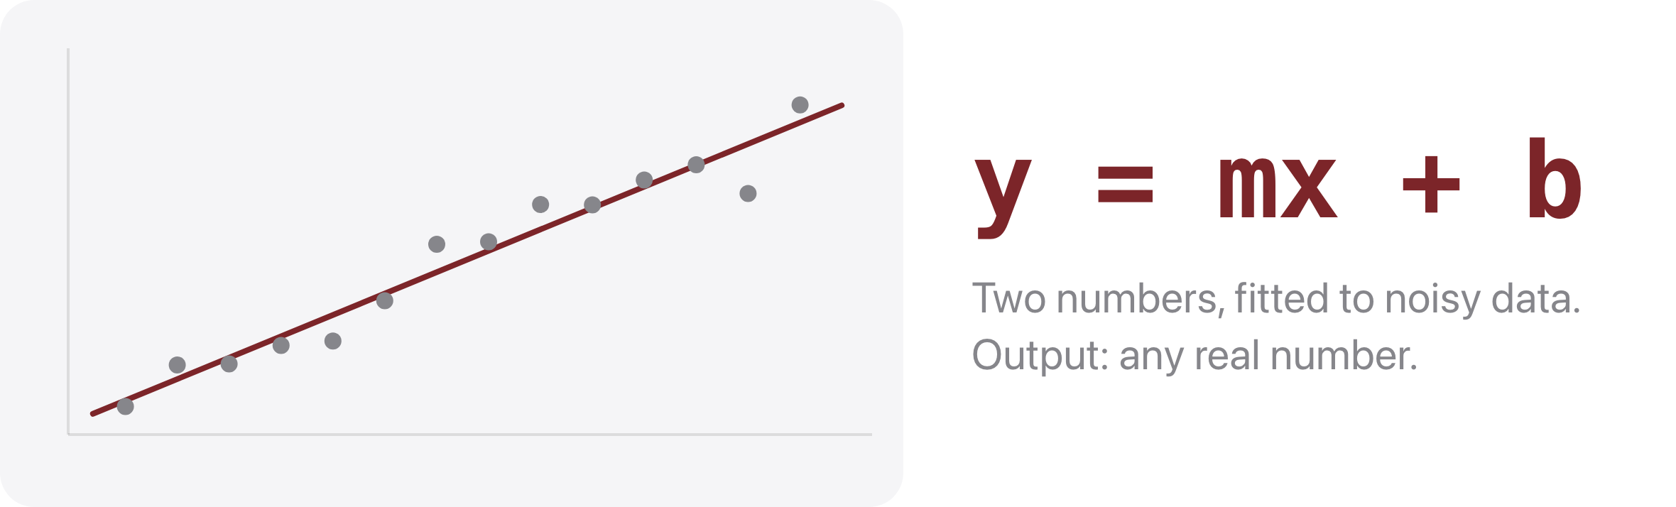
First, the shape you already know
Source: original figure

Slide 12
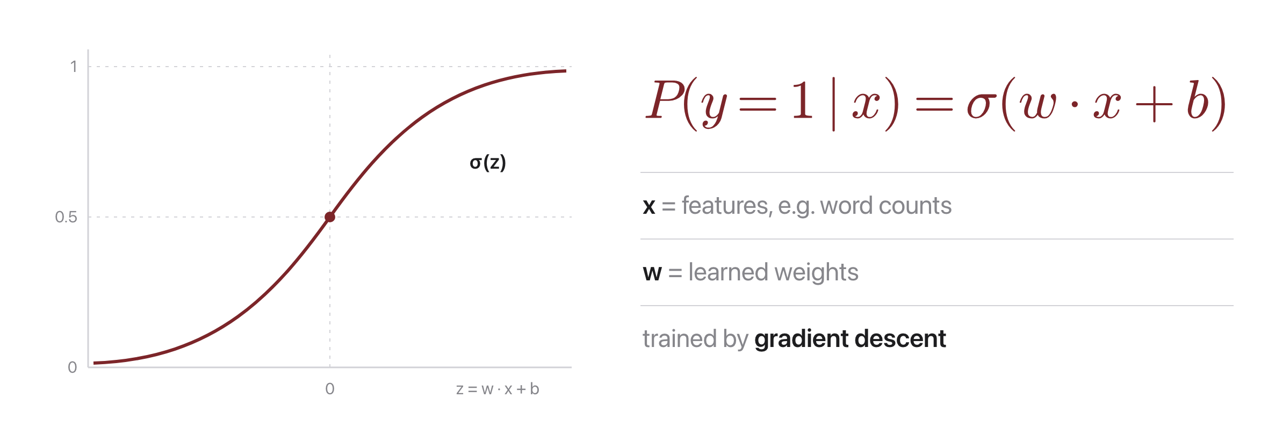
Logistic regression: the idea
Source: original figure

Slide 13
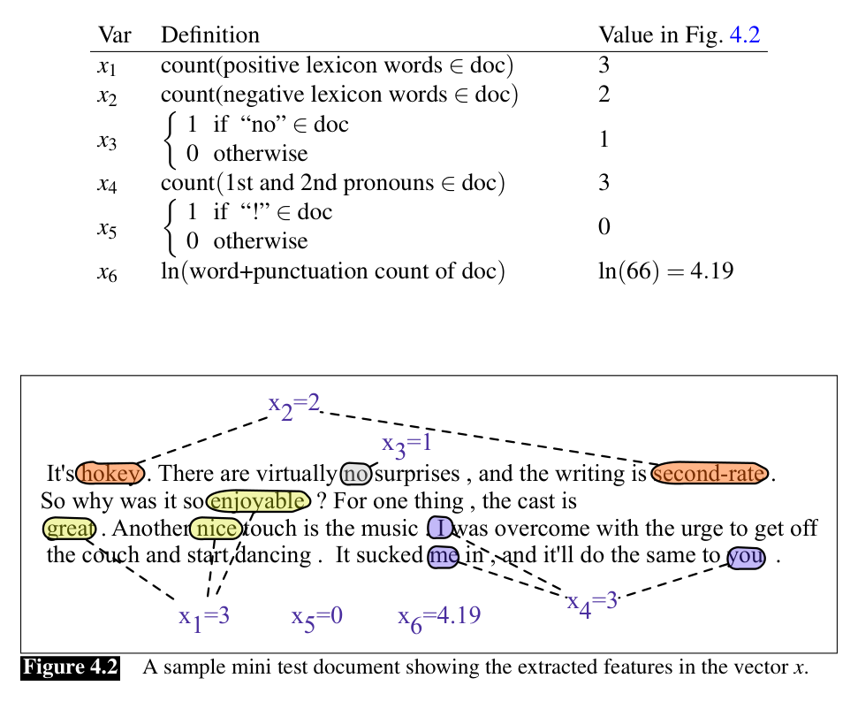
What the model sees: a feature vector x
Source: Jurafsky & Martin, SLP3 (Jan 2026 draft), Fig. 4.2

Slide 14
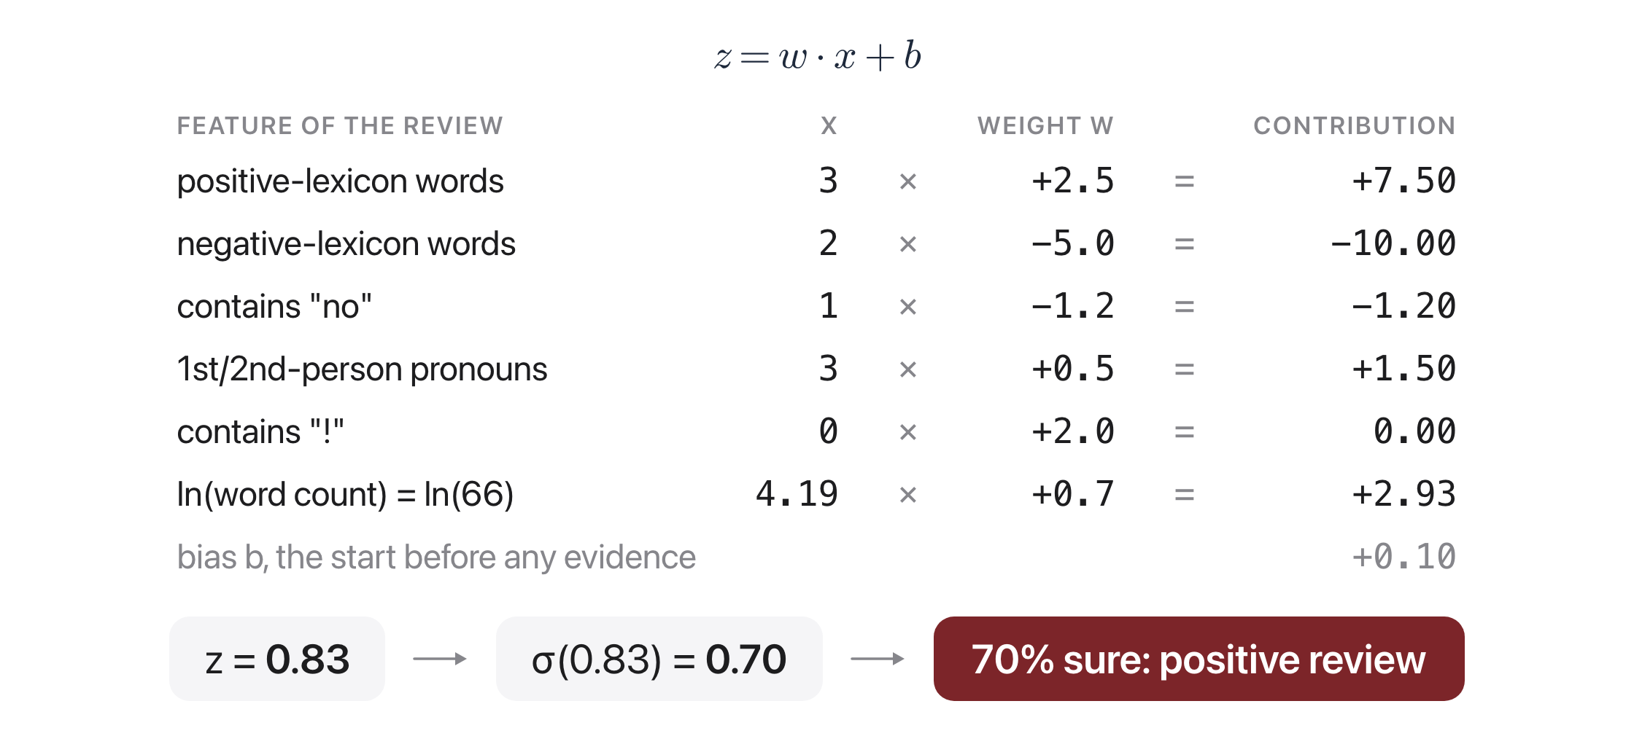
The entire model: multiply, add, squash
Source: Jurafsky & Martin, SLP3 (Jan 2026 draft), Ch. 4.3.1 worked example

Slide 15
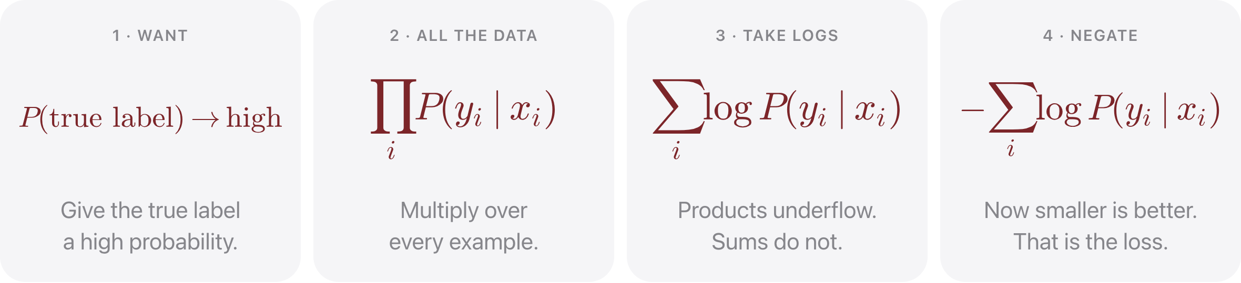
Where does the loss come from?
Source: original figure

Slide 16
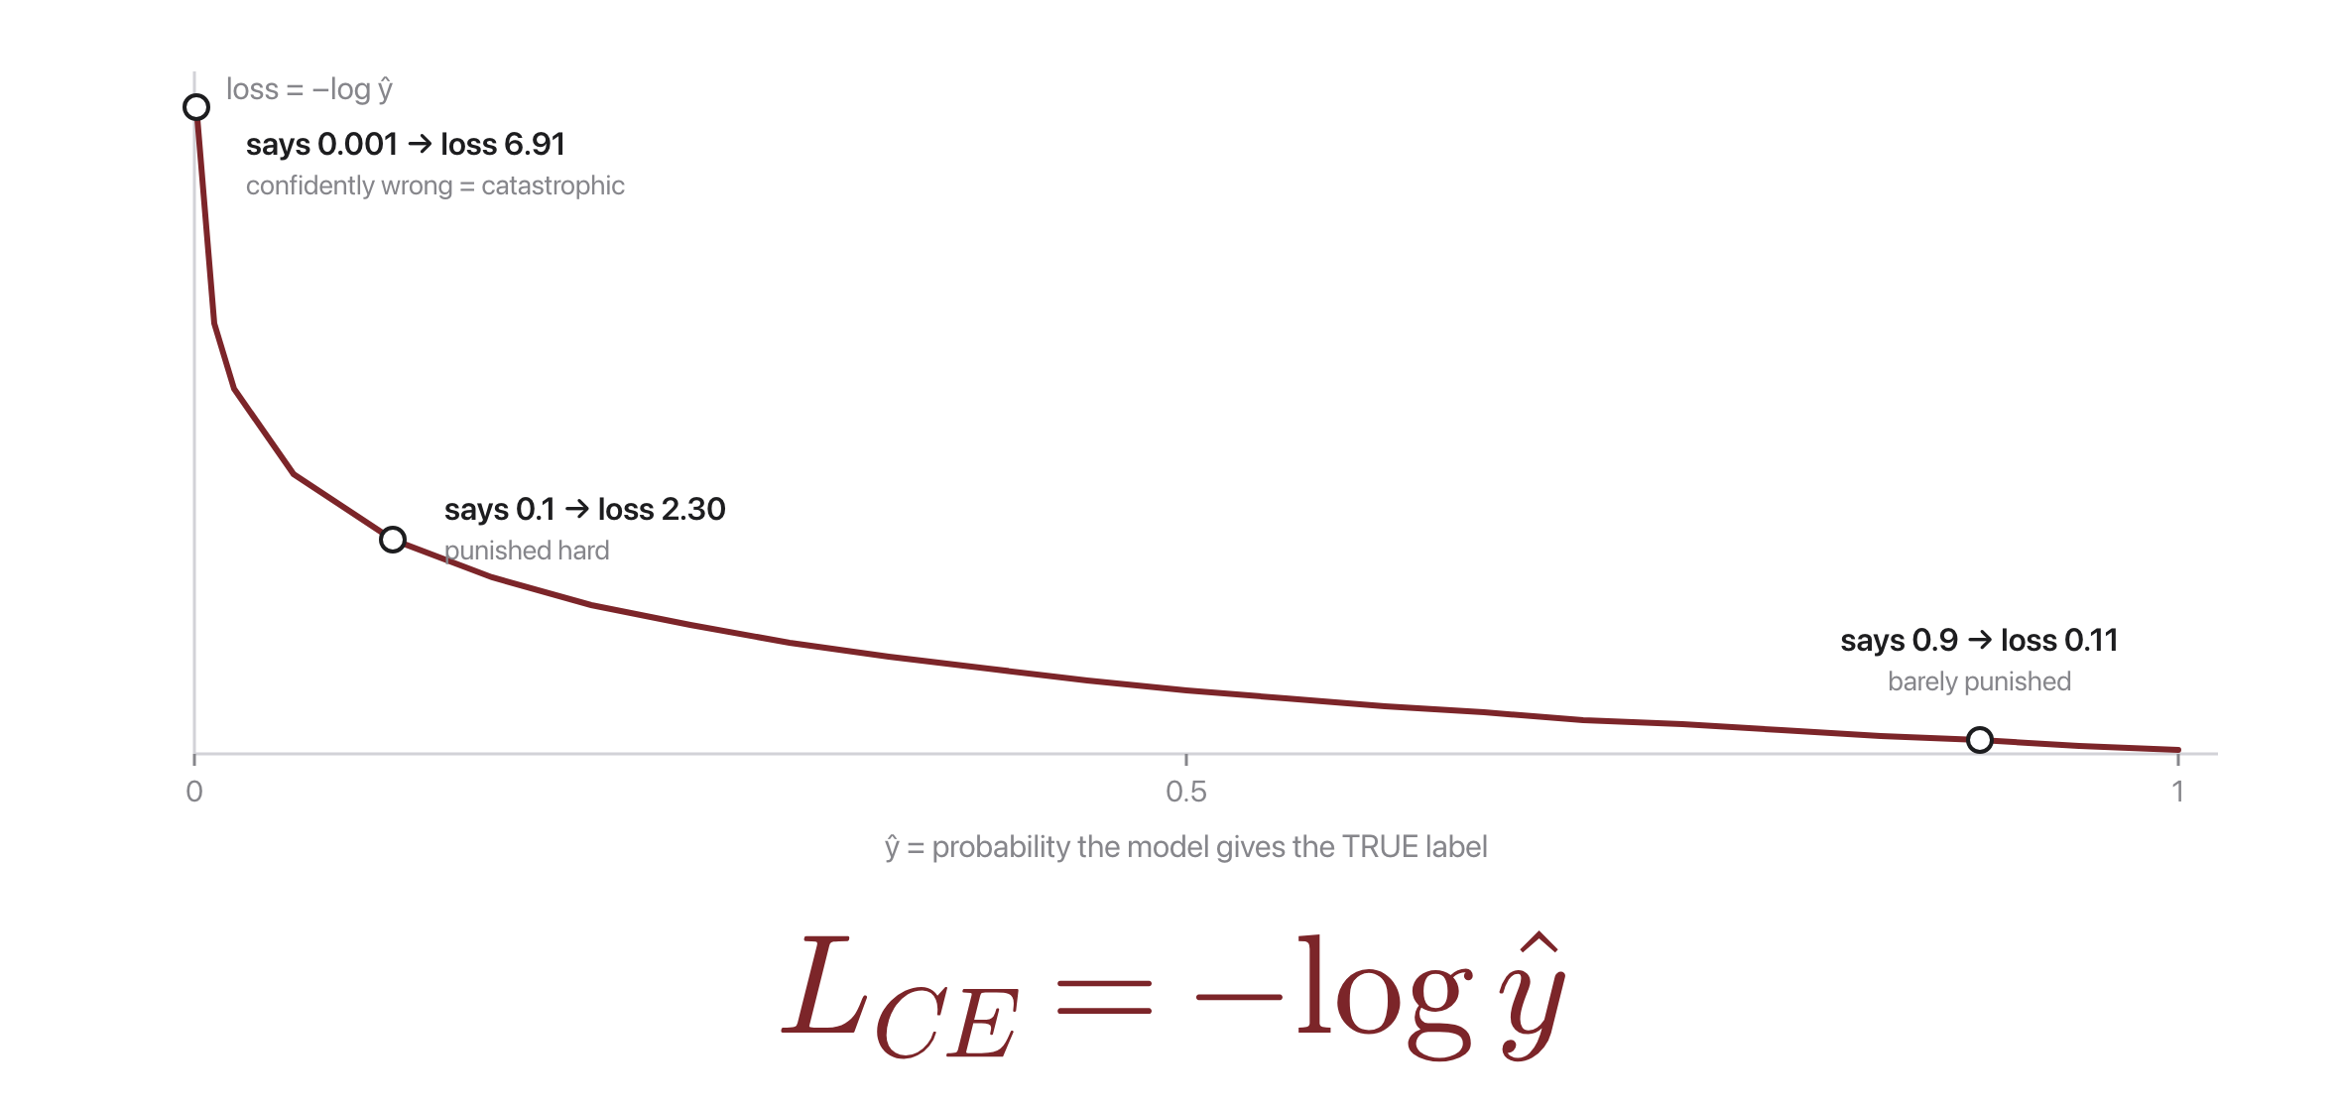
One example, one number
Source: Jurafsky & Martin, SLP3 (Jan 2026 draft), Ch. 4.5, cross-entropy loss

Slide 17
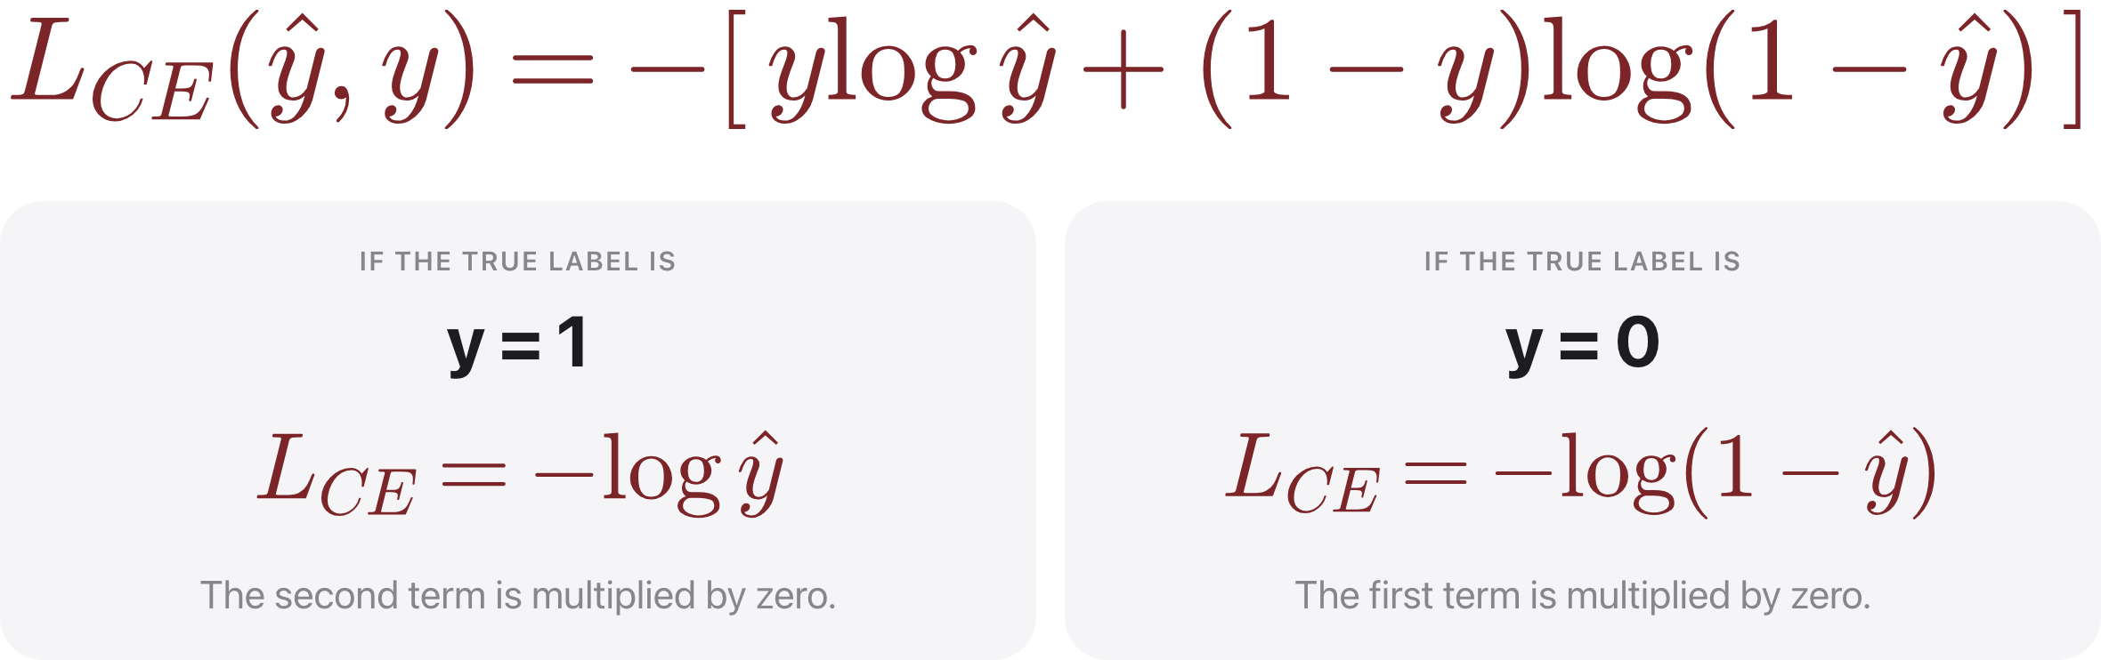
The two-class form
Source: original figure

Slide 18
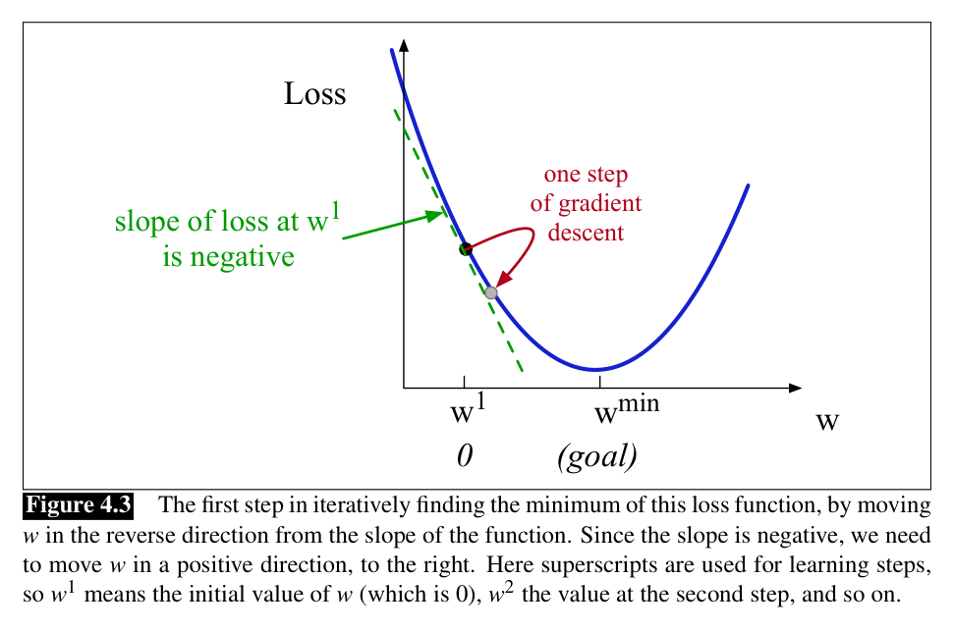
Learning = rolling downhill on the loss
Source: Jurafsky & Martin, SLP3 (Jan 2026 draft), Fig. 4.3

Slide 19
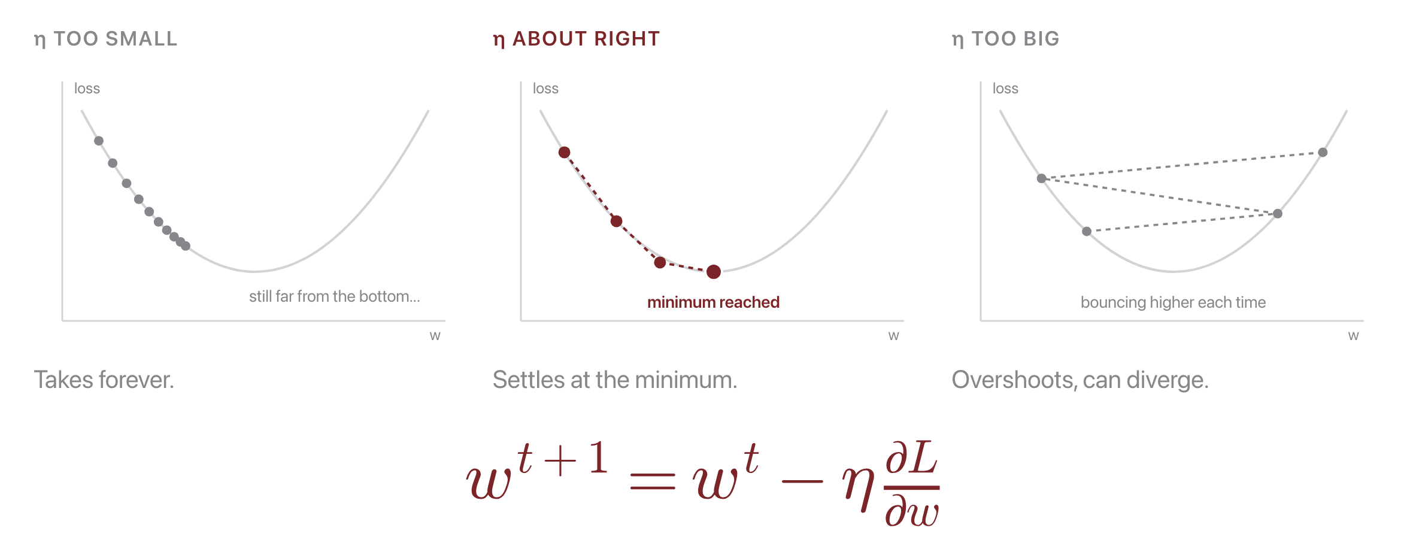
The learning rate sets the step size
Source: original figure; Jurafsky & Martin, SLP3 (Jan 2026 draft), Ch. 4.6

Slide 20
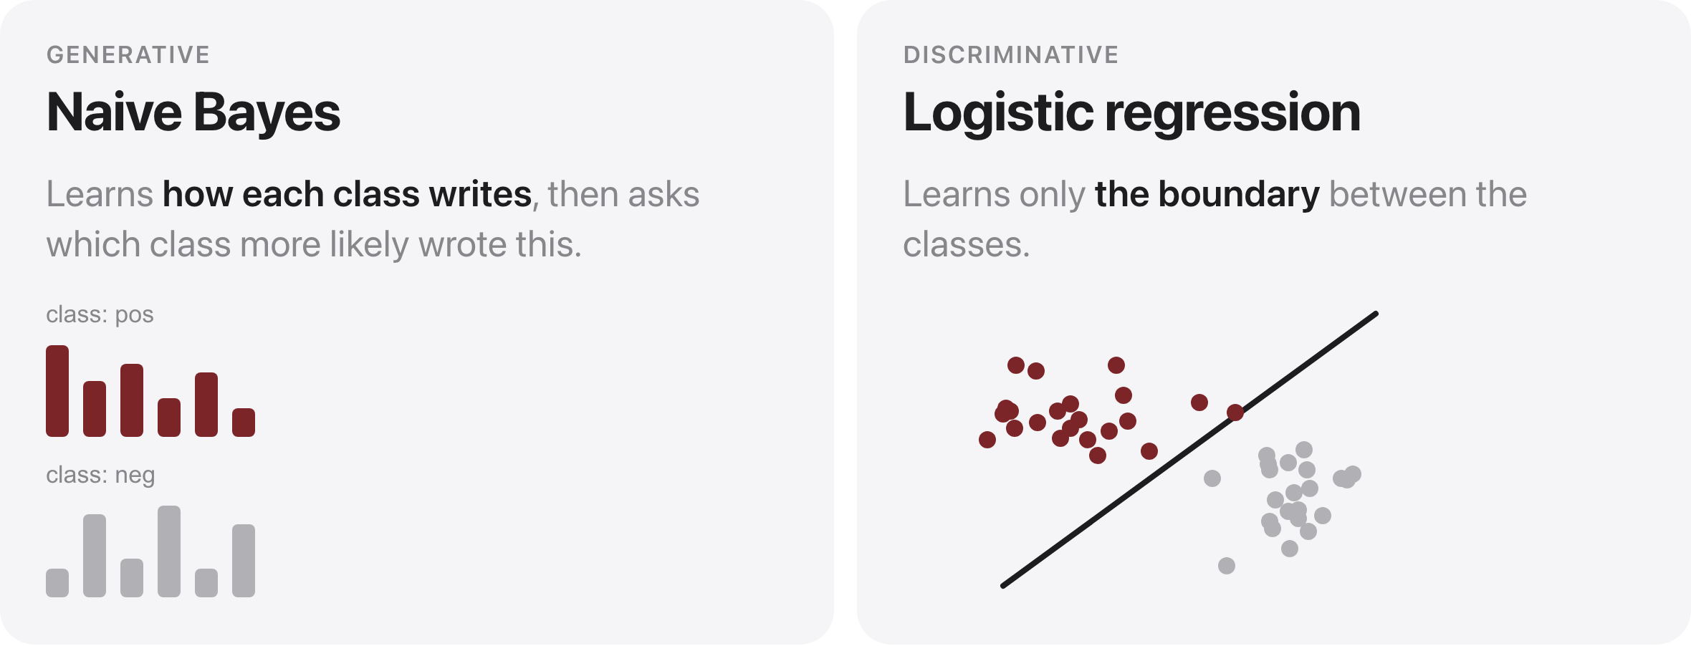
NB vs. logistic regression
Source: original figure

Slide 21
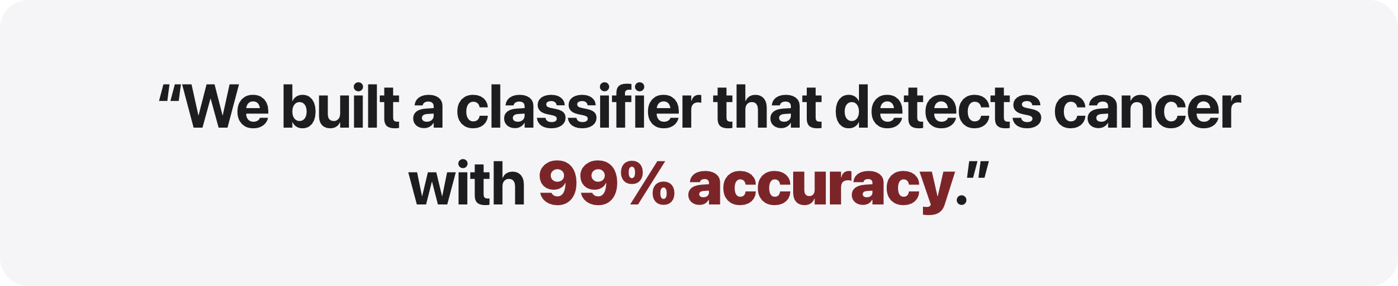
What is wrong with this sentence?
Source: original figure

Slide 22
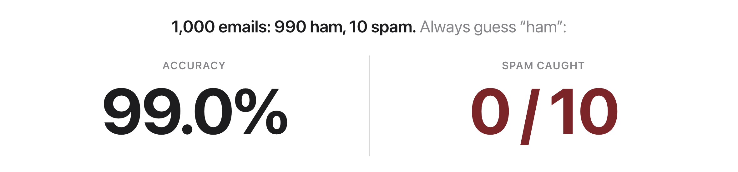
Accuracy hid the only case that mattered
Source: original figure

Slide 23
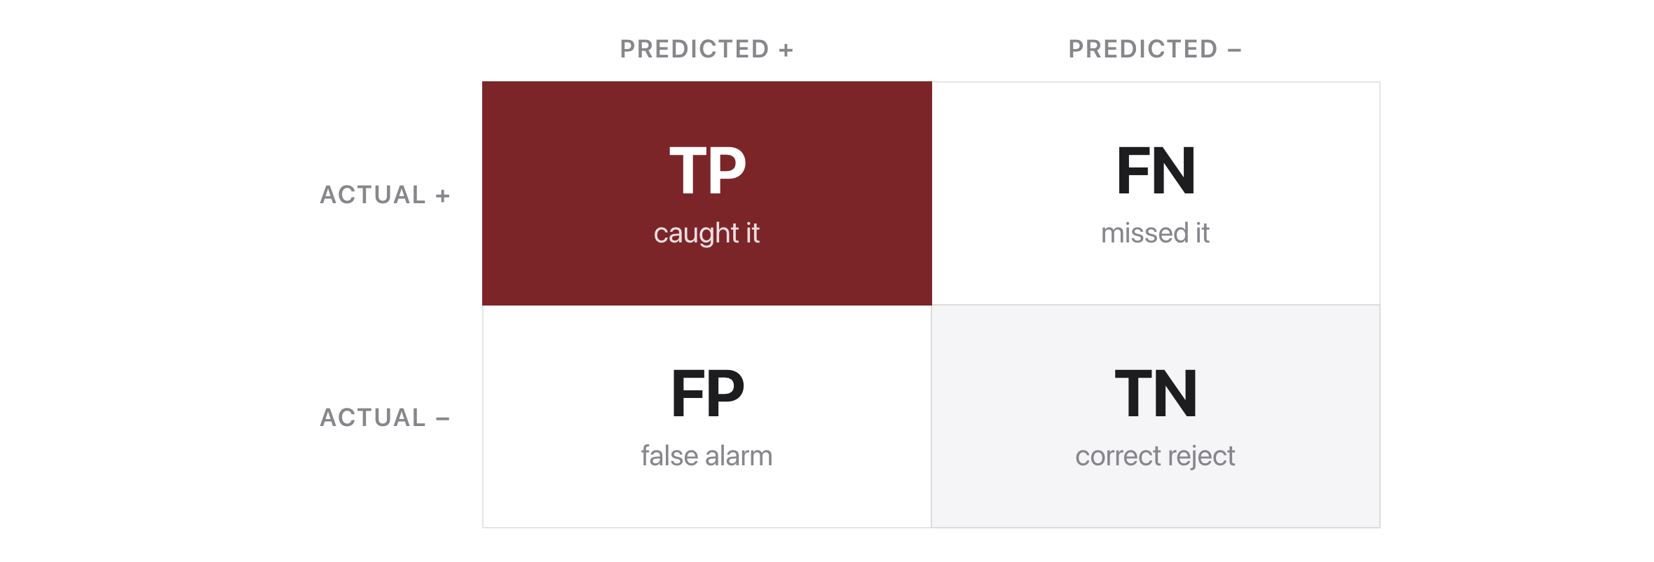
The confusion matrix
Source: original figure

Slide 24
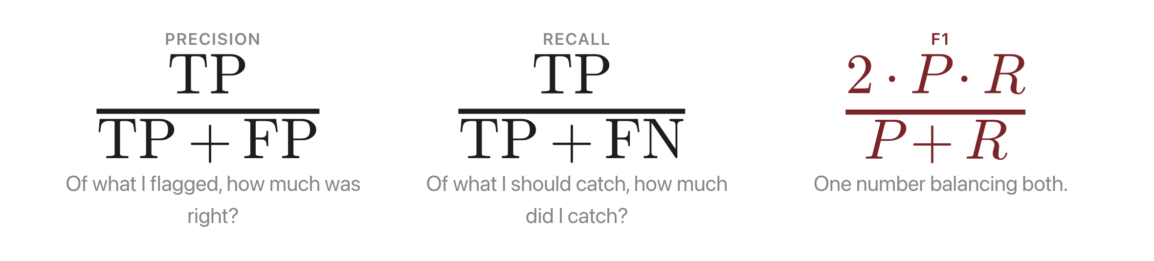
Precision, recall, F1
Source: original figure

Slide 25
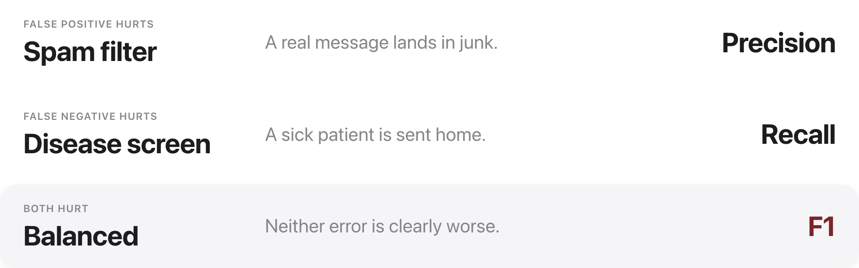
Which metric matters?
Source: original figure

Slide 26
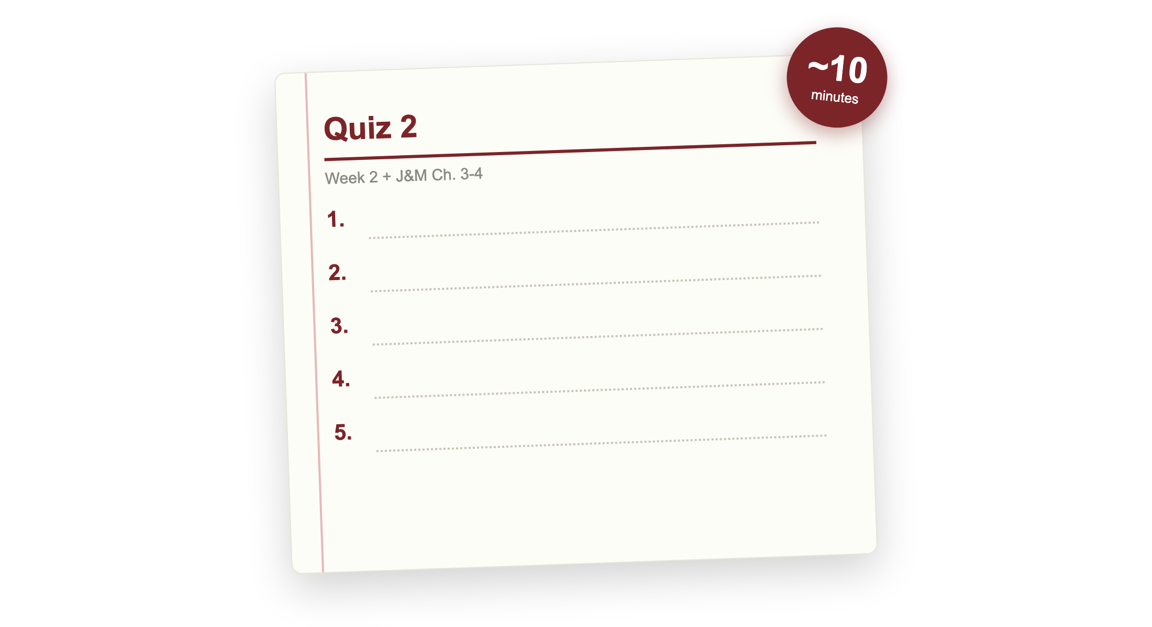
Quiz 2 (paper)
Source: original figure

Slide 27

Break
Source: original figure

Slide 28
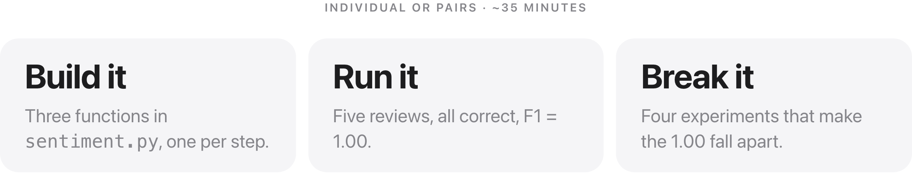
Sentiment Showdown
Source: weeks/week-02/class-02/exercise/sentiment.py

Slide 29
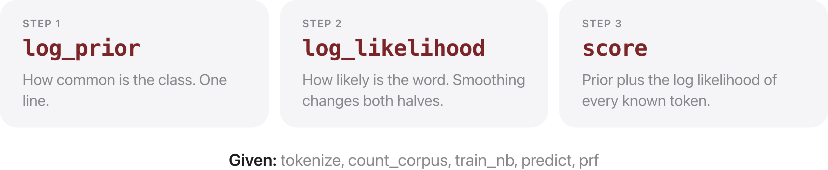
Three functions to write
Source: weeks/week-02/class-02/exercise/sentiment.py

Slide 30
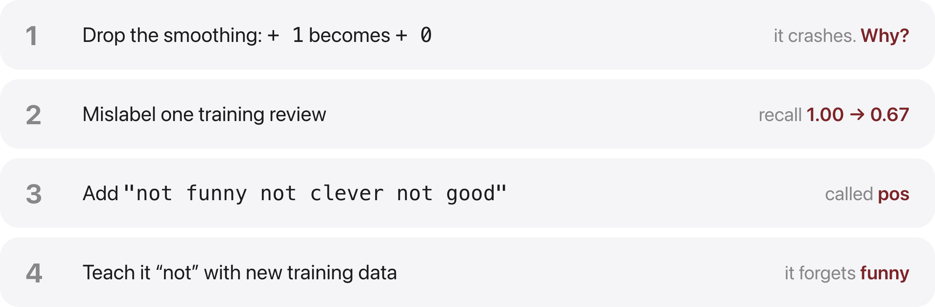
Then break it
Source: weeks/week-02/class-02/exercise/sentiment.py

Slide 31
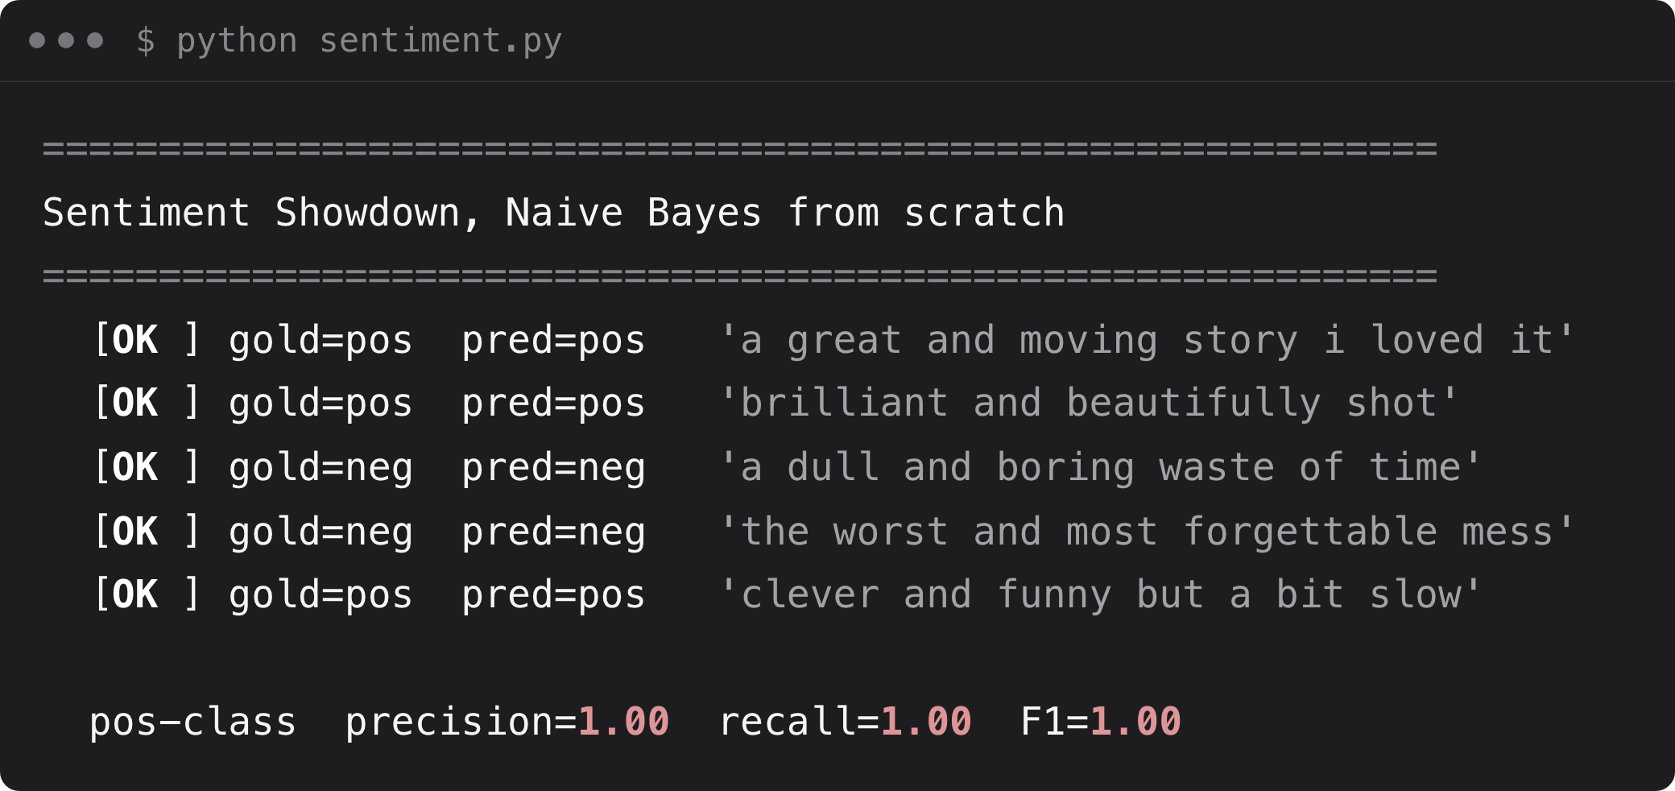
What you should see
Source: example run, solutions/sentiment.py

