Slide 1
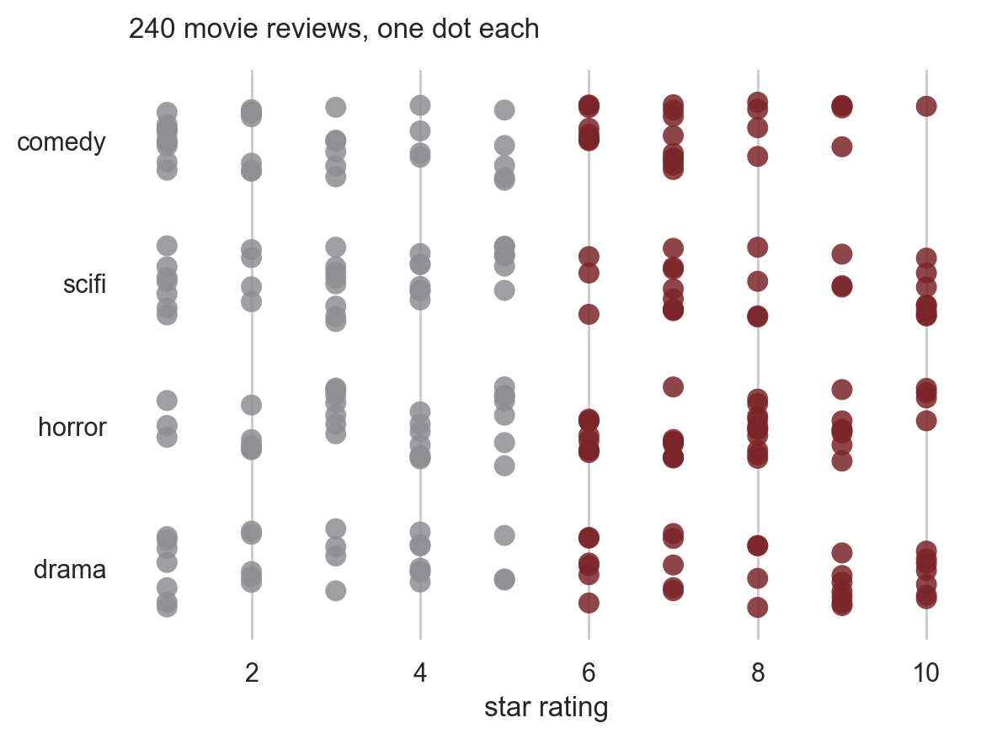
CSCI 3495
Data Science for NLP
Natural Language Processing & Large Language Models
Week 3, Class 1 · Wed Sep 9, 2026
Source: original figure, drawn from the course corpus of 240 reviews

Slide 2
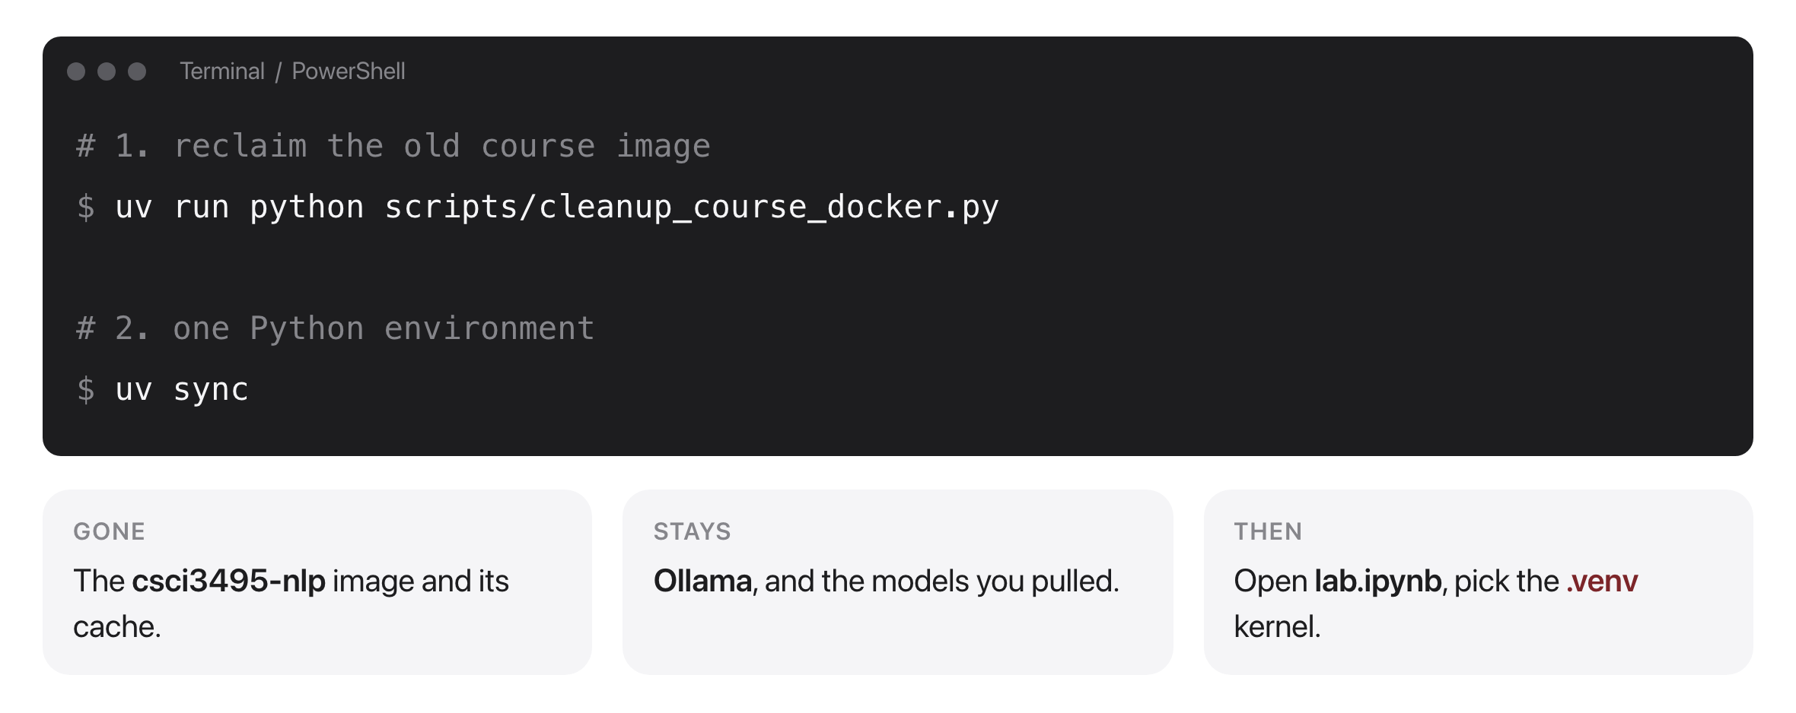
One environment for the whole term
Source: original figure; scripts/cleanup_course_docker.py

Slide 3
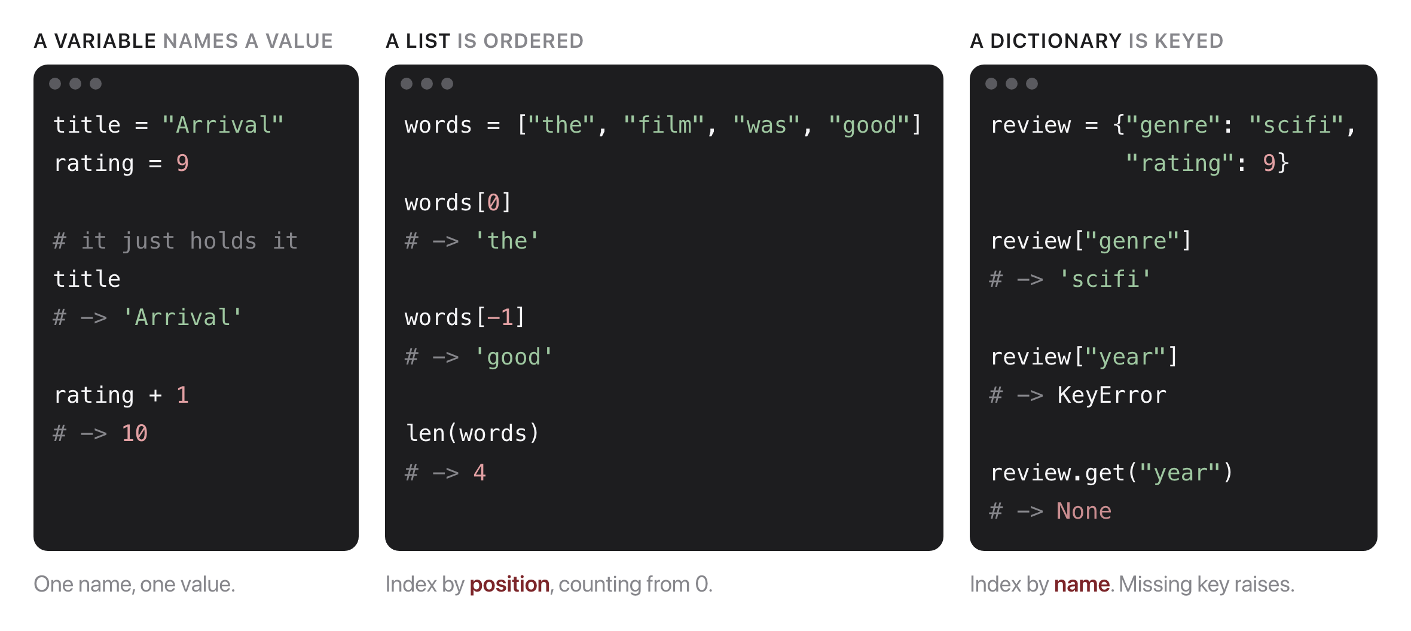
Python, in one slide
Source: original figure

Slide 4
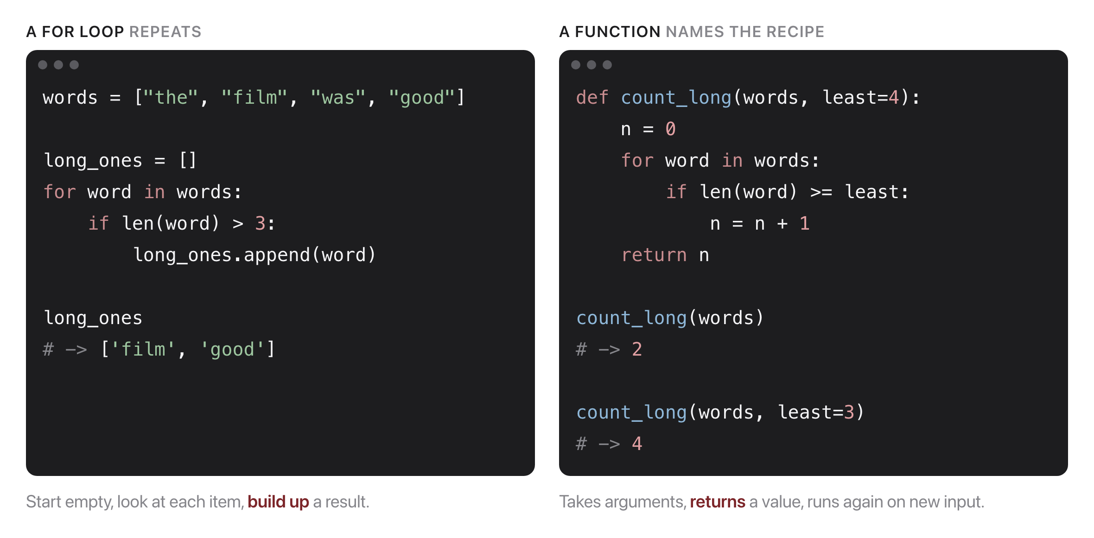
Two things you do with them
Source: original figure

Slide 5
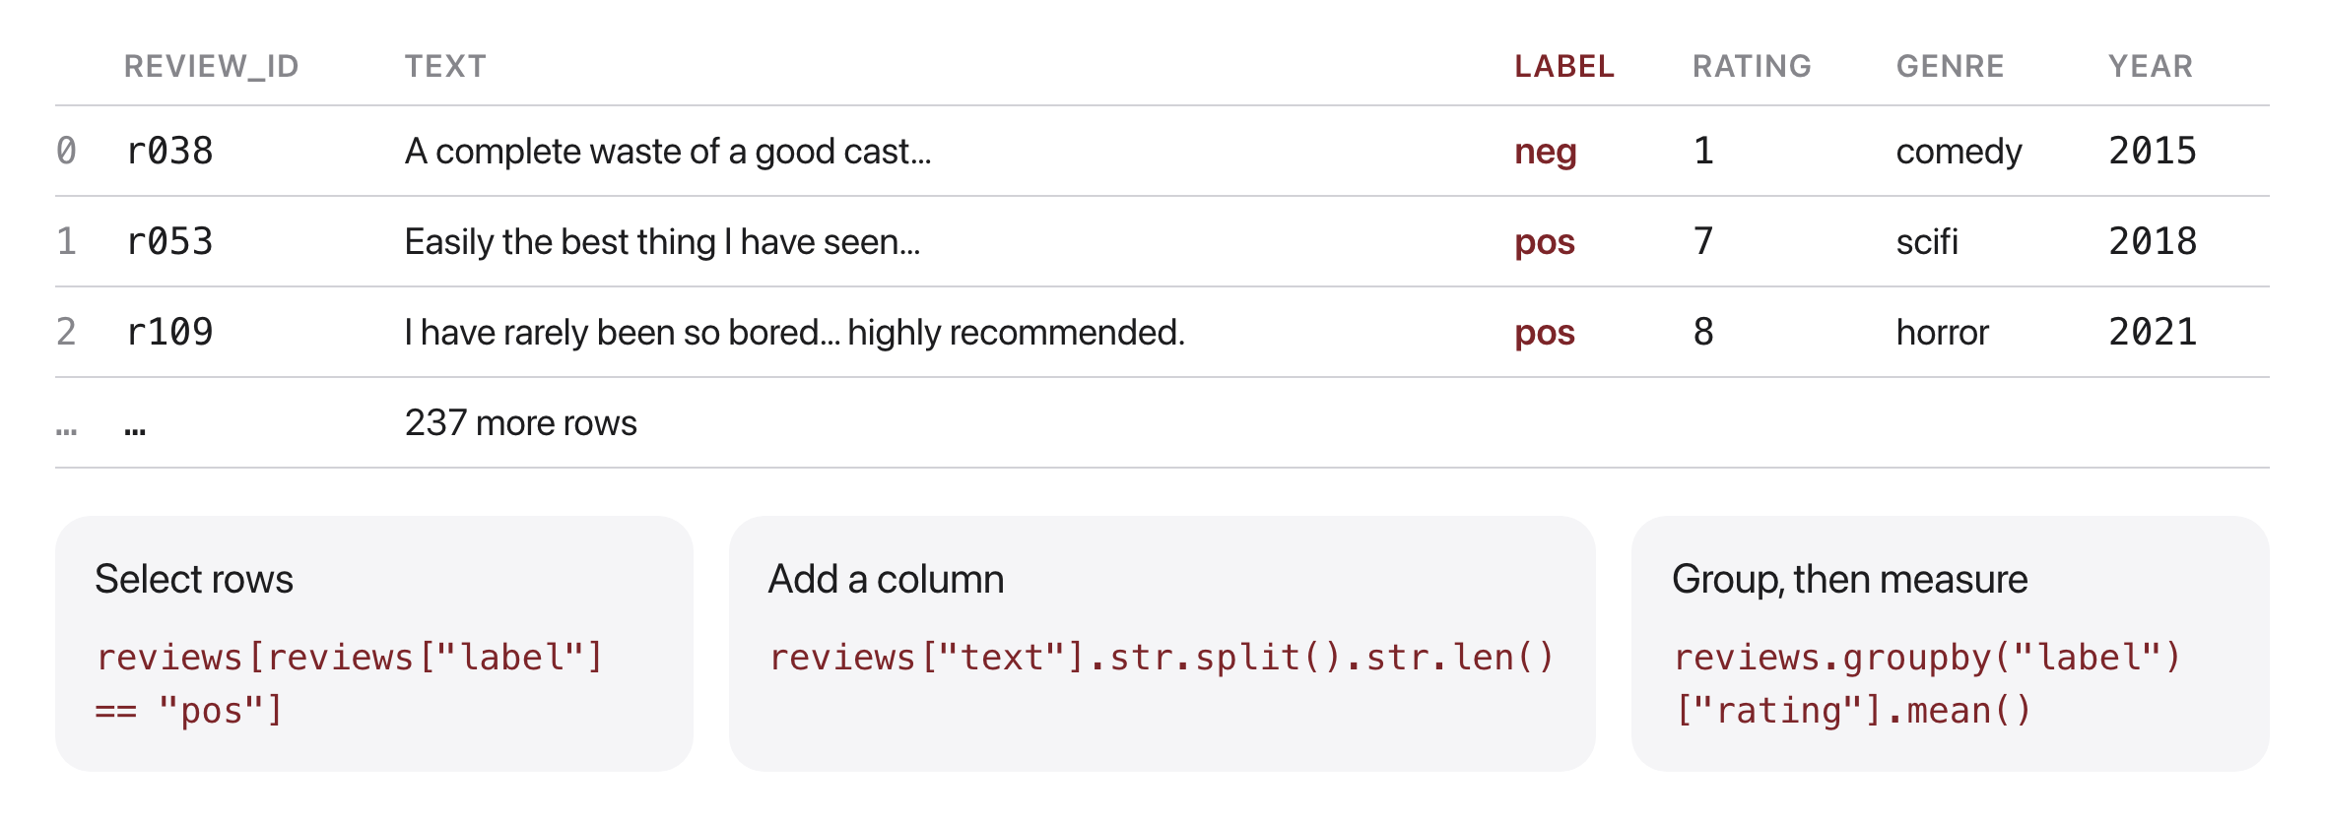
A DataFrame answers questions
Source: original figure; data from the course corpus

Slide 6
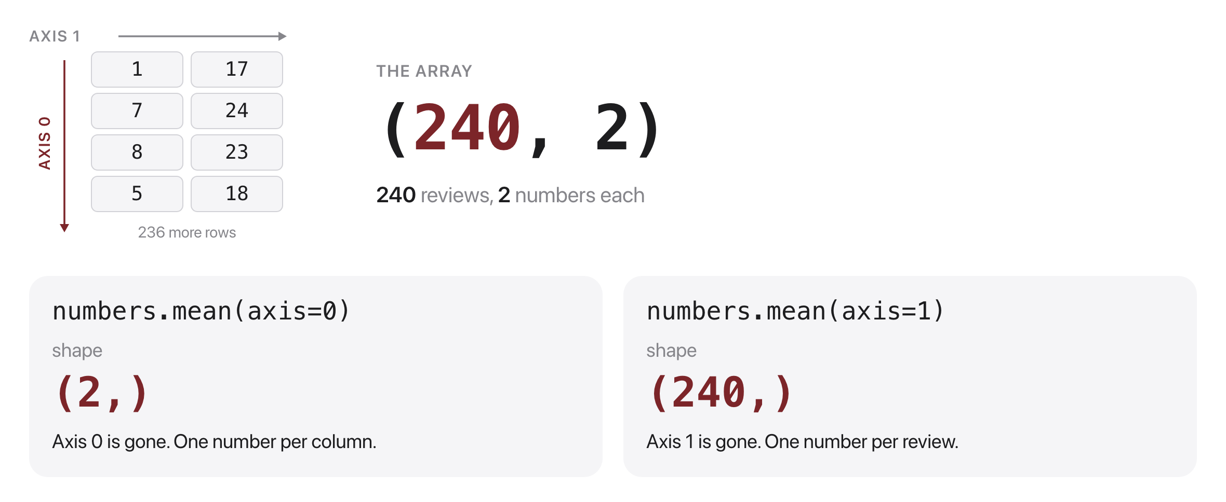
The axis you name is the one that disappears
Source: original figure

Slide 7
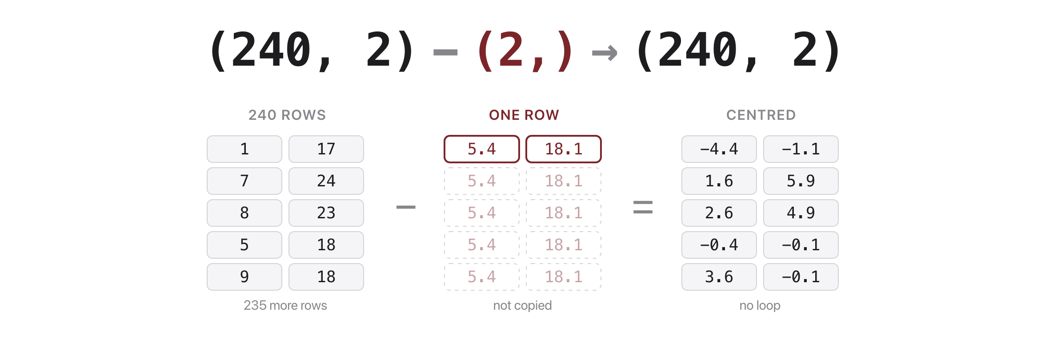
Broadcasting writes the loop for you
Source: original figure

Slide 8
Let's walk through Parts 1 and 2 in the notebook
Load it, filter it, group it.

Slide 9
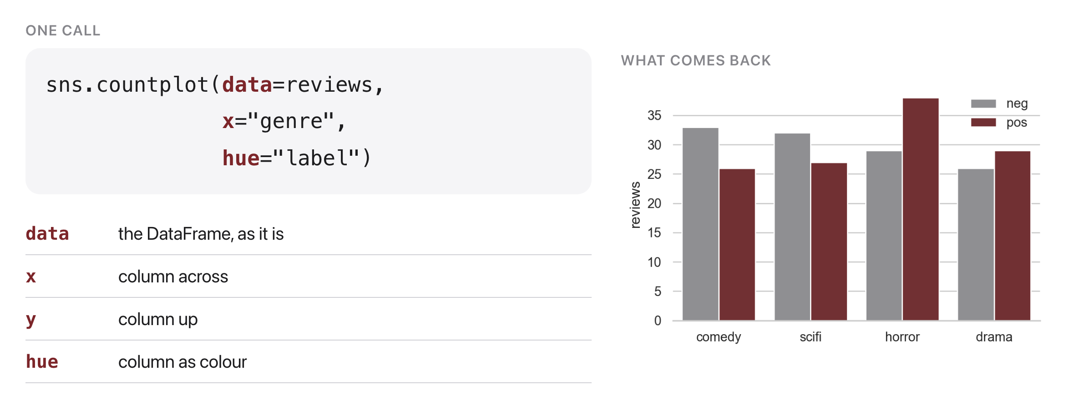
Name the columns, seaborn draws
Source: original figure; seaborn 0.13, data from the course corpus

Slide 10
Let's walk through Part 3 in the notebook
Four charts, four lines.

Slide 11
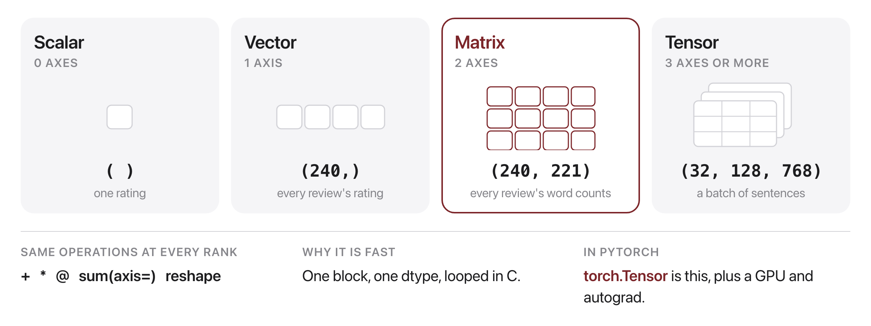
One library, any number of axes
Source: original figure

Slide 12
Let's walk through Part 4 in the notebook
Shape, axis, broadcasting, masking.

Slide 13
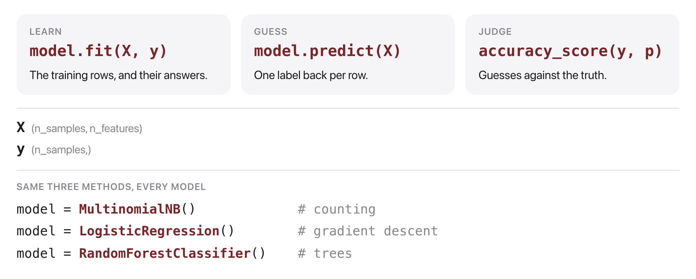
Every model: fit, predict, score
Source: original figure; scikit-learn 1.9

Slide 14
Let's walk through Part 5 in the notebook
Split, vectorize, train, read the mistakes.

Slide 15

Break
Source: course-standard break figure

Slide 16
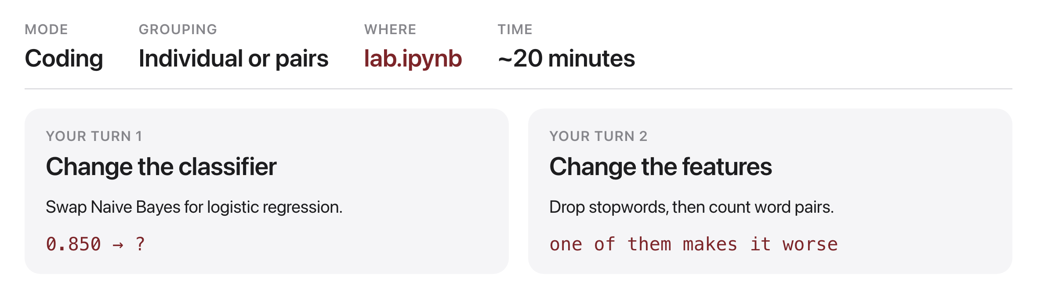
Your turn
Source: original figure

