Slide 1
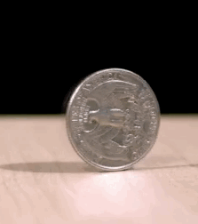
CSCI 3495
Probability for NLP
Natural Language Processing & Large Language Models
Week 4, Class 1 · Mon Sep 14, 2026
Source: original figure

Slide 2

What is Probability?

Slide 3
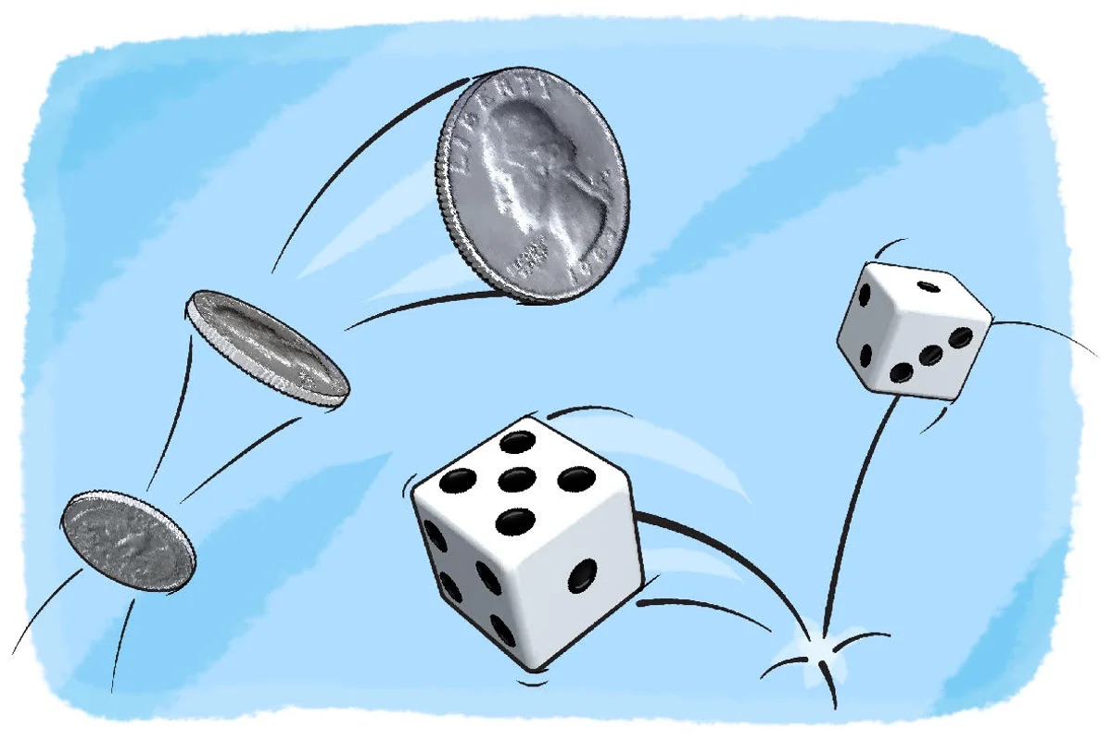

Slide 4
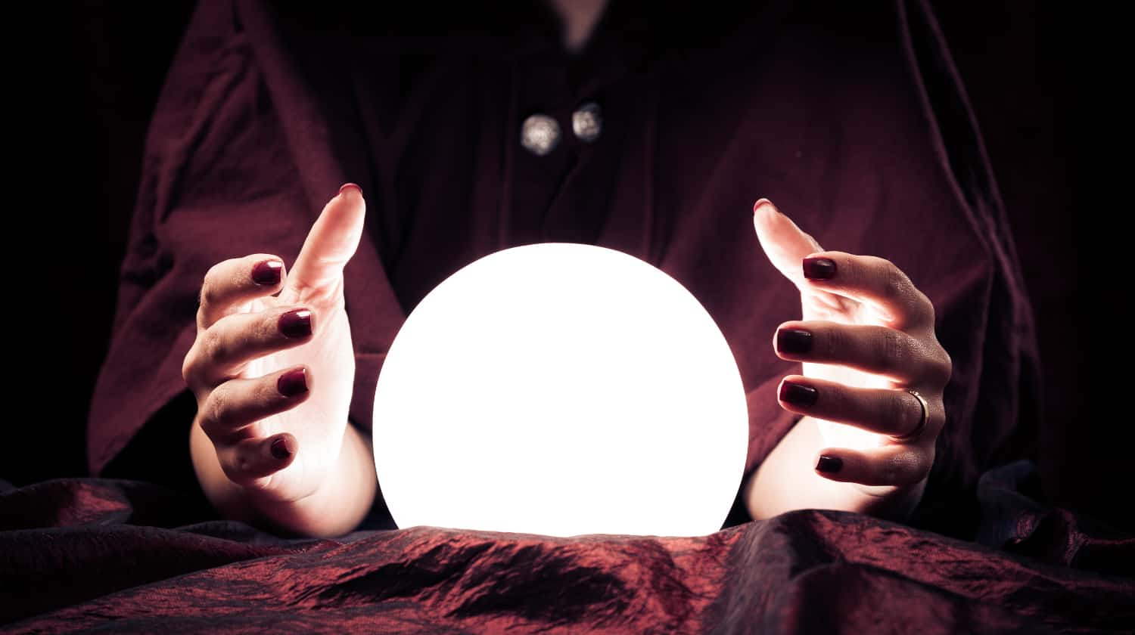

Slide 5
Every one of these is a count, divided
PROBABILITY
P(A) = count(A) / N
AND
P(A ∩ B)
OR
P(A ∪ B) = P(A) + P(B) - P(A ∩ B)
GIVEN
P(A | B) = P(A ∩ B) / P(B)
CHAIN RULE
P(A ∩ B) = P(A | B) P(B)
INDEPENDENCE
P(A ∩ B) = P(A) P(B)
BAYES'S RULE
P(A | B) = P(B | A) P(A) / P(B)
TOTAL PROBABILITY
P(B) = P(B|A) P(A) + P(B|¬A) P(¬A)
Source: original figure

Slide 6
Probability Example: Twenty app reviews
 | HAS "CRASHES" | NO "CRASHES" | TOTAL
1 star | 7 | 3 | 10
4-5 star | 1 | 9 | 10
total | 8 | 12 | 20
FOUR OF THE TWENTY
1 STAR crashes every time I open it
1 STAR unusable since the update
4 STAR much faster since the update
5 STAR fast, and it never crashes
Source: original figure

Slide 7
How would you compute each of these?
1
P(1 star), P(crashes), P(crashes ∩ 1 star)
2
P(crashes ∪ 1 star)
3
P(1 star | crashes) and P(crashes | 1 star)
4
Is P(crashes ∩ 1 star) = P(crashes) × P(1 star)?
5
"update" is in 10, five of them 1 star. Same question as Q4.
6
Flagger catches 80% of 1 star, 20% of the rest. P(1 star | flagged)?
Source: original figure

Slide 8

Break
Source: course-standard break figure

Slide 9
Twenty messages, counted
 | HAS "FREE" | NO "FREE" | TOTAL
spam | 5 | 3 | 8
ham | 1 | 11 | 12
total | 6 | 14 | 20
FOUR OF THE TWENTY
SPAM claim your free prize
SPAM urgent: verify your account
HAM free parking in lot B this week
HAM can we move the meeting
Source: original figure

Slide 10
Six problems, in teams
1
P(spam), P(free), P(free ∩ spam)
2
P(free ∪ spam)
3
P(spam | free) and P(free | spam)
4
Is P(free ∩ spam) = P(free) × P(spam)?
5
"meeting" is in 5, two of them spam. Same question as Q4.
6
Filter flags 90% of spam, 10% of ham. P(spam | flagged)?
Source: original figure

Slide 11
If you finish early
THE WHOLE CORPUS
the cat sat
the cat ran
the dog sat
a cat sat
WORK OUT
P(the cat sat)
= P(w1) × P(w2 | w1) × P(w3 | w2)
Source: original figure

