Slide 1

CSCI 3495
How scary is it?
Boo!
Natural Language Processing & Large Language Models
Week 4, Class 2 · Wed Sep 16, 2026
Source: original figure, the loss from the run we do in class

Slide 2
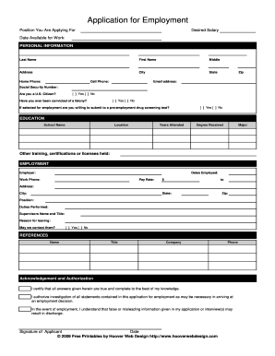

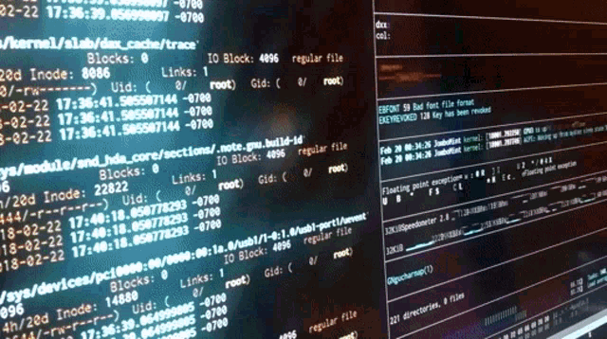

Slide 3


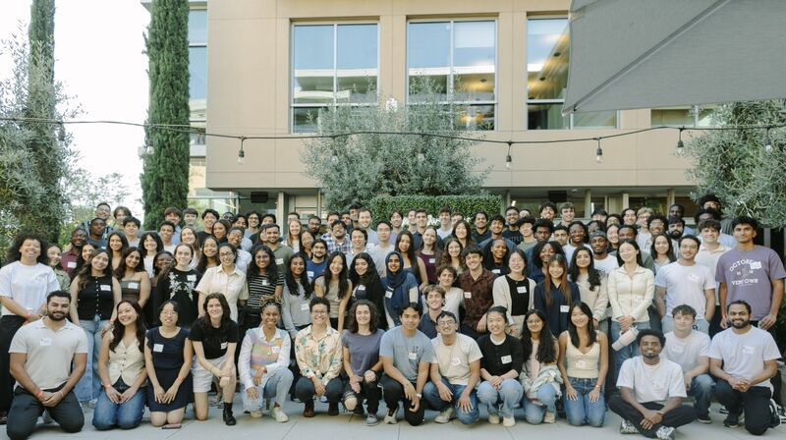


🎊
🎉
🎉
🎉

Slide 4
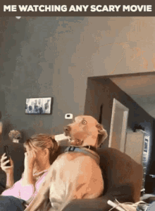
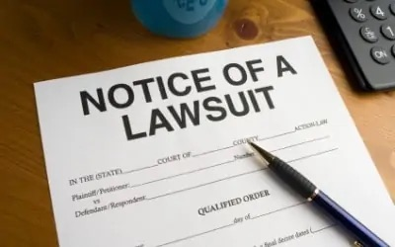
Ohh No!!!!
Netflix users are filing lawsuits cause Netflix is recommending too scary movies.

Slide 5

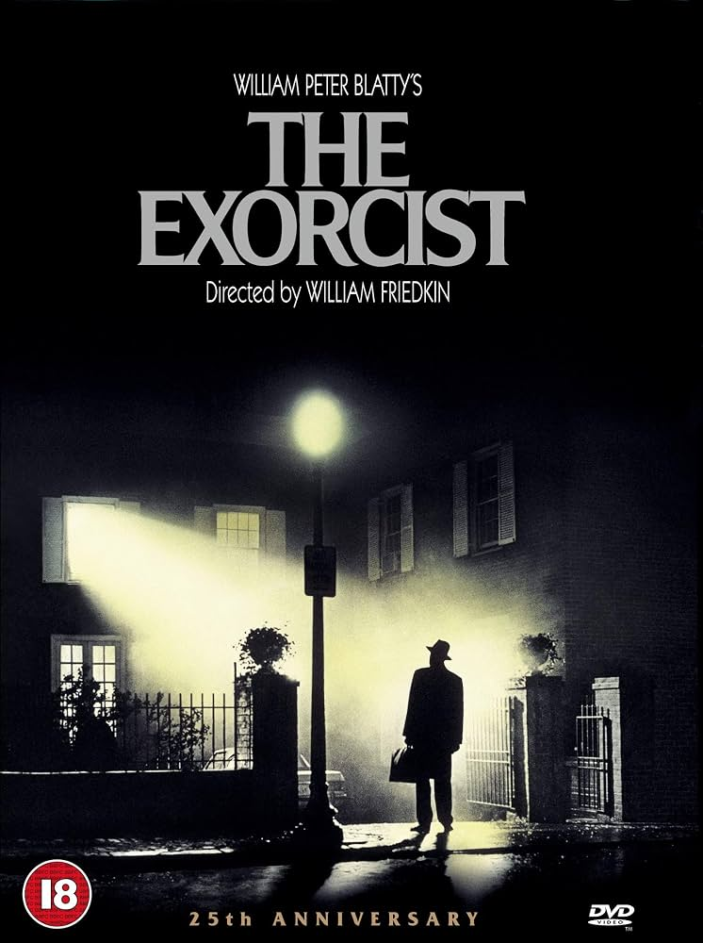

Your first assignment:
Detect the scariness of movies based on move reviews

Slide 6
Example Reviews
LOW SIGNAL, 2012
"The score is chilling and never lets up. That long hallway shot is unsettling. I found the whole thing terrifying. The sound design alone is ominous. The third act is gory."
9.6 out of 10
SALT CHAPEL, 2015
"It gets silly once the twist lands. A tame retread of better films. Every beat is predictable. The third act is brutal. Ninety minutes, no padding."
1.6 out of 10
Source: two films from the course corpus

Slide 7
A list of adjectives is a feature extractor
"The score is chilling and never lets up. That long hallway shot is unsettling. I found the whole thing terrifying. The sound design alone is ominous. The third act is gory."
FEAR
terrifying chilling eerie creepy unsettling haunting ominous sinister
4 found
GORE
gory bloody gruesome brutal grisly
1 found
DULL
boring predictable tedious silly tame
0 found
Source: the three word lists we use all session

Slide 8
Data Pipeline
REVIEWS
120 films
COUNTS
fear gore dull
TENSOR
120 x 3
SCARINESS
w . x + b
the loss blames w and b, and backward() works out by how much
Source: original

Slide 9
Linear Regression learns Dull Words
what one more word of each kind is worth
120 films, none of them held back
Source: the 200-step run in today's notebook

Slide 10

Break
Source: course-standard break figure

Slide 11
Your turn
THE TASK
comedy_reviews.csv
140 films, predict funniness.
THE RULE
funny.txt crude.txt flat.txt
Loss near 0.80. Judge it against 3.135.
Source: original

