Slide 1

CSCI 3495
Neural Networks for NLP
Natural Language Processing & Large Language Models
Week 5, Class 1 · Mon Sep 21, 2026

Slide 2
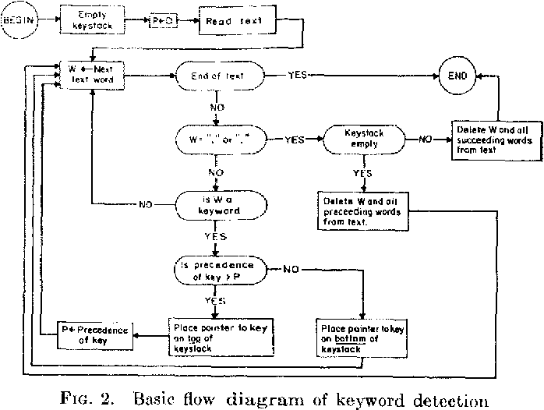
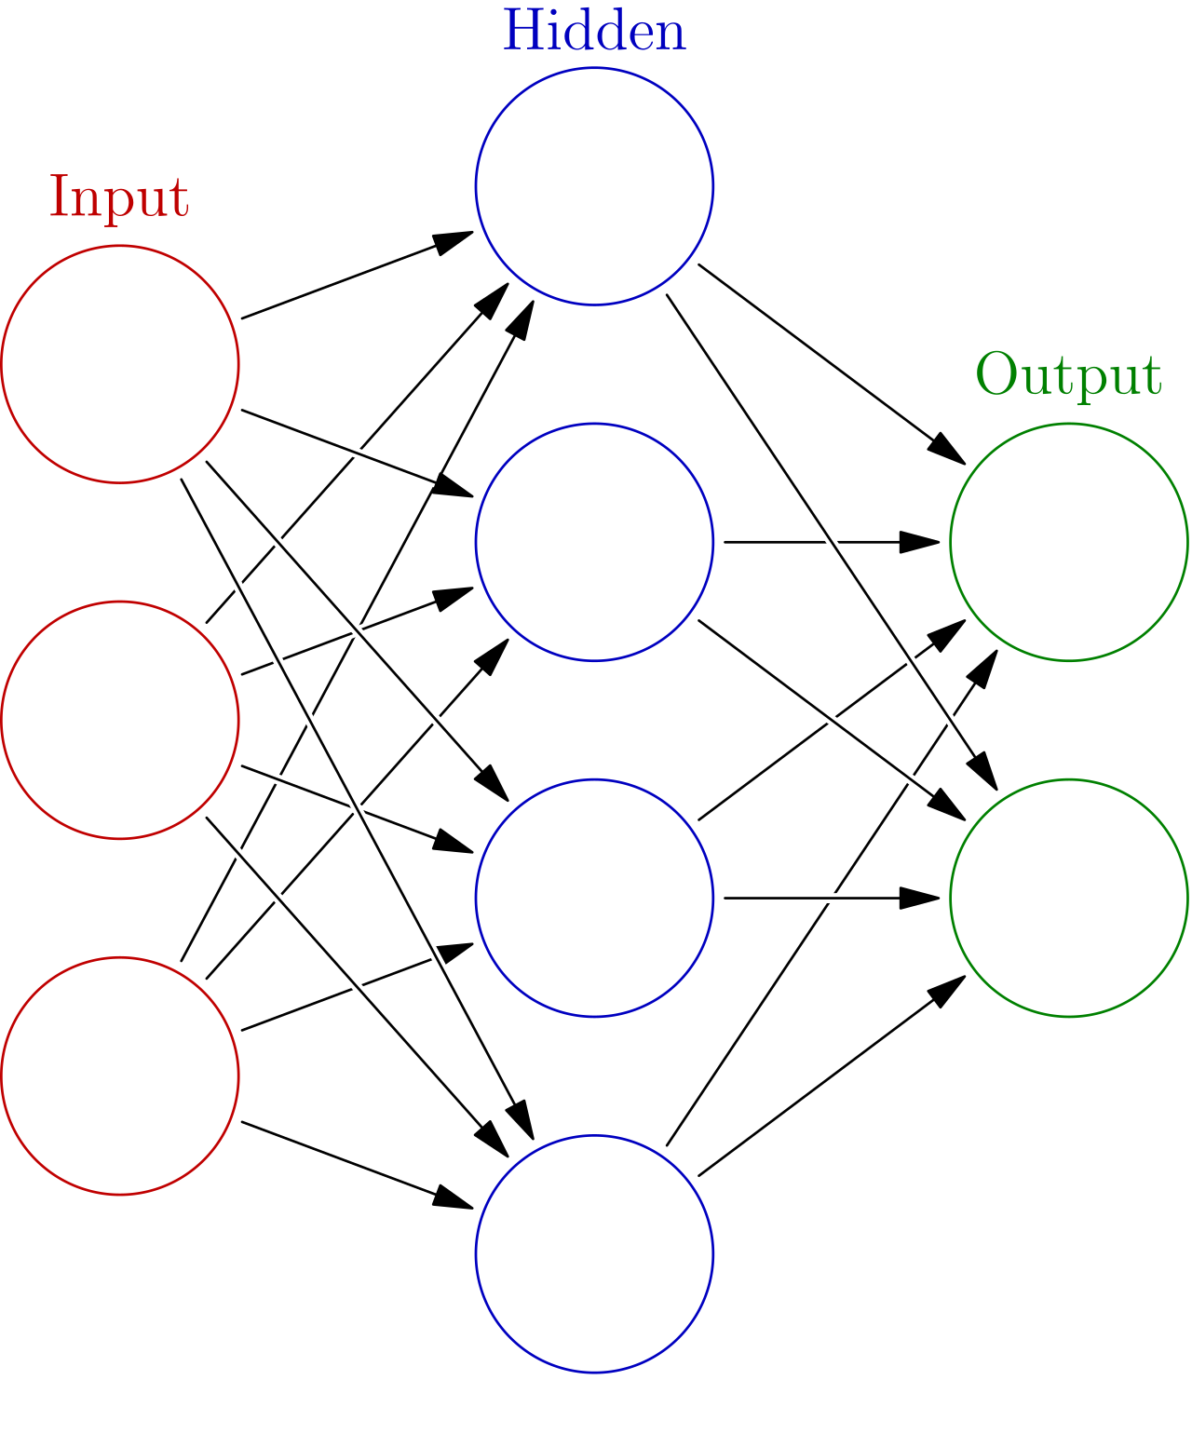
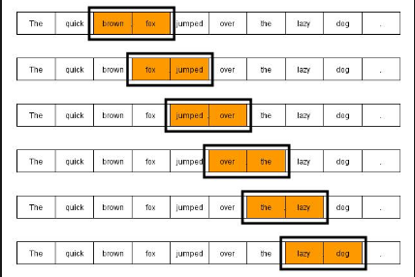
Recap
Rules-Based
Statistical N-gram
Neural Networks

Slide 3
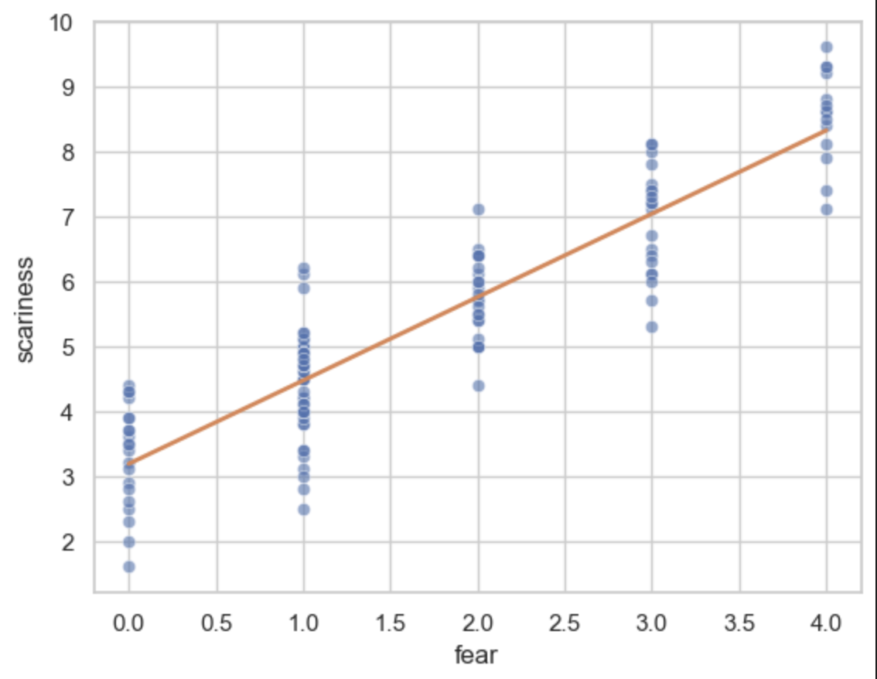
Last Week: Simple Linear Regression
Trained a simple y = mx + b model
Performed linear regression
Input: Human-Defined Features
Output: Scariness Rating (1-10)

Slide 4
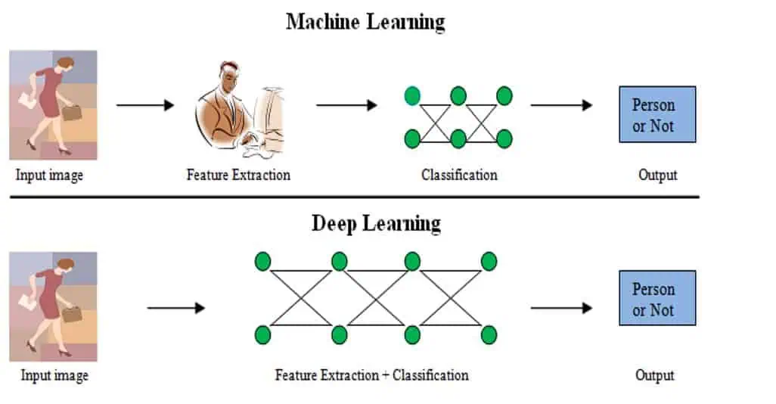
Feature Engineering vs Representation Learning

Slide 5
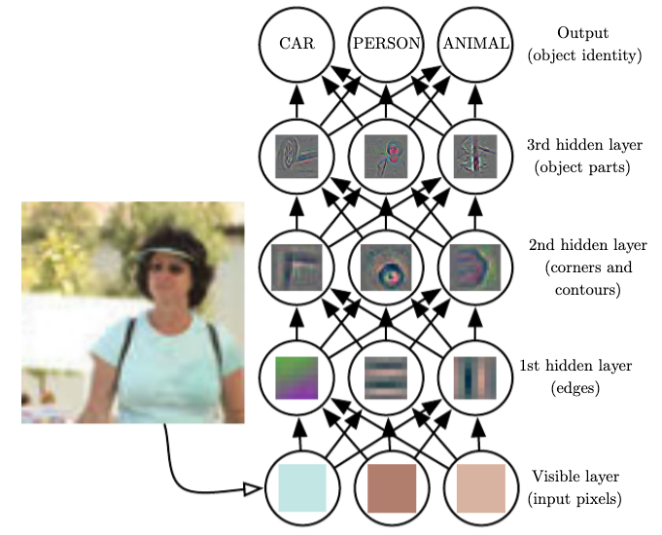
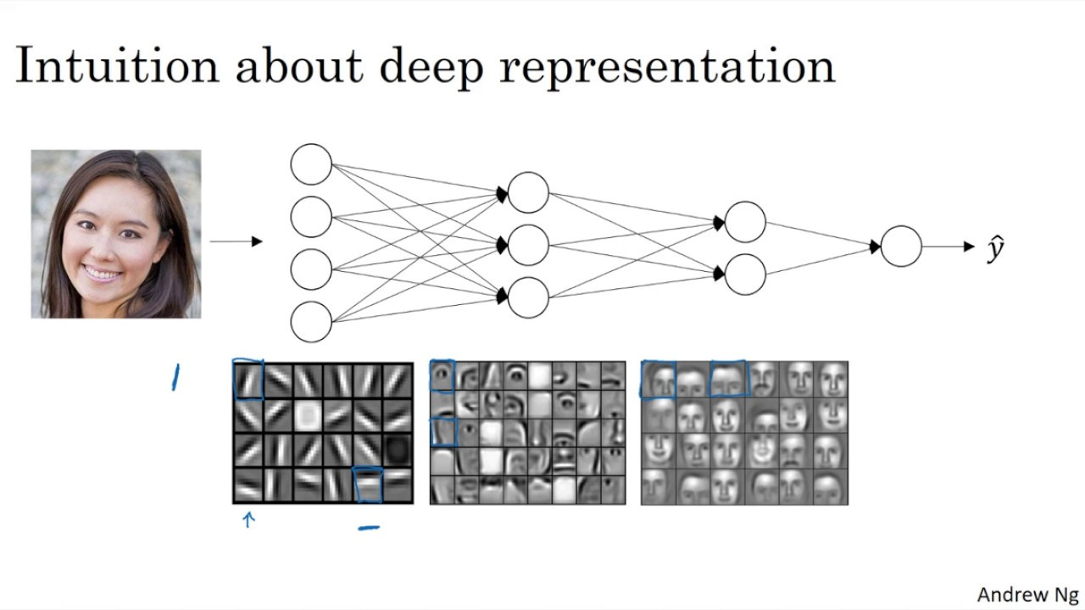
Feature Engineering vs Representation Learning

Slide 6
Why Neural Networks?
Neural networks are non-linear systems that are capable of learning complex non-linear relationships

Slide 7
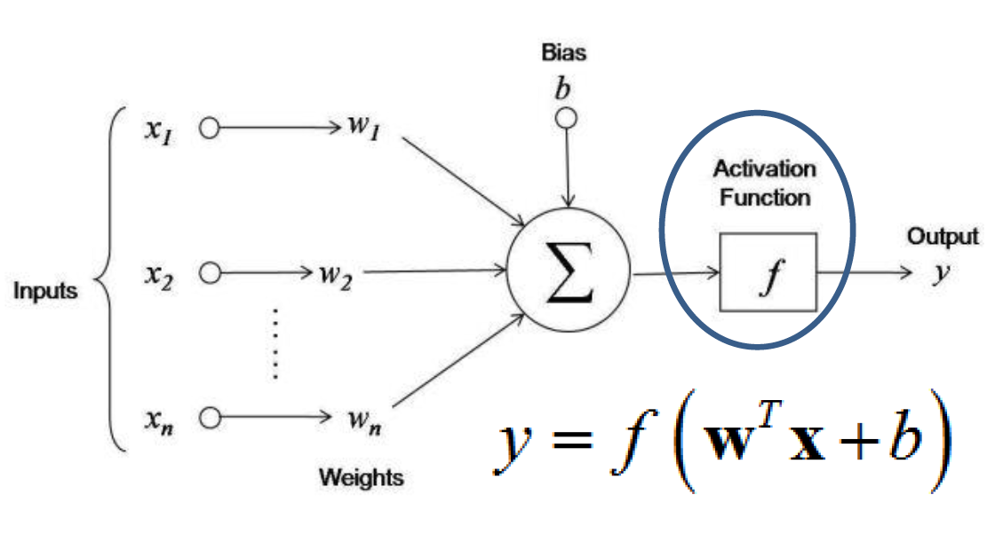
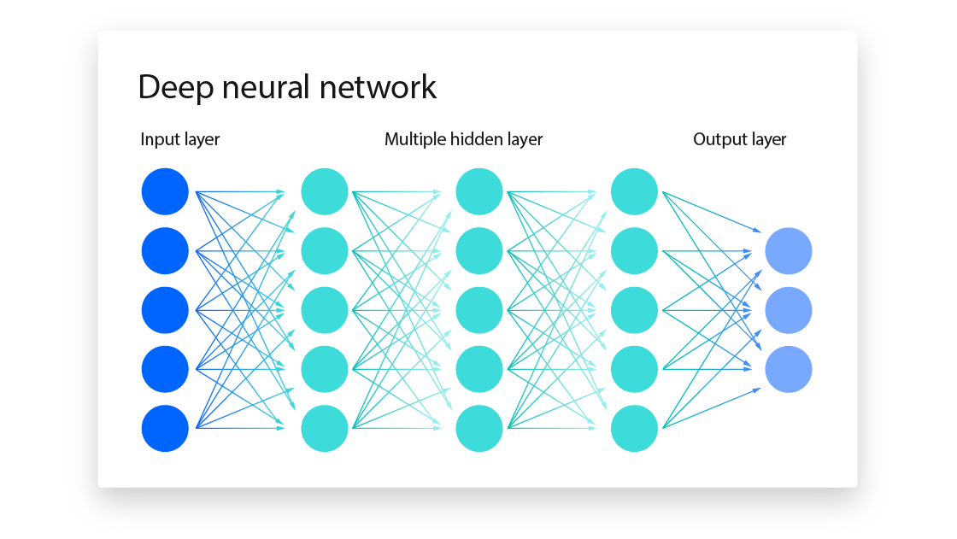
Neural Network

Slide 8
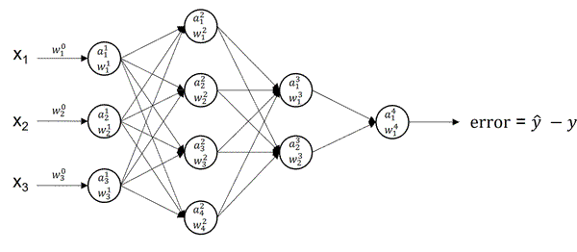
Forward and Back propagation

Slide 9
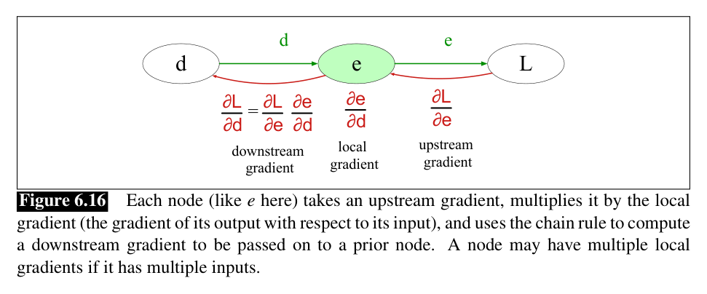
Backpropagation: Chain Rule

Slide 10
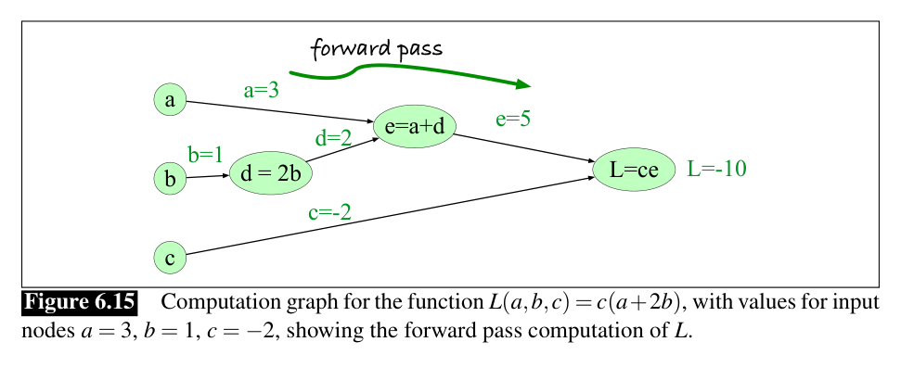
Backpropagation: Example

Slide 11
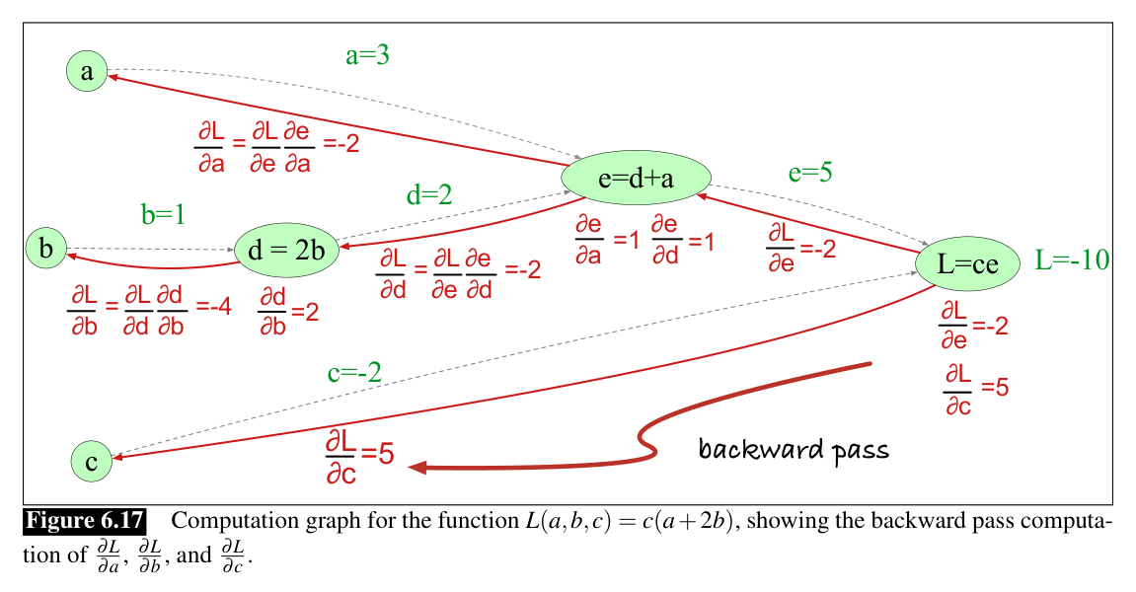
Backpropagation: Solution

Slide 12
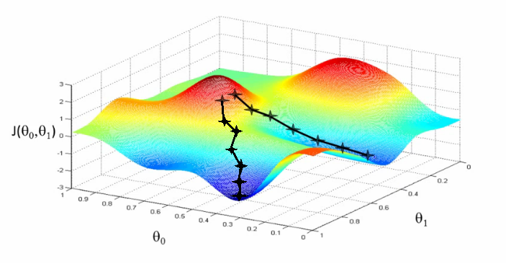

Loss & Gradient Descent
$L=loss(y, \hat{y})$
$w=w −α\frac{∂L}{∂w}$

Slide 13
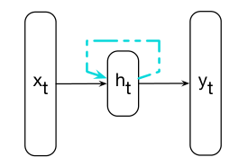
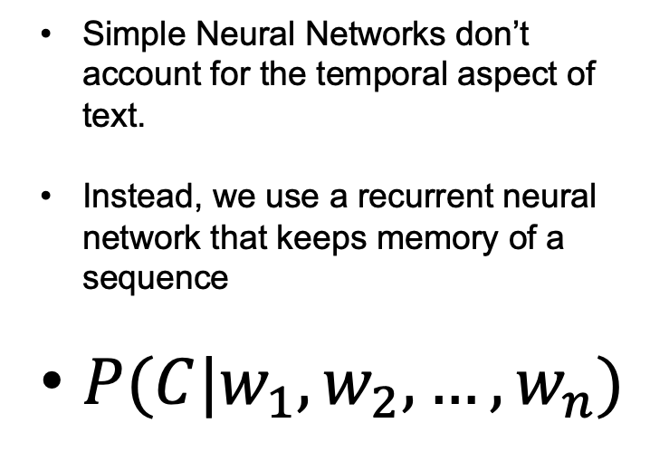
Sneak peak: Recurrent Neural Networks
Simple Neural Networks don’t account for the temporal aspect of text.
Instead, we use a recurrent neural network that keeps memory of a sequence
$P(C|w_{1},w_{2},…,w_{n})$

Slide 14
Let’s Code! Create a JNB File
Create this lab.ipynb within the exercise folder of the week-5/class-01

Slide 15

Break
Source: course-standard break figure

Slide 16

Work on Your Proposal
Source: original; the casebook in today's notebook

