Slide 1
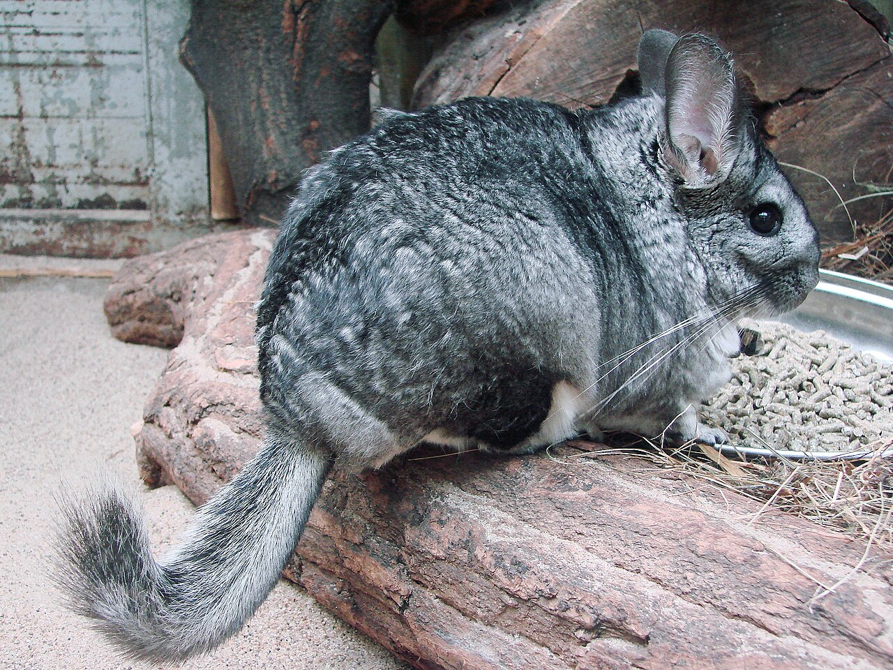
CSCI 3495
Scaling Laws & Emergent Abilities
Natural Language Processing & Large Language Models
Week 9, Class 2 · Wed Oct 21, 2026
Source: Guerin Nicolas, Wikimedia Commons, CC BY-SA 3.0

Slide 2
The central question
1
How does performance change as we scale?
2
For a fixed budget, what should we scale?
3
Do new abilities appear, or just smaller error?
Source: original figure

Slide 3
Three axes of scale
N, PARAMETERS
model size
the number of weights
D, DATA
training tokens
how much text it saw
C, COMPUTE
total FLOPs
roughly N x D
Source: original figure

Slide 4
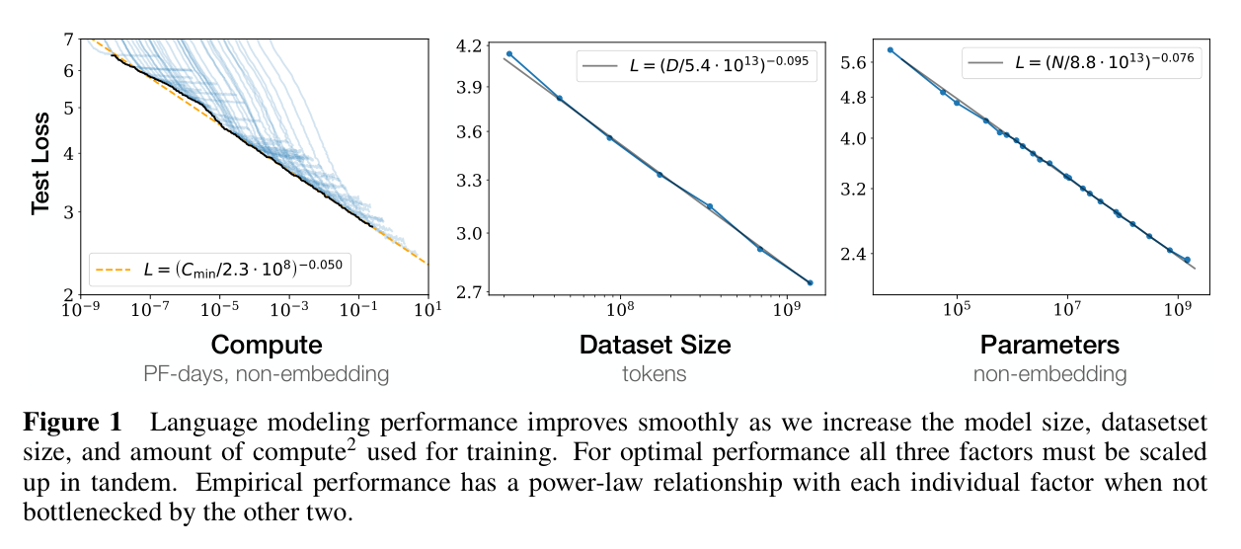
Scaling laws (Kaplan et al., 2020)
Source: Kaplan et al. 2020, "Scaling Laws for Neural Language Models" (arXiv:2001.08361), Fig. 1

Slide 5
Why power laws matter
1
Train a few small models, fit the curve, extrapolate
2
Plan the compute budget before spending the millions
3
Diminishing returns: each 10x of compute buys a fixed drop in loss
Source: original figure

Slide 6
What 175B parameters bought
sea otter => loutre de mer
cheese => fromage
plush giraffe =>
the first two lines are the entire training set, written in the prompt
gradient updates: 0
Source: Brown et al. 2020, "Language Models are Few-Shot Learners" (arXiv:2005.14165)

Slide 7
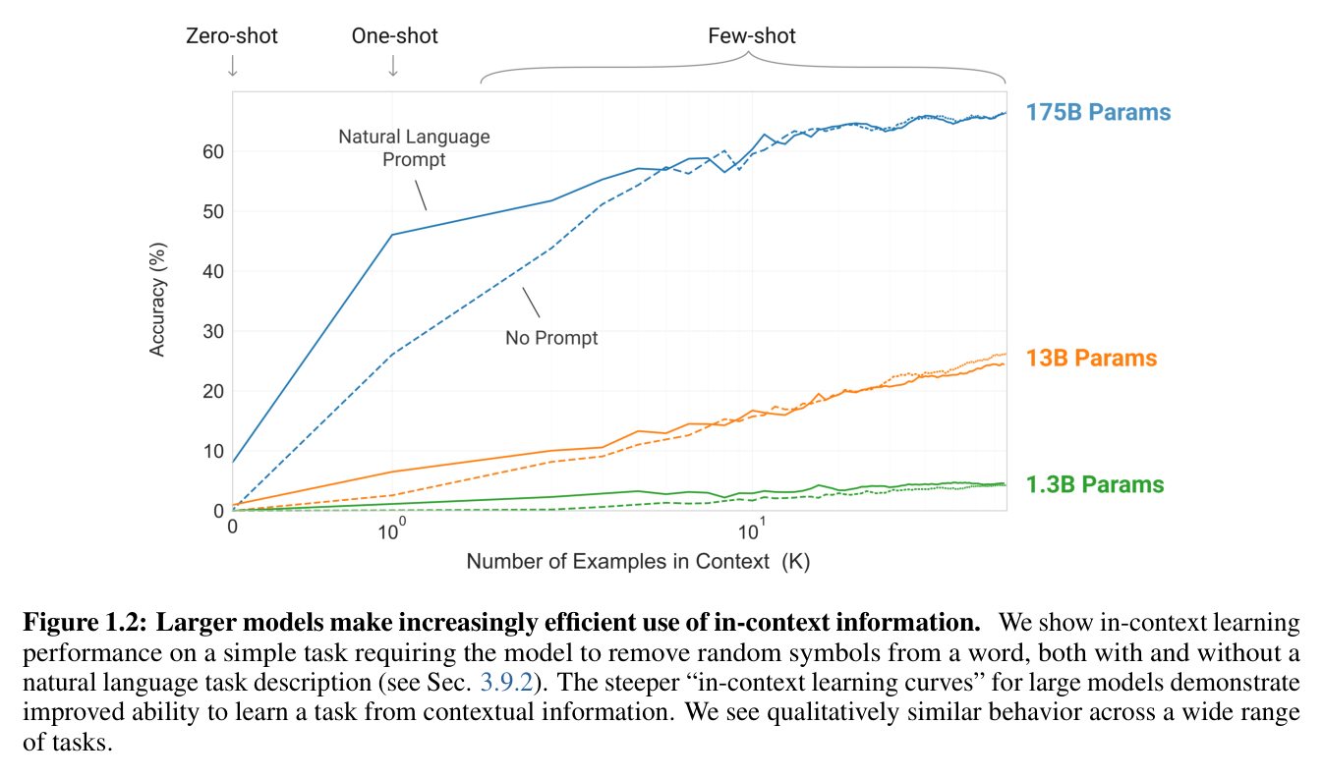
Bigger models squeeze more from a prompt
Source: Brown et al. 2020, "Language Models are Few-Shot Learners" (arXiv:2005.14165), Fig. 1.2

Slide 8
The Chinchilla result
GOPHER
280B parameters, ~300B tokens
Four times bigger, and under-trained.
CHINCHILLA
70B parameters, 1.4T tokens
Same compute budget. The smaller, data-heavier model won.
Source: Hoffmann et al. 2022, "Training Compute-Optimal LLMs" (arXiv:2203.15556)

Slide 9
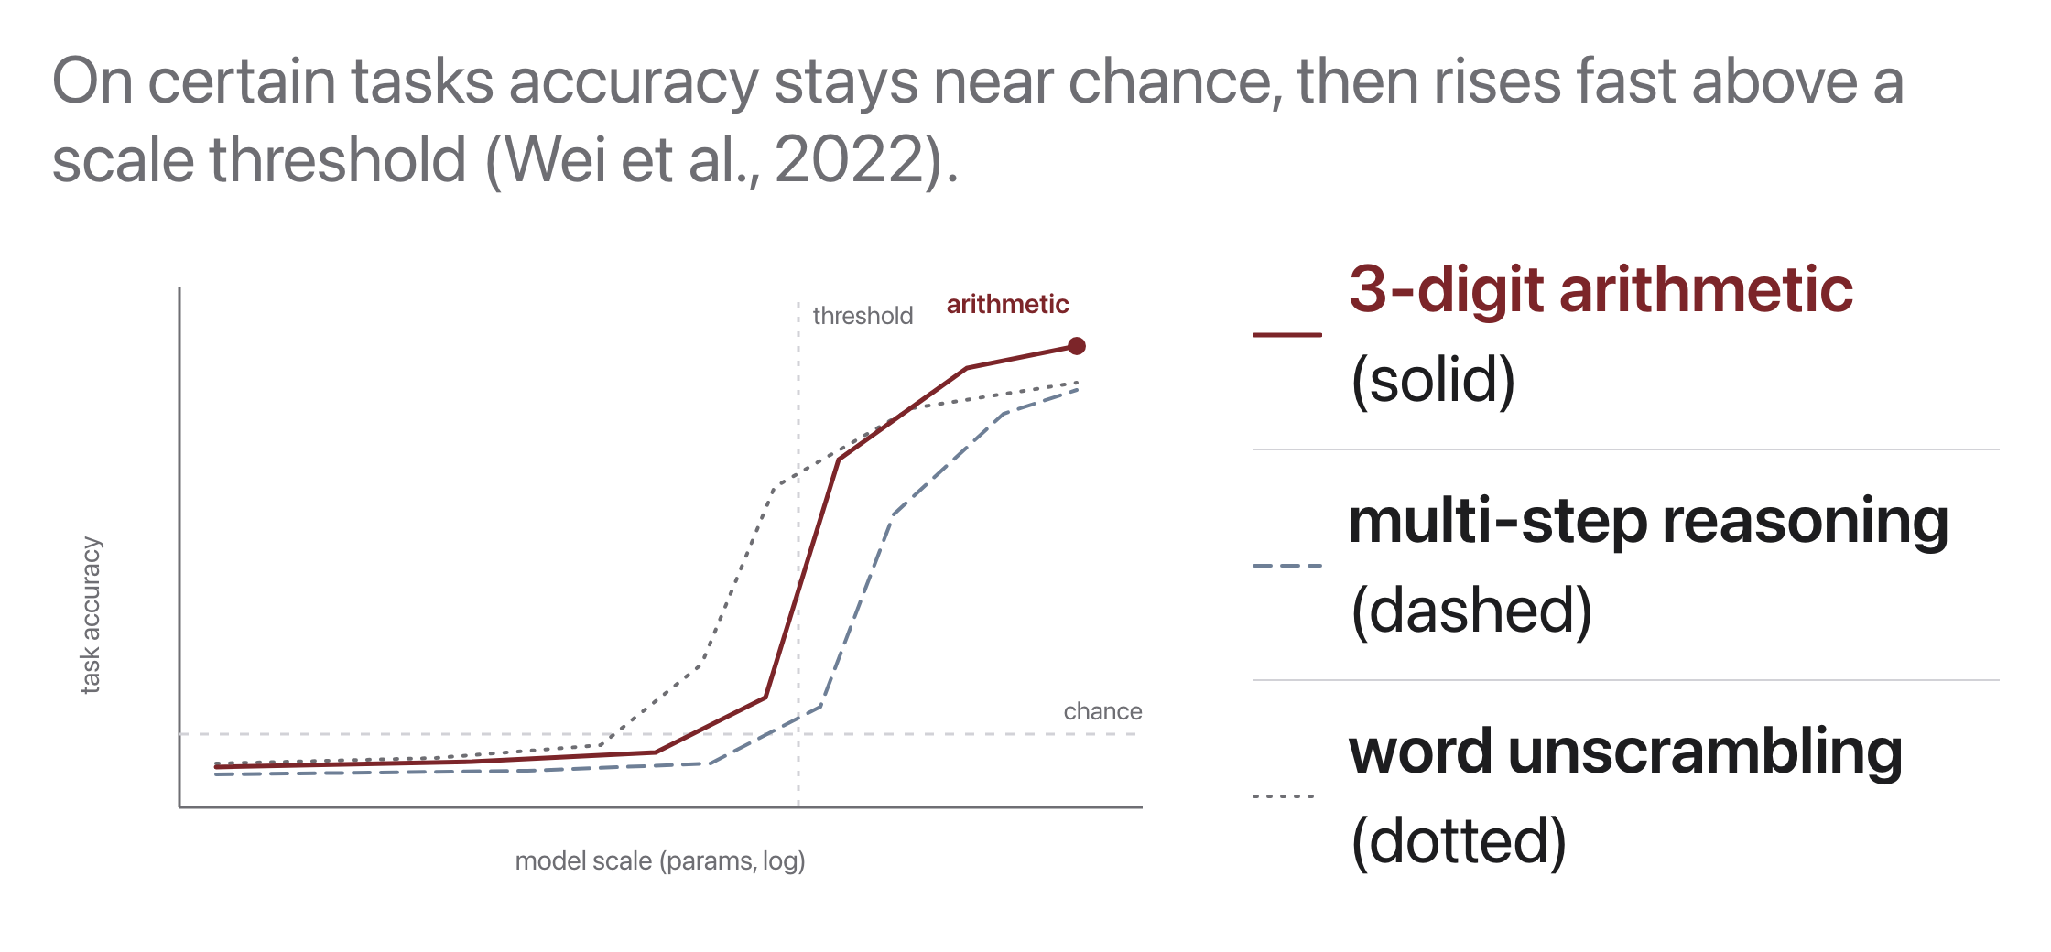
Emergent abilities
Source: original figure; Wei et al. 2022, "Emergent Abilities of Large Language Models"

Slide 10
Loss ≠ usefulness
WHAT SCALING GIVES YOU
low next-token loss
Strong raw capability, and it does correlate with skill.
WHAT YOU ACTUALLY WANT
helpful and safe
A model can have excellent loss and still be neither.
Source: original figure

Slide 11
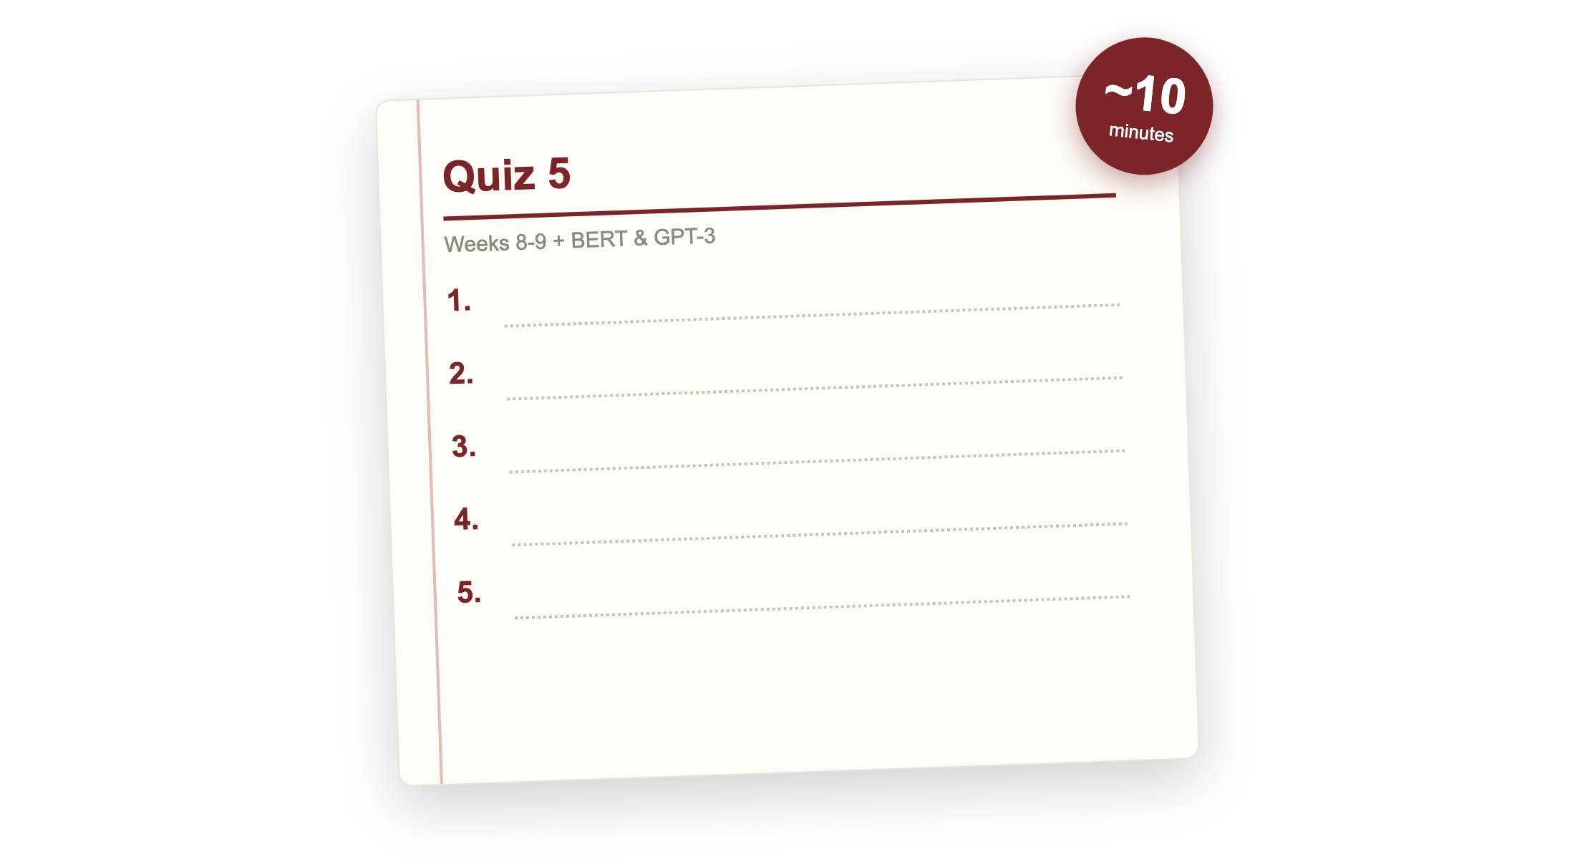
Quiz 5 (paper)
Source: quizzes/quiz-05.md

Slide 12

Break
Source: original figure

Slide 13
You have a compute budget. Spend it.
1
You have 1.2 x 10^22 FLOPs of training compute. Spend all of it
2
Team A: 80B tokens of licensed text, and you may not repeat any of it
3
Team B: inference must run on one 16GB GPU, with 4GB kept for activations
4
Team C: it will serve 5 x 10^12 tokens over its life, at 2N FLOPs each
Source: original figure; C = 6ND per Kaplan et al. 2020; D = 20N per Hoffmann et al. 2022

Slide 14
Teams of four, boards, no laptops
5 min: the unconstrained answer. 15 min: your team's constraint. 10 min: we compare.

Slide 15
So who was right?
Two of the three constraints push the same way, and it is not the way Kaplan pointed.

