Slide 1
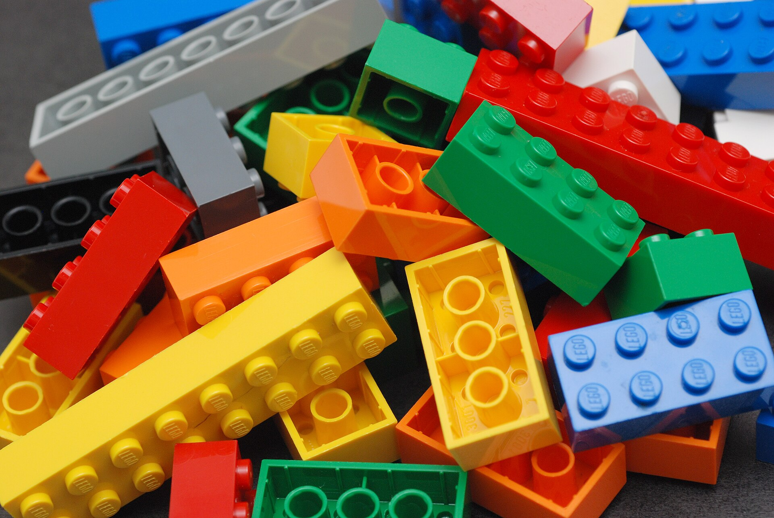
CSCI 3495
Tokenization at Scale, Pretraining Data & Instruction Tuning
Natural Language Processing & Large Language Models
Week 10, Class 1 · Mon Oct 26, 2026
Source: Alan Chia, Wikimedia Commons, CC BY-SA 2.0

Slide 2
A model reads pieces, not words
ONE TOKEN PER WORD
unhappiness
Every name, typo and new word needs its own entry, or becomes UNK.
ONE TOKEN PER CHARACTER
u n h a p p i n e s s
Eleven tokens for one word, so every sequence gets long and slow.
SUBWORDS, FROM BPE
un happi ness
Frequent pieces stay whole, rare ones split, nothing is unencodable.
Source: original figure; splits and ids from the GPT-2 tokenizer

Slide 3
Tokens are the unit of everything
CONTEXT WINDOWS
measured in tokens
not in words
PRICING
hosted models charge per token
not per word
DATA BUDGETS
scaling laws count tokens
Chinchilla counted tokens
Source: original figure

Slide 4
Let's walk through Part 1 in the notebook
Feed it your own words and watch what it does to them.

Slide 5
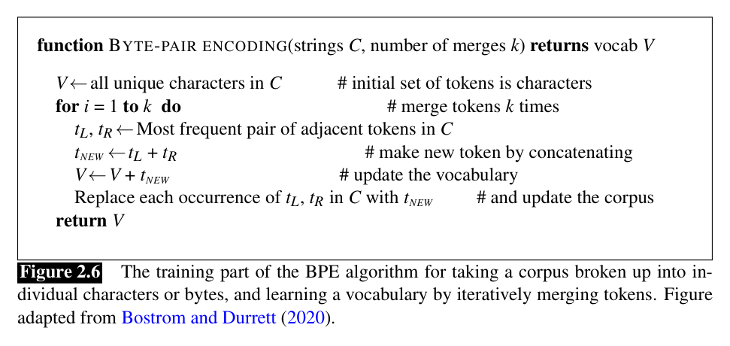
How BPE learns a vocabulary
Source: Jurafsky & Martin, SLP3 (Jan 2026 draft), Fig. 2.6, adapted from Bostrom & Durrett 2020

Slide 6
A worked example
STEP | THE WORD, SO FAR
start | l o w e r /w
merge 1, e+r | l o w er /w
merge 2, w+er | l o wer /w
merge 3, l+o | lo wer /w
THE RULE
Repeatedly merge the most frequent adjacent pair. Nothing else.
Source: original figure

Slide 7
Let's walk through Part 2 in the notebook
Run the merge loop and watch the vocabulary build itself.

Slide 8
Where the text comes from
WHAT GOES IN
web crawl, books, wikipedia, code
Filtered and deduplicated, into trillions of tokens.
AND WHAT RIDES ALONG
duplication, contamination, bias
None of it was asked for, and all of it is learned.
Source: original figure

Slide 9

It only ever learned to predict the next word.
So why does ChatGPT answer your questions? That gap is the rest of today.
Source: Unsplash License, https://images.unsplash.com/photo-1481627834876-b7833e8f5570

Slide 10
The base model is not an assistant
YOU ASK
What is the capital of France?
A BASE MODEL ANSWERS
What is the capital of Germany?
It is not being unhelpful. It is predicting the next line of a list.
Source: original figure

Slide 11
Instruction tuning
BASE MODEL
predicts the next token
INSTRUCTION DATA
thousands of pairs
ASSISTANT
follows instructions
Source: FLAN, Wei et al. 2021 (arXiv:2109.01652)

Slide 12
Three routes to an assistant
ROUTE 1, HUMANS WRITE THEM
"Explain the moon landing to a six-year-old"
Best quality, slowest. A person demonstrates the ideal answer. InstructGPT.
ROUTE 2, TEMPLATES WRAP OLD DATA
"Review: fast, funny. Positive or negative?"
Cheap, and only as varied as the datasets you already had.
Source: InstructGPT (Ouyang et al. 2022); FLAN (Wei et al. 2021); Self-Instruct (Wang et al. 2022); Alpaca (Taori et al. 2023)

Slide 13
Let's walk through Part 3 in the notebook
An instruction pair is just formatted text, and the format is vocabulary.

Slide 14

Break
Source: original figure

Slide 15
The tokenizer bake-off
TRAINED ON | ENG | PY | ESP | CHAT | CHEM
english | 1.3 | 6.2 | 3.7 | 2.6 | 5.4
HOW TO READ IT
Train 300 merges on your corpus, then encode every team's held-out text.
Tokens per word. Lower is better, and the diagonal should win.
Source: original figure; scores from weeks/week-10/class-01/exercise/lab.ipynb

Slide 16
Whose text is cheap?
Every team won its own column and lost everywhere else. A shipped model gets one vocabulary.

