Slide 1
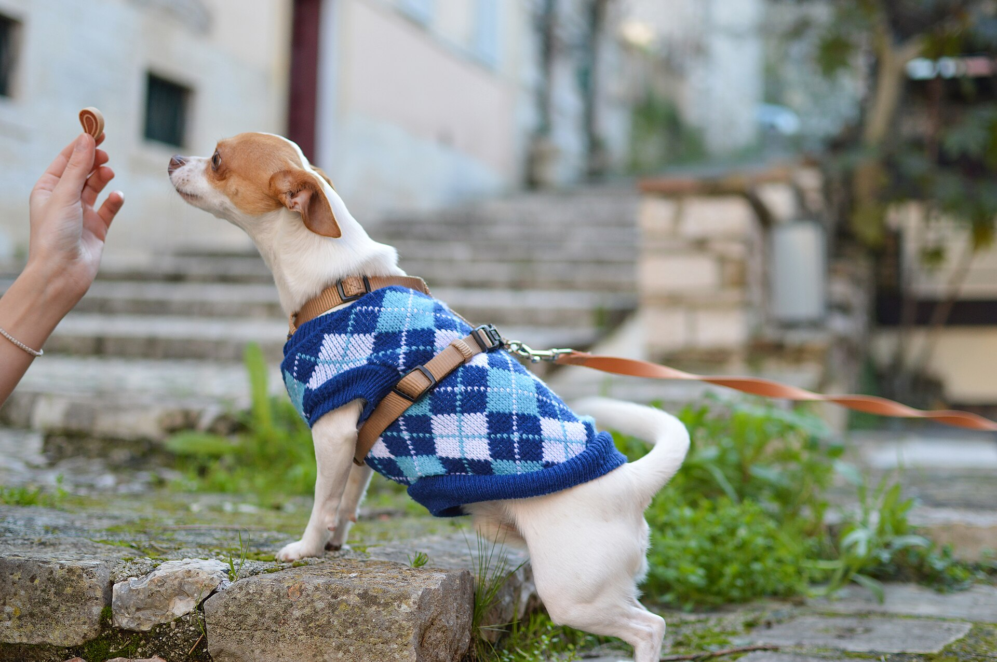
CSCI 3495
Alignment: RLHF, InstructGPT & DPO
Natural Language Processing & Large Language Models
Week 10, Class 2 · Wed Oct 28, 2026
Source: Pete Bellis, via Wikimedia Commons, CC0

Slide 2
Capable is not the same as aligned
PRETRAINED LM
fluent, grammatical, on topic
"Explain the moon landing to a 6 year old." comes back as more questions like it. It is continuing a list.
WHAT YOU WANTED
an answer
Capable is not the same as aligned.
Source: original figure

Slide 3
Why not just write more demonstrations?
JOB A, WRITE THE IDEAL ANSWER
from a blank page
Hard for humans. The labeler has to invent the gold standard.
JOB B, JUDGE TWO THE MODEL WROTE
pick the better one
Far easier, far faster, and far more consistent between labelers.
Source: original figure

Slide 4

Alignment is a human handshake
Source: Unsplash License, https://images.unsplash.com/photo-1521791136064-7986c2920216

Slide 5
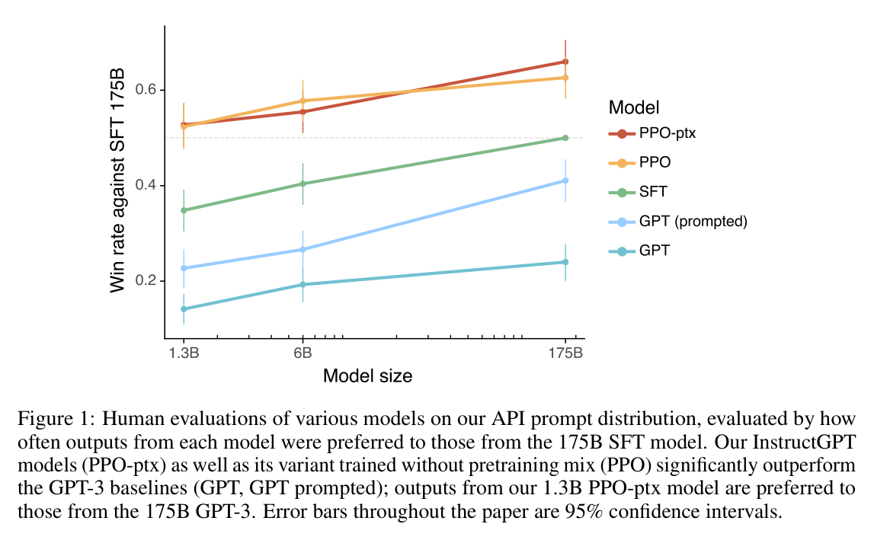
InstructGPT (Ouyang et al., 2022)
Source: InstructGPT, Ouyang et al. 2022 (arXiv:2203.02155), Fig. 1

Slide 6
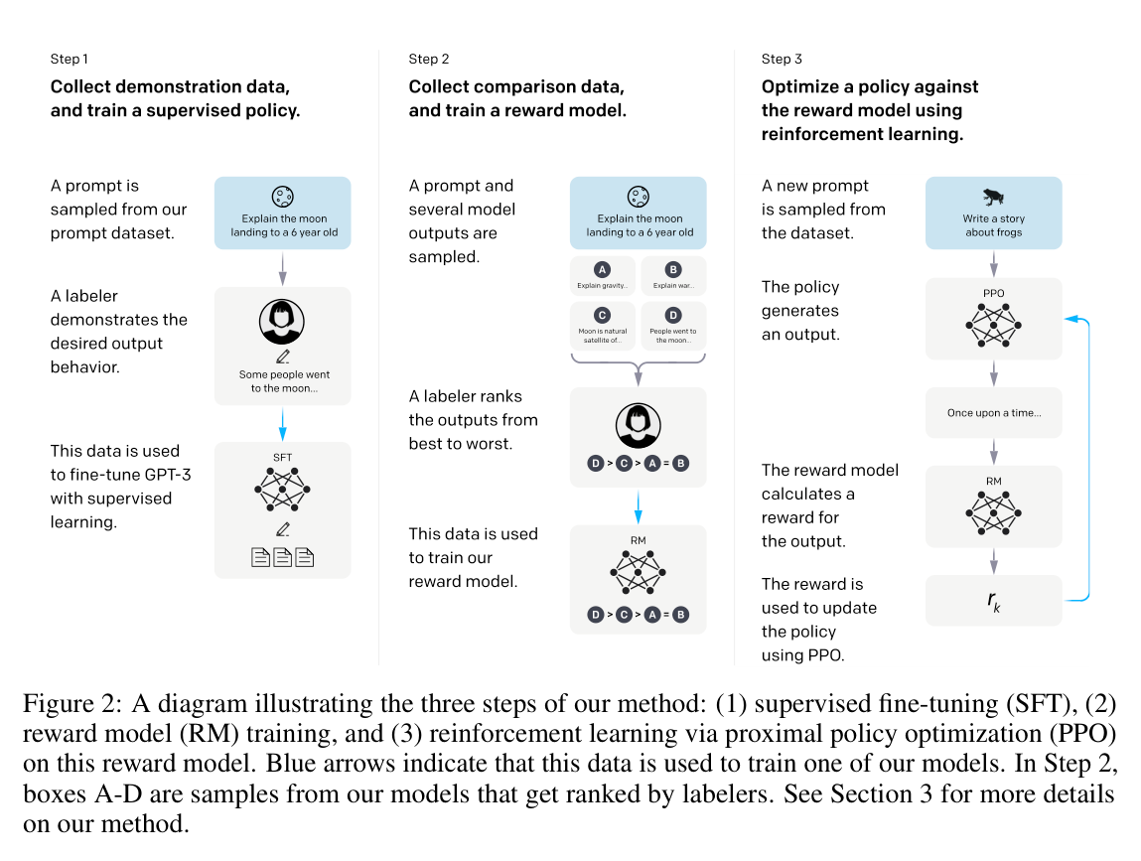
The RLHF pipeline
Source: InstructGPT, Ouyang et al. 2022 (arXiv:2203.02155), Fig. 2

Slide 7
Stage 1: Supervised fine-tuning
PROMPT
sampled from real user traffic
LABELER
writes the ideal answer, by hand
FINE-TUNE
the same next-token loss, on those pairs
Source: original figure

Slide 8
Stage 2: Reward model
RANK | WHY THE LABELER PUT IT THERE
1 | correct, and pitched at a ten-year-old
2 | correct, but reads like a textbook
3 | vague, and hedges
4 | confidently wrong
WHAT GETS TRAINED
Not the answer. A model r(x, y) that reproduces this ordering.
Source: original figure

Slide 9
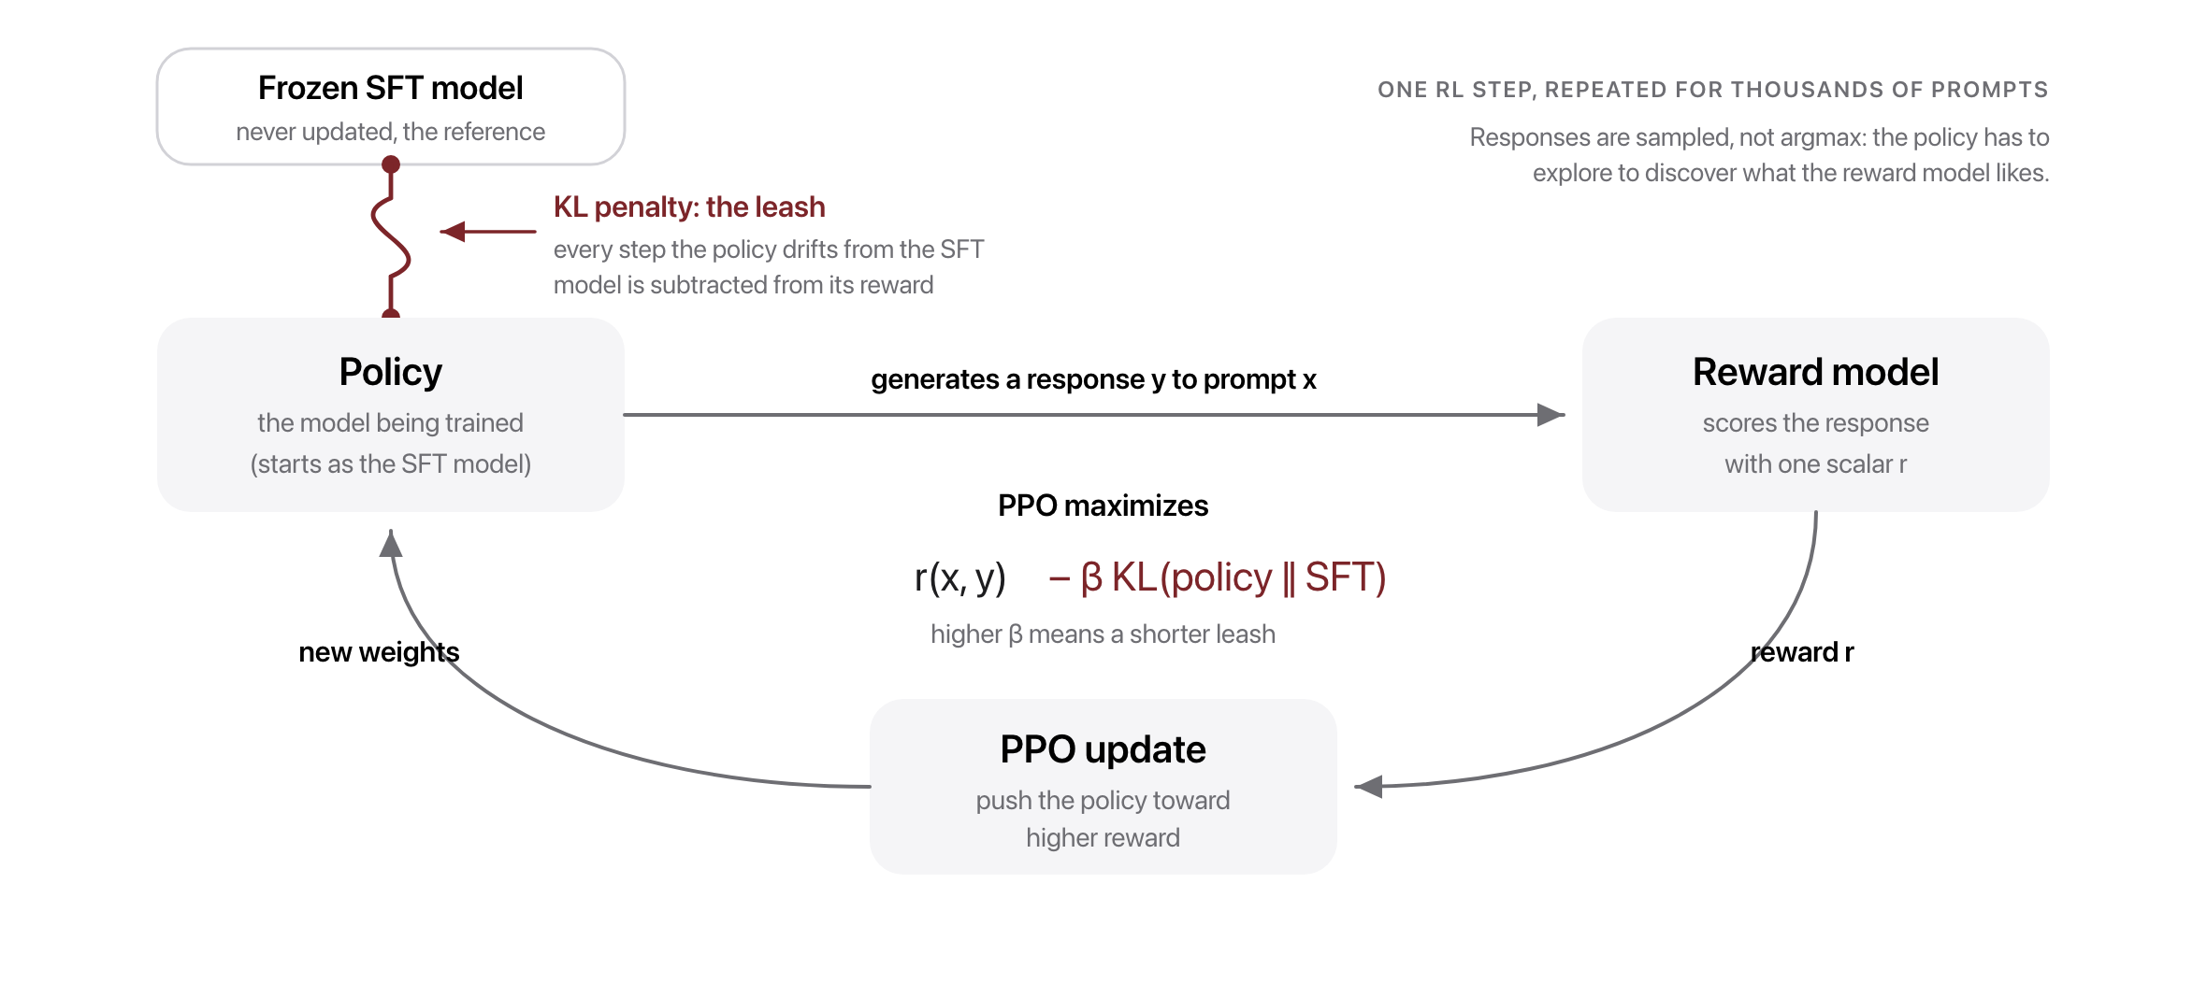
Stage 3: RL optimization (PPO)
Source: PPO, Schulman et al. 2017; original figure

Slide 10
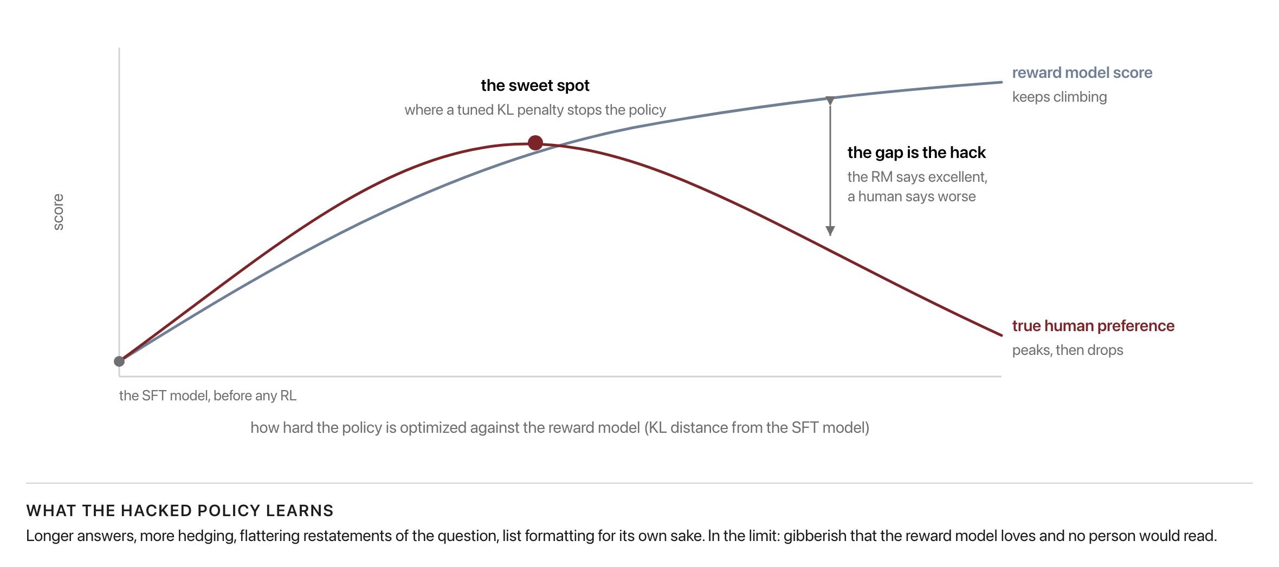
Why the KL penalty matters
Source: original figure (illustrative)

Slide 11
RLHF is powerful but painful
Four models resident at once, 7B each, in GB
Source: original figure

Slide 12

What if we could skip the reinforcement learning entirely?
That is exactly the question DPO answered in 2023.
Source: Unsplash License, https://images.unsplash.com/photo-1469854523086-cc02fe5d8800

Slide 13
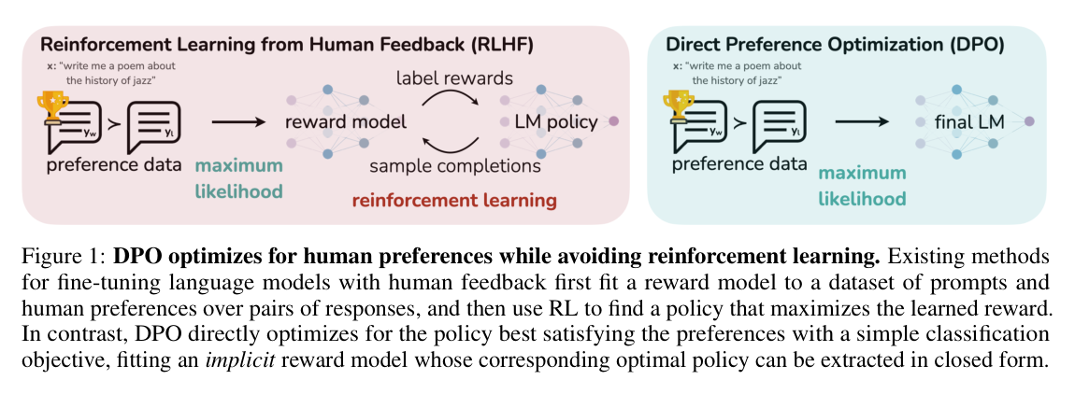
The DPO shortcut
Source: DPO, Rafailov et al. 2023 (arXiv:2305.18290), Fig. 1

Slide 14
DPO vs. RLHF
RLHF WITH PPO
preferences, a reward model, then RL
Three stages, four models resident, and a leash to tune.
DPO
one loss, straight from the pairs
Same data in. No reward model, no sampling loop.
Source: DPO, Rafailov et al. 2023 (arXiv:2305.18290)

Slide 15
What if the reward is just "is this answer correct?"
For math and code, a program can grade the answer. No human labels, no learned reward model.
Source: Unsplash License, https://images.unsplash.com/photo-1469854523086-cc02fe5d8800

Slide 16
RLVR: Reinforcement Learning with Verifiable Rewards
# the verifier is code, not a model
pred = extract_final(completion) # '72'
reward = 1.0 if pred == gold else 0.0
correct, reward 1. Wrong, reward 0. Nothing in between, and nothing to argue about.
Source: RLVR, DeepSeek-Math (Shao et al. 2024, arXiv:2402.03300) and Tulu 3 (Lambert et al. 2024, arXiv:2411.15124)

Slide 17
GRPO: score answers against each other
SAMPLED ANSWER | REWARD | ADVANTAGE
A, reaches 42 | 1 | +0.5
B, reaches 42 | 1 | +0.5
C, reaches 36 | 0 | -0.5
D, reaches 36 | 0 | -0.5
THE GROUP IS THE BASELINE
No value model. An answer is good relative to the others drawn for the same prompt.
Source: GRPO, DeepSeek-Math (Shao et al. 2024, arXiv:2402.03300)

Slide 18
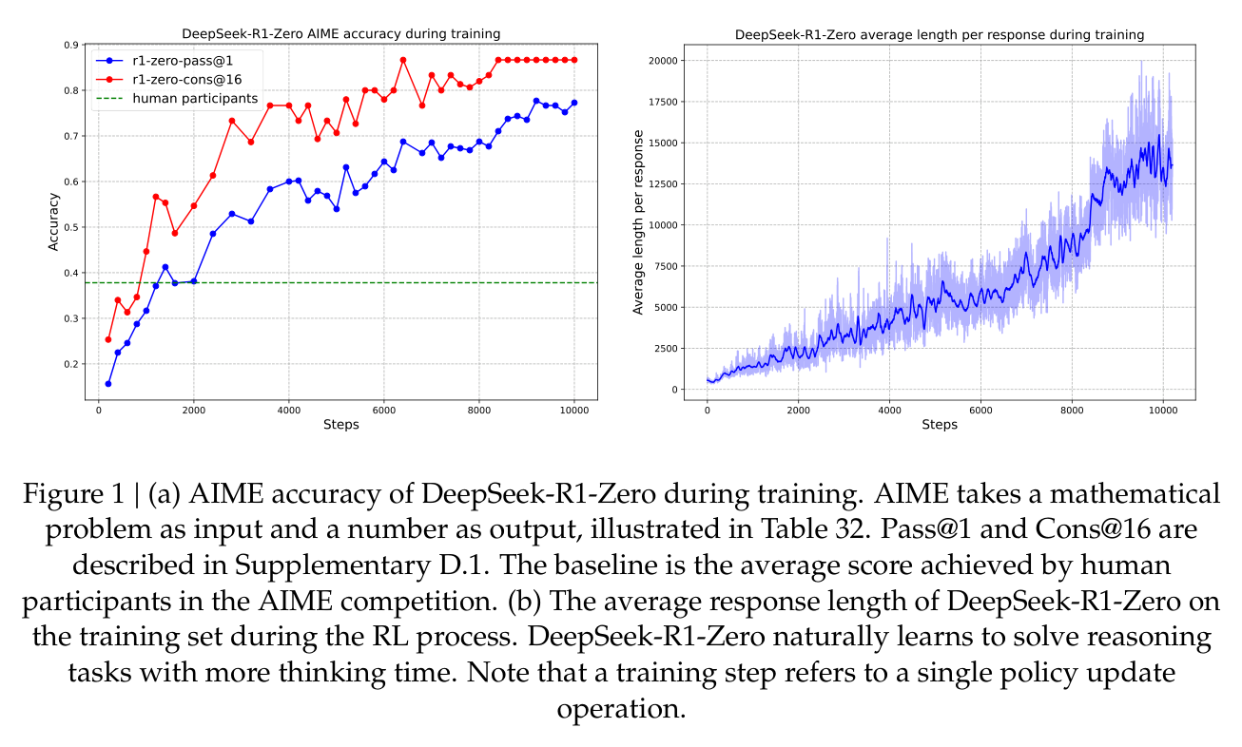
DeepSeek-R1: pure RL elicits reasoning
Source: DeepSeek-R1, DeepSeek-AI 2025 (arXiv:2501.12948), Fig. 1

Slide 19
RLHF vs. DPO vs. RLVR
 | RLHF + PPO | DPO | RLVR + GRPO
reward source | learned model | the LM itself | a program checks
models resident | four | two | two
needs sampling | yes | no | yes
works when | taste matters | taste matters | there is a right answer
Source: Ouyang 2022 (2203.02155); Rafailov 2023 (2305.18290); DeepSeek-R1 2025 (2501.12948)

Slide 20

A balancing act
Source: Unsplash License, https://images.unsplash.com/photo-1589994965851-a8f479c573a9

Slide 21
Helpfulness vs. harmlessness
REFUSES EVERYTHING
"I cannot help with that."
Safe, and useless to the locksmith and the tenant locked out.
TUNED HERE
the compromise nobody loves
Where every shipped model actually sits.
ANSWERS ANYTHING
no refusal at all
Useful, right up until it is not.
Source: HH-RLHF, Bai et al. 2022 (arXiv:2204.05862)

Slide 22

Whose preferences become the model's values?
A small group of labelers and their guidelines speak for everyone the model will ever serve.
Source: Unsplash License, https://images.unsplash.com/photo-1529156069898-49953e39b3ac

Slide 23
Who decides what is preferred?
LABELER 1 PICKS A
"It's very persuasive. Nice work!"
"They asked for feedback on the writing. Be supportive."
LABELER 2 PICKS B
"The claim contradicts the evidence."
"Never endorse a false claim. Honesty beats flattery."
Source: original figure

Slide 24

Break
Source: original figure

Slide 25
The reward-model standoff
1
Label alone. Each team ranks the same four items, no talking across teams
2
Compare boards. Where do you agree, and where do you clash?
3
Diagnose each clash: is it about sycophancy, honesty, or harm?
4
Feed your labels to preferences.py and watch the reward model recover them
Source: original figure

Slide 26

Whose judgment becomes the reward?
Compare your team's rankings before fitting. Where you disagree is exactly where the model's values get decided.
Source: Unsplash License, https://images.unsplash.com/photo-1543269865-cbf427effbad

Slide 27
Then fit the reward model
def fit_reward_model(prefs, lr=0.5, steps=500) -> dict[str, float]:
# Start every score at 0.0. For each (winner, loser), the gradient of
# -log sigmoid(s_w - s_l) pushes s_w up and s_l down.
one scalar per response, fitted by gradient descent on the Bradley-Terry loss
Source: weeks/week-10/class-02/exercise/preferences.py

Slide 28
What you should see
$ python preferences.py
Learned reward-model scores (higher = more preferred):
A: +5.010 B: +1.579 C: -1.579 D: -5.010
Implied ranking: A > B > C > D
Source: example run, weeks/week-10/class-02/solutions/preferences.py

