Slide 1

CSCI 3495
Chain-of-Thought, Self-Consistency & Decomposition
Natural Language Processing & Large Language Models
Week 12, Class 2 · Wed Nov 11, 2026
Source: Kurt:S, Wikimedia Commons, CC BY 2.0

Slide 2
Where we left off
IN-CONTEXT LEARNING
new tasks from the prompt alone
No weight updates, no training run.
PROMPTS AS EXPERIMENTS
variants, an eval set, fixed decoding
Then compare. Today: patterns that improve reasoning.
Source: original figure

Slide 3
One-step answers fail multi-step problems
THE PROMPT
"23 muffins, sold 17, baked 12 more. Answer with only the number."
WHAT IT SAYS
23
Wrong. It echoed the first number it saw.
THE WORK IT SKIPPED
23 - 17 = 6, then 6 + 12 = 18
Two easy steps that never happened, because there was no room to take them.
Source: original figure

Slide 4
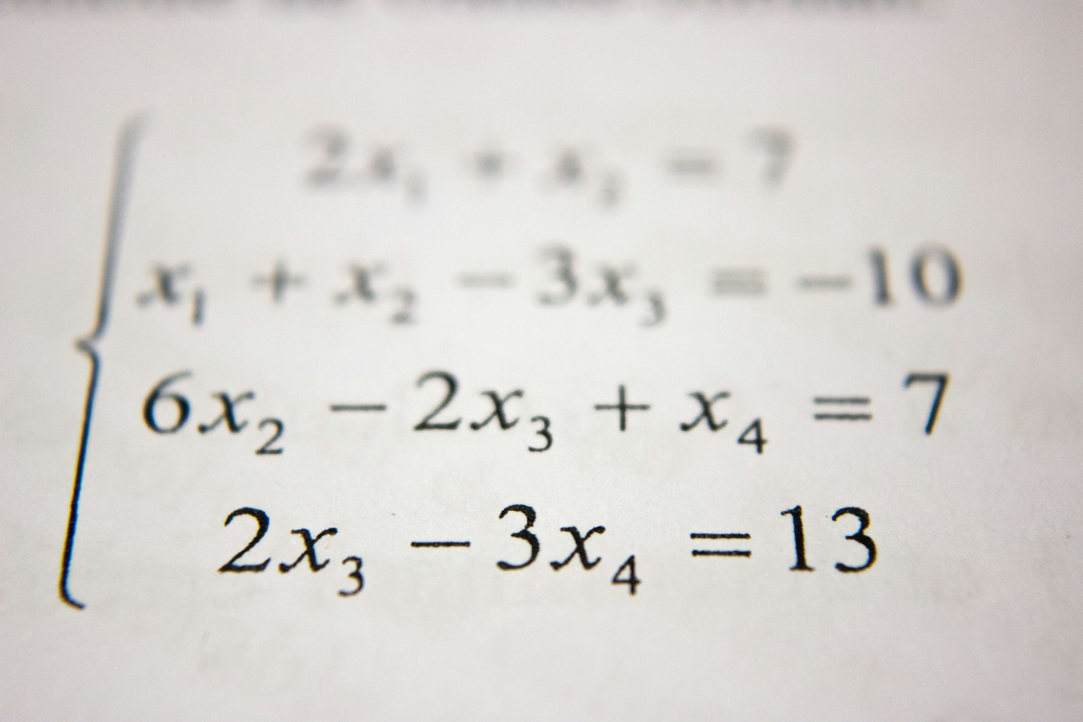
Could you solve this in one glance, or do you need to show your work?
Hard problems need steps. So do language models.
Source: Unsplash License, https://images.unsplash.com/photo-1509228468518-180dd4864904

Slide 5
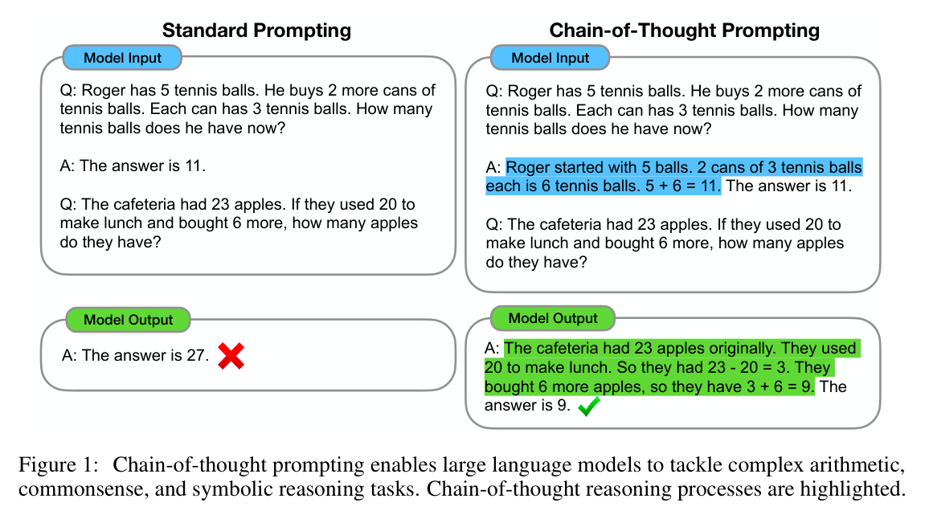
CoT: put the steps in the exemplar
Source: Wei et al. 2022 (arXiv:2201.11903), Fig. 1

Slide 6
Why does CoT help?
1
More compute: every generated token is another pass through the model
2
The intermediate state is written down instead of held in one activation
3
The chain is inspectable, so a wrong step is visible rather than hidden
Source: original figure; Wei et al. 2022 (arXiv:2201.11903)

Slide 7
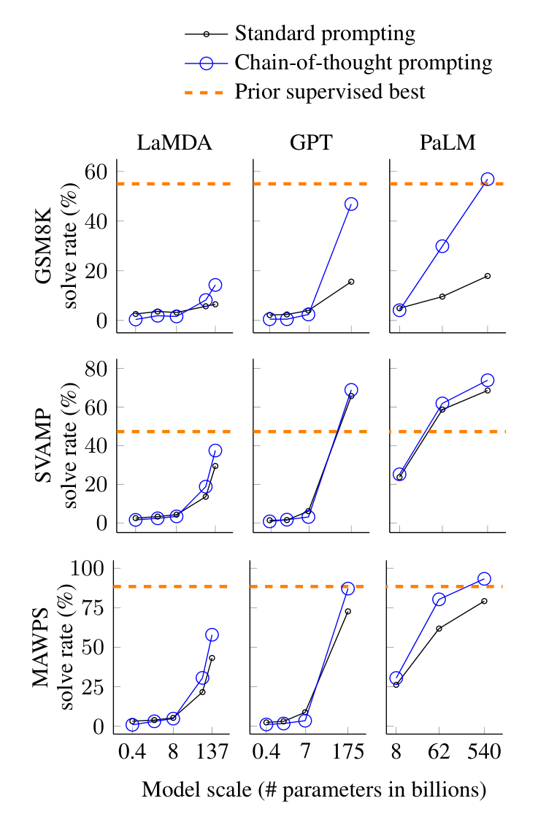
CoT and scale
Figure 4: Chain-of-thought prompting enables large language models to solve challenging math problems. Notably, chain-of-thought reasoning is an emergent ability of increasing model scale. Prior best numbers are from Cobbe et al. (2021) for GSM8K, Jie et al. (2022) for SVAMP, and Lan et al. (2021) for MAWPS.
Source: Wei et al. 2022 (arXiv:2201.11903), Fig. 4

Slide 8
Zero-shot CoT
WITHOUT IT
"Answer: 42"
A fast, often wrong guess. No steps to inspect.
WITH ONE PHRASE
"Let's think step by step."
The model lays out steps first, then answers. No exemplars to write.
Source: original figure; Kojima et al. 2022 (arXiv:2205.11916)

Slide 9
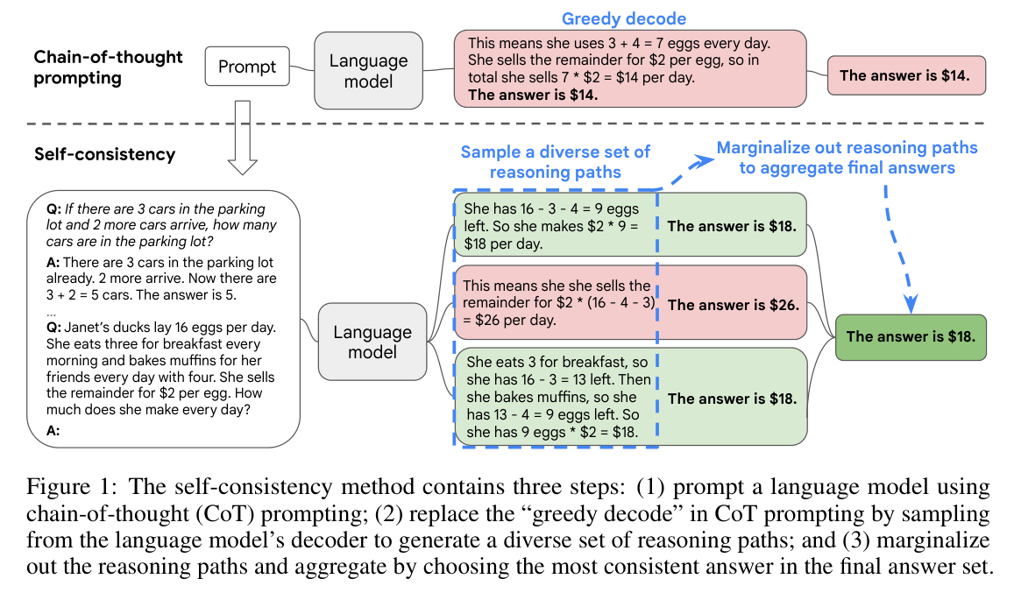
Sample many chains, then vote
Source: Wang et al. 2022 (arXiv:2203.11171), Fig. 1

Slide 10
Decomposition: break the task apart
PATTERN | FIRST | THEN | FINALLY
Least-to-most | solve the easiest part | feed it forward | build to the whole
Self-ask | ask a sub-question | answer it | combine
Plan then execute | write the plan | run each step | assemble
Source: original figure; least-to-most, Zhou et al. 2022 (arXiv:2205.10625)

Slide 11
What if we stopped prompting for reasoning and trained it in?
The 2024 to 2025 idea: make the chain a learned behavior, not a prompt you write.
Source: Unsplash License, https://images.unsplash.com/photo-1509228468518-180dd4864904

Slide 12
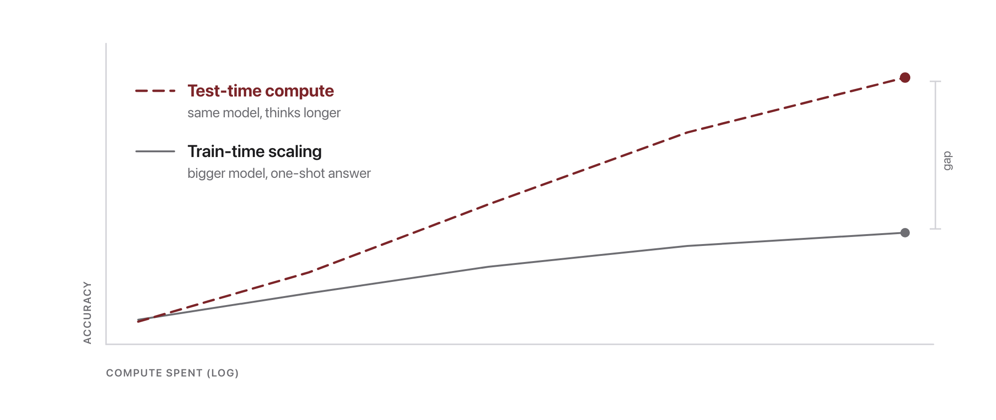
Scale inference, not just parameters
Source: original schematic; test-time compute scaling, Snell et al. 2024 (arXiv:2408.03314)

Slide 13
CoT to trained reasoning
PROMPT FOR IT
you write the chain
SAMPLE IT
the chain is drawn many times
TRAIN FOR IT
the chain is learned
Source: original figure; Wei et al. 2022 (2201.11903); DeepSeek-R1 2025 (2501.12948)

Slide 14
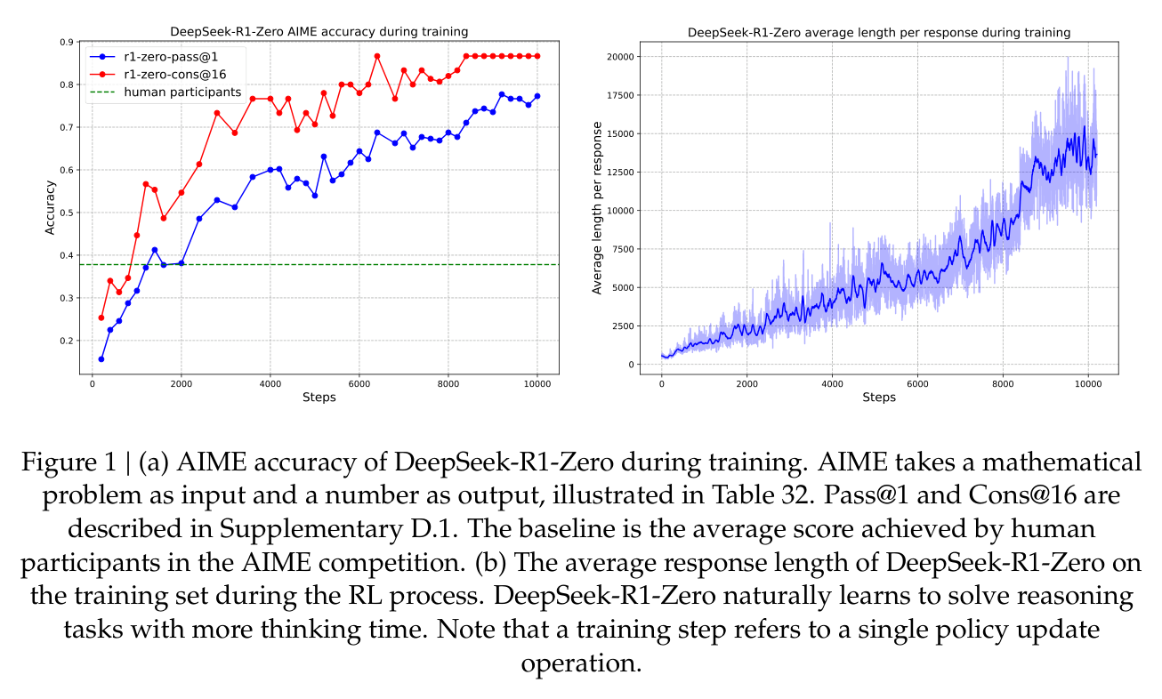
Reasoning models: what RL training buys
Source: DeepSeek-AI 2025 (arXiv:2501.12948), Fig. 1

Slide 15
Extract the answer reliably
Start with 23 muffins. Sold 17 -> 23 - 17 = 6.
Baked 12 more -> 6 + 12 = 18.
Therefore, the answer is 18.
parse the last tagged value: 18
reasoning and final answer are different things, so separate them
Source: original figure

Slide 16
When NOT to use CoT
SKIP IT
"What is the capital of France?"
Single-step lookup. CoT adds cost and risk.
SKIP IT
10,000 reviews a minute
Latency critical. Reasoning tokens are not free.
MEASURE FIRST
anything arithmetic or multi-step
This is where it pays, and you should prove it does.
Source: original figure

Slide 17
Risks: plausible ≠ correct
THE CHAIN
"30 marbles. Remove half -> 15. Then add 4 -> 21."
THE SLIP
15 + 4 = 19
One arithmetic step is wrong and every sentence around it reads perfectly. CoT makes output look authoritative.
Source: original figure

Slide 18
Looking ahead
REASONING
CoT, self-consistency, decomposition
RELIABLE OUTPUTS
structured JSON, function calling, RAG
AGENTS
reasoning steps become actions
Source: schedule/SCHEDULE.md; thumbnails: Wei et al. 2022 (2201.11903) Fig. 1, Lewis et al. 2020 (2005.11401) Fig. 1, Yao et al. 2022 (2210.03629) Fig. 1

Slide 19

Break
Source: original figure

Slide 20
Predict, then Verify CoT
1
On the whiteboard, hand-write a CoT trace for both problems, no laptops
2
A: 23 muffins, sold 17, baked 12 more. B: 4 nests of 3 eggs, 2 hatch
3
Predict for each: will CoT beat a direct answer, and why?
4
Then run them and see whether your prediction held
Source: weeks/week-12/class-02/exercise/cot_lab.py

Slide 21
Verify your predictions
PROMPT STYLE | ACCURACY
direct | 33%
chain-of-thought | 67%
+ self-consistency | 83%
REASONING, THEN VOTING
Both beat one-shot guessing, and they stack.
Source: example run, qwen2.5:0.5b via Ollama

Slide 22
Midterm next class
points | 100
time | about 70 minutes
you may bring | one 8.5x11 sheet, handwritten, both sides
not allowed | printouts, photocopies, textbook, laptop, phone
PUT YOUR NAME ON THE SHEET
You hand it in with the exam.
Source: exams/midterm-study-guide.md

