Slide 1
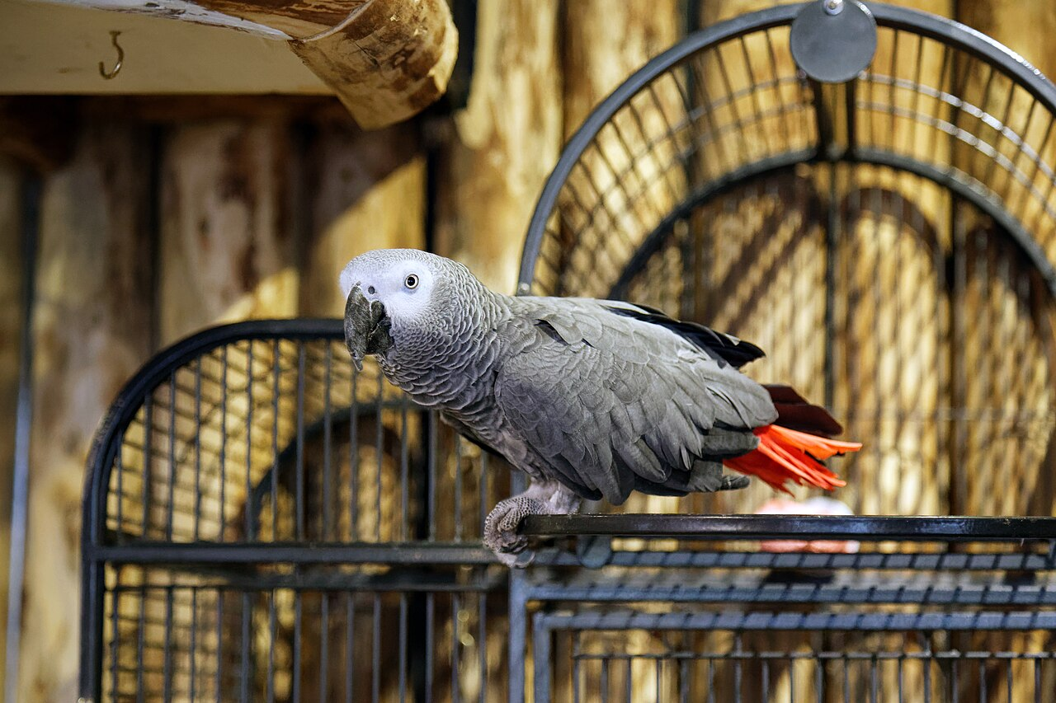
CSCI 3495
Ethics & Society: The Stakes of Language Technology
Natural Language Processing & Large Language Models
Week 15, Class 1 · Mon Dec 7, 2026
Source: photo: Acabashi, Wikimedia Commons, CC BY-SA 4.0

Slide 2
Why this, why now
UNTIL NOW, BUILD
tokenizers, embeddings, agents
How to make language systems work.
TODAY, QUESTION
who benefits, who is harmed
Every data, objective and deployment choice has stakes.
Source: original figure

Slide 3
"Stochastic Parrots" (Bender et al., 2021)
1
Environmental and financial cost
2
Unfathomable training data, and what it encodes
3
Research effort spent on the wrong questions
4
Illusions of meaning, and who is harmed by them
Source: Bender et al., FAccT 2021, dl.acm.org/doi/10.1145/3442188.3445922

Slide 4
Form vs. meaning
WHAT IT LEARNS
form
Which words follow which. Fluent, grammatical, plausible.
WHAT IT HAS NO ACCESS TO
meaning, intent
Coherence at the surface, with nothing underneath that refers to the world.
Source: Bender et al., FAccT 2021

Slide 5
Fault line 1: Bias & fairness
HUMAN TEXT
encodes stereotypes
THE MODEL
learns, and amplifies
UNEVEN HARM
falls on some more than others
bigger data is not automatically better data
Source: Bender et al., FAccT 2021

Slide 6
Fault line 2: Misinformation
WHY IT PERSUADES
fluent but false
Confident text can be wrong, and fluency makes falsehood more persuasive.
WHY IT SPREADS
cheap and scalable
Generation costs almost nothing, so disinformation industrialises.
Source: original figure; hallucination (Week 11)

Slide 7
Fault line 3: Environmental cost
Metric tons of CO2e
Source: Strubell et al. 2019 Table 1; Bender et al. 2021 section 3; Patterson et al. 2021

Slide 8
Fault line 4: Copyright & data provenance
1
Whose text?
2
With what consent?
3
Can creators opt out?
4
You cannot audit harms in data you never documented
Source: original figure; datasheets/data statements

Slide 9
Fault line 5: Labor
HIDDEN HUMAN WORK
annotation and moderation
Often low-paid, often psychologically taxing.
DISPLACEMENT
writers, translators, support
Pressure on the people whose text trained it.
CONCENTRATION
value accrues upward
To whoever owns the compute.
Source: original figure

Slide 10
Fault line 6: Safety & policy
DUAL-USE
the same model does both
Capability is value-neutral. Deployment is not.
SINGLE POINT OF FAILURE
everyone builds on a few bases
One flaw or bias propagates everywhere at once.
Source: original figure

Slide 11
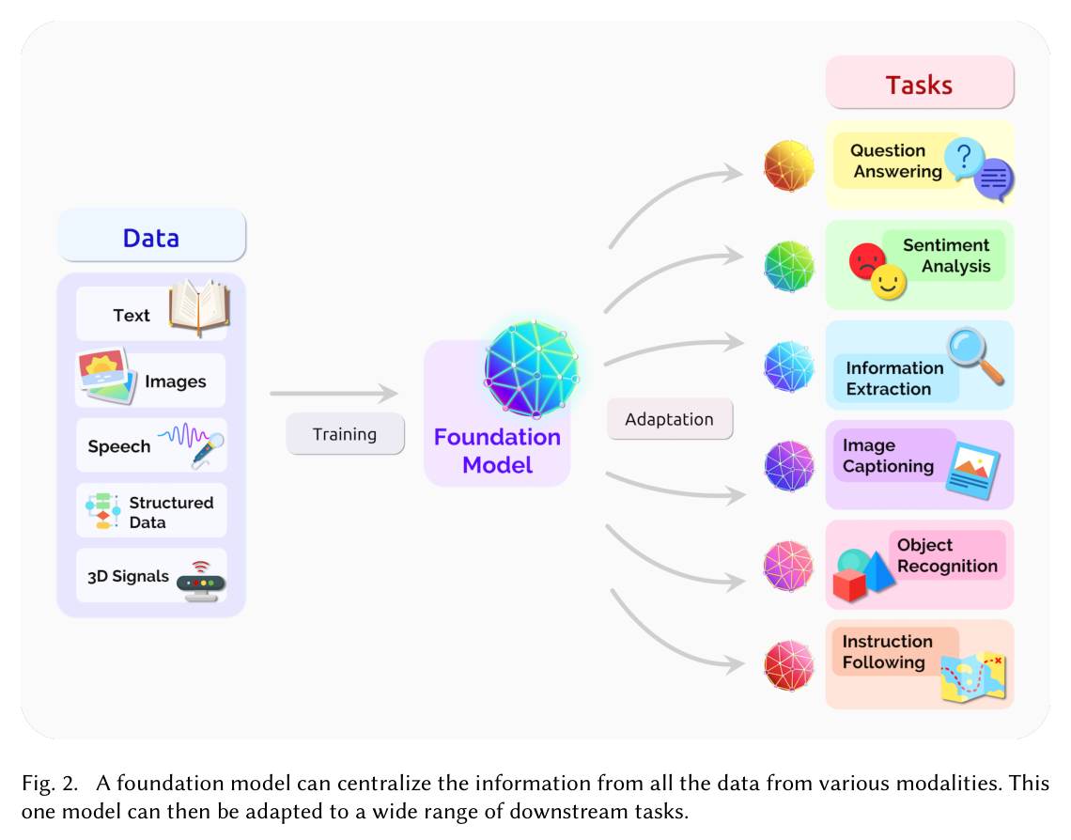
One model beneath everything
Source: Bommasani et al. 2021 (arXiv:2108.07258), Fig. 2

Slide 12
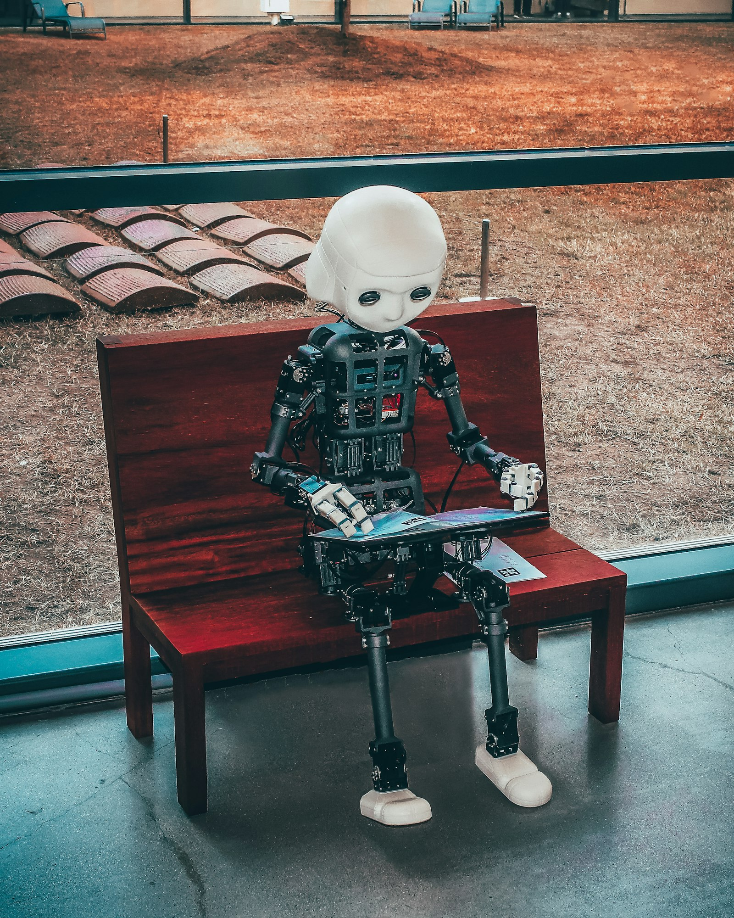
If it reads every book, does it owe the authors anything?
Sit with this one. The hardest questions in this field are not technical.
Source: Unsplash License, https://unsplash.com/photos/black-and-white-robot-toy-on-red-wooden-table-zwd435-ewb4

Slide 13
The landscape, at a glance
1
Bias and fairness: models absorb stereotypes from text, and can amplify them
2
Misinformation: fluent, confident, wrong, and cheap to mass-produce
3
Environmental cost: training and serving are not free
4
Labour and consent: whose text, whose annotation, whose job
5
Concentration: value accrues to whoever owns the compute
6
Dual use: capability is neutral, deployment is not
Source: original figure; Bender et al. 2021 & Bommasani et al. 2021

Slide 14
Planning is the mitigation
POST-MORTEM
"Why did it fail?"
Asked after somebody was already harmed, when the plan is already spent.
PRE-MORTEM
the same question, on day one
Assume it failed, then work out why. You can still act on the answer.
Source: Bender et al., FAccT 2021, section 6; Klein, Harvard Business Review, 2007

Slide 15
What responsible builders can do
MODEL CARD | TOXFILTER V2
training data | 1.2M forum comments, 2019-2023, English only
known gap | dialects such as AAVE are under-represented
evaluation | 91% accurate, but 2.4x the false-positive rate on AAVE
out of scope | anything it was not measured on
Source: original figure (worked example); model cards (Mitchell et al., 2019); datasheets (Gebru et al., 2018)

Slide 16

Break
Source: original figure

Slide 17
Pre-mortem a real deployment (teams)
TEAM 1, TRANSLATION
a county auto-translates evacuation orders, no human reads the output
residents with no English
TEAM 2, TUTORING
a 24/7 tutor answers homework and drafts TA feedback
students with no one else to ask
TEAM 3, ACCOUNTING
an agent reads receipts and categorises every expense
whoever the errors land on
Source: exercise/premortem-guide.md

Slide 18
Running the pre-mortem
1
Write the obituary. One year on, it was shut down and made the news
2
The headline needs a number in it, not "it was biased"
3
Reverse-engineer four causes, and tag each to one of the six fault lines
4
Pick the one you could have caught cheapest, and say how
Source: method: Klein 2007, via Bender et al. 2021 section 6

Slide 19
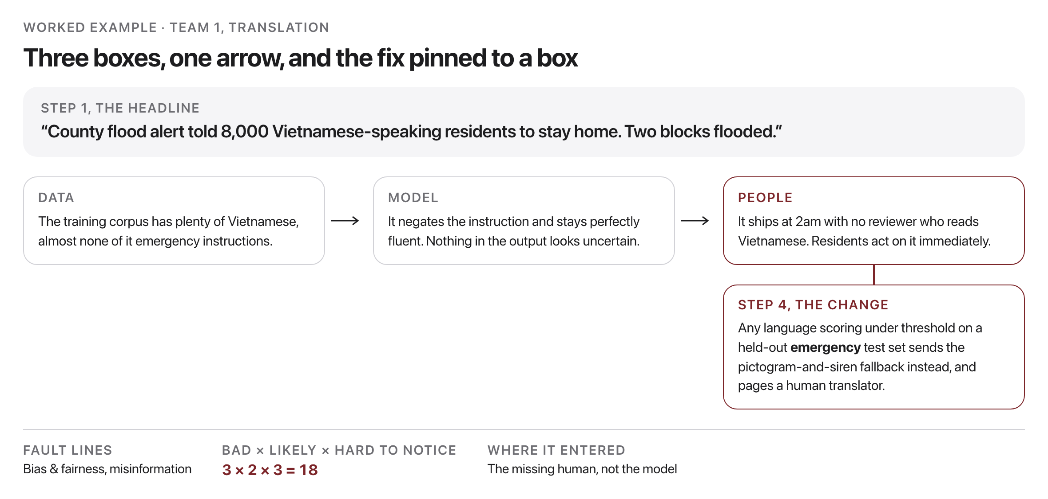
What your whiteboard should look like
Source: worked example, exercise/premortem-guide.md

Slide 20
Take-home demo: measure the bias
$ python bias_probe.py
engineer association(male - female) = +1.014
programmer association(male - female) = +1.021
scientist association(male - female) = +0.869
nurse association(male - female) = -1.016
teacher association(male - female) = -0.884
homemaker association(male - female) = -1.120
nobody wrote these associations down. They were learned from text.
Source: example run, weeks/week-15/class-01/exercise/bias_probe.py

Slide 21
Looking ahead
NEXT CLASS
the future, and synthesis
Final project presentations begin.
AFTER THAT
the finals period
Remaining presentations, the paper exam, and the final report.
Source: schedule/SCHEDULE.md; readings.md

