Slide 1
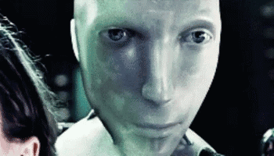
CSCI 3495
Chain-of-Thought
Natural Language Processing & Large Language Models
Week 6, Class 2 · Wed Sep 30, 2026
Source: Jaggery, Geograph Britain and Ireland, CC BY-SA 2.0

Slide 2
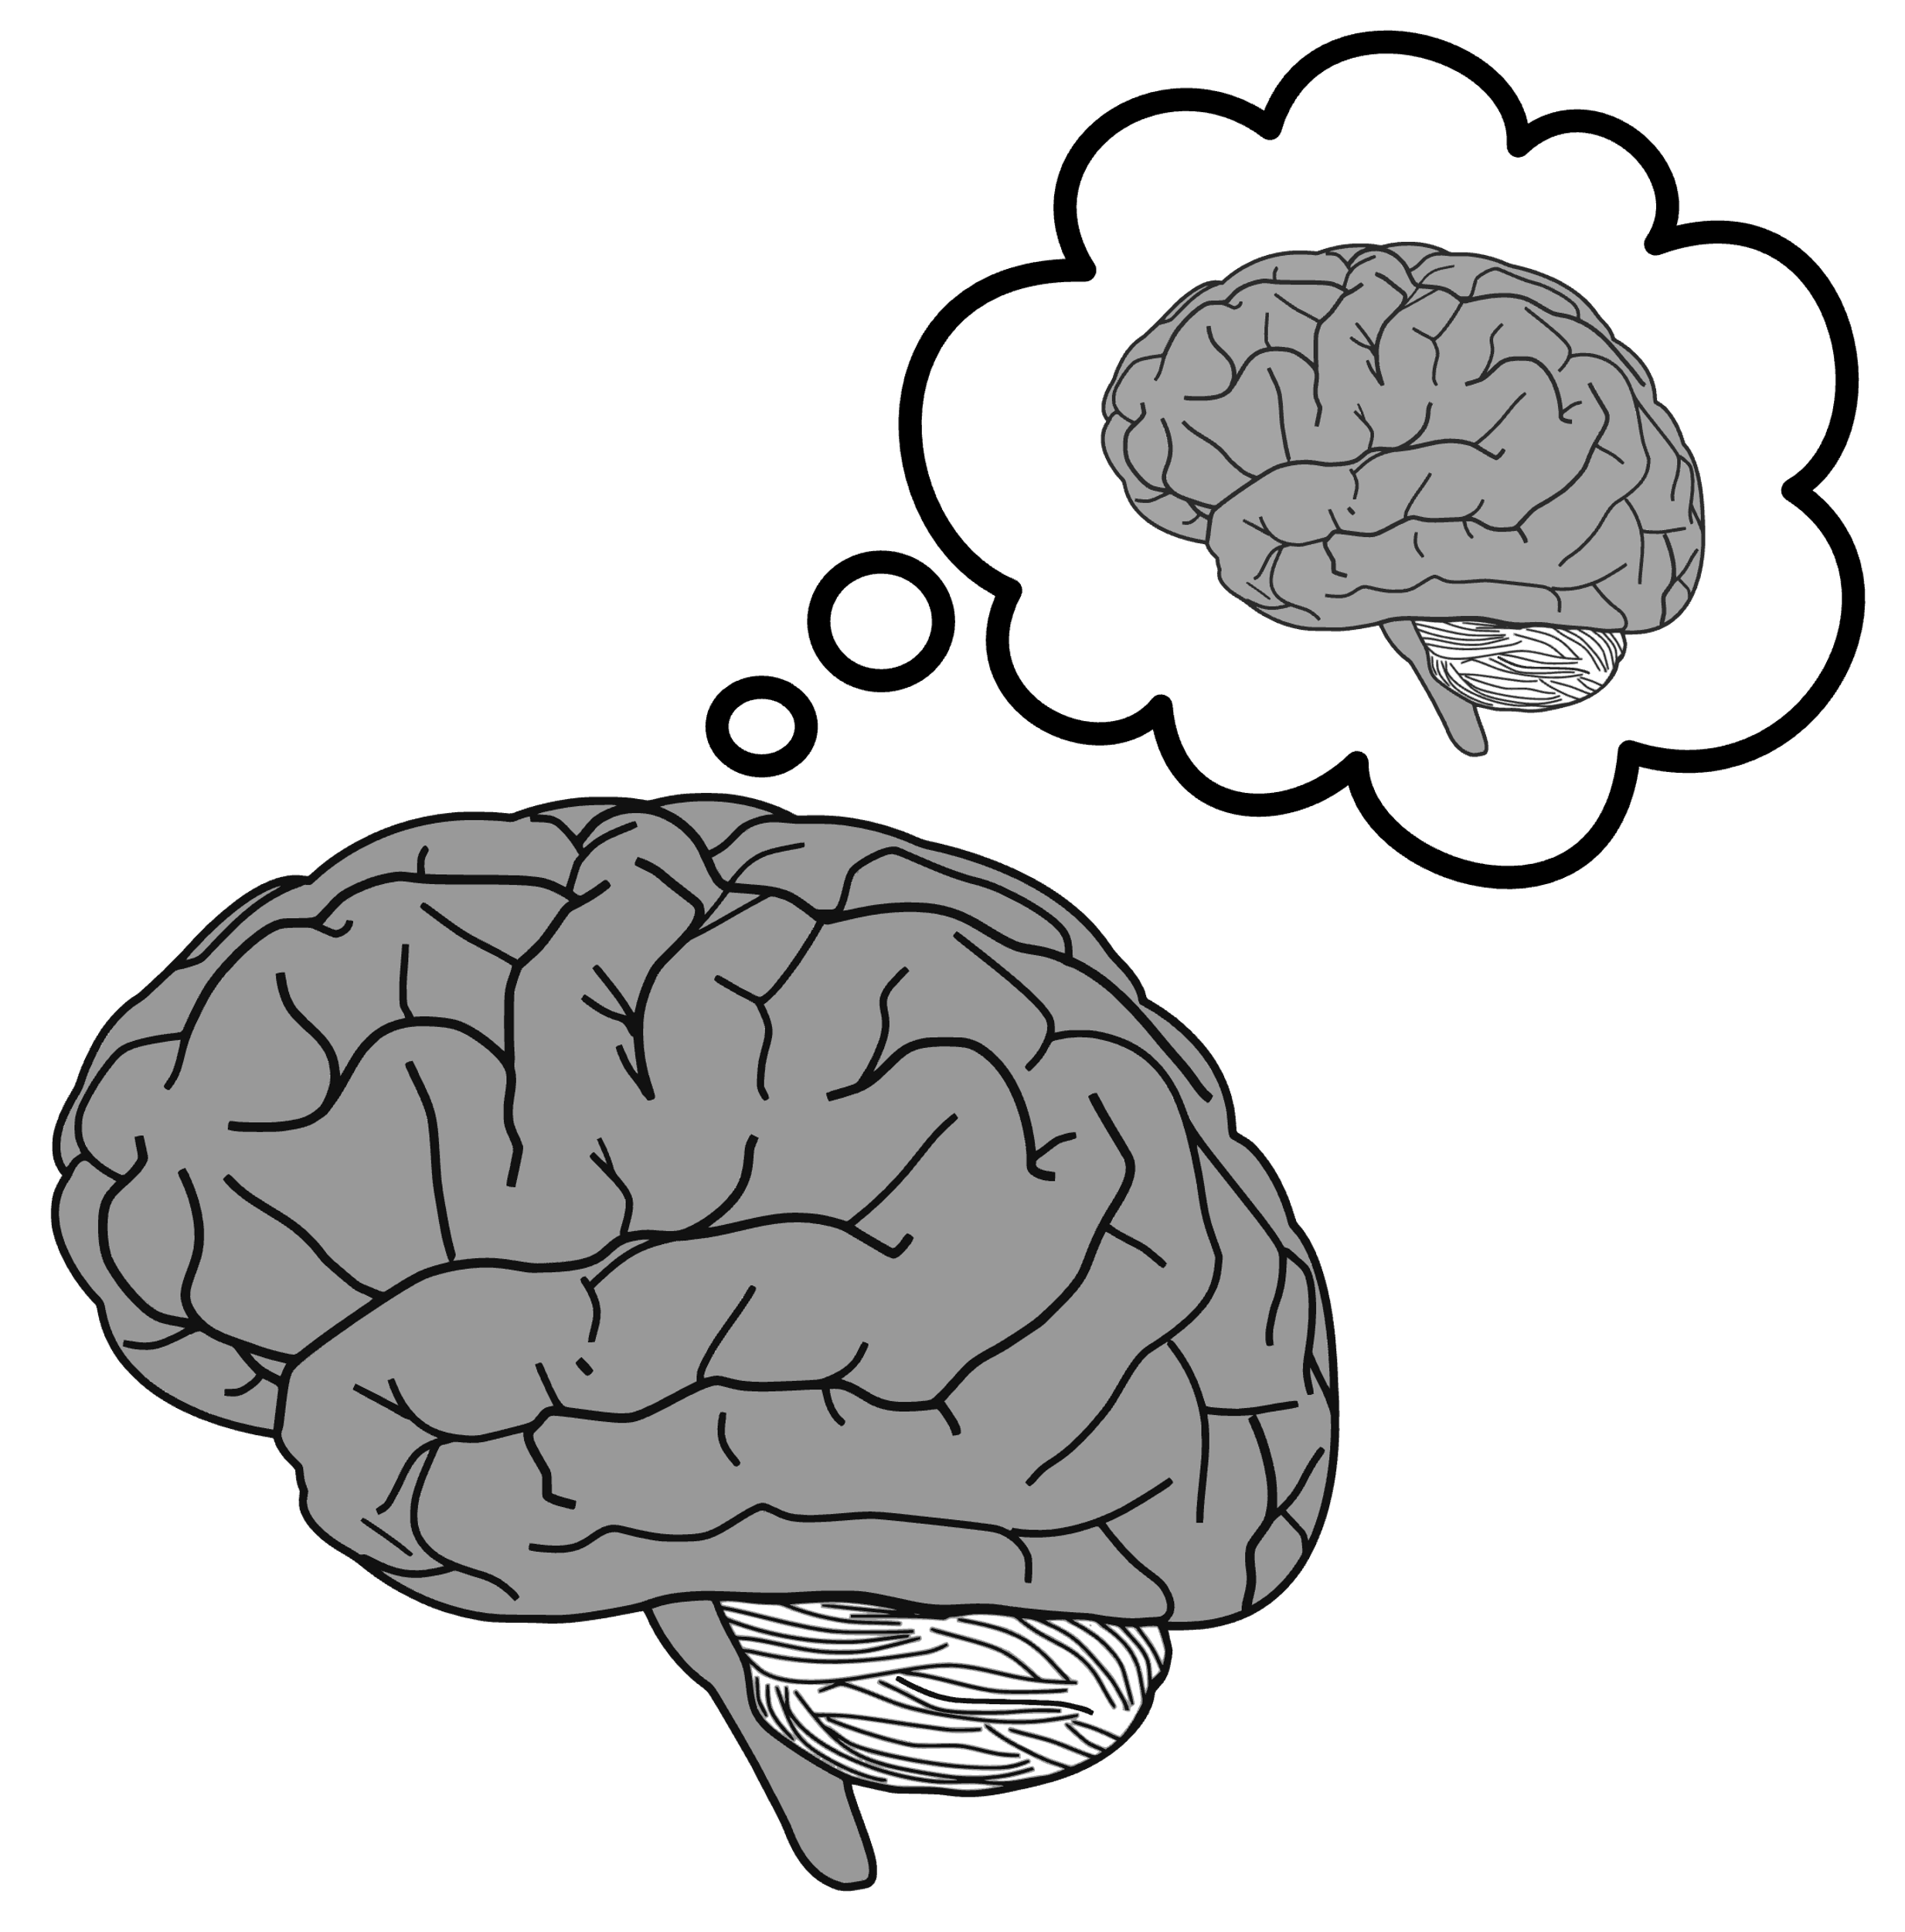
Be mindful of your mind

Slide 3

Our Internal Monologue
Why do we talk to ourselves?
Does it affect our logical thought process?

Slide 4
Let’s use our brains
5 years ago Kate was 5 times as old as her Son.
In 5 years her age will be 8 less than three times her Son's age at that time.
Find their ages.

Slide 5
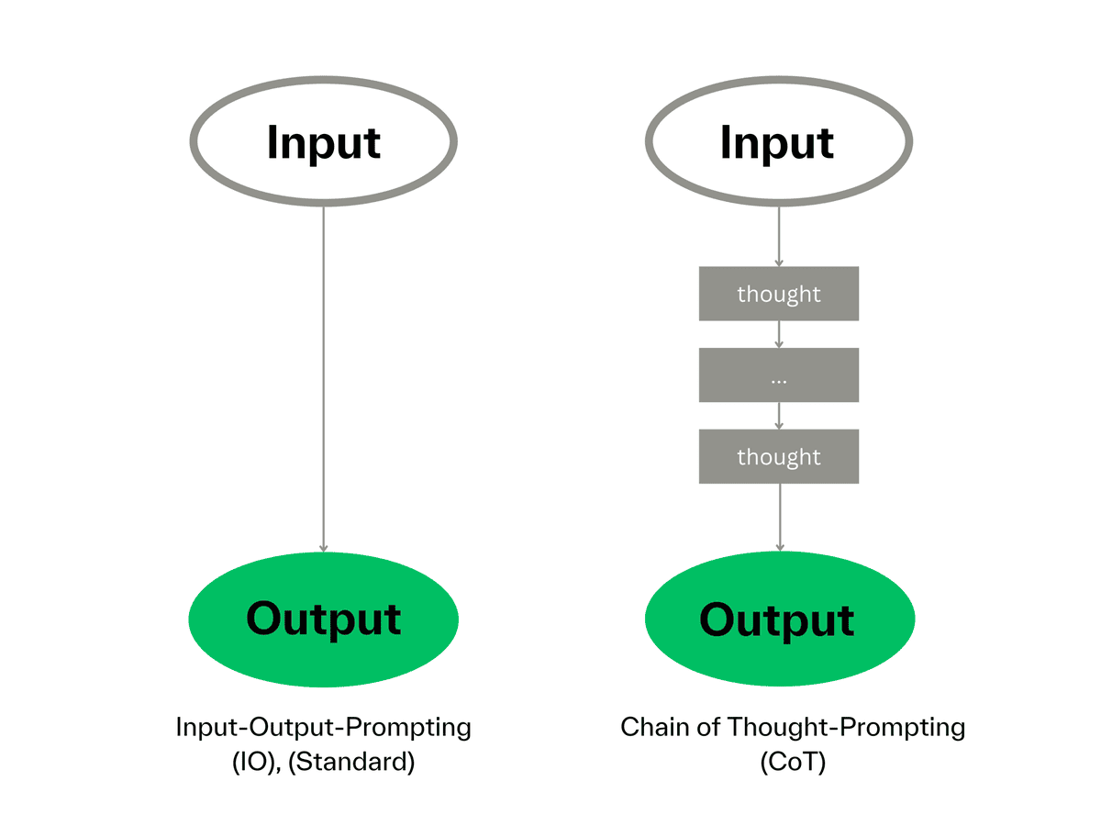
Chain-of-Thought
Instead of asking for a direct answer, you give the LLM breathing room to breakdown the problem, think through each step, and reach a natural conclusion

Slide 6
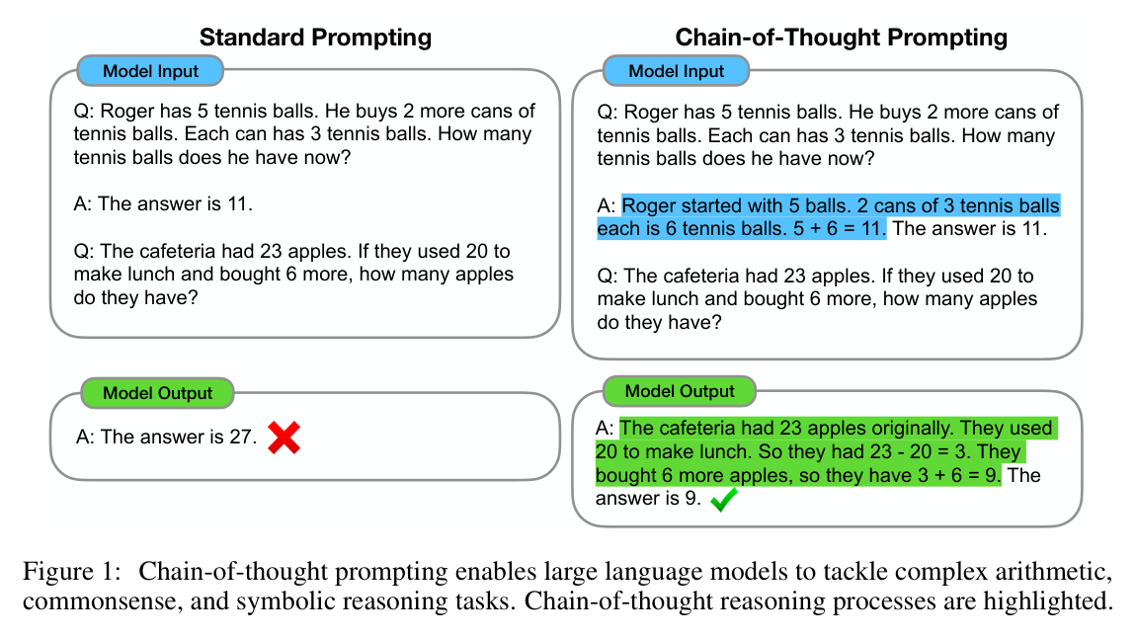
Example of Chain-of-Thought

Slide 7
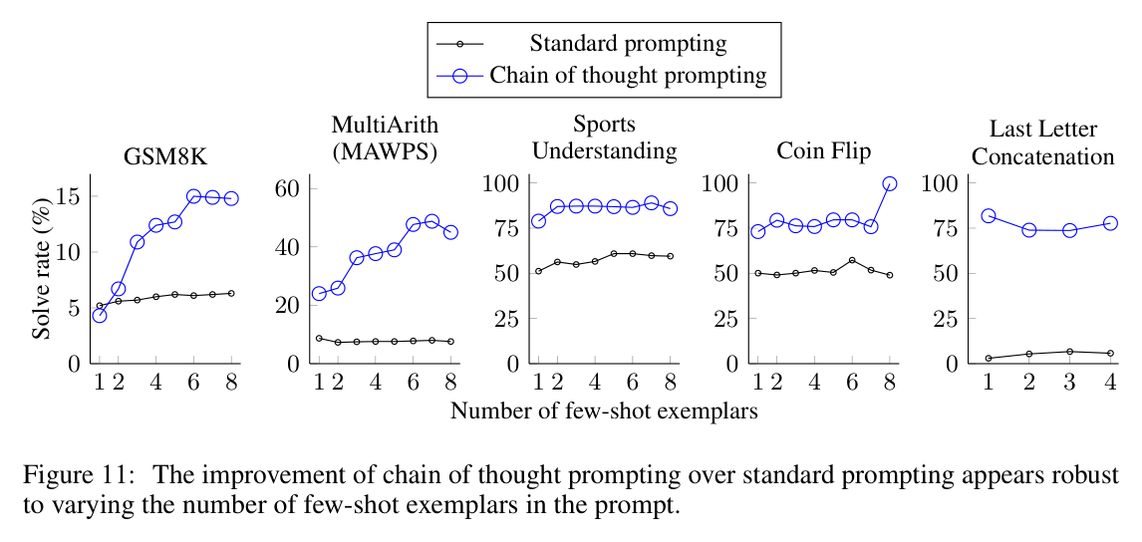
But, does it really work?
Yes, it makes:
Across multiple tasks
Across multiple models

Slide 8
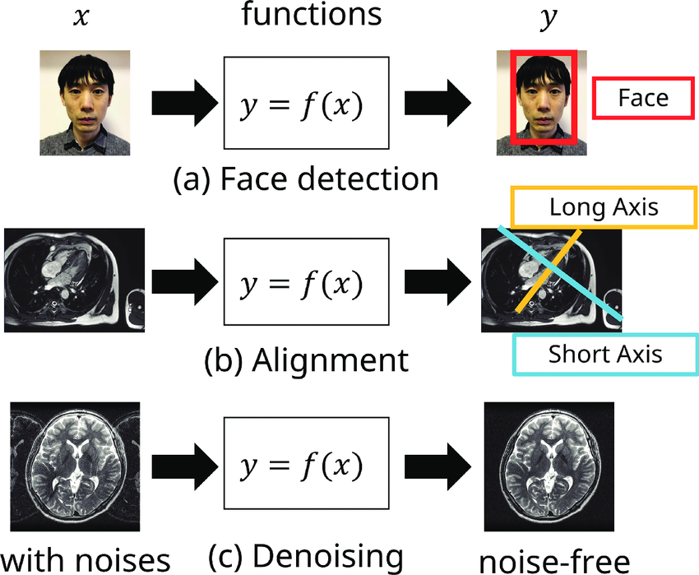
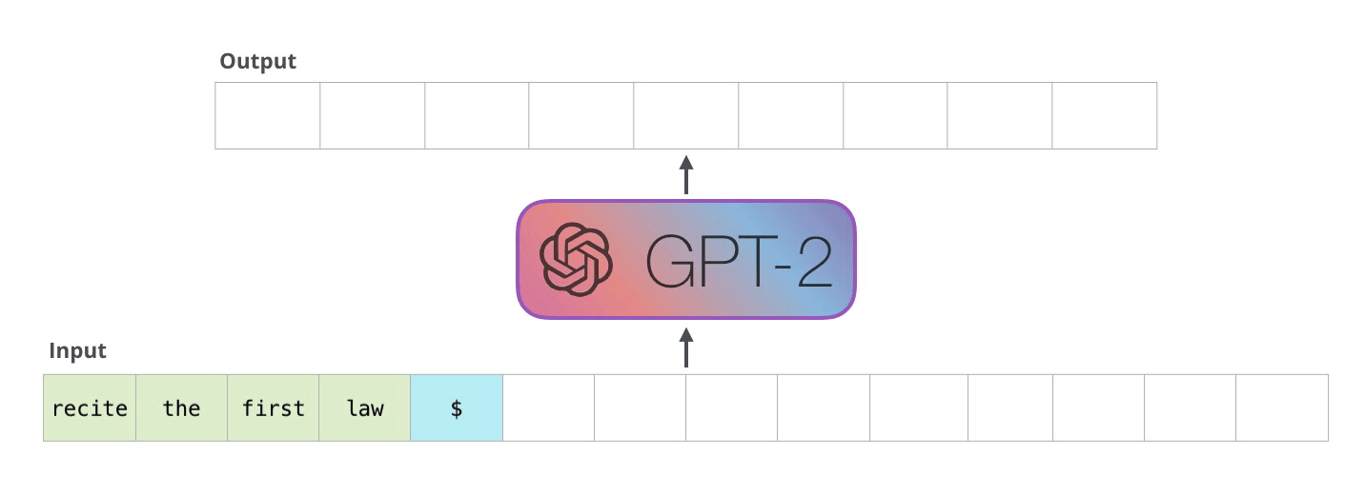
But, why?
Traditional AI
Generative AI:
Autoregressive Generation

Slide 9

Break
Source: original figure

Slide 10

Exercises of Prompts
Testing different prompts:
Zero-shot
Few-Shot
Chain-of-Thought
Ending with implementing two chatbots talking to each other.

