Slide 1
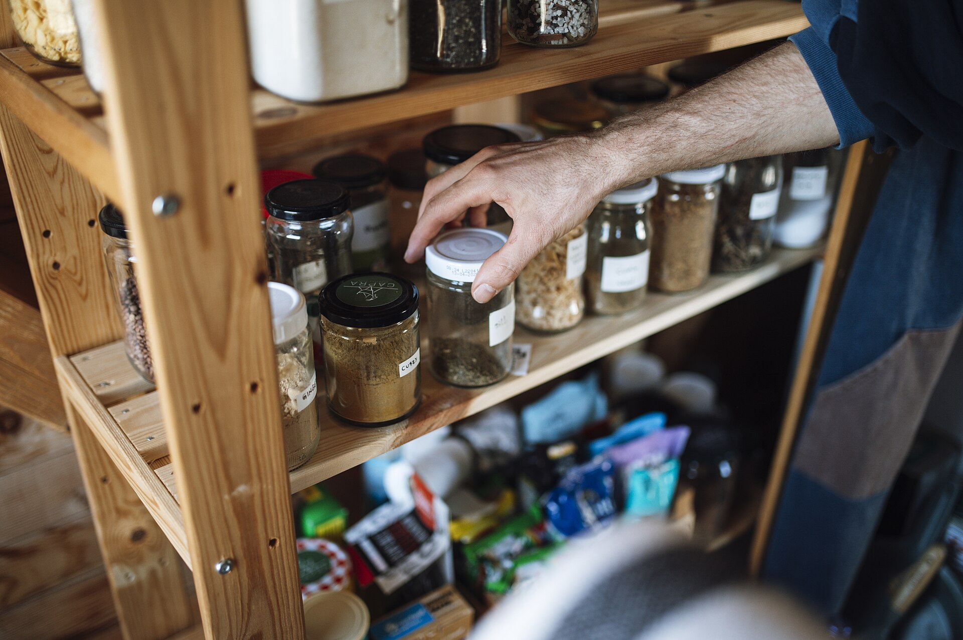
CSCI 3495
Vector Semantics
Natural Language Processing & Large Language Models
Week 5, Class 1 · Mon Sep 21, 2026
Source: Shixart1985, Wikimedia Commons, CC BY 2.0
Notes:
Open with the picture, not the topic. It is ten past midnight, you are hungry, and that is everything in the cupboard. What can you cook? Notice what kind of question that is: not "where is this word", which is what Ctrl+F answers, but "which of these hundred things is most like what I have", which it cannot. We spend the first five minutes watching the tool they already own fail at it, and by the break they will have written the one that works.

Slide 2
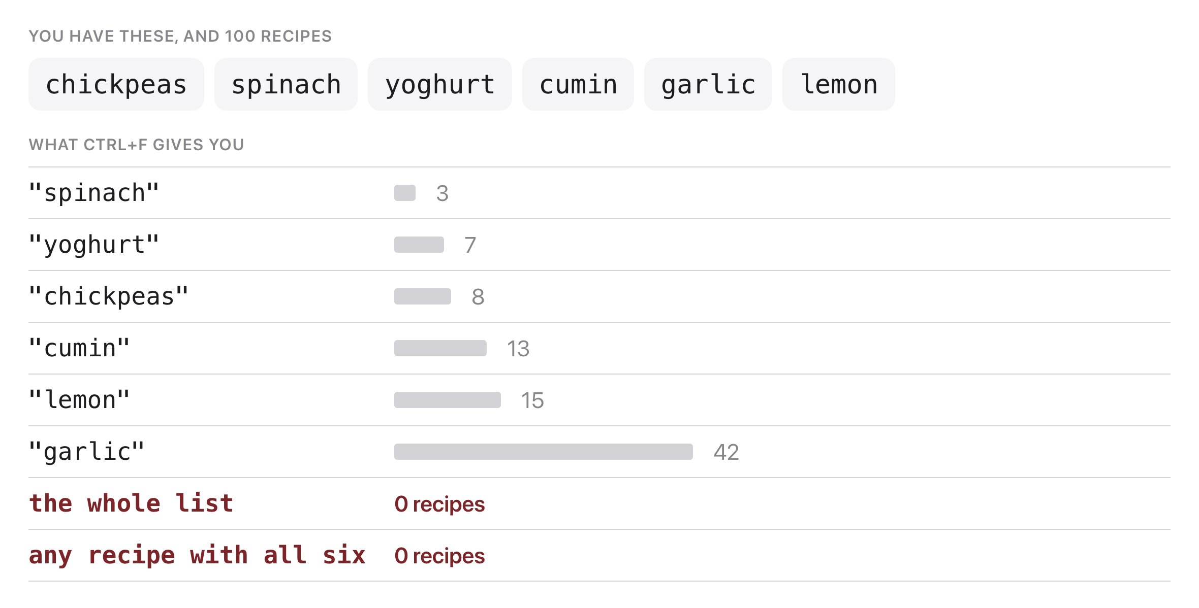
Ctrl+F finds a word, not a ranking
Source: original figure; the 100-recipe corpus in today's notebook
Notes:
Have them run the first two cells now, before any theory. You have six things in the cupboard and a hundred recipes. Ctrl+F on the whole list gives nothing, Ctrl+F on garlic gives forty-two, and no recipe uses all six. So there is no string to find. The question is which recipe uses the most of what you have, counting a rare ingredient for more than one that everything contains, and that is a ranking problem. Everything today is built to answer it.

Slide 3
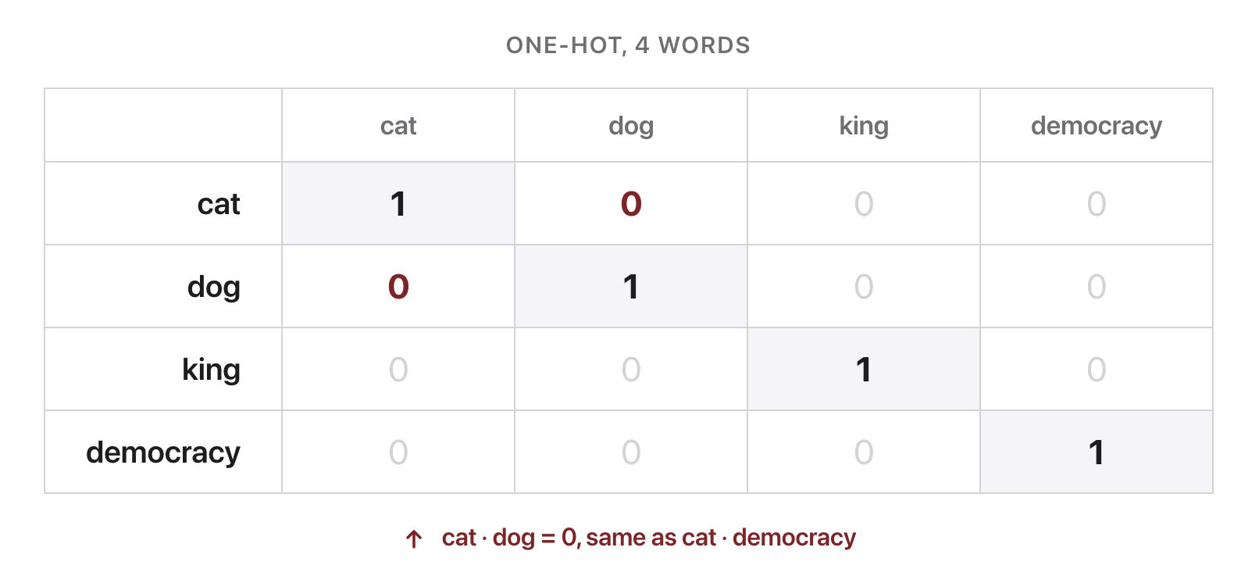
"cat" is as far from "dog" as from "algebra"
Source: original figure
Notes:
One-hot vectors give every word its own dimension, so every pair of distinct words is equally dissimilar. That is plainly wrong, and it is the problem the whole week is about. Note it is the same defect we just saw in Ctrl+F: a word either matches or it does not, and nothing is nearer than anything else.

Slide 4
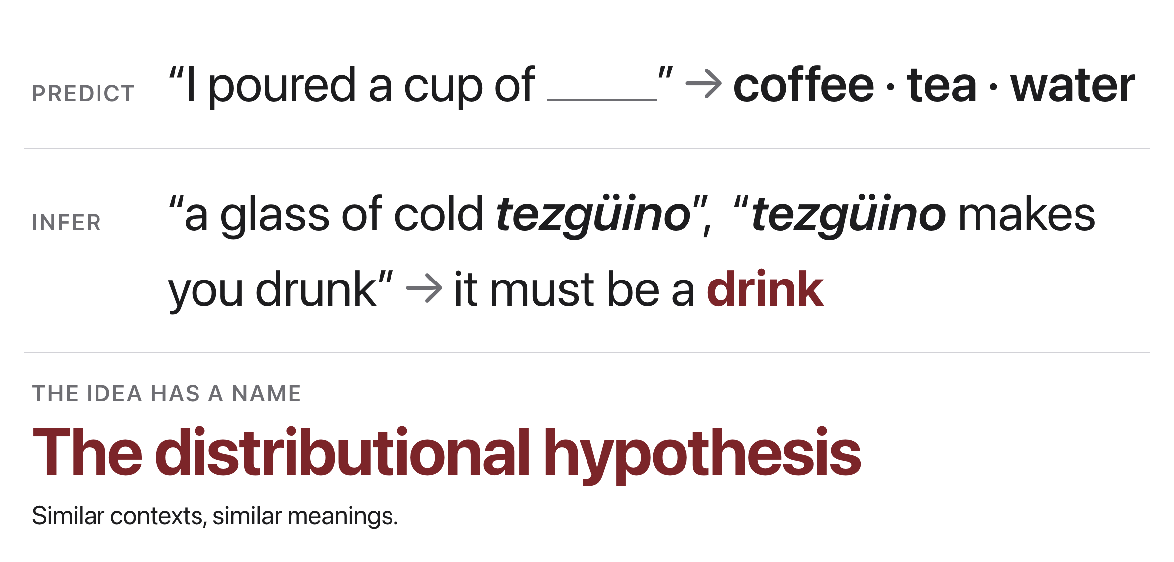
"You shall know a word by the company it keeps"
Source: original figure; Firth 1957; the tezguino example is from Lin 1998, via SLP3 Ch. 5
Notes:
You have never seen the word tezguino, and after two sentences you know it is a drink, because you know what surrounds a drink. That is the distributional hypothesis, and it is the single idea the next four weeks are built on: meaning can be estimated from context, and context can be counted.

Slide 5
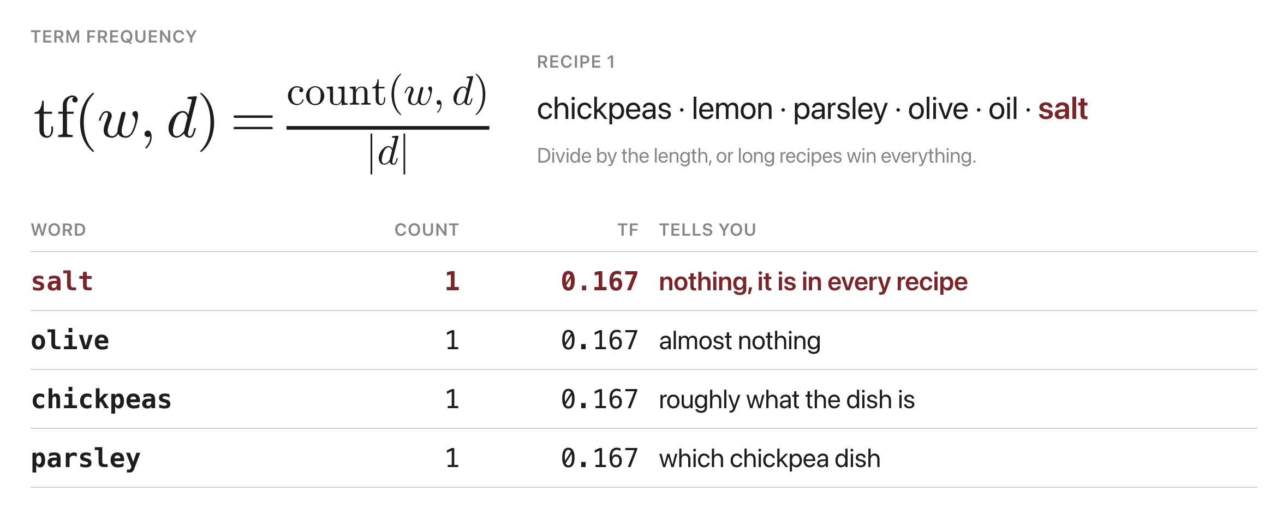
tf gives salt the same score as chickpeas
Source: original figure; the four-recipe corpus in today's notebook
Notes:
Count the word, divide by the recipe's length so a long recipe does not win everything by being long. Then look at the tf column: every ingredient scores 0.167, so tf says salt matters exactly as much as chickpeas. Counting alone cannot rank, which is the same complaint we made about Ctrl+F ten minutes ago and the reason idf exists.

Slide 6
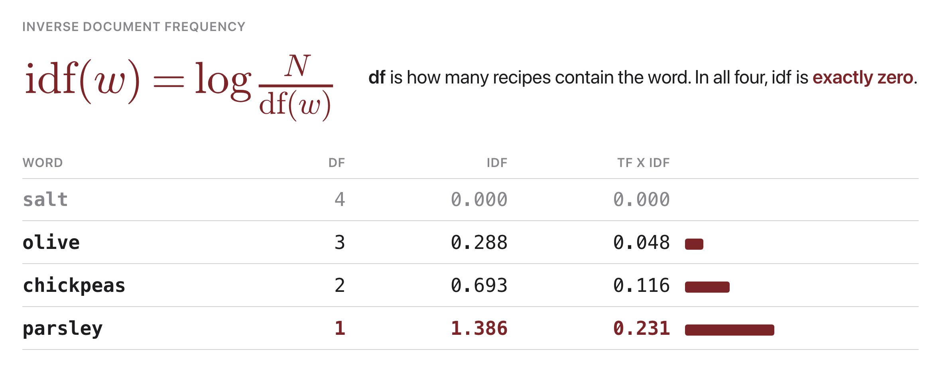
idf switches salt off by arithmetic
Source: original figure; the four-recipe corpus in today's notebook
Notes:
Count how many recipes contain the ingredient at all, and weight by the log of the total over that. Salt is in all four, so it divides by itself, the log is zero, and salt is switched off. Not filtered by a list of boring words: switched off by the arithmetic. Multiply tf by idf and parsley comes out on top, because it is the only ingredient here that tells you which recipe you are looking at.

Slide 7
Let's walk through Parts 1 and 2 in the notebook
Count them, then weight them by rarity.
Notes:
Four tiny recipes, and we write tf and idf out as loops so nothing is hidden. Twelve ingredients, so the whole table fits on screen. Two TRY IT cells, one at the end of each part.

Slide 8
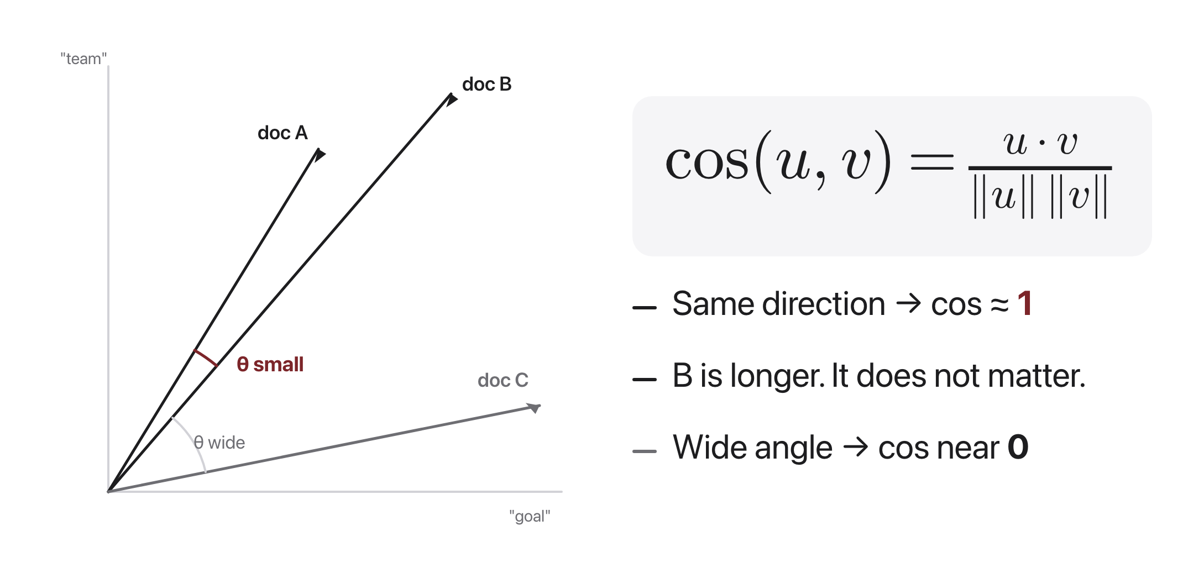
Cosine: the angle, not the distance
Source: original figure; SLP3 Ch. 5
Notes:
A nine-ingredient stew and a three-ingredient salad about the same thing sit far apart by straight-line distance, purely because one has more numbers in it, so distance is the wrong tool. The cosine of the angle throws length away: same direction gives 1, nothing in common gives 0. Dividing by both lengths is what does the throwing away.

Slide 9
Let's walk through Parts 3 and 4 in the notebook
Then point it at all one hundred recipes.
Notes:
Part 3 compares recipes to each other, then scores a pantry against them, which is the punchline: a pantry is just another short recipe. Part 4 hands the same job to TfidfVectorizer over the full hundred and answers the question we opened with. Pause on Chana saag at 0.828: it uses five of their six ingredients and no recipe uses all six.

Slide 10

Break
Source: course-standard break figure

Slide 11
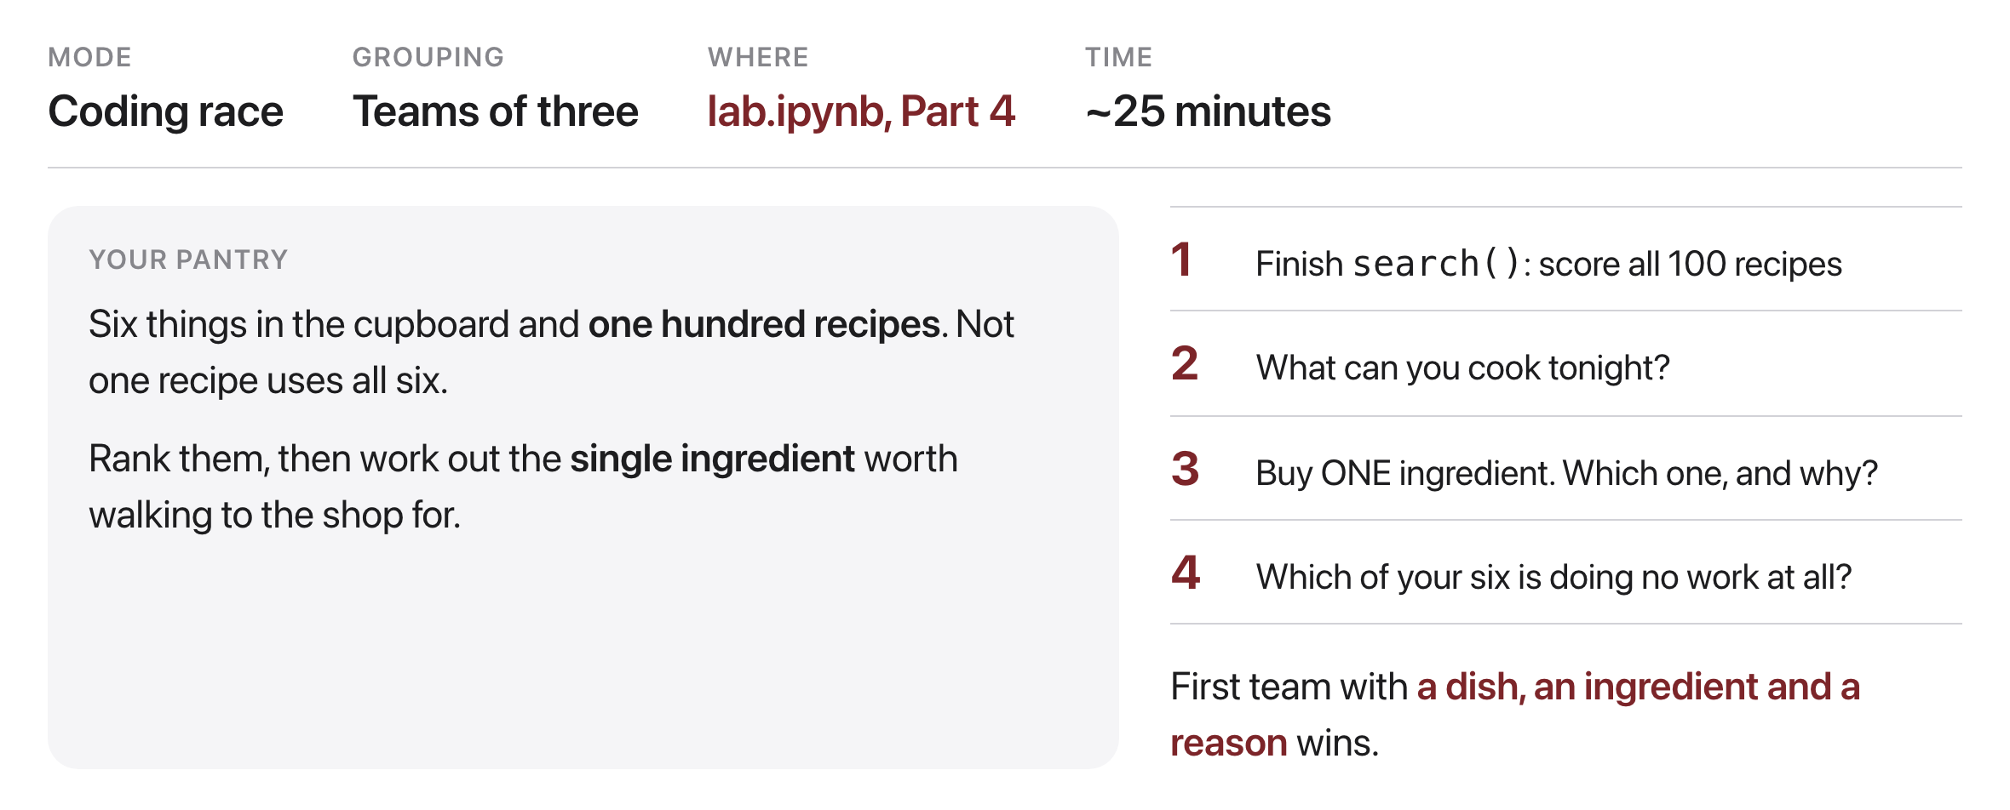
Six things in the cupboard, a hundred recipes
Source: original figure; the recipe corpus in today's notebook
Notes:
Teams of three, twenty-five minutes. First they finish the search loop, which is the one piece of real code today. Then three questions: what can you cook, which single ingredient is worth walking to the shop for, and which of your six is doing no work at all. The middle one is the interesting one, because buying saffron raises the score and buying tomato lowers it, and working out why is the whole lesson.

