Slide 1
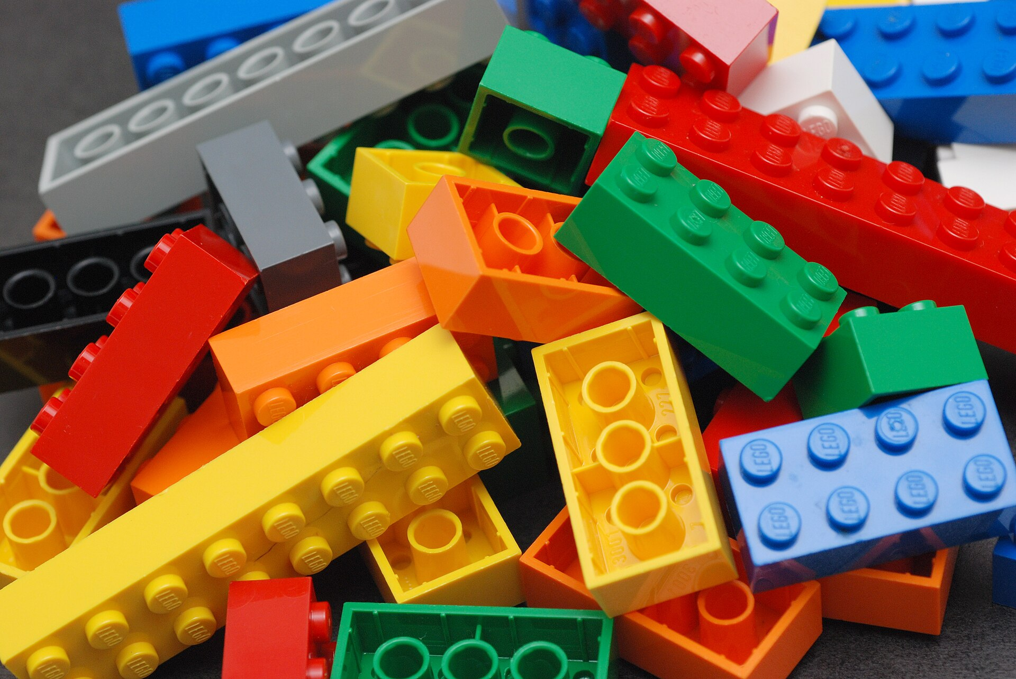
CSCI 3495
Tokenization at Scale, Pretraining Data & Instruction Tuning
Natural Language Processing & Large Language Models
Week 10, Class 1 · Mon Oct 26, 2026
Source: Alan Chia, Wikimedia Commons, CC BY-SA 2.0
Notes:
An LLM never sees words. It sees bricks. Today: where the bricks come from, what they cost, and how a pile of bricks turns into something that answers you.

Slide 2
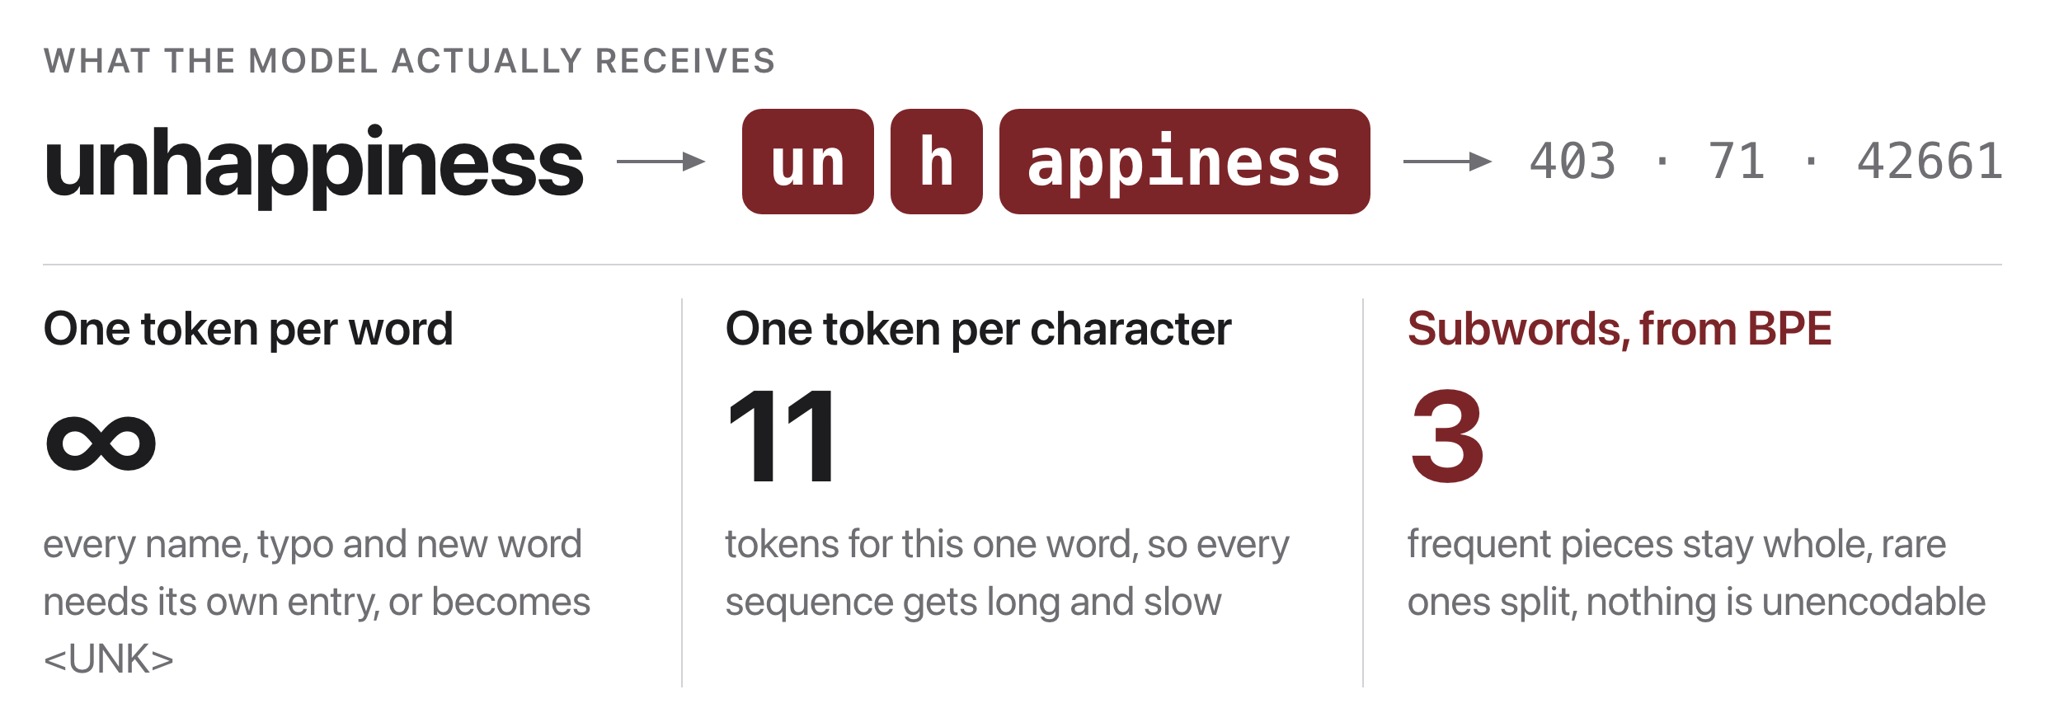
A model reads pieces, not words
Source: original figure; splits and ids from the GPT-2 tokenizer
Notes:
Two obvious designs both fail. One token per word means the vocabulary is unbounded, because names, typos and new words never stop arriving, and anything missing becomes an unknown token. One token per character keeps the vocabulary tiny but makes every sequence long, and attention cost grows with sequence length. BPE learns the middle: frequent pieces stay whole, rare strings break into parts, and nothing is unencodable. Those integers on the right are the only thing the model ever sees.

Slide 3
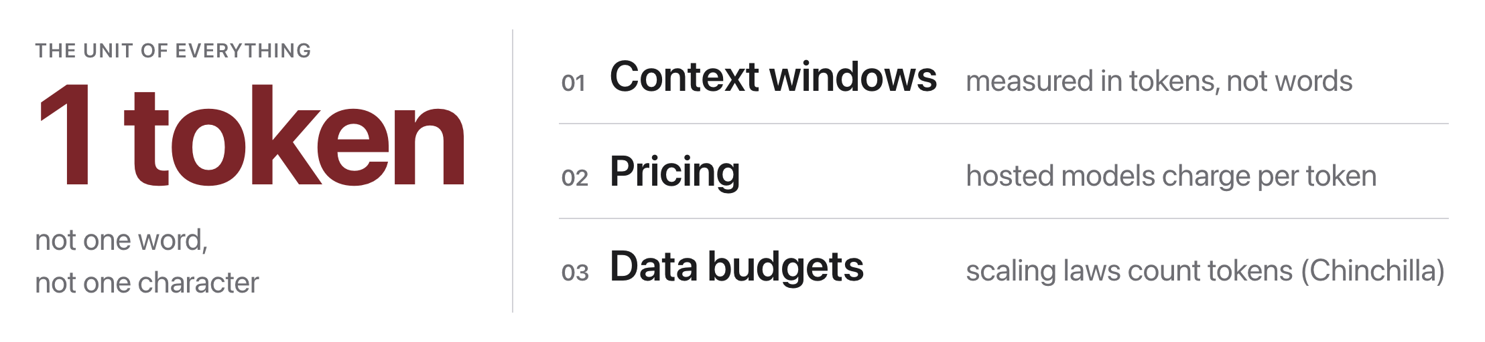
Tokens are the unit of everything
Source: original figure
Notes:
Context windows, API pricing and training data budgets are all counted in tokens, never in words. So the tokenizer is not a preprocessing detail, it decides what a sentence costs. Keep that in mind, because we come back to it as a competition after the break.

Slide 4
Let's walk through Part 1 in the notebook
Feed it your own words and watch what it does to them.
Notes:
Have them put their own names, a word in another language and an emoji into WORDS. The pattern they should find: ordinary English words cost one token however long they are, and everything else costs three to ten.

Slide 5
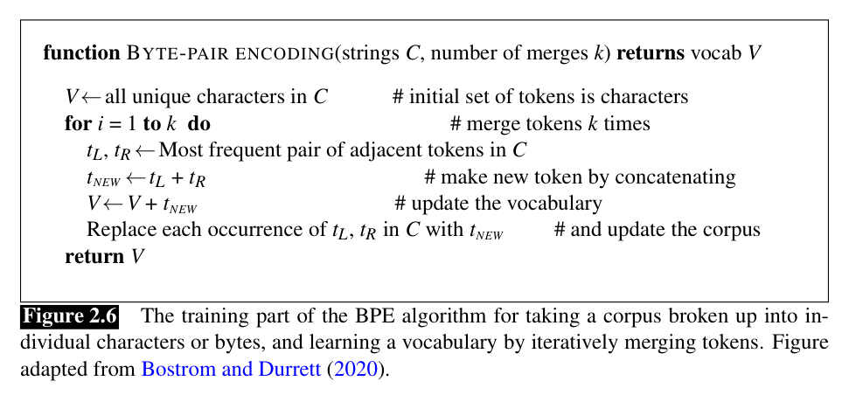
How BPE learns a vocabulary
Source: Jurafsky & Martin, SLP3 (Jan 2026 draft), Fig. 2.6, adapted from Bostrom & Durrett 2020
Notes:
The whole algorithm is a loop: count adjacent pairs, merge the commonest one, repeat k times. Each merge adds exactly one new token to the vocabulary. The ordered list of merges IS the tokenizer, and encoding is replaying that list.

Slide 6
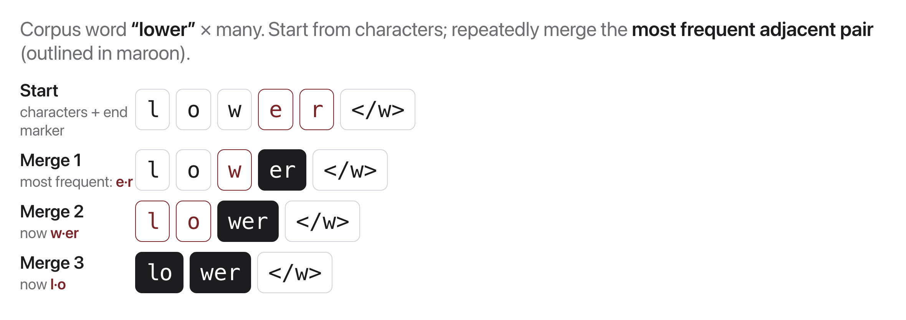
A worked example
Source: original figure
Notes:
Watch what the merges pick up: common endings and common whole words, purely by frequency of adjacency, never by meaning. Real vocabularies stop somewhere between thirty and a hundred thousand entries. Rare words simply stay in pieces, which is why there is no unknown token to handle.

Slide 7
Let's walk through Part 2 in the notebook
Run the merge loop and watch the vocabulary build itself.
Notes:
Two merges and thirty merges are the two ends of the trade. Push them to say what a bigger vocabulary actually costs: every entry is a row in the embedding matrix and a row in the output layer.

Slide 8
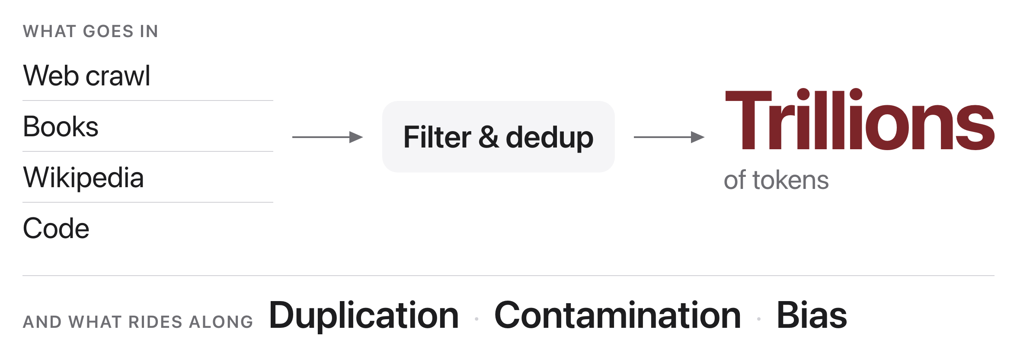
Where the text comes from
Source: original figure
Notes:
Trillions of tokens, filtered and deduplicated, mostly scraped. Three things ride along with it. Duplication drives memorization. Contamination is benchmark answers leaking into the training set, which is why an impressive score is not always evidence. Bias comes back out the way it went in.

Slide 9

It only ever learned to predict the next word.
So why does ChatGPT answer your questions? That gap is the rest of today.
Source: Unsplash License, https://images.unsplash.com/photo-1481627834876-b7833e8f5570
Notes:
Say it plainly and let it sit for a moment. Nothing in pretraining teaches a model to answer a question, follow an instruction, or refuse one. Everything after this slide is about closing that gap.

Slide 10
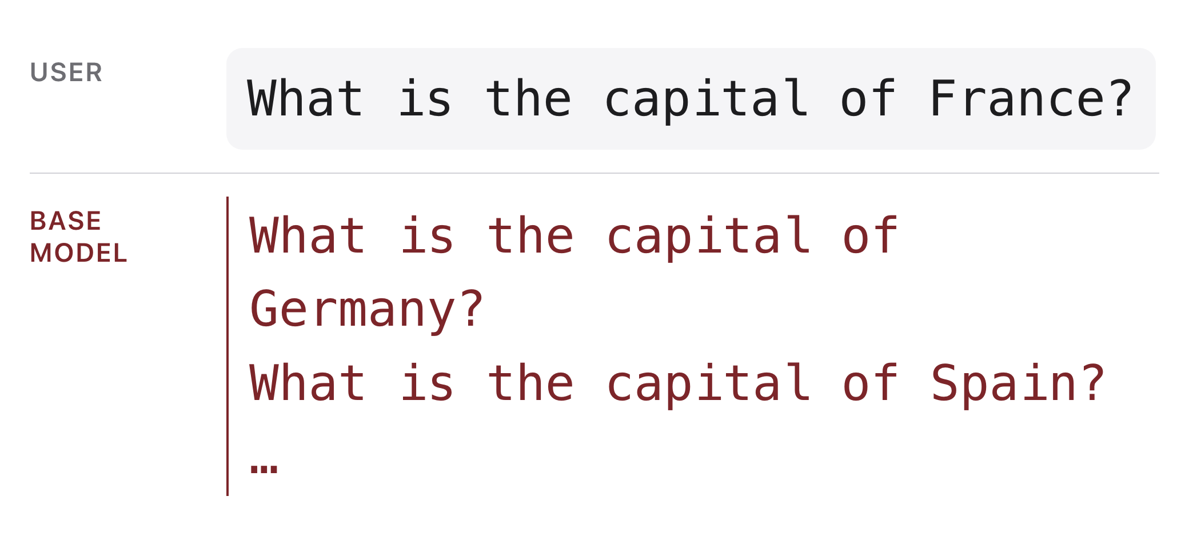
The base model is not an assistant
Source: original figure
Notes:
Ask a base model a question and it writes more questions, because a plausible continuation of a list of questions is another question. It is not refusing. It is doing exactly what it was trained to do.

Slide 11
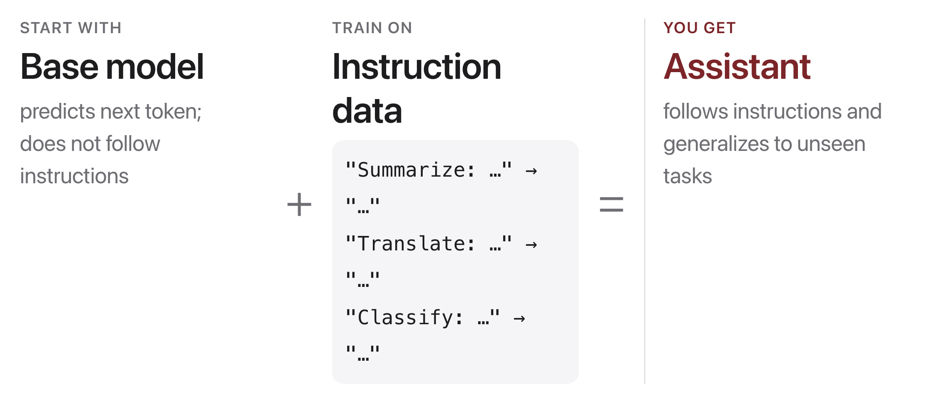
Instruction tuning
Source: FLAN, Wei et al. 2021 (arXiv:2109.01652)
Notes:
Fine-tune on pairs of instruction and response. FLAN and T0 showed the surprising part: train on a mix of tasks phrased as instructions and the model follows instructions it has never seen. This step, supervised fine-tuning, is the first stage of alignment; preference training is the second.

Slide 12
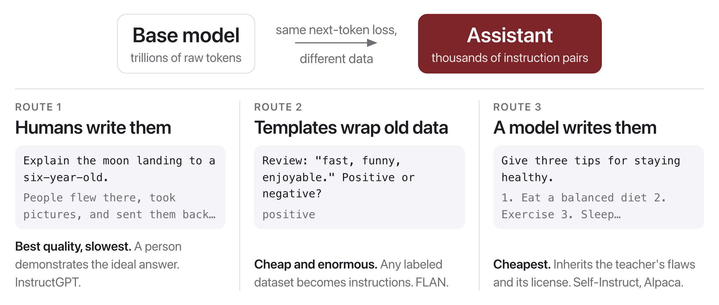
Three routes to an assistant
Source: InstructGPT (Ouyang et al. 2022); FLAN (Wei et al. 2021); Self-Instruct (Wang et al. 2022); Alpaca (Taori et al. 2023)
Notes:
The loss never changes; only the data does. The three routes trade quality against volume. Humans write the best pairs and the fewest. Templates turn any labeled dataset into millions of instructions for almost nothing. A stronger model can write the pairs, which is cheapest and inherits everything the teacher got wrong, plus whatever its license says. Most real datasets are a blend.

Slide 13
Let's walk through Part 3 in the notebook
An instruction pair is just formatted text, and the format is vocabulary.
Notes:
The punchline that ties the two halves of the session together: the chat markers are single tokens in an instruction-tuned model and seven tokens in a base one, because they were added to the vocabulary on purpose. Ask which tokens the loss should actually be computed on, the answer is the response only.

Slide 14

Break
Source: original figure

Slide 15
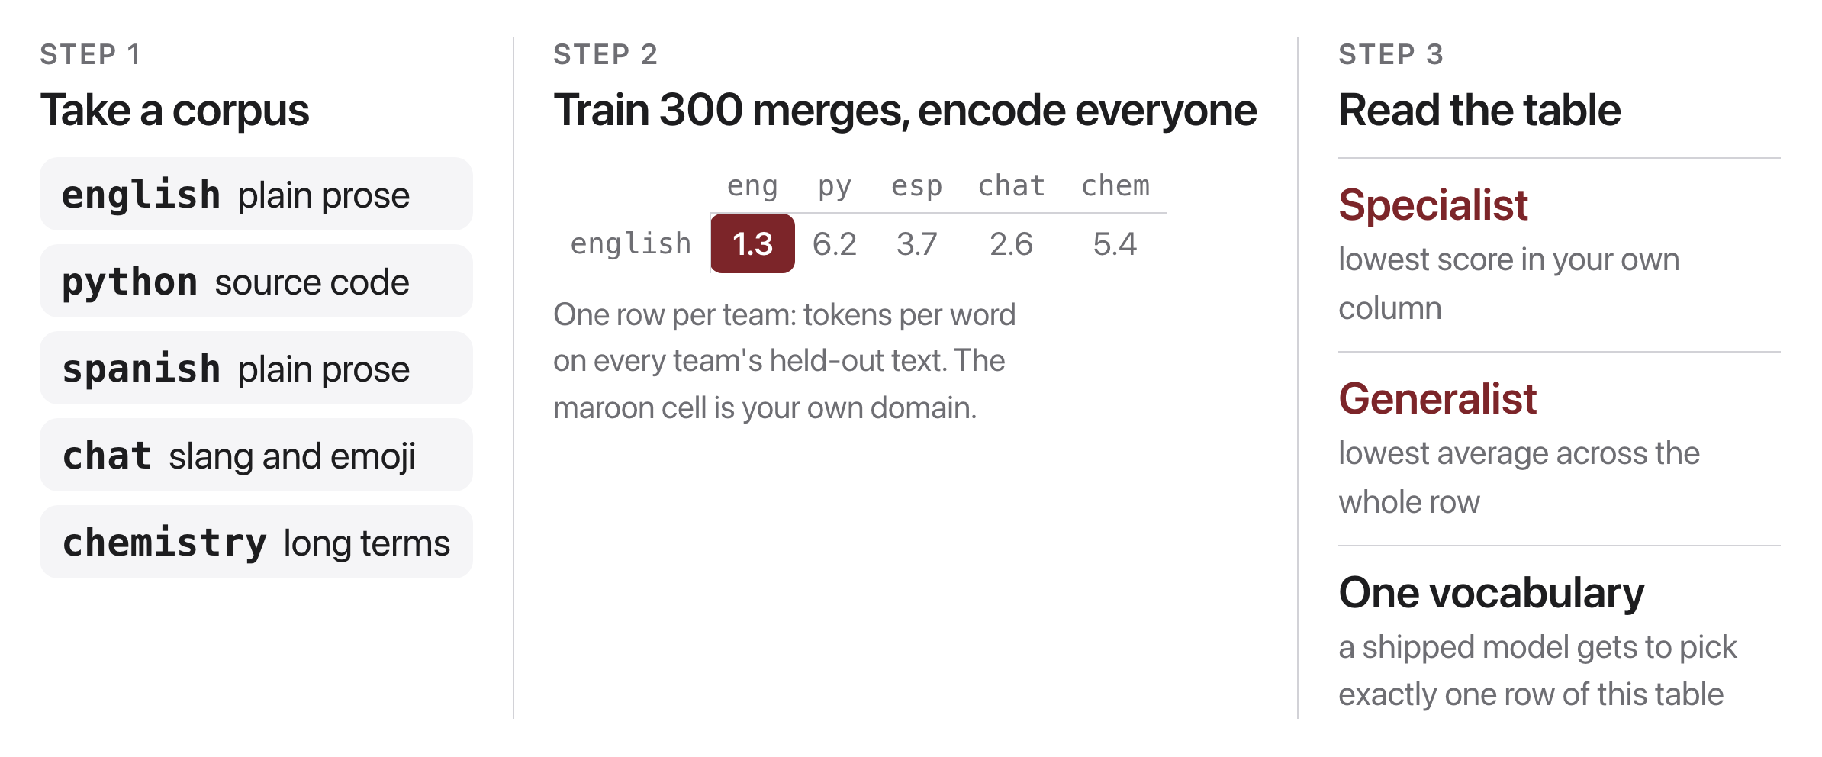
The tokenizer bake-off
Source: original figure; scores from weeks/week-10/class-01/exercise/lab.ipynb
Notes:
Teams of three or four, one corpus each, claimed out loud so no two teams take the same one. Train three hundred merges, score your tokenizer on all five held-out texts, and put your own-domain number and your average on the board. Two winners: the specialist with the lowest number in its own column, and the generalist with the lowest row average. Give them about twenty minutes, then read the board together.

Slide 16
Whose text is cheap?
Every team won its own column and lost everywhere else. A shipped model gets one vocabulary.
Notes:
Land the board. The English tokenizer needs roughly three times as many tokens for Spanish and five times for code. Since context, price and training budget are all counted in tokens, the same meaning costs a non-English user more money and fits less of it in the window. Nobody chose that as a policy; it fell out of which corpus the merges were counted on. Next class: how preferences, not just instructions, get trained in.

