Slide 1
Project Gemini
Team 3 - BEAM Solutions
Anastasia Semionova (Team Leader)
Matthew Schranz
Bryan Cohen
Edouard Davlatian

Slide 2

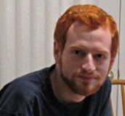
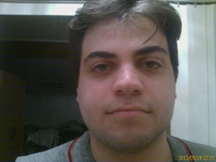


Introduction
B(ryan)
E(douard)
A(nastasia)
M(atthew)
Solutions
Our place in the 5th semester of the Computer Programming and Analyst program gives us a broad base of knowledge. We all share the same passions in web programming which allow us to be focused in our efforts to produce the best system possible for your needs. We are confident that we have the education, potential and enthusiasm to be successful with this project

Slide 3
Project Requirements
Connect a group of PRJ566 students to a potential Sponsor
Host the current semesters PRJ566 teams and projects
Archive all past teams and projects
Enable students to give descriptions about themselves and the team for interested Sponsors
Sponsors should be aware of Legal Terms before proposing a project
Sponsors should be able to register and provide information about their company and the project they want to be designed and implemented.
Sponsors should be aware of their project status through their web page
Teams and Sponsors should be able to rank each other based on their interest level and should be matched based on their preferences.

Slide 4
Business Rules
BR# 1: Only projects approved by appointed site administrator can became available for PRJ566 students.
BR# 2: Company Representative and Team Leader accounts can only be created by the appointed site administrator.
BR# 3: Approved project can became current project available only if it is registered before the date set by the site administrator.
BR# 4: All team and project ranking must be done before appointed administrator can match them.
BR# 5: In case there are more projects available then teams, team leaders must rank the same amount of project as there are teams in the particular semester.
BR# 6: Each team/project must be ranked with a different ranking number (sequentially).
BR# 7: Appointed site administrator must be notified when a new project is proposed.
BR# 8: Before a company representative can register a company and propose a new project, he/she must acknowledge the Legal Agreement Contract.
BR# 9: Company page must be created during the company account creation (generated from a template).
BR#10: Team Page must be created from a template.
BR#11: Team Leader must specify the team constraints when publishing the page.

Slide 5
Business Rules
BR#12: Appointed site administrator should be able to edit the matching results and all changes must be tracked.
BR#13: Company Representative should be able to check project status.
BR#14: Project status must be up to date and updated by a team leader.
BR#15: When teams are matched with the projects all parties must be notified.
BR#16: Each project must have milestones with the appropriate status.
BR#17: All created accounts must have a temporary password generated by the system, and it must be change on first log in.
BR#18: Company representative should be able to leave comments upon project completion.
BR#19: Appointed site administrator must be notified when a comment is left.
BR#20: Company comments can be viewed by site visitors only after appointed site administrator approval.
BR#21: Appointed site administrator should be able to notify all parties when it is time to do ranking.
BR#22: A project can become a current project after date set by appointed site administrator only if there are not enough projects and new project should be matched manually with an “orphan” team.
BR#23: Visitors should be able to view all projects upon completion as past projects.
BR#24: Team leader should be able to customize project milestones.
BR#25: Appointed site administrator should be able to set the deadline of project registration.

Slide 6
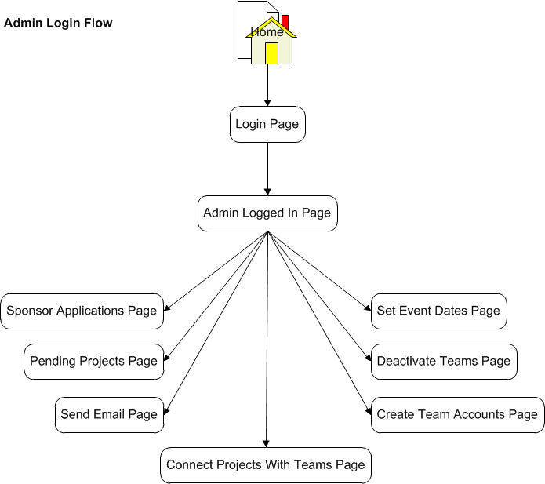
System Work-flow

Slide 7
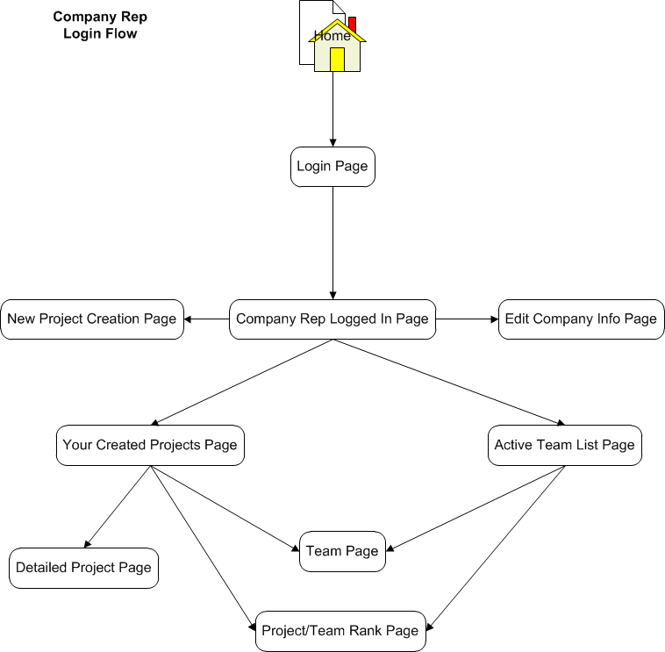
System Work-flow

Slide 8
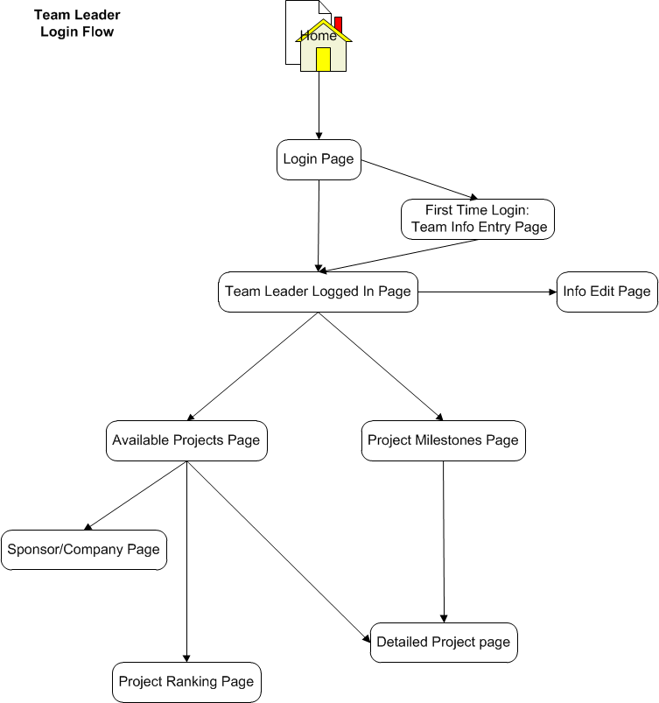
System Work-flow

Slide 9
Screen Prototypes
*Team’s Page

Slide 10
System Use Case Diagram
*Team’s Page

Slide 11
Use Case Specs
*Team’s Page

Slide 12
Questions and Discussion

