Slide 1
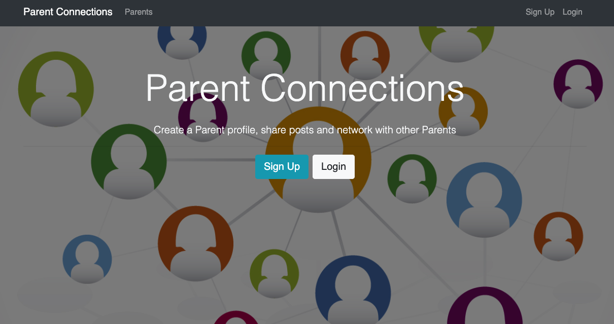
Ethel Cofresi 2019

Slide 2
The Concept and Goals
Concept:
Provides an online forum for parents to connect, chat, share notes, etc. that is outside of the school’s social media and out of public view.
This application is created to demonstrate ability to build a complete full-stack application using MongoDB, Express, Node.js, React, and Redux.
Build backed API with Node.js and Express
Protect routes/endpoints with JSON Web Token – stateless authentication practices
Use React for the frontend
Use Redux for application state management
Develop views using Bootstrap for responsive design

Slide 3
User Experience
Demo - https://parent-connections.herokuapp.com/

Slide 4
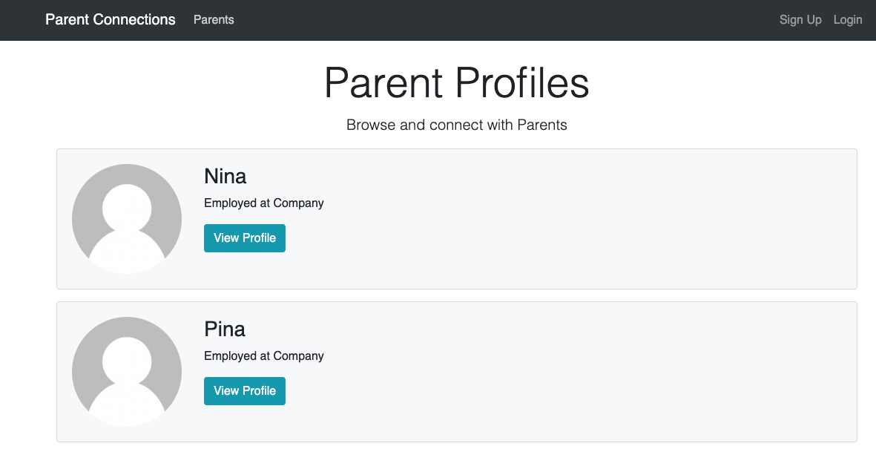
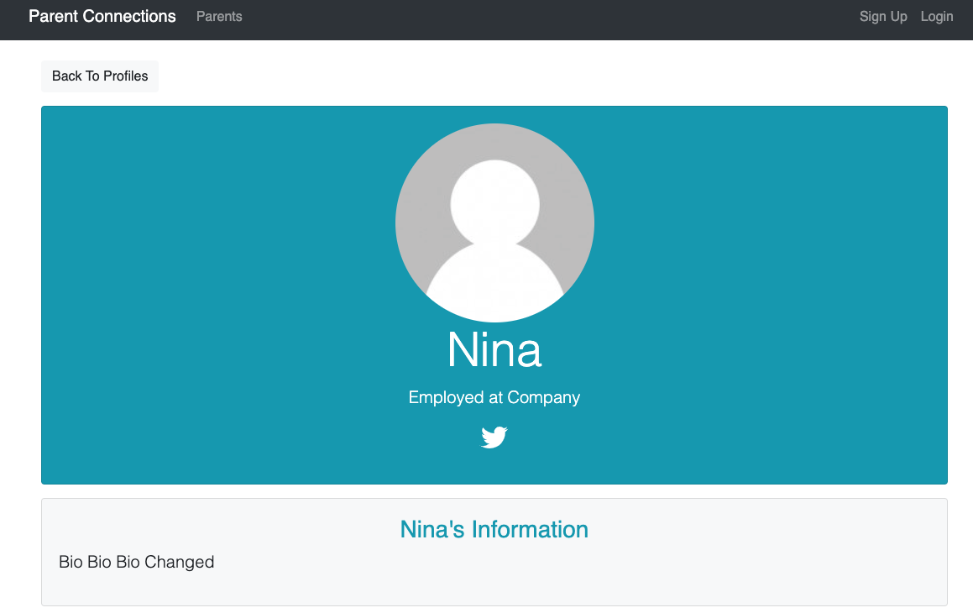
User Experience
Demo - https://parent-connections.herokuapp.com/

Slide 5
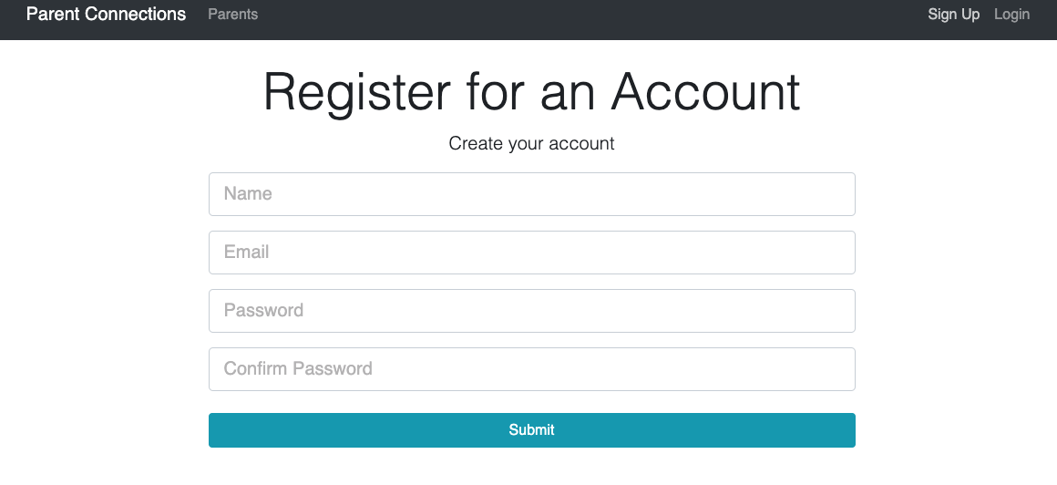
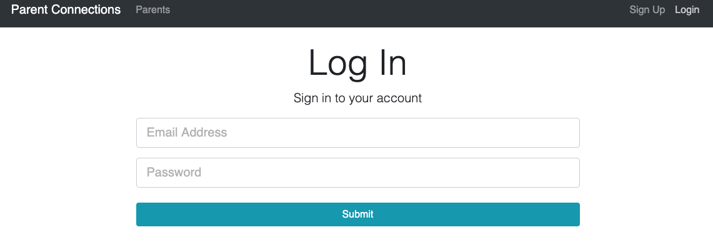
User Experience
Demo - https://parent-connections.herokuapp.com/
Test
Login:
nina@email.com
password

Slide 6
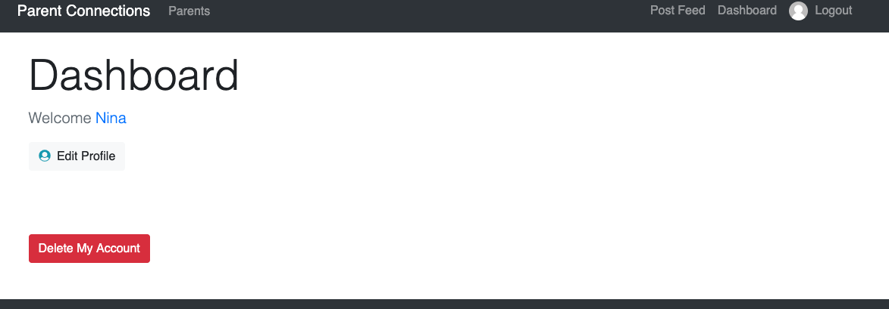
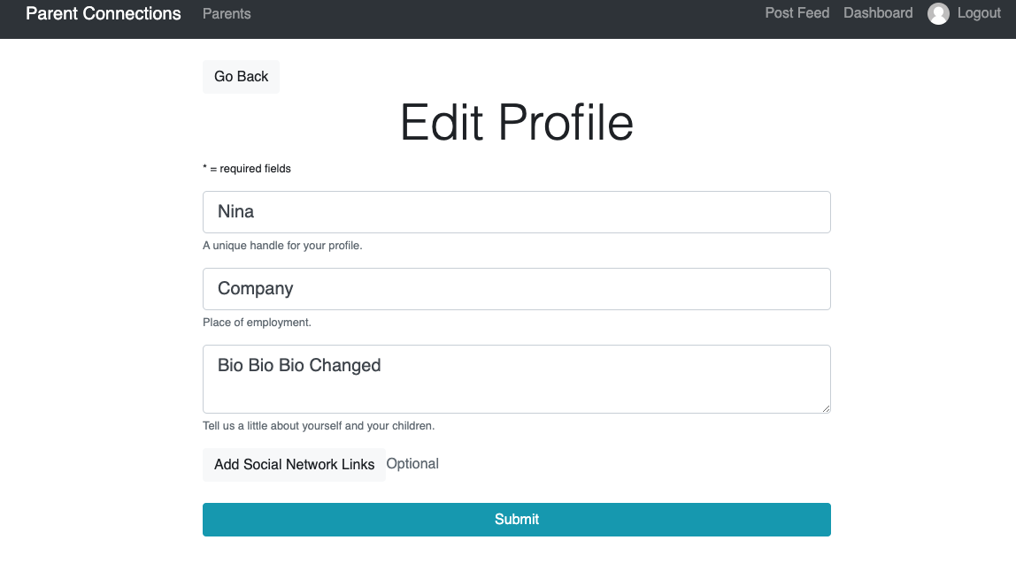
User Experience
Demo - https://parent-connections.herokuapp.com/

Slide 7
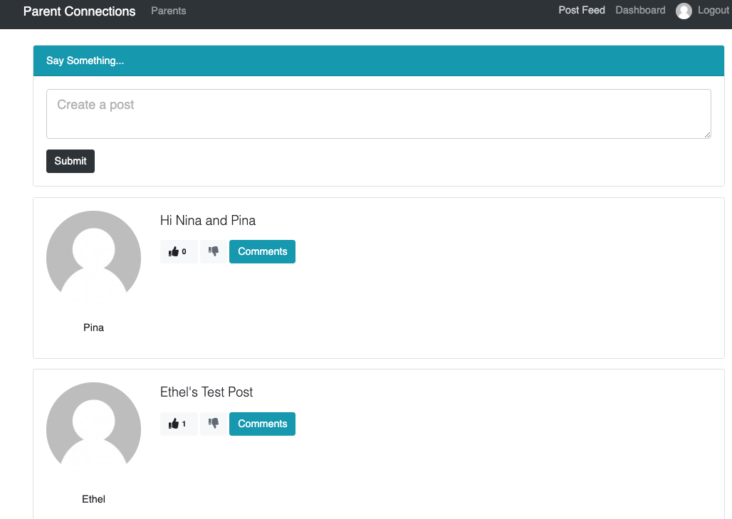
User Experience
Demo - https://parent-connections.herokuapp.com/

Slide 8


Technologies Used
Demo - https://parent-connections.herokuapp.com/
Backend
Frontend

Slide 9
Challenges
Demo - https://parent-connections.herokuapp.com/

