Slide 1
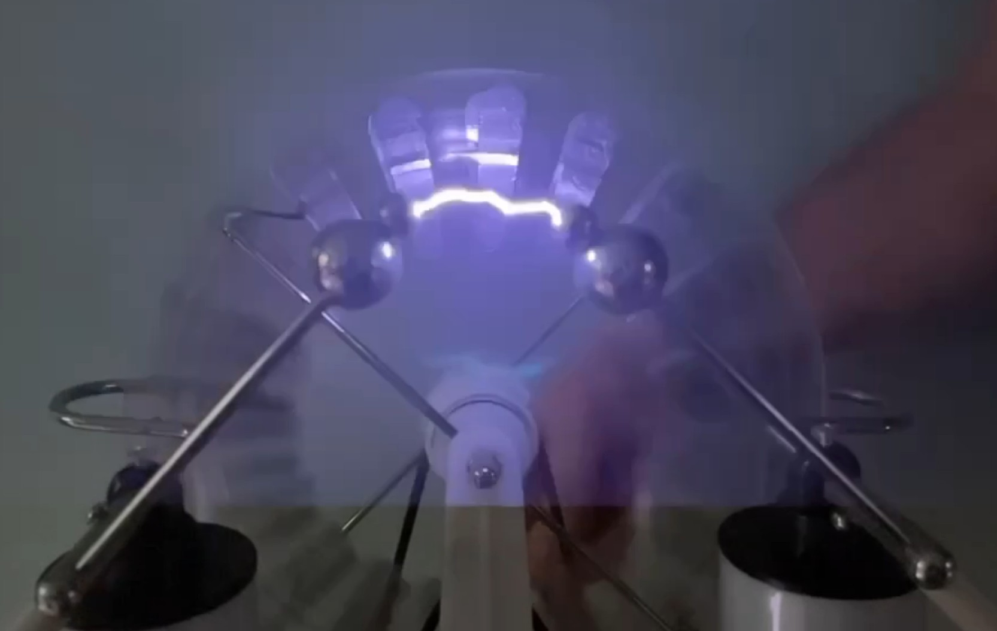
Charge, Capacitance & High Voltage
Investigating a Wimshurst Electrostatic Generator
Science Project Presentation

Slide 2
What Does a Wimshurst Machine Do?
Mechanical motion separates electrical charge and creates a very large potential difference.
Opposite charges accumulate
High electric field breaks down the air
Counter-rotating insulating disks
Mechanical energy → charge separation → high voltage → spark

Slide 3
Four Quantities to Keep Separate
Charge (Q)
Voltage (V)
Capacitance (C)
Current (I)
How much electrical charge has accumulated. Measured in coulombs.
Electrical potential difference between the terminals.
How much charge can be stored for a given voltage.
Rate at which charge flows. Measured in amperes.
Q = C V and V = Q / C
Low capacitance means only a small amount of charge is needed to reach a very high voltage.

Slide 4
Without Leyden Jars: Rapid Thin Blue Discharges
What is happening?
• Effective capacitance is small. • A little transferred charge produces a large voltage rise. • Surface charge creates a strong electric field. • Air ionizes quickly. • The small stored charge discharges, then the cycle repeats rapidly.
Small C → little Q needed → breakdown reached quickly

Slide 5
With Leyden Jars: Slower, Brighter, More Energetic Sparks
What changes?
• The jars greatly increase capacitance. • More charge is needed to reach the same breakdown region. • Charging takes longer. • Much more charge and energy are available when breakdown occurs. • The result is a thick, bright, loud spark.
Stored energy: E = ½ C V²

Slide 6
Same Generator — Very Different Discharge
WITHOUT LEYDEN JARS
WITH LEYDEN JARS
Low capacitance Voltage rises quickly Frequent discharge Thin blue stream Little energy per event
Higher capacitance More charge must accumulate Less frequent discharge Thick, bright spark Much more energy per event
The jars primarily change charge storage and discharge energy — not the basic mechanism that creates the high voltage.

Slide 7
Estimating Voltage with the Spark Gap
Air breakdown provides a practical indirect measurement.
V ≈ (3 kV/mm) × d
Example: 10 mm × 3 kV/mm ≈ 30 kV
measured gap d
This is an estimate, not a precision measurement. Humidity, pressure, electrode shape and other factors affect air breakdown.
Best practice: measure the maximum repeatable spark gap over several trials.

Slide 8
Why Not Use an Ordinary Voltmeter or Oscilloscope?
Voltage Rating
Loading
Oscilloscope Ground
A Wimshurst machine may reach tens of kilovolts. Ordinary meters and probes are commonly rated for hundreds of volts to about 1 kV—not 30–60 kV.
A normal meter has finite resistance. On a very-low-current electrostatic source, the meter can draw enough current to collapse the voltage instead of simply measuring it.
Many scopes have an earth-referenced probe ground. Connecting it to a floating electrostatic generator can alter the circuit and create an unintended discharge path.
Direct measurement requires specialized high-voltage, very-high-impedance instrumentation.

Slide 9
High Voltage Does Not Necessarily Mean High Power
P = V I
Example Wimshurst calculation
Compare: USB Supply
V = 30,000 V = 30 kV I = 10 µA = 0.000010 A P = (30,000 V)(0.000010 A) P = 0.30 W
5 V × 2 A = 10 W The USB supply has 6,000× less voltage, yet can deliver more than 33× as much continuous power in this example.
30,000 volts sounds enormous — but with only 10 millionths of an ampere, the calculated power is just 0.30 watt.
Important: the 10 µA value is an example. Actual power requires a reliable current measurement or specification.

Slide 10
Why Can a Low-Power Machine Make Such a Dramatic Spark?
E_stored = ½ C V²
Energy is accumulated, then released quickly
A Leyden jar may charge over a relatively long interval, then release much of its stored energy in a tiny fraction of a second. Example only: 0.05 J ÷ 0.0001 s = 500 W during that brief interval. That does NOT mean the generator continuously produces 500 W.
P_discharge ≈ E_stored / t
Average generator power and instantaneous spark power are different quantities.

Slide 11
Demonstrations for the Science Project
1. Spark Gap
2. No Jars vs. Jars
3. Neon Lamp
4. Optional Pendulum
Measure the maximum repeatable gap and estimate voltage using ~3 kV/mm.
Compare rapid thin blue discharge with slower, bright energetic sparks.
Show that high voltage can ionize neon and produce visible light with very small current.
Demonstrate electrostatic attraction, contact charging, and repulsion.
A coherent story: charge separation → electric field → voltage → capacitance → energy storage → breakdown.

Slide 12
What the Experiment Demonstrates
The Wimshurst machine produces high voltage in both configurations.
Without jars: small C → rapid voltage rise → frequent weak discharges
With jars: larger C → more stored Q and E → less frequent, stronger sparks
Spark gap → indirect estimate of high voltage
Key lesson: voltage, current, power, charge, capacitance and stored energy are related — but they are not the same thing.

Slide 13
Safety
High voltage requires respect
• Do not deliberately discharge the machine through a person. • Treat Leyden jars as charged capacitors even after cranking stops. • Discharge them with an appropriate insulated discharge tool before touching conductors. • Keep away from flammable vapors and sensitive electronics. • Do not connect ordinary meters or oscilloscope probes directly to the generator. • Keep people with implanted electronic medical devices away from the discharge area. • Perform the demonstration with responsible adult supervision.
High voltage sources capable of sustained current can be far more dangerous than a Wimshurst machine.

Slide 14
A Spark Is Also an Electromagnetic Signal
A rapid electrical discharge produces a broadband electromagnetic disturbance.
AM
Spark → fast-changing current/field → electromagnetic pulse → AM radio click
Historical connection: early spark-gap transmitters intentionally used electrical sparks to generate radio-frequency energy.

Slide 15
Experiment: Detect the Spark with an AM Radio
Compare the radio interference with and without the Leyden jars.
Setup
Without Leyden Jars
With Leyden Jars
1. Battery-powered AM radio 2. Tune between stations 3. Start about 1–2 m away 4. Keep volume fixed 5. Use the same spark gap and similar cranking speed
Expected: rapid, weaker impulses may sound like fast crackling or buzzing. The discharge repeats quickly because little charge is stored per event.
Expected: less frequent but stronger individual clicks or pops. Each spark releases more stored energy.
Optional measurement: move the radio farther away in measured steps and compare the maximum clear detection distance.

Slide 16
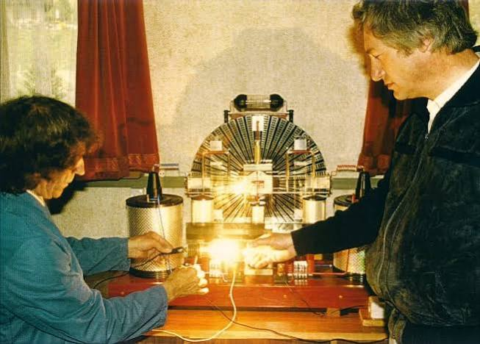
From Electrostatic Generation to Practical Electrical Power
The Testatika can be presented as a proposed example, assuming its reported operation is valid.
Engineering concept
The Wimshurst-type electrostatic stage can be viewed as the high-voltage front end. A practical system would then collect, store, convert, and condition that electrical output for useful loads.
INSERT TESTATIKA IMAGE HERE
Electrostatic source → storage → conversion/regulation → useful load
Suggested caption: Testatika — Methernitha community, Linden, Switzerland
Inductive loads such as motors and transformers may require starting current, reactive current and transient handling. An intermediate DC bus and power converter/inverter could isolate the electrostatic source from those load demands.
Testatika electrostatic generator — Methernitha community, Linden, Switzerland
Project framing: assuming the reported Testatika operation is valid, it illustrates how electrostatic generation might be adapted into a complete power-generation system.

