Slide 1
Advanced Algorithms Plagiarism Detection using a dynamic LCS algorithm
Edward Beeching, Joe Renner, Josselin Marnat,
Jérémie Blanchard & Anthony Deveaux

Slide 2
Introduction
Pre-processing
Summary of Algorithms Implemented
LCS
Printing Neatly
Algorithms
Branch and Bound
Complexity
Longest common sub-sequence
Printing Neatly
Plagiarism Detection techniques
Outliers
Demo of UI
Project planning and Execution
Lessons Learned and Challenges
Conclusions

Slide 3
Pre-processing
Summary of Algorithms Implemented
LCS
Printing Neatly
Algorithms
Branch and Bound
Complexity
Longest common sub-sequence
Printing Neatly
Plagiarism Detection techniques
Outliers
Demo of UI
Project planning and Execution
Lessons Learned and Challenges
Conclusions

Slide 4
Pre-processing
Four different techniques :
Light Pre-processing
Advanced Pre-processing
Stop Word Removal
Word Ordering

Slide 5
Light Pre-processing
A basic pre-processing technique which simply removes or replaces given symbol such as :
Directional quotes -> Straight quotes
Extra newline characters are removed
Extra spaces are removed

Slide 6
Advanced Pre-processing
A more advanced technique which remove all non-ASCII characters, and all symbols that are not periods or comma. It makes everything in lower case.
This pre-processing technique allow the LCS to be more robust to changes in punctuation.

Slide 7
Advanced Pre-processing
Text before the pre-process:
This kind of relationship can be visualised as a tree structure, where ‘student’ would be the more general root node and both ‘postgraduate’ and ‘undergraduate’ would be more specialised extensions of the ‘student’ node (or the child nodes).
Text after :
this kind of relationship can be visualised as a tree structure, where student would be the more general root node and both postgraduate and undergraduate would be more specialised extensions of the student node or the child nodes.

Slide 8
Stop word removal
Text before the pre-process:
this kind of relationship can be visualised as a tree structure, where student would be the more general root node and both postgraduate and undergraduate would be more specialised extensions of the student node or the child nodes.
Text after :
kind relationship visualised tree structure, student would general root node postgraduate undergraduate specialised extensions student node child nodes

Slide 9
Word Ordering
Word Ordering is a technique that allow us to see if a text has been copied but rearranged. In order to see that we order every sentence of the text.
The technique reordered words in alphabetical order. However, we did not find this technique to be an improvement on the plagiarism score, so we did not include it in the final plagiarism detector.

Slide 10
Pre-processing
Summary of Algorithms Implemented
LCS
Printing Neatly
Algorithms
Branch and Bound
Complexity
Longest common sub-sequence
Printing Neatly
Plagiarism Detection techniques
Outliers
Demo of UI
Project planning and Execution
Lessons Learned and Challenges
Conclusions

Slide 11
LCS Forward
LCS Forward on « ABBA » and « ABCD » -> 2
 | A | B | B | A
A | 1 | 1 | 1 | 1
B | 1 | 2 | 2 | 2
C | 1 | 2 | 2 | 2
D | 1 | 2 | 2 | 2
 | A | B | B | A
A | D | L | L | L
B | U | D | L | L
C | U | D | U | U
D | U | U | U | U
Time Complexity : O(m*n)
Space Complexity : O((m*n) *2)

Slide 12
LCS Backward
LCS Forward on « ABBA » and « ABCD » -> 2
 | A | B | B | A
A | 2 | 1 | 0 | 0
B | 1 | 1 | 0 | 0
C | 1 | 1 | 0 | 0
D | 0 | 0 | 0 | 0
 | A | B | B | A
A | U | L | L | L
B | L | U | L | L
C | L | U | L | L
D | L | L | L | D
Time Complexity : O(m*n)
Space Complexity : O((m*n) *2)

Slide 13
LCS Space efficient (Forwards)
LCS Forward on « ABBA » and « ABCD » -> 2
Dynamic
Space Efficient
 | A | B | B | A
A | 1 | 1 | 1 | 1
B | 1 | 2 | 2 | 2
C | 1 | 2 | 2 | 2
D | 1 | 2 | 2 | 2
 | A | B | B | A
- | 0 | 0 | 0 | 0
A | 1 | 1 | 1 | 1
Time Complexity : O(m*n)
Space Complexity : O(2n)

Slide 14
LCS Space efficient (Forwards)
LCS Forward on « ABBA » and « ABCD » -> 2
Dynamic
Space Efficient
 | A | B | B | A
A | 1 | 1 | 1 | 1
B | 1 | 2 | 2 | 2
C | 1 | 2 | 2 | 2
D | 1 | 2 | 2 | 2
 | A | B | B | A
A | 1 | 1 | 1 | 1
B | 1 | 2 | 2 | 2
Time Complexity : O(m*n)
Space Complexity : O(2n)

Slide 15
LCS Space efficient (Forwards)
LCS Forward on « ABBA » and « ABCD » -> 2
Dynamic
Space Efficient
 | A | B | B | A
A | 1 | 1 | 1 | 1
B | 1 | 2 | 2 | 2
C | 1 | 2 | 2 | 2
D | 1 | 2 | 2 | 2
 | A | B | B | A
B | 1 | 2 | 2 | 2
C | 1 | 2 | 2 | 2
Time Complexity : O(m*n)
Space Complexity : O(2n)

Slide 16
LCS Space efficient (Forwards)
LCS Forward on « ABBA » and « ABCD » -> 2
Dynamic
Space Efficient
 | A | B | B | A
A | 1 | 1 | 1 | 1
B | 1 | 2 | 2 | 2
C | 1 | 2 | 2 | 2
D | 1 | 2 | 2 | 2
 | A | B | B | A
C | 1 | 2 | 2 | 2
D | 1 | 2 | 2 | 2
Time Complexity : O(m*n)
Space Complexity : O(2n)

Slide 17
LCS Divide and Conquer
Space Efficient Forwards
Array for result of column B
Sum of forwards + Backwards
 | B
A | 0
B | 0
C | 0
D | 0
 | B
A | 1
B | 0
C | 0
D | -
 | A | B | B | -
- | 0 | 0 | 0 | -
A | 1 | 1 | 1 | -
 | B
A | 1
B | 0
C | 0
D | 0
 | B
A | 1
B | 2
C | 2
D | 2
+
=
Space Efficient Backwards
 | - | - | B | A
D | - | - | 0 | 0
- | - | - | 0 | 0
Time Complexity : O(m*n)
Space Complexity : O(2n)

Slide 18
LCS Divide and Conquer
Space Efficient Forwards
Array for result of column B
Sum of forwards + Backwards
 | B
A | 0
B | 0
C | 0
D | 0
 | B
A | 1
B | 2
C | 1
D | 1
 | A | B | B | -
A | 1 | 1 | 1 | -
B | 1 | 2 | 2 | -
 | B
A | 1
B | 2
C | 0
D | 0
 | B
A | 1
B | 2
C | 2
D | 2
+
=
Space Efficient Backwards
 | - | - | B | A
C | - | - | 0 | 0
D | - | - | 0 | 0
Time Complexity : O(m*n)
Space Complexity : O(2n)

Slide 19
LCS Divide and Conquer
Space Efficient Forwards
Array for result of column B
Sum of forwards + Backwards
 | B
A | 0
B | 0
C | 0
D | 0
 | B
A | 1
B | 1
C | 1
D | 1
 | A | B | B | -
B | 1 | 2 | 2 | -
C | 1 | 2 | 2 | -
 | B
A | 1
B | 2
C | 2
D | 0
 | B
A | 1
B | 2
C | 2
D | 2
+
=
Space Efficient Backwards
 | - | - | B | A
B | - | - | 0 | 0
C | - | - | 0 | 0
Time Complexity : O(m*n)
Space Complexity : O(2n)

Slide 20
LCS Divide and Conquer
Space Efficient Forwards
Array for result of column B
Sum of forwards + Backwards
 | A | B | B | A
C | 1 | 2 | 2 | -
D | 1 | 2 | 2 | -
 | B
A | 1
B | 2
C | 2
D | 2
 | B
A | 0
B | 0
C | 0
D | 0
 | B
A | 1
B | 2
C | 2
D | 2
+
=
Space Efficient Backwards
 | - | - | B | A
A | - | - | 0 | 0
B | - | - | 0 | 0
Time Complexity : O(m*n)
Space Complexity : O(2n)

Slide 21
LCS Divide and Conquer
 | A | B | B | A
A | 1 | 1 | 1 | 1
B | 1 | 2 | 2 | 2
C | 1 | 2 | 2 | 2
D | 1 | 2 | 2 | 2
Time Complexity : O(m*n)
Space Complexity : O(2n)

Slide 22
LCS Divide and Conquer
 | A | B | B | A
A | 1 | 1 | 1 | 1
B | 1 | 2 | 2 | 2
C | 1 | 2 | 2 | 2
D | 1 | 2 | 2 | 2
Time Complexity : O(m*n)
Space Complexity : O(2n)

Slide 23
LCS: Recursive
[A,B,C]
[A,D,E]
Possible solutions are explored recursively, with the best results being taken.
[A,B]
[A,D,E]
[A,B,C]
[A,D]

Slide 24
LCS: Recursive
[A,B,C]
[A,D,E]
Possible solutions are explored recursively, with the best results being taken.
[A,B]
[A,D,E]
[A,B,C]
[A,D]
[A]
[A,D,E]
[A,B]
[A,D]
[A,B]
[A,D]
[A,B,C]
[A]

Slide 25
LCS: Recursive
[A,B,C]
[A,D,E]
Possible solutions are explored recursively, with the best results being taken.
[A,B]
[A,D,E]
[A,B,C]
[A,D]
[A]
[A,D,E]
[A,B]
[A,D]
[A,B]
[A,D]
[A,B,C]
[A]
…
…
…
…
…
…
…
…

Slide 26
LCS: Recursive
[A,B,C]
[A,D,E]
Possible solutions are explored recursively, with the best results being taken.
Duplicate items in tree demonstrate why dynamic approach is suitable for this problem
[A,B]
[A,D,E]
[A,B,C]
[A,D]
[A]
[A,D,E]
[A,B]
[A,D]
[A,B]
[A,D]
[A,B,C]
[A]
…
…
…
…
…
…
…
…

Slide 27
Introduction
Pre-processing
Summary of Algorithms Implemented
LCS
Printing Neatly
Algorithms
Branch and Bound
Complexity
Longest common sub-sequence
Printing Neatly
Plagiarism Detection techniques
Outliers
Demo of UI
Project planning and Execution
Lessons Learned and Challenges
Conclusions

Slide 28
Branch and Bound: Bounds
Upper Bound
Computed as the sum of the common letters between two sequences.
Lower Bound
Computed as the maximum number of common letters between the two sequences.
E.g. For Letters [A,B,C,A] & [B,C,A,A]
Common letters are A:2, B:1 & C:1
The Upper bound = 2+1+1 = 4
The Lower bound = 2

Slide 29
Branch and Bound: Implementation
Implemented with a LIFO queue
The last element added to the queue is the branch with the largest bound (the most potential)
Items are only added to the queue if their upper bound is evaluated to be higher than the current best
Elements are popped off the queue, if their upper bound is greater than the current best, they are explored further.

Slide 30
Branch and Bound: Index and Tracker
Index
A B C A
B C A A
Tracker

Slide 31
Branch and Bound: Index and Tracker
Index
A B C A
B C A A
Tracker

Slide 32
Branch and Bound: Index and Tracker
Index
A B C A
B C A A
Tracker

Slide 33
[A,B,C,A]
[B,C,A,A]
(Solution, bound, index, tracker)
LIFO QUEUE
(represented as a stack)

Slide 34
[A,B,C,A]
[B,C,A,A]
([A,?,?,?] , 3, 1, 0)
([A,?,?,?] , 2, 1, 3)
[A,?,?,?] ¹ ⁺ ¹
[A,?,?,?] ⁰ ⁺ ³
(Solution, bound, index, tracker)
LIFO QUEUE
(represented as a stack)

Slide 35
[A,B,C,A]
[B,C,A,A]
([A,B,?,?] , 3, 2, 1)
([A,B,?,?] , 2, 2, 0)
([A,?,?,?] , 3, 1, 0)
([A,?,?,?] , 2, 1, 3)
[A,?,?,?] ¹ ⁺ ¹
[A,?,?,?] ⁰ ⁺ ³
[A,B,?,?] ¹ ⁺ ²
[A,B,?,?] ⁰ ⁺ ²
(Solution, bound, index, tracker)
LIFO QUEUE
(represented as a stack)

Slide 36
[A,B,C,A]
[B,C,A,A]
([A,B,C,?] , 3, 3, 2)
([A,B,C,?] , 2, 3, 2)
([A,B,?,?] , 3, 2, 1)
([A,B,?,?] , 2, 2, 0)
([A,?,?,?] , 3, 1, 0)
([A,?,?,?] , 2, 1, 3)
[A,?,?,?] ¹ ⁺ ¹
[A,?,?,?] ⁰ ⁺ ³
[A,B,?,?] ¹ ⁺ ²
[A,B,?,?] ⁰ ⁺ ²
[A,B,C,?] ² ⁺ ¹
[A,B,C,?] ¹ ⁺ ¹
(Solution, bound, index, tracker)
LIFO QUEUE
(represented as a stack)

Slide 37
[A,B,C,A]
[B,C,A,A]
([A,B,C,A] , 3, 4, 3)
([A,B,C,A] , 2, 4, 3)
([A,B,C,?] , 3, 3, 2)
([A,B,C,?] , 2, 3, 2)
([A,B,?,?] , 3, 2, 1)
([A,B,?,?] , 2, 2, 0)
([A,?,?,?] , 3, 1, 0)
([A,?,?,?] , 2, 1, 3)
[A,?,?,?] ¹ ⁺ ¹
[A,?,?,?] ⁰ ⁺ ³
[A,B,?,?] ¹ ⁺ ²
[A,B,?,?] ⁰ ⁺ ²
[A,B,C,?] ² ⁺ ¹
[A,B,C,?] ¹ ⁺ ¹
(Solution, bound, index, tracker)
LIFO QUEUE
(represented as a stack)
[A,B,C,A] ³ ⁺ ⁰
[A,B,C,A] ² ⁺ ⁰

Slide 38
[A,B,C,A]
[B,C,A,A]
([A,B,C,A] , 3, 4, 3)
([A,B,C,A] , 2, 4, 3)
([A,B,C,?] , 3, 3, 2)
([A,B,C,?] , 2, 3, 2)
([A,B,?,?] , 3, 2, 1)
([A,B,?,?] , 2, 2, 0)
([A,?,?,?] , 3, 1, 0)
([A,?,?,?] , 2, 1, 3)
[A,?,?,?] ¹ ⁺ ¹
[A,?,?,?] ⁰ ⁺ ³
[A,B,?,?] ¹ ⁺ ²
[A,B,?,?] ⁰ ⁺ ²
[A,B,C,?] ² ⁺ ¹
[A,B,C,?] ¹ ⁺ ¹
(Solution, bound, index, tracker)
LIFO QUEUE
(represented as a stack)
[A,B,C,A] ³ ⁺ ⁰
[A,B,C,A] ² ⁺ ⁰

Slide 39
[A,B,C,A]
[B,C,A,A]
([A,B,C,A] , 3, 4, 3)
([A,B,C,A] , 2, 4, 3)
([A,B,C,?] , 3, 3, 2)
([A,B,C,?] , 2, 3, 2)
([A,B,?,?] , 3, 2, 1)
([A,B,?,?] , 2, 2, 0)
([A,?,?,?] , 3, 1, 0)
([A,?,?,?] , 2, 1, 3)
[A,?,?,?] ¹ ⁺ ¹
[A,?,?,?] ⁰ ⁺ ³
[A,B,?,?] ¹ ⁺ ²
[A,B,?,?] ⁰ ⁺ ²
[A,B,C,?] ² ⁺ ¹
[A,B,C,?] ¹ ⁺ ¹
(Solution, bound, index, tracker)
LIFO QUEUE
(represented as a stack)
[A,B,C,A] ³ ⁺ ⁰
[A,B,C,A] ² ⁺ ⁰

Slide 40
[A,B,C,A]
[B,C,A,A]
([A,B,C,A] , 3, 4, 3)
([A,B,C,A] , 2, 4, 3)
([A,B,C,?] , 3, 3, 2)
([A,B,C,?] , 2, 3, 2)
([A,B,?,?] , 3, 2, 1)
([A,B,?,?] , 2, 2, 0)
([A,?,?,?] , 3, 1, 0)
([A,?,?,?] , 2, 1, 3)
[A,?,?,?] ¹ ⁺ ¹
[A,?,?,?] ⁰ ⁺ ³
[A,B,?,?] ¹ ⁺ ²
[A,B,?,?] ⁰ ⁺ ²
[A,B,C,?] ² ⁺ ¹
[A,B,C,?] ¹ ⁺ ¹
(Solution, bound, index, tracker)
LIFO QUEUE
(represented as a stack)
[A,B,C,A] ³ ⁺ ⁰
[A,B,C,A] ² ⁺ ⁰

Slide 41
[A,B,C,A]
[B,C,A,A]
([A,B,C,A] , 3, 4, 3)
([A,B,C,A] , 2, 4, 3)
([A,B,C,?] , 3, 3, 2)
([A,B,C,?] , 2, 3, 2)
([A,B,?,?] , 3, 2, 1)
([A,B,?,?] , 2, 2, 0)
([A,?,?,?] , 3, 1, 0)
([A,?,?,?] , 2, 1, 3)
[A,?,?,?] ¹ ⁺ ¹
[A,?,?,?] ⁰ ⁺ ³
[A,B,?,?] ¹ ⁺ ²
[A,B,?,?] ⁰ ⁺ ²
[A,B,C,?] ² ⁺ ¹
[A,B,C,?] ¹ ⁺ ¹
(Solution, bound, index, tracker)
LIFO QUEUE
(represented as a stack)
[A,B,C,A] ³ ⁺ ⁰
[A,B,C,A] ² ⁺ ⁰

Slide 42
[A,B,C,A]
[B,C,A,A]
([A,B,C,A] , 3, 4, 3)
([A,B,C,A] , 2, 4, 3)
([A,B,C,?] , 3, 3, 2)
([A,B,C,?] , 2, 3, 2)
([A,B,?,?] , 3, 2, 1)
([A,B,?,?] , 2, 2, 0)
([A,?,?,?] , 3, 1, 0)
([A,?,?,?] , 2, 1, 3)
[A,?,?,?] ¹ ⁺ ¹
[A,?,?,?] ⁰ ⁺ ³
[A,B,?,?] ¹ ⁺ ²
[A,B,?,?] ⁰ ⁺ ²
[A,B,C,?] ² ⁺ ¹
[A,B,C,?] ¹ ⁺ ¹
(Solution, bound, index, tracker)
LIFO QUEUE
(represented as a stack)
[A,B,C,A] ³ ⁺ ⁰
[A,B,C,A] ² ⁺ ⁰

Slide 43
Introduction
Pre-processing
Summary of Algorithms Implemented
LCS
Printing Neatly
Algorithms
Branch and Bound
Complexity
Longest common sub-sequence
Printing Neatly
Plagiarism Detection techniques
Outliers
Demo of UI
Project planning and Execution
Lessons Learned and Challenges
Conclusions

Slide 44
LCS: Time complexity

Slide 45
LCS: Time complexity

Slide 46
LCS: Time complexity

Slide 47
Printing Neatly: Time complexity

Slide 48
Printing Neatly: Time complexity

Slide 49
Printing Neatly: Time complexity

Slide 50
Introduction
Pre-processing
Summary of Algorithms Implemented
LCS
Printing Neatly
Algorithms
Branch and Bound
Complexity
Longest common sub-sequence
Printing Neatly
Plagiarism Detection techniques
Outliers
Demo of UI
Project planning and Execution
Lessons Learned and Challenges
Conclusions

Slide 51
Plagiarism Detection Techniques
Several methods were explored:
Comparing ratio of # words in LCS with # words in corpus example
Generating the ratio above without stop words
Looking at number of plagiarised sentences in the body of text
Looking at the grouping of words and weighting large groups of words higher than small groups of words.

Slide 52
Introduction
Pre-processing
Summary of Algorithms Implemented
LCS
Printing Neatly
Algorithms
Branch and Bound
Complexity
Longest common sub-sequence
Printing Neatly
Plagiarism Detection techniques
Outliers
Demo of UI
Project planning and Execution
Lessons Learned and Challenges
Conclusions

Slide 53
Project Planning
At the start of the project, a project plan was made and all team members agreed.
The following are the changes made to the schedule:
The original plan did not include LCS linear space, LCS recursive or printing neatly branch and bound
It was noted that the implementation of the linear space algorithm was taking longer than expected, so another team-member was moved onto the LCS branch & bound algorithm.
The complexity tests and final technique for plagiarism took longer than expected to finalise.

Slide 54
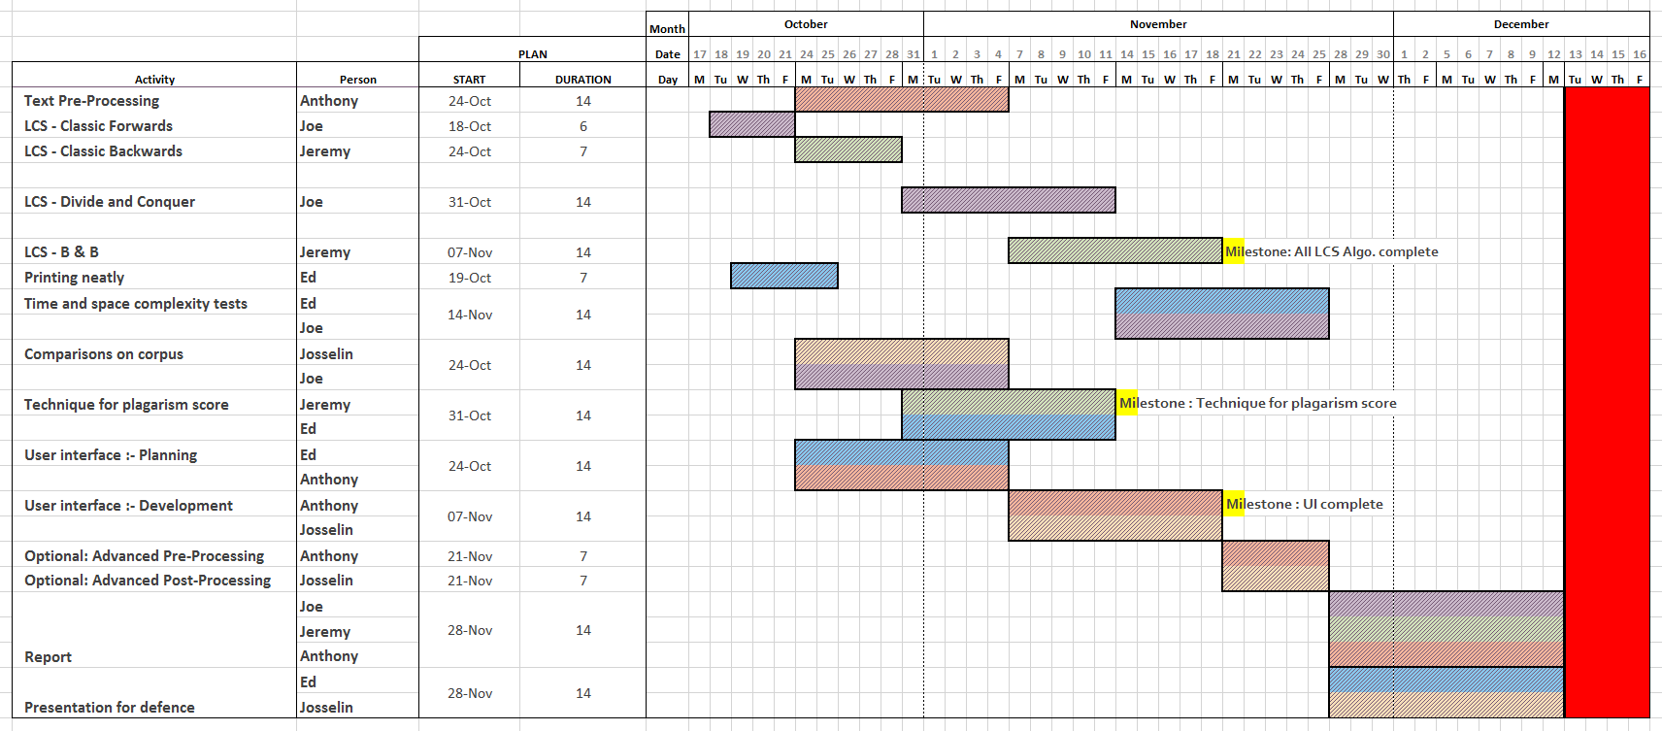
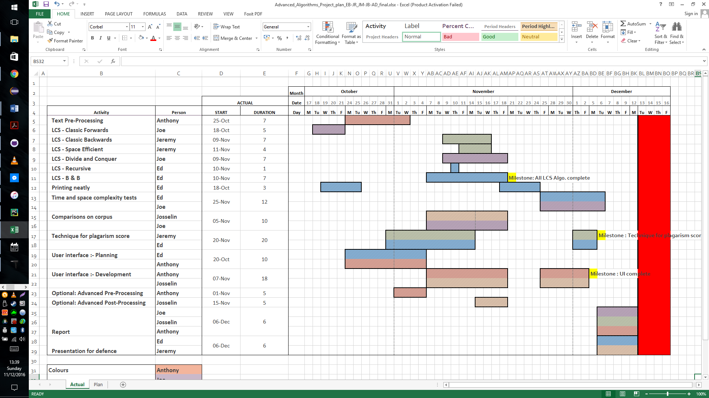
Project Planning : Plan

Slide 55
Project Planning : Plan

