Slide 1
Advanced Algorithms Plagiarism Detection using a dynamic LCS algorithm
Edward Beeching, Joe Renner, Josselin Marnat,
Jérémie Blanchard & Anthony Deveaux

Slide 2
Introduction
Pre-processing
Summary of Algorithms Implemented
LCS
Printing Neatly
Algorithms
Branch and Bound
Complexity
Longest common sub-sequence
Printing Neatly
Plagiarism Detection techniques
Outliers
Demo of UI
Project planning and Execution
Lessons Learned and Challenges
Conclusions

Slide 3
Introduction
The objective of this project was to design a plagiarism detection system using a longest common subsequence algorithm.
Various LCS algorithms were implemented including:
A dynamic approach
A dynamic approach in linear space
A branch and bound solution
Results were to be printed using a printing neatly algorithm

Slide 4
Introduction
Students were provided a corpus containing 95 examples of different levels of plagiarism.
The plagiarised texts were from 5 different topics:
Inheritance in Object Oriented Programming
Googles PageRank algorithm
The Vector space model, used in information retrieval
Bayes’ Theorem
Dynamic Programming
Levels of plagiarism ranged from cut & paste, light changes, heavy changes and original material.

Slide 5
Pre-processing
Summary of Algorithms Implemented
LCS
Printing Neatly
Algorithms
Branch and Bound
Complexity
Longest common sub-sequence
Printing Neatly
Plagiarism Detection techniques
Outliers
Demo of UI
Project planning and Execution
Lessons Learned and Challenges
Conclusions

Slide 6
Pre-processing
Four different techniques :
Light Pre-processing
Advanced Pre-processing
Stop Word Removal
Word Ordering

Slide 7
Light Pre-processing
A basic pre-processing technique which simply removes or replaces given symbol such as :
Directional quotes -> Straight quotes
Extra newline characters are removed
Extra spaces are removed

Slide 8
Advanced Pre-processing
A more advanced technique which remove all non-ASCII characters, and all symbols that are not periods or comma. It makes everything in lower case.
This pre-processing technique allow the LCS to be more robust to changes in punctuation.

Slide 9
Advanced Pre-processing
Text before the pre-process:
This kind of relationship can be visualised as a tree structure, where ‘student’ would be the more general root node and both ‘postgraduate’ and ‘undergraduate’ would be more specialised extensions of the ‘student’ node (or the child nodes).
Text after :
this kind of relationship can be visualised as a tree structure, where student would be the more general root node and both postgraduate and undergraduate would be more specialised extensions of the student node or the child nodes.

Slide 10
Stop word removal
Text before the pre-process:
this kind of relationship can be visualised as a tree structure, where student would be the more general root node and both postgraduate and undergraduate would be more specialised extensions of the student node or the child nodes.
Text after :
kind relationship visualised tree structure, student would general root node postgraduate undergraduate specialised extensions student node child nodes

Slide 11
Word Ordering
Word Ordering is a technique that allow us to see if a text has been copied but rearranged. In order to see that we order every sentence of the text.
The technique reordered words in alphabetical order. However, we did not find this technique to be an improvement on the plagiarism score, so we did not include it in the final plagiarism detector.

Slide 12
Pre-processing
Summary of Algorithms Implemented
LCS
Printing Neatly
Algorithms
Branch and Bound
Complexity
Longest common sub-sequence
Printing Neatly
Plagiarism Detection techniques
Outliers
Demo of UI
Project planning and Execution
Lessons Learned and Challenges
Conclusions

Slide 13
LCS Forward
LCS Forward on « ABBA » and « ABCD » -> 2
 | A | B | B | A
A | 1 | 1 | 1 | 1
B | 1 | 2 | 2 | 2
C | 1 | 2 | 2 | 2
D | 1 | 2 | 2 | 2
 | A | B | B | A
A | D | L | L | L
B | U | D | L | L
C | U | D | U | U
D | U | U | U | U
Time Complexity : O(m*n)
Space Complexity : O((m*n) *2)

Slide 14
LCS Backward
LCS Forward on « ABBA » and « ABCD » -> 2
 | A | B | B | A
A | 2 | 1 | 0 | 0
B | 1 | 1 | 0 | 0
C | 1 | 1 | 0 | 0
D | 0 | 0 | 0 | 0
 | A | B | B | A
A | U | L | L | L
B | L | U | L | L
C | L | U | L | L
D | L | L | L | D
Time Complexity : O(m*n)
Space Complexity : O((m*n) *2)

Slide 15
LCS Space efficient (Forwards)
LCS Forward on « ABBA » and « ABCD » -> 2
Dynamic
Space Efficient
 | A | B | B | A
A | 1 | 1 | 1 | 1
B | 1 | 2 | 2 | 2
C | 1 | 2 | 2 | 2
D | 1 | 2 | 2 | 2
 | A | B | B | A
- | 0 | 0 | 0 | 0
A | 1 | 1 | 1 | 1
Time Complexity : O(m*n)
Space Complexity : O(2n)

Slide 16
LCS Space efficient (Forwards)
LCS Forward on « ABBA » and « ABCD » -> 2
Dynamic
Space Efficient
 | A | B | B | A
A | 1 | 1 | 1 | 1
B | 1 | 2 | 2 | 2
C | 1 | 2 | 2 | 2
D | 1 | 2 | 2 | 2
 | A | B | B | A
A | 1 | 1 | 1 | 1
B | 1 | 2 | 2 | 2
Time Complexity : O(m*n)
Space Complexity : O(2n)

Slide 17
LCS Space efficient (Forwards)
LCS Forward on « ABBA » and « ABCD » -> 2
Dynamic
Space Efficient
 | A | B | B | A
A | 1 | 1 | 1 | 1
B | 1 | 2 | 2 | 2
C | 1 | 2 | 2 | 2
D | 1 | 2 | 2 | 2
 | A | B | B | A
B | 1 | 2 | 2 | 2
C | 1 | 2 | 2 | 2
Time Complexity : O(m*n)
Space Complexity : O(n)

Slide 18
LCS Space efficient (Forwards)
LCS Forward on « ABBA » and « ABCD » -> 2
Dynamic
Space Efficient
 | A | B | B | A
A | 1 | 1 | 1 | 1
B | 1 | 2 | 2 | 2
C | 1 | 2 | 2 | 2
D | 1 | 2 | 2 | 2
 | A | B | B | A
C | 1 | 2 | 2 | 2
D | 1 | 2 | 2 | 2
Time Complexity : O(m*n)
Space Complexity : O(n)

Slide 19
LCS Divide and Conquer
Space Efficient Forwards
Array for result of column B
Sum of forwards + Backwards
 | B
 | 0
A | 0
B | 0
C | 0
D | 0
 | B
A | 1
B | 0
C | 0
D | -
 |  | A | B | - | -
- | 0 | 0 | 0 | - | -
A | - | - | - | - | -
 | B
 | 0
A | 0
B | 0
C | 0
D | 0
 | B
 | 0
A | 0
B | 0
C | 0
D | 0
+
=
Space Efficient Backwards
 | - | B | B | A
D | - | 0 | 0 | 0 | 0
 | - | - | - | - | -
Time Complexity : O(m*n)
Space Complexity : O(n)

Slide 20
LCS Divide and Conquer
Space Efficient Forwards
Array for result of column B
Sum of forwards + Backwards
 | B
 | 0
A | 0
B | 0
C | 0
D | 0
 | B
A | 1
B | 0
C | 0
D | -
 |  | A | B | - | -
- | 0 | 0 | 0 | - | -
A | 0 | 1 | 1 | - | -
 | B
 | 0
A | 1
B | 0
C | 0
D | 0
 | B
 | 0
A | 1
B | 0
C | 0
D | 0
+
=
Space Efficient Backwards
 | - | B | B | A
C | - | 0 | 0 | 0 | 0
D | - | 0 | 0 | 0 | 0
Time Complexity : O(m*n)
Space Complexity : O(n)

Slide 21
LCS Divide and Conquer
Space Efficient Forwards
Array for result of column B
Sum of forwards + Backwards
 | B
 | 0
A | 0
B | 0
C | 0
D | 0
 | B
A | 1
B | 2
C | 1
D | 1
 |  | A | B | - | -
A | 0 | 1 | 1 | - | -
B | 0 | 1 | 2 | - | -
 | B
 | 0
A | 1
B | 2
C | 0
D | 0
 | B
 | 0
A | 1
B | 2
C | 0
D | 0
+
=
Space Efficient Backwards
 | - | B | B | A
B | - | 0 | 0 | 0 | 0
C | - | 0 | 0 | 0 | 0
Time Complexity : O(m*n)
Space Complexity : O(n)

Slide 22
LCS Divide and Conquer
Space Efficient Forwards
Array for result of column B
Sum of forwards + Backwards
 | B
 | 0
A | 1
B | 0
C | 0
D | 0
 | B
A | 1
B | 1
C | 1
D | 1
 |  | A | B | - | -
B | 0 | 1 | 2 | - | -
C | 0 | 1 | 2 | - | -
 | B
 | 0
A | 1
B | 2
C | 2
D | 0
 | B
 | 0
A | 2
B | 2
C | 2
D | 0
+
=
Space Efficient Backwards
 | - | B | B | A
A | - | 1 | 1 | 0 | 0
B | - | 0 | 0 | 0 | 0
Time Complexity : O(m*n)
Space Complexity : O(n)

Slide 23
LCS Divide and Conquer
Space Efficient Forwards
Array for result of column B
Sum of forwards + Backwards
 |  | A | B | B | A
C | 0 | 1 | 2 | - | -
D | 0 | 1 | 2 | - | -
 | B
 | 0
A | 1
B | 2
C | 2
D | 2
 | B
 | 1
A | 1
B | 0
C | 0
D | 0
 | B
 | 1
A | 2
B | 2
C | 2
D | 2
+
=
Space Efficient Backwards
 | - | B | B | A
 | - | 1 | 1 | 1 | 0
A | - | 1 | 1 | 0 | 0
Time Complexity : O(m*n)
Space Complexity : O(n)

Slide 24
LCS Divide and Conquer
 | A | B | B | A
 |  | 1
A | - | 2 | - | -
B | - | 2 | - | -
C | - | 2 | - | -
D | - | 2 | - | -
Time Complexity : O(m*n)
Space Complexity : O(n)

Slide 25
LCS Divide and Conquer
 | A | B | B | A
A | 1 | 1 | - | -
B | 1 | 2 | - | -
C | - | - | 0 | 0
D | - | - | 0 | 0
Time Complexity : O(m*n)
Space Complexity : O(n)

Slide 26
LCS: Recursive
[A,B,C]
[A,D,E]
Possible solutions are explored recursively, with the best results being taken.
[A,B]
[A,D,E]
[A,B,C]
[A,D]

Slide 27
LCS: Recursive
[A,B,C]
[A,D,E]
Possible solutions are explored recursively, with the best results being taken.
[A,B]
[A,D,E]
[A,B,C]
[A,D]
[A]
[A,D,E]
[A,B]
[A,D]
[A,B]
[A,D]
[A,B,C]
[A]

Slide 28
LCS: Recursive
[A,B,C]
[A,D,E]
Possible solutions are explored recursively, with the best results being taken.
[A,B]
[A,D,E]
[A,B,C]
[A,D]
[A]
[A,D,E]
[A,B]
[A,D]
[A,B]
[A,D]
[A,B,C]
[A]
…
…
…
…
…
…
…
…

Slide 29
LCS: Recursive
[A,B,C]
[A,D,E]
Possible solutions are explored recursively, with the best results being taken.
Duplicate items in tree demonstrate why dynamic approach is suitable for this problem
[A,B]
[A,D,E]
[A,B,C]
[A,D]
[A]
[A,D,E]
[A,B]
[A,D]
[A,B]
[A,D]
[A,B,C]
[A]
…
…
…
…
…
…
…
…

Slide 30
Printing Neatly
Algorithm aims to fits words of a provides text within a line limit.
All but the greedy approach associate a cost with the empty space at the end of each line and aim to find the solution that minimizes it.
The cost of the last line in the text is 0.
Example with a line length of 12:
Mickey Rat | Mickey |
likes to | Rat likes |
code | to code |
Everyday | everyday |
Cost = 603 Cost = 495 (optimal solution)

Slide 31
Printing Neatly: Greedy
Aims to fit as many words per line as is possible, without regard for the cost.
This algorithm produces a solution quickly (linear time) but the solution is not always optimal.
Mickey Rat |
likes to |
code |
Everyday |
Cost = 603
Time Complexity : O(n)
Space Complexity : O(n)

Slide 32
Printing Neatly: Dynamic
Computes an n by n extras and cost matrix that define the empty space remaining when all combinations of words appear on different lines.
By looking for minimum values in the line costs matrix, the dynamic approach can fine the optimal solution.
Mickey |
Rat likes |
to code |
Everyday |
Cost = 495
Time Complexity : O(n²)
Space Complexity : O(n²)

Slide 33
Printing Neatly: Recursive
Explores all possible solutions in a recursive manner and returns the solution with the lowest cost.
Easy to code, but extremely slow to run in practice, as there is an exponential runtime complexity.
Mickey |
Rat likes |
to code |
Everyday |
Cost = 495
Time Complexity : O(2^{n})
Space Complexity : O(n)

Slide 34
Printing Neatly: Branch and Bound
First estimates an upper bound using a greedy approach.
Explores all solutions, but keeps track of the accumulated cost of the solution. When this exceeds the upper bound, the solution is cut and back tracks.
Fast than the recursive approach but still an exponential runtime.
A solution that estimates a bound on the remaining words using a greedy approach was explored, but was found to not be optimal.
Mickey |
Rat likes |
to code |
Everyday |
Cost = 495
Time Complexity : O(2^{n})
Space Complexity : O(n)

Slide 35
Introduction
Pre-processing
Summary of Algorithms Implemented
LCS
Printing Neatly
Algorithms
Branch and Bound
Complexity
Longest common sub-sequence
Printing Neatly
Plagiarism Detection techniques
Outliers
Demo of UI
Project planning and Execution
Lessons Learned and Challenges
Conclusions

Slide 36
Branch and Bound: Bounds
Upper Bound
Computed as the sum of the common letters between two sequences.
Lower Bound
Computed as the maximum value of a single common letter shared between the two sequences.
E.g. For Letters [A,B,C,A] & [B,C,A,A]
Common letters are A:2, B:1 & C:1
The Upper bound = 2+1+1 = 4
The Lower bound = 2
Bounds were taken from paper:
Gaofeng Huang and Andrew Lim.
An Effective Branch-and-Bound Algorithm to Solve the k-Longest Common Subsequence Problem

Slide 37
Branch and Bound: Implementation
Implemented with a LIFO queue
The last element added to the queue is the branch with the largest bound (the most potential)
Items are only added to the queue if their upper bound is evaluated to be higher than the current best
Elements are popped off the queue, if their upper bound is greater than the current best, they are explored further.
The item in the queue also stores the indices of the most recent word/letter that was found as part of the solution.

Slide 38
Branch and Bound: Index and Tracker
Index
A B C A
B C A A
Tracker

Slide 39
Branch and Bound: Index and Tracker
Index
A B C A
B C A A
Tracker

Slide 40
Branch and Bound: Index and Tracker
Index
A B C A
B C A A
Tracker

Slide 41
Best = 1
[A,B,C,A]
[B,C,A,A]
(Solution, bound, index, tracker)
LIFO QUEUE
(represented as a stack)

Slide 42
Best = 1
[A,B,C,A]
[B,C,A,A]
([A,?,?,?] , 3, 1, 0)
([A,?,?,?] , 2, 1, 3)
[A,?,?,?] ¹ ⁺ ¹
[A,?,?,?] ⁰ ⁺ ³
(Solution, bound, index, tracker)
LIFO QUEUE
(represented as a stack)

Slide 43
Best = 1
[A,B,C,A]
[B,C,A,A]
([A,B,?,?] , 3, 2, 1)
([A,B,?,?] , 2, 2, 0)
([A,?,?,?] , 3, 1, 0)
([A,?,?,?] , 2, 1, 3)
[A,?,?,?] ¹ ⁺ ¹
[A,?,?,?] ⁰ ⁺ ³
[A,B,?,?] ¹ ⁺ ²
[A,B,?,?] ⁰ ⁺ ²
(Solution, bound, index, tracker)
LIFO QUEUE
(represented as a stack)

Slide 44
Best = 1
[A,B,C,A]
[B,C,A,A]
([A,B,C,?] , 3, 3, 2)
([A,B,C,?] , 2, 3, 2)
([A,B,?,?] , 3, 2, 1)
([A,B,?,?] , 2, 2, 0)
([A,?,?,?] , 3, 1, 0)
([A,?,?,?] , 2, 1, 3)
[A,?,?,?] ¹ ⁺ ¹
[A,?,?,?] ⁰ ⁺ ³
[A,B,?,?] ¹ ⁺ ²
[A,B,?,?] ⁰ ⁺ ²
[A,B,C,?] ² ⁺ ¹
[A,B,C,?] ¹ ⁺ ¹
(Solution, bound, index, tracker)
LIFO QUEUE
(represented as a stack)

Slide 45
Best = 1
[A,B,C,A]
[B,C,A,A]
([A,B,C,A] , 3, 4, 3)
([A,B,C,A] , 2, 4, 3)
([A,B,C,?] , 3, 3, 2)
([A,B,C,?] , 2, 3, 2)
([A,B,?,?] , 3, 2, 1)
([A,B,?,?] , 2, 2, 0)
([A,?,?,?] , 3, 1, 0)
([A,?,?,?] , 2, 1, 3)
[A,?,?,?] ¹ ⁺ ¹
[A,?,?,?] ⁰ ⁺ ³
[A,B,?,?] ¹ ⁺ ²
[A,B,?,?] ⁰ ⁺ ²
[A,B,C,?] ² ⁺ ¹
[A,B,C,?] ¹ ⁺ ¹
(Solution, bound, index, tracker)
LIFO QUEUE
(represented as a stack)
[A,B,C,A] ³ ⁺ ⁰
[A,B,C,A] ² ⁺ ⁰

Slide 46
Best = 3
[A,B,C,A]
[B,C,A,A]
([A,B,C,A] , 3, 4, 3)
([A,B,C,A] , 2, 4, 3)
([A,B,C,?] , 3, 3, 2)
([A,B,C,?] , 2, 3, 2)
([A,B,?,?] , 3, 2, 1)
([A,B,?,?] , 2, 2, 0)
([A,?,?,?] , 3, 1, 0)
([A,?,?,?] , 2, 1, 3)
[A,?,?,?] ¹ ⁺ ¹
[A,?,?,?] ⁰ ⁺ ³
[A,B,?,?] ¹ ⁺ ²
[A,B,?,?] ⁰ ⁺ ²
[A,B,C,?] ² ⁺ ¹
[A,B,C,?] ¹ ⁺ ¹
(Solution, bound, index, tracker)
LIFO QUEUE
(represented as a stack)
[A,B,C,A] ³ ⁺ ⁰
[A,B,C,A] ² ⁺ ⁰

Slide 47
Best = 3
[A,B,C,A]
[B,C,A,A]
([A,B,C,A] , 3, 4, 3)
([A,B,C,A] , 2, 4, 3)
([A,B,C,?] , 3, 3, 2)
([A,B,C,?] , 2, 3, 2)
([A,B,?,?] , 3, 2, 1)
([A,B,?,?] , 2, 2, 0)
([A,?,?,?] , 3, 1, 0)
([A,?,?,?] , 2, 1, 3)
[A,?,?,?] ¹ ⁺ ¹
[A,?,?,?] ⁰ ⁺ ³
[A,B,?,?] ¹ ⁺ ²
[A,B,?,?] ⁰ ⁺ ²
[A,B,C,?] ² ⁺ ¹
[A,B,C,?] ¹ ⁺ ¹
(Solution, bound, index, tracker)
LIFO QUEUE
(represented as a stack)
[A,B,C,A] ³ ⁺ ⁰
[A,B,C,A] ² ⁺ ⁰

Slide 48
Best = 3
[A,B,C,A]
[B,C,A,A]
([A,B,C,A] , 3, 4, 3)
([A,B,C,A] , 2, 4, 3)
([A,B,C,?] , 3, 3, 2)
([A,B,C,?] , 2, 3, 2)
([A,B,?,?] , 3, 2, 1)
([A,B,?,?] , 2, 2, 0)
([A,?,?,?] , 3, 1, 0)
([A,?,?,?] , 2, 1, 3)
[A,?,?,?] ¹ ⁺ ¹
[A,?,?,?] ⁰ ⁺ ³
[A,B,?,?] ¹ ⁺ ²
[A,B,?,?] ⁰ ⁺ ²
[A,B,C,?] ² ⁺ ¹
[A,B,C,?] ¹ ⁺ ¹
(Solution, bound, index, tracker)
LIFO QUEUE
(represented as a stack)
[A,B,C,A] ³ ⁺ ⁰
[A,B,C,A] ² ⁺ ⁰

Slide 49
Introduction
Pre-processing
Summary of Algorithms Implemented
LCS
Printing Neatly
Algorithms
Branch and Bound
Complexity
Longest common sub-sequence
Printing Neatly
Plagiarism Detection techniques
Outliers
Demo of UI
Project planning and Execution
Lessons Learned and Challenges
Conclusions

Slide 50
LCS: Time complexity

Slide 51
LCS: Time complexity

Slide 52
LCS: Time complexity

Slide 53
Printing Neatly: Time complexity

Slide 54
Printing Neatly: Time complexity

Slide 55
Printing Neatly: Time complexity

Slide 56
Introduction
Pre-processing
Summary of Algorithms Implemented
LCS
Printing Neatly
Algorithms
Branch and Bound
Complexity
Longest common sub-sequence
Printing Neatly
Plagiarism Detection techniques
Outliers
Demo of UI
Project planning and Execution
Lessons Learned and Challenges
Conclusions

Slide 57
Plagiarism Detection Techniques
Several methods were explored:
Comparing ratio of # words in LCS with # words in corpus example
Generating the ratio above without stop words
Looking at number of plagiarised sentences in the body of text
Looking at the grouping of words and weighting large groups of words higher than small groups of words.

Slide 58
Plagiarism Detection Technique
The final method combines the metrics:
Number of sentences plagiarised
Squared word grouping score.
The results are summed, and if this exceeds a given threshold (0.2) the text is considered to be plagiarised.

Slide 59
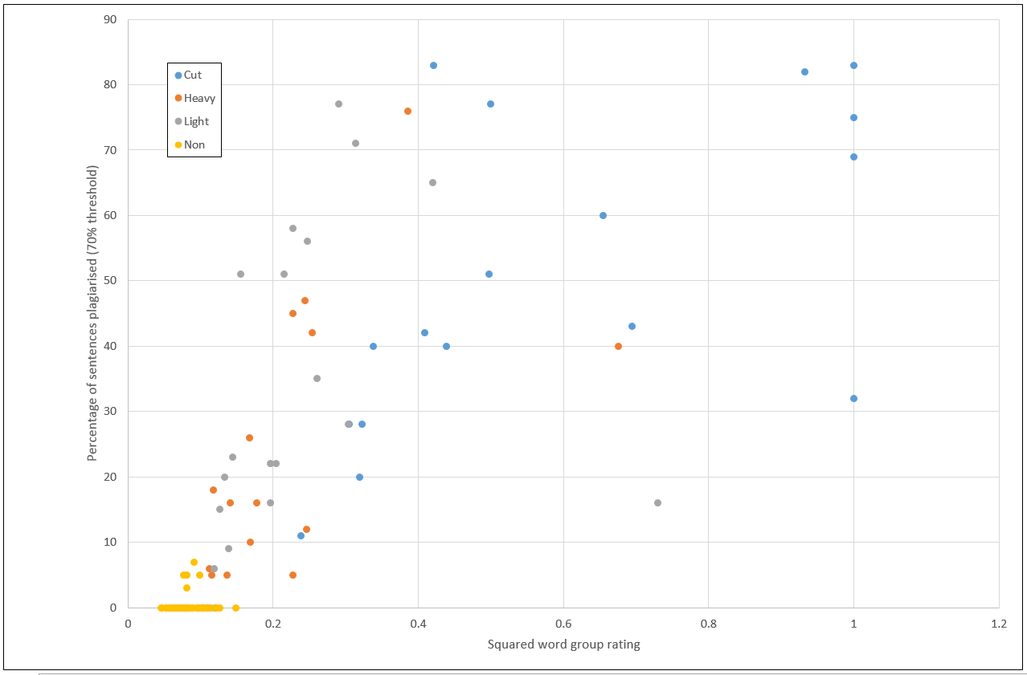
Plagiarism Detection Technique

Slide 60
Introduction
Pre-processing
Summary of Algorithms Implemented
LCS
Printing Neatly
Algorithms
Branch and Bound
Complexity
Longest common sub-sequence
Printing Neatly
Plagiarism Detection techniques
Outliers
Demo of UI
Project planning and Execution
Lessons Learned and Challenges
Conclusions

Slide 61
Outliers
There are some outliers observed in the example text, it appears that some examples in the corpus have been assigned the wrong label.
For example the text from g4pD_taskb.txt is meant to be a copy and paste. But is clearly not, this will be demo’d with the UI.

Slide 62
Introduction
Pre-processing
Summary of Algorithms Implemented
LCS
Printing Neatly
Algorithms
Branch and Bound
Complexity
Longest common sub-sequence
Printing Neatly
Plagiarism Detection techniques
Outliers
Demo of UI
Project planning and Execution
Lessons Learned and Challenges
Conclusions

Slide 63
Introduction
Pre-processing
Summary of Algorithms Implemented
LCS
Printing Neatly
Algorithms
Branch and Bound
Complexity
Longest common sub-sequence
Printing Neatly
Plagiarism Detection techniques
Outliers
Demo of UI
Project planning and Execution
Lessons Learned and Challenges
Conclusions

Slide 64
Project Planning
At the start of the project, a project plan was made and all team members agreed.
The following are the changes made to the schedule:
The original plan did not include LCS linear space, LCS recursive or printing neatly branch and bound
It was noted that the implementation of the linear space algorithm was taking longer than expected, so another team-member was moved onto the LCS branch & bound algorithm.
The complexity tests and final technique for plagiarism took longer than expected to finalise.

Slide 65
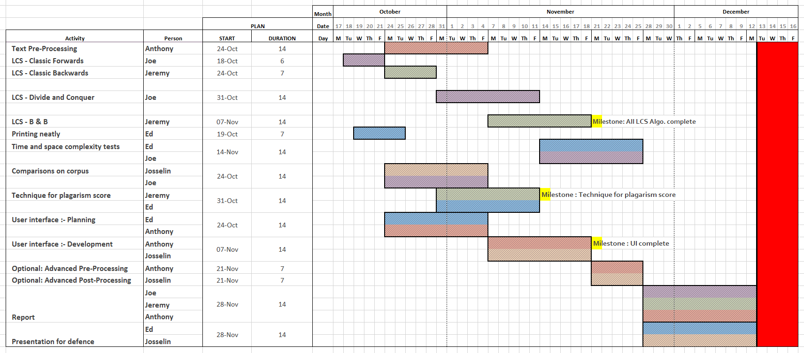
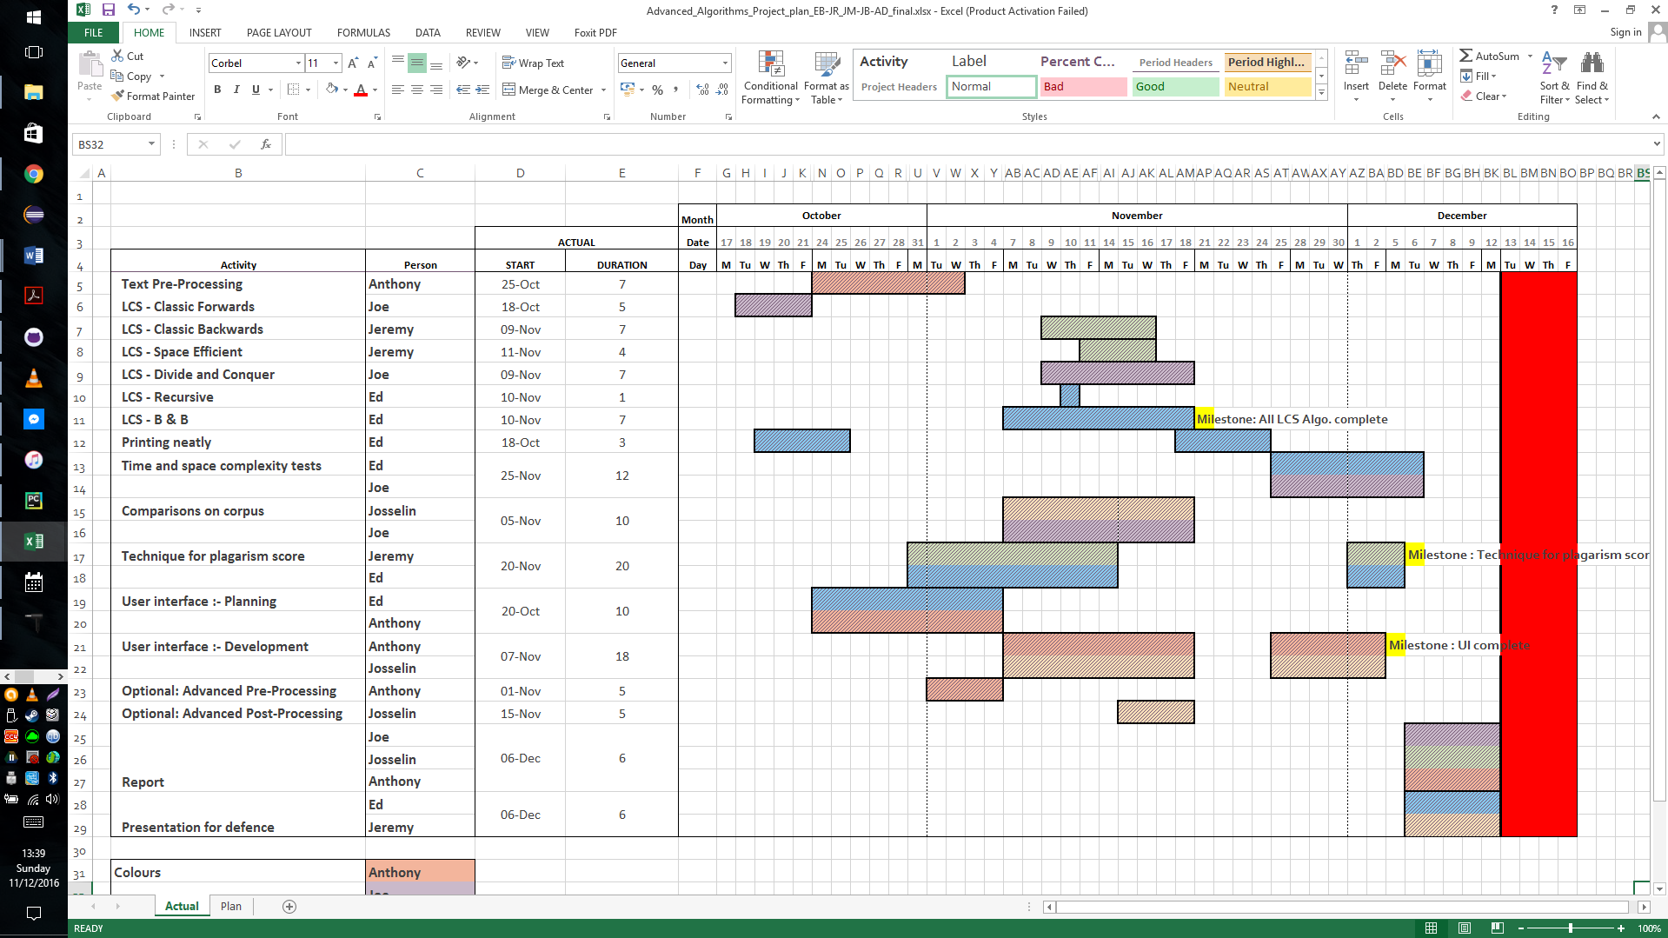
Project Planning : Plan

Slide 66
Project Planning : Plan

