Slide 1
DLOG
Dual-LoRA Orthogonal Gating for Continual Learning on Large Language Models
Backbone: Qwen2.5-1.5B | Tasks: SST-2, AG News, Amazon Reviews, DBPedia-14
Skripsi Presentation — 2026

Slide 2
!
Problem: Catastrophic Forgetting
LLMs fine-tuned on new tasks forget previous knowledge
Sequential learning: Task 1 → Task 2 → ... → Task N
DLOG Solution: 3 complementary mechanisms
1. Dual-LoRA Architecture — separate Slow (memory) and Fast (task) adapters
2. Orthogonal Gating — soft + hard constraints keep Fast ⊥ Slow
3. IPC Neuron Freezing — freeze the most important modules to protect memory
+ Experience Replay — reservoir sampling from past tasks

Slide 3
1
Model Backbone: Qwen2.5-1.5B
Qwen2.5-1.5B (FROZEN)
├── Embedding Layer
├── Transformer Layers x28
│ ├── Self-Attention
│ │ ├── q_proj ← DualLoRA injected
│ │ ├── k_proj ← DualLoRA injected
│ │ ├── v_proj ← DualLoRA injected
│ │ └── o_proj ← DualLoRA injected
│ └── MLP (frozen)
└── Classification Head (TRAINABLE)
└── score: Linear(1536, 22)
Base: Qwen2.5-1.5B (decoder-only LLM)
Head: AutoModelForSequenceClassification
Total labels = sum of all task classes (2+4+2+14 = 22)
All base weights FROZEN (requires_grad=False)
Only LoRA adapters + classification head are trainable
LoRA Config:
rank = 16, alpha = 16, scaling = alpha/rank = 1.0
Target modules: q_proj, k_proj, v_proj, o_proj (4 per layer × 28 layers = 112 DualLoRA modules)

Slide 4
2
Dual-LoRA: Slow (Memory) + Fast (Task)
Slow LoRA (Memory)
Fast LoRA (Task)
Stores consolidated knowledge from ALL past tasks
ZERO-initialized → silent during Task 1
NEVER trained directly (requires_grad=False)
Only updated at task boundary via consolidation
Provides null-space for orthogonal projection
Learns the CURRENT task only
Kaiming-init A_fast, Zero-init B_fast
Trained via backprop every step
RESET after each task consolidation
Constrained to be orthogonal to Slow
y = W_frozen · x + (α/r) · B_slow @ A_slow @ x + (α/r) · B_fast @ A_fast @ x Base (frozen) Slow (Memory) Fast (Task)
# Initialization
Slow: A_slow = 0, B_slow = 0 # Silent until consolidation
Fast: A_fast = Kaiming, B_fast = 0 # Standard LoRA init

Slide 5
3
Forward Pass: How DualLoRALinear Works
def forward(self, x): # x: [batch, seq_len, d_in]
# 1. Base frozen linear
out = F.linear(x, W_frozen, bias) # [batch, seq_len, d_out]
# 2. Slow LoRA (Memory branch) — encodes knowledge from tasks 1..t-1
slow = F.linear(F.linear(x, A_slow), B_slow) * (α/r)
# x → [b,s,d_in] @ A_slow^T → [b,s,r] @ B_slow^T → [b,s,d_out]
# 3. Fast LoRA (Task branch) — learns current task t
fast = F.linear(F.linear(x, A_fast), B_fast) * (α/r)
return out + slow + fast # Sum of all 3 branches
Task 1: Slow = 0 (zero-init), so y = W·x + Fast — only Fast learns
Task 2+: Slow = consolidated memory (frozen), Fast learns in null-space of Slow
After consolidation, Fast is merged into Slow → y = W·x + Slow_new

Slide 6
4
Forward & Backward Transfer
Forward Transfer
Backward Transfer
New task starts with: y = W·x + Slow_memory
Fast learns complementary features in null-space
Shared classification head accumulates all classes
Replay mixes old + new data → shared representations
3 mechanisms prevent catastrophic forgetting:
(a) Orthogonal Gating: Fast ⊥ Slow
(b) Reservoir Replay: rehearse old data
(c) IPC Freezing: lock critical modules
Slow is NEVER modified during training

Slide 7
5
Mechanism 1: Replay
Reservoir Sampling — uniform coverage of ALL past tasks
Buffer size: 400-750 samples per task
Replay ratio: 10-20% of each training batch
Samples added from current task too (for future replay)
Mixed batch = (1−ρ) · current_data + ρ · replay_data
combined_batch, replay_batch = create_mixed_batch(
current_batch,
replay_buffer,
replay_ratio=0.1, # 10% replay, 90% current task
)
replay_buffer.add_batch(current_batch) # Add to buffer for future tasks
loss = model(combined_batch) # Train on mixed data

Slide 8
6
Mechanism 2a: Soft Orthogonal Constraint
Penalize overlap between Fast and Slow subspaces via regularization loss
def compute_orth_loss(dual_layers):
loss = 0
for layer in dual_layers:
A_s, B_s = layer.get_slow_params() # [r, d_in], [d_out, r]
A_f, B_f = layer.get_fast_params()
# Penalize row-space overlap: A_f · A_sᵀ should be zero-matrix
loss += ||A_f @ A_s.T||²_F # [r, r] → scalar
# Penalize column-space overlap: B_fᵀ · B_s should be zero-matrix
loss += ||B_f.T @ B_s||²_F # [r, r] → scalar
return loss
L_total = L_task + λ_orth · L_orth (λ_orth = 0.01)
Intuition: If A_fast ⊥ A_slow, they span different directions → new task doesn't interfere with memory

Slide 9
7
Mechanism 2b: Hard Gradient Projection
After backward: project Fast gradients into the null-space of Slow's subspace
For A_fast (shape [r, d_in]):
Q_A, _ = QR(A_slowᵀ) ← orthonormal basis
g_proj = g − (g · Q_A) · Q_Aᵀ
→ removes component in A_slow's row-space
For B_fast (shape [d_out, r]):
Q_B, _ = QR(B_slow) ← orthonormal basis
g_proj = g − Q_B · (Q_Bᵀ · g)
→ removes component in B_slow's col-space
def project_gradients_parameter(dual_layers):
for layer in dual_layers:
A_s, B_s = layer.get_slow_params()
A_f, B_f = layer.get_fast_params()
# A_fast: null-space of A_slow's row-space (in R^{d_in})
Q_A, _ = torch.linalg.qr(A_s.T) # [d_in, r]
A_f.grad = g - (g @ Q_A) @ Q_A.T # project out Slow's directions
# B_fast: null-space of B_slow's column-space (in R^{d_out})
Q_B, _ = torch.linalg.qr(B_s) # [d_out, r]
B_f.grad = g - Q_B @ (Q_B.T @ g) # project out Slow's directions

Slide 10
8
Mechanism 3: Important Module Freezing
Freeze the most "important" LoRA modules to permanently protect critical memory
Step 1: Sensitivity (per step)
I(θ) = |∇θ| (gradient magnitude)
Step 2: EMA Smoothing
bar_I ← β₁·bar_I + (1−β₁)·I (β₁=0.85)
Step 3: Module Score
S(module) = mean(bar_I) over A_fast, B_fast
Step 4: Freeze top-p% (p=10%, cap=30%)
# At each task boundary:
scores = tracker.get_module_scores()
ranked = sort(scores, descending)
# Freeze top 10% of 112 modules
# ≈ 11 modules per task boundary
for key in ranked[:top_p]:
A_fast.requires_grad = False
B_fast.requires_grad = False
# Skip in consolidate_after_task()
Why |∇θ| instead of |θ·∇θ|? B_fast starts at 0 (LoRA init), so |θ·∇θ| = 0 always — scores collapse to zero
Frozen modules: excluded from optimizer, Slow slot preserved during consolidation
Effect: critical past-task parameters are permanently locked, preventing overwrite

Slide 11
9
Task Consolidation: QR + SVD Compression
At end of each task: merge Slow + Fast back into rank-r Slow adapter
1. Concatenate: B_cat = [B_slow, B_fast] (d_out × 2r)
A_cat = [A_slow; A_fast] (2r × d_in)
2. Thin QR: Q_B, R_B = QR(B_cat) Q_A, R_A = QR(A_catᵀ)
3. Core matrix: M = R_B · R_Aᵀ (small 2r × 2r matrix)
4. Best rank-r: U, S, Vᵀ = SVD(M) truncate to top-r singular values
5. New Slow: B_slow_new = Q_B · U_r · √S_r
A_slow_new = √S_r · V_rᵀ · Q_Aᵀ
# After consolidation:
layer.A_slow = A_slow_new # Updated memory (rank r preserved)
layer.B_slow = B_slow_new
layer.A_fast = Kaiming_init # Reset for next task
layer.B_fast = zeros # Clean slate

Slide 12
10
Full Training Pipeline
for task_idx, task in enumerate([SST-2, AG_News, Amazon_Reviews, DBPedia_14]):
# ── Phase: Training ──────────────────────────────────────────
freeze(Slow_LoRA) # Slow is read-only during training
optimizer = AdamW(Fast_params + classification_head)
for step in range(670): # num_train_steps_per_task
batch = mix(current_data, replay_buffer, ratio=0.1) # Step 1: Replay
loss = model(batch) # Step 2: Forward (base + slow + fast)
L = loss + λ · L_orth # Step 3: Soft orthogonal penalty
L.backward() # Step 4: Backward
ipc_tracker.update(grads) # Step 5: Update importance stats
project_gradients(Fast, Slow) # Step 6: Hard gradient projection (GPM)
optimizer.step() # Step 7: Update Fast only
# ── Phase: Task Boundary ─────────────────────────────────────
consolidate_after_task() # QR+SVD: merge Fast → Slow, reset Fast
ipc_freeze(top_10%) # Freeze most important modules
evaluate(all_tasks) # Track CL metrics (ACC, BWT, FWT)

Slide 13
11
Experiment Setup
Training Configuration
DLOG-Specific Hyperparams
Model: Qwen2.5-1.5B
Tasks: SST-2 → AG News → Amazon → DBPedia-14
Training steps: 670 per task
Learning rate: 2e-4 (AdamW + linear warmup)
Batch size: 15 (+ 4 replay)
Max input length: 256 tokens
LoRA rank: 16, alpha: 16
Replay buffer: 400 per task (reservoir)
Replay ratio: 10%
Soft constraint: λ_orth = 0.01
Hard constraint: GPM parameter projection
IPC: freeze top 10%
Baselines for Comparison:
Single LoRA + Replay — no Slow/Fast separation, no orthogonal gating
DLOG (no replay) — ablation: same architecture but pure sequential fine-tuning
DLOG (full) — complete system with all 3 mechanisms

Slide 14
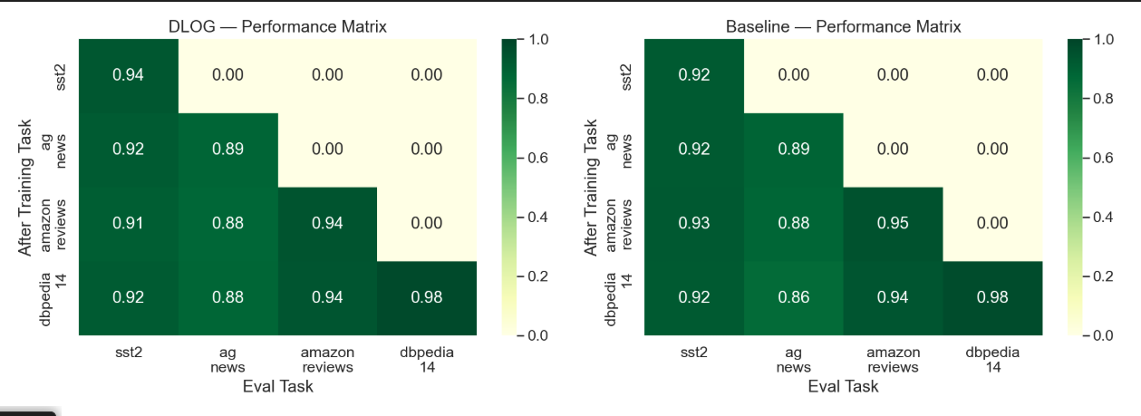
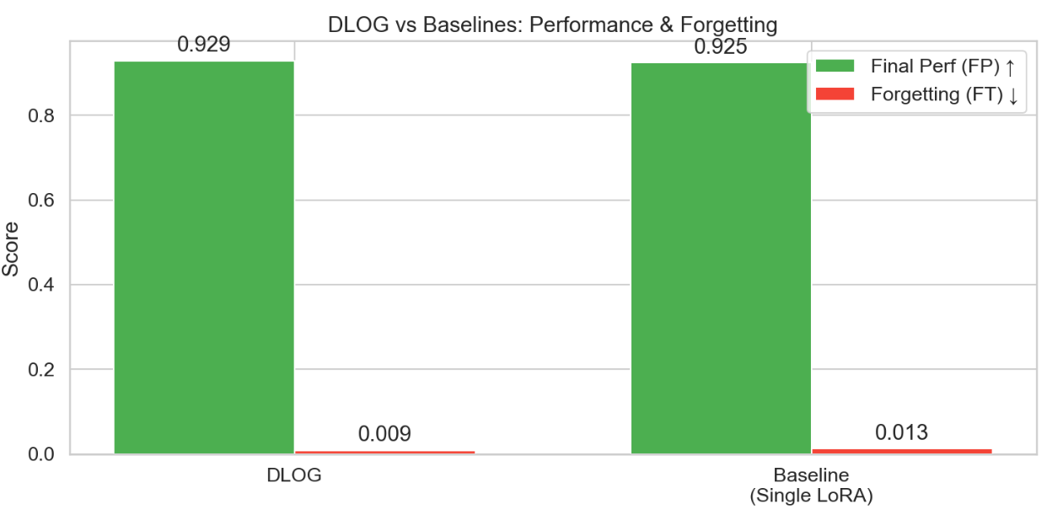

Slide 15
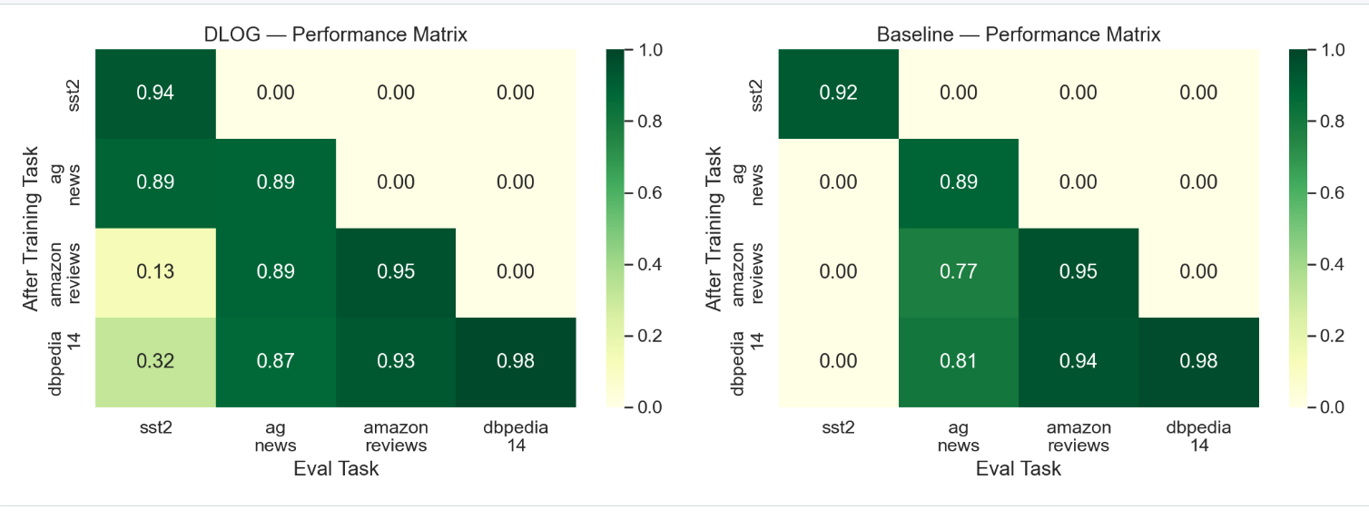
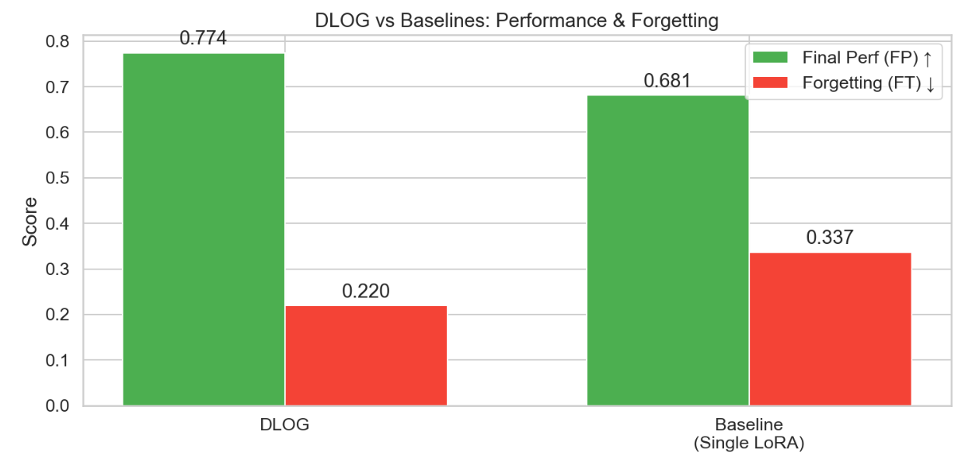

Slide 16
Summary
DLOG separates knowledge into Slow (memory) and Fast (task) LoRA adapters
Orthogonal Gating (soft + hard) ensures new learning does not corrupt old knowledge
Reservoir Replay provides gradient signal from past tasks
IPC Freezing permanently protects the most critical modules
QR+SVD consolidation compresses both adapters back to rank-r at each task boundary
All mechanisms are complementary — each addresses a different aspect of forgetting

