Slide 1
What Restaurant to Open in Singapore?
Edbert Fernando Widjaja

Slide 2
What Restaurant to Open in Singapore?
Singapore is a country with advance economy in the world.
Each year it not only attracts people to the country in the form of tourism but also in the form of skilled labor.
As a result of the diverse demographic, Singaporean pride themselves for the diverse cuisine available in their country.

Slide 3
Singapore is divided into 5 districts:
Central Singapore
North West
North East
South West
South East

Slide 4
Point of Interest:
Finding the most popular cuisine in each of the 5 districts in Singapore.

Slide 5
Data Acquisition & Cleaning:
Data used is acquired from list of postal districts (Urban Redevelopment Authority Singapore 2021) as well as its respective postcode and is categorized into the 5 distinct districts in Singapore (Mapanet/ Divex 2021).

Slide 6
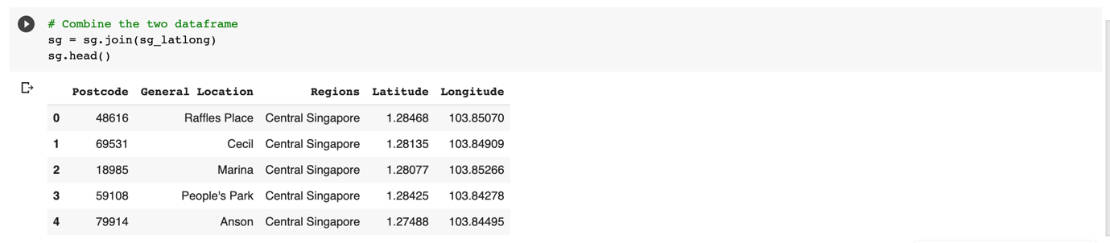
Cleaned Data:

Slide 7
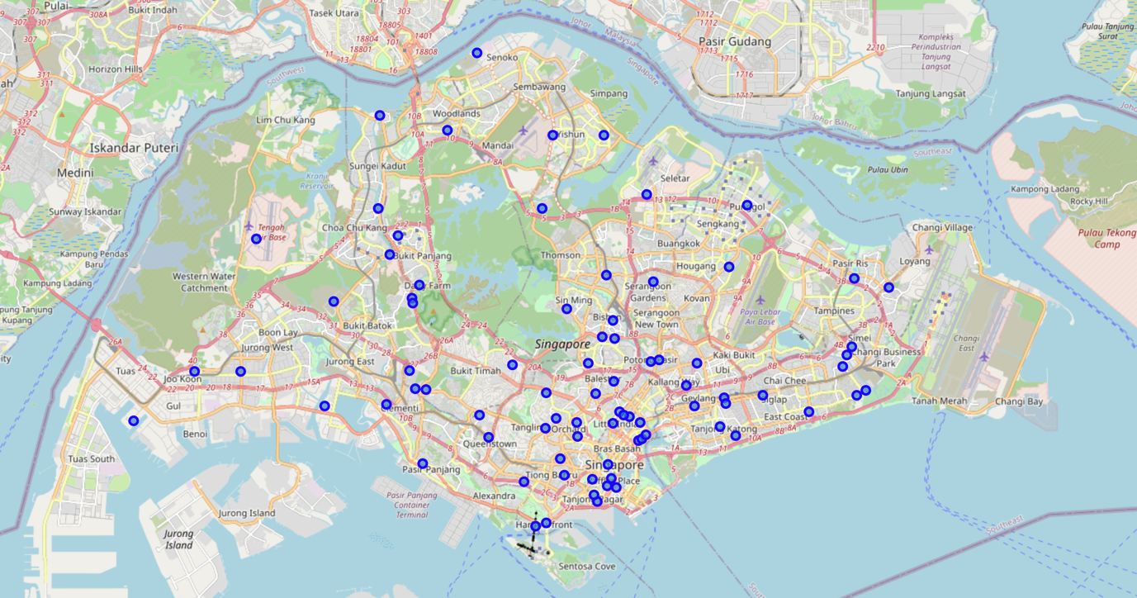

Slide 8
Central Singapore
Cluster 1: Chinese Restaurant
Cluster 2: Chinese Restaurant
Cluster 3: Coffee Shop

Slide 9
North East Singapore
Cluster 1: Chinese Restaurant
Cluster 2: Asian Restaurant
Cluster 3: Coffee Shop

Slide 10
North West Singapore
Cluster 1: Coffee Shop
Cluster 2: Coffee Shop
Cluster 3: Halal Food

Slide 11
South East Singapore
Cluster 1: Malay Restaurant
Cluster 2: Chinese Restaurant
Cluster 3: Chinese Restaurant

Slide 12
South West Singapore
Cluster 1: Comfort Food
Cluster 2: Chinese Restaurant
Cluster 3: Fast Food Restaurant

Slide 13
Limitations:
There may be some ambiguity in the data provided from Foursquare such as noodle restaurant, Asian restaurant, comfort food, halal food and fast food.
Inability to categorize further from the data provided.

Slide 14
Recommendation:
1. One would like to open a restaurant of the most common type of cuisine from the cluster as the people from that cluster love that cuisine.
2. One would avoid opening a restaurant of the most common type of cuisine from the cluster so as to avoid competition.
3. Given people from same region behave similarly, one would be attracted to open the most common cuisine from other clusters of the same region.

Slide 15
Conclusion:
Data presented gives the most common venue for each cluster from each region in Singapore.
This can give a potential restauranter of what type of cuisine is most common and depending on his/her judgement, whether to open the most common cuisine in the area or to avoid opening.

