Slide 1
Pemrograman perangkat telekomunikasi bergerak

Slide 2

My Blog
Jonathan Wijaya 18115024
Edbert Ongko 18115044

Slide 3
Specifications
A simple social media focusing on posting photos
Using Firebase
Minimum requirement: Android 5.0 Lollipop

Slide 4
Features
Account Management
Login
Register
Account Settings
Post Management
New Post
Likes
Comments
Image Management
Cropping
Compressing

Slide 5
Contributions
Jonathan Wijaya
Splash Screen
Account Management
Image Cropping
Comment Activity
Firebase
Main Activity Layout
Edbert Ongko
Main Activity Code
New Post Activity
Likes
Image Compressing

Slide 6
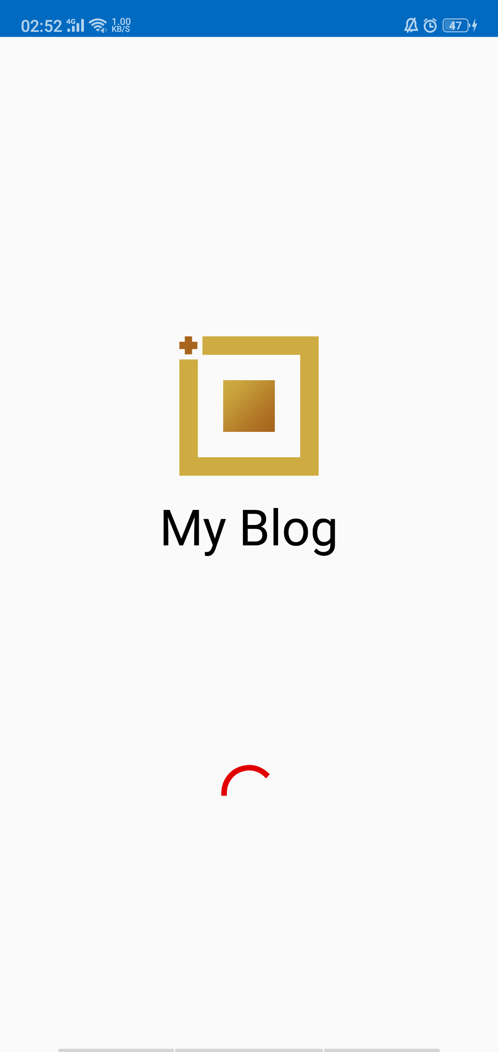
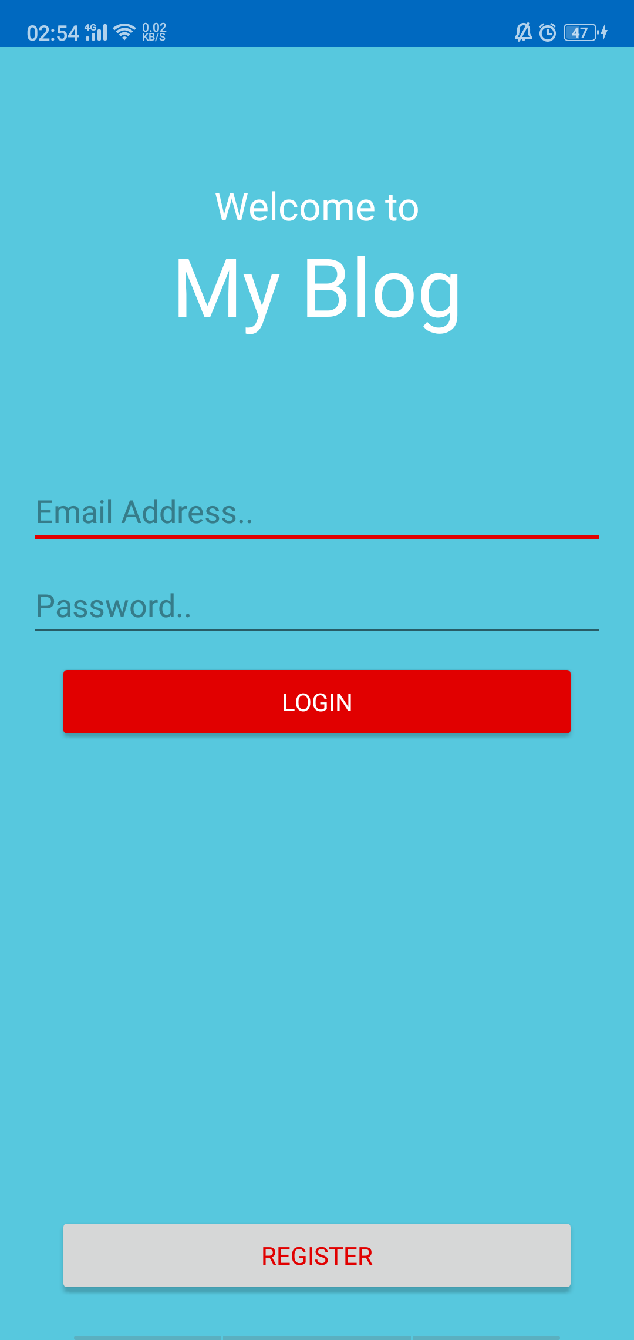
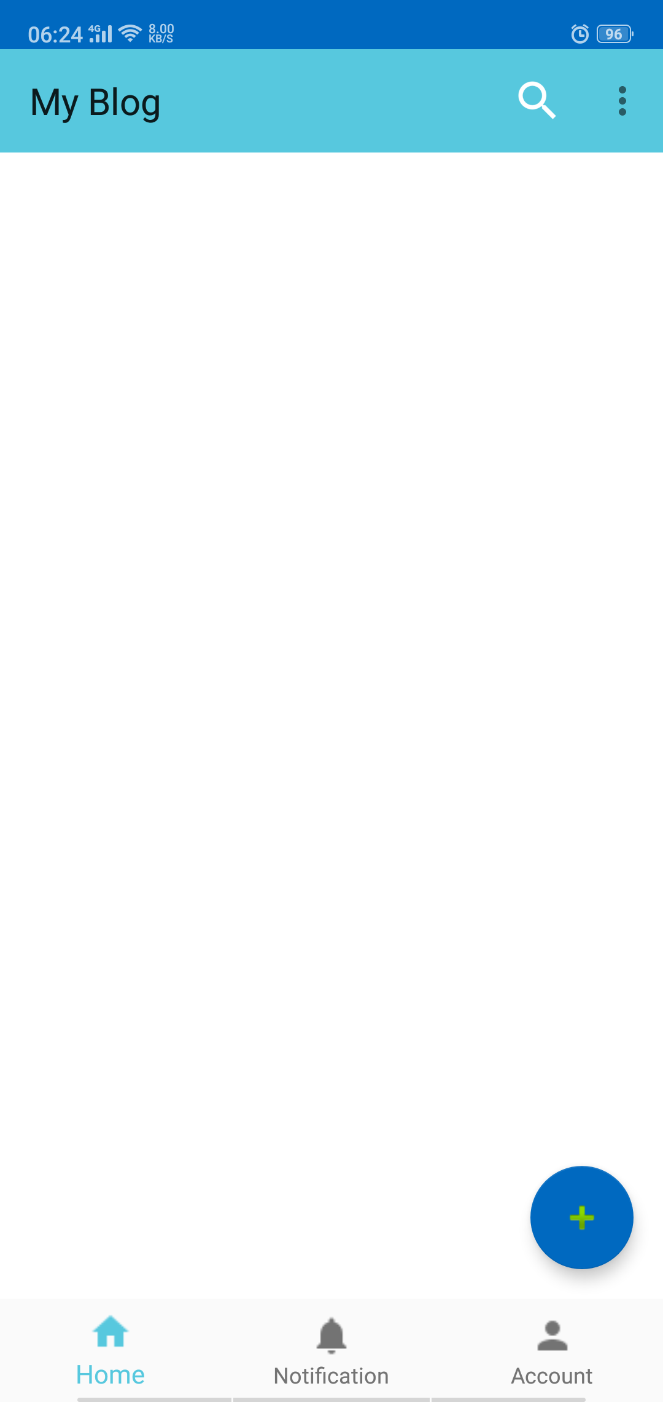
Starting Up
Haven’t Logged in
Logged in

Slide 7
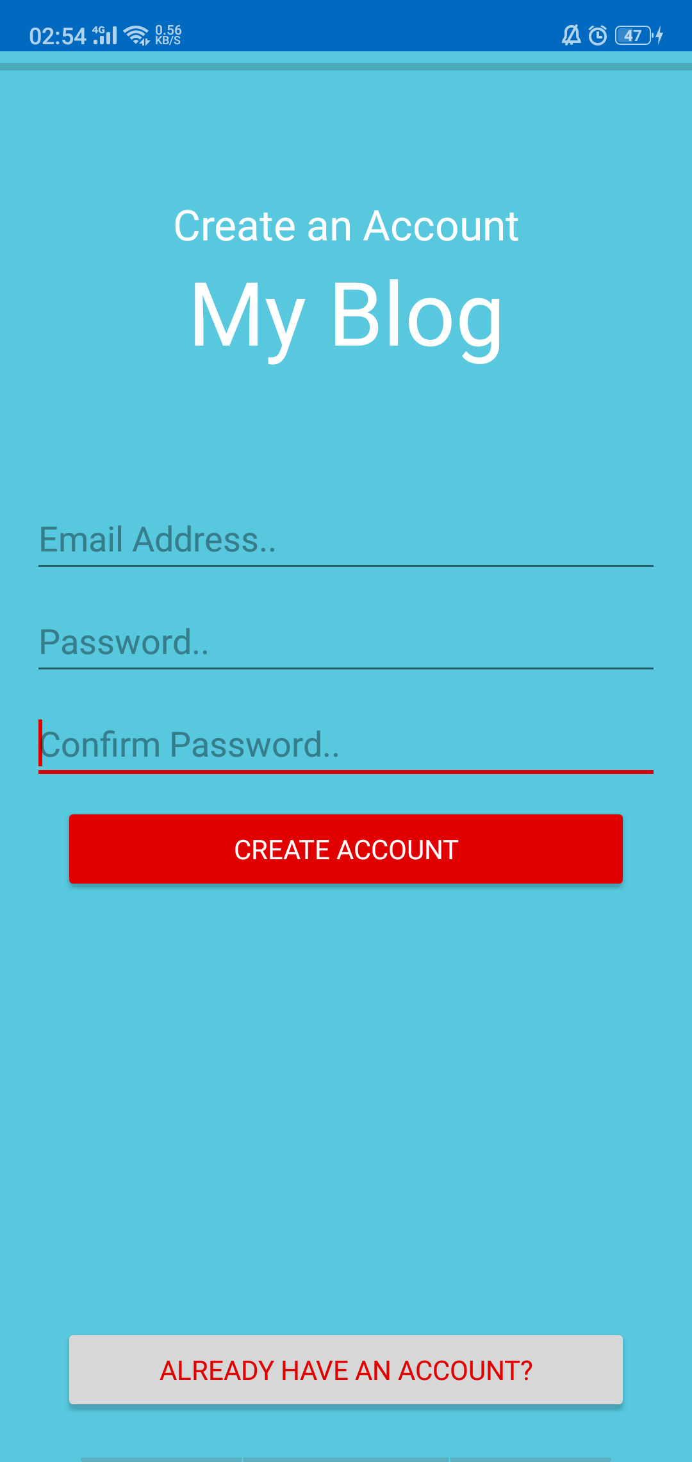
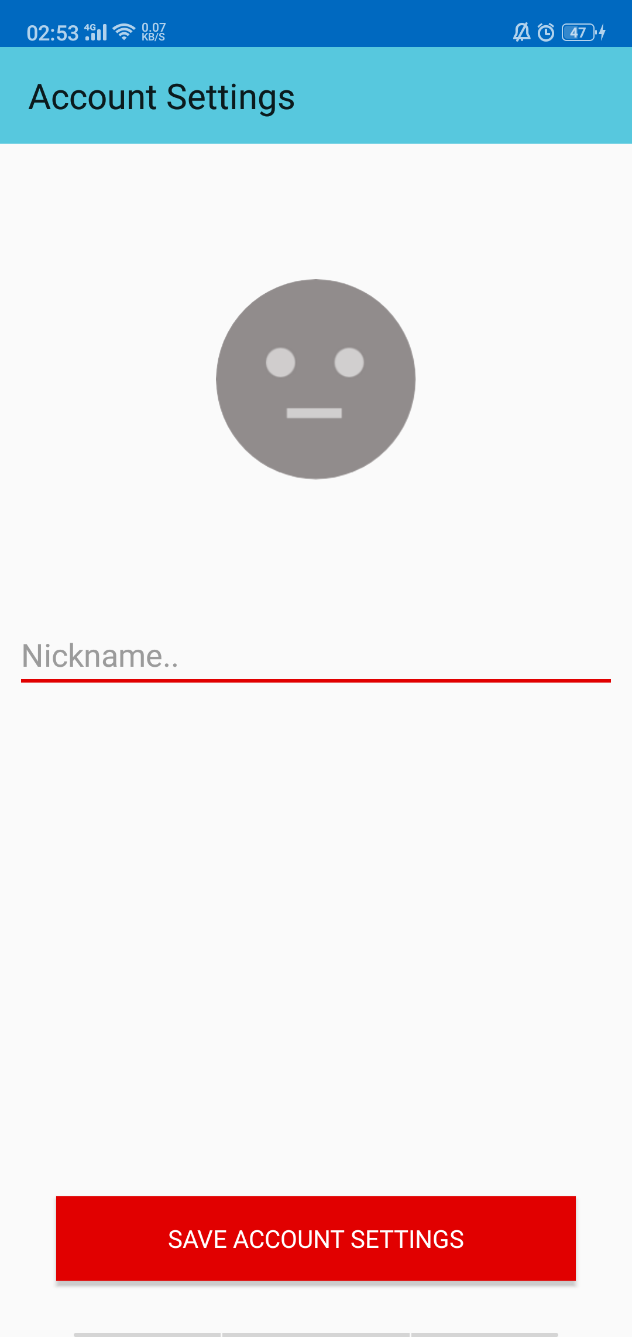
Account Management
Login
Register
Settings

Slide 8
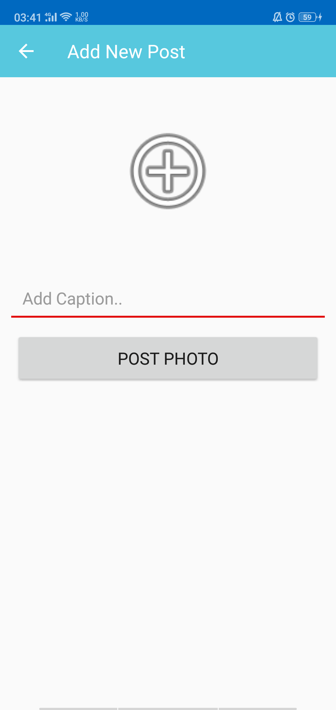
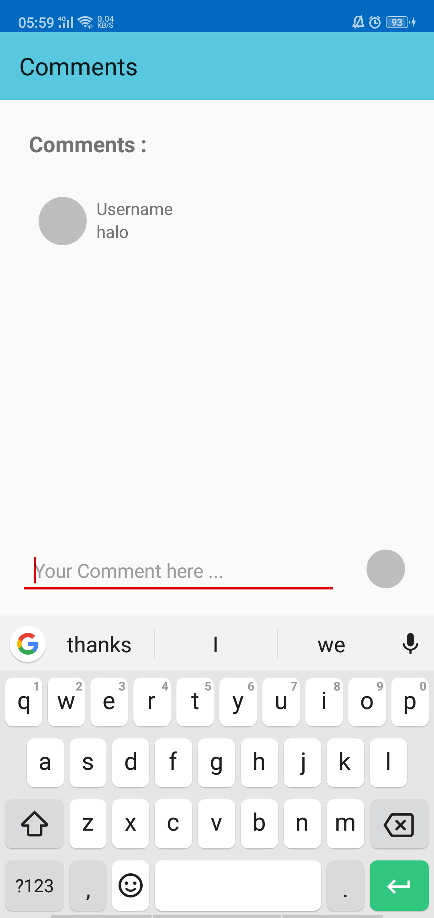
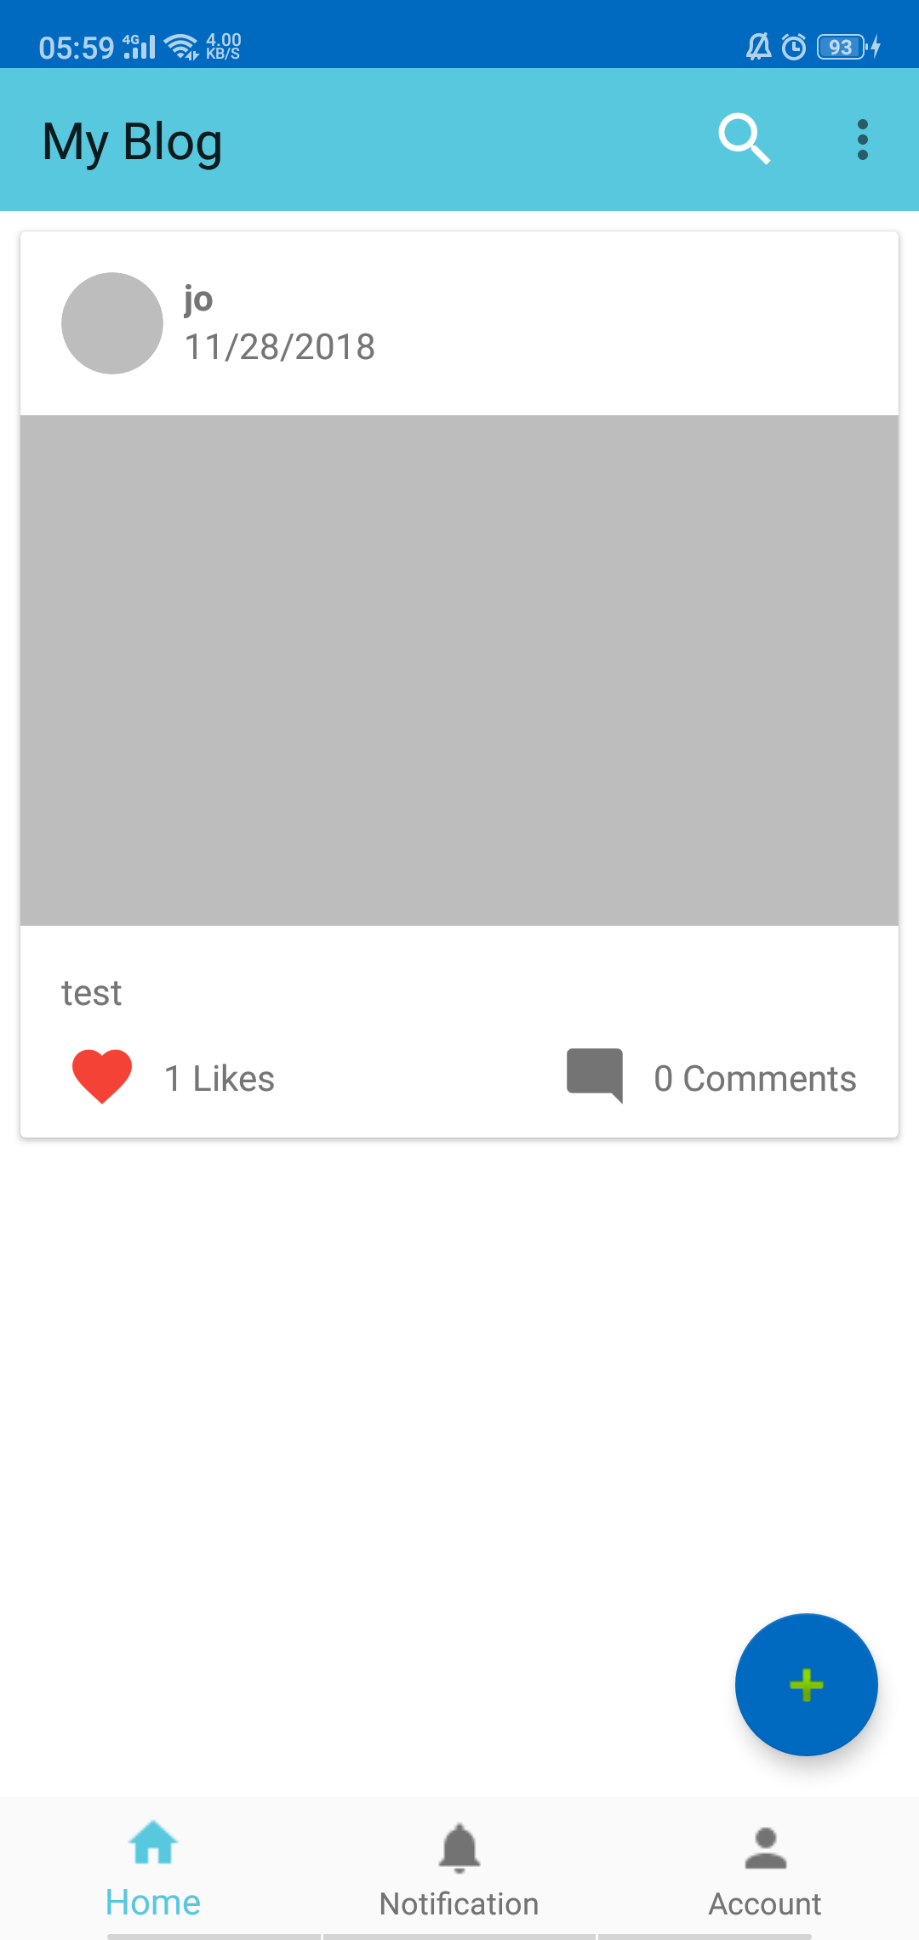
Post Management
New Post
Comments
Likes

Slide 9
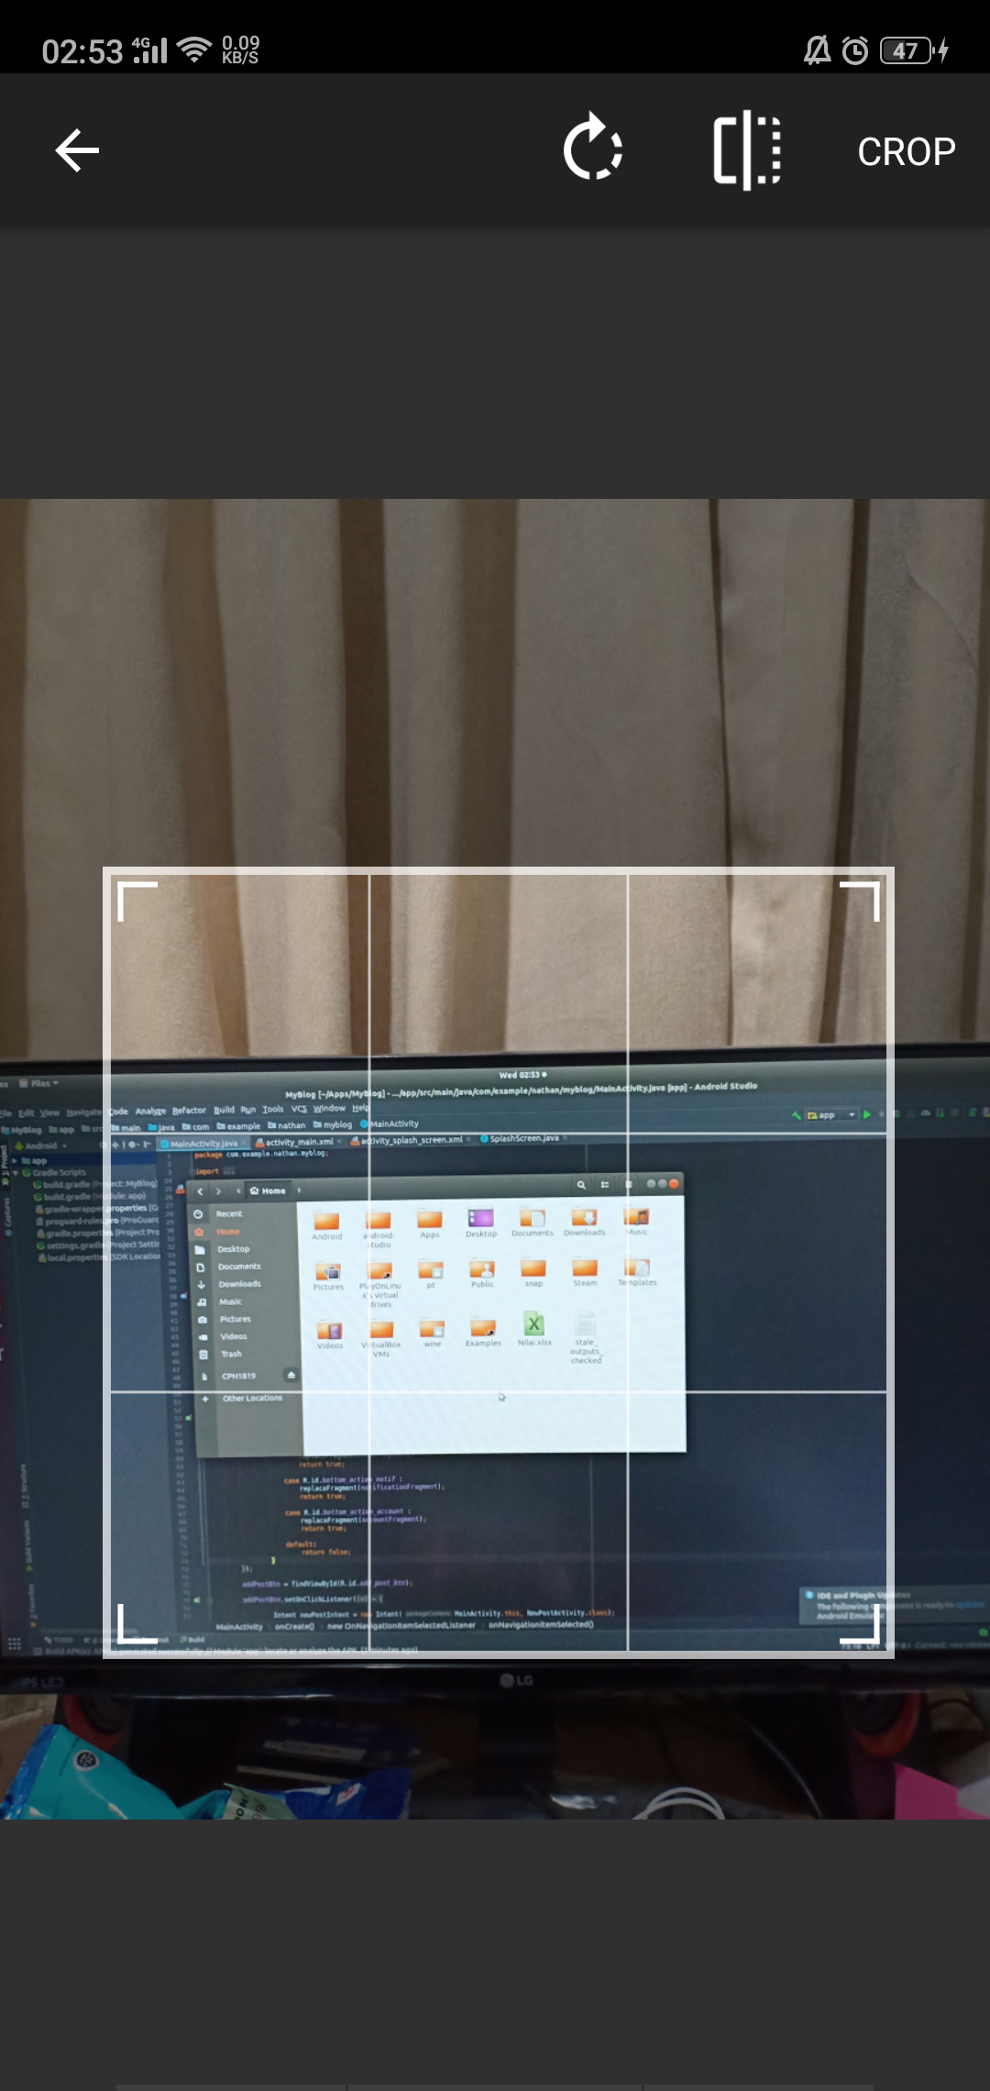
Additional
Image Cropping

Slide 10
References
https://www.youtube.com/channel/UCl6DxakCjDR5AfRwWhWNbMg (TVAC Studio)
https://github.com/akshayejh
https://github.com/hdodenhof
https://github.com/ArthurHub
https://github.com/zetbaitsu

