Slide 1
CERN ROOT Minuit2 Demo
E.C. Birdsall

Slide 2
What this is
A brief introduction to Minuit2
Intended for new PhD students to “get something working fast”
Produced quickly one evening, there could be a bug lurking, don’t use this as a “de-facto standard”

Slide 3
What this is not
Not a guide to best practices
Not a detailed overview of technicalities relating to obtaining correct minima or verification of results
Not an in depth guide to all of Minuit2 functionality

Slide 4
What we will do
example.C
Find minimum value of x²
Find minimum value of x² with a Gaussian constraint

Slide 5
What we will do
example2.C
Create some fake data using TRandom3 random number generator
Scale this data, and create a new dataset from it
Use Minuit2 to find the scaling coefficients in a mock parameter fit

Slide 6
Download the example
https://github.com/edbird/Minuit2-Examples
Video for the first 2 demos (3rd one – the best one – not yet online)
https://www.youtube.com/watch?v=OVvgcfyNCBY

Slide 7
Download the example
If the examples do not work, then the following slides show their output

Slide 8
Example 1
2-in-1: First minimize x² starting from x=3
Then minimize x² with a Gaussian constraint
$ root
root[0] .L example.C
root[1] example()

Slide 9
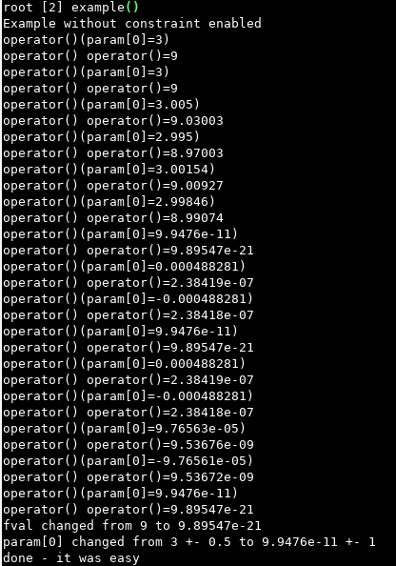
Example 1

Slide 10
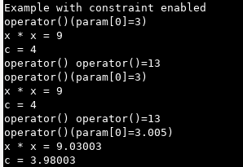
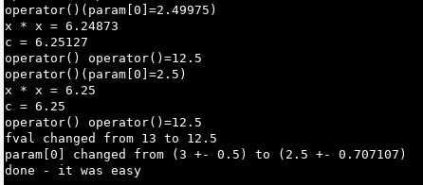
Example 1
...

Slide 11
Example 2
$ root
root[0] .L example2.C
root[1] example()

Slide 12
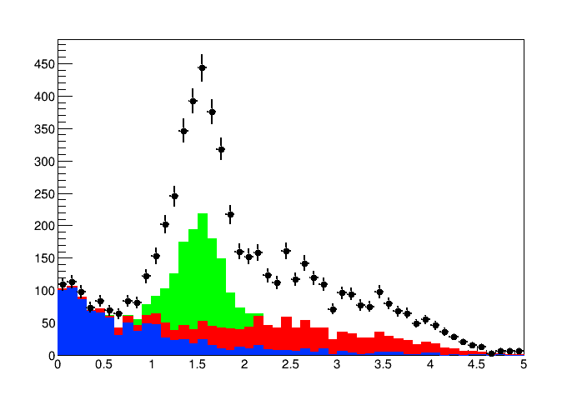
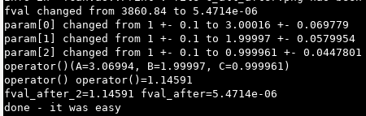
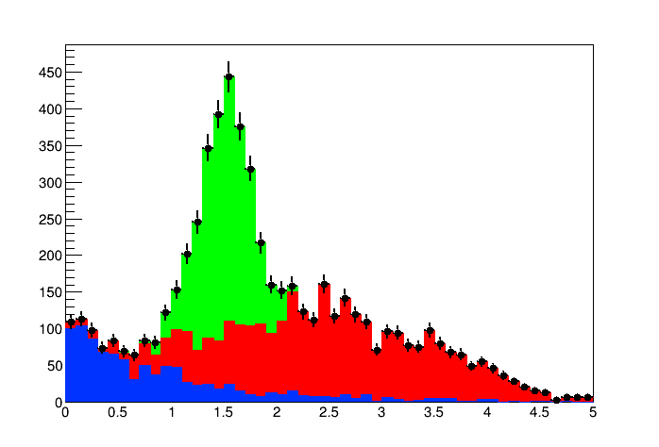

Example 2
before
after

Slide 13
Example 3
Same as Example 2, but pseudo data generated from separate random MC
$ root
root[0] .L example3.C
root[1] example()

Slide 14
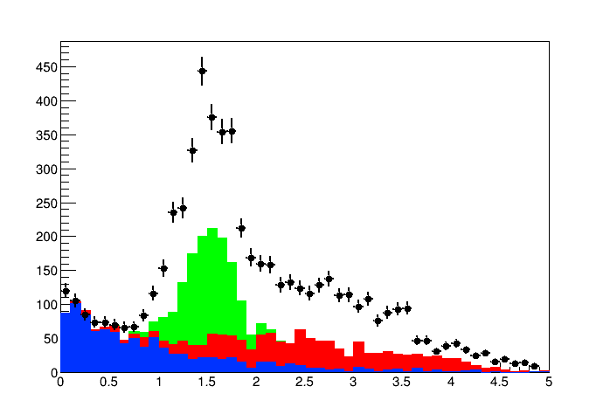
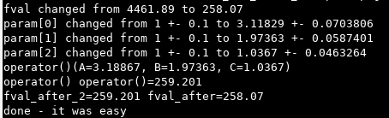
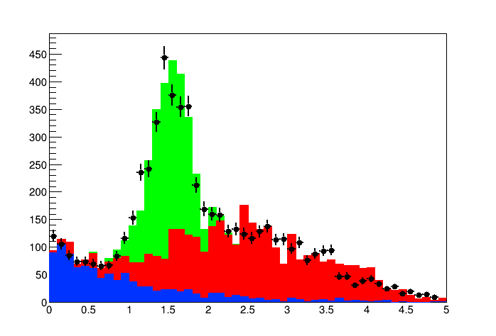
Example 3
before
after

Slide 15
End
End

