Slide 1
project2.ipynb
main
config
parameters
generations,
population_size,
crossover_probability,
mutation_probability,
values,
costs,
weights,
Cargo,
strategies
uses
GeneticAlgorithmFacade
config
execute()
Use Cases

Slide 2
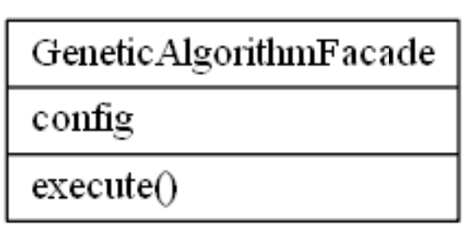
Genetic_algorithm.py

Slide 3
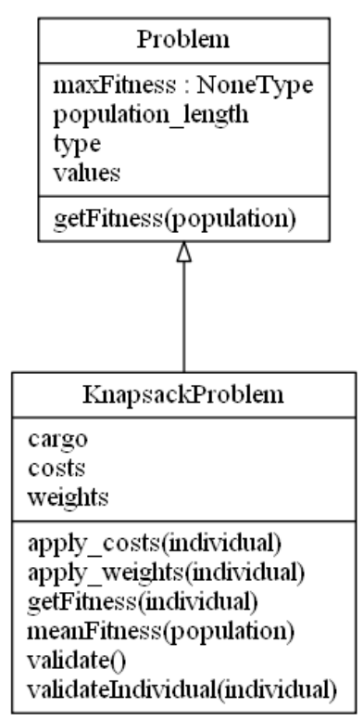
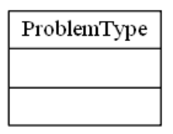
problem.py

Slide 4
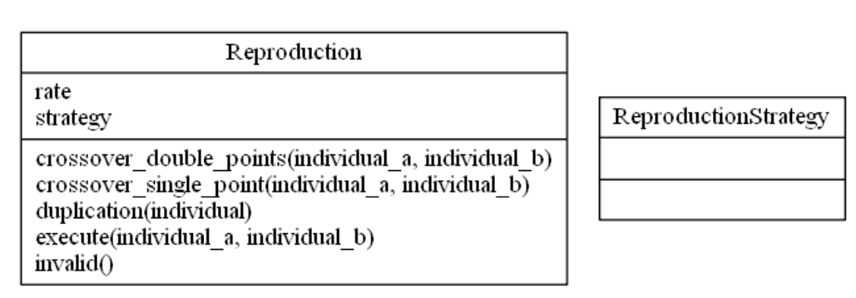
reproduction.py

Slide 5
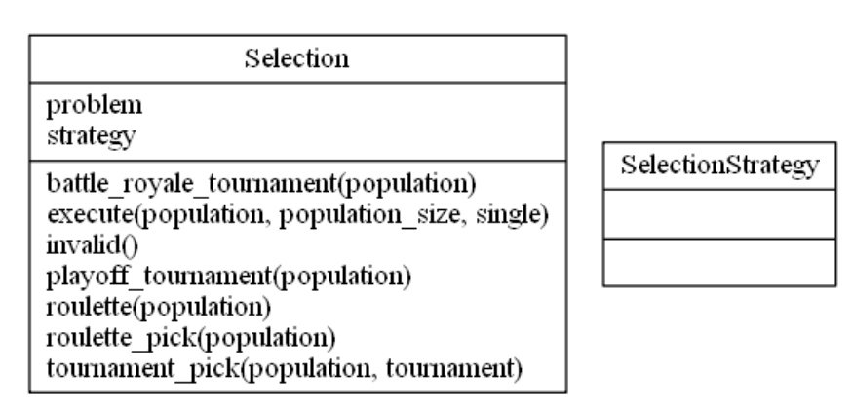
selection.py

Slide 6
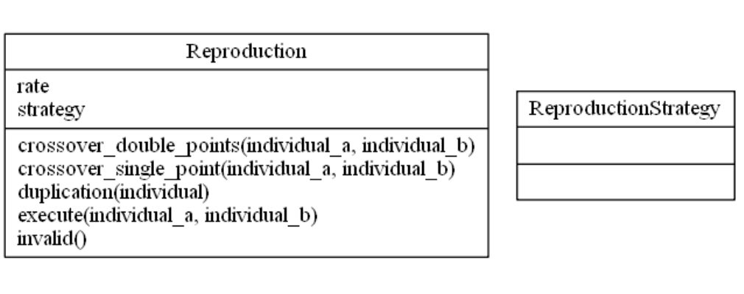
reproduction.py

Slide 7
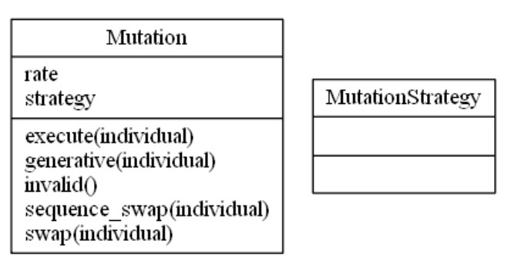
mutation.py

Slide 8
stop_criteria.py
StopCriteriaType
StopCriteriaType
type,
num_generations
Fitness
quorum
__init__(type, num_generation, fitness, quorum)

