Slide 1
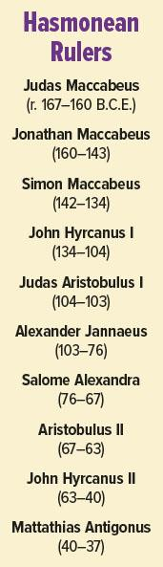
Hasmonean
From the Maccabean Revolt in 167 BC an independent kingdom
Tension between roles of High Priest and King, although some held both simultaneously
Pompey the Great conquers Jerusalem in 63 BC, ending political autonomy, though Hasmoneans will hold the High Priesthood until Herod the Great
Click to download color PDF

Slide 2
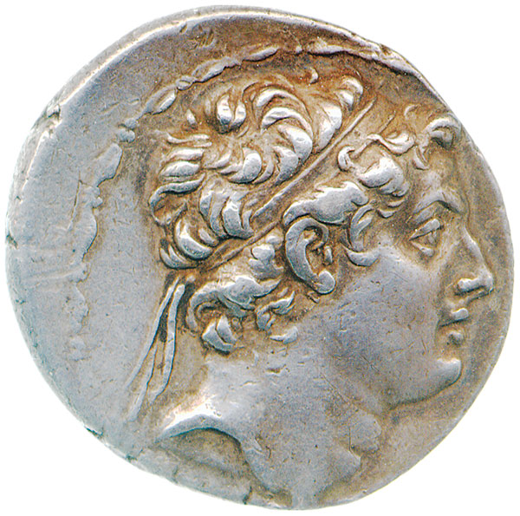
Mattathias revolts against the Seleucid Antiochus IV
Mattathias Maccabee and his five sons, who led the Jewish revolt against Antiochus IV Epiphanes, the Seleucid ruler of Judea, in the 160s B.C.E. When Antiochus desecrated the Temple and forbade circumcision and Sabbath observance, the Maccabees led a successful revolt. Their victory is still celebrated in the annual Jewish festival of Hanukkah.
Antiochus IV
Biblical Archaeology Review 40:2, March/April 2014
Modi’in: Hometown of the Maccabees

Slide 3
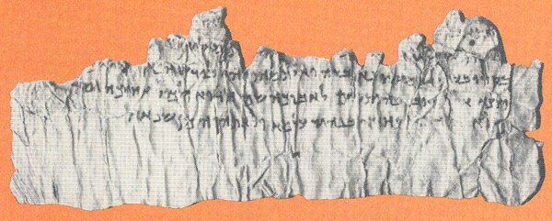
Qumran Fragments “The Suffering Servant”
“A man of suffering…wounded for our transgressions” (Isaiah 53:3, 5), described in four passages in the Book of Isaiah (42:1–7, 49:1–6, 50:4–9 and 52:13–53:12), came to be viewed by Christians as a prophecy of Jesus’ passion. Fragments 9 and 24 of the Dead Sea Scroll known as 4Q541 contain tantalizing suggestions of a parallel with this “suffering servant” from Isaiah according to scholar Emile Puech. The leather fragments date to about 100 B.C.E. The language is Aramaic, the Semitic vernacular in Judea at the turn of the era. If these fragments refer to a suffering messiah, this would suggest that the suffering servant of the Isaiah passages was understood to be a messianic figure at least a century before Jesus.
Professor John Collins, however, presents an alternative interpretation. Although characterized as a sage and a priest, the subject of these fragments, observes Collins, does not experience the personal violence and death described in Isaiah and suffered by Jesus. It seems instead that this eschatological priest may have been modeled on the Teacher of Righteousness, the leader of the Dead Sea Scroll sect. The Teacher of Righteousness also suffered lies from opponents who led the people astray. Without any hint of a messiah, the references to “hanging” (crucifixion) and “the nail” in fragment 24 lack special significance, because crucifixion was a common punishment of the time.
Bible Review 9:6, December 1993
The Suffering Servant at Qumran

Slide 4
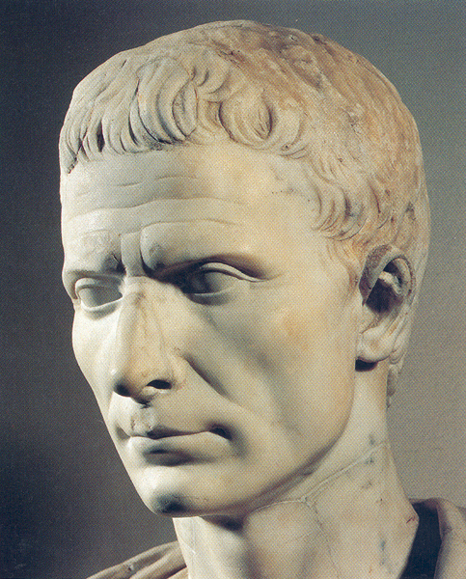
John Hyrcanus II and Julius Caesar
The Hasmoneans conquered territories in Samaria, the Galilee, and Transjordan; fought against the Seleucids, the Nabateans, and Hellenistic cities; and maintained contacts with the Ptolemies and the Romans.
Josephus, Antiquities 14.8.1
“Antipater, who managed the Jewish affairs, became very useful to Cesar, when he made war against Egypt; and that by the order of Hyrcanus. …Antipater came to him, conducting three thousand of the Jews armed men.” “…Antipater persuaded [the Jews of Egypt] to come over to their party; because he was of the same people with them and that chiefly by showing them the epistles of Hyrcanus the High Priest; wherein he exhorted them to cultivate friendship with Caesar.”
Archaeology Odyssey 4:1, January/February 2001
Vestal Virgins
Biblical Archaeology Review 44:6, November/December 2018
The Hasmonean Kings: Jewish or Hellenistic?

Slide 5
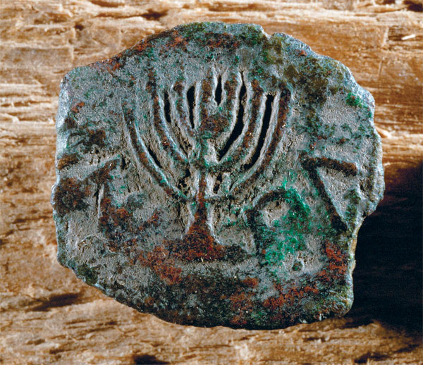
The Last Hasmonean King Matthias Antigonos
A Lepton coin from the Hasmonean era depicts a Menorah and the inscription, “King Antigonos.” It was apparently a propaganda tool of Mattathias Antigonos, king of Judea (40–37 B.C.E.) in his conflict with the usurper Herod. The reverse of the coin (not shown) shows the Showbread table, with the Hebrew words “Mattatayah the High Priest.”
Biblical Archaeology Review 31:4, July/August 2005
The Temple Menorah—Where Is It?

