Slide 1
A More Perfect Union
Different, maybe better, ways of counting votes

Slide 2
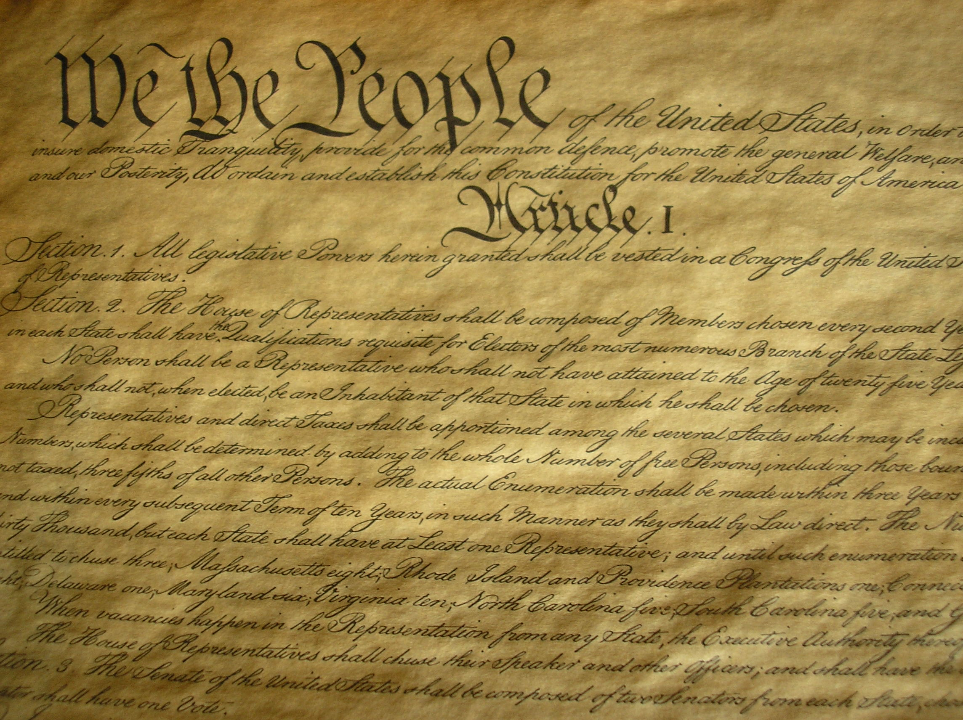
Notes:
We the People of the United States, in Order to form a more perfect Union, establish Justice, insure domestic Tranquility, provide for the common defense, promote the general Welfare, and secure the Blessings of Liberty to ourselves and our Posterity, do ordain and establish this Constitution for the United States of America.”

Slide 3
Introduction
Lots of things to vote for
Lots of ways to count the votes

Slide 4
Things to vote for: People
Single seat
President
Senator
Governor
Mayor
Member of House of Representatives
Multiple seat
Board of supervisors
School Board
Homeowner’s Association
City Council

Slide 5
Things to vote for: Things
Oscars: Movies
Grammys: Music
Tonys: Live productions (plays, musicals)
Newbery and Caldecott Medals: Books
Products
Amazon reviews
Yelp ratings
Tripadvisor ratings

Slide 6
Ways to Count the Votes
SO MANY WAYS!
At least 12 distinctly different systems, with numerous variations of each.
No commonly agreed upon names for all the systems.
Which one is best?
Remember, we’re trying to build a more perfect union.
There is no perfect system. Every one has its flaws

Slide 7
Three Classes of Voting Systems
Proportional Representation Systems
Multi-member bodies
Mixed Member Systems
Multi-member bodies
Plurality/Majoritarian systems
Single-seat

Slide 8
Focus on Plurality/Majoritarian
First Past The Post
What we have now
We inherited it from the British. It’s used in Britain and its former colonies (USA, India, Canada)
Two-round systems
Like first past the post, but if no candidate has > 50% of the votes, a second round is triggered, with only the top two vote getters as candidates

Slide 9
Focus on Plurality/Majoritarian
Instant Runoff
Rank your candidates in decreasing order of desirability
Process of elimination until one candidate has > 50%
Score Voting
Score each candidate on a scale
1 – 10
0 – 5 ★’s
Approval voting: each candidate gets zero or one vote

