Slide 1

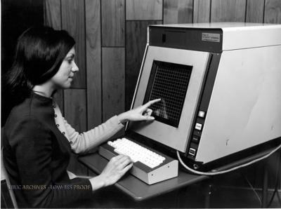
Computer Programming
Ed Burns, Oracle Corporation

Slide 2


Computer Programming
What is a program?
A computer program is a file, just like a document in Microsoft Word or a picture in KidPix.

Slide 3

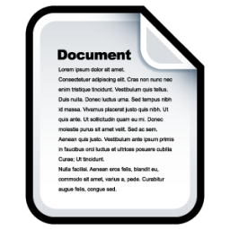


Computer Programming
What is a program?
With Microsoft Word or KidPix you use the computer to create text or images to be read or viewed by humans.
+
=
+
=

Slide 4
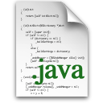


Computer Programming
What is a program?
With a computer program, you use the computer to create instructions to be read by a computer!
+
=

Slide 5
Computer Programming
What are instructions?
The instructions that make up a computer program can be really simple.
+
=

Slide 6

Computer Programming
What are instructions?
The instructions that make up a computer program can be really simple...
print “Hello world!”
+
=

Slide 7
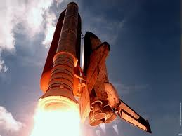
Computer Programming
What are instructions?
...or very complex.
launch “space shuttle”
+
=

Slide 8
Computer Programming
What are instructions?
...or very complex.
Instructions are also called statements.
+
=

Slide 9
Computer Programming
Why are programs special?
Since the beginning of humanity, there have only ever been five different ways that humans can store and transmit knowledge!

Slide 10

Computer Programming
Why are programs special?
Brains
From the beginning
of humans

Slide 11
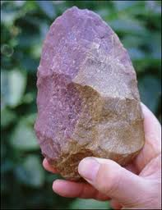
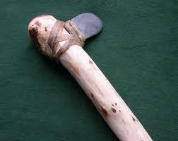

Computer Programming
Why are programs special?
Tools
Scientists say
3.5 million years ago

Slide 12
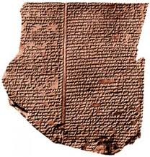
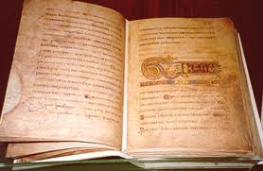
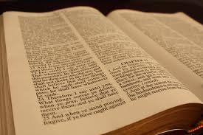
Computer Programming
Why are programs special?
Books
600 years
ago

Slide 13
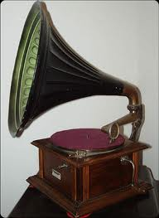
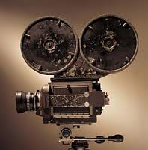
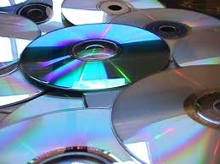
Computer Programming
Why are programs special?
Recorded sound and images
152 years ago

Slide 14
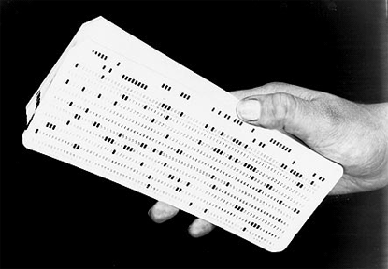
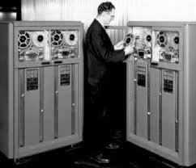
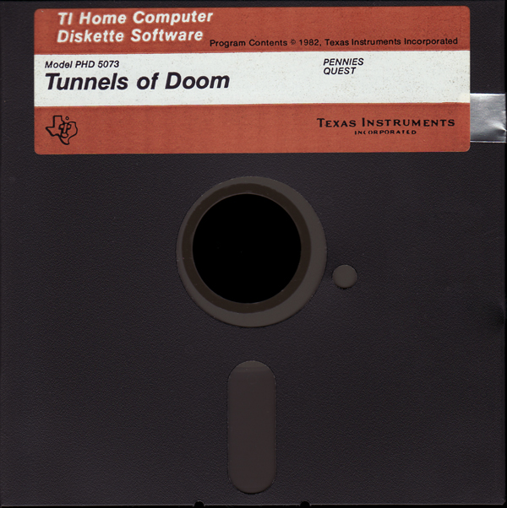
Computer Programming
Why are programs special?
Computer programs
68 years ago

Slide 15
Computer Programming
What does a program do?
Because computer programs are so special, there are lots of special words to talk about them.
The first special word describes what a computer does with a program.

Slide 16

Computer Programming
What does a program do?

Slide 17
Computer Programming
What does a program do?
It runs.
What runs the program?

Slide 18
Computer Programming
What does a program do?
When a program runs, the computer looks at each instruction and does what the instruction says, one instruction at a time.

Slide 19

Computer Programming
Who makes programs?
A person who writes a computer program is called a Programmer.
You can be a programmer too!

Slide 20
Computer Programming
Who makes programs?
A person who writes a computer program is called a Programmer.
You can be a programmer too!
Let’s get started!

Slide 21
Computer Programming
Getting Started With Programming

Slide 22
Computer Programming
Simple instructions
Five basic concepts
  Variables
  If and if else statements
  Lists
  Loops
  Sub-routines

Slide 23
Computer Programming
Simple instructions
variable
A place to store information so the computer can work with it
Real world example: What’s for lunch?
  Hot dog
  Hamburger

Slide 24
Computer Programming
Simple instructions
variable
A place to store information so the computer can work with it
Programming example: What’s for lunch?
lunch = “Hot Dog”;
lunch = “Hamburger”;

Slide 25
Computer Programming
Simple instructions
if
Make choices based on the value of a variable
Real world example:
If lunch is hamburger, get ketchup. If lunch is hot dog, get mustard.

Slide 26
Computer Programming
Simple instructions
if
Make choices based on the value of a variable
Programming example:
if (lunch.equals(“Hamburger”)) {
getKetchup();
}
if (lunch.equals(“Hot Dog”)) {
getMustard();
}

Slide 27
Computer Programming
Simple instructions
if else
Use when you only have two choices to choose from.
Real world example:
If lunch is hamburger, get ketchup, otherwise, get mustard.

Slide 28
Computer Programming
Simple instructions
if else
Use when you only have two choices to choose from.
Programming example:
if (lunch.equals(“Hamburger”)) {
getKetchup();
} else {
getMustard();
}

Slide 29
Computer Programming
Simple instructions
lists
A special kind of variable that holds a list of values
Real world example:
Your lunch choices are: hamburger, hot dog, chicken nuggets or green salad
The items in the list are called elements. The lunch choices list has four elements.

Slide 30
Computer Programming
Simple instructions
lists
A special kind of variable that holds a list of values
Programming example:
lunchChoices = { “hamburger”,
“hot dog”,“chicken nuggets”,
“green salad” };
print lunchChoices.size();
Prints out “4”.

Slide 31
Computer Programming
Simple instructions
loops
A statement that lets you do something with each element in a list.
Real world example:
Look at the lunch menu and decide what to eat.

Slide 32
Computer Programming
Simple instructions
loops
A statement that lets you do something with each element in a list.
Programming example:
for each (item : lunchChoices) {
if (iLikeIt(item)) {
eat(item);
}
}

Slide 33
Computer Programming
Simple instructions
Subroutines
A program within a program. Basically a way to organize your program so it’s easier to read.
Real world example:
To eat lunch, you must:
  Decide what to eat
  Buy it
  Take it to your table
  Eat it.

Slide 34
Computer Programming
Simple instructions
Subroutines
A program within a program. Basically a way to organize your program so it’s easier to read.
Programming example:
lunch = readMenuAndPickItem();
buyItem(lunch);
table = chooseTable();
eatLunchAtTable(lunch, table);

Slide 35
Computer Programming
Simple instructions
Subroutines
Programming example:
lunch = readMenuAndPickItem();
buyItem(lunch);
table = chooseTable();
eatLunchAtTable(lunch, table);
Subroutines need information to get their work done. The pieces of information given to a subroutine are called arguments.

Slide 36
Computer Programming
Simple instructions
Review
Five basic concepts
  Variables
  If and if else statements
  Lists
  Loops
  Sub-routines

Slide 37
Computer Programming
Ed Burns, Oracle Corporation

