Slide 1


Software Carpentry School of Physics and Astronomy The University of Edinburgh 19-20 February 2018

Slide 2









The Software Sustainability Institute
A national facility for cultivating better, more sustainable, research software to enable world-class research
Supported by EPSRC/ESRC/BBSRC grant EP/N006410/1, with additional project funding from Jisc and NERC

Slide 3
Schedule
Day 1
9:00 Registration
09:30 Automating tasks with the Unix shell
12:30 Lunch break
13:30 Version control with Git
16:30 Wrap-up
17:00 END
Day 2
09:00 Effective code review and continuous integration practices
10:00 Building programs with Python
12:30 Lunch break
13:30 Building programs with Python (continued)
16:45 Wrap-up
17:00 END

Slide 4
Best practices for scientific computing
Wilson G, Aruliah DA, Brown CT, Chue Hong NP, Davis M, et al. (2014) Best Practices for Scientific Computing. PLoS Biol 12(1): e1001745. http://dx.doi.org/10.1371/journal.pbio.1001745.
Let the computer do the work
Write programs for people, not computers
Use version control
Achieve more, in less time with less pain!
Notes:
Write programs for people, not computers.
A program should not require its readers to hold more than a handful of facts in memory at once.
Make names consistent, distinctive, and meaningful.
Make code style and formatting consistent.
Let the computer do the work.
Make the computer repeat tasks.
Save recent commands in a file for re-use.
Use a build tool to automate workflows.
Make incremental changes.
Work in small steps with frequent feedback and course correction.
Use a version control system.
Put everything that has been created manually in version control.
Don't repeat yourself (or others).
Every piece of data must have a single authoritative representation in the system.
Modularize code rather than copying and pasting.
Re-use code instead of rewriting it.
Plan for mistakes.
Add assertions to programs to check their operation.
Use an off-the-shelf unit testing library.
Turn bugs into test cases.
Use a symbolic debugger.
Optimize software only after it works correctly.
Use a profiler to identify bottlenecks.
Write code in the highest-level language possible.
Document design and purpose, not mechanics.
Document interfaces and reasons, not implementations.
Refactor code in preference to explaining how it works.
Embed the documentation for a piece of software in that software.
Collaborate.
Use pre-merge code reviews.
Use pair programming when bringing someone new up to speed and when tackling particularly tricky problems.
Use an issue tracking tool.

Slide 5
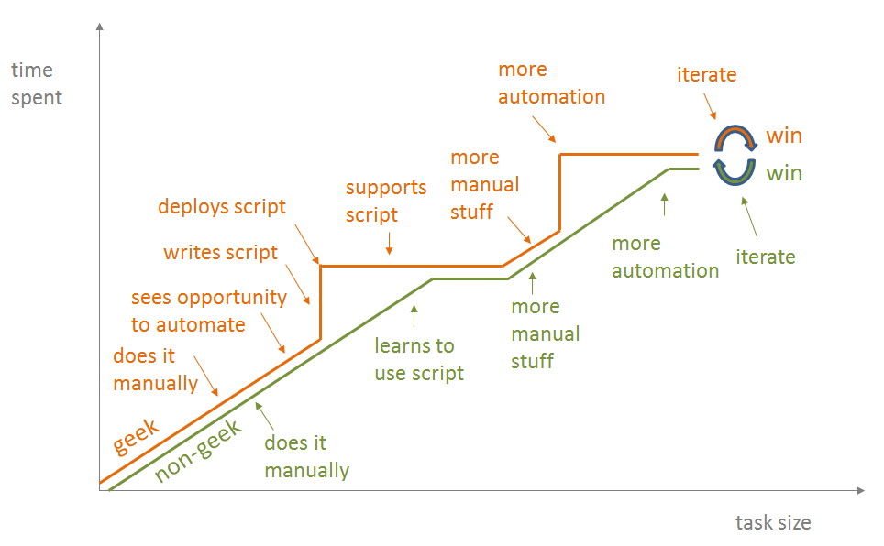
Let the computer do the work
https://blog.jonudell.net/2012/01/09/another-way-to-think-about-geeks-and-repetitive-tasks/

Slide 6
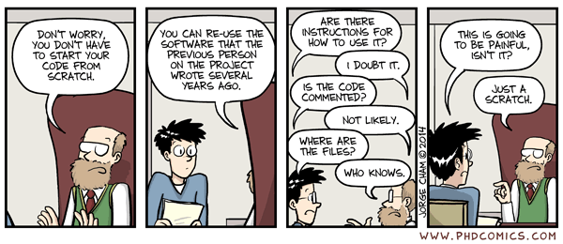
Write programs for people, not computers
http://phdcomics.com/comics/archive.php?comicid=1689

Slide 7
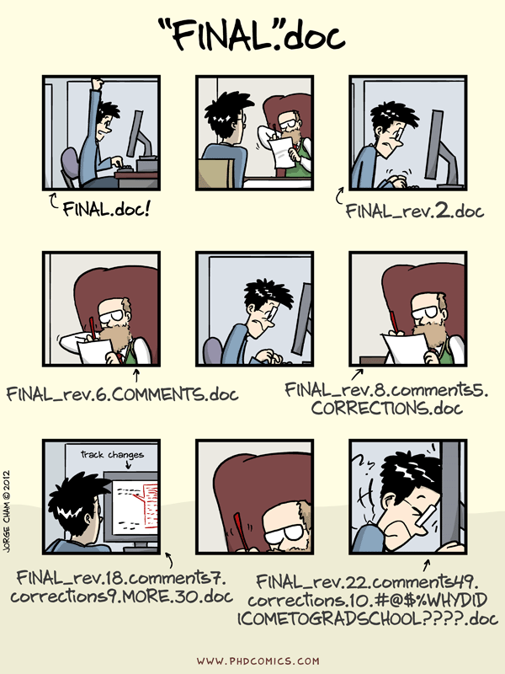
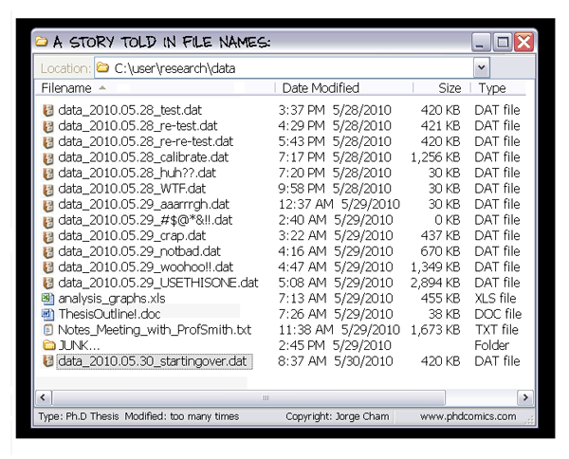
Use version control
http://phdcomics.com/comics/archive.php?comicid=1323
http://phdcomics.com/comics/archive.php?comicid=1531

Slide 8




Important bits and pieces
All images from https://icons8.com/license/
Creative Commons Attribution-NoDerivs 3.0 Unported (CC BY-ND 3.0) https://creativecommons.org/licenses/by-nd/3.0/

Slide 9

How to ask for help
Flag down a helper
Stick up your sticky note
Red – I’m stuck, help!
Green – I’m fine
All images from https://icons8.com/,
Creative Commons Attribution-NoDerivs 3.0 Unported (CC BY-ND 3.0) https://creativecommons.org/licenses/by-nd/3.0/

Slide 10
Collaborative document
Link available from Edinburgh carpentry site
https://marioa.github.io/2018-02-19-edinburgh/
Allows us to communicate with you:
Post long URLs
Code snippets
Tips/Comments from helpers/instructors
You can share your notes with others
http://pad.software-carpentry.org/2018-02-19-Edinburgh

Slide 11
Code of Conduct
Details:
https://software-carpentry.org/conduct/
Essentially:
Be courteous and nice to each other.

Slide 13
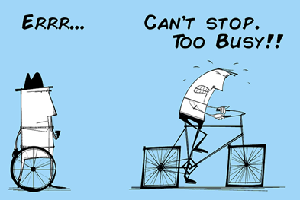
Image from Alan O’Rourke, https://audiencestack.com, Creative Commons Attribution 2.0 Generic (CC BY 2.0) https://creativecommons.org/licenses/by/2.0/

Slide 14
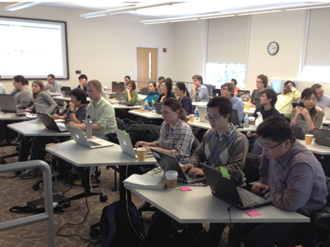
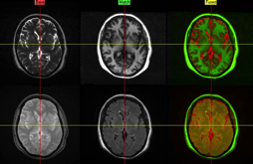

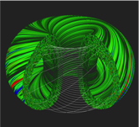
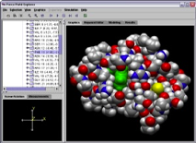
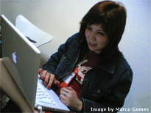

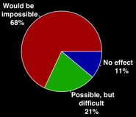
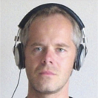
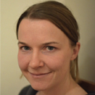
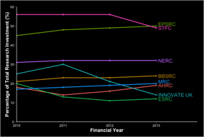
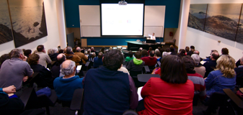
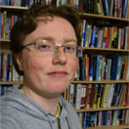

The Software Sustainability Institute
Software
Deliver essential software skills to researchers via CDTs, institutions and doctoral schools
Training
Help researchers to develop software that meets the needs of reliable, reproducible, and reusable research
Communications
Exploit our platform to enable engagement, delivery and uptake
Collect evidence on the use of research software and share results with stakeholders
Bring together the right people to understand and address topical issues
Policy
Community

Slide 15


The Carpentries
https://software-carpentry.org/
http://www.datacarpentry.org/

Slide 16
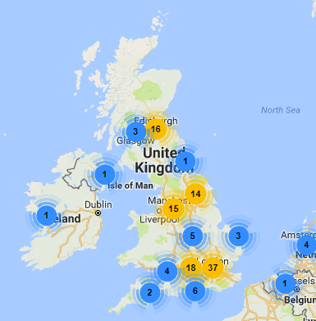

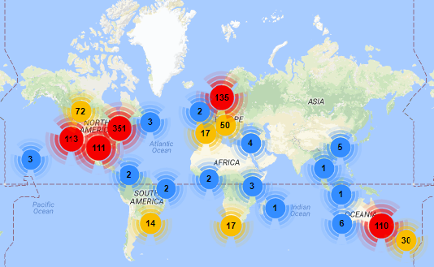


Get involved
https://software-carpentry.org/join/

Slide 17
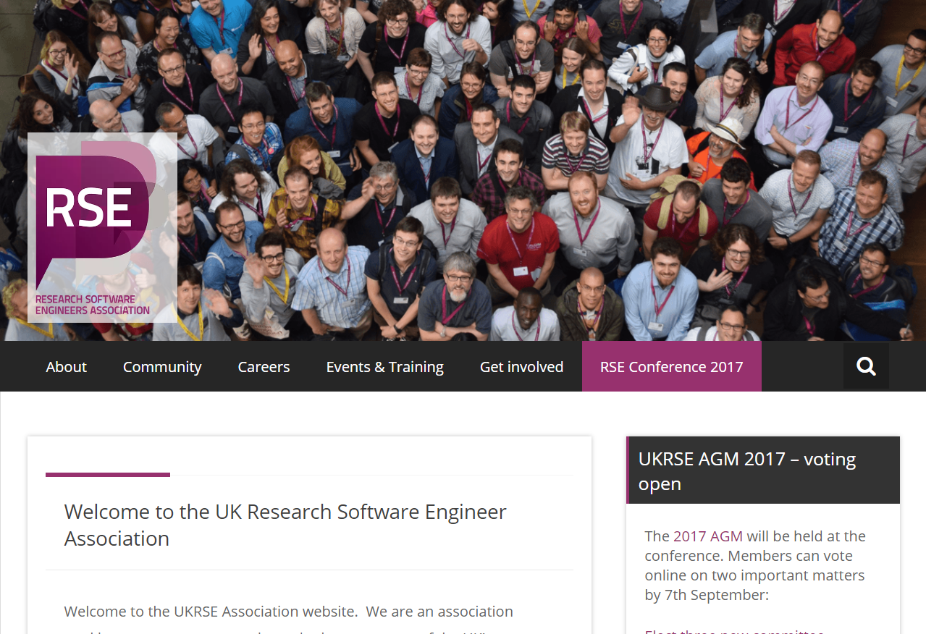
Research Software Engineer community
http://www.rse.ac.uk

