Slide 1


Software Carpentry
Heriot Watt University
28-29 March 2019

Slide 2











The Software Sustainability Institute
A national facility for cultivating better, more sustainable, research software to enable world-class research
Supported
by:

Slide 3
Schedule
Day 1
09:00 Automating tasks with the Unix shell
10:30 Coffee
12:00 Lunch break
13:30 Building programs with Python
16:00 Wrap-up
16:30 END
Day 2
09:00 Version control with Git
10:30 Coffee
12:00 Lunch break
13:30 Building programs with Python (continued)
16:00 Wrap-up
16:30 END
https://edcarp.github.io/2019-03-28-heriotwatt/

Slide 4
Best practices for scientific computing
Wilson G, Aruliah DA, Brown CT, Chue Hong NP, Davis M, et al. (2014) Best Practices for Scientific Computing. PLoS Biol 12(1): e1001745. http://dx.doi.org/10.1371/journal.pbio.1001745.
Let the computer do the work
Write programs for people, not computers
Use version control
Achieve more, in less time with less pain!
Notes:
Write programs for people, not computers.
A program should not require its readers to hold more than a handful of facts in memory at once.
Make names consistent, distinctive, and meaningful.
Make code style and formatting consistent.
Let the computer do the work.
Make the computer repeat tasks.
Save recent commands in a file for re-use.
Use a build tool to automate workflows.
Make incremental changes.
Work in small steps with frequent feedback and course correction.
Use a version control system.
Put everything that has been created manually in version control.
Don't repeat yourself (or others).
Every piece of data must have a single authoritative representation in the system.
Modularize code rather than copying and pasting.
Re-use code instead of rewriting it.
Plan for mistakes.
Add assertions to programs to check their operation.
Use an off-the-shelf unit testing library.
Turn bugs into test cases.
Use a symbolic debugger.
Optimize software only after it works correctly.
Use a profiler to identify bottlenecks.
Write code in the highest-level language possible.
Document design and purpose, not mechanics.
Document interfaces and reasons, not implementations.
Refactor code in preference to explaining how it works.
Embed the documentation for a piece of software in that software.
Collaborate.
Use pre-merge code reviews.
Use pair programming when bringing someone new up to speed and when tackling particularly tricky problems.
Use an issue tracking tool.

Slide 5
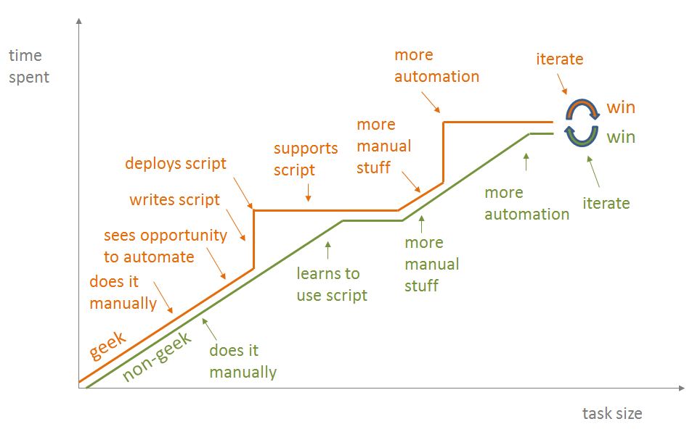
Let the computer do the work
https://blog.jonudell.net/2012/01/09/another-way-to-think-about-geeks-and-repetitive-tasks/

Slide 6
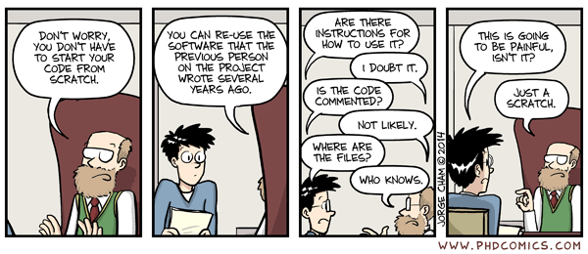
Write programs for people, not computers
http://phdcomics.com/comics/archive.php?comicid=1689

Slide 7
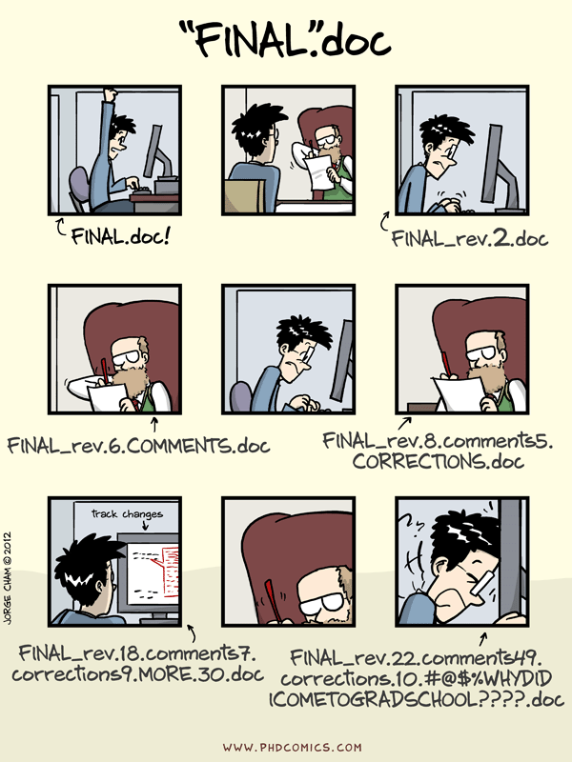
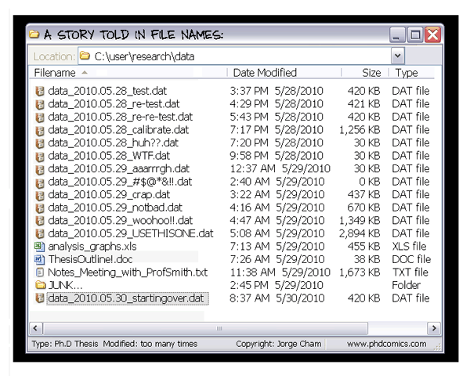
Use version control
http://phdcomics.com/comics/archive.php?comicid=1323
http://phdcomics.com/comics/archive.php?comicid=1531

Slide 8




Important bits and pieces
All images from https://icons8.com/license/
Creative Commons Attribution-NoDerivs 3.0 Unported (CC BY-ND 3.0) https://creativecommons.org/licenses/by-nd/3.0/

Slide 9

How to ask for help
Flag down a helper
Stick up your sticky note
  Red – I’m stuck, help!
  Green – I’m fine
Use for feedback at the end of every session
  Red – something that could be better
  Green – something that I liked
Base note from:
https://openclipart.org/detail/17620/blank-sticky-note

Slide 10
Collaborative document
Link available from Edinburgh carpentry site
  https://edcarp.github.io/2019-03-28-heriotwatt/
Allows us to communicate with you:
  Post long URLs
  Code snippets
  Tips/Comments from helpers/instructors
You can share your notes with others
  https://pad.carpentries.org/2019-03-28-heriotwatt
    Title Name, Department, Position (PhD student/Postdoc/Staff), Why you are here and what you hope to learn.

Slide 11
Code of Conduct
Details:
  https://software-carpentry.org/conduct/
Essentially:
  Be courteous and nice to each other.

