Slide 1
Data Organization in Spreadsheets for Social Scientists
https://datacarpentry.org/spreadsheets-socialsci/

Slide 2
Introduction

Slide 3





What you will need
Spreadsheet programs
Excel
calc from OpenOffice or LibreOffice
numbers bundled in with Macs
GoogleSheets
…
For this course we will be using Excel
You can use another program, but problems may be different
The other thing you will need is data

Slide 4
Data
Get the data from:
https://datacarpentry.org/spreadsheets-socialsci/setup.html
More information on the meaning of the fields:
https://datacarpentry.org/socialsci-workshop/data/
There are three files got download:
SAFI_clean.csv
SAFI_messy.xlsx
SAFI_dates.xlsx
Data comes from SAFI (Studying African Farmer-Led Irrigation)
131 rows from a much bigger data set (only mozambique and tanzania, Nov 2016 – Jun 2017))

Slide 5
What will be covered
Good data entry practices - formatting data tables in spreadsheets
How to avoid common formatting mistakes
Approaches for handling dates in spreadsheets
Basic quality control and data manipulation in spreadsheets
Exporting data from spreadsheets

Slide 6
Potential Problems with spreadsheets
taking data out of Spreadsheets can be problematical
Formatting elements may not be easily exported
colours with semantics
Merged cells
…
Generating statistics and figures
Difficult to keep an audit trail – provenance and Reproducibility impacted
Easy to make a mistake
Sorting column and not all the data
Making a mistake in a formula

Slide 7

What will not be covered
How to do statistics in a spreadsheet
How to do plotting in a spreadsheet
How to write code in spreadsheet programs
If you’re looking to do this, a good reference is Head First Excel, published by O’Reilly.

Slide 8
Exercise
How many people have used spreadsheets in their work/research?
WHO has accidentally done something that frustrated or upset you?
Notes:
Go round the group, start with myself

Slide 9
Summary
Spreadsheets can be incredibly useful
Can quickly generate stats or a diagram
Can use them for data cleaning
However, they can also introduce problem
We shall see that Organizing data tables according to tidy data principles
Every column represents a variable, e.g. temperature
Every row is an observation
Will make them easier for you and others to use for analysis.
Hadley Wickham, Tidy Data, https://vita.had.co.nz/papers/tidy-data.pdf

Slide 10
Formatting Data Tables in Spreadsheets

Slide 11
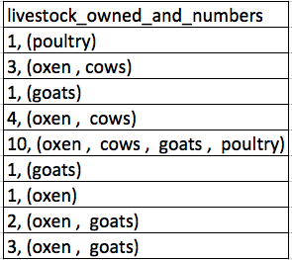
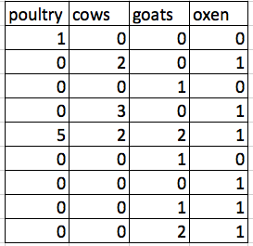
keep track of your analysis
do not modify the original data
Work on a copy of the data in a different tab
keep track of your modifications
Use another tab or a separate text file
Structuring data
Put all your variables in columns – e.g. weight or temperature.
Put each observation in its own row.
Do not combine multiple pieces of information in one cell.
Export data to a text-based format, csv (comma separated values)

Slide 12
Exercise
We’re going to take a messy version of the SAFI data and describe how we would clean it up.
Download/open the SAFI_messy.xlsx data.
there are two tabs.
Two researchers conducted the interviews, one in Mozambique and the other in Tanzania.
They both structured their data tables in different ways.
Now, you’re the person in charge of this project and you want to be able to start analyzing the data.
identify what is wrong with this spreadsheet. Discuss the steps you would need to take to clean up the two tabs, and to put them all together in one spreadsheet.
REMEMBER to create a new file/tab for the cleaned data, never modify your original (raw) data.
Notes:
10 minutes
Come back to solutions later on

Slide 13
Type of errors
Using multiple tables in the same tab
Using multiple tabs
Not filling in zeros
Using problematical null values (-999, 999, 0, see next slide)
using formatting to convey information
using formatting to make the data sheets look pretty
placing comments or units in cells
More than one piece of information per cell
Using problematic field names (embedded spaces)
Using special characters in data

Slide 14
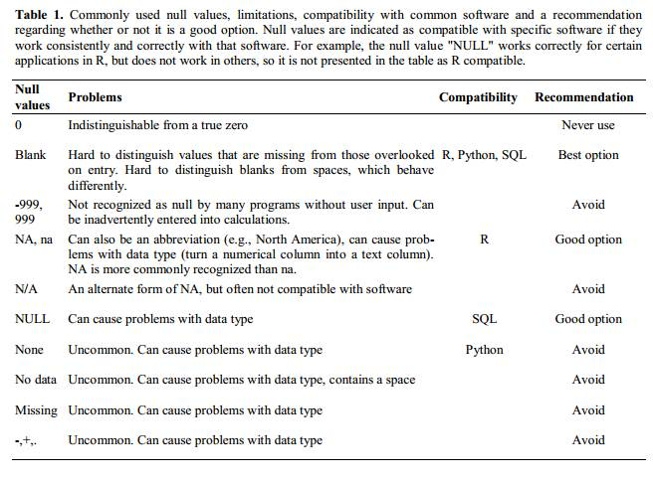
Notes:
From: Nine simple ways to make it easier to (re)use your data,.https://ojs.library.queensu.ca/index.php/IEE/article/view/4608

Slide 15
Metadata
data about data
Allows you/other to interpret your data correctly
Meaning of fields
special values
Keep the metadata close to the data, same file if possible or in the same folder
have a data dictionary/codebook, what does each field mean?
Try to use a recognised standard

Slide 16
Exercise
Have a look at SAFI_clean.csv.
This data has many more variables that were not included in the messy spreadsheet
It is formatted according to tidy data principles.
make a list of some of the types of metadata that should be recorded for this dataset.
It may be helpful ask yourself
What is not immediately obvious to me about this data?
What questions would I need to answers to in order to analyse and interpret this data?
Notes:
the exact wording of questions used in the interviews (if interviews were structured) or general prompts used (if interviews were semi-structured)
a description of the type of data allowed in each column (e.g. the allowed range for numerical data with a restricted range, a list of allowed options for categorical variables, whether data in a numerical column should be continuous or discrete)
definitions of any categorical variables (e.g. definitions of “burntbricks” and “sunbricks”)
definitions of what was counted as a “room”, a “plot”, etc. (e.g. was there a minimum size)
learners may come up with additional questions to add to this list

Slide 17
Key points
Never modify your raw data. Always make a copy before making any changes.
Keep track of all of the steps you take to clean/transform your data.
Organize your data according to tidy data principles.
Record metadata in a separate plain text file or in the file itself.

Slide 18
Dates as Data

Slide 19
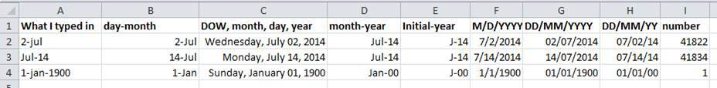
Dates
Can lead to ambiguities
Best To separate a date into separate columns: day, Month, year
EXCEL stores dates as numbers:
days since December 31 1899 in windows (assumes 1900 was a leap year)
Days since December 31 1904 on a mac
Notes:
Excel stores numbers as the number of days since December 31, 1899. Since 1904 on a Mac. Also it incorrectly assumes that 1900 was a leap year

Slide 20
exercise
openthe SAFI_dates.xlsx file
pick the tab that corresponds to you: DD_mm_YEAR or MM_dd_year
split the interview_date column into day, month, year
=DAY(cell)
=month(cell)
=year(CELL)
Add another interview_date with the date 17/11
What do you get for the year?

Slide 21
summary
Use extreme caution when working with date data.
Splitting dates into their component values can make them easier to handle.
Excel is unable to parse dates from before 1899-12-31
will thus leave these untouched.

Slide 22
Quality assurance

Slide 23
validating data on input
Restrict the type of data you can input into a column
look at two use cases
restrict data to a numeric range
restrict data to items from a list
look at the safi_clean.xlsx
Notes:
no_membrs (number of no_membs). expect +ve integers with a given max
Data -> Validation -> Whole numbers
Data -> Validity… on Libre office
On the Data ribbon Data Validation -> circle invalid data

Slide 24
exercise
Apply a data validation rule to another numeric columns in this data table.
create informative input and error messages.
Notes:
Look at respondent_wall_type
Data –Validation -> List
grass, muddaub, burntbricks, sunbricks, cement
Now get a pull down list.
Type an invalid message you get an error

Slide 25
exercise
Apply a data validation rule to one of the other categorical columns.
create informative input and error messages.

Slide 26
Exporting data

Slide 27
is excel A good format to store data in?
Proprietary format, may not be there in the future
Other spreadsheet programs may not be able to open the data
different versions of excel handle data differently, leading to inconsistencies
journals require data to be deposited in repositories, excel not accepted
Above points apply to other spreadsheet packages

Slide 28
what should I use instead
open, static format
CSV (comma separated values) or TSV (tab separated values)
Plain text with values separated by commas or tabs or semicolons or …
makes your data portable
Can be used by other applications more easily: R, python, …
to save in csv
file -> Save as …
Pick “Comma separated values (*.csv) for the “file format”
save
can read csv files back into excel

Slide 29
key points
never modify the original data, always work on a copy
spreadsheets are good to use for quick stats, plots but
be aware how it affects the portability of your data
if you export the data nothing will be lost
try to log metadata close to the data
keep track of the provenance of your data
think of the long term availability of your data
use spreadsheets responsibly

Slide 30
Openrefine for social science
https://datacarpentry.org/openrefine-socialsci/

Slide 31
motivation
openrefine makes it easier to clean data
Data volumes up to 100,000 – more depending on your machine
keeps track of the changes you make to your data
Actions are reversible
actions can be repeated on different files
your data stays local – it does not leave your machine
modified data is saved to a new file
open refine is open source
more documentation at – https://openrefine.org

Slide 32
what you will need
openrefine installed on your machine
dataset safi_openrefine.csv:
https://ndownloader.figshare.com/files/11502815

Slide 33
Exercise
Using faceting
find out how many different interview_date values there are in the survey results.
Is the column formatted as Text or Date?
Use faceting to produce a timeline display for interview_date.
You will need to use:
Edit cells > Common transforms > To date to convert this column to dates.
During what period were most of the interviews collected?

Slide 34
More on facets
As well as ‘Text facets’ Refine also supports a range of other types of facet. These include:
Numeric facets
Timeline facets (for dates)
Custom facets
Scatterplot facets
Numeric and Scatterplot facets display graphs instead of lists of values. The numeric facet graph includes ‘drag and drop’ controls you can use to set a start and end range to filter the data displayed. These facets are explored further in Examining Numbers in OpenRefine
Custom facets are a range of different types of facets. Some of the default custom facets are:
Word facet - breaks down text into words and counts the number of records each word appears in
Duplicates facet - results in a binary facet of ‘true’ or ‘false’. Rows appear in the ‘true’ facet if the value in the selected column is an exact match for a value in the same column in another row
Text length facet - creates a numeric facet based on the length (number of characters) of the text in each row for the selected column.
Facet by blank - Rows appear in the ‘true’ facet if they have no data present in that column.

Slide 35
Exercise
Use the `Edit Cells`>`Transform` on the items_owned column to remove
The single quotes (‘)
The right square bracket (])

Slide 36
Exercise
Apply the transformation to remove the "[", "'" and "]" for
res_change
no_food_mitigation

Slide 37
Exercise
Sort the data by gps_Altitude.
Do you think the first few entries may have incorrect altitudes?

Slide 38
exercise
We discovered in an earlier lesson that the value for one of the village entries was given as 49. This is clearly wrong. By looking at the GPS coordinates for the entries of the other villages can we decide what village the data in that column was collected from?
Sort on gps_Latitude as a number with the smallest first.
Add a sort on gps_Longitude as a number with the smallest first.
Using the drop down arrow on the village column, select Edit column > Move column to end. This will allow you to compare village names with GPS coordinates.
Scroll through the entries until you find village 49. Can you tell from it’s GPS coordinates which village it belong to?
Now sort only by interview_date as date. Move the village column to the start of the table. Does the row where village is 49 group with one particular village? Is it the same village as when comparing GPS coordinates?

Slide 39
exercise
Transform three more columns from text to numbers:
no_members,
yrs_liv, and
buildings_in_compound.
Can all columns be transformed to numbers? - Try it with village for example.

Slide 40
exercise
For a column you transformed to numbers, edit one or two cells, replacing the numbers with text (such as "abc") or blank (no number or text). You will need to change the Data type to text using the drop-down menu.
Use the column pulldown menu to apply a numeric facet to the column you edited. The facet will appear in the left panel.
Notice that there are several checkboxes in this facet: Numeric, Non-numeric, Blank, and Error. Below these checkboxes are counts of the number of cells in each category. You should see checks for Non-numeric and Blank if you changed some values.
Experiment with checking or unchecking these boxes to select subsets of your data.
Remember to undo (undo/redo) these changes at the end of the exercise

