Slide 1


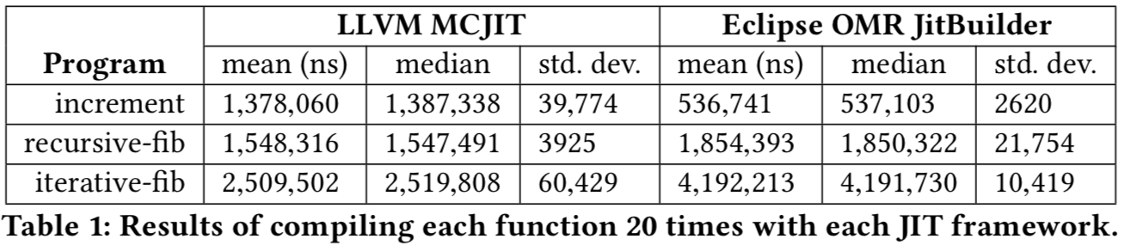
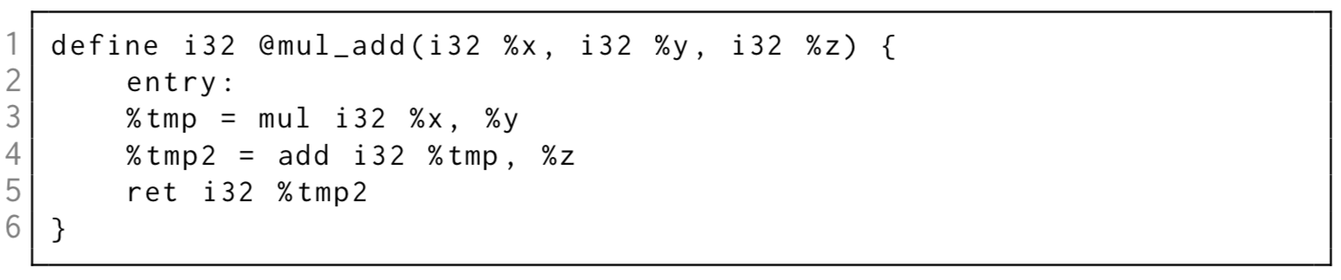
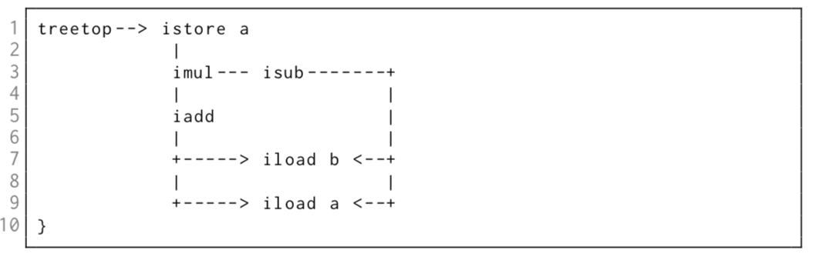
A Comparison of API-based JIT Compiler Overhead during Run-time
Eric Coffin
Faculty of Computer Science
University of New Brunswick
eric.coffin@unb.ca
Test Programs
Embedded frameworks with test programs
  Increment: add 1 to an integer argument
  Recursive-fib: recursive fibonacci
  Iterative-fib: iterative Fibonacci
Measured memory overhead, throughput, CPU time, disk space, and usability.
Ubuntu 19.04, 32GB RAM, Intel i7-8700 CPU (6 core)
Background
Just-in-Time (JIT) compilation can provide significant performance gains for applications.
Rather than writing a JIT compiler from scratch why not embed an existing one?
Two popular embeddable JIT frameworks are LLVM MCJIT and Eclipse OMR JitBuilder.
Results
LLVM - MCJIT
Designed for life-long application analysis and transformation.
IR is in SSA form organized in basic blocks
31 RISC style opcodes
JIT compiler is MCJIT which shares code with frontend.
Can perform 40 analysis and 60 transform passes.
JitBuilder
Embeddable JIT API for Eclipse OMR
Eclipse OMR provides many runtime components for OpenJ9
IR is a DAG of nodes (called trees)
Unorderable nodes belong to a list called tree-tops
Nodes can be reused to simplify optimizations such as CSE
TRJIT offers 170 optimizations (limited in JitBuilder)
Motivation
Port MicroJIT to Eclipse Open J9 platform while adding additional performance enhancements:
Increase bytecode support – MicroJIT does not support all bytecodes. We will increase support, further reducing the number of switches to the interpreter.
Port instructions to 64-bit – MicroJIT is limited to 32-bit instructions. Adding 64-bit support will allow the MicroJIT to run on larger platforms.
Asynchronous compilation – MicroJIT compiles methods synchronously on the executing thread. We will investigate an asynchronous approach further increasing performance.

