Slide 1
First fold
Test Set 1
Train/Test Run 1
Second fold
Training Set 1
Third fold
Second fold
Test Set 2
Train/Test Run 2
Original Dataset
Third fold
Training Set 2
First fold
Third fold
Test Set 3
Train/Test Run 3
First fold
Training Set 3
Second fold

Slide 2

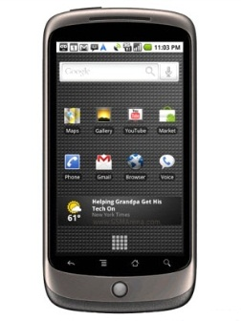
HTTP
HTTP
Web service
SOAP/XML
SOAP/XML
Mobile App
Mobile App
Database

Slide 3
MODEL
VIEW
CONTROLLER

Slide 4
Internet
GUI
Activities
Internet Helper
Models
SQLite Helper
SQLite
Utilities

Slide 5
Tab All
Tab Sugesstions
Map
TabBar
Tab Favorites
Details
Tab Context
Rate
Tab Profile

