Slide 1
https://github.com/edynox/libhif https://github.com/edynox/dnf
SWDB
Unified Software database for DNF
Eduard Čuba 2017

Slide 2

DNF
Dandified YUM
- Default package manager in Fedora since 22
- More efficient, faster and modular
- Using several libraries:
- librepo – metadata and packages
- libsolv – dependency solving
- libdnf, libcomps...
https://github.com/rpm-software-management/dnf
Notes:
- inappropriate current state of database
- actual solution too complicated – historical reasons
- single module, not 3
- reimplementation into libhif, single data storage, not 3

Slide 3
HISTORY BACKEND
What is wrong?
yumdb – flat directory database
- inefficient
- slow
- no binding capability history/history*.sqlite
- outdated design
- duplicity with yumdb groups.json
- no binding capability
Notes:
- inappropriate current state of database
- actual solution too complicated – historical reasons
- single module, not 3
- reimplementation into libhif, single data storage, not 3

Slide 4
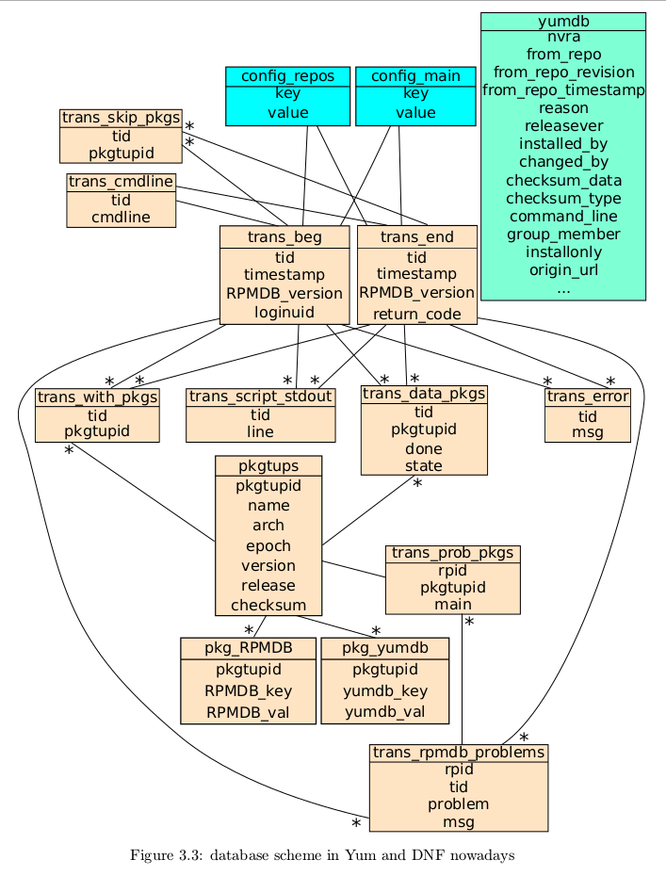
ACTUAL DESIGN
groups.json:
GROUPS:
- GroupID
- full_list
- pkg_exclude
- name
- pkg_types
- ui_name
- grp_types
Meta:
- version
ENVIRONMENTS:
...
Source: UNIFIED SOFTWARE DATABASE FOR RPM BASED SYSTEMS – Jan Šihlan 2014

Slide 5

DEVELOPMENT
What to do?
- New database design
- Transformation tool
- database API
- DNF refactor
Notes:
- inappropriate current state of database
- actual solution too complicated – historical reasons
- single module, not 3
- reimplementation into libhif, single data storage, not 3

Slide 6
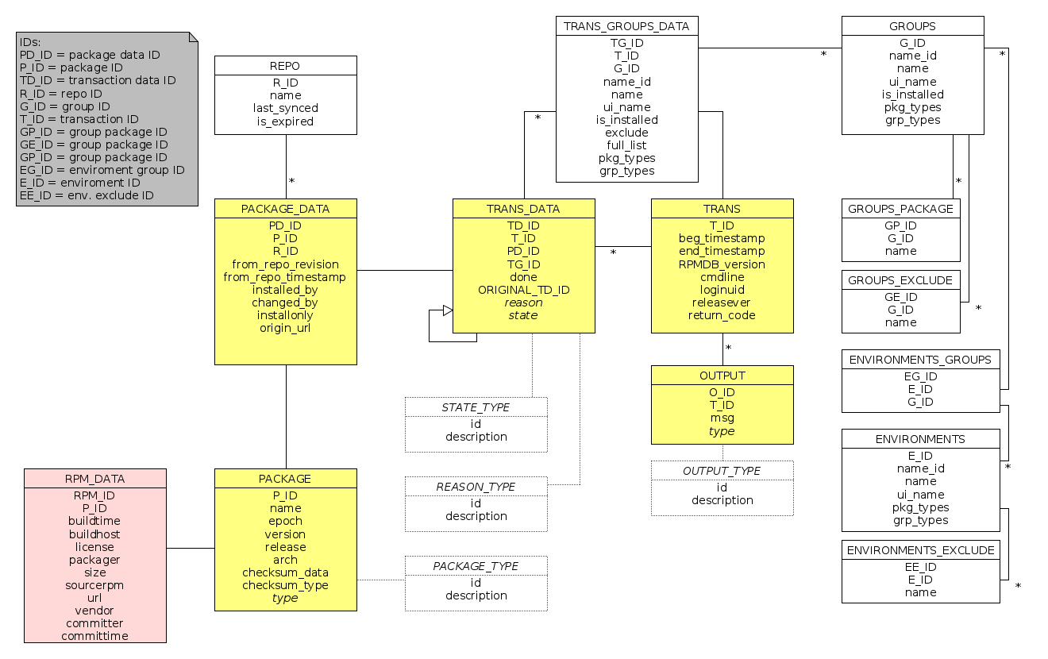
NEW DATABASE DESIGN

Slide 7
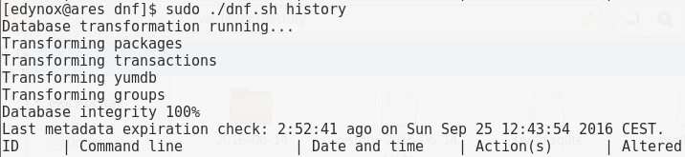
SWDB TRANSFORMER dnf/yum/swdb_transformer.py
Automatically triggered
Transforms:
yumdb
history*.sqlite
groups.json
Into:
swdb.sqlite
Notes:
- inappropriate current state of database
- actual solution too complicated – historical reasons
- single module, not 3
- reimplementation into libhif, single data storage, not 3

Slide 8
DNF-SWDB
LIBDNF MODULE WRITTEN IN C
Providing required functionality for SWDB
- rewritten DNF modules for:
- groups
- history
- yumdb
Passing data to DNF
- GObject Introspection
libdnf/dnf-swdb*
Notes:
- inappropriate current state of database
- actual solution too complicated – historical reasons
- single module, not 3
- reimplementation into libhif, single data storage, not 3

Slide 9
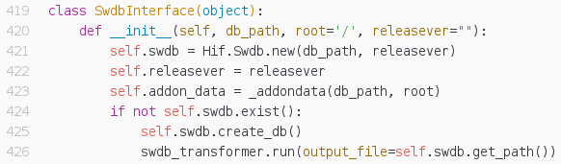
SWDB INTERFACE
DNF EXTENSION FOR SWDB
Interface for using hif-swdb from DNF
- Wraps up swdb functions into Python Class
- Replaces some classes from yum/history.py
- Better maintainability
Notes:
- inappropriate current state of database
- actual solution too complicated – historical reasons
- single module, not 3
- reimplementation into libhif, single data storage, not 3

Slide 10
TODO
WHAT ELSE?
- Finish unit and CI tests
- Fix some bugs (history info command)
- Unify package objects (future)
- Integration with PackageKit? (future)
- Talk about your questions and ideas :)
Notes:
- inappropriate current state of database
- actual solution too complicated – historical reasons
- single module, not 3
- reimplementation into libhif, single data storage, not 3

Slide 11
SOMETHING USEFUL
CODE: https://github.com/edynox/libhif https://github.com/edynox/dnf
ME: cuba.edo@gmail.com xcubae00@stud.fit.vutbr.cz
Notes:
- inappropriate current state of database
- actual solution too complicated – historical reasons
- single module, not 3
- reimplementation into libhif, single data storage, not 3

