Slide 1
INGI2145: CLOUD COMPUTING (Fall 2015)
Web Programming
19 November 2015
Lecture slides adapted from Upenn NETS212 by A. Haeberlen, Z. Ives Reproduced with permission

Slide 2
Announcements
HW2 will soon be available
It will be due by 17 Dec 2015
Organized as a problem-oriented assignment
Will work in groups; each of 4 students
Goal: solving the challenges to scale a simplified micro-blogging Cloud application
Put together many aspects of Cloud computing saw in class

Slide 3



Where we are
Browser
Internet
User
"Cloud" / data center
So far: The 'backend'
Large-scale distributed system processes lots of data
Economic model, architecture, programming (MapReduce)
Next: The 'frontend'
How to get the data to the users
How to build interactive web applications

Slide 4
Goals for the next two lectures
Architecture of the Web
Key concepts: Hyperlink, URI/URL, ...
Building blocks: HTML, HTTP, DNS, ...
Servers (esp., web servers)
Client/server model
State, and where to keep it
Architecture: Threads, thread pools, events
Web applications
Dynamic content; maintaining state
Example use case at SoundCloud

Slide 5

The World Wide Web (WWW)
A service that runs on the Internet
Not identical to the Internet!
A collection of interconnected documents and other resources
Not a hierarchy - any document can reference any other!

Slide 6
Making the Web: Ingredients
What do we need to build the Web?

Slide 7
What do we need to make the Web work?
Formats for writing the documents
A program for displaying documents
Unique names for the documents
A way to find documents
A system for delivering documents
Architecture
Efficient implementation
A protocol for transferring documents
A way to make content dynamic
Programming model
Keeping state
HTML
Browser
URIs, URLs
DNS
Client/server model
Threads; event-driven prog.
HTTP
Scripting; servlets
Cookies

Slide 8
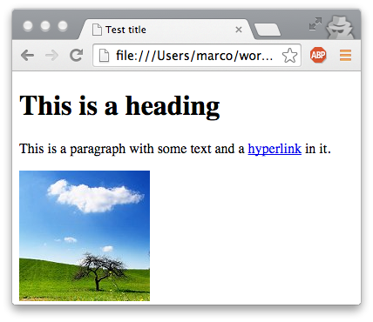
HTML
Begin tag
Content
<!doctype html> <html> <head> <title>Test title</title> </head> <body> <h1>This is a heading</h1> <p>This is a paragraph with some text and a <a href="foo.html">hyperlink</a> in it.</p> <img src="cloud.jpg" alt="Cloud"> </body> </html>
End tag
Attributes
General structure: Elements, tags, content
Most elements have a begin tag and an end tag (denoted by /)
Tags may have attributes, e.g., <img> has URL of the image
Hierarchy of elements

Slide 9
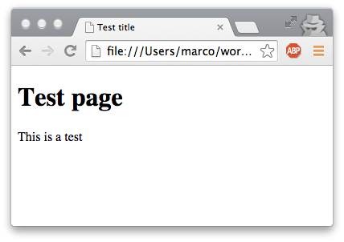
HTML: Presentation and representation
<!doctype html> <html> <head> <title>Test title</title> </head> <body> <h1>Test page</h1> <p>This is a test</p> </body> </html>
Representation (bits and bytes in the document)
Presentation (document displayed by the browser)
Original idea: Separate the two
Document representation would only describe the structure and the semantic content
Browser would take care of the visual layout
Pros and cons of this approach?
Do you think people are following it today?

Slide 10
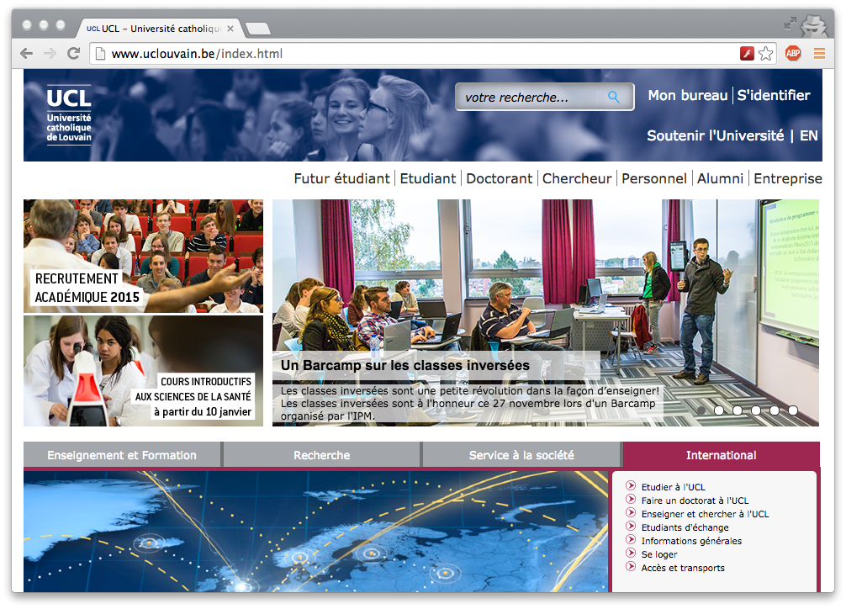
Is basic HTML rendering enough?
vs.

Slide 11
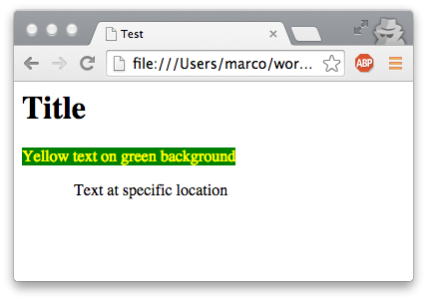
Cascading Style Sheets
<html> <head><title>Test</title></head> <link rel="stylesheet" href="test.css"> <body> <h1>Title</h1> <span class="ytext">Yellow text on green background</span> <span class="loc">Text at specific location</span> </body> </html>
Reference
.ytext { color:yellow; background:green }
.loc { position:absolute; top:100px; left:60px }
Idea: Separate content and formatting again
Formatting instructions are kept in a separate file that is linked from the document
Document is annotated with references to the formatting instructions, via class="xxx" attribute or special elements (<span>...</span>, <div>...</div>)

Slide 12
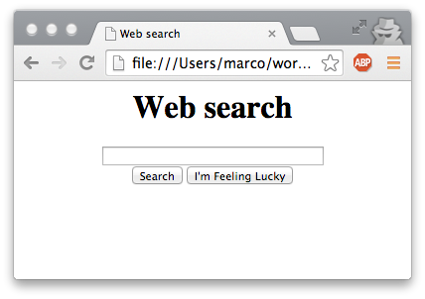
Forms
<html> <head><title>Web search</title></head> <body> <center><h1>Web search</h1> <form action="search.html" method="post"> <input type="text" size="40" name="term"><br> <input type="submit" value="Search"> <input type="button" value="I'm Feeling Lucky"> </form></center> </body> </html>
What if we want the user to input some data?
<form> element creates and input form in the document
Several input types available: Single line of text, multiline text, radio buttons, checkboxes, buttons, dropdown boxes...
Data is sent over the network once the form is submitted
One way to create interactive 'web applications'; more about this later

Slide 13
What do we need to make the Web work?
Formats for writing the documents
A program for displaying documents
Unique names for the documents
A way to find documents
A system for delivering documents
Architecture
Efficient implementation
A protocol for transferring documents
A way to make content dynamic
Programming model
Keeping state
HTML
Browser
NEXT

Slide 14




The peer-to-peer model
Alice
How the Web could work (but doesn't):
Each machine locally stores some documents
If a machine needs a new document, it asks some other machines until it finds one that already has the document
No machine is special - they are all 'peers'
Pros and cons of this approach?

Slide 15

The client-server model
Request
Response
Servers
Clients
How the Web actually works today:
Some machines (servers) offer documents
Other machines (clients) use documents
Clients can request documents from servers
Model is used for many other services, not just for the web
Pros and cons of this approach?

Slide 16


Servers
Please send index.html
Server: A machine that offers services to other machines
Examples: Mail server, file server, chat server, print server, terminal server, web server, name server, game server, ...
Protocol often uses request/response pattern

Slide 17
State, and where to keep it
What if clients make multiple related requests?
Example: Open file, read data, read more data, close file
Need to remember some state between requests, e.g., which file was opened, or how much data has already been read
Who should keep this state: Client, server, or both?
If it is kept on the client, how does the server access it?
If it is on the server, how does the client reference it?
If there is no state, or the client keeps all of it, we can build a stateless server
Server can forget everything about completed requests
Pros and cons of such a design?
Notes:
Pros:
No need to allocate state
If client dies mid-way, no need to clean up the present state of the server
If the server dies, also no big problem; bring up a new instance
Cons:
- It may require additional information in every request/response to identify necessary state; communication and processing overheads

Slide 18
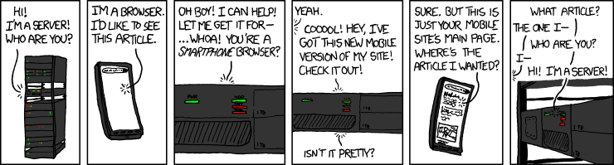
Server attention span
http://xkcd.com/869/

Slide 19
Recap: Client-server model
Many possible system architectures
Examples: Client/server and peer-to-peer
Each has its own set of tradeoffs
Web uses client/server, but it could have been otherwise
Client-server model
Functionality implemented by special machines
Request/response pattern
State, and where to keep it
Could be on the client, on the server, or on both; pros/cons
Stateless servers

Slide 20
What do we need to make the Web work?
Formats for writing the documents
A program for displaying documents
Unique names for the documents
A way to find documents
A system for delivering documents
Architecture
Efficient implementation
A protocol for transferring documents
A way to make content dynamic
Programming model
Keeping state
HTML
Browser
URIs, URLs
DNS
NEXT
Client/server model

Slide 21
URIs, URNs, and URLs
Scheme name
Scheme-specific part
http://sites.google.com/site/uclingi2145/schedule
Identifies a server (for HTTP)
Path on the server (for HTTP)
Uniform Resource Identifier (URI)
Comes in two forms: URN and URL
Uniform Resource Name (URN)
Specifies what to find, independent of its location
Example: urn:isbn:1449311520 (for the course textbook)
Uniform Resource Locator (URL)
Specifies where to find something
<scheme>://[user[:password]@]<server>[:port]/[path][/resource][?param1=value1&param2=value2&...]

Slide 22
DNS namespace
Top-level domains
arpa
com
org
gov
mil
net
be
biz
info
name
...
de
fr
sg
uk
...
ebay
google
facebook
ulg
uclouvain
...
docs
groups
...
www
icampus
student
Hierarchical namespace
First level managed by the Internet Corporation for Assigned Names and Numbers (ICANN)
Authority over other levels is delegated
Second level generally managed by registrars
Further levels managed by organizations or individuals
Given a DNS name, how can we find the corresponding host?
mail

Slide 23
Name servers
Root servers
Root zone
arpa
com
org
gov
mil
net
be
biz
info
name
...
de
fr
sg
uk
ebay
google
facebook
ulg
uclouvain
...
Authoritative server for uclouvain.be
docs
groups
...
www
icampus
student
mail
Namespace is divided into zones
TLDs belong to the root zone
Each zone has an authoritative name server
Authoritative server knows, for each name in its zone, which machine corresponds to a given name, or which other name server is responsible

Slide 24
What do we need to make the Web work?
Formats for writing the documents
A program for displaying documents
Unique names for the documents
A way to find documents
A system for delivering documents
Architecture
Efficient implementation
A protocol for transferring documents
A way to make content dynamic
Programming model
Keeping state
HTML
Browser
URIs, URLs
DNS
Client/server model
HTTP
NEXT

Slide 25
The HTTP protocol
How to communicate with a web server?
Use the HyperText Transfer Protocol (HTTP)
A very simple protocol
First specified in 1990
Runs on top of TCP/IP
Default port 80 (unsecure), or 443 (secure, with SSL)
Originally stateless (HTTP/1.0), but current version (HTTP/1.1) added support for persistent connections
Why?
Development continues (e.g., SPDY)
HTTP/2 specs published in May 2015
By Oct 2015, 1.9% of the top 10M websites supports HTTP/2
[W3Techs]

Slide 26
Example: A simple HTTP request
URI
Method
GET /marco.canini/ingi2145/test.html HTTP/1.1 Host: perso.uclouvain.be
Accept: */* User-Agent: Mozilla/5.0 (...) If-Modified-Since: Wed, 26 Nov 2014 14:12:37 GMT
Headers
Status
HTTP/1.1 200 OK Date: Wed, 26 Nov 2014 14:18:19 GMT Server: Apache/2.2.3 (CentOS) Last-Modified: Wed, 26 Nov 2014 14:15:46 GMT Content-Length: 103 Content-Type: text/html
<html><head><title>Test document</title></head> <body><h3>Test</h3><p>This is a test</p></body> </html>
Headers
Content (optional)

Slide 27
Common HTTP methods
GET
Retrieve whatever information is identified by the URI
HEAD
Like GET, but retrieves only metadata, not the actual object
PUT
Store information under the specified URI
DELETE
Delete the information specified by the URI
POST
Adds new information to whatever is identified by the URI
Intended, e.g., for newsgroup posts; today, used mostly to implement dynamic content via forms

Slide 28
Forms and GET/POST
<html> <head><title>Web search</title></head> <body> <center><h1>Web search</h1> <form action="search.html" method=" "> <input type="text" size="40" name="term"><br> <input type="submit" value="Search"> <input type="button" value="I'm Feeling Lucky"> </form></center> </body> </html>
foo
What happens when we hit 'Search'?
With method="get":
GET /search.html?term=foo HTTP/1.1 Accept: text/html
With method="post":
POST /search.html HTTP/1.1 Accept: text/html term=foo

Slide 29
GET or POST?
GET should be used for idempotent requests
Requests that are safe to re-execute without side-effects, such as making a purchase or committing an edit
Browser warns user when resending a POST, but not a GET
GET has length restrictions
Data is put into the URL, whose length is restricted
GET should only be used with text
POST works with arbitrary data (including binaries)

Slide 30
Headers
GET /index.html HTTP/1.1
Host: www.uclouvain.be
Connection: keep-alive
Accept: text/html,application/xhtml+xml,application/xml;q=0.9, image/webp,*/*;q=0.8
User-Agent: Mozilla/5.0 (Macintosh; Intel Mac OS X 10_9_5) AppleWebKit/537.36 (KHTML, like Gecko) Chrome/38.0.2125.122 Safari/537.36
Referer: https://www.google.com/
Accept-Encoding: gzip,deflate,sdch
Accept-Language: en-US,en;q=0.8
HTTP/1.1 200 OK
Date: Wed, 26 Nov 2014 14:28:13 GMT
Server: Apache/2.2.3 (CentOS) Set-Cookie: JSESSIONID=62CC31...; Path=/cps
Set-Cookie: CPSSESSIONID_ucl=SID-E...; Path=/
Expires: Wed, 26 Nov 2014 14:28:13 GMT
Connection: Keep-Alive
Content-Type: text/html;charset=UTF-8
<html>...
Both the request and the response can contain headers with additional information

Slide 31
Status codes
Server sends back a status code to report how the request was processed
Common status codes:
200 OK
301 Moved Permanently
304 Not Modified
401 Unauthorized
403 Forbidden
404 Not Found
500 Internal Server Error

Slide 32
Recap: HTTP
HTTP - a simple, stateless protocol
Server does not (need to) remember past requests
Request and response contain headers
Used to exchange additional information, e.g., to request content in specific formats, or to exchange metadata
Common HTTP methods:
GET - Retrieve a specific document
HEAD - Get metadata for a specific document
POST - 'Add' information to a document (used for forms)

Slide 33
What do we need to make the Web work?
Formats for writing the documents
A program for displaying documents
Unique names for the documents
A way to find documents
A system for delivering documents
Architecture
Efficient implementation
A protocol for transferring documents
A way to make content dynamic
Programming model
Keeping state
HTML
Browser
URIs, URLs
DNS
Client/server model
NEXT
Threads; event-driven prog.
HTTP

Slide 34
A simple web server
socket = listen(port 80);
while (true) { connection = accept(socket); request = connection.read(); if (request == "GET <document>") { data = filesystem.read(document); connection.write("HTTP/1.1 200 OK"); connection.write(data); } else { connection.write("HTTP/1.1 400 Bad request"); } close(connection); }
Is this a good (web) server? If not, why not?

Slide 35
The need for concurrency
What if the server receives lots of requests?
Idea #1: Process them serially
Problem: Slow client can block everyone else
Idea #2: One server for each request
Problem: Wasteful
Server needs to handle requests concurrently
Available resources are multiplexed between requests
How do we do this?
Threads, thread pools
Events

Slide 36
Refresher: Threads and processes
Physical machine has some fixed number of processor cores - say, c
What if we need more than c threads of execution?
Idea: Time-share cores
A single core works on one thread for a while, then context-switch to another one
Switching can be done cooperatively: Each thread yields the core to another thread when it has nothing to do
Switching can also be preemptive: Each thread gets to run for a fixed amount of time (quantum, typ. 10-100ms)
Pros and cons of preemption?
Difference between a thread and a process?
Notes:
Harder to handle concurrency with pre-emptive: need to reason hard about accessing shared variables
On the other hand, cooperative needs to remember to yield to other threads
Cooperative has better efficiency, no need to lock (on a single core)
Preemptive normally works better on multi-core machines, since multiple threads execute at once

Slide 37
A simple thread-based web server
worker(connection) { request = connection.read(); if (request == "GET <document>") { data = filesystem.read(document); connection.write("HTTP/1.1 200 OK"); connection.write(data); } else { connection.write("HTTP/1.1 400 Bad req"); } close(connection); } main() {
socket = listen(port 80); while (true) { connection = accept(socket); (new Thread).run(worker, connection); } }
Worker thread (one per connection)
Main loop (accepts new connections and launches new threads)

Slide 38
Thread-based servers
Relevant Java constructs:
Worker can be a subclass of Thread + implement run()
Worker w = new Worker(); w.start();
Alternative: Worker implements Runnable
Thread t = new Thread(w); t.start();
What if the threads share some resources?
Potential race conditions + consistency issues
Can use synchronization and locking
Need to be careful about deadlock, livelock, starvation

Slide 39
Thread pools
Problem: Threads operations are expensive
Creating and destroying a thread takes time
Context switching between threads takes time
Making too many threads can exhaust available resources
Idea: Keep a thread pool with a fixed number of worker threads
When a worker is done handling a request, it is assigned another one
When there are more concurrenct requests than workers, requests must wait in a queue until a worker is available
When there are few requests, some workers may be idle
How many threads should we put into the pool?
Notes:
Sizing thread pools isn’t an exact science: it depends on many factors of the deployed environments
Still, it is important to avoid extremes: “too small” or “too big”
If a thread pool is too big, then threads compete for scarce CPU and memory resources, resulting in higher memory usage and possible resource exhaustion
If it is too small, throughput suffers as processors go unused despite available work
For CPU-bound tasks, a size of # CPUs + 1 achieves on average an optimum utilization

Slide 40
Event-driven programming
What benefits did the threads really give us?
If we have one core and run 1,000 threads on it, does the work really get done faster than with one thread?
The server's work is driven by events, e.g.:
Incoming connection: Need to set up data structures
Request arrives: Need to parse + start reading document
Document read: Need to send back to the client
Entire document sent: Close connection, clean up structures
Why not base server architecture on events?
All we need is a single thread!

Slide 41
An event-based web server
handleNewConnection(e) { startReading(e.connection); } handleRequestRead(e) { if (e.request == "GET <document>") { issueFilesystemRead(document); } else {
issueWrite(e.connection, "HTTP/1.1 400 Bad req"); } } /* other handlers go here */
main() { EventQueue q; while (true) { e = q.getNextEvent(); case e of { NewConnection: handleNewConnection(e); RequestArrived: handleRequestRead(e); FileReadCompleted: handleFileRead(e); AllDataWritten: handleDataWritten(e); } } }
Event handlers (must not block)
Who puts events into the queue?
Dispatch loop (distributes events to handlers)

Slide 42
Continuations
What if, in response to some event, we must perform a blocking system call?
Example: Request arrives; now we need to read the file from disk (blocking read() call) and send it back to the client
What would happen if we called read() in the event handler?
Solution: Write two event handlers:
Handler A parses the request and issues a non-blocking read (using a special system call)
Handler B is called when the read completes and sends data to client
What if handler A has some state that handler B needs to know?
Must be saved explicitly in a continuation

Slide 43
Event-driven programming in Node
var queryByID = function(ID, callback) {
dynamo.query({TableName:'students', KeyConditions: {“NOMA” : … ID …}},
function (err, data) {
if (err) {
console.log("Error occurred!");
callback(null);
} else if (data.Items.length == u0) {
console.log("No results!");
callback(null);
} else {
console.log("Got data for student: " + ID);
console.log("The data is: "+data);
callback(data);
}
}
);
};
Must always call callback, even if the operation has failed!
Inner callback has access to the state of the outer function!
function complete_send(data) {
if (data == null) {
resp.write(“An error occurred”);
} else {
resp.write(“Student info: “ + render(data));
}
resp.end();
}
…
queryByID(someID, complete_send)
Node programs are event-driven
If a function needs to block (e.g., network I/O), it must take a callback function and call that function once the blocking operation completes
Where is the continuation?

Slide 44
Pros and cons
Thread-based server or event-driven one?
Event-driven servers typically have better performance
Event-driven servers do not need as much synchronization
Just a single thread - no concurrency!!! (on a single core)
However, may need some flags if events can share resources
Thread-based servers are typically easier to write+maintain
What about scaling?
Thread-based can immediately take advantage of all cores
Event-driven servers require a bit of extra care

Slide 45
Scaling single-threaded server
To take advantage of multiple cores:
Replicate the same flow of execution using many processes
To scale out to multiple machines:
Deploy multiple instances on many machines
Use a reverse proxy to load balance requests across machines

Slide 46
Recap: Web servers
Need to process requests concurrently
Otherwise, extremely difficult to achieve high throughput
Common server architectures:
Single-threaded
Multithreaded
Thread pools
Event-driven
Event-driven architecture:
Harder to program, but very efficient
Most of this also applies to other kinds of servers, not just to web servers

Slide 47
What do we need to make the Web work?
Formats for writing the documents
A program for displaying documents
Unique names for the documents
A way to find documents
A system for delivering documents
Architecture
Efficient implementation
A protocol for transferring documents
A way to make content dynamic
Programming model
Keeping state
HTML
Browser
URIs, URLs
DNS
Client/server model
Threads; event-driven prog.
HTTP
NEXT

Slide 48

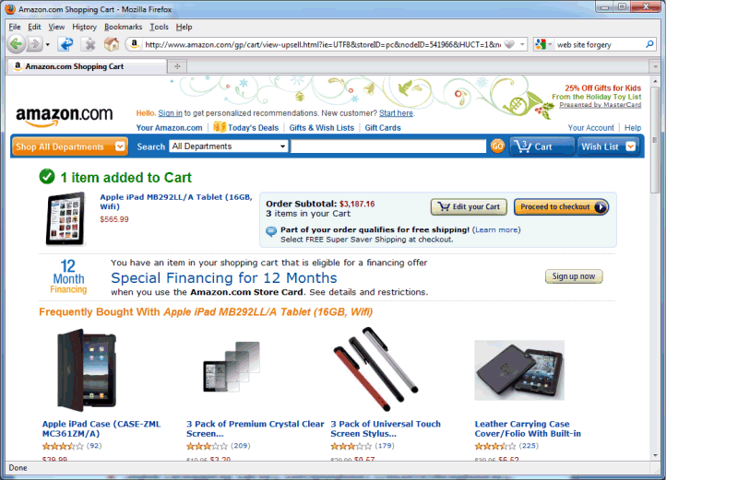
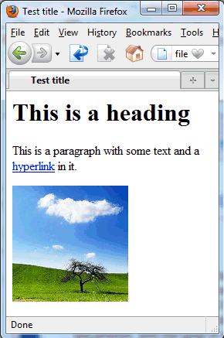

Web applications
So far: Writing and delivering static content
But many web pages today are dynamic
State (shopping carts), computation (recommendations), rich I/O (videoconferencing), interactivity, ...

Slide 49
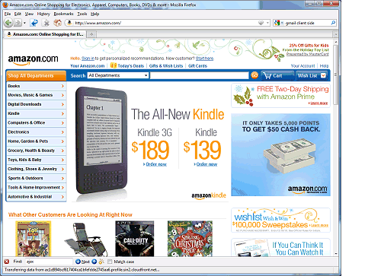
Client-side and server-side
Internet
Web server
Client (web browser)
User
Where does the web application run?
Can run on the server, on the client, or have parts on both
Modern browsers are highly programmable and can run complex applications (example: client-side part of Google's Gmail)
Some believe the browser will be 'the new operating system'
Client-side technologies: JavaScript, Java applets, Flash, ...
Server-side technologies: CGI, PHP, Java servlets, Node.js, …

Slide 50
Dynamic content
Web application technologies
Background: CGI
Java Servlets
Node.js / Express / EJS
AJAX
Session management and cookies
NEXT

Slide 51
Dynamic content
How can we make content dynamic?
Web server needs to return different web pages, depending on how the user interacts with the web application
Idea #1: Build web app into the web server
Why is this not a good idea?
Idea #2: Loadable modules
Is this a good idea?
Pros and cons?

Slide 52
CGI
x=2 y=3
Perl script
GET /add.cgi?x=2&y=3
<html> ... 5 ... </html>
200 OK ... <html>...5...</html>
Web server
Client (browser)
Common Gateway Interface (CGI)
Idea: When dynamic content is requested, the web server runs an external program that produces the web page
Program is often written in a scripting language ('CGI script')
Perl is among the most popular choices

Slide 53
CGI
A little more detail:
Server receives HTTP request
Example: GET /cgi-bin/shoppingCart.pl?user=ahae&product=iPad
Server decides, based on URL, which program to run
Server prepares information for the program
Metadata goes into environment variables, e.g., QUERY_STRING, REMOTE_HOST, REMOTE_USER, SCRIPT_NAME, ...
User-submitted data (e.g., in a PUT or POST) goes into stdin
Server launches the program as a separate process
Program produces the web page and writes it to stdout
Server reads the web page and returns it to the client

Slide 54
Drawbacks of CGI
Each invocation creates a new process
Time-consuming: Process creation can take much longer than the actual work
Inefficient: Many copies of the same code in memory
Cumbersome: Must store session state in the file system
CGIs are native programs
Security risk: CGIs can do almost anything; difficult to run third-party CGIs; bugs (shell escapes! buffer overflows!)
Low portability: A CGI that runs on one web server may not necessarily run on another
However, this can also be an advantage (high speed)

Slide 55
What is a servlet?
Unload
Servlet 3
Servlet 17
HTTP frontend
Load
Storage
Servlet container (e.g., Apache Tomcat, Jetty...)
Client (browser)
Servlet: A Java class that can respond to HTTP requests
Implements a specific method that is given the request from the client, and that is expected to produce a response
Servlets run in a special web server, the servlet container
Only one instance per servlet; each request is its own thread
Servlet container loads/unloads servlets, routes requests to servlets, handles interaction with client (HTTP protocol), ...

Slide 56
Servlets vs CGI
 | CGI | Servlets
Requests handled by
Copies of the code in memory
Session state stored in
Security
Portability
Processes (heavyweight)
Threads (lightweight)
Potentially many
One
File system
Servlet container (HttpSession)
Problematic
Handled by Java sandbox
Varies (many CGIs platform-specific)
Java

Slide 57
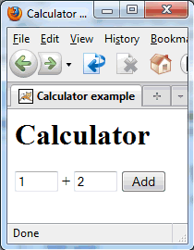
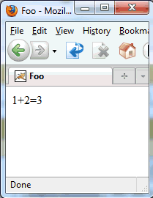
A simple example
47+11=58
47
11
Running example: A calculator web-app
User enters two integers into a HTML form and submits
Result: GET request to calculate?num1=47&num2=11
Web app adds them and displays the sum

Slide 58
The Calculator servlet
import java.io.*; import javax.servlet.*; import javax.servlet.http.*; public class CalculatorServlet extends HttpServlet { }
Numbers from the GET request become parameters
public void doGet(HttpServletRequest request, HttpServletResponse response) throws java.io.IOException { }
int v1 = Integer.valueOf(request.getParameter("num1")).intValue(); int v2 = Integer.valueOf(request.getParameter("num2")).intValue();
response.setContentType("text/html"); PrintWriter out = response.getWriter(); out.println("<html><head><title>Hello</title></head>"); out.println("<body>"+v1+"+"+v2+"="+(v1+v2)+"</body></html>");
Two easy steps to make a servlet:
Create a subclass of HttpServlet
Overload the doGet() method
Read input from HttpServletRequest
Do not use instance variables to store session state! (why?)
, write output to HttpServletResponse

Slide 59

Dynamic content
Web application technologies
Background: CGI
Java Servlets
Node.js / Express / EJS
AJAX
Session management and cookies
NEXT

Slide 60

What is Node.js?
A platform for JavaScript-based network apps
Based on Google's JavaScript engine from Chrome
Comes with a built-in HTTP server library
Lots of libraries and tools available; even has its own package manager (npm)
Event-driven programming model
There is a single "thread", which must never block
If your program needs to wait for something (e.g., a response from some server you contacted), it must provide a callback function

Slide 61
What is JavaScript?
A widely-used programming language
Started out at Netscape in 1995
Widely used on the web; supported by every major browser
Also used in many other places: PDFs, certain games, ...
... and now even on the server side (Node.js)!
What is it like?
Dynamic typing, duck typing
Object-based, but associative arrays instead of 'classes'
Prototypes instead of inheritance
Supports run-time evaluation via eval()
First-class functions

Slide 62
What is Express?
Express is a minimal and flexible framework for writing web applications in Node.js
Built-in handling of HTTP requests
You can tell it to 'route' requests for certain URLs to a function you specify
Example: When /login is requested, call function handleLogin()
These functions are given objects that represent the request and the response, not unlike Servlets
Supports parameter handling, sessions, cookies, JSON parsing, and many other features
API reference: http://expressjs.com/api.html
var express = require('express'); var app = express();
app.get('/', function(req, res) { res.send('hello world'); }); app.listen(3000);

Slide 63
What is Embedded JS (EJS)?
app.get('/', function(req, res) { res.send('<html><head><title>'+
'Lookup result</title></head>'+
'<body><h1>Search result</h1>'+ req.param('word')+' means '+ +lookupWord(req.param('word')));
); });
...
w = req.param('word'); res.render('results.ejs', {blank1:w, blank2:lookupWord(w)});
<html><head><title>Lookup result</title> </head><body><h1>Search result</h1> <% =blank1 %> means <% =blank2 %>
We don't want HTML in our code!
EJS allows you to write 'page templates'
You can have 'blanks' in certain places that can be filled in by your program at runtime
<% =value %> is replaced by variable 'value' from the array given to render()
<% someJavaScriptCode() %> is executed
Can do conditionals, loops, etc.

Slide 64


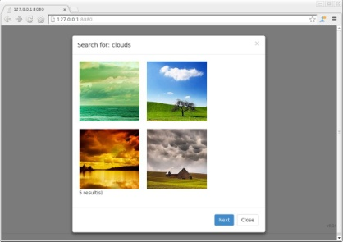
How do the pieces fit together?
Server machine (e.g., EC2 node)
Server
Server code
require('http'); http.createServer (…)
Amazon DyanmoDB
Internet
Web page
<html><head> <body>…
Browser
User

Slide 65
Dynamic content
Web application technologies
Background: CGI
Java Servlets
Node.js / Express / EJS
AJAX
Session management and cookies
NEXT

Slide 66
What about the client side?
Javascript was created as a script language for web browsers
Runs directly in the browser → can respond to user interactions quickly, without wide-area latencies
Can interact with web pages through the DOM
Developed at Netscape (1995)
Standardized as ECMAscript (1997)

Slide 67

What is the Document Object Model?
root
attribute
Root
p-i
element
?xml
dblp
text
mastersthesis
article
XML document
mdate
mdate
key
key
2002…
author
title
year
school
editor
title
journal
volume
year
ee
ee
XML parser
1992
2002…
ms/Brown92
tr/dec/…
The…
1997
PRPL…
Digital…
db/labs/dec
Kurt P….
Univ….
Paul R.
SRC…
http://www.
Document components represented by objects
Objects have methods like getFirstChild(), getNextSibling()... → can be used to traverse the tree
Can also modify the tree, and thus alter the document, via insertAfter(), etc.

Slide 68
Functions for accessing the DOM
The HTML page itself is called 'document'
To get information from the document:
var price = document.getElementById('price').value;
var allimages = document.getElementsByName('img');
var firstimg = document.getElementsByName('img')[0];
To put information into the document:
Create new elements; replace, or append to, existing nodes
// Find thing to be replaced var mainDiv = document.getElementById("main-page"); var orderForm = document.getElementById("target"); // Create replacement var paragraph = document.createElement("p"); var text = document.createTextNode("Here is the new text."); paragraph.appendChild(text); // Do the replacement mainDiv.replaceChild(paragraph, target);

Slide 69
Event handlers
Client-side JS can react to various events
Examples: User clicks on an element or presses a key, user submits a form, user changes a selection in a form, page finishes loading, mouse moves over a certain element...
Web page can request that the browser call a certain JavaScript function when the event occurs
Events can be requested from the web page:
<a href="foo.html" onClick="alert('You\'ve clicked!')">
... or directly from JavaScript:
theElement.onclick = functionName (DOM 0)
theElement.addEventListener(type, function, opt)

Slide 70
A simple client-side example
<html>
<head><title>Test</title></head>
<script type="text/javascript">
<!--
function check(myform) {
if (myform.term.value=="") {
alert("Please enter a search term!");
return false;
} else {
return true;
}
} // -->
</script>
<body>
<h1>Input a search term</h1>
<form method="post" action="process.php" onsubmit="return check(this)">
<input type="text" name="term" size="20">
<input type="submit" value="Search">
</form>
</body>
</html>
Prevents problems if browser does not support scripting
Script is embedded in the web page
Calls function when form is submitted; aborts submission when function returns false
Example: Form validation
Warns the user if no search term is specified

Slide 71
Including JavaScript in HTML
Option #1: Embed entirely in HTML document
As in previous example: Use <script>...</script>
To be safe, enclose script in HTML comments (to avoid confusing browsers that don't recognize JavaScript)
Option #2: Attach as a separate file
<script type="text/javascript" src="myscript.js"> </script>
Some browsers need the space between <script>...</script> and don't load the script if this is omitted
Remember that script is visible to the client!
Do NOT hardcode any passwords or include any secrets

Slide 72
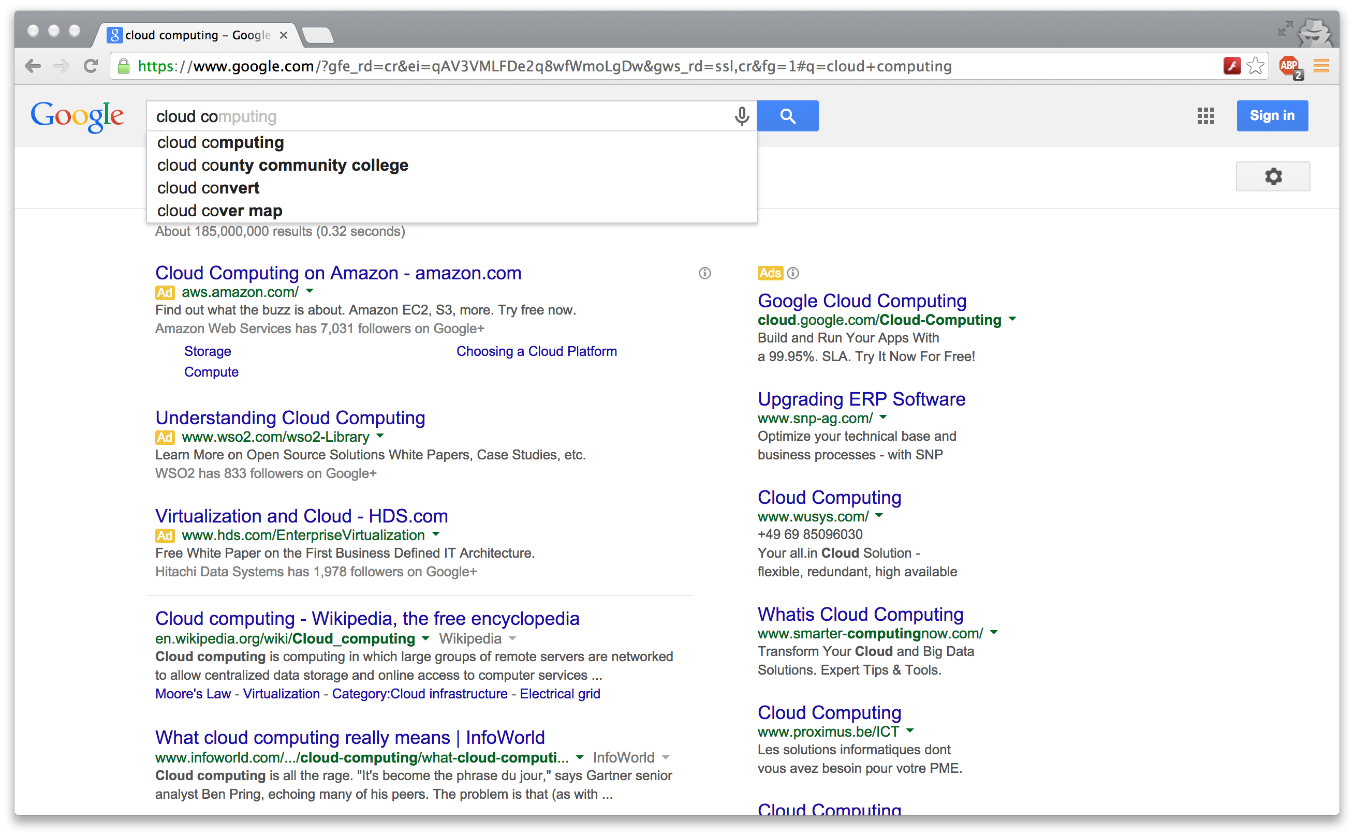
Implementing search suggestions
How would you do this with pure JavaScript?

Slide 73
XMLHttpRequest
A JavaScript object that enables web pages to dynamically load more content
Example: Ask the server for search suggestions while the user is typing the search term
Request can be asynchronous
Browser performs the HTTP request in the background while the user continues to interact with the web page
Script defines a callback function that should be invoked when the requested content has arrived
Content does not have to be XML
But often is XML (or JSON)

Slide 74
XMLHttpRequest workflow
Instantiate a new XMLHttpRequest object
Prepare the object
Call open() to set the URL and the method (GET, POST, ...)
Can add headers, HTTP authentication, ...
Need to send a callback function that will be called by the browser when the results are available
Send the request
Invoke send(), optionally with data to submit (for POST)
Handle invocations of the callback function
Do something with the response if request was successful
Optionally, handle errors

Slide 75
Example: Client side
<html>
<head><title>Test</title></head>
<script type="text/javascript">
<!--
function updateSuggestions() {
var term = document.getElementById('abc').value;
request = new XMLHttpRequest();
request.open("GET", "http://localhost:8080/suggest/"+escape(term));
request.onreadystatechange = function() {
if ((request.readyState == 4) && (request.status == 200)) {
var xmldoc = request.responseXML;
var root = xmldoc.getElementsByTagName('root').item(0);
var elements = root.getElementsByTagName('element');
var htmlOut = (elements.length)+ " suggestion(s):<br><br>";
for (var i=0; i<elements.length; i++)
htmlOut += "#"+(1+i)+": "+elements.item(i).textContent+"<br>";
document.getElementById('xyz').innerHTML = htmlOut;
}
}
request.send();
} // -->
</script>
<body>
<h1>Input a search term</h1>
<form action="" method="" onSubmit="return false">
<input type="text" name="thetext" size="20" id="abc" onKeyUp="updateSuggestions()">
<input type="submit" value="Replace">
</form>
<div id="xyz">(this is where the text will go)</div>
</body>
</html>
URL of server-side component (servlet)
Get data from XML
Callback function
Put data into page via DOM
Registers event handler

Slide 76
What is AJAX?
Asynchronous JavaScript and XML
Firsty mentioned by Jesse James Garrett in 2005
Not a single technology - a mix of technologies for building faster web apps
HTML and CSS for presentation
DOM for dynamic display
XML for data interchange
XMLHttpRequest for asynchronous requests
JavaScript for binding everything together

Slide 77
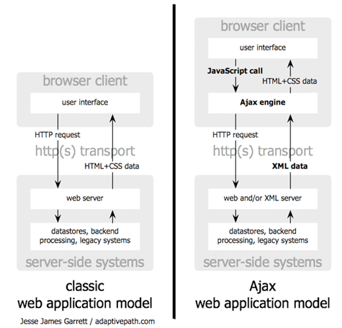
How does AJAX work?
http://www.adaptivepath.com/images/publications/essays/ajax-fig1_small.png

Slide 78
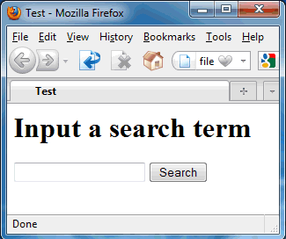
Building Web applications with AJAX
Host page
app.js
Internet
Node
Server
Browser
function updateSuggestions() {
var term = document.getElementById('abc').value;
request = new XMLHttpRequest();
request.open("GET", "http://localhost:8080/ajaxdemo/suggest/?t="+escape(term));
request.onreadystatechange = function() {
if ((request.readyState == 4) && (request.status == 200)) {
var xmldoc = request.responseXML;
var root = xmldoc.getElementsByTagName('root').item(0);
var elements = root.getElementsByTagName('element');
var htmlOut = (elements.length)+ " suggestion(s):<br><br>";
for (var i=0; i<elements.length; i++)
htmlOut += "#"+(1+i)+": "+elements.item(i).textContent+"<br>";
document.getElementById('xyz').innerHTML = htmlOut;
}
}
request.send();
}
Several puzzle pieces are needed
Host page: A web page that we'd like to make interactive
Client-side script: A JavaScript program that
registers handlers for relevant events, such as inputs or mouse clicks
requests additional data from the server using XMLHttpRequest objects
integrates the responses with the web page using the DOM
Server side: Another JavaScript program that supplies the data
Example: Given a partial search term, return XML with suggestions
Client-side script runs in browser, server-side in Node!
JavaScript program

Slide 79
Pros and cons of AJAX
Much more responsive than plain HTML
Can avoid wide-area latency in many cases (why not all?)
Faster - can transfer just the required information after each interaction, rather than the entire page (+less bandwidth)
Difficult to integrate navigation elements
'Back' button, bookmarks, external links from other pages etc. require special care (window.location.hash)
Difficult to accommodate search engines
Need to use site maps or carefully construct initial page
JavaScript compatibility issues
Messy to develop and debug
But new frameworks are simplifying things: e.g., AngularJS

Slide 80
Dynamic content
Web application technologies
Background: CGI
Java Servlets
Node.js / Express / EJS
AJAX
Session management and cookies
NEXT

Slide 81
Client-side vs server-side (last time)
What if web app needs to remember information between requests in a session?
Example: Contents of shopping cart, login name of user, ...
Recap from last time: Client-side/server-side
Even if the actual information is kept on the server side, client still needs some kind of identifier (session ID)
Now: Discuss four common approaches
URL rewriting and hidden variables
Cookies
Session object

Slide 82
URL rewriting and hidden variables
Idea: Session ID is part of every URL
Example 1: http://my.server.com/shoppingCart?sid=012345
Example 2: http://my.server.com/012345/shoppingCart
Why is the first one better?
Technique #1: Rewrite all the URLs
Before returning the page to the client, look for hyperlinks and append the session ID
Example: <a href="foo.html"> → <a href="foo.html?sid=012345">
In which cases will this approach not work?
Technique #2: Hidden variables
<input type="hidden" name="sid" value="012345">
Hidden fields are not shown by the browser

Slide 83
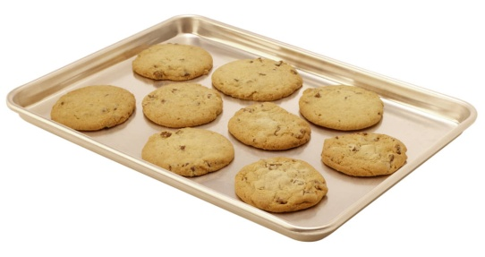
HTTP cookies
GET /index.html HTTP/1.1
HTTP/1.1 200 OK Content-Type: text/html Set-Cookie: sessionid=12345 ... contents of the page ...
Server
Client (browser)
GET /index.html HTTP/1.1 Cookie: sessionid=12345
...
What is a cookie?
A set of key-value pairs that a web site can store in your browser (example: 'sessionid=12345')
Created with a Set-Cookie header in the HTTP response
Browser sends the cookie in all subsequent requests to the same web site until it expires

Slide 84
Node solution: express.session
var cookieParser = require('cookie-parser')
var session = require('express-session')
app.use(cookieParser());
app.use(session({secret: 'thisIsMySecret'});
...
app.get('/test', function(req, res) { if (req.session.lastPage)
req.write('Last page was: '+req.session.lastPage); req.session.lastPage = '/test';
req.send('This is a test.');
}
Abstracts away details of session management
Developer only sees a key-value store
Behind the scenes, cookies are used to implement it
State is stored and retrieved via the 'req.session' object

Slide 85
A few more words on cookies
... Set-Cookie: sessionid=12345; expires=Tue, 02-Nov-2010 23:59:59 GMT; path=/; domain=.mkse.net ...
Each cookie can have several attributes:
An expiration date
If not specified, defaults to end of current session
A domain and a path
Browser only sends the cookies whose path and domain match the requested page
Why this restriction?

Slide 86
What are cookies being used for?
Many useful things:
Convenient session management (compare: URL rewriting)
Remembering user preferences on web sites
Storing contents of shopping carts etc.
Some problematic things:
Storing sensitive information (e.g., passwords)
Tracking users across sessions & across different web sites to gather information about them

Slide 87
Recap: Session management, cookies
Several ways to manage sessions
URL rewriting, hidden variables, cookies...
HttpSession
Abstract key-value store for session state
Implemented by the servlet container, e.g., with URL rewriting or with cookies
Cookies
Small pieces of data that web sites can store in browsers
Cookies can persist even after the browser is closed
Useful for many things, but also for tracking users

