Slide 1
INGI2145 Cloud Computing
Lab 1: Introduction to AWS
Muhammad Bilal
Thanh Nguyen
Lecture slides adapted from Upenn NETS212 by A. Haeberlen, Z. Ives Reproduced with permission
Université catholique de Louvain

Slide 2
Plan for today
Introduction to Amazon Web Services (AWS)
Elastic Compute Cloud (EC2)
Elastic Block Storage (EBS)
Other services: Elastic MapReduce, CloudFront, ...
Hands on session
Next time: Introduction to Vagrant and Puppet
NEXT
Université catholique de Louvain

Slide 3
Why Amazon AWS and not ?
Insert your favorite cloud here
Amazon is only one of several cloud providers
Others include Microsoft Azure, Google App Engine, ...
But there is no common standard (yet)
App Engine is PaaS and supports Java/JVM or Python
Azure is PaaS and supports .NET/CLR
AWS is PaaS/IaaS and supports IA-32 and 64 bit virtual machines
So we had to pick one specific provider
Amazon AWS is going to be used for the rest of this class
Full disclosure: Amazon's only involvement is providing free EC2 credits for this class
Université catholique de Louvain

Slide 4
Amazon AWS Educate
Visit https://aws.amazon.com/education/awseducate/ and Sign up, if you want.
Free credits for students and a few other benefits.

Slide 5
What is Amazon AWS?
Amazon Web Services (AWS) provides a number of different services, including:
Amazon Elastic Compute Cloud (EC2) Virtual machines for running custom software
Amazon Simple Storage Service (S3) Simple key-value store, accessible as a web service
Amazon DynamoDB Simple distributed database
Amazon Elastic MapReduce Scalable MapReduce computation
Amazon CloudFront Content delivery network
...
Used for the labs and projects
Université catholique de Louvain

Slide 6
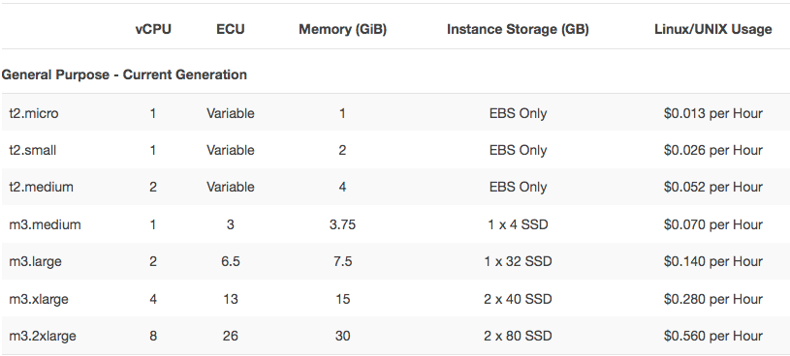
What is Amazon EC2?
http://aws.amazon.com/ec2/#pricing (09/2014)
Infrastructure-as-a-Service (IaaS)
You can rent various types of virtual machines by the hour
In your VMs, you can run your own (Linux/Windows) programs
Examples: Web server, search engine, movie renderer, ...
Université catholique de Louvain
Notes:
Remove the screenshot
Report pricing of (subset of) general purpose
Mention about the free tier option

Slide 7
Accessing EC2
AWS Management Console
REST API
AWS CLI tool

Slide 8
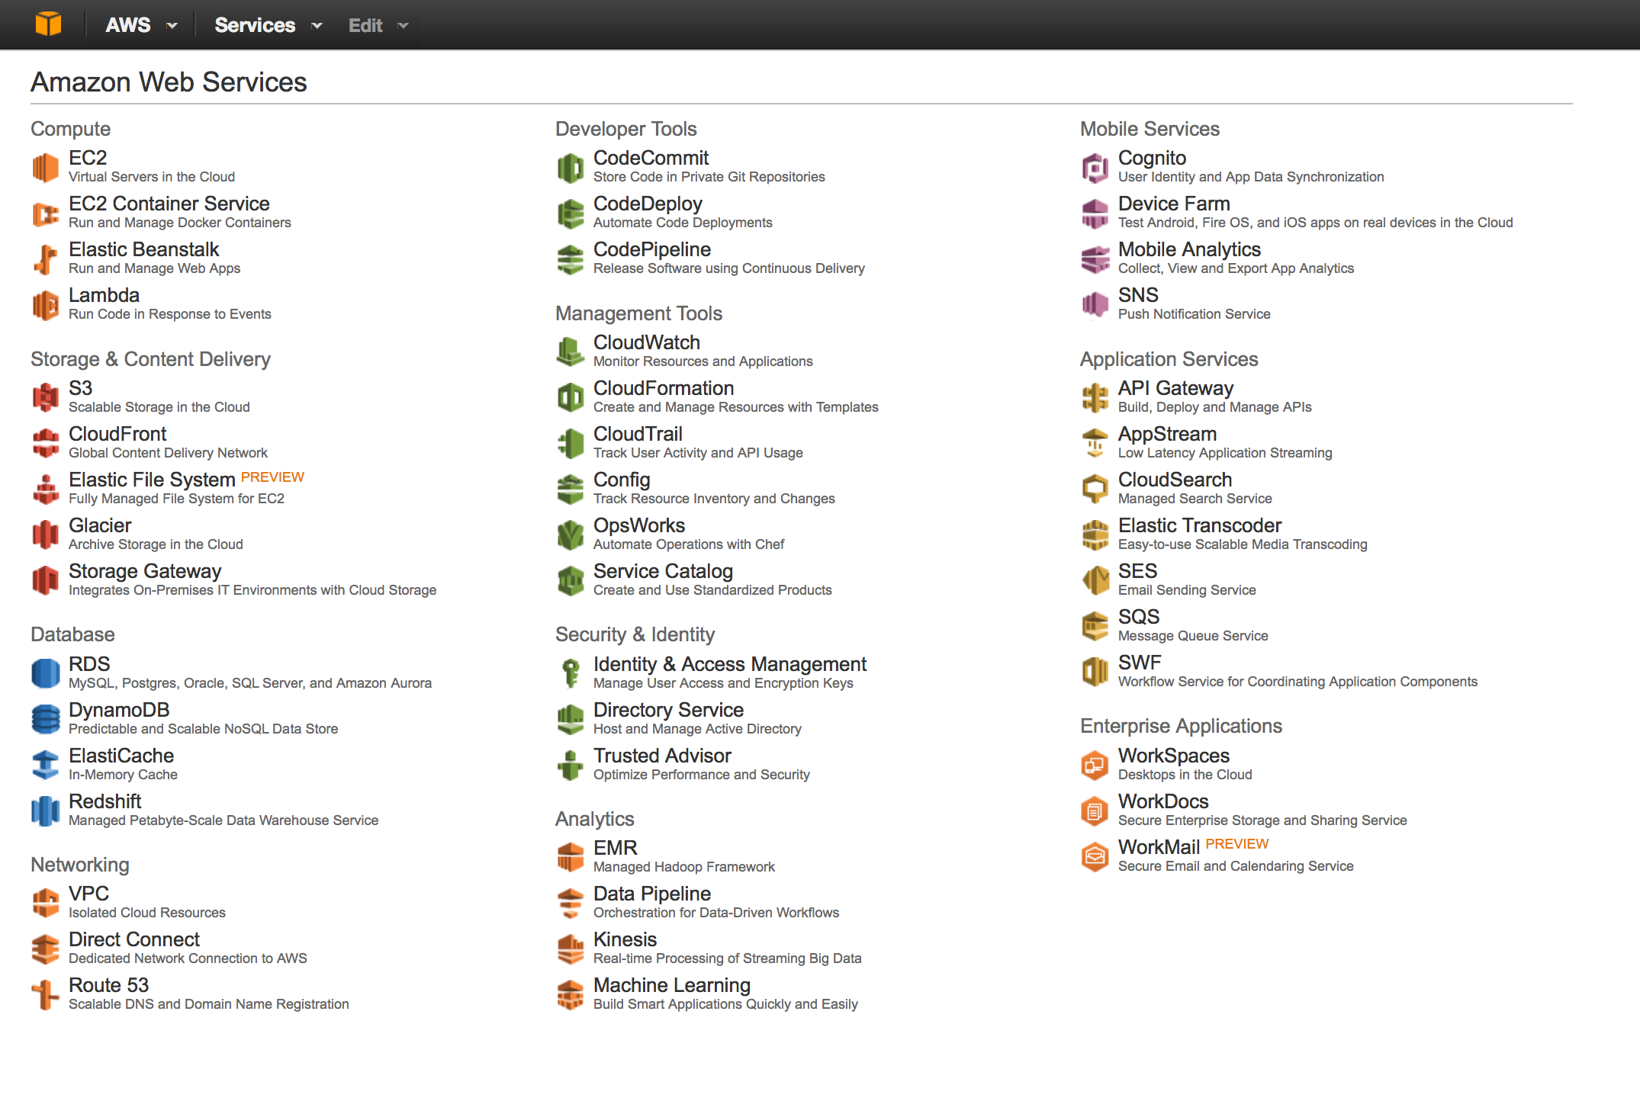
The AWS management console
Used to control many AWS services:
For example, start/stop EC2 instances, create S3 buckets...
Université catholique de Louvain

Slide 9
Example: REST
Invoked method
https://ec2.amazonaws.com/?Action=DescribeKeyPairs
&KeyName.1=my-key-pair
&X-Amz-Algorithm=AWS4-HMAC-SHA256
&X-Amz-Credential=AKIAIOSFODNN7EXAM …
&X-Amz-Date=20130813T150206Z
&X-Amz-SignedHeaders=content-type%3host%3x-amz-date
&X-Amz-Signature=ced6826de92d2bdeed8f8 …
Parameters
Sample request
Credentials
<DescribeKeyPairsResponse xmlns="http://ec2.amazonaws.com/doc/2014-06-15/"> <requestId>59dbff89-35bd-4eac-99ed-be587EXAMPLE</requestId> <keySet> <item> <keyName>my-key-pair</keyName> <keyFingerprint>1f:51:ae:28:bf:89:e9:d8:1f:25:5d:37:2d:7d:b8:ca:9f:f5:f1:6f</keyFingerprint> </item>
</keySet>
</DescribeKeyPairsResponse>
Response elements
Sample response
Source: http://awsdocs.s3.amazonaws.com/SDB/latest/sdb-dg.pdf
Université catholique de Louvain

Slide 10
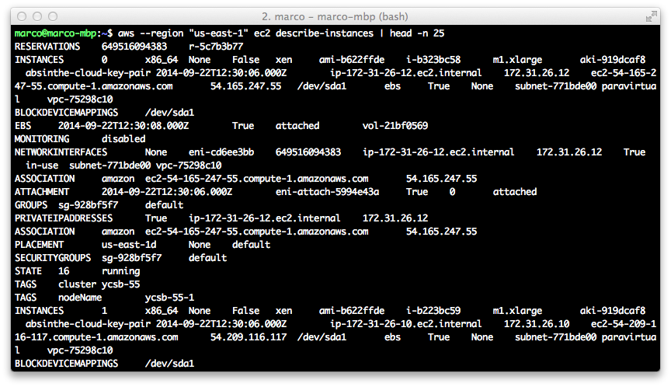
Accessing AWS via CLI
Example of access via Command Line Interface
http://aws.amazon.com/cli/
Université catholique de Louvain

Slide 11

Oh no - where is my data?
EC2 instances do not have persistent storage
Data survives stops & reboots, but not termination
So where should I put persistent data?
Elastic Block Store (EBS) - in a few slides
Ideally, use an AMI with an EBS root (Amzon's default AMI has this property)
If you store data on the virtual hard disk of your instance and the instance fails or you terminate it, your data WILL be lost!
Université catholique de Louvain

Slide 12
Amazon Machine Images
When I launch an instance, what software will be installed on it?
Software is taken from an Amazon Machine Image (AMI)
Selected when you launch an instance
Essentially a file system that contains the operating system, applications, and potentially other data
Lives in S3
How do I get an AMI?
Amazon provides several generic ones, e.g., Amazon Linux, Fedora Core, Windows Server, ...
You can make your own
You can even run your own custom kernel (with some restrictions)
Université catholique de Louvain

Slide 13




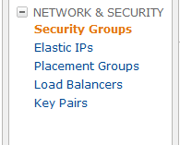
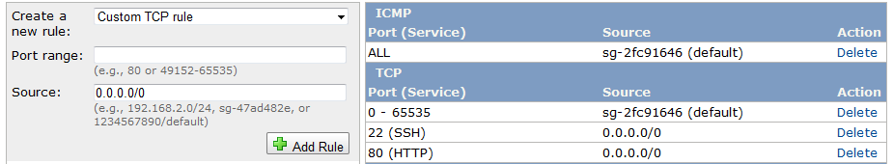
Security Groups
Evil attacker
Legitimate user (you or your customers)
Instance
Basically, a set of firewall rules
Can be applied to groups of EC2 instances
Each rule specifies a protocol, port numbers, etc...
Only traffic matching one of the rules is allowed through
Sometimes need to explicitly open ports
Université catholique de Louvain

Slide 14
Regions and Availability Zones
Where exactly does my instance run?
No easy way to find out - Amazon does not say
Instances can be assigned to regions
Currently 9 available: US East (Northern Virginia), US West (Northern California), US West (Oregon), EU (Ireland), Asia/Pacific (Singapore), Asia/Pacific (Sydney), Asia/Pacific (Tokyo), South America (Sao Paulo), AWS GovCloud
Important, e.g., for reducing latency to customers
Instances can be assigned to availability zones
Purpose: Avoid correlated fault
Several availability zones within each region
Université catholique de Louvain

Slide 15
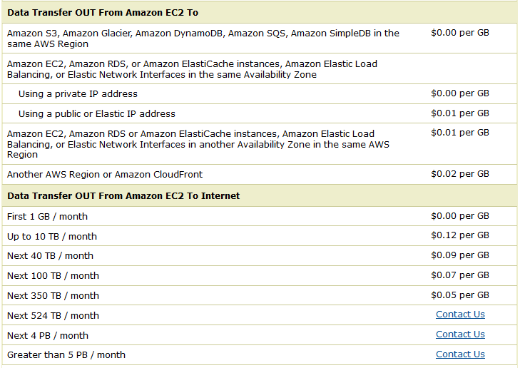
Network pricing
http://aws.amazon.com/ec2/#pricing (9/11/2013)
AWS does charge for network traffic
Price depends on source and destination of traffic
Free within EC2 and other AWS svcs in same region (e.g., S3)
Remember: ISPs are typically charged for upstream traffic
Université catholique de Louvain

Slide 16
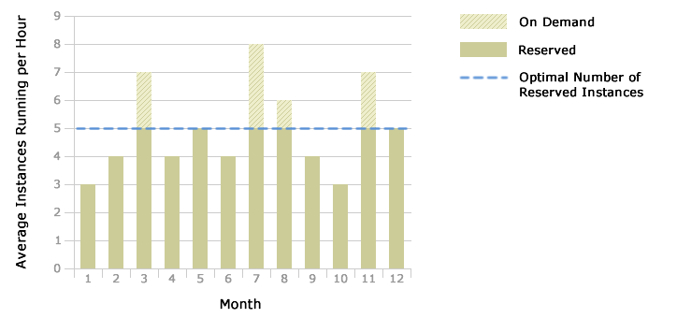
Instance types
Source: http://aws.amazon.com/ ec2/reserved-instances/
So far: On-demand instances
Also available: Reserved instances
One-time reservation fee to purchase for 1 or 3 years
Usage still billed by the hour, but at a considerable discount
Also available: Spot instances
Spot market: Can bid for available capacity
Instance continues until terminated or price rises above bid
Université catholique de Louvain

Slide 17
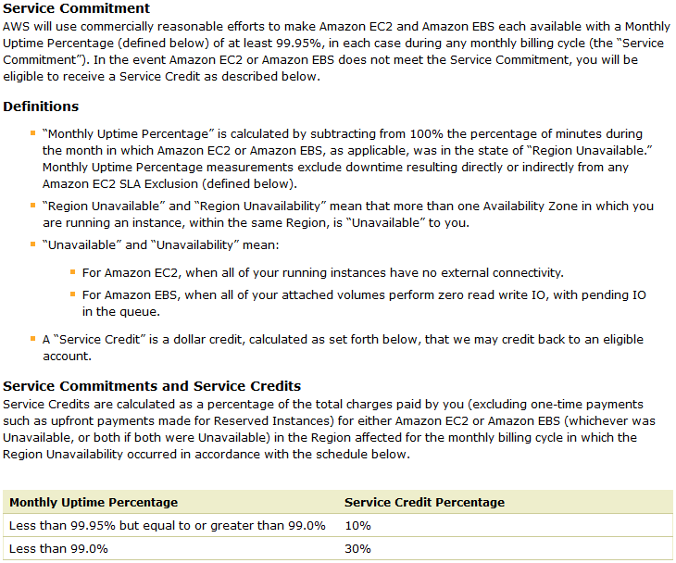
Service Level Agreement
4.38h downtime per year allowed
http://aws.amazon.com/ec2-sla/ (1 June 2013; excerpt)
Université catholique de Louvain

Slide 18
Recap: EC2
What EC2 is:
IaaS service - you can rent virtual machines
Various types: Very small to very powerful
How to use EC2:
Ephemeral state - local data is lost when instance terminates
AMIs - used to initialize an instance (OS, applications, ...)
Security groups - "firewalls" for your instances
Regions and availability zones
On-demand/reserved/spot instances
Service level agreement (SLA)
Université catholique de Louvain

Slide 19
Plan for today
Introduction to Amazon Web Services (AWS)
Elastic Compute Cloud (EC2)
Elastic Block Storage (EBS)
Other services: Elastic MapReduce, CloudFront, ...
Hands on session
Next time: Introduction to Vagrant and Puppet
NEXT
Université catholique de Louvain
Notes:
UPDATE IT

Slide 20
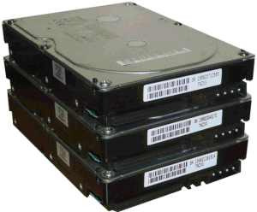
What is Elastic Block Store (EBS)?
Instance
EBS storage
Persistent storage
Unlike the local instance store, data stored in EBS is not lost when an instance fails or is terminated
Should I use the instance store or EBS?
Typically, instance store is used for temporary data
Université catholique de Louvain

Slide 21
Volumes
EBS storage is allocated in volumes
A volume is a 'virtual disk' (size: 1GB - 1TB)
Basically, a raw block device
Can be attached to an instance (but only one instance at a time)
A single instance can access multiple volumes
Placed in specific availability zones
Why is this useful?
Be sure to place it near instances (otherwise can't attach)
Replicated across multiple servers
Data is not lost if a single server fails
Amazon: Annual failure rate is 0.1-0.5% for a 20GB volume
Université catholique de Louvain

Slide 22
EC2 instances with EBS roots
EC2 instances can have an EBS volume as their root device ("EBS boot")
Result: Instance data persists independently from the lifetime of the instance
You can stop and restart the instance, similar to suspending and resuming a laptop
You won't be charged for the instance while it is stopped (only for EBS)
You can enable termination protection for the instance
Blocks attempts to terminate the instance (e.g., by accident) until termination protection is disabled again
Alternative: Use instance store as the root
You can still store temporary data on it, but it will disappear when you terminate the instance
You can still create and mount EBS volumes explicitly
Université catholique de Louvain

Slide 23
Snapshots
Time
You can create a snapshot of a volume
Copy of data in the volume at the time snapshot was made
Only the first snapshot makes a full copy; subsequent snapshots are incremental
What are snapshots good for?
Sharing data with others
Access control list (specific account numbers) or public access
Instantiate new volumes
Point-in-time backups
Université catholique de Louvain

Slide 24
Pricing
You pay for...
Storage space: $0.10 per allocated GB per month
I/O requests: $0.10 per million I/O requests
Charge is only for actual storage used
Empty space does not count
Université catholique de Louvain
Notes:
Check prices, see if need updating

Slide 25
Recap: Elastic Block Store (EBS)
What EBS is:
Basically a virtual hard disk; can be attached to EC2 instances
Persistent - state survives termination of EC2 instance
How to use EBS:
Allocate volume - empty or initialized with a snapshot
Attach it to EC2 instance and mount it there
Can create snapshots for data sharing, backup
Université catholique de Louvain

Slide 26
Plan for today
Introduction to Amazon Web Services (AWS)
Elastic Compute Cloud (EC2)
Elastic Block Storage (EBS)
Other services: Elastic MapReduce, CloudFront, …
Hands on session
Next time: Introduction to Vagrant and Puppet
NEXT
Université catholique de Louvain
Notes:
Update

Slide 27
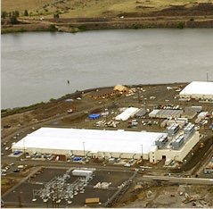



AWS Import/Export
Method | Time
Internet (20Mbps) | 45 days
FedEx | 1 day
Time to transfer 10TB [AF10]
Import/export large amounts of data to/from S3 buckets via physical storage device
Mail an actual hard disk to Amazon (power adapter, cables!)
Signature file for authentication
Discussion: Is this the Right Way to be shipping data, or should we rather be using a network?
Université catholique de Louvain

Slide 28
Amazon Elastic MapReduce (EMR)
Manage Hadoop Framework for big data processing
Also allows execution of Spark and Presto
Support for Amazon S3 and Amazon DynamoDB
Jobs are submitted by providing the program to execute
Input and output can be done via Amazon Data stores or private data centers

Slide 29

CloudFront
Content distribution network
Caches S3 content at edge locations for low-latency delivery
Some similarities to other CDNs like Akamai, Limelight, ...
Université catholique de Louvain

Slide 30
Plan for today
Introduction to Amazon Web Services (AWS)
Elastic Compute Cloud (EC2)
Elastic Block Storage (EBS)
Other services: Elastic MapReduce, CloudFront, …
Hands on session
Next time: Introduction to Vagrant and Puppet
NEXT
Université catholique de Louvain
Notes:
Update

Slide 31
Demo
Username: ingi2145-firstname.lastname
Password: aghaMeJ9Zu4sho
Provisioning the VM
Logging into AWS Management Console
Launching an instance
Contacting the instance via ssh
Creating an EBS volume
Attaching & mounting the volume on the instance via the CLI
Terminating an instance
Details are on your handouts
Université catholique de Louvain

Slide 32
INGI2145 mandatory conventions
Instances live in a single namespace
We need a convention that everyone must follow to share the AWS resources
1. Your login on AWS is:
ingi2145-<username>
2. Tag each virtual machine with a tag
key=user
value=<username>
3. Name your key-pair name as your login
ingi2145-<username>
NOTE: you need one key-pair in each region!
Université catholique de Louvain

Slide 33
INGI2145 mandatory conventions
Use only the following AWS regions
us-west-2
us-west-1
us-east-1
Never terminate a virtual machine that you do not own!
Always terminate instances that you don’t need!
Remember each of you has about $100 of credit!
Université catholique de Louvain

Slide 34
Up Next
Introduction to Vagrant, Puppet and possibly Docker

