Slide 1
INGI2145: CLOUD COMPUTING (Fall 2015)
Coordination in distributed applications
3 December 2015
Certain lecture slides adapted from Eurecom DSCC by P. Michiardi, M. Vukolic and and from Cornell CS5412 by K. Birman Reproduced with permission

Slide 2
Today
Distributed systems coordination
Apache Zookeeper
Simple, high performance kernel for building distributed coordination primitives
Zookeeper is not a specific coordination primitive per se, but a platform/API for building different coordination primitives

Slide 3
Plan for today
Distributed systems coordination
Consensus, FLP
Atomic broadcast, replicated state machine
Apache Zookeeper
Coordination kernel
Semantics
Programming Zookeeper
Internal Architecture
NEXT

Slide 4
Why do we need coordination?
Large-scale distributed applications require different forms of coordination. For example:
Configuration management
E.g., list of operational parameters
Rendezvous
E.g., discover final system configuration at run time
Group membership
I.e., which processes are member of the cluster
Leader election
Locking
I.e., exclusive access to critical resources

Slide 5
Why is coordination difficult?
Coordination among multiple parties involves agreement among those parties
In general, N processes must agree on something, e.g. a bit
Agreement ←→ Consensus ←→ Consistency
Consensus in brief
All correct processes propose a value
All correct processes decide a value (exactly once)
A decision must be proposed
All decisions must be the same

Slide 6
Connection to consistency
A system behaves consistently if users can’t distinguish it from a non-distributed system that supports the same functionality
Many notions of consistency reduce to agreement on the events that occurred and their order
Could imagine that our “bit” represents
Whether or not a particular event took place
Whether event A is the “next” event
Thus fault-tolerant consensus is deeply related to fault-tolerant consistency

Slide 7
Why is coordination difficult?
Coordination among multiple parties involves agreement among those parties
In general, N processes must agree on something, e.g. a bit
Agreement ←→ Consensus ←→ Consistency
FLP impossibility result + CAP theorem
Agreement is difficult in a dynamic asynchronous system in which processes may fail or join/leave

Slide 8
Fischer, Lynch and Patterson (FLP)
A surprising result
Impossibility of Asynchronous Distributed Consensus with a Single Faulty Process
They prove that no asynchronous algorithm for agreeing on a one-bit value can guarantee that it will terminate in the presence of crash faults
A node that crashes is indistinguishable from a node that is infinitely slow
And this is true even if no crash actually occurs!

Slide 9
In the real world?
Asynchronous model with crash faults
A bit like the real world!
Fault-tolerant consensus is...
Definitely possible (not even all that hard). Just vote!
And we can prove protocols of this kind correct
But we can’t prove that they will terminate
Impossibility doesn’t mean the consensus solutions are wrong – only that they live within this limit

Slide 10

Plan for today
Distributed systems coordination
Consensus, FLP
Atomic broadcast, replicated state machine
Apache Zookeeper
Coordination kernel
Semantics
Programming Zookeeper
Internal Architecture
NEXT

Slide 11
Atomic broadcast
A.k.a. total order broadcast
Critical synchronization primitive in many distributed systems
Fundamental building block to building replicated state machines

Slide 12
Atomic Broadcast (safety)
Total Order property
Let m and m’ be any two messages
Let p and q be any two correct processes that deliver m and m’
If p delivers m before m’, then q delivers m before m’
Integrity (a.k.a. No creation)
No message is delivered unless it was broadcast
No duplication
No message is delivered more than once
(Zookeeper Atomic Broadcast – ZAB deviates from this)

Slide 13
State machine replication
Think of, e.g., a database (RDBMS)
Use atomic broadcast to totally order database operations
All database replicas apply updates/queries in the same order
Since database is deterministic, the state of the database is fully replicated
To tolerate ≤ f failures, deploy 2f+1 replicas
(e.g. with 3 replicas can tolerate 1 failure)
Extends to any (deterministic) state machine

Slide 14
Consistency of total order
Very strong consistency
“Single-replica” semantics

Slide 15
Plan for today
Distributed systems coordination
Consensus, FLP
Atomic broadcast, replicated state machine
Apache Zookeeper
Coordination kernel
Semantics
Programming Zookeeper
Internal Architecture
NEXT

Slide 16
Zookeeper Origins
Developed initially at Yahoo!
On Apache since 2008
Hadoop subproject
Top Level project since Jan 2011
http://zookeeper.apacher.org

Slide 17
How do we go about coordination?
One approach
For each coordination primitive build a specific service
Some recent examples
Chubby, Google [Burrows et al, USENIX OSDI, 2006]
Lock service
Centrifuge, Microsoft [Adya et al, USENIX NSDI, 2010]
Lease service

Slide 18
But there is a lot of applications …
How many distributed services need coordination?
Amazon/Google/Yahoo/Microsoft/IBM/…
And which coordination primitives exactly?
Want to change from Leader Election to Group Membership? And from there to Distributed Locks?
There are also common requirements in different coordination services
Duplicating is bad and duplicating poorly even worse
Maintenance?

Slide 19
How do we go about coordination?
Alternative approach
A coordination service
Develop a set of lower level primitives (i.e., an API) that can be used to implement higher-level coordination services
Use the coordination service API across many applications
Example: Apache Zookeeper

Slide 20
Plan for today
Distributed systems coordination
Consensus, FLP
Atomic broadcast, replicated state machine
Apache Zookeeper
Coordination kernel
Semantics
Programming Zookeeper
Internal Architecture
NEXT

Slide 21
Zookeeper overview
Client-server architecture
Clients access Zookeeper through a client API
Client library also manages network connections to Zookeeper servers
Zookeeper data model
Similar to file system
Clients see the abstraction of a set of data nodes (znodes)
Znodes are organized in a hierarchical namespace that resembles customary file systems

Slide 22
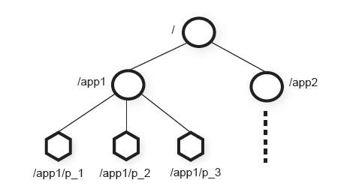
Hierarchical znode namespace

Slide 23
Types of Znodes
Regular znodes
Clients manipulate regular znodes by creating and deleting them explicitly
(We will see the API in a moment)
Ephemeral znodes
Can manipulate them just as regular znodes
However, ephemeral znodes can be removed by the system when the session that creates them terminates
Session termination can be deliberate or due to failure

Slide 24
Data model
In brief, it’s a file system with a simplified API
Only full reads and writes
No appends, inserts, partial reads
Znode hierarchical namespace
Think of directories that may also contain some payload data
Payload not designed for application data storage but for application metadata storage
Znodes also have associated version counters and some metadata (e.g., flags)

Slide 25
Sessions
Client connects to Zookeeper and initiates a session
Sessions enables clients to move transparently from one server to another
Any server can serve client’s requests
Sessions have timeouts
Zookeeper considers client faulty if it does not hear from client for more than a timeout
This has implications on ephemeral znodes

Slide 26
Client API
create(znode, data, flags)
Flags denote the type of the znode:
REGULAR, EPHEMERAL, SEQUENTIAL
SEQUENTIAL flag: a monotonically increasing value is appended to the name of znode
znode must be addressed by giving a full path in all operations (e.g., ‘/app1/foo/bar’)
returns znode path
delete(znode, version)
Deletes the znode if the version is equal to the actual version of the znode
set version = -1 to omit the conditional check (applies to other operations as well)

Slide 27
Client API (cont’d)
exists(znode, watch)
Returns true if the znode exists, false otherwise
watch flag enables a client to set a watch on the znode
watch is a subscription to receive an information from the Zookeeper when this znode is changed
NB: a watch may be set even if a znode does not exist
The client will be then informed when a znode is created
getData(znode, watch)
Returns data stored at this znode
watch is not set unless znode exists

Slide 28
Client API (cont’d)
setData(znode, data, version)
Rewrites znode with data, if version is the current version number of the znode
version = -1 applies here as well to omit the condition check and to force setData
getChildren(znode, watch)
Returns the set of children znodes of the znode
sync()
Waits for all updates pending at the start of the operation to be propagated to the Zookeeper server that the client is connected to

Slide 29
API operation calls
Can be synchronous or asynchronous
Synchronous calls
A client blocks after invoking an operation and waits for an operation to respond
No concurrent calls by a single client
Asynchronous calls
Concurrent calls allowed
A client can have multiple outstanding requests

Slide 30
Convention
Update/write operations
Create, setData, sync, delete
Read operations
exists, getData, getChildren

Slide 31
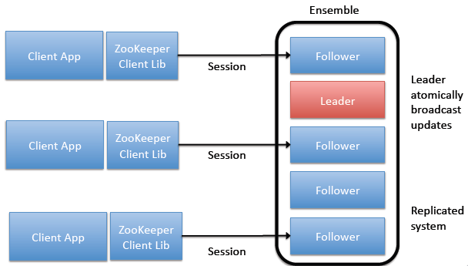
Session overview

Slide 32
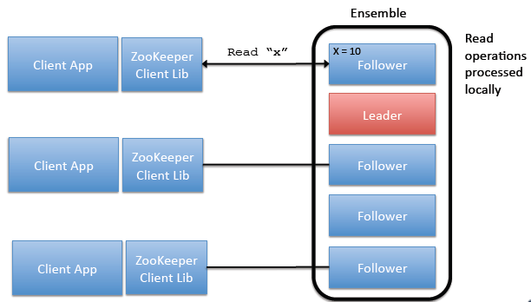
Read operations

Slide 33
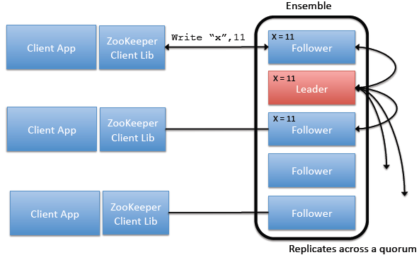
Write operations

Slide 34
Plan for today
Distributed systems coordination
Consensus, FLP
Atomic broadcast, replicated state machine
Apache Zookeeper
Coordination kernel
Semantics
Programming Zookeeper
Internal Architecture
NEXT

Slide 35
Zookeeper semantics
CAP perspective: Zookeeper is in CP
It guarantees consistency
May sacrifice availability under system partitions (strict quorum based replication for writes)
Consistency (safety)
Linearizable writes: all writes are linearizable
FIFO client order: all requests from a given client are executed in the order they were sent by the client
Matters for asynchronous calls

Slide 36
Zookeeper Availability
Wait-freedom
All operations invoked by a correct client eventually complete
Under condition that a quorum of servers is available
Zookeeper uses no locks although it can implement locks

Slide 37
Zookeeper consistency vs. Linearizability
Linearizability
All operations appear to take effect in a single, indivisible time instant between invocation and response
Zookeeper consistency
Writes are linearizable
Reads might not be
To boost performance, Zookeeper has local reads
A server serving a read request might not have been a part of a write quorum of some previous operation
➔ A read might return a stale value

Slide 38
Linearizability
Write (25)
Client 1
Write (11)
Client 2
Client 3
Read (11)

Slide 39
Zookeeper
Write (25)
Client 1
Write (11)
Client 2
Client 3
Read (25)

Slide 40
Is this a problem?
Depends what the application needs
May cause inconsistencies in synchronization if not careful
Despite this, Zookeeper API is a universal object → its consensus number is ∞
i.e., Zookeeper can solve consensus (agreement) for arbitrary number of clients
If an application needs linearizability
There is a trick: sync operation
Use sync followed by a read operation within an application-level read
This yields a “slow read”

Slide 41
sync
Sync
Asynchronous operation
Before read operations
Flushes the channel between follower and leader
Enforces linearizability
Client
1: sync
2: getData(“/foo”)
Follower
/foo = C1
Leader

Slide 42
sync
Sync
Asynchronous operation
Before read operations
Flushes the channel between follower and leader
Enforces linearizability
Client
Follower
/foo = C1
getData
sync
Leader
setData

Slide 43
sync
Sync
Asynchronous operation
Before read operations
Flushes the channel between follower and leader
Enforces linearizability
Client
Follower
/foo = C1
getData
sync
sync
Leader
setData
sync

Slide 44
sync
Sync
Asynchronous operation
Before read operations
Flushes the channel between follower and leader
Enforces linearizability
Client
Follower
/foo = C1
getData
sync
setData(“/foo”,C2)
Leader
sync

Slide 45
sync
Sync
Asynchronous operation
Before read operations
Flushes the channel between follower and leader
Enforces linearizability
Client
Follower
/foo = C2
getData
sync
Leader

Slide 46
sync
Sync
Asynchronous operation
Before read operations
Flushes the channel between follower and leader
Enforces linearizability
Client
return “/foo”, C2
Follower
/foo = C2
Leader

Slide 47
Read performance
Slow reads (sync + read)
Linerizability
Slow, leader bottleneck
“Normal” reads
Might be non-linearizable
1 round-trip client/server
One more option: Caching reads
Cache reads at a client, save on a round-trip
Set a watch for a notification needed for cache invalidation

Slide 48
Write operations (summary)
Always go through the slow “path”
A write request is forwarded by a follower server to the leader
Leader uses atomic (total-order) broadcast to disseminate messages
Using ZAB protocol
ZAB
A variant of Paxos tweaked to support FIFO/causal consistency of asynchronous calls
Quorum-based (2f+1 servers, tolerates f failures)

Slide 49
Session consistency
What if a follower that a client is talking to fails?
Or connection is lost for any other reason
Some operations might have not been executed
Upon disconnection
Client library tries to contact another server before session expires

Slide 50
Plan for today
Distributed systems coordination
Consensus, FLP
Atomic broadcast, replicated state machine
Apache Zookeeper
Coordination kernel
Semantics
Programming Zookeeper
Internal Architecture
NEXT

Slide 51
Implementing consensus
Consensus in brief
All correct processes propose a value
All correct processes decide a value (exactly once)
A decision must be proposed
All decisions must be the same
Propose(v)
create(“/c/proposal-”, “v”, SEQUENTIAL)
Decide()
C = getChildren(“/c”)
Select znode z in C with smallest sequence number
v’ = getData(z)
Decide v’

Slide 52
Simple configuration management
Clients initialized with the name of znode
E.g., “/config”
config = getData(“/config”, TRUE)
while (true)
wait for watch notification on “/config”
config = getData(“/config”, TRUE)
Note: A client may miss some configuration, but it will always “refresh” when it realizes the configuration is stale

Slide 53
Group membership
Idea: leverage ephemeral znodes
Fix a znode “/group”
Assume every process (client) is initialized with its own unique name and ID
What to do if there are no unique names?
joinGroup()
create(“/group/” + name, [address,port], EPHEMERAL)
getMembers()
getChildren(“/group”, false)
Set to true to get notified about membership changes

Slide 54
Locks
Can also use Zookeeper to implement blocking primitives
Not to be confused with the fact that Zookeeper is wait-free
Let’s try Locks

Slide 55
A simple lock
Lock(filename)
1: create(filename, “”, EPHEMERAL)
2: if create is successful
3: return //have lock
4: else
5: getData(filename,TRUE)
6: wait for filename watch
7: goto 1:
Release(filename)
delete(filename)

Slide 56
Problems?
Herd effect
If many clients wait for the lock they will all try to get it as soon as it is released
Only implements exclusive locking

Slide 57
Simple Lock without Herd Effect
Lock(filename)
1: myLock=create(filename + “/lock-”, “”, EPHEMERAL & SEQUENTIAL)
2: C = getChildren(filename, false)
3: if myLock is the lowest znode in C then return
4: else
5: precLock = znode in C ordered just before myLock
6: if exists(precLock, true)
7: wait for precLock watch
8: goto 2:
Release(filename)
delete(myLock)

Slide 58
Read/Write Locks
The previous lock solves herd effect but makes reads block other reads
How to do it such that reads always get the lock unless there is a concurrent write?

Slide 59
Read/Write Locks
Write Lock(filename)
1: myLock=create(filename + “/write-”, “”, EPHEMERAL & SEQUENTIAL)
[...] // same as simple lock w/o herd effect
Read Lock(filename)
1: myLock=create(filename + “/read-”, “”, EPHEMERAL & SEQUENTIAL)
2: C = getChildren(filename, false)
3: if no write znodes lower than myLock in C then return
4: else
5: precLock = write znode in C ordered just before myLock
6: if exists(precLock, true)
7: wait for precLock watch
8: goto 3:
Release(filename)
delete(myLock)

Slide 60
Plan for today
Distributed systems coordination
Consensus, FLP
Atomic broadcast, replicated state machine
Apache Zookeeper
Coordination kernel
Semantics
Programming Zookeeper
Internal Architecture
NEXT

Slide 61

Zookeeper components (high-level)
Write
requests
Request
processor
Tx
DB
Commit log
ZAB
Atomic broadcast
Tx
In-memory
Replicated
DB
Tx
Read
requests

Slide 62
Zookeeper DB
Fully replicated
To be contrasted with partitioning/placement in storage systems
Each server has a copy of in-memory DB
Store the entire znode tree
Default max 1 MB per znode (configurable)
Crash-recovery model
Commit log
+ periodic snapshots of the database

Slide 63
ZAB: a very brief overview
Used to totally order write requests
Relies on a quorum of servers (f+1 out of 2f+1)
ZAB internally elects leader replica
Not to be confused with Leader Election using Zookeeper API
Zookeeper adopts this notion of a leader
Other servers are followers
All write requests are sent by followers to the leader
Leader sequences the requests and invokes ZAB atomic broadcast

Slide 64
Request processor
Upon receiving a write request
the leader calculates in what state system will be after the write is applied
Transforms the operation in the transactional update
Such transactional updates are then processed by ZAB, DB
Guarantees idempotency of updates to the DB originating from the same operation
Idempotency: Important since ZAB may redeliver a message
Upon recovery not during normal operation
Also allows more efficient DB snapshots

Slide 65
Further reading
P. Hunt, M. Kumar, F. P. Junqueira and B. Reed: Zookeeper: Wait-free coordination for Internet-scale systems. In proc. USENIX ATC (2010)
http://static.usenix.org/event/usenix10/tech/full_papers/Hunt.pdf
Zookeeper 3.4 Documentation
http://zookeeper.apache.org/doc/trunk/index.html
(optional)
F. P. Junqueira, B. C. Reed, M. Serafini: Zab: High-performance broadcast for primary-backup systems. DSN 2011: 245-256
M. Burrows: The Chubby Lock Service for Loosely-Coupled Distributed Systems. OSDI 2006: 335-350
A. Adya, J. Dunagan, A. Wolman: Centrifuge: Integrated Lease Management and Partitioning for Cloud Services. NSDI 2010: 1-16

