Slide 1
INGI2145: CLOUD COMPUTING (Fall 2015)
Cloud Basics & Storage
1 October 2015
Certain lecture slides adapted from Upenn NETS212 by A. Haeberlen, Z. Ives, Eurecom DSCC by P. Michiardi, M. Vukolic and from Cornell CS5412 by K. Birman. Reproduced with permission

Slide 2
Announcements
First homework assignment will be announced next week
You will need to be setup with AWS
Next week’s lab (9 Oct) will cover important background for this assignment
Tomorrow’s lab session is about Amazon Storage Services
Bring your own laptop
Lab will be in BARB 91
Deadline of readings’ quizzes extended to Thursdays at noon
Will post quizzes online 6 days in advance
Will improve organization of information by having links on the website and a FAQ

Slide 3
Plan for today
Distributed programming and its challenges
Faults, failures, and what we can do about them
Network partitions, CAP theorem, relaxed consistency
Cloud basics
Anatomy of Cloud applications
Scaling: stateless, caching, and sharding
Cloud storage
Overview
KVS and current systems
Amazon Dynamo
NEXT

Slide 4






Masking faults with replication
Server A
Bob
Alice
Server B
Alice can store her data on both servers
Bob can get the data from either server
A single crash fault on a server does not lead to a failure
Availability is maintained
What about other types of faults, or multiple faults?

Slide 5
Problem: Maintaining consistency
Server A
Bob
X:=5
X:=7
X:=7
X:=5
Alice
Server B
What if multiple clients are accessing the same set of replicas?
Requests may be ordered differently by different replicas
Result: Inconsistency! (remember race conditions?)
For what types of requests can this happen?
What do we need to do to maintain consistency?

Slide 6
Types of consistency
Strong consistency
After an update completes, any subsequent access will return the updated value
Weak consistency
Updated value not guaranteed to be returned immediately, only after some conditions are met (inconsistency window)
Eventual consistency
A specific type of weak consistency
If no new updates are made to the object, eventually all accesses will return the last updated value

Slide 7
Eventual consistency variations
Causal consistency
If client A has communicated to client B that it has updated a data item, a subsequent access by B will return the updated value, and a write is guaranteed to supersede the earlier write. Client C that has no causal relationship to client A is subject to the normal eventual consistency rules
Read-your-writes consistency
Client A, after it has updated a data item, always accesses the updated value and will never see an older value
Session consistency
Like previous case but in the context of a session, for as long as the sessions remains alive

Slide 8
Eventual consistency variations
Monotonic read consistency
If client A has has seen a particular value for the object, any subsequent accesses will never return any previous values
Monotonic write consistency
In this case the system guarantees to serialize the writes by the same process
Systems that do not guarantee this level of consistency are notoriously hard to program
Few consistency properties can be combined
monotonic reads + read-your-writes most desirable for eventual consistency. Why?

Slide 9
Example: Storage system
Replica
Scenario: Replicated storage
We have N nodes that can store data
Data contains a monotonically increasing timestamp
To write a value:
Pick W replicas and write the value to each, using a fresh timestamp (say, the current wallclock time)
To read a value:
Pick R replicas and read the value from each
Return the value with the highest timestamp
If any replicas had a lower timestamp, send them the newer value
X=3 v1
X=3 v1
X=5 v2
X=2 v4
X=3 v1
X=5 v2

Slide 10
How to set N, R, and W
Write set
For strong consistency?
What happens otherwise?
Will the data ever become consistent again?
To avoid conflicting writes?
To make reads fast? Writes?
To minimize the risk of data loss?
Let's do some examples!
N=2, W=2, R=1
N=2, W=1, R=1
Read set

Slide 11
Strong consistency: Quorum principle
Majority quorum
Always write to and read from a majority of nodes
At least one node knows the most recent value
Pro: tolerate up to ⌈N/2⌉ - 1 crashes
Con: have to read/write ⌊N/2⌋ + 1 values
Read/write quorums
Read R nodes, write W nodes, s.t. R + W > N
Pro: adjust performance of reads/writes
Con: availability can suffer
Read set
Write set

Slide 12
Consensus
Replicas need to agree on a single order in which to execute client requests
How can we do this?
Does the specific order matter?
Problem: What if some replicas are faulty?
Crash fault: Replica does not respond; no progress (bad)
Byzantine fault: Replica might tell lies, corrupt order (worse)
Solution: Consensus protocol
Paxos (for crash faults), PBFT (for Byzantine faults)
Works as long as no more than a certain fraction of the replicas are faulty (PBFT: one third)

Slide 13

How do consensus protocols work?
Idea: Correct replicas 'outvote' faulty ones
Clients send requests to each of the replicas
Replicas coordinate and each return a result
Client chooses one of the results, e.g., the one that is returned by the largest number of replicas
If a small fraction of the replicas returns the wrong result, or no result at all, they are 'outvoted' by the other replicas

Slide 14

Plan for today
Distributed programming and its challenges
Faults, failures, and what we can do about them
Network partitions, CAP theorem, relaxed consistency
Cloud basics
Anatomy of Cloud applications
Scaling: stateless, caching, and sharding
Cloud storage
Overview
KVS and current systems
Amazon Dynamo
NEXT

Slide 15
Network partitions
What if this link breaks?
Server A
Bob
Alice
Server B
Network can partition
Hardware fault, router misconfigured, undersea cable cut, ...
Result: Gobal connectivity is lost
What does this mean for the properties of our system?

Slide 16
The CAP theorem
What we want from a web system:
Consistency: All clients see up-to-date copy of the data, even in the presence of concurrent updates
Availability: Every request (including updates) received by a non-failing node in the system must result in a response, even when faults occur
Partition-tolerance: Consistency and availability hold even when the network partitions
Can we get all three?
CAP theorem: We can get at most two out of the three
Which ones should we choose for a given system?
Conjecture by Brewer; proven by Gilbert and Lynch

Slide 17
Visual CAP
A
Availability: Each client can always read and write despite node failures
C&A
A&P
Pick Two
C
P
C&P
Consistency: All clients always have the same view of the data at the same time
Partition-tolerance: The system continues to operate despite arbitrary message loss

Slide 18
Common CAP choices
Example #1: Consistency & Partition tolerance
Many replicas + consensus protocol
Do not accept new write requests during partitions
Certain functions may become unavailable
Example #2: Availability & Partition tolerance
Many replicas + relaxed consistency
Continue accepting write requests
Clients may see inconsistent state during partitions

Slide 19
“2 of 3” view is misleading
Meaning of C&A over P is unclear
If a partition occurs, the choice must be reverted to C or A
No reason to forfeit C or A when system is not partitioned
Choice of C and A can occur many times within the same system at fine granularity
Three properties are more of a continuous
Availability is 0 to 100
Many levels of consistency
Disagreement within the system whether a partition exists
The modern CAP goal should be to maximize application-specific combinations of C and A

Slide 20
Dealing with partitions
Detect partition
Enter an explicit partition mode that can limit some operations
Initiate partition recovery when communication is restored
Restore consistency and compensate for mistakes made while the system was partitioned
State: S
State: S1
State: S’
Partition recovery
Operations on S
State: S2
Time
Partition mode

Slide 21
Which operations should proceed?
Depends primarily on the invariants that the system intends to maintain
If an operation is allowed and turns out to violate an invariant, the system must restore the invariant during recovery
Example: 2 objects are added with the same (unique) key; to restore, we check for duplicate keys and merge objects
If invariant cannot be violated, system must prohibit or modify the operation (e.g. record the intent and execute it after)
Example: delay charging the credit card; user does not see system is not available

Slide 22


Eventual consistency
Server A
Server B
Alice
Idea: Optimistically allow updates
Don't coordinate with ALL replicas before returning response
But ensure that updates reach all replicas eventually
What do we do if conflicting updates were made to different replicas?
Good: Decouples replicas. Better performance, availability under partitions
(Potentially) bad: Clients can see inconsistent state

Slide 23
Partition recovery
State on both sides must become consistent
Compensation for mistakes during partition
Start from state at the time of the partition and roll forward both sets of operations in some way, maintaining consistency
The system must also merge conflicts
constraint certain operations during partition mode so that conflicts can always be merged automatically
detect conflicts and report them to a human
use commutative operations as a general framework for automatic state convergence
commutative replicated data types (CRDTs)

Slide 24
Compensate for mistakes
Tracking and limitation of partition-mode operations ensures the knowledge of which invariants could have been violated
trivial ways such as “last writer wins”, smarter approaches that merge operations, and human escalation
For externalized mistakes typically requires some history about externalized outputs
System could execute orders twice
If the system can distinguish two intentional orders from two duplicate orders, it can cancel one of the duplicates
If externalized, send an e-mail explaining the order was accidentally executed twice but that the mistake has been fixed and to attach a coupon for a discount

Slide 25
Relaxed consistency: ACID vs. BASE
Classical database systems: ACID semantics
Atomicity
Consistency
Isolation
Durability
Modern Internet systems: BASE semantics
Basically Available
Soft-state
Eventually consistent

Slide 26
Recap: Consistency and partitions
Use replication to mask limited # of faults
Can achieve strong consistency by having replicas agree on a common request ordering
Even non-crash faults can be handled, as long as there are not too many of them (typical limit: 1/3)
Partition tolerance, availability, consistency?
Can't have all three (CAP theorem)
Typically trade-off between C and A
If service works with weaker consistency guarantees, such as eventual consistency, can get a compromise (BASE)

Slide 27
Plan for today
Distributed programming and its challenges
Faults, failures, and what we can do about them
Network partitions, CAP theorem, relaxed consistency
Cloud basics
Anatomy of Cloud applications
Scaling: stateless, caching, and sharding
Cloud storage
Overview
KVS and current systems
Amazon Dynamo
NEXT

Slide 28
Recap: Cloud benefits
Elastic, just-in-time infrastructure
More efficient resource utilization
Pay for what you use
Potential to reduce processing time
Parallelization
Leverage multiple data centers
High availability, lower response times
How do applications exploit these benefits?

Slide 29
Today’s Cloud applications
Web applications
Client/server paradigm
Request/response messaging pattern
Interactive communication
Processing pipelines
Examples: Indexing, data mining, image processing, video transcoding, document processing
Batch processing systems
Example: report generation, fraud detection, analytics, backups, automated testing

Slide 30
Many styles of system
Near the edge of the application focus is on vast numbers of clients and rapid response
Inside we find data-intensive services that operate in a pipelined manner, asynchronously
Deep inside the application we see a world of virtual computer clusters that are scheduled to share resources and on which applications like MapReduce (Hadoop) are very popular

Slide 31
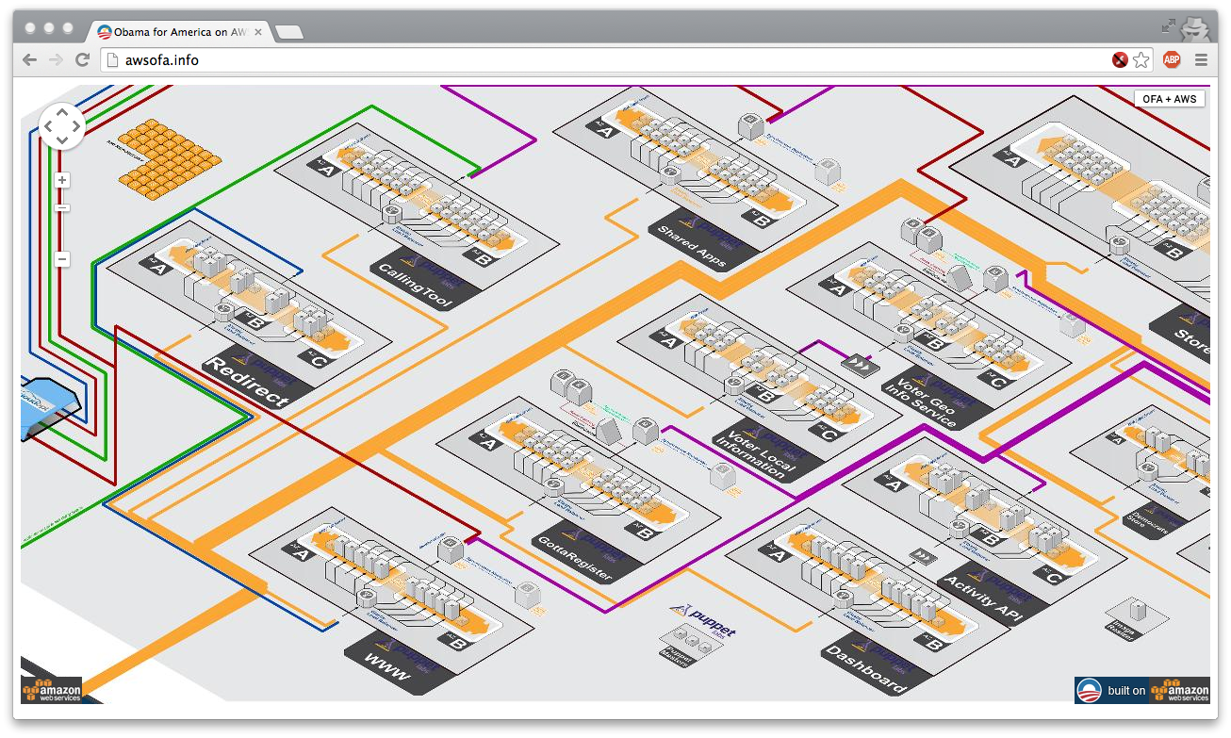
Example: Obama for America AWS
http://awsofa.info/

Slide 32
How are Cloud apps structured?
Clients talk to application using Web browsers or the Web services standards
But this only gets us to the outer “skin” of the data center, not the interior
Consider Amazon: it can host entire company web sites (like Netflix.com), data (S3), servers (EC2), databases (RDS) and even virtual desktops!

Slide 33

Big picture overview
Client requests are handled in by front-end Web servers
Application servers are invoked for dynamic content generation and run app logic
PHP, Java, Python, …
Back-end databases manage and provide access to data
Web
Web
App
Web
Web
App
App
Web
App
Shards
App
Cache
Cache
DB
DB
Index

Slide 34
Applications with multiple tiers
Web servers
Application servers
Data store (or database)

Slide 35
Redundancy at each tier
Web servers
Application servers
Data store

Slide 36
Load balancer
Load balancer
Web servers
Application servers
Data store

Slide 37
Plan for today
Distributed programming and its challenges
Faults, failures, and what we can do about them
Network partitions, CAP theorem, relaxed consistency
Cloud basics
Anatomy of Cloud applications
Scaling: stateless, caching, and sharding
Cloud storage
Overview
KVS and current systems
Amazon Dynamo
NEXT

Slide 38
Stateless servers are easiest to scale
Views a client request as an independent transaction and responds to it
Advantages:
Simpler and easier to scale: does not maintain state
More robust: tolerating instance failures does not require overheads restoring state
Stateless servers

Slide 39
Caching
Load balancer
Web servers
Application servers
Caching
Data store

Slide 40
Caching
Caching is central to responsiveness
Basic idea is to always used cached data if at all possible, so the inner services (data stores) are shielded from “online” load
Caching is only temporary storage, hence it is stateless
We can add multiple cache serves to spread loads
Must think hard about patterns of data access
Some data needs to be heavily replicated to offer very fast access on vast numbers of nodes
In principle the level of replication should match level of load and the degree to which the data is needed

Slide 41
Stateful servers require attention
Scaling a relational database is challenging
Traditional approach is replication
Data is written to a master server and then replicated to one or more slave servers (synchronously or asynchronously)
Read operations can be handled by the slaves
All writes happen on the master
Master
Slave
Data store

Slide 42
Stateful servers require attention
Scaling a relational database is challenging
Traditional approach is replication
Data is written to a master server and then replicated to one or more slave servers (synchronously or asynchronously)
Read operations can be handled by the slaves
All writes happen on the master
Cons:
Master becomes the write bottleneck
Master is a single point of failure
As load increases, cost of replication increases
Slaves may fall behind and serve stale data

Slide 43
Sharding
Data partitioning strategy
Basic idea: split data between multiple machines and have a way to make sure you always access data from the right place
Typically define a sharding key and create a shard mapping (e.g., shard_idx = hash(key) mod N)
Other partitioning schemes exist: e.g., allocate whole tables on the same machine
Partition 1
Partition 2
Partition 3

Slide 44
Benefits of sharding
Increased read and write throughput
High availability
Possibility of doing more work in parallel within the application server
Challenge: picking a good partitioning scheme
Otherwise risk of having hotspots in the system due to load imbalance

Slide 45
Sharding used in many ways
Sharding is not only for partitioning data within a database
Applies essentially to every application tier
Notion of sharding is cross-cutting
Example: partition data across caching servers
Two popular in-memory caching systems:
memcached: distributed object caching system
redis: distributed data structure server (also works as store)

Slide 46
And it isn’t just about updates
Should also be thinking about patterns that arise when doing reads (“queries”)
Some can just be performed by a single representative of a service
But others might need the parallelism of having several (or even a huge number) of machines do parts of the work concurrently
The term sharding is used for data, but here we might talk about “parallel computation on a shard”

Slide 47
First-tier parallelism
Parallelism is vital for fast interactive services
Key question:
Request has reached some service instance X
Will it be faster…
… For X to just compute the response
… Or for X to subdivide the work by asking subservices to do parts of the job?
Glimpse of an answer
When you make a search on Bing, the query is processed in parallel by even 1000s of servers that run in real-time on your request!
Parallel actions must focus on the critical path

Slide 48
What does “critical path” mean?
Focus on delay until a client receives a reply
Critical path are actions that contribute to this delay
Request
Service instance
Response delay seen by end-user would include Internet latencies
Service response delay
Response

Slide 49
Parallel speedup
In this example of a parallel read-only request, the critical path centers on the middle “subservice”
Request
Service instance
Critical path
Response delay seen by end-user would include Internet latencies
Service response delay
Critical path
Critical path
Response

Slide 50
With replicas we just load balance
Request
Service instance
Response delay seen by end-user would include Internet latencies
Service response delay
Response

Slide 51
What if a request triggers updates?
If updates are done “asynchronously” we might not experience much delay on the critical path
Cloud systems often work this way
Avoids waiting for slow services to process the updates but may force the tier-one service to “guess” the outcome
For example, store in the master database and replicate to the slave in the background
Many cloud systems use these sorts of “tricks” to speed up response time

Slide 52
What if we send updates without waiting?
Several issues now arise
Are all the replicas applying updates in the same order?
Might not matter unless the same data item is being changed
But then clearly we do need some “agreement” on order
What if the leader replies to the end user but then crashes and it turns out that the updates were lost in the network?
Data center networks can be surprisingly lossy at times
Also, bursts of updates can queue up
Such issues result in inconsistency

Slide 53
Is inconsistency a bad thing?
How much consistency is really needed in the first tier of the cloud?
Think about YouTube videos. Would consistency be an issue here?
What about the Amazon “number of units available” counters. Will people notice if those are a bit off?
Puzzle: can you come up with a general policy for knowing how much consistency a given thing needs?

Slide 54


eBay’s Five Commandments
As described by Randy Shoup at LADIS 2008
Thou shalt…
1. Partition Everything
2. Use Asynchrony Everywhere
3. Automate Everything
4. Remember: Everything Fails
5. Embrace Inconsistency

Slide 55
Recap
Cloud applications are multi-tiered systems
Caching can enable significant speedups for read-heavy workloads
Sharding provides opportunities for parallelization and improve read/write throughputs
Asynchronous operations decouple systems and enable quicker responses at the expense strong consistency

Slide 56
Plan for today
Distributed programming and its challenges
Faults, failures, and what we can do about them
Network partitions, CAP theorem, relaxed consistency
Cloud basics
Anatomy of Cloud applications
Scaling: stateless, caching, and sharding
Cloud storage
Overview
KVS and current systems
Amazon Dynamo
NEXT

Slide 57
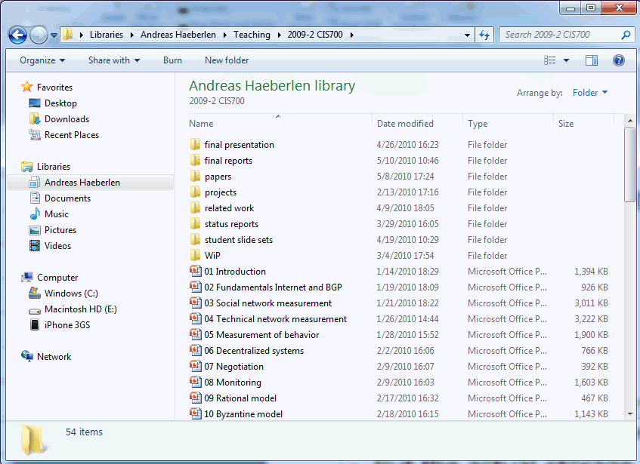




Complex service, simple storage
Variable-size files - read, write, append - move, rename - lock, unlock - ...
Operating system
Fixed-size blocks - read - write
PC users see a rich, powerful interface
Hierarchical namespace (directories); can move, rename, append to, truncate, (de)compress, view, delete files, ...
But the actual storage device is very simple
HDD only knows how to read and write fixed-size data blocks
Translation done by the operating system

Slide 58



Analogy to cloud storage
Shopping carts Friend lists User accounts Profiles ...
Web service
Key/value store - read, write - delete
Many cloud services have a similar structure
Users see a rich interface (shopping carts, product categories, searchable index, recommendations, ...)
But the actual storage service is very simple
Read/write 'blocks', similar to a giant hard disk
Translation done by the web service

Slide 59
What’s Wrong with Relational DBs?
Most applications interact through a database
Recall RDBMS:
Manage data access, enforce data integrity, control concurrency, support recovery after a failure
Many applications push traditional RDBMS solutions to the limit by demanding:
High scalability
Very large amounts of data
Minimal latency
High availability
Solution is far from ideal

Slide 60
Ideal data stores on the Cloud
Many situations need hosting of large data sets
Examples: Amazon catalog, eBay listings, Facebook pages, …
Ideal: Abstraction of a 'big disk in the clouds', which would have:
Perfect durability – nothing would ever disappear in a crash
100% availability – we could always get to the service
Zero latency from anywhere on earth – no delays!
Minimal bandwidth utilization – we only send across the network what we absolutely need
Isolation under concurrent updates – make sure data stays consistent

Slide 61
The inconveniences of the real world
Why isn't this feasible?
The “cloud” exists over a physical network
Communication takes time, esp. across the globe
Bandwidth is limited, both on the backbone and endpoint
The “cloud” has imperfect hardware
Hard disks crash
Servers crash
Software has bugs
Can you map these to the previous desiderata?

Slide 62
Finding the right tradeoff
In practice, we can't have everything
... but most applications don't really need 'everything'!
Some observations:
Read-only (or read-mostly) data is easiest to support
Replicate it everywhere! No concurrency issues!
But only some kinds of data fit this pattern – examples?
Granularity matters: “Few large-object” tasks generally tolerate longer latencies than “many small-object” tasks
Fewer requests, often more processing at the client
But it’s much more expensive to replicate or to update!
Maybe it makes sense to develop separate solutions for large read-mostly objects vs. small read-write objects!
Different requirements → different technical solutions

Slide 63
Many situations need hosting of large data sets
Examples: Amazon catalog, eBay listings, Facebook pages, …
General trend:
From performance at any cost to …
reliability at the lowest possible cost

Slide 64
Plan for today
Distributed programming and its challenges
Faults, failures, and what we can do about them
Network partitions, CAP theorem, relaxed consistency
Cloud basics
Anatomy of Cloud applications
Scaling: stateless, caching, and sharding
Cloud storage
Overview
KVS and current systems
Amazon Dynamo
NEXT

Slide 65

Key-value stores
Keys
Values
(bob, bschmitt@foo.com)
(gettysburg, "Four score and seven years ago...")
(29ck2dxa1, 0128ckso1$9#*!!8349e)
(windows, )
The key-value store (KVS) is a simple abstraction for managing persistent state
Data is organized as (key,value) pairs
Only three basic operations:
PUT(key, value)
GET(key) → value
Delete(key)

Slide 66
Examples of KVS
Where have you seen this concept before?
Conventional examples outside the cloud:
In-memory associative arrays and hash tables – limited to a single application, only persistent until program ends
On-disk indices (like BerkeleyDB)
"Inverted indices" behind search engines
Database management systems – multiple KVSs++
Distributed hashtables
Decentralized distributed systems inspired by P2P (see LSINF2345)
Examples: Chord/Pastry

Slide 67
Supporting an Internet service with a KVS
We’ll do this through a central server, e.g., a Web or application server
Two main issues:
There may be multiple concurrent requests from different clients
These might be GETs, PUTs, DELETEs, etc.
These requests may come from different parts of the network, with message propagation delays
It takes a while for a request to make it to the server!
We’ll have to handle requests in the order received (why?)
A
B
S

Slide 68
Managing concurrency in a KVS
What happens if we do multiple GET operations in parallel?
... over different keys?
... over the same key?
What if we do multiple PUT operations in parallel? or a GET and a PUT?
What is the unit of protection (concurrency control) that is necessary here?

Slide 69
Concurrency control
Most systems use locks on individual items
Each requestor asks for the lock
A lock manager processes these requests (typically in FIFO order) as follows:
Lock manager grants the lock to a requestor
Requestor makes modifications
Then releases the lock when it’s done

Slide 70
Limitations of per-key concurrency control
Suppose I want to transfer credits from my WoW account to my friend’s?
… while someone else is doing a GET on my (and her) credit amounts to see if they want to trade?
This is where one needs a database management system (DBMS) or transaction processing manager (app server)
Allows for “locking” at a higher level, across keys and possibly even systems (see LINGI2172 for more details)
Could you implement higher-level locks within the KVS? If so, how?

Slide 71
No longer one-size-fits-all solution

Slide 72
Specialized data stores
Example: Amazon’s solutions
Dynamo [SOSP’07]
Many services only store and retrieve data by primary key
Examples: user preferences, shopping cart, best seller lists
Don’t require querying and management RDBMS functionality
Simple Storage Service (S3)
Need to store large objects that change infrequently
Examples: virtual machines, pictures

Slide 73
Specialized data stores
Example: Google’s solutions
The Google File System [SOSP’03]
Distributed file system for large data-intensive applications
No POSIX API; focus on multi-GB files divided in fixed-size chunks (64 MB); mostly mutated by appending new data
Single master node maintains all file metadata
Bigtable [OSDI’06]
Distributed storage system for structured data
Data model is a sparse multi-dimensional sorted map indexed by row and column keys and a timestamp
Each value in the map is opaque to the storage system

Slide 74
Specialized data stores
Example: Facebook’s solutions
Cassandra [Ladis’09]
A distributed storage system for large sets of structured data
Optimized for very high write throughput; no master nodes
Haystack [OSDI’10]
Object store system optimized for photos
In 2010, over 260 billion images; 20 PB of data; 60 TB/week
Data written once, read often, never modified, rarely deleted
TAO [ATC’13]
A read-optimized graph data store to serve the social graph
Sustains 1 billion reads/s on a changing data set of many PBs
Explicitly favors availability over consistency

Slide 75
Specialized data stores
Example: LinkedIn’s solutions
Kafka [NetDB’11]
A high-throughput distributed messaging system
Pub/sub architecture designed for aggregating log data
Messages are persisted on disk for durability and replicated for fault tolerance; guarantees at-least-once delivery
Voldemort
A distributed key-value store supporting only get/put/delete
Inspired by Amazon’s Dynamo: tunable consistency, highly available

Slide 76
Plan for today
Distributed programming and its challenges
Faults, failures, and what we can do about them
Network partitions, CAP theorem, relaxed consistency
Cloud basics
Anatomy of Cloud applications
Scaling: stateless, caching, and sharding
Cloud storage
Overview
KVS and current systems
Amazon Dynamo
NEXT

Slide 77
Amazon Web Services (AWS)
[Vogels09] At the foundation of Amazon’s cloud computing are infrastructure services such as
Amazon’s S3 (Simple Storage Service), SimpleDB, and EC2 (Elastic Compute Cloud)
These provide the resources for constructing Internet-scale computing platforms and a great variety of applications.
The requirements placed on these infrastructure services are very strict; need to
Score high in security, scalability, availability, performance, and cost-effectiveness, and
Serve millions of customers worldwide, continuously.

Slide 78
AWS
Observation
Vogels does not emphasize consistency
AWS is in AP, sacrificing consistency
AWS follows BASE philosophy
BASE (vs ACID)
Basically Available
Soft state
Eventually consistent

Slide 79
Why Amazon favors availability over consistency?
“even the slightest outage has significant financial consequences and impacts customer trust”
Surely, consistency violations may as well have financial consequences and impact customer trust
But not in (a majority of) Amazon’s services
NB: Billing is a separate story

Slide 80
Amazon Dynamo
Not exactly part of the AWS offering
however, Dynamo and similar Amazon technologies are used to power parts of AWS (e.g., S3)
Dynamo powers internal Amazon services
Hundreds of them!
Shopping cart, Customer session management, Product catalog, Recommendations, Order fulfillment, Bestseller lists, Sales rank, Fraud detection, etc.
So what is Amazon Dynamo?
A highly available key-value storage system
Favors high availability over consistency under failures

Slide 81
Key-value store
put(key, object)
get(key)
We talk also about writes/reads (the same here as put/get)
In Dynamo case, the put API is put(key, context, object)
where context holds some critical metadata (will discuss this in more details)
Amazon services (see previous slide)
Predominantly do not need transactional capabilities of RDBMs
Only need primary-key access to data!
Dynamo: stores relatively small objects (typically <1MB)

Slide 82
Amazon Dynamo: Features
High performance (low latency)
Highly scalable (hundreds of server nodes)
“Always-on” available (especially for writes)
Partition/Fault-tolerant
Eventually consistent
Dynamo uses several techniques to achieve these features
Which also comprise a nice subset of a general distributed system toolbox

Slide 83
Amazon Dynamo: Key Techniques
Consistent hashing [Karger97]
For data partitioning, replication and load balancing
Sloppy Quorums
Boosts availability in presence of failures
might result in inconsistent versions of keys (data)
Vector clocks [Fidge88/Mantern88]
For tracking causal dependencies among different versions of the same key (data)
Gossip-based group membership protocol
For maintaining information about alive nodes
Anti-entropy protocol using hash/Merkle trees
Background synchronization of divergent replicas

Slide 84
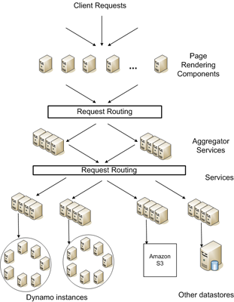
Amazon SOA platform
Runs on commodity hardware
This is low-end server class rather than low-end PC
Stringent latency requirements
Measured at 99.9%
Part of SLAs
Every service runs its own Dynamo instance
Only internal services use Dynamo
No Byzantine nodes

Slide 85
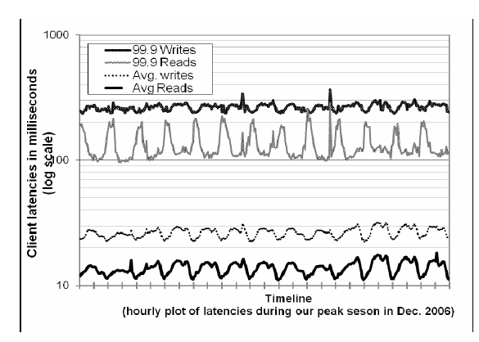
SLAs and three nines
Sample SLA
A service XYZ guarantees to provide a response within 300 ms for 99.9% of requests for a peak load of 500 req/s
Amazon focuses on 99.9 percentile

Slide 86
Dynamo design decisions
“always-writable” data store
Think shopping cart: must be able to add/remove items
If unable to replicate the changes?
Replication is needed for fault/disaster tolerance
Allow creations multiple versions of data (vector clocks)
Reconcile and resolve conflicts during reads
How/who should reconcile
Application: depending on e.g., business logic
Complicates programmer’s life, flexible
Dynamo: deterministically, e.g., “last-write” wins
Simpler, less flexible, might loose some value wrt. Business logic

Slide 87
Dynamo architecture
Scalable and robust components for
Load balancing, membership/fault detection, failure recovery, replica synchronization, overload handling, state transfer, concurrency, job scheduling, request marshalling, request routing, system monitoring and alarming, configuration management
We focus on techniques for
Partitioning, replication, versioning, membership, failure-handling, scaling

Slide 88
Partitioning using consistent hashing
Dynamo dynamically partitions a set of keys over a set of storage nodes
Used also in many DHTs (e.g., Chord)
Hashes of keys give key m-bit identifiers
(MD5, can use SHA-1, …)
Consistent hashing
Identifiers are ordered in an identifier circle
Partitioning
A key is assigned to the closest successor node id
i.e., key k is assigned to the first node with id ≥ k
or if such a node does not exist to the node with smallest id (circle)

Slide 89
Consistent hashing: Example
m=3: 3-bit namespace
3 nodes (0,2,3)
4 keys (1,3,5,6)
Node 0 stores keys 5,6
Node 2 stores key 1
Node 3 stores key 3
0
1
6
2
5
3

Slide 90
Consistent hashing
Designed to let nodes enter and leave the network with minimal disruption
Key to incremental scalability
Maintenance
When node n joins
certain keys previously assigned to n’s successor now become assigned to n.
When node n leaves
all of n’s assigned keys are reassigned to n’s successor.

Slide 91
Consistent hashing: Properties
Assume N nodes and K keys. Then (with high probability) [Karger97]
Each node is responsible for at most (1+ε)K/N keys
When N+1st node joins/leaves, O(K/N) keys change hands (optimal)
ε=O(logN)
Can have ε→0 with “virtual” nodes
“Virtual” nodes
Each physical node mapped multiple times to the circle
Load balancing!
Dynamo employs virtual nodes — also in order to leverage heterogeneity among physical nodes

Slide 92
Replication
k
A
To achieve high availability and durability
Each data item (key) replicated at N nodes
N is configurable per Dynamo instance
Assume N=3
For key k, B is the 1st successor node (coordinator)
B replicates k to N-1 further successor nodes (C and D)
B, C and D
are preference list for k
Virtual nodes
Same physical nodes skipped in a preference list
H
B
G
C
F
D
E

Slide 93
Data versioning
Replication performed after a response is sent to a client
This is called asynchronous replication
May result in inconsistencies under partitions
Read does not return the last value. Eventual consistency!
But operations should not be lost
“add to cart” should not be rejected but also not forgotten
If “add to cart” is performed when latest version is not available it is performed on an older version
We may have different versions of a key/value pair

Slide 94
Data versioning
Once a partition heals versions are merged
The goal is not to lose any “add to cart”
Most of the time there will be no partitions and the system will be consistent
New versions subsume all previous ones
It is vital to understand that the application must know that different versions might exist
This is the Achilles’ heel of eventual consistency (more difficult to reason about, program with)
Key data versioning technique: Vector clocks
Capture causality between different versions of an object

Slide 95
Vector clocks in Dynamo
Each write to a key k is associated with a vector clock VC(k)
VC(k) is an array (map) of integers
In theory: one entry VC(k)[i] for each node i
When node i handles a write of key k it increments VC(k)[i]
VCs are included in the context of the put call
In practice:
VC(k) will not have many entries (only nodes from the preference list should normally have entries), and
Dynamo truncates entries if more than a threshold (say 10)

Slide 96
Vector clocks in Dynamo
VC3
=
([x,2],[y,1])
Write
handled
by node x
Write
handled
by node y
Write
handled
by node x
VC5
=
([x,3], [y,1], [z,1])
VC1=([x,1])
VC2=([x,2])
Write
handled
by node z
VC4
=
([x,2],[z,1])
Reconciled and
written
by node x
NB: one VC per key

Slide 97
Number of different versions (#DV)
These are the evidence of consistency violations (#DV>1)
24h experiment on the shopping cart
#DV=1: 99.94% of requests (all but 1 in cca 1700 req)
#DV=2: 0.00057% of requests
#DV=3: 0.00047% of requests
…
Attributed to busy robots (automated client programs)
Rarely visible to humans

Slide 98
Handling puts and gets (failure-free case)
Any Dynamo storage node can receive get/put request for any key. This node is selected by
Generic load balancer
By a client library that immediately goes to coordinator nodes in a preference list
If the request comes from the load balancer
Any node can coordinate a read request
For a write request, the node routes the request a node in the key’s preference list
Each node has routing info to all other nodes
0-hop DHT
Not the most scalable, but latency is critical

Slide 99
Handling puts and gets
Extended preference list
N nodes from preference list + some additional nodes (following the circle) to account for failures
Failure-free case
Nodes from preference list are involved in get/put
Failures
First N alive nodes from extended preference list are involved

Slide 100
Dynamo’s quorums
Two configurable parameters
R number of nodes that need to participate in a get
W number of nodes that need to participate in a write
R + W > N (a quorum system)
Handling put (by coordinator) // rough sketch
Generate new VC, Write new version locally
Send value, VC to N selected nodes from preference list
Wait for W-1
Handling get (by coordinator) // rough sketch
Send READ to N selected nodes from preference list
Wait for R
Select highest versions per VC, return all such versions (causally unrelated)
Reconcile/merge different versions
Writeback reconciled version

Slide 101
Of choices of R, W
R, W smaller than N
To decrease latency
Slowest replica dictates the latency
W=1
Always-available for writes
Yields R=N (reads pay the penalty)
Most often in Dynamo (W,R,N)=(2,2,3)

Slide 102
Handling failures
N selected nodes are the first N healthy nodes
Might change from request to request
Hence these quorums are “Sloppy” quorums
“Sloppy” vs. strict quorums
“sloppy” allow availability under a much wider range of partitions (failures) but sacrifice consistency
Also, important to handle failures of an entire data center
Power outages, cooling failures, network failures, disasters
Preference list accounts for this (nodes spread across data centers)

Slide 103
Handling temporary failures: hinted handoff
If a replica in the preference list is down then another replica is created on a new node
Assume again N=3
A replica A is down
Coordinator will involve D
With a hint that this D
substitutes A until A comes back
again
When D gets info A is back up
it hands back the data to A
A
H
B
G
C
F
D
E

Slide 104
Anti-entropy synchronization using hash/Merkle trees
Each Dynamo node keeps a Merkle tree for each of its key ranges
Remember, one key range per virtual node
Compares the root of the tree with replicas
If equal, all keys in a range are equal (replicas in sync)
If not equal
Traverse the branches of the tree to pinpoint the children that differ
The process continues to all leaves
Synchronize on those keys that differ

Slide 105
Merkle trees
rootHash=
hash(H0||H1)
H0=
hash(H00||H01)
H1=
hash(H10||H11)
H00=
hash(V1)
H01=
hash(V2)
H10=
hash(V3)
H11=
hash(V4)
V1
V2
V3
V4
Data

Slide 106
Membership
Node outages temporary
Not considered as permanent leaves
Dynamo relies on administrator explicitly declaring joins/leaves on any Dynamo node
This triggers membership changes (with the aid of seeds)
Membership info are also eventually consistent — propagated by background gossip protocol
Node contacts a random node every 1s
2 nodes reconcile the membership info
This gossip used also for exchanging partitioning/placement metadata

Slide 107
Failure detection
Unreliable failure detection (FD)
Used, e.g., to refresh the healthy node info in the extended preference list
With steady load node A will find out if node B is unavailable
E.g., if B does not respond to A’s messages
But this is clearly unreliable, B might be partitioned not faulty
Then, A periodically checks on B to see if B recovers
In the absence of traffic A might not find out B is unavailable
But this info anyway does not matter w/o traffic
Dynamo has in-band FD, rather than a dedicated component

Slide 108
Dynamo: Summary
An eventually consistent highly available key value store
AP in the CAP space
Focuses on low latency, SLAs
Very low latency writes, reconciliation in reads
Key techniques used in many other distributed systems
Consistent hashing, (sloppy) quorum-based replication, vector clocks, gossip-based membership, Merkle-tree based synchronization

Slide 109

Stay tuned
Next time you will learn about: A programming model for the Cloud

