Slide 1
Lecture 6 illustrations
Dark Matter & The Universe, Ed Daw

Slide 2
probe
signal
first
amplifier
resonant cavity

Slide 4
first
amplifier
resonant cavity

Slide 5
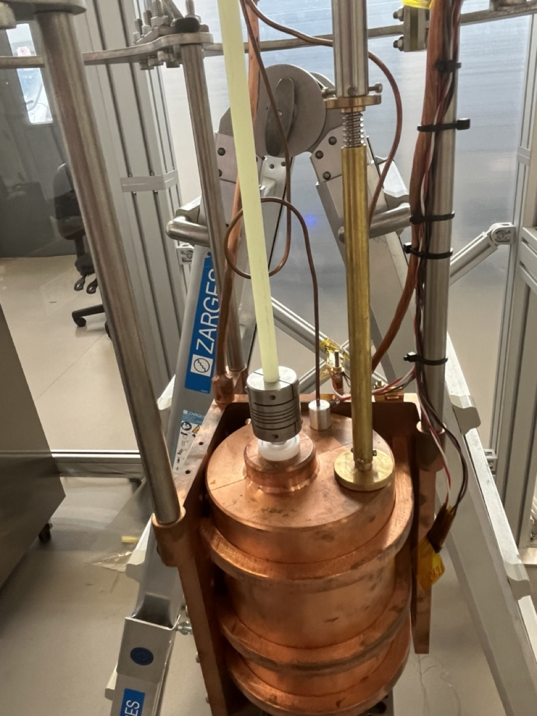

Slide 6
