Slide 1
The Differential WIMP elastic scattering rate
Ed Daw

Slide 2
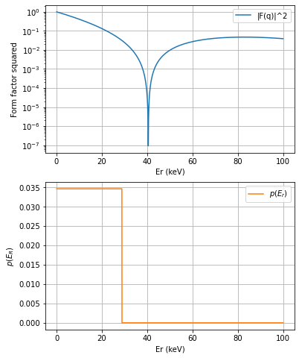

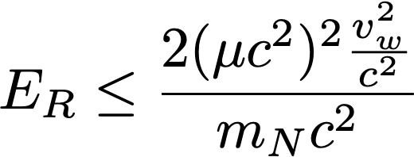
for

