Slide 1
Lecture 7 illustrations
Dark Matter detectors, Ed Daw

Slide 2
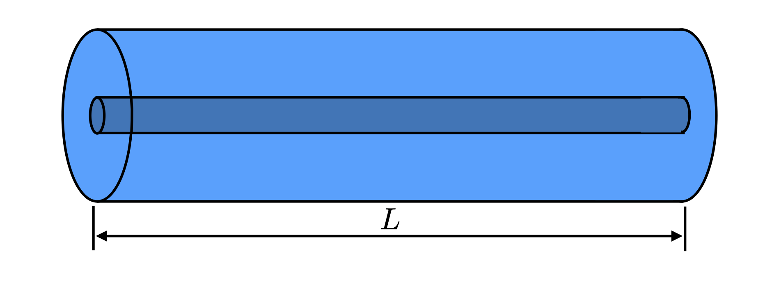

Slide 3
