Slide 1
Dark Matter Detectors
Ed Daw
Office hours: D28 Hicks, Wednesday 12:00, Friday 4pm
Course plan: 8 lectures on dark matter detectors.
Today: Theory of WIMPs and Axions
Then 3.5 lectures on WIMP detectors
Finally 3.5 lectures on axion detectors
You’ve had a virtual tour of an underground dark matter lab, used for several WIMP searches. You can have a tour of my axion search experiment, which is on C floor.
Questions are welcome – raise your hand. Be considerate of other students by not talking loudly otherwise. There will be 1 blackboard homework, and the rest of the assessment is via the exam.

Slide 2
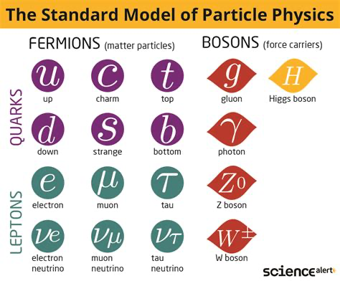

Slide 3
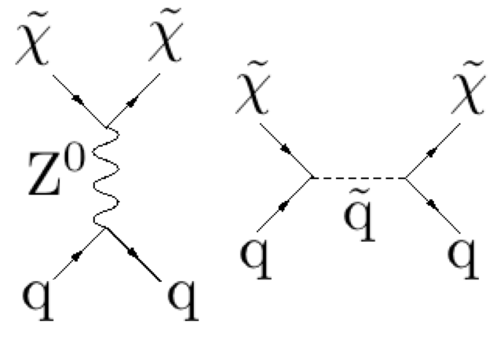

Slide 4
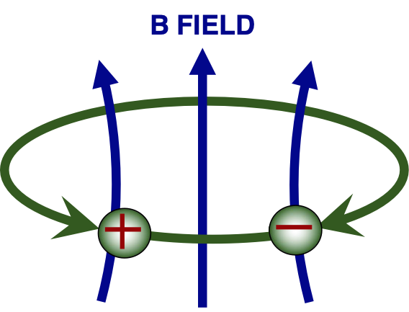

Slide 5
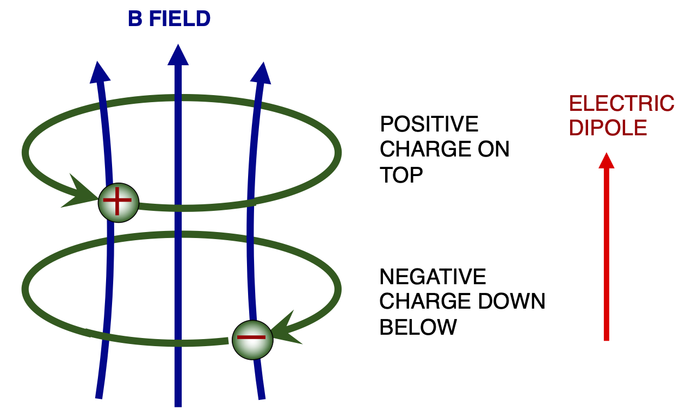

Slide 6
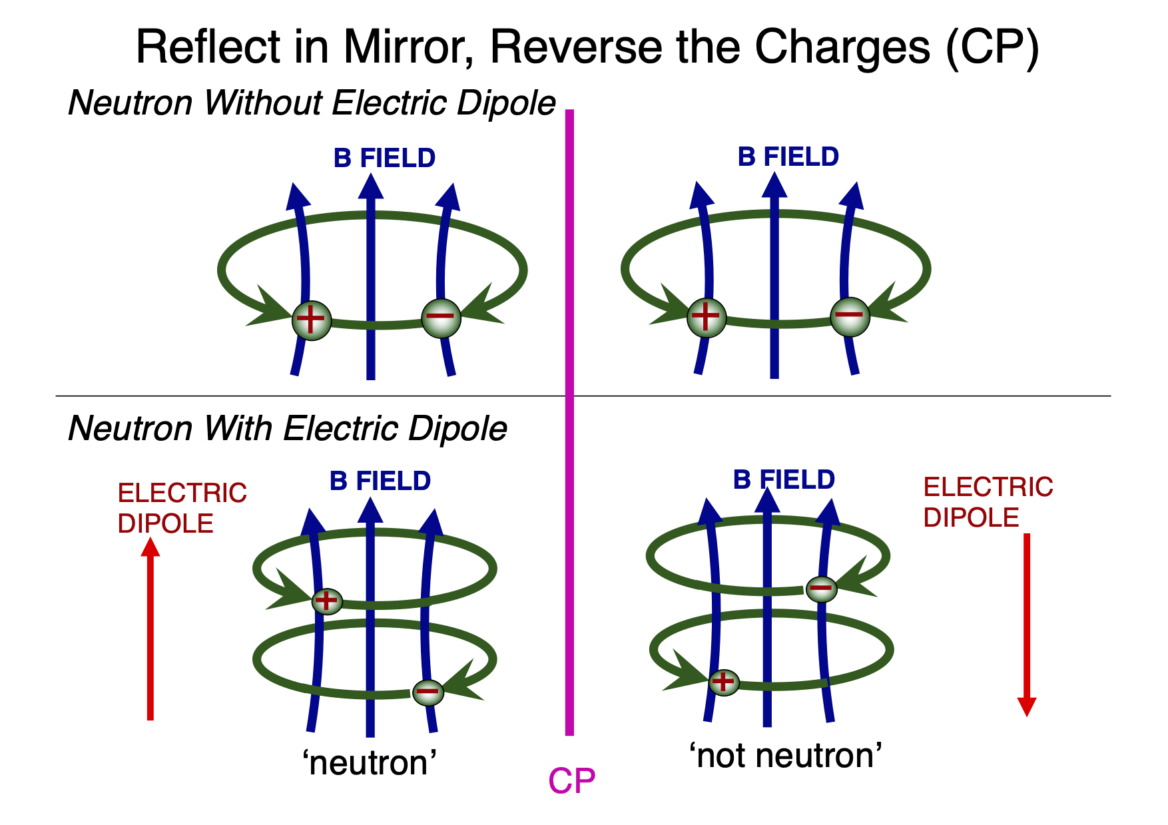

Slide 7
Peccei Quinn Potential

Slide 8
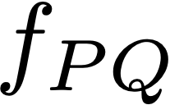
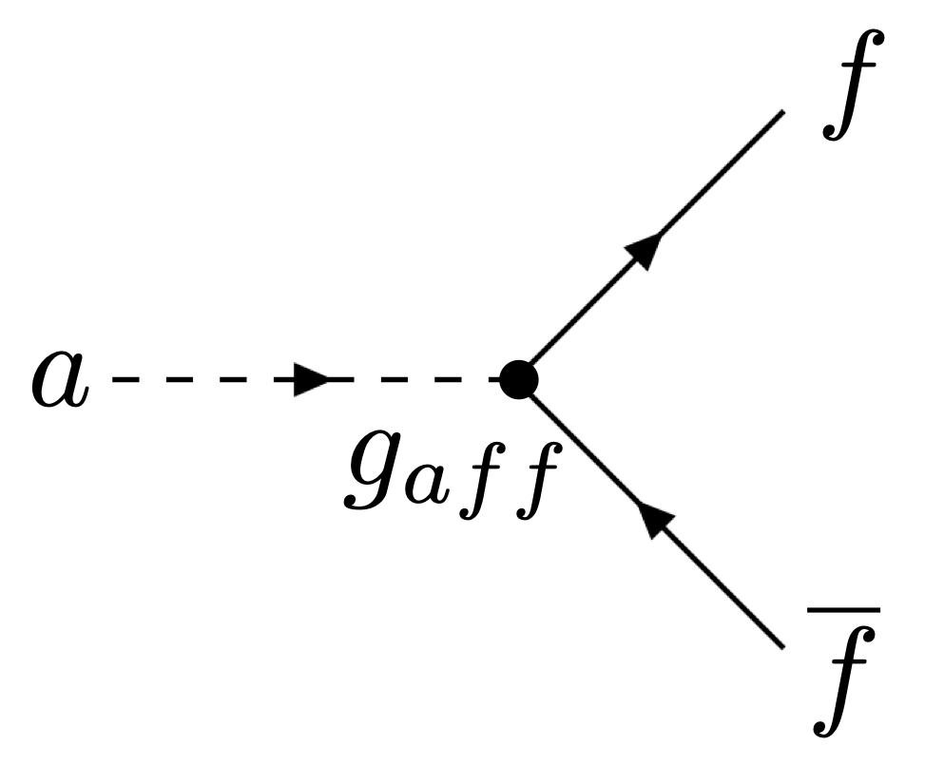
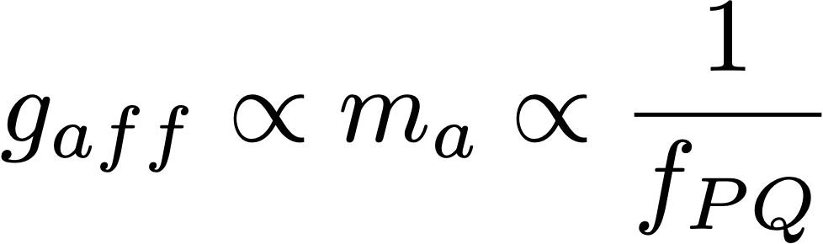
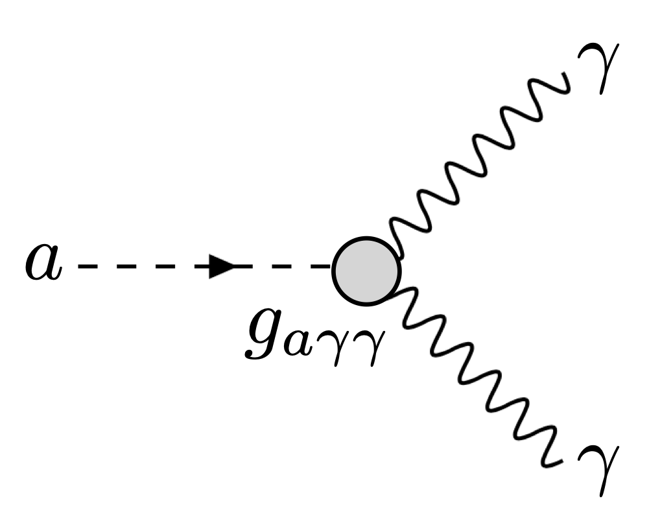
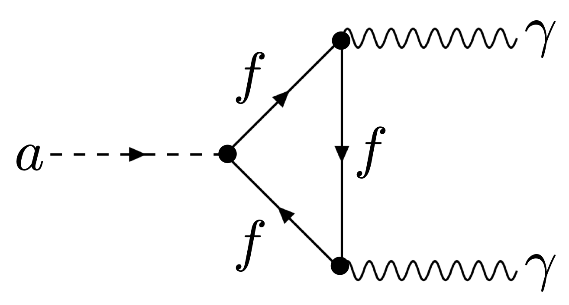
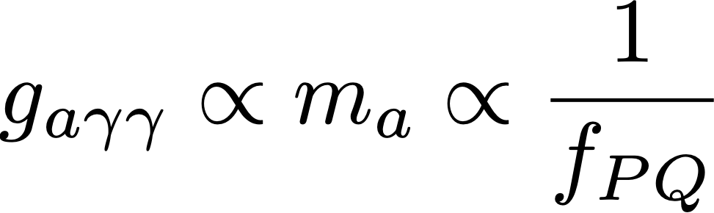

Axion properties
INTERACTIONS [ is the energy scale at the Peccei Quinn phase transition ]
The axion has the same quantum numbers as the , therefore there is a scaling rule between axion and pion properties.

Slide 9
’Easy’ way to work out the De Broglie wavelength from the momentum
In the non relativistic limit,
The mc² term is the energy of the particle at rest, or its rest mass in GeV/c².
I’ve used , a convenient thing to remember that comes in handy a lot. The quantity (v/c) is dimensionless; just make sure the units for v and c match. The answer is in femtometers.

Slide 10
Summary
WIMPs
Originate in high energy accelerator ‘frontier’ new physics.
Are associated with the weak interactions, so the WIMP mass is within a couple of orders of magnitude of 100 GeV/c².
Are particle-like, if they are dark matter.
Have De Broglie wavelengths of order the diameter of a nucleus.
Axions
Originate as a by-product of the Peccei Quinn mechanism introduced to explain why strongly interacting hadrons are CP-symmetric in the low energy limit.
Are associated with the strong interactions, so the axion mass is far lower than the WIMP mass, with its mass constrained by astrophysical observations and cosmological arguments. See a later lecture for further disussion
Are wave-like, if they are dark matter.
Have De Broglie wavelengths of order a hundred metres.

