Slide 1
Dark Matter Lecture 2
Elastic scattering modelled with hard spheres
Ed Daw

Slide 3
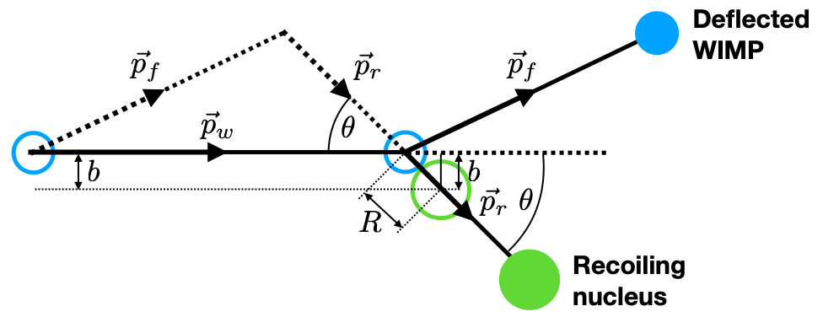

Slide 4

Nucleus at rest
WIMP at rest

Slide 5




