Slide 1
Dieharder
An Open Source
Random Number Generator Tester
Robert G. Brown
Physics Department
rgb@phy.duke.edu
Duke TechExpo 2011

Slide 2
What’s a Random Number
Unpredictable.
Uniform on some range!
Uncorrelated (related to unpredictable).
Minimal information content, maximum entropy.
Cannot be generated! "Random Number Generator" is an Oxymoron!
Even in nature – maybe quantum processes, but how can you tell?

Slide 3
Why do we care?
Because random numbers are really useful!
Games
Simulations
Mathematics
Encryption (online commerce!)
Statistics

Slide 4
Random Number Generator (RNG)
Oxymoron (information theory), should be pseudorandom number generator.
Computational: Iterated map of one sort or another, chaotic but not really random
Physical (e.g. dice, coins): "Unpredictable" but deterministic, often biased or nonuniform
Quantum: Maybe random. But this is empirical question. How can we tell?
How can we tell?

Slide 5
How can we tell?
Given a RNG, we need ways to test the "random" qualities of the sequence of numbers it returns.
Failures of RNG randomness expensive! Imagine failure of Secure Socket Layer...
Hard problem in Computer Science (Knuth!), Statistics (Marsaglia), Mathematics.
Hypothesis Testing. No such thing as a random number (is "7" random?) -- only (maybe) random process or generator!

Slide 6
Testing the Null Hypothesis:
Suppose that this is a perfect RNG. Then what is the probability of getting...
Find mathematical distribution generated from random sequence with known statistical properties.
Generate result from RNG sequence.
Compute probability of getting result given null hypothesis (p-value).
If p-value small, null hypothesis fails. So does RNG...

Slide 7
Example: Coin Flip (or bits in "random" bit stream)
Flip n coins (or generate n random bits), get k heads/1s.
Binomial
If k is not close to n/2, this (p-value) is very small! We expect a random coin to generate roughly p = 1/2 heads, and we expect a random bit string to contain roughly p = 1/2 1s
However, if k always = n/2, then the process isn’t random either, is it...?

Slide 8
Of course, not that simple... p-value itself is a uniform random number on [0,1) under null hypothesis!
"p happens" – one in a thousand trials one should get a number of heads/1s with p-value 0.001. Is it this trial? Who knows?
Chance exactly the same for p in 0.500-0.501 range! Would you fail null hypothesis then?
Many different ways randomness can fail! Some where p difficult to evaluate. Need suite of tests: e.g. multinomial 00/01/10/01 etc.

Slide 9
Test suites: Diehard, NIST STS, Dieharder
Diehard applies many global tests for long range failures of randomness. Very complex tests, but short test sequences, few values of p.
STS intended for cryptographic testing, many "bitlevel" tests, some diehard tests. Again, few values of p.
Dieharder – all of Diehard, working on STS, many, many values of p! Tests distribution of sequence of independent trial p’s for uniformity to push p unambiguously to 0 on failure.

Slide 10
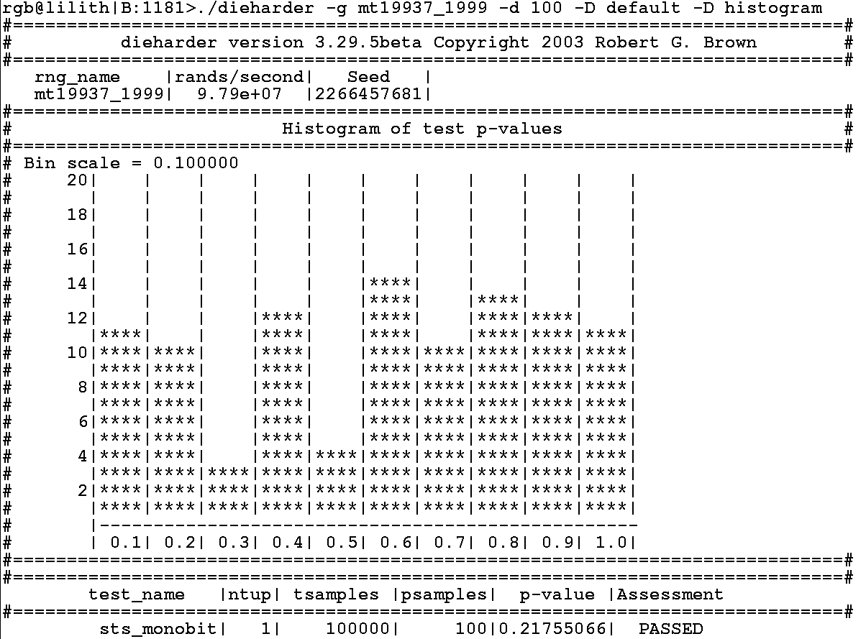
Distribution of p-values mt19937_1999

Slide 11
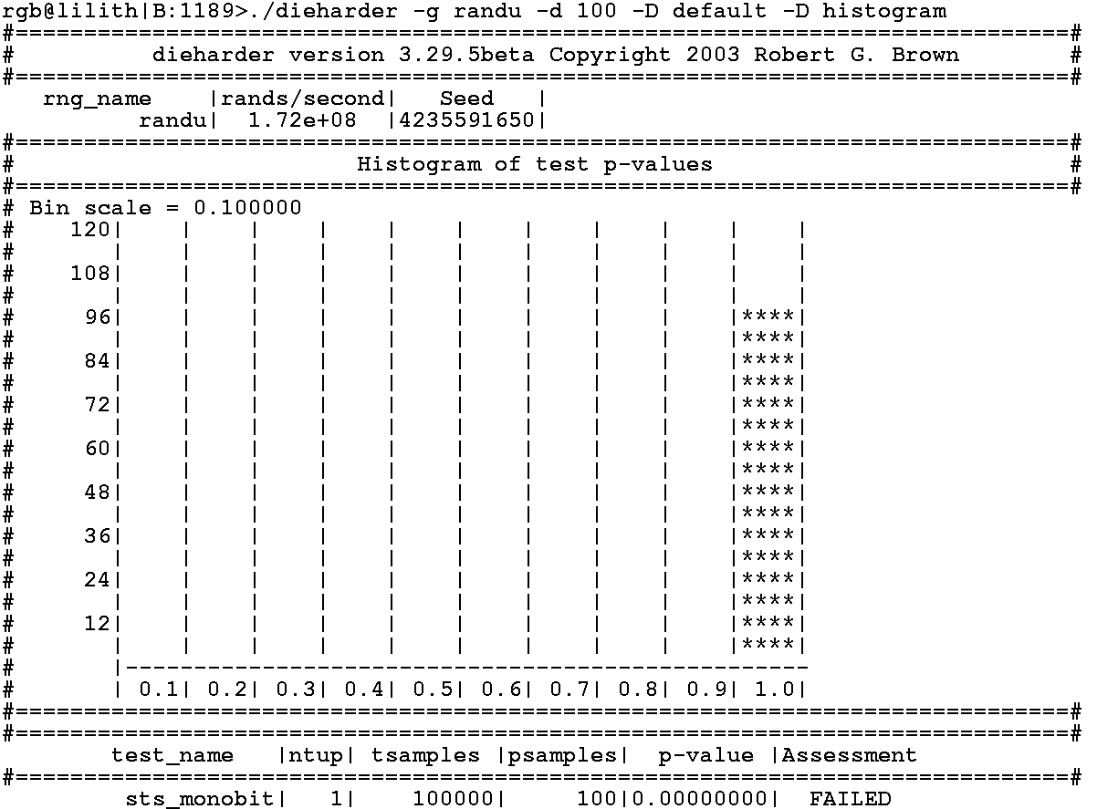
Distribution of p-values randu

Slide 12
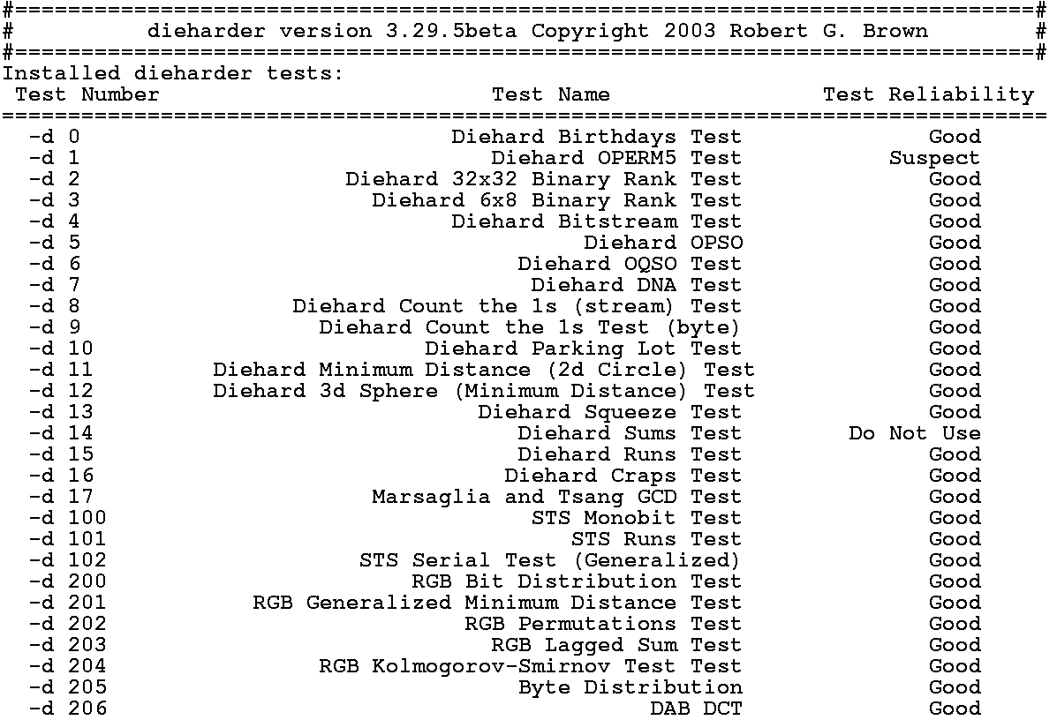
Dieharder Tests

Slide 13
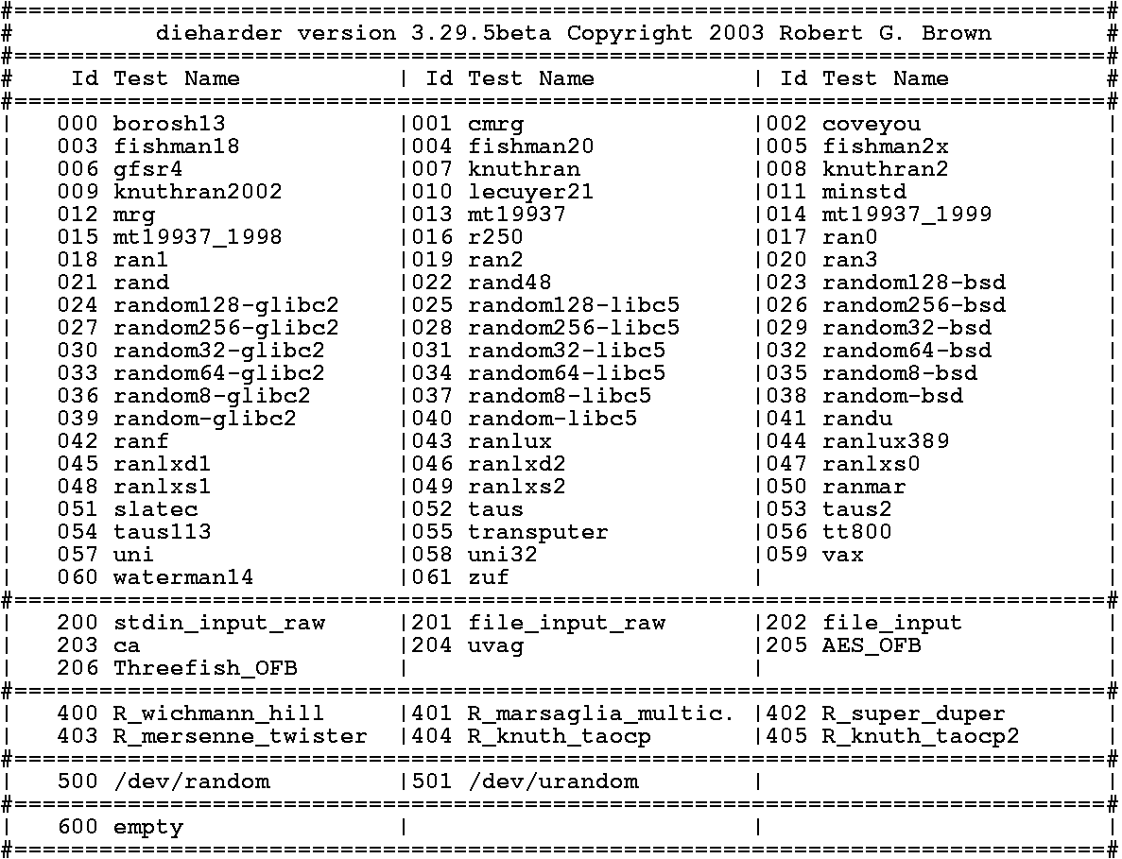
Dieharder Built-in Generators (GSL)

Slide 14
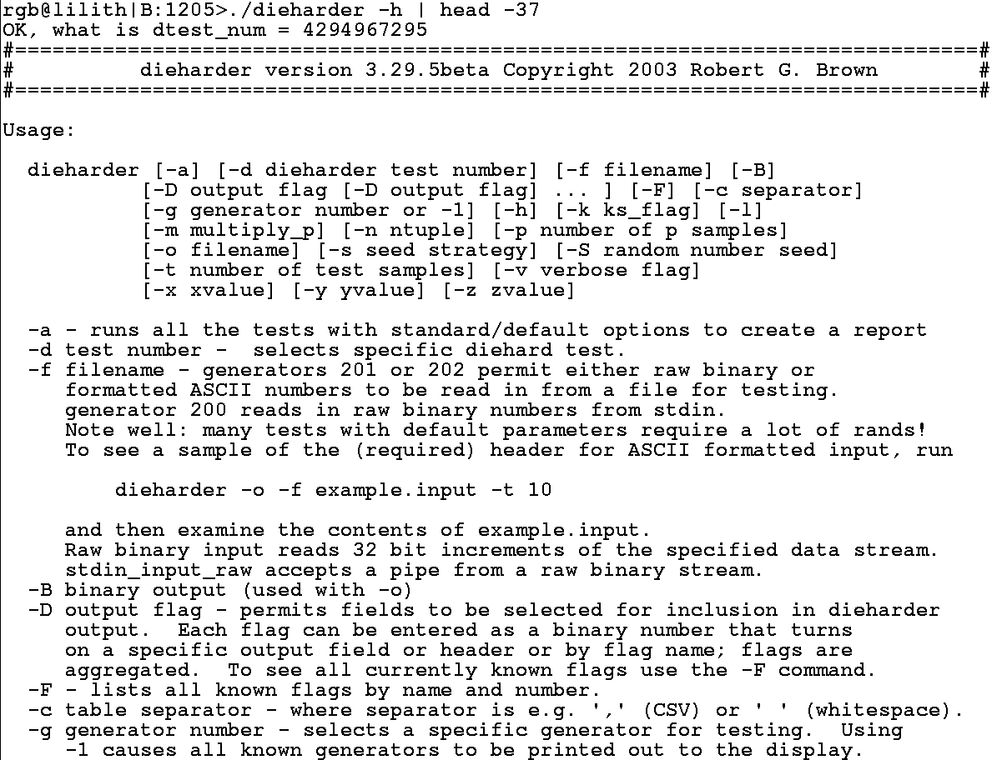
Dieharder Auto-documentation

Slide 15
Demo and Conclusion
Dieharder has many more features, plus more planned to increase its "resolution" – ability to detect generator failure before it fails itself.
R integration!
More generators (e.g. KISS) will be added to dieharder for in-place testing (and possible addition to GSL.
Many more tests will be added to the suite. My goal is all of STS and diehard, plus tests from a variety of sources and original papers. I’d like to make dieharder the RNG test suite.

Slide 16
Some Interesting Questions...
Can one use dieharder to test the hypothesis that quantum processes are truly random?
Can one systematically resolve the mode of failure of an RNG – e.g. STS generalized serial or RGB bit distribution tests, lagged, to high order?
Can one use information theory (plus knowledge of mode of failure from dieharder’s "test to failure" mode) to identify source RNGs and/or crack various encryption schemes?

